Slide 1
Generation of synthetic experimental resonance data in support of reliable and reproducible cross section uncertainty evaluation
Noah Walton¹, Vladimir Sobes¹, Jesse Brown²
The University of Tennessee¹
Oak Ridge National Laboratory²

Slide 2
Motivation
Notes:
Evaluation of experimental nuclear data provides suggested values and uncertainties that are a vital input to many applications.
One of the most important pieces of which is the neutron cross section in the resolved resonance range.
For evaluation of these RRR cross section, the default method for UQ is known to underpredict uncertainties.
The solution to this is non-systematic, requires expert judgement to inflate uncertainties in order to be more appropriate.

Slide 3
Motivation
Data synthesis methodology unlimited, labelled data
Pseudo-validation for UQ
  Current & Future methods
Exploratory analysis & Model Training
  ATARI Project

Slide 4
Motivation
ATARI – AI/ML Tool for Automated Resonance Identification
  Proof-of-concept, low-fidelity physics (SLBW, 1 spin-group)
  Promising results
  Nonlinear, mixed-integer optimization
  Accurate resonance identification
Walton, N.A.W., Armstrong, J.L., Sobes, V., Automated resonance evaluation tool; non-convex decomposition method for resonance regression and uncertainty quantification. Proceedings of the 2022 International conference on Nuclear Data, (2022).

Slide 5
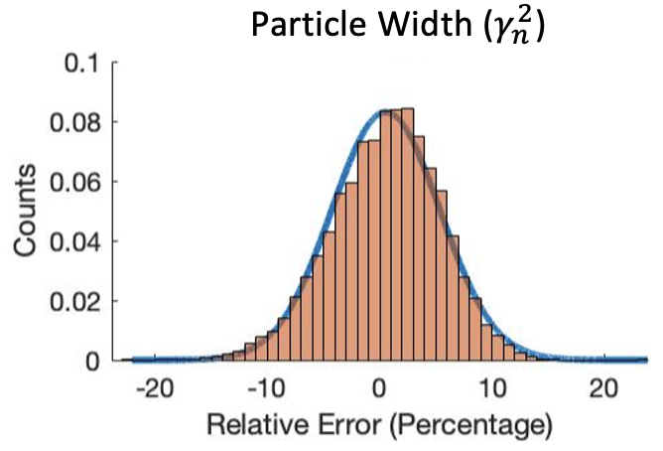
Motivation
ATARI – AI/ML Tool for Automated Resonance Identification
  Proof-of-concept, low-fidelity physics (SLBW, 1 spin-group)
  Promising results
  Nonlinear, mixed-integer optimization
  Accurate resonance identification
  Performance statistics
Empirical UQ
Inferred UQ
Density
Notes:
Because we had synthesized data with accessible solutions, we were able to build up performance statistics, tune hyperparameters, and identify biases in the model.

Slide 6
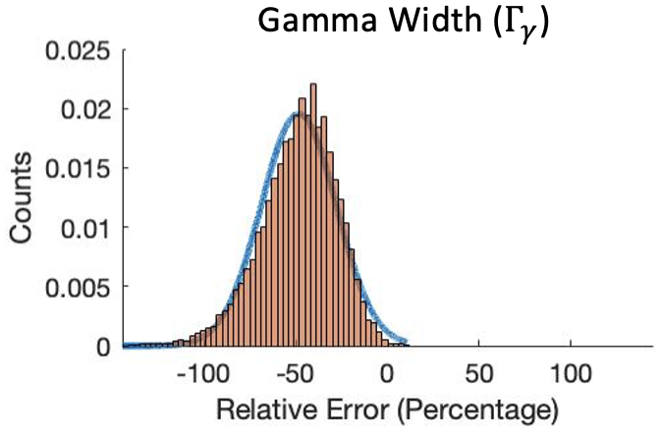
Motivation
ATARI – AI/ML Tool for Automated Resonance Identification
  Proof-of-concept, low-fidelity physics (SLBW, 1 spin-group)
  Promising results
  Nonlinear, mixed-integer optimization
  Accurate resonance identification
  Performance statistics
  Identify model bias
Empirical UQ
Inferred UQ
Density
Notes:
Because we had synthesized data with accessible solutions, we were able to build up performance statistics, tune hyperparameters, and identify biases in the model.
Explain this graph

Slide 7
Motivation
Data synthesis methodology unlimited, labelled data [supervised machine learning]
Pseudo-validation for UQ
  Current & Future methods
Exploratory analysis & Model Training
  Next steps for ATARI Project
De Saint Jean, Cyrille, Archier, Pascal, Privas, Edwin, and Noguere, Gilles, “On the use of bayesian monte-carlo in evaluation of nuclear data,” EPJ Web Conf., vol. 146, p. 02007, 2017. [Online]. Available: https://doi.org/10.1051/epjconf/201714602007
Notes:
Some researchers at the CEA used ‘fake’ data with 1% statistical noise directly

Slide 8
Data Synthesis
Common practice in many statistical and ML applications
Medical data
Language/image processing
Financial analytics
Goal
Create data with similar statistical properties s.t. an analysis would yield similar results.
Method
Create a generative model that approximates the distribution/process of the real data. Sample from the generative model.
R. J. Chen, M. Y. Lu, T. Y. Chen, D. F. K. Williamson, and F. Mahmood, “Synthetic data in machine learning for medicine and healthcare,” Nature Biomedical Engineering, vol. 5, no. 6, pp. 493–497, 2021. [Online]. Available: https://doi.org/10.1038/s41551-021-00751-8s

Slide 9
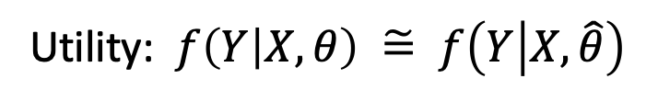
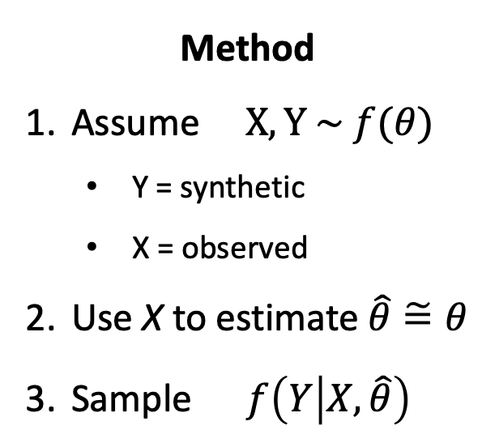
Data Synthesis
Method
Assume $X, Y \sim f(θ)$
  Y = synthetic
  X = observed
Use X to estimate $\hat{θ}\tilde{=}θ$
Sample $f\left(Y | X,\hat{θ}\right)$
Can be physics-informed
Utility: $f\left(Y | X,θ\right) \tilde{=} f\left(Y | X,\hat{θ}\right)$
M. W. Hopwood, J. S. Stein, J. L. Braid, and H. P. Seigneur, “Physics-based method for generating fully synthetic iv curve training datasets for machine learning classification of pv failures,” Energies, vol. 15, no. 14, 2022. [Online]. https://doi.org/10.3390/en15145085
T. Burr, M. Hamada, T. Graves, and S. Myers, “Augmenting real data with synthetic data: An application in assessing radio-isotope identification algorithms,” Quality and Reliability Engineering International, vol. 25, pp. 899 – 911, 12 2009.

Slide 10
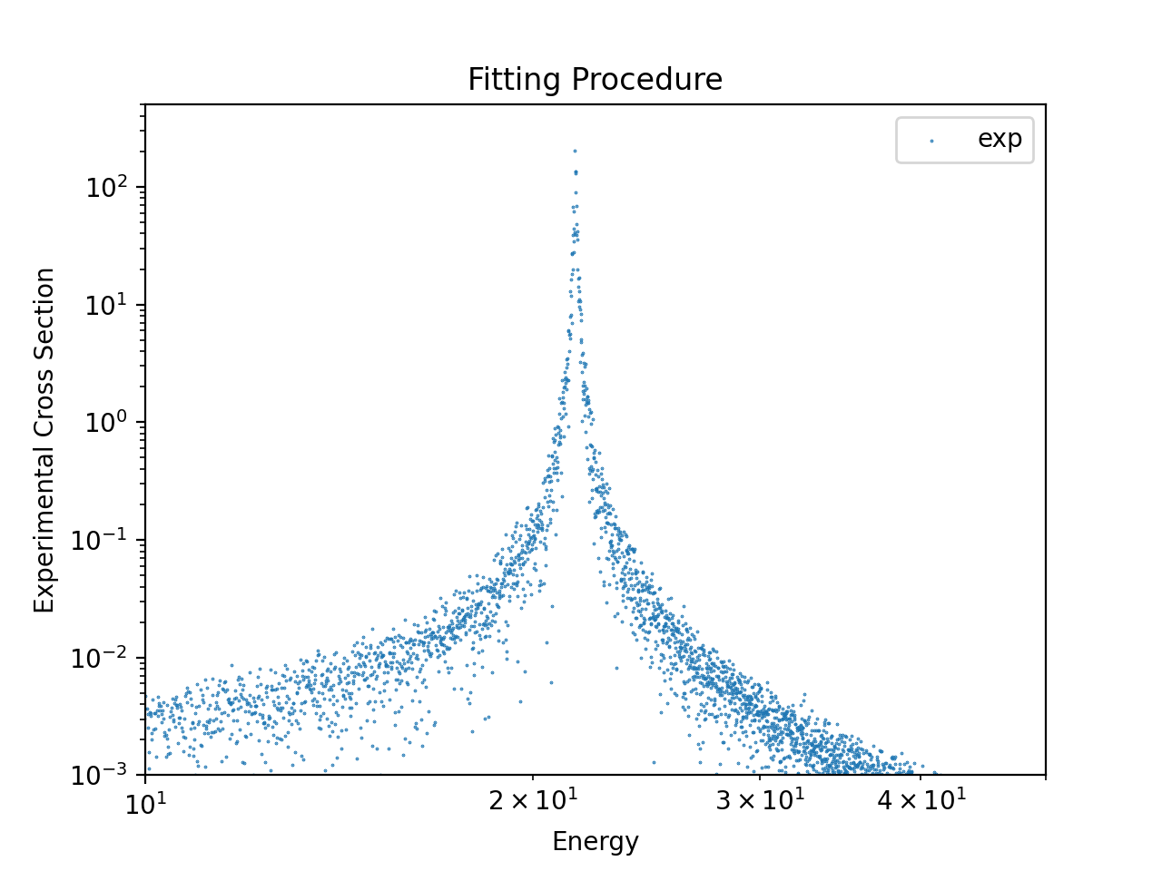
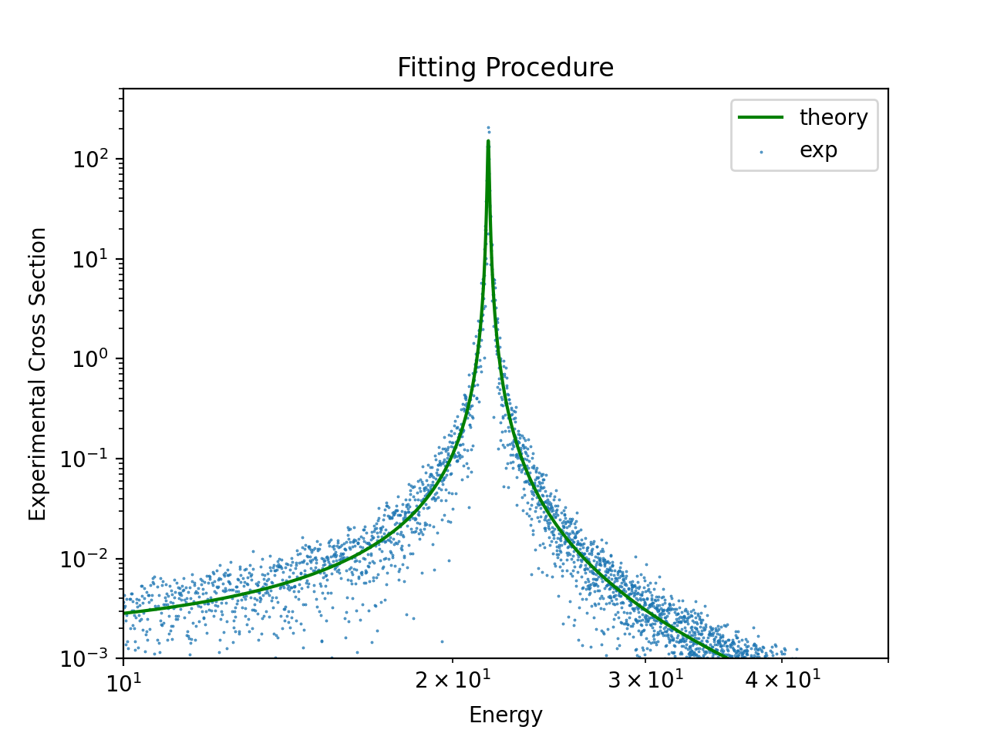
Experimental Resonance data
ToF Measurement
Reduced Experimental Data
Data Reduction
R-Matrix
Theory
Experimental
Cross Section
Experimental Corrections
Suggested Values + Uncertainty
Notes:
Well established theoretical model
We have physics-informed pdfs for the resonance parameters, and an a-priori pdf for the noise in the count measurements.
Therefore, we need a generative model from resonance parameters parameters to counts on a detector
Generative model for the process (cross section realizations) and generative model for noise.

Slide 11
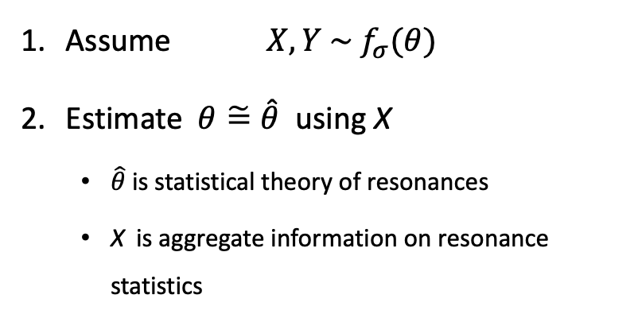
Process
Assume ${X,Y \sim f}_{σ}(θ)$
Estimate $θ\tilde{=}\hat{θ}$ using X
  $\hat{θ}$ is statistical theory of resonances
  X is aggregate information on resonance statistics
1. Statistical distributions
of resonance
parameters

Slide 12




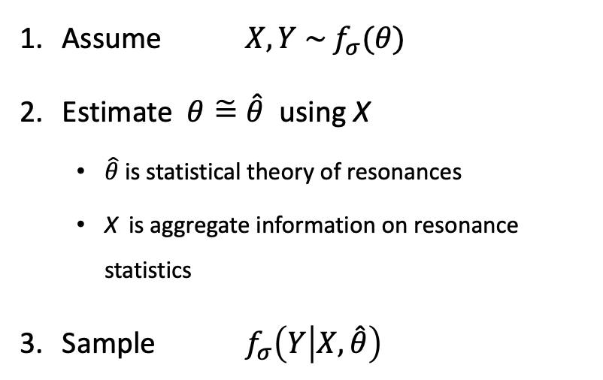


Process
Assume ${X,Y \sim f}_{σ}(θ)$
Estimate $θ\tilde{=}\hat{θ}$ using X
  $\hat{θ}$ is statistical theory of resonances
  X is aggregate information on resonance statistics
Sample $f_{σ}\left(Y | X,\hat{θ}\right)$
1. Statistical distributions
of resonance
parameters
2. Sample
resonances
$$Γ_{i}$$
$$ΔE_{i−1}$$
$$Γ_{j}$$
$$E_{i−1}$$
$$E_{i}$$
$$E_{j}$$

Slide 13

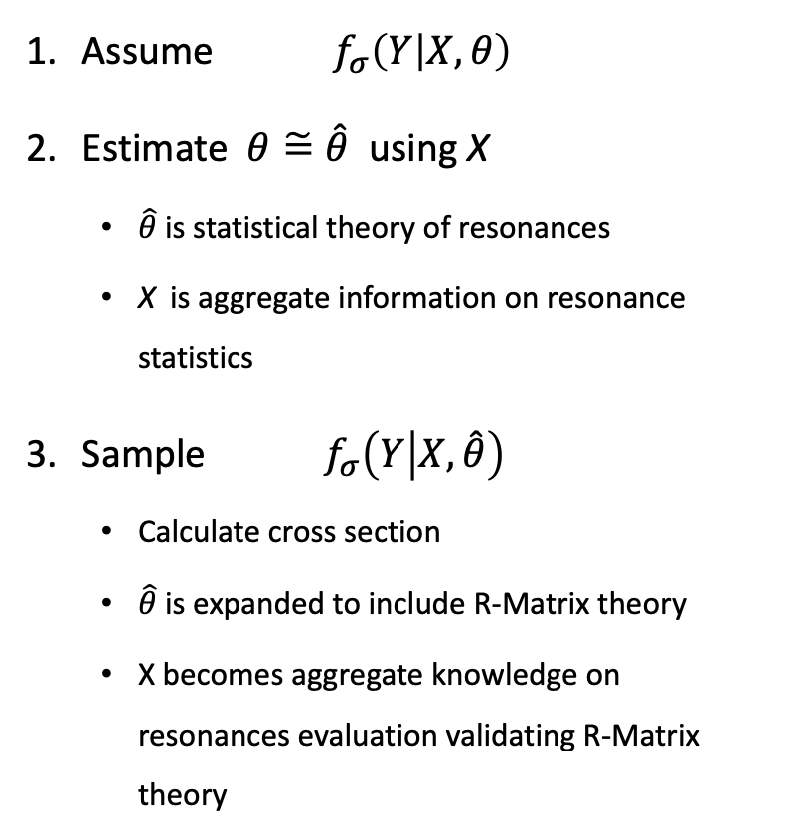
Process
Assume $f_{σ}\left(Y | X,θ\right)$
Estimate $θ\tilde{=}\hat{θ}$ using X
  $\hat{θ}$ is statistical theory of resonances
  X is aggregate information on resonance statistics
Sample $f_{σ}\left(Y | X,\hat{θ}\right)$
  Calculate cross section
  $\hat{θ}$ is expanded to include R-Matrix theory
  X becomes aggregate knowledge on resonances evaluation validating R-Matrix theory
1. Statistical distributions
of resonance
parameters
2. Sample
resonances
$$Γ_{i}$$
$$ΔE_{i−1}$$
$$Γ_{j}$$
$$E_{i−1}$$
$$E_{i}$$
$$E_{j}$$

Slide 14
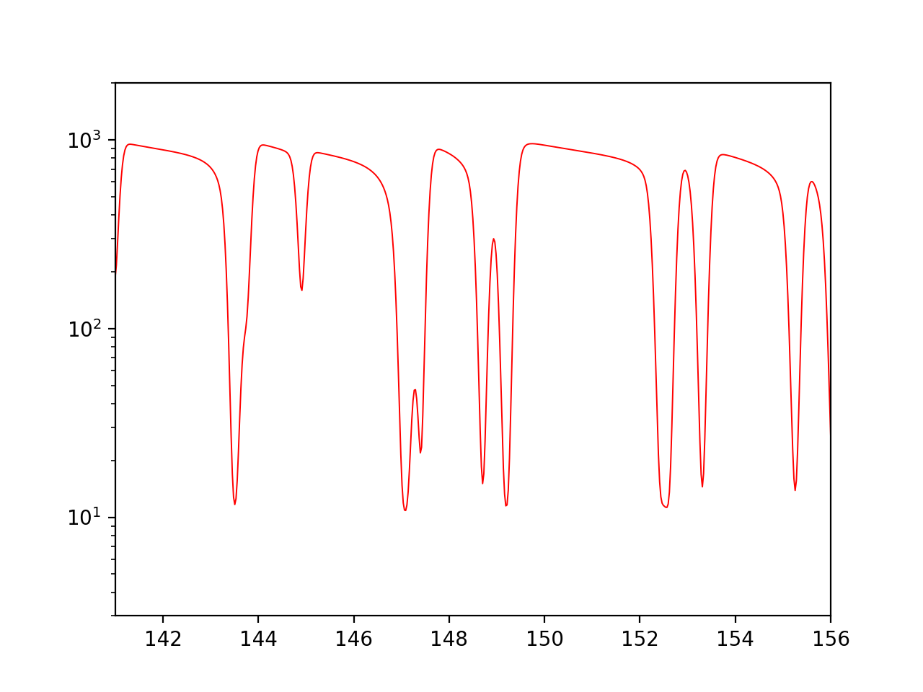


Process
1. Statistical distributions
of resonance
parameters
2. Sample
resonances
3. Inverse reduction
$$counts$$
$$Γ_{i}$$
$$ΔE_{i−1}$$
$$Γ_{j}$$
$$E_{i−1}$$
$$E_{i}$$
$$E_{j}$$

Slide 15
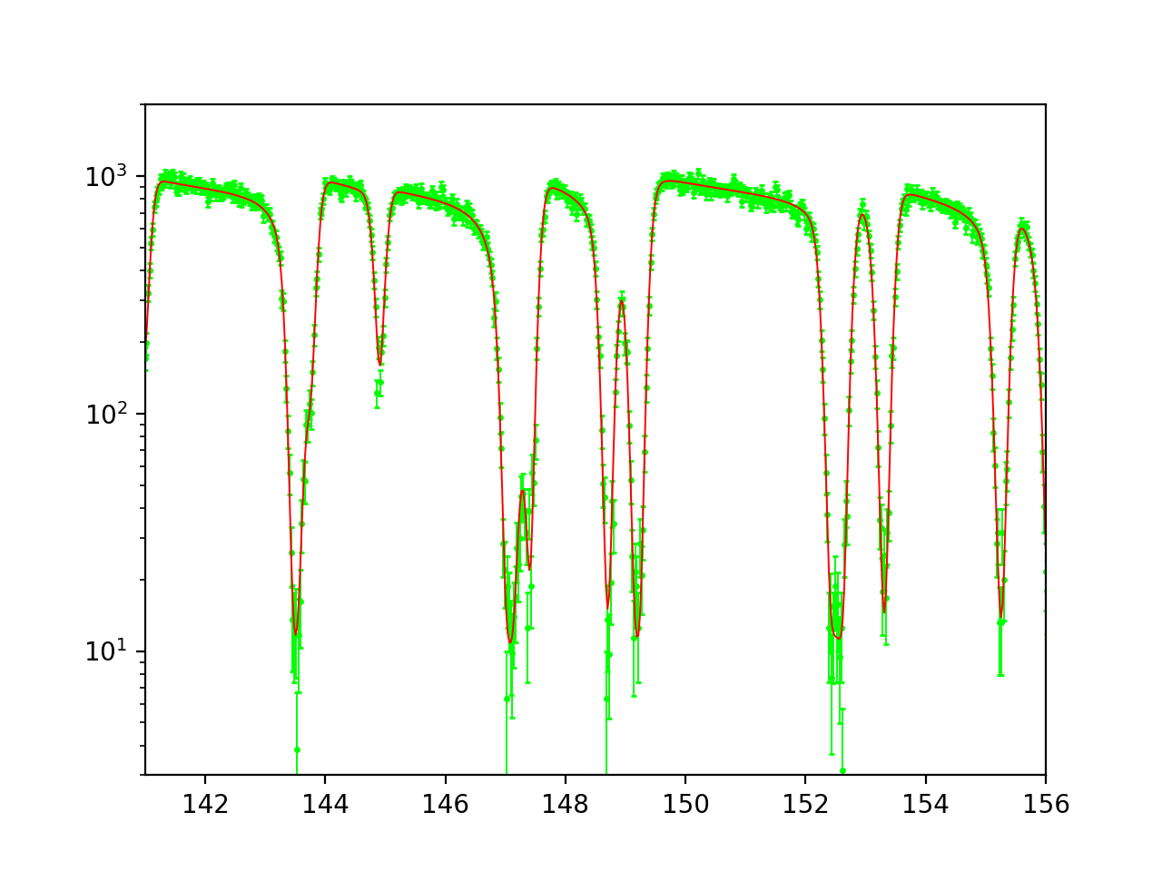
Process
1. Statistical distributions
of resonance
parameters
2. Sample
resonances
3. Inverse reduction
$$counts$$
$$Γ_{i}$$
$$ΔE_{i−1}$$
$$Γ_{j}$$
$$E_{i−1}$$
$$E_{i}$$
$$E_{j}$$

Slide 16
Process
1. Statistical distributions
of resonance
parameters
2. Sample
resonances
Established reduction process
3. Inverse reduction
$$counts$$
$$Γ_{i}$$
$$ΔE_{i−1}$$
$$Γ_{j}$$
$$E_{i−1}$$
$$E_{i}$$
$$E_{j}$$

Slide 17
Process
1. Statistical distributions
of resonance
parameters
Reaction & experiment dependent
2. Sample
resonances
3. Inverse reduction
$$counts$$
$$Γ_{i}$$
$$ΔE_{i−1}$$
$$Γ_{j}$$
$$E_{i−1}$$
$$E_{i}$$
$$E_{j}$$
Notes:
This is our generative model! Then we have an a-priori noise model to apply at the count level

Slide 18
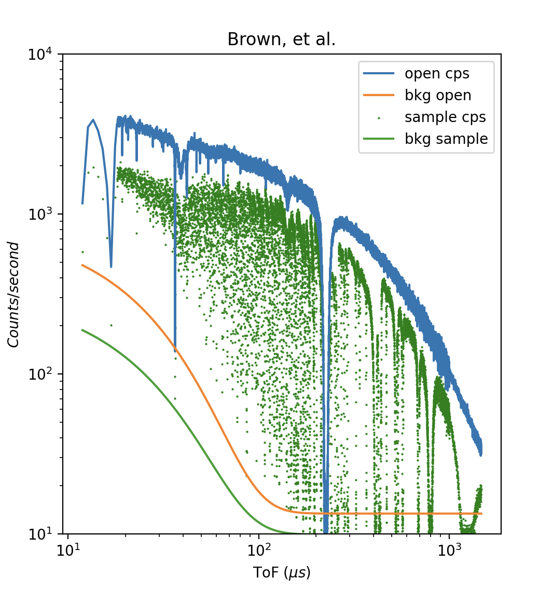
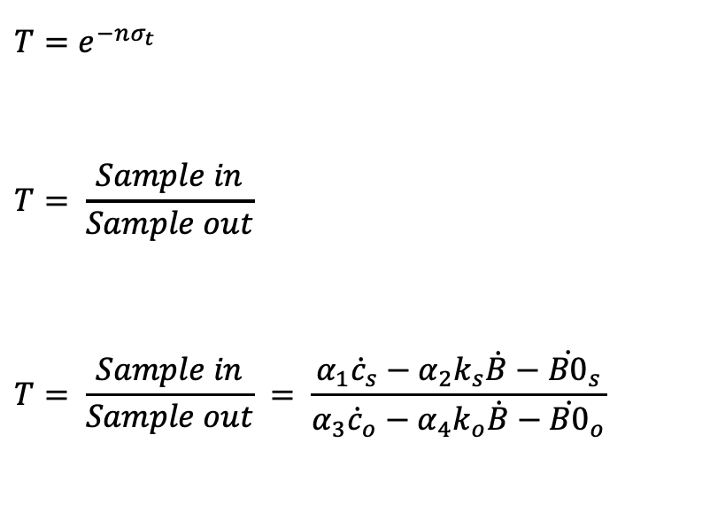
Transmission Measurement
$$T=e^{−nσ_{t}}$$
$$T= \frac{Sample in}{Sample out}$$
$$T= \frac{Sample in}{Sample out} = \frac{α_{1}{\dot{c}}_{s}−α_{2}k_{s}\dot{B}−{\dot{B0}}_{s}}{α_{3}{\dot{c}}_{o}−α_{4}k_{o}\dot{B}−{\dot{B0}}_{o}}$$
J. Brown, “Measurements, evaluation, and validation of ta-181 resolved and
unresolved resonance regions,” Ph.D. dissertation, Rensselaer Polytechnic
Institute, 2019.

Slide 19
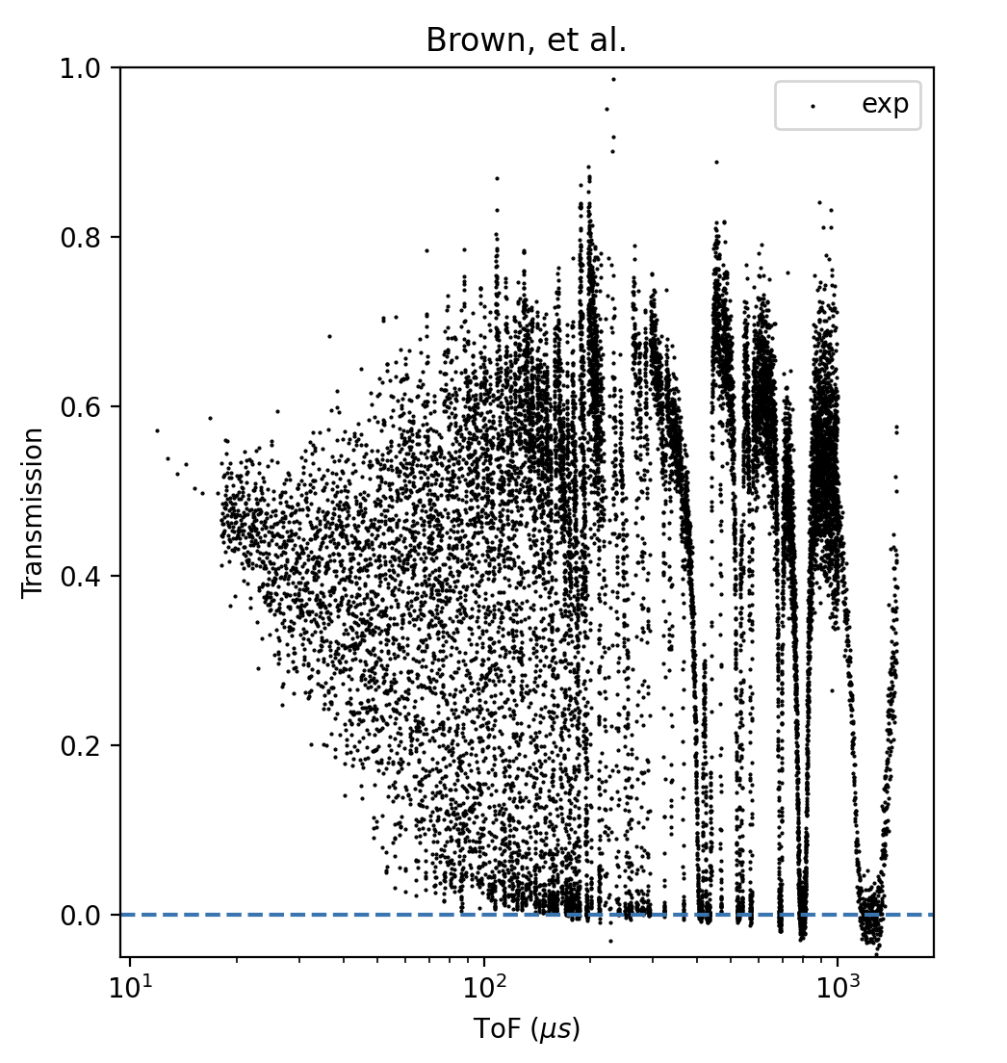
Transmission Measurement
$$T=e^{−nσ_{t}}$$
$$T= \frac{Sample in}{Sample out}$$
$$T= \frac{Sample in}{Sample out} = \frac{α_{1}{\dot{c}}_{s}−α_{2}k_{s}\dot{B}−{\dot{B0}}_{s}}{α_{3}{\dot{c}}_{o}−α_{4}k_{o}\dot{B}−{\dot{B0}}_{o}}$$

Slide 20
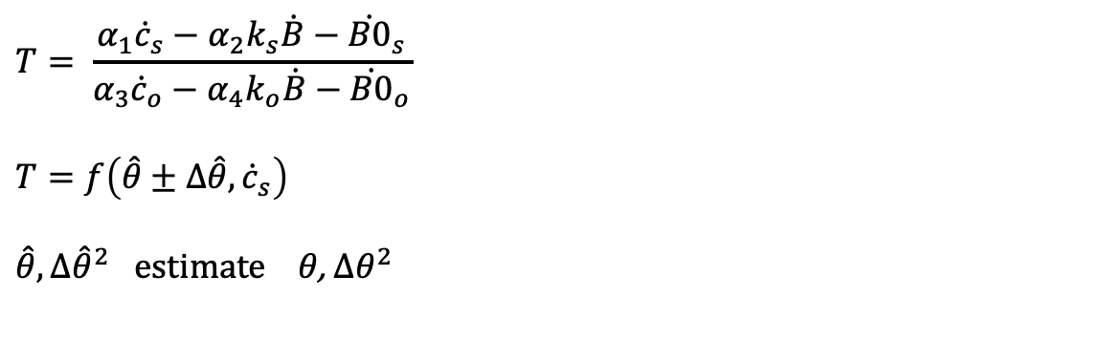
Forward Reduction Process
ToF Measurement
Reduced Experimental Data
Data Reduction
$$T= \frac{α_{1}{\dot{c}}_{s}−α_{2}k_{s}\dot{B}−{\dot{B0}}_{s}}{α_{3}{\dot{c}}_{o}−α_{4}k_{o}\dot{B}−{\dot{B0}}_{o}}$$
$$T=f\left(\hat{θ}±∆\hat{θ},{\dot{c}}_{s}\right)$$
$$\hat{θ}, {∆\hat{θ}}^{2} estimate θ\text{, }{∆θ}^{2}$$

Slide 21

Novel Method to Inverse Reduction
Reduced Experimental Cross Section
ToF Measurement
Data Reduction
$$T= \frac{α_{1}{\dot{c}}_{s}−α_{2}k_{s}\dot{B}−{\dot{B0}}_{s}}{α_{3}{\dot{c}}_{o}−α_{4}k_{o}\dot{B}−{\dot{B0}}_{o}}$$
$$T=f\left(\hat{θ}±∆\hat{θ},{\dot{c}}_{s}\right)$$
$$\hat{θ},{∆\hat{θ}}^{2} estimate θ\text{, }{∆θ}^{2}$$
$\hat{θ}$’ sampled using $\hat{θ}, {∆\hat{θ}}^{2}$
Take $\hat{θ}$’ as determined $\hat{θ}$’ = $θ$’
$${\dot{c}}_{s}=f^{−1}\left(θ′, T\right)$$

Slide 22
Verification

Slide 23
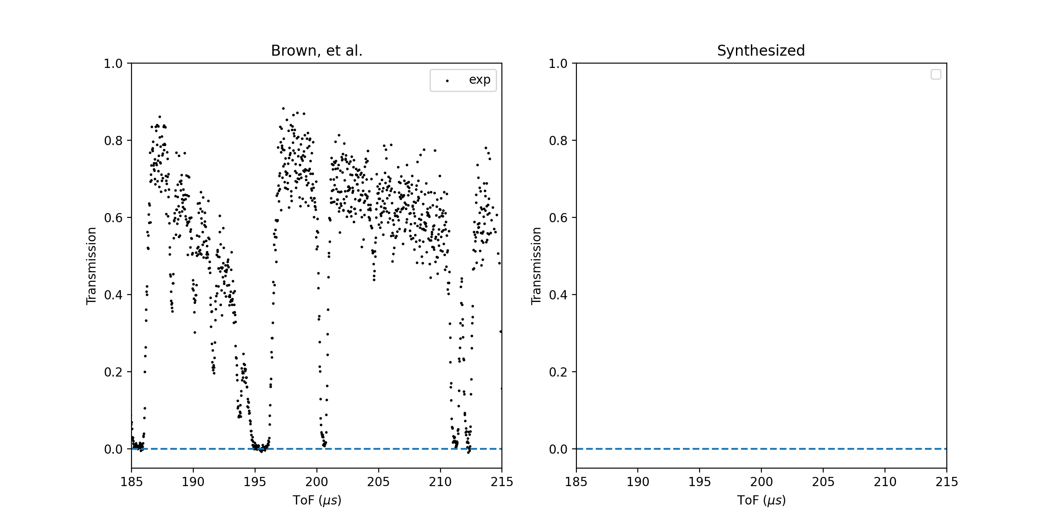
Verification

Slide 24
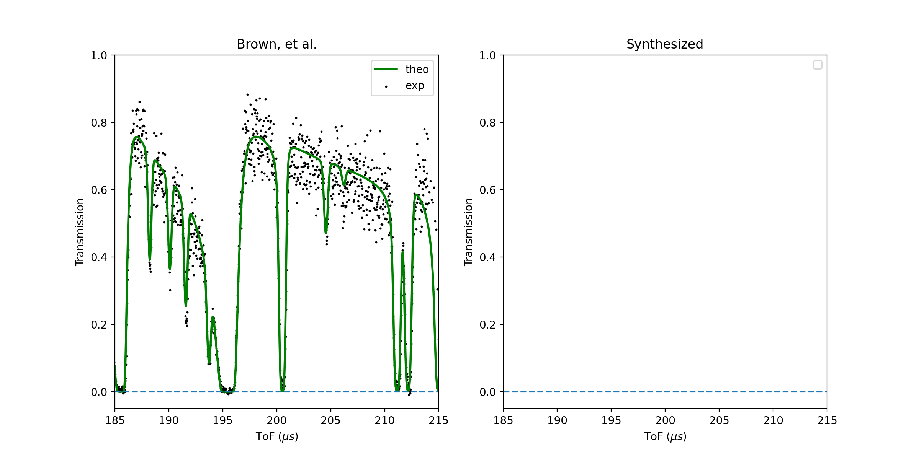
Verification

Slide 25
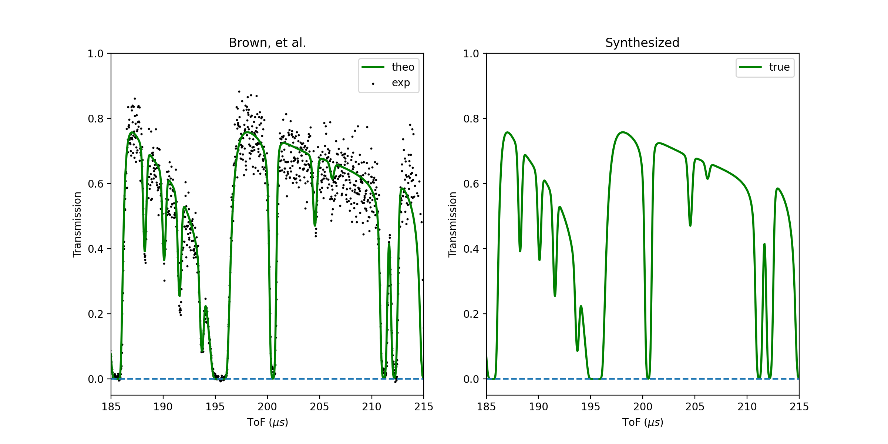
Verification

Slide 26
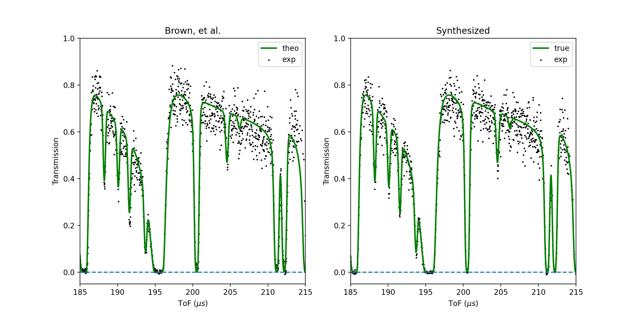
Verification
1

Slide 27
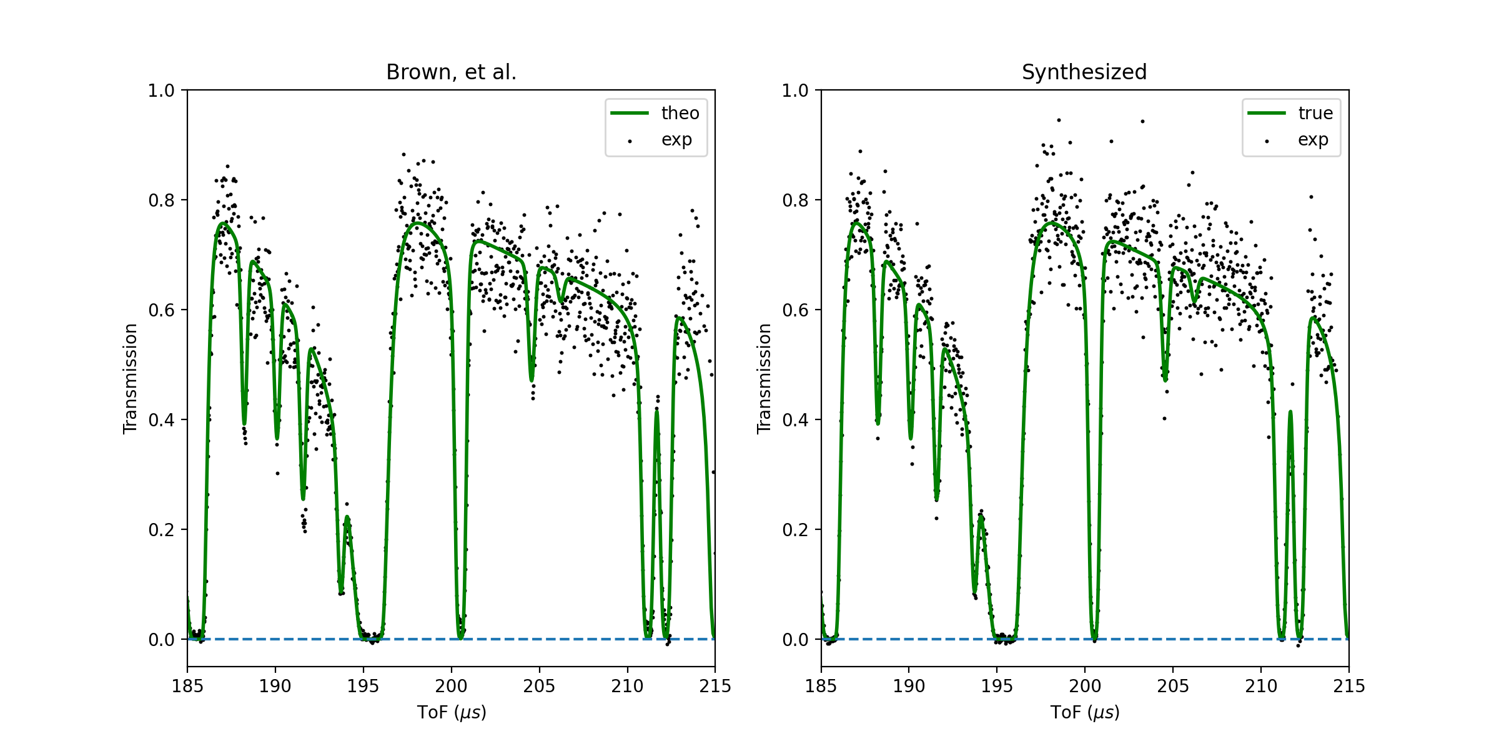
Verification
2

Slide 28
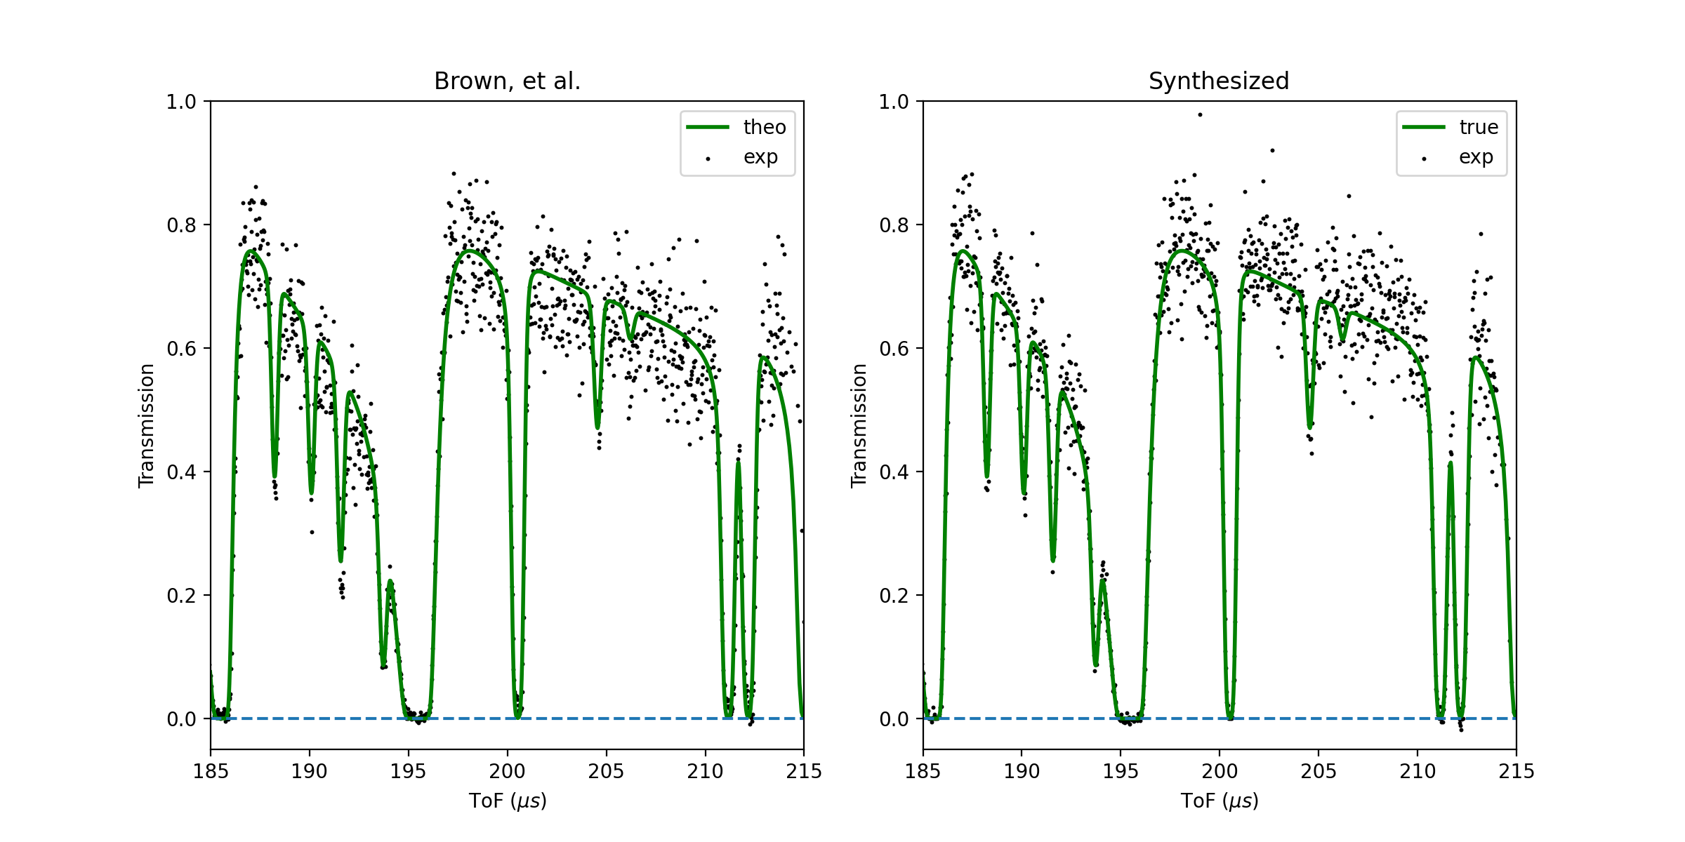
Verification
3

Slide 29
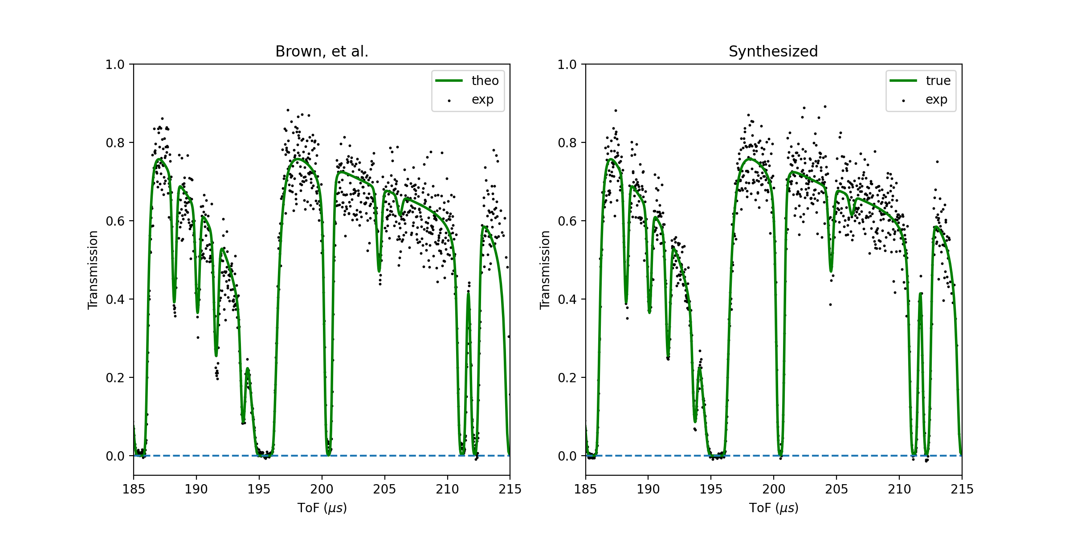
Verification
4

Slide 30
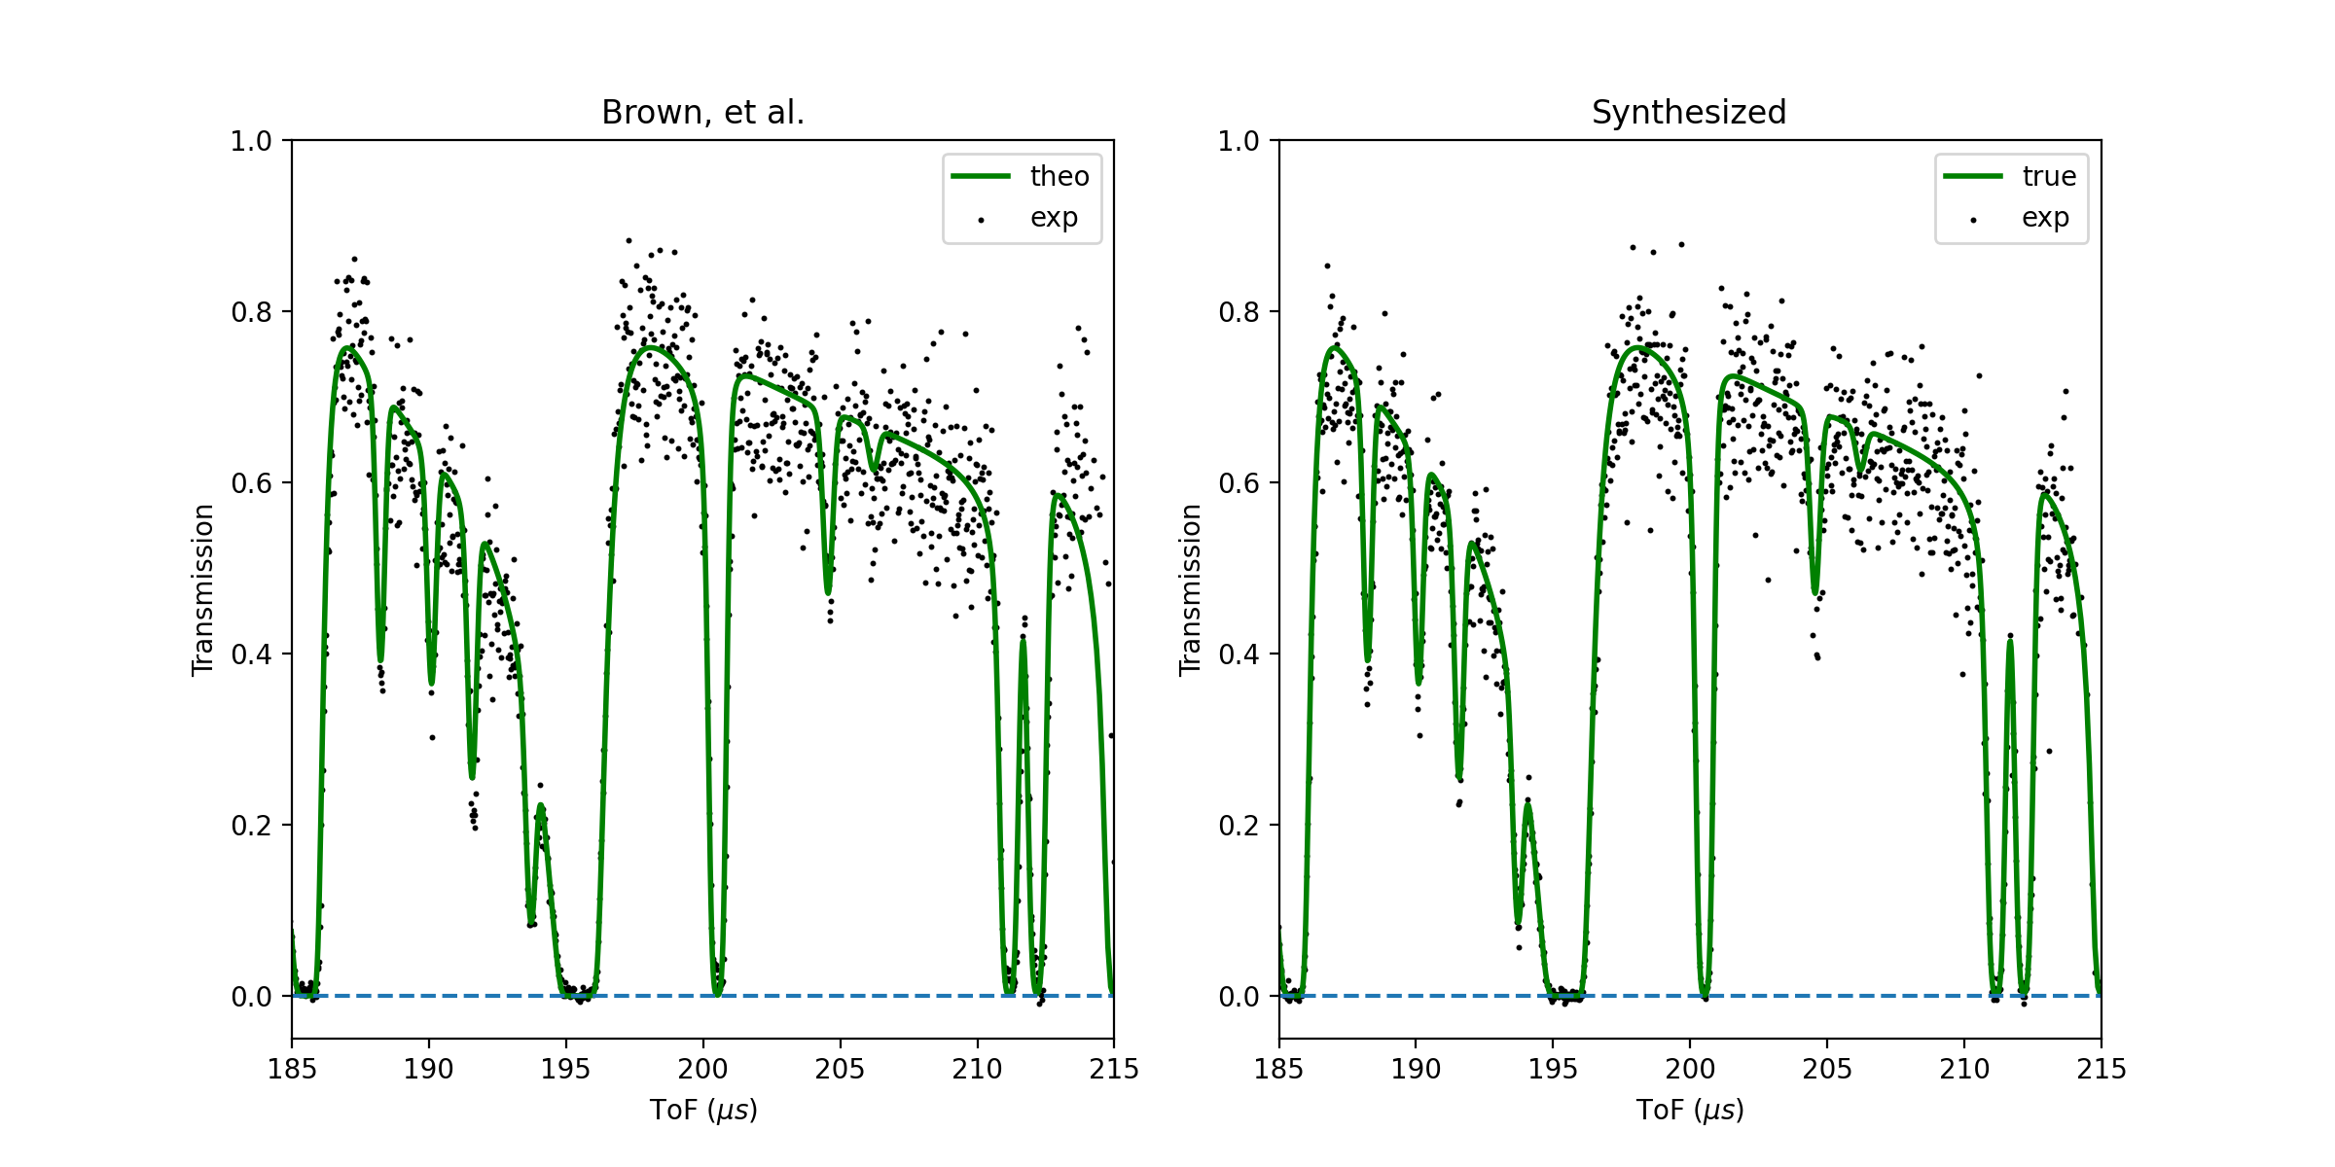
Verification
5

Slide 31
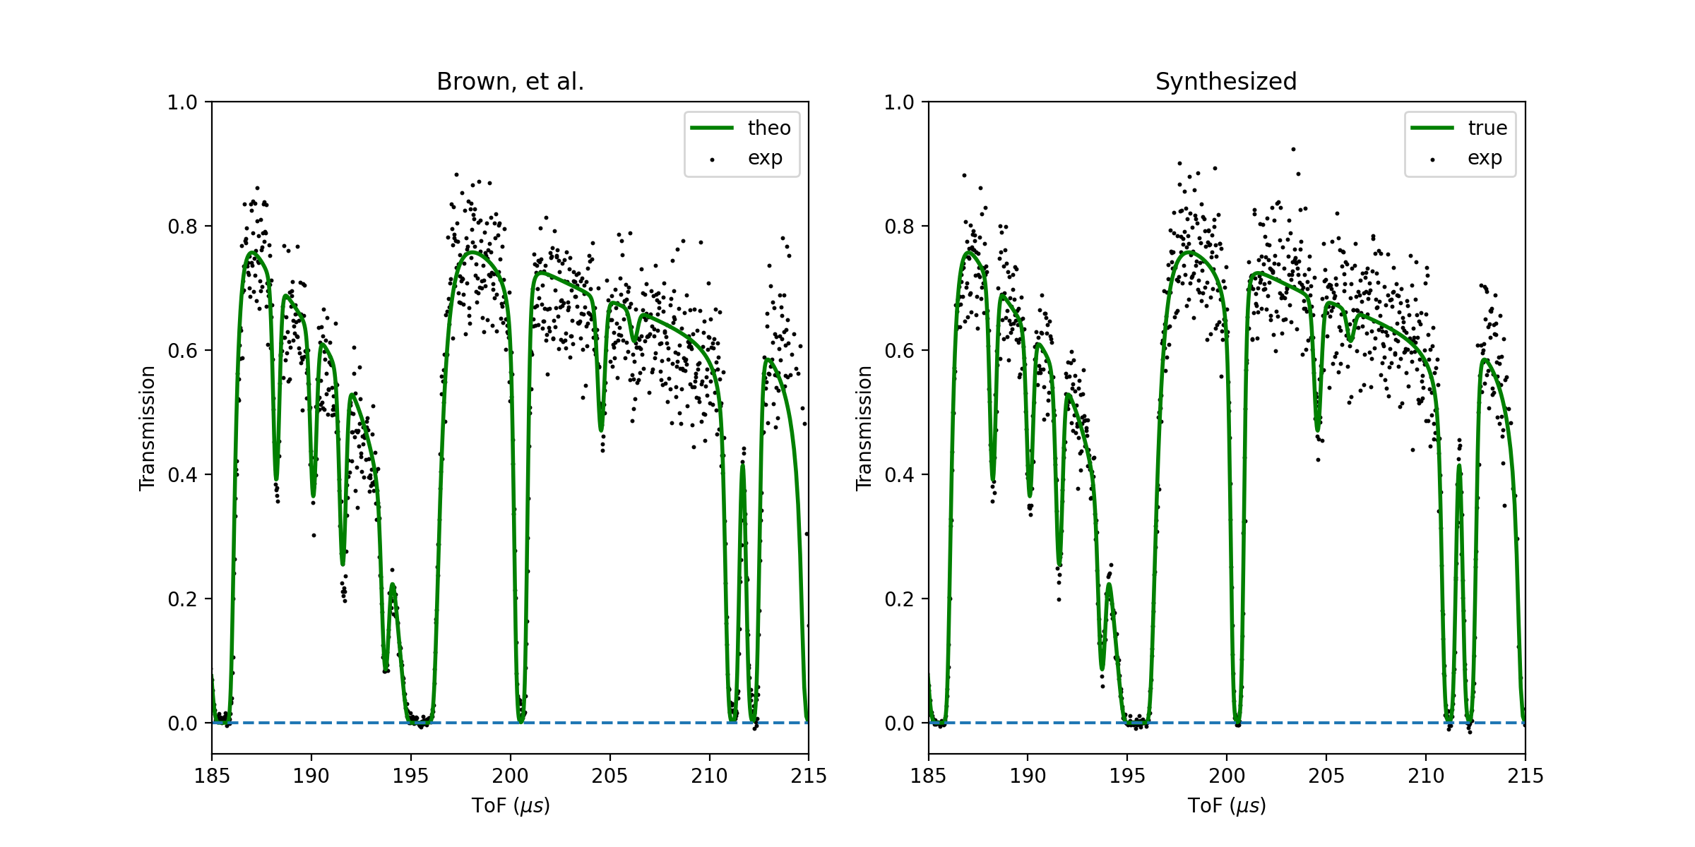
Verification
6

Slide 32
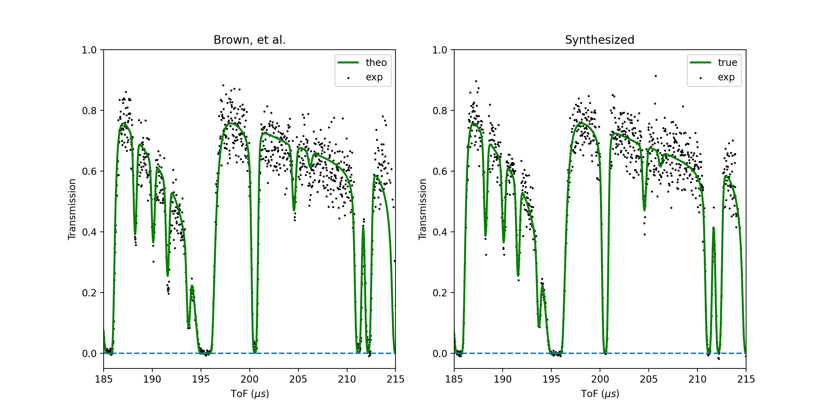
Verification
7

Slide 33
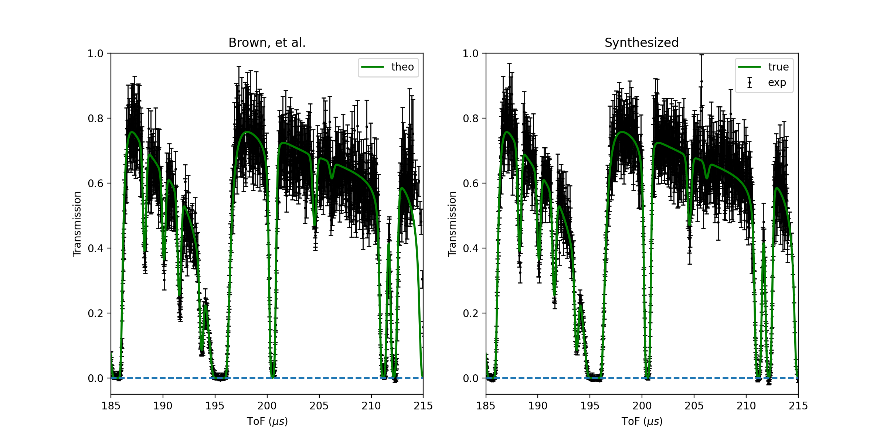
Verification

Slide 34
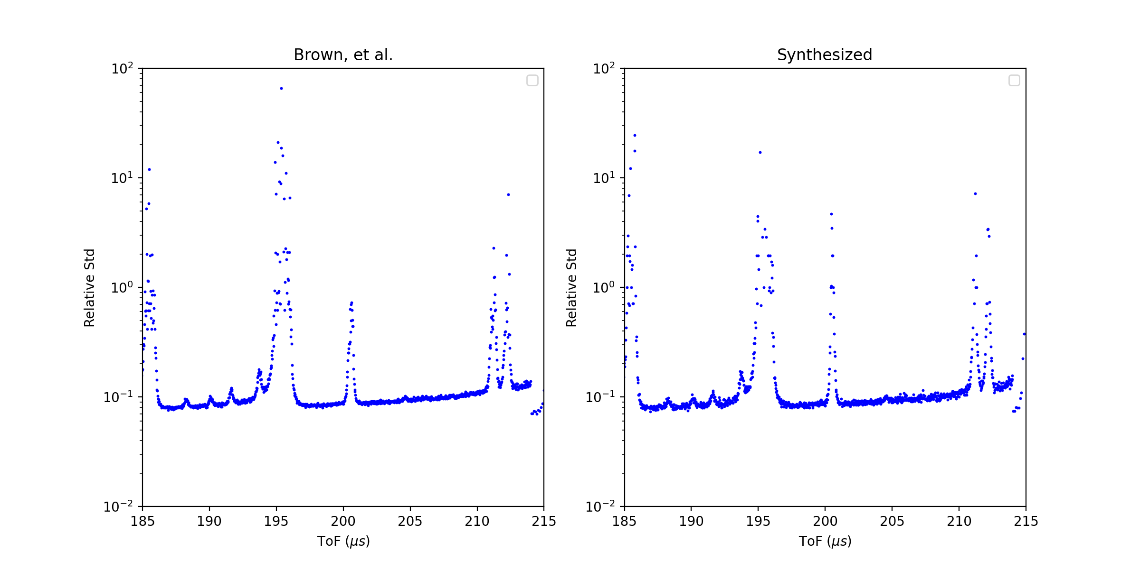
Verification

Slide 35
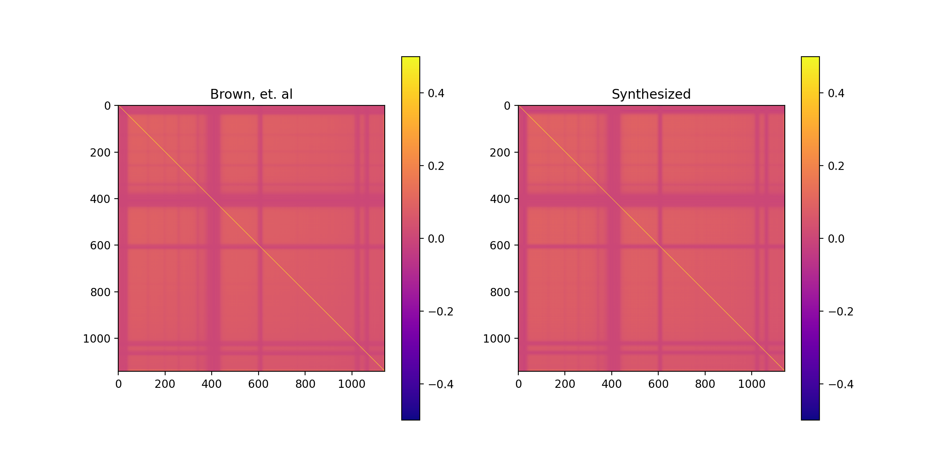
Verification
Correlation
Correlation

Slide 36
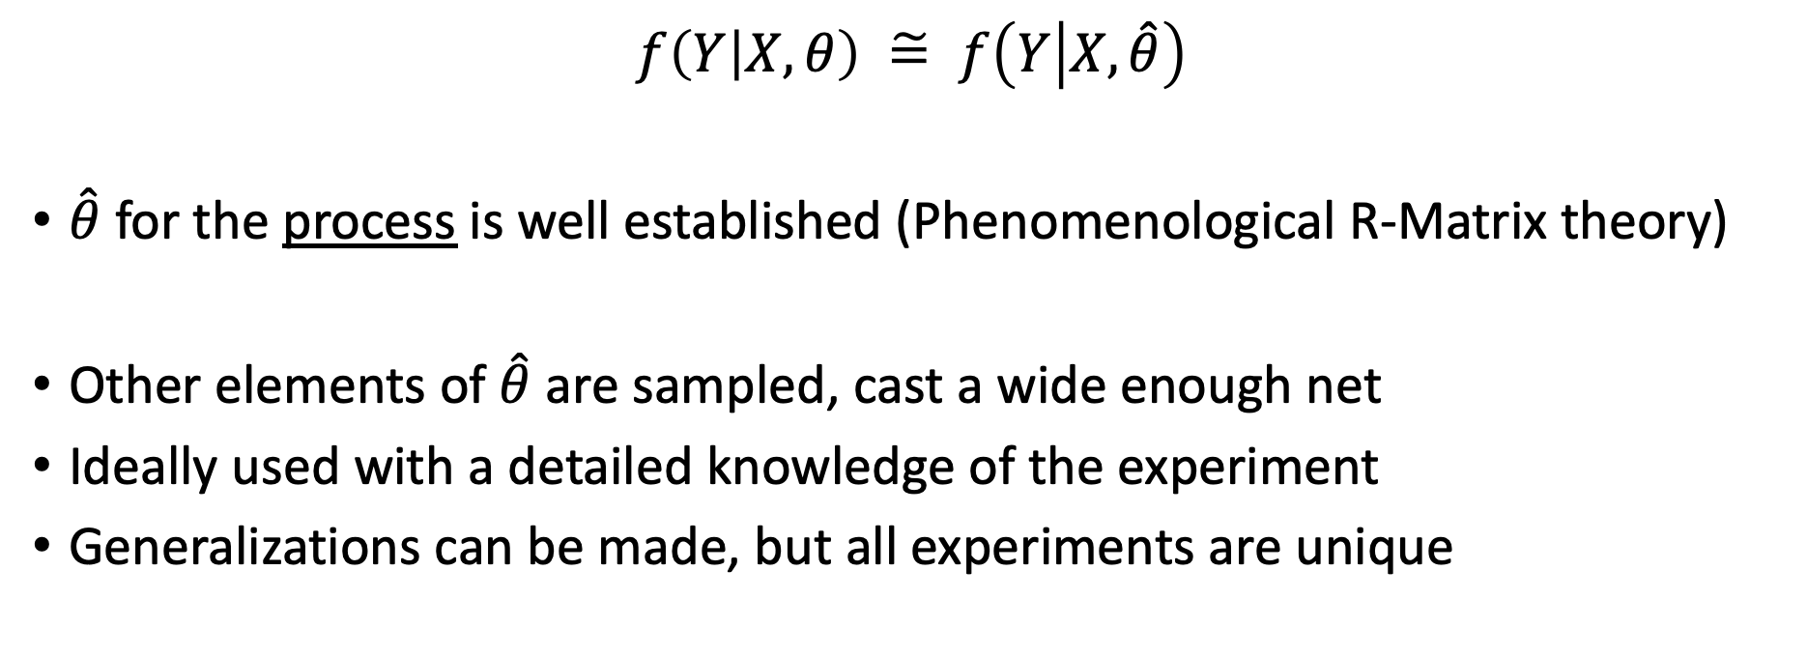
Utility
$$f\left(Y | X,θ\right) \tilde{=} f\left(Y | X,\hat{θ}\right)$$
$\hat{θ}$ for the process is well established (Phenomenological R-Matrix theory)
Other elements of $\hat{θ}$ are sampled, cast a wide enough net
Ideally used with a detailed knowledge of the experiment
Generalizations can be made, but all experiments are unique

Slide 37

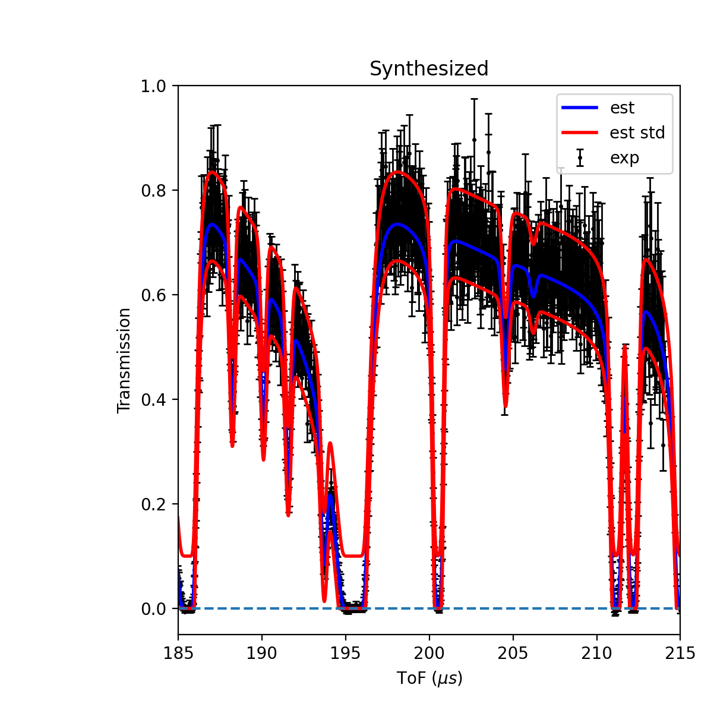
Conclusions
Infinite, labelled experimental resonance data
Very useful for exploratory analysis & model training
Tool for pseudo-validation of current & future UQ methods
This material is based upon work supported by the Department of Energy National Nuclear Security Administration through the Nuclear Science and Security Consortium under Award Number DE-NA0003996.

Slide 38
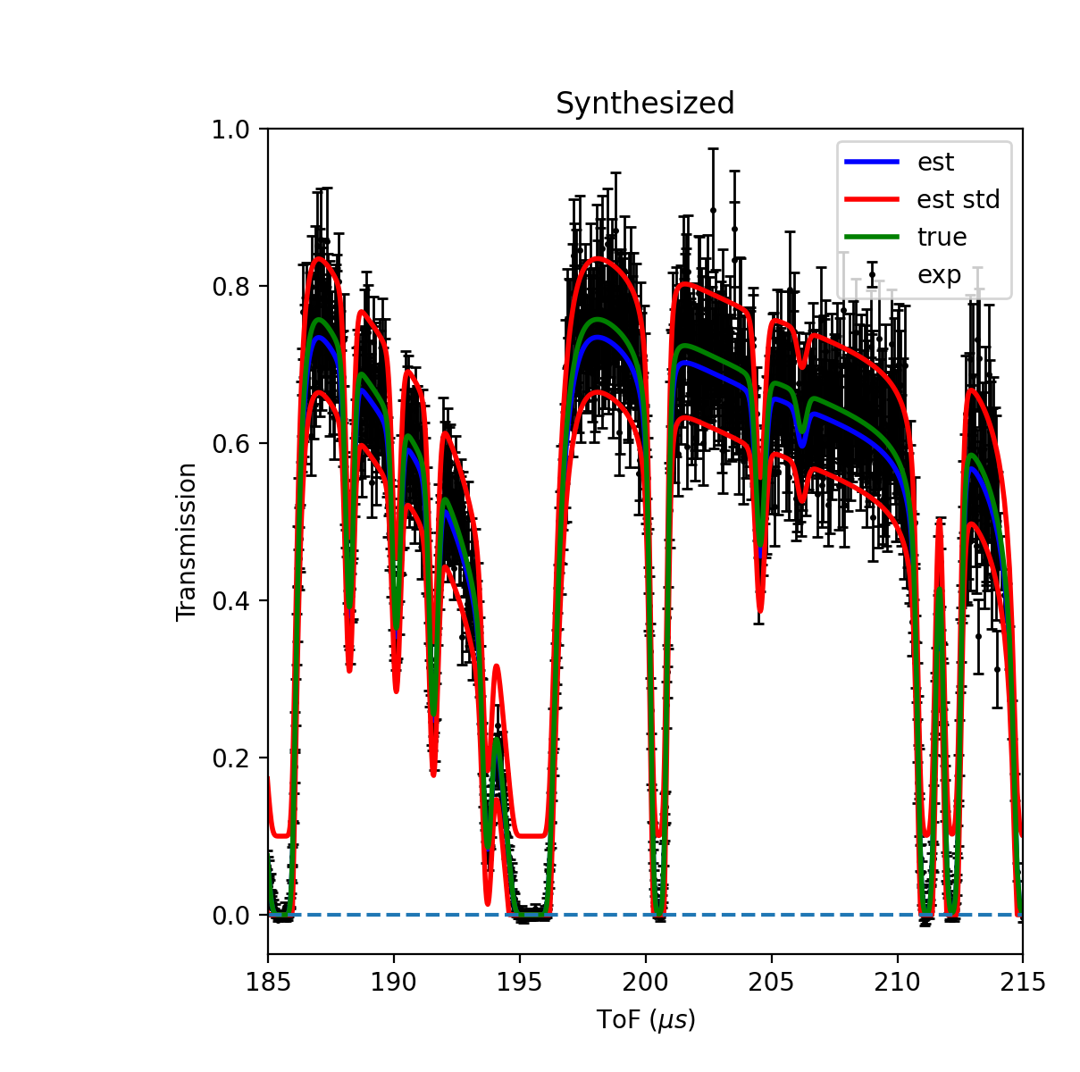
Conclusions
Infinite, labelled experimental resonance data
Very useful for exploratory analysis & model training
Tool for pseudo-validation of current & future UQ methods
This material is based upon work supported by the Department of Energy National Nuclear Security Administration through the Nuclear Science and Security Consortium under Award Number DE-NA0003996.

Slide 39
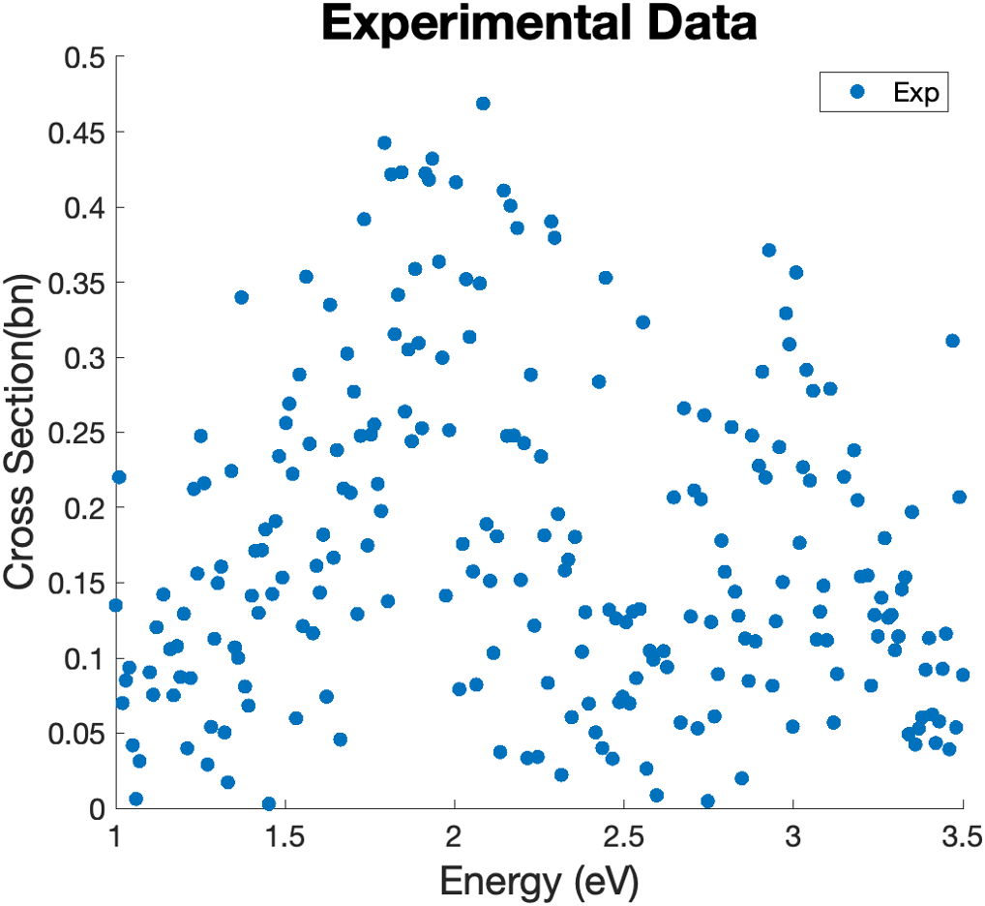
Motivation
ATARI – AI/ML Tool for Automated Resonance Identification
  Proof-of-concept, low-fidelity physics
  Promising results
  Nonlinear, mixed-integer optimization

Slide 40
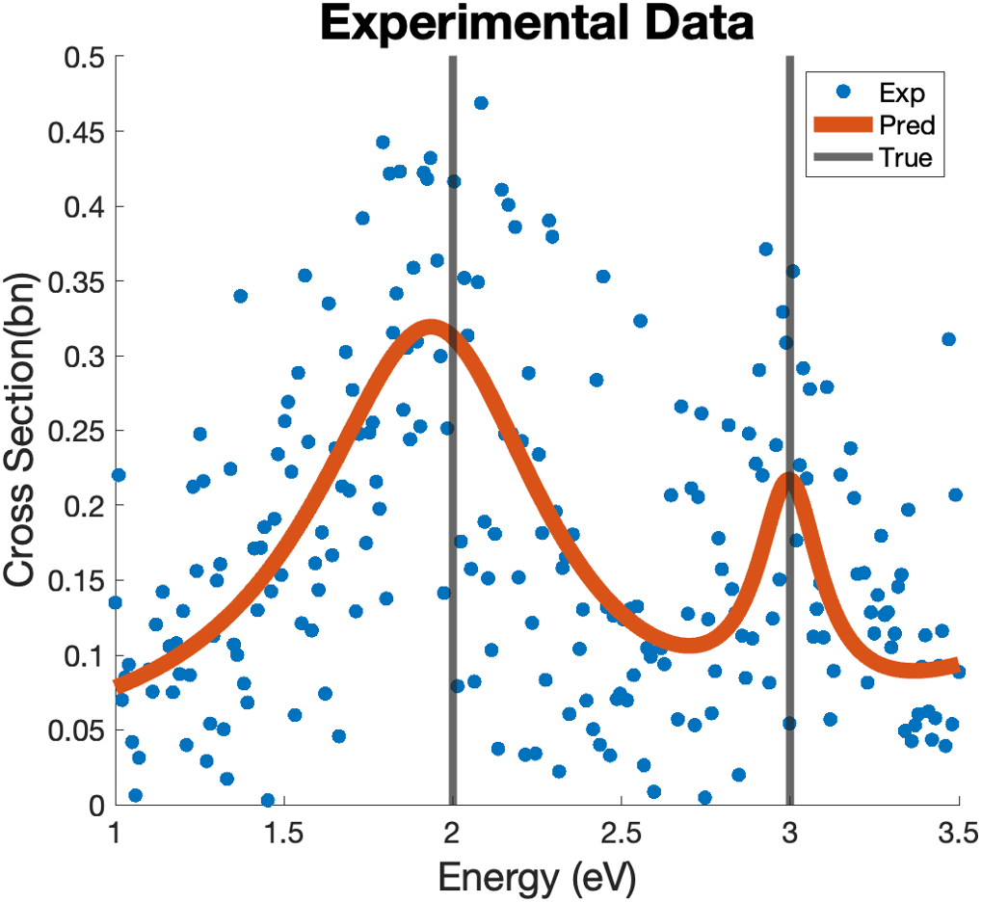
Motivation
ATARI – AI/ML Tool for Automated Resonance Identification
  Proof-of-concept, low-fidelity physics
  Promising results
  Nonlinear, mixed-integer optimization
  Accurate resonance identification

