Slide 1
Cross section measurements at ASP and VENOM
CSEWG 2022 Andrew Simons – Radiation Data Team Leader and Project Scientist
Simon Rice, Verity Woolhead, Tom Harrington and Tom Hodge
Andrew.simons@awe.co.uk

Slide 2
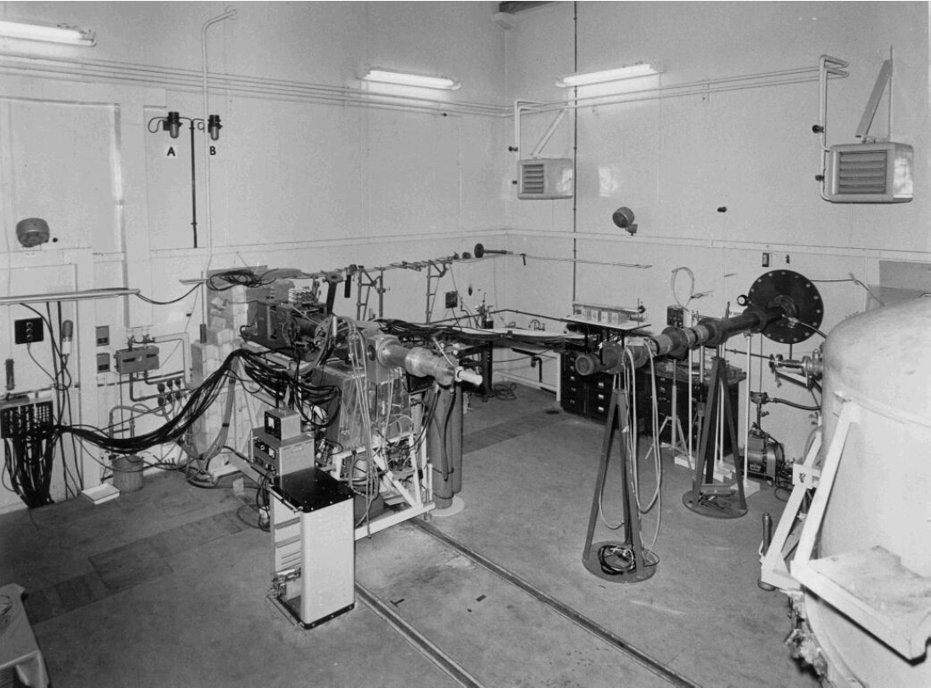
AWE’s Current Fast neutron capability - ASP
Designed in the mid fifties
Commissioned in 1962
Generated nuclear data until 1972
Used to provide neutron dose to experiments
Work began in 2011 to demonstrate the machine could still be used to benchmark nuclear data
2015 to 2019 ASP undertook a modernisation programme
2019 nuclear data generation programme recommenced and post Covid has resumed

Slide 3
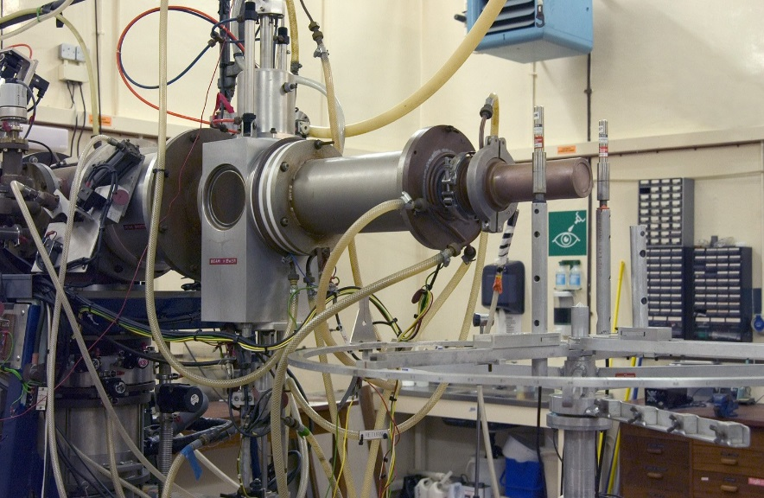
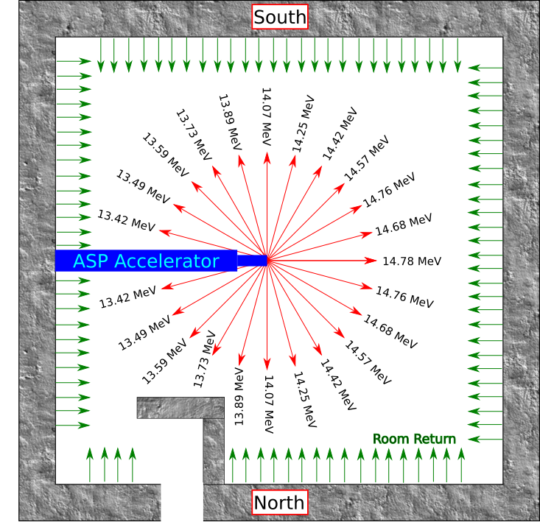
What is ASP?
ASP is a Cockcroft-Walton accelerator generating D₁⁺, D₂⁺ and D₃⁺ molecular beams
The beams impinge titanium tritide or titanium deuteride targets generating ~ 14.7 or 3.0 MeV neutrons
ASP was designed (~1960’s) to produce up to 10¹² n/s (from source)
In 2015 the measured nominal output level is 10¹⁰ n/s
Current nominal output for DT (on sample)
~5x10⁷ n/cm²/s at 200 mm
The cell is a 9x9x9 m room
However the facility is aging

Slide 4
Understanding ASP
The ASP facility spent nearly two decades supporting engineering trials work at a low level
Detailed knowledge of neutron generation and field diagnosis were degraded during this time
Since 2012 a modernisation programme has invested in the facility, the operations staff and the machine itself
A new generation of field diagnostics have been demonstrated at the facility including:
Additional Fission Counters - ~ 1m from the source
Rotating Neutron Spectrometer and Simple Scintillating Spectrometer
Activation Foils – cross calibrated with the UK’s National Physical Laboratory

Slide 5
Campaign Strategy
From past experiences working at the facility a campaign strategy has been developed and followed to create cross section data
Field assessment campaigns (FA) are undertaken using multiple diagnostics to check the field output
As soon as possible (scheduling/maintenance permitting) after the field assessment a cross section experimental campaign is undertaken
This year, for the first time in over 15 years, a deuterium target was utilised thus we have had four campaigns: FA, CX2 (at 14 MeV) and Fad, CX2d (at 3 MeV)
Foils are mounted at multiple angles around the (D-T or D-D) interaction volume in the target typically 10 cm from the source – thus we can neutron energies in the range (2.5-3.0 MeV [DD] and 13.5 to 14.7 [DT])

Slide 6
Experimental process
Use high-purity natural abundance foils, weighed to high accuracy and precision
Irradiation is monitored by fission counters for temporal information and Gas proportional counters plus plastic scintillators for spectral information
Monitor foils are used as a cross check
Gamma spectroscopy measurements are made using multiple HPGe systems with the DAQs networked to the ASP control system
Gamma spectroscopy can be undertaken within 10 seconds of the end of irradiation and usually up to a week afterwards with each sample measured multiple times

Slide 7
Data of interest
To date ASP has been used to look at cross sections of interest accessible from stable targets
We have collected data on the ⁸⁹Y(n,2n)⁸⁸Y ⁸⁹Y(n,n’)⁸⁹Y^{m} reactions for comparison with historic experiments
Since 2021 we have conducted 8 campaigns that are still being analysed with data on: Y, W, Fe, Cu and Ni
Decay of 89Y isomer (~15 second half life)

Slide 8
New Capabilities
ASP is an old facility and the cost to maintain the machine (in time and money) is high
AWE has a requirement to maintain a nuclear experiments capability hence investing in people and equipment
ASP is proving an invaluable training ground for operations, science and diagnostics and as a base for technology review and trials
The replacement is unlikely to be a like for like in capability as the project is requirements lead and AWE’s needs require extended capabilities
Greater range of neutron energies
Higher brightness of neutron sources
Use of modern radiochemical techniques
Potentially Accelerator Mass Spectroscopy coupled with bespoke diagnostics

Slide 9
What is VENOM?
Variable Energy Neutron Output Machine
VENOM is a project to deliver a fast neutron capability for AWE
Currently the project has passed stage gate 1 (Demonstration of feasibility)
working towards gate 2 (Conceptual design)
A proposed solution has been identified against prime stakeholder’s requirements
The concept’s neutron field has a variable peak neutron energy
0.5 to 23 MeV
The concept’s neutron field has high brightness (depending on the energy selected)
~2x10⁹ to ~8x10¹² n/cm²/s (lowest and highest intensities at quoted energies)
The concept’s capability consists of two accelerators pointing into the same irradiation cell.

Slide 10
Concept Solution Space
KEY:
Nuclear data
Dose testing
Concept delivery
ASP
Use three main reactions – D(⁷Li, D(d and D(t
Two more p(⁷Li and p(t, can be used to extend the range
n/cm²/s | >1.E+14
 | 1.E+14
 | 1.E+13
 | 1.E+12
 | 1.E+11
 | 1.E+10
 | 7.E+09
 | <7.E+09
 |  | 0 |  | 1 |  | 2 |  | 3 |  | 4 |  | 5 |  | 6 |  | 7 |  | 8 |  | 9 |  | 10 |  | 11 |  | 12 |  | 13 |  | 14 |  | 15 |  | 16 |  | 17 |  | 18 |  | 19 |  | 20 |  | 21 |  | 22 |  | 23
 |  | [MeV]

Slide 11
What else is in VENOM’s scope?
The project scope is to realise business benefits for the prime stakeholders: nuclear data and component testing
In order to do this the concept requires the following supporting equipment :
Accelerator Mass Spectrometer (AMS)
Hot Radiochemistry cell
Neutron-field diagnostics
γ-field diagnostics
Support areas
Activated equipment and sample storage
Transfer system and automated sample loading/retrieval systems
Activation counting laboratory

Slide 12
Possible layout and scale
Hot Cell
AMS
Ion Optics
Accelerator
Diagnostics Bay
& Active Equipment Bay
Irradiation Cell
Possible Support areas
Nuclear assay lab

Slide 13
Example: Nuclear Data experiments – radioactive samples
START
Move Sample to Hot Cell
Split and Prep Sample for Irradiation
Remote Move Sample to Irradiation Cell
RUN AMS
Split and Prep Sample for AMS
Remote move sample(s) to Hot Cell 2
Irradiate
Includes Field Diagnostics
Includes Source Readiness
FINISH
Remote move sample(s) to Secondary diagnostics

Slide 14
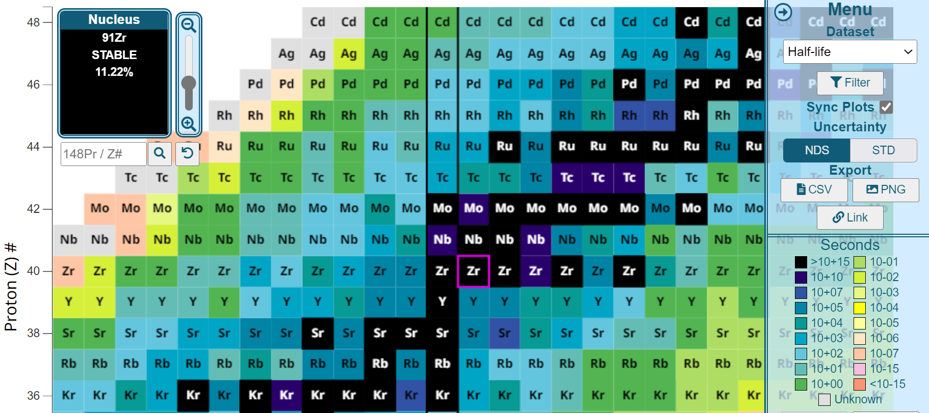
Example of extended access to areas of the Segre chart

Slide 15
Example of extended access to areas of the Segre chart
In essence we believe that the VENOM concept will allow us to make a range of cross section measurements on long lived radioactive isotopes – moving one or two steps away from the valley of stability
NOTE: both parent and daughter isotopes must have suitable half lives to meet irradiation and measurement criteria

Slide 16
Summary
Measurement campaigns have commenced at AWE’s ASP facility
VENOM is a project seeking to deliver a fast neutron capability for AWE
The VENOM concept solution generates a variable peak neutron energy
0.5 to 23 MeV
The concept’s neutron field has high brightness
~2x10⁹ to ~8x10¹² n/cm²/s (lowest and highest intensities at quoted energies)
The concept’s capability consist of two accelerators pointing into the same irradiation cell.
Sample to be assayed through gamma spectroscopy and AMS techniques

Slide 17
Summary
Measurement campaigns have commenced at AWE’s ASP facility
VENOM is a project seeking to deliver a fast neutron capability for AWE
The VENOM concept solution generates a variable peak neutron energy
0.5 to 23 MeV
The concept’s neutron field has high brightness
~2x10⁹ to ~8x10¹² n/cm²/s (lowest and highest intensities at quoted energies)
The concept’s capability consist of two accelerators pointing into the same irradiation cell.
Sample to be assayed through gamma spectroscopy and AMS techniques
Happy for any questions, comments, advice or useful contacts…

