Slide 1
Recent Standards Work
Allan D. Carlson
NIST Associate
Under Contract with BNL
Presented at
The CSEWG Meeting
Nov. 2, 2022

Slide 2
The Neutron Cross Section Standards
Reaction Energy Range
_________________________________________________
H(n,n) 1 keV to 20 MeV
³He(n,p) 0.0253 eV to 50 keV
⁶Li(n,t) 0.0253 eV to 1 MeV
¹⁰B(n,α) 0.0253 eV to 1 MeV
¹⁰B(n,α₁γ) 0.0253 eV to 1 MeV
C(n,n) 10 eV to 1.8 MeV
Au(n,γ) 0.0253 eV, 0.2 to 2.5 MeV, 30 keV MACS
²³⁵U(n,f) 0.0253 eV, 7.8-11 eV, 0.15 MeV to 200 MeV
²³⁸U(n,f) 2 MeV to 200 MeV

Slide 3
Outline of Recent Work on the Neutron Standards
Measurements of Neutron Cross Section Standards Proposed, Underway or Completed
  Including results presented at ND2022 and the Oct 2022 Standards meeting
Due to time limitations for this presentation mostly very recent work will be discussed. The following areas will not be shown:
  Prompt γ-ray production Reference cross section measurements
    ⁷Li(n, n’)γ and ⁴⁸Ti(n,n’)γ Reference cross sections

Slide 4
H(n,n)H Angular Distribution
A very important measurement was done by Jiang et al. at the Chinese Spallation Neutron Source (CSNS)
  Differential cross section data were obtained at 10 angles from 10 to 55 degrees. The shape measurements extend from 6 MeV to 52 MeV with 23 energy points. The flight path was 57.99m.
    The measurements generally agree well compared with existing measurements, evaluations and theoretical calculations (H. Jiang et al., Eur. Phys. J. A 57 6 (2021))
The hydrogen standard is limited to 20 MeV at the present time. The Jiang et al. data combined with the database being developed by Paris and Hale at LANL will allow an evaluation with an extended energy range to be produced. Their objective is to extend the evaluation to about 350 MeV the threshold for neutral pi production.
It has been decided to wait until the next evaluation of the standards before extending the hydrogen energy range.

Slide 5
Hydrogen Scattering Angular Measurements by Jiang at CSNS Facility

Slide 6
⁶Li(n,t) Measurements
Measurements are being made by Anastasiou et al. of the ²³⁵U(n,f)/⁶Li(n,t) cross section ratio with the NIFFTE fission TPC.
  The expected energy range is from about 0.1 MeV up to 3 MeV (possibly 4 MeV). The data will impact evaluations of both the ²³⁵U(n,f) and ⁶Li(n,t) cross sections.
  Some results of this work were given by Anastasiou at the ND2022 conference and the 2022 standards meeting .
    Preliminary results were given that agree well with the standards evaluation and suggest a rise in the ratio above 1 MeV.

Slide 7
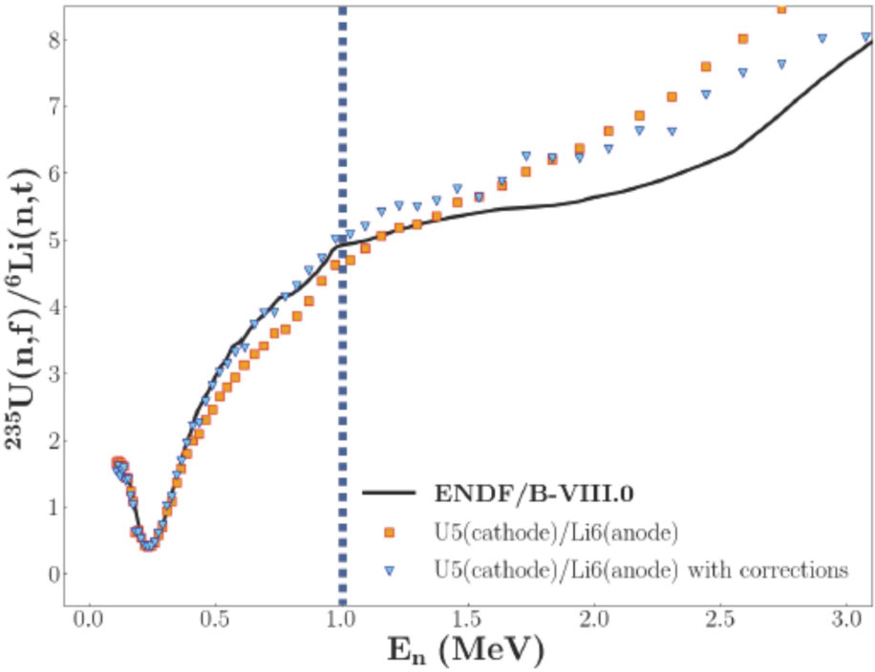
²³⁵U(n,f)/6Li(n,t) Cross Section Ratio Measurements by Anastasiou et al.

Slide 8
⁶Li(n,t) and ¹⁰B(n,α) and ¹⁰B(n,α₁) Measurements at CSNS
Extensive measurements of the ⁶Li(n,t) angular distribution by Bai et al. for energies from 1 eV to 3 MeV
Angular distribution data were also obtained by Jiang et al. for the boron standards from 1 eV to 2.5 MeV
  For both of these experiments there are some concerns due to the use of the ²³⁵U(n, f) cross section for fluence determination where it is not a standard.
  Since the experimental conditions for the two measurements were the same, the fluence concern was eliminated by re-processed the experimental data and obtaining ratios of the measurements.
The integrated data shown here will be used in a Python based analysis (based on the GMA analysis formerly used.) The angular distribution shape data for the two experiments will be used in an R-matrix analysis. These data will be used with earlier measurements to obtain final results
The ⁶Li angular distribution data can be seen in
Huaiyong Bai, et al Chinese Phys. C 44, 2020 014003.
The ¹⁰B angular distribution data can be seen in
The Haoyu Jiang et al Chinese Phys. C 43, 2019 124002.
The ratios of the angle-integrated cross sections for the ¹⁰B(n, α)⁷Li divided by the ⁶Li(n, t)⁴He reactions vs energy

Slide 9
Measurements Directly Related to the ¹⁰B(n,α) Standardand ¹⁰B(n,α₁γ) Measurements
Massey et al. have measured ¹⁰B(n,Z) reactions for neutron energies from 2 to 20 MeV.
  The work was done at the LANSCE WNR facility (Phys. Rev. C 105, 054612 (2022))
More work by Massey et al.
  Several measurements of the ¹⁰Be(p,n)¹⁰B reaction by Massey and Jones-Aberty at Ohio University.
  They include two angular distributions at 2.5 and 3.5 MeV.
All of these data can be used in R-matrix fits to improve the ¹⁰B(n,α) standards

Slide 10
¹⁰B(n,x)⁷Li and Li Measurements
Extension in the energy ranges to above 1 MeV of the ⁶Li(n,t) and ¹⁰B standards may be possible with the work by Anastasiou et al., Bai et al., Jiang et al. and the Massey et al. data.
The It is important to extend the energy range of these standards to above 1 MeV, the present limit of this standard. That would allow convenient overlap with the H(n,n) standard.

Slide 11
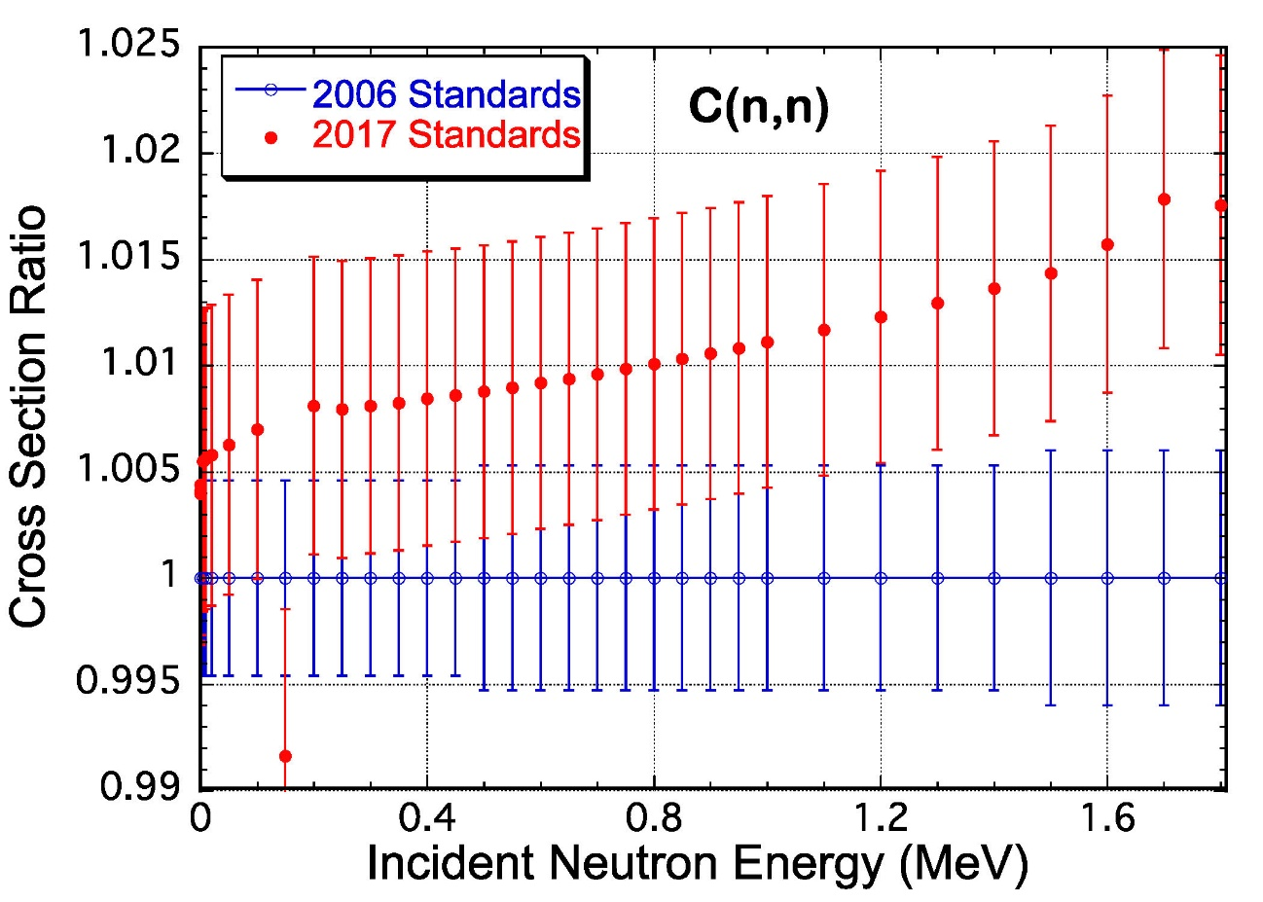
C(n,n) Cross Section
The most recent evaluation of the carbon standard by Hale was done by combining ¹²C and ¹³C R-matrix evaluations to obtain the elemental cross section that is the standard. That evaluation, the ENDF/B-VIII standards evaluation (the 2017 standard), is somewhat higher than the ENDF/B-VII standards evaluation (the 2006 standard). The difference is most noticeable at the highest energies.
Danon at RPI made total cross section measurements that are slightly lower than the 2017 standard values in the 150 to 400 keV energy region. Those data with uncertainties from a fraction of a percent to about 1% are in better than 1% agreement with the 2006 standards evaluation.
The basic difference here is due to the addition of ¹³C data.
New measurements are now underway at the University
of Kentucky by Vanhoy of ¹³C scattering from 0.5 MeV
to about 3 MeV. Thus the data will include the highest
energy needed for the standards, 1.8 MeV.
Hale is investigating this problem!

Slide 12
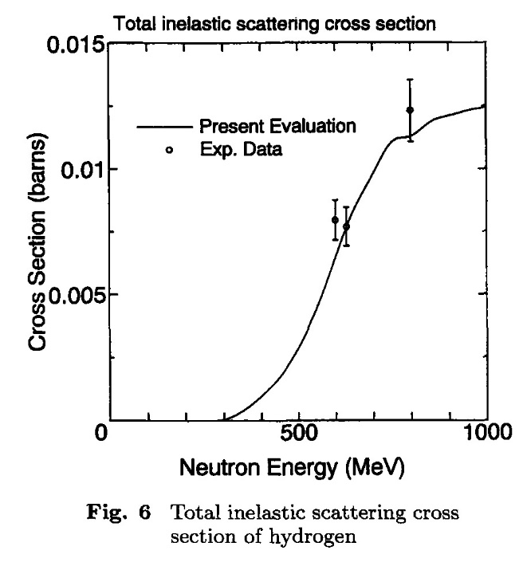
Absolute measurements by the n_TOF collaboration were made of the ²³⁵U(n,f) cross section relative to hydrogen scattering from 20 MeV to about 1 GeV.
  The analysis of the data from 20 MeV to 200 MeV was discussed by Pirovano et al. at the ND2022 conference. Their results have systematic uncertainties of 3-5%. The preliminary results generally agree with the standards results with some local differences.
  The data analysis above 200 MeV was given by Manna et al. also at the ND2022 conference. The preliminary results up to about 425 MeV are similar to those of the ²³⁵U(n,f) Reference cross section The present standard is limited to 200 MeV. There is a strong need for an extension to higher neutron energies that may be possible with these data.
  A experimental complication for this experiment is inelastic scattering
  for n-p protons above about 300 MeV.
²³⁵U(n,f) and ²³⁸U(n,f) cross sections measurements at CSNS
  Shown by Chen. at the ND2022 conference.
    Relative to the hydrogen scattering standard
    Further measurements will be absolute
They extend from 10 to 66 MeV and agree reasonably well with the
standard.
Uranium Fission Cross Section Measurements

Slide 13
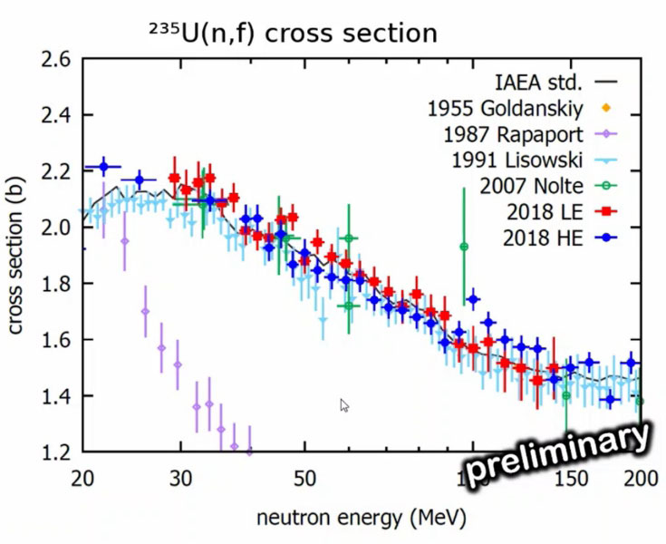
²³⁵U(n,f) Cross Section Measurements by Pirovano et al. (2018 LE) and (2018 HE)

Slide 14
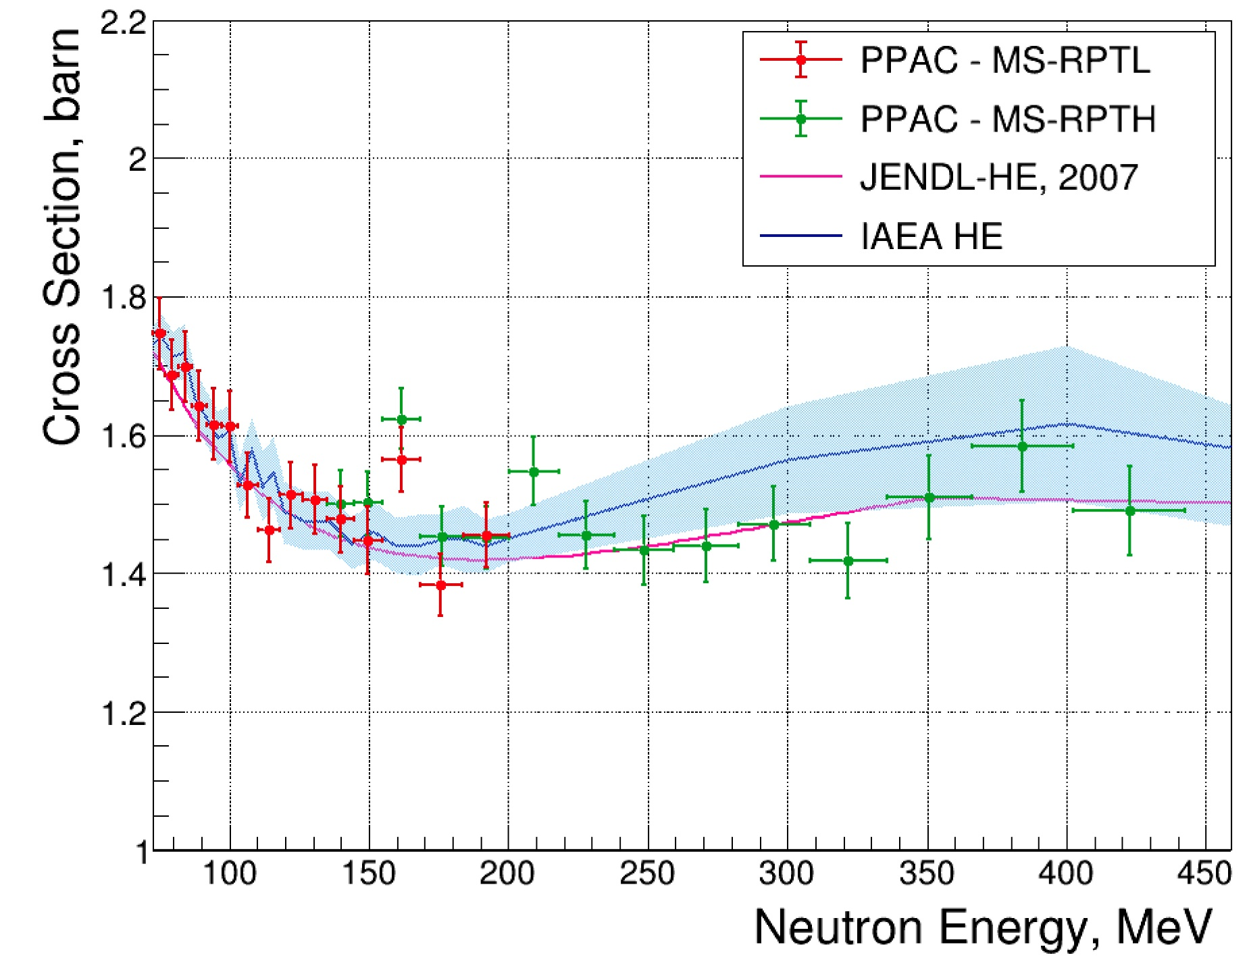
²³⁵U(n,f) High Energy Cross Section Measurements by Manna et al.

Slide 15
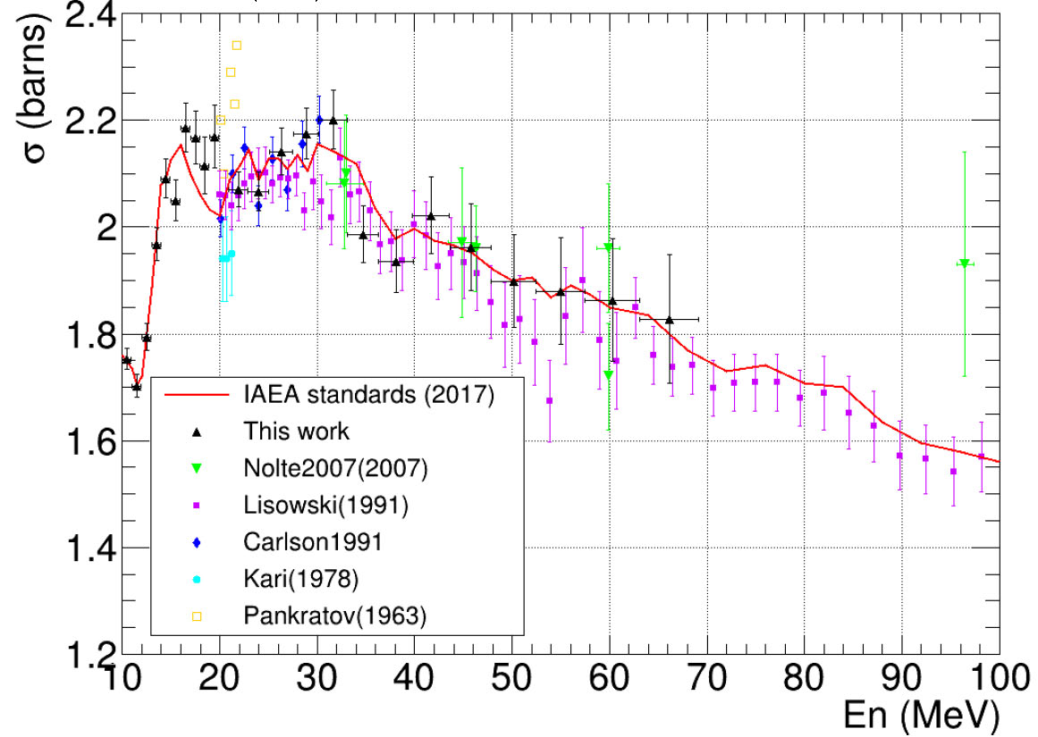
²³⁵U(n,f) Cross Section Measurements by Chen at CSNS Facility

Slide 16
²³⁹Pu(n,f)/²³⁵U(n,f) cross section ratio measurements by Snyder et al. made at LANSCE by the NIFFTE collaboration have been published (L. Snyder, Nuclear Data Sheets 178 1 (2021) ). These data are higher than the standards evaluation by about 2%. They are recommended to be used as ratio shape data. They agree in shape with the standards evaluation. New measurements have been made with an improved sample. They were shown at the ND2022 conference by Snyder. The new data look identical to the former measurements. It’s normalization is still under investigation.
Also measurements have been made of the ²³⁹Pu(n,f)/⁶Li(n,t) cross section ratio with the NIFFTE fission TPC.
These data will impact evaluations of both the ²³⁹Pu(n,f) and ⁶Li(n,t) cross sections. At the lower energies these measurements may help define the normalization of the shape of the ²³⁹Pu(n,f) cross section and give information about the ²³⁹Pu(n,f) /²³⁵U(n,f) cross section ratio 2% concern. These data are not finalized.
Plutonium Fission Cross Section Related Measurements

Slide 17
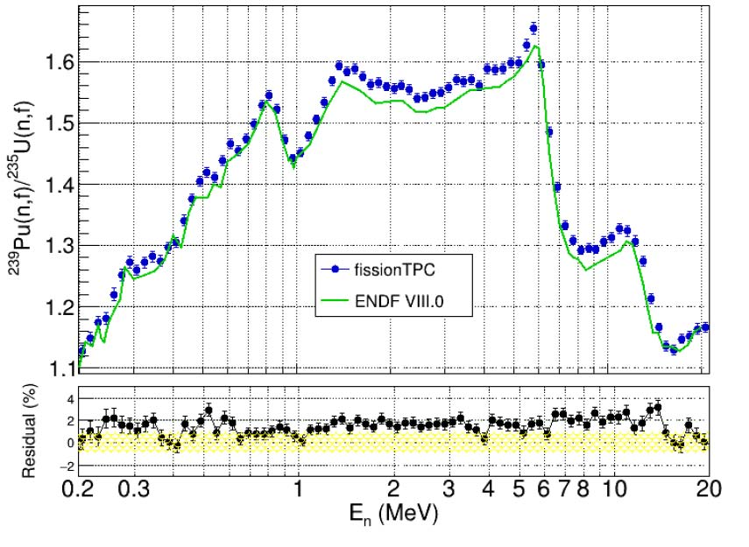
      Comparison of the Published NIFFTE ²³⁹Pu(n,f)/ ²³⁵U(n,f) Cross Section Ratio with the Standards Evaluation

Slide 18
Beginning with the standards for the ENDF/B-VI evaluation, very “clean” integral data were used.
The data used were measurements of the ²³⁵U(n,f) and ²³⁹Pu(n,f) cross sections in the ²⁵²Cf spontaneous fission (neutron spectrum (Spectrum Averaged Cross Sections, SACSs).
Since there is a relatively small change in the cross section for these nuclides over most of the energy range of the ²⁵²Cf spectrum, an accurate determination of the cross section is possible. The result is also only weakly dependent on the uncertainty in the spectrum shape. These integral data basically help provide normalization for the standards evaluation.
An improvement in use of these SACS would be possible if ratios can be used.
  With ratios, the dependence on neutron fluence is removed.
  GMAP unfortunately can not handle SACS ratios
  A new Python based code was written by Schnabel (GMA-py) so these ratios are now being used.
Use of Integral Data

Slide 19
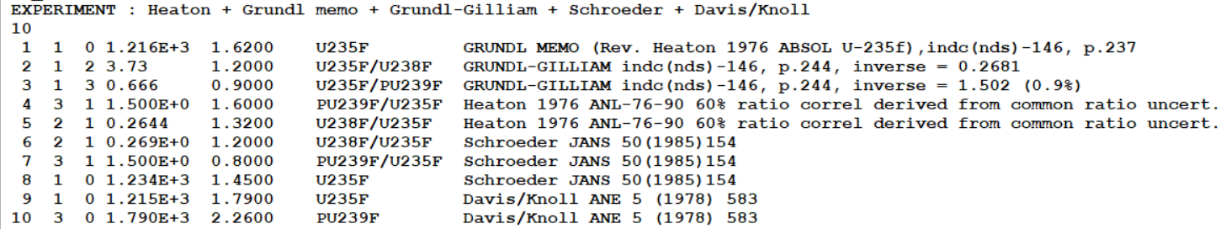
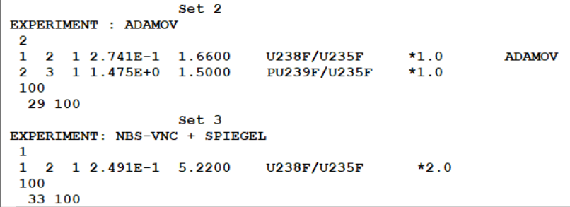
7 data of ²³⁵U(n,f) & ²³⁹Pu(n,f) SACS-Cf (no ratios !)
in STD 2017 evaluation (GMA)
Updated GMA-py +13 data incl. precise ratios -> New Evaluation

Slide 20
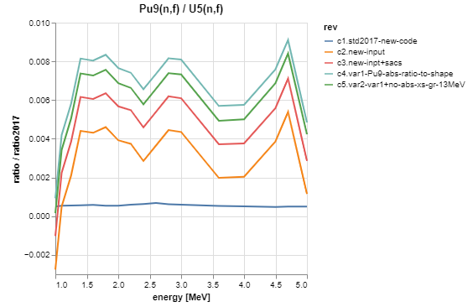
Pu9f/U5f: 2017 vs current – GMA-py
@ 1.5 MeV
+0.2% due to SACS
+0.3% rel. to INDEN p57

Slide 21
Summary-what is needed
Improved experimental work is necessary for all the standards
  Especially the boron and lithium standards so the upper energy bound can be increased
    Also for gold capture that has some of the largest uncertainties for the standards
Extension of the hydrogen standard to about 150 MeV and possibly higher (work is underway by Hale and Paris)
  It is now 20 MeV but there are cross section ratio data to much higher energies
  Note that changes to a standard are not allowed for a given version but extensions are allowed
Further work on unrecognized sources of uncertainty
  An understanding of the energy dependence of USU
Consider improved evaluation techniques for the standard cross sections

