Slide 1
EXFOR and NSR Update
B. Pritychenko¹,
1 National Nuclear Data Center, Brookhaven National Laboratory, Upton, NY 11973-5000, USA

Slide 2
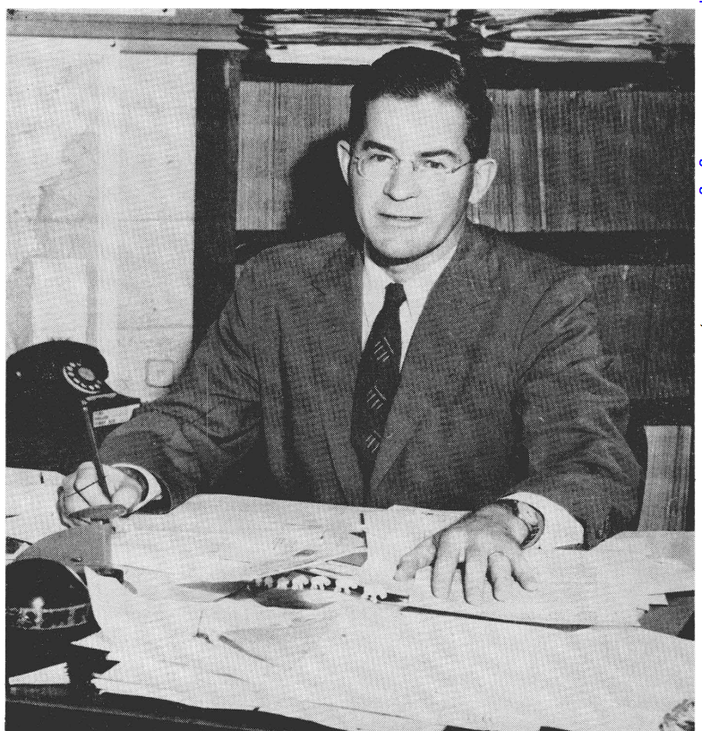
Outline of Nuclear Reaction Data Compilations in USA & Worldwide
Experimental neutron reaction data compilations have been pioneered at the Metallurgical Laboratory, University of Chicago and Los Alamos National Laboratory in 1945-1947.
1947 - Publicly available compilations.
Donald J. Hughes (1915-1960) was behind the BNL-170 (1952); it is a precursor of BNL-325 (Atlas of Neutron Resonances).
SCISRS (Sigma Center Information and Retrieval System) at BNL (1964) was a precursor of EXFOR.
Other data centers were created in Paris, France (NEA-Databank), Vienna, Austria (NDS-IAEA), and Obninsk, USSR (IPPE) in 1963-1964.
Around 1970 four neutron data centers agreed on the data interchange format (EXFOR). The four centers could store data locally in its formats. The Nuclear Data Centres Reaction (NRDC) network was founded in 1979 under the auspices of the IAEA.
75 Years of Experimental Nuclear Reaction Data Compilations

Slide 3
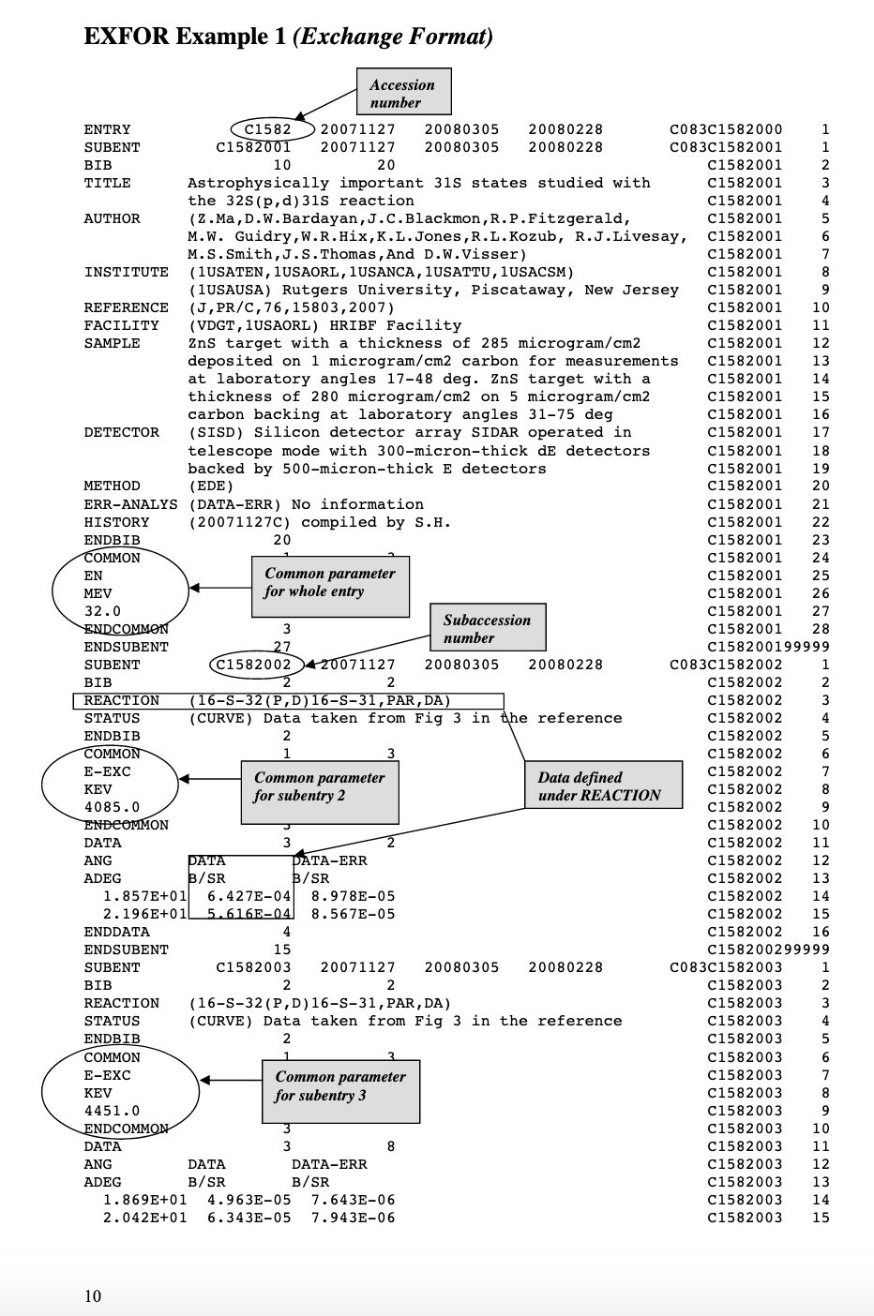
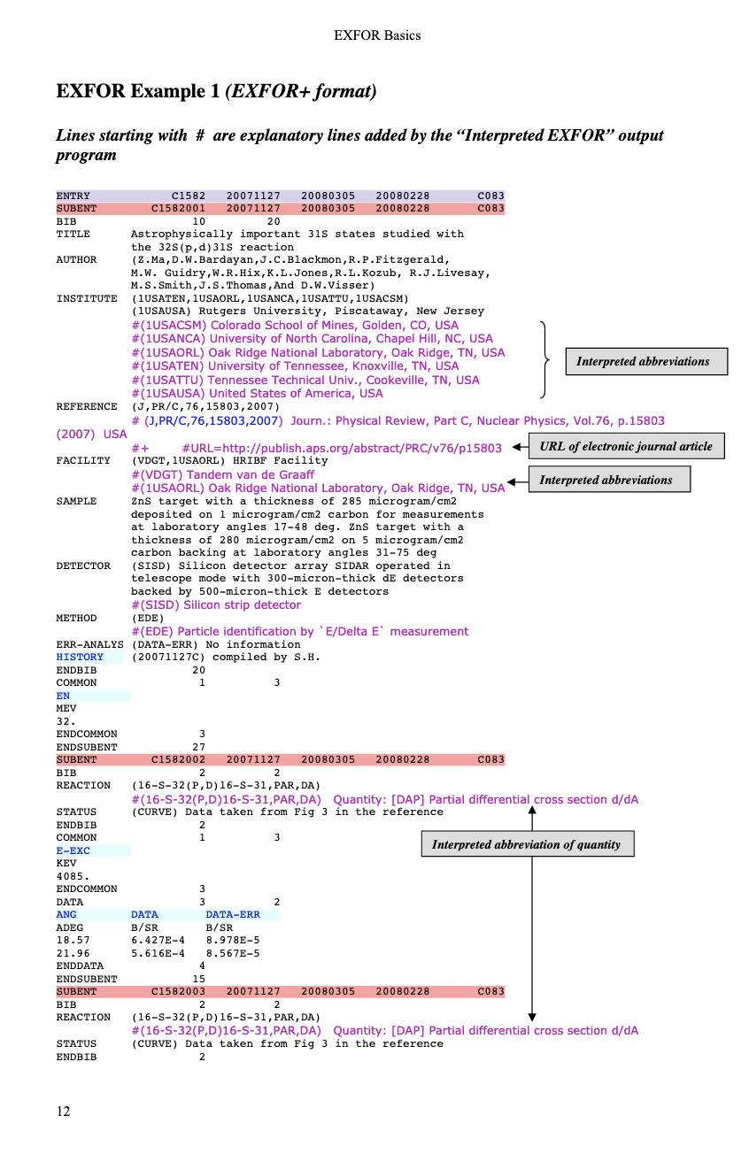
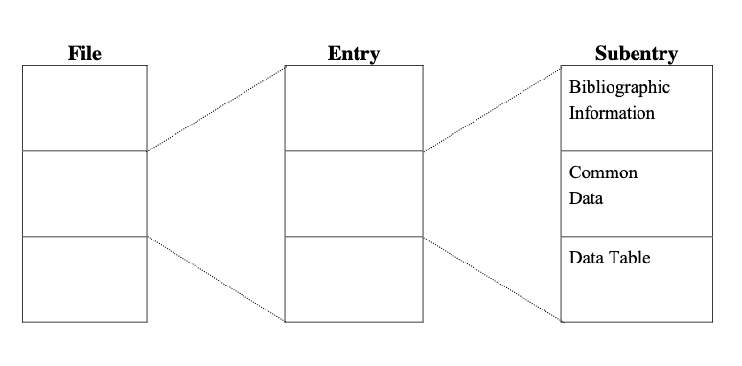
EXFOR DB Structure
EXFOR File (database)
EXFOR Entries (experiments)
EXFOR SubEntries (data sets)
NRDC Referred Compilations.

Slide 4
Area #1 FY 2022 Statistics
New compilations: 158
Updated compilations: 210
Finished compilation of missing Los Alamos reports.
Actively worked on missing α-induced reactions.
Preliminary NRDC transmissions: 29
Final NRDC transmissions: 31
EXFOR DB Updates: 41

Slide 5
The IAEA EXFOR compilation control system
EXFOR compilation control system is one of the tools used for this co-ordination.
Top panel: New entries only.
Bottom panel: New and Updated entries, number of data points and transmissions.

Slide 6
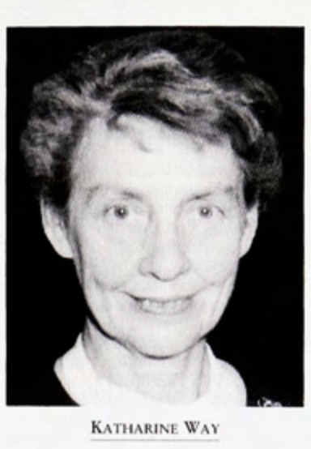
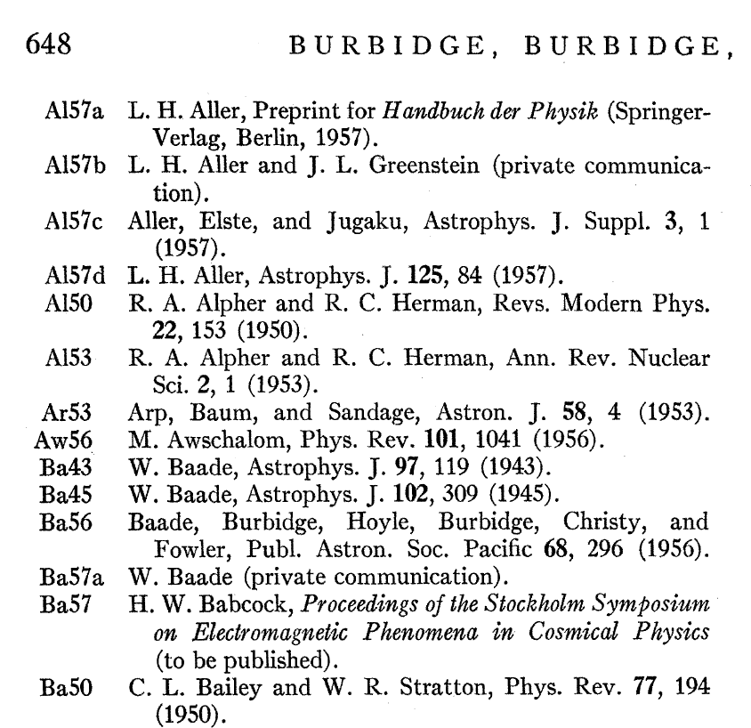
Nuclear Science References (NSR)
Katherine Way (formerly at Met Lab, Chicago) recognized the importance of keywords and convinced several journals to include them.
Oak Ridge NSR entry consisted of authors, journal and simple nuclear structure keywords; title was often missing.
References were stored at the ORNL library.
In 1980 NSR operation was transferred from Oak Ridge to Brookhaven.
In subsequent years the database was integrated with XUNDL/ENSDF and EXFOR.
However, evaluators worldwide were still spending plenty of time for references location because not everyone had access to good library resources.

Slide 7
NSR FY 2022 Statistics
Total number of new compilations: 3,284
Total number of keyworded compilations: 2,391
Lack of conferences: Proceedings of Nuclear Data 1992 were added among others.
NSR Dictionaries:
2,371 new authors
14 new journals
123 new decays
123 new reactions
573 new nuclides
NSR DB updates: 169
NSR Web: 1,035,004 retrievals in FY2022 ??? 301,455 from October 2021 to June 2022.
Brookhaven Lab ITD scanning is responsible for high number of retrievals in July-August 2022.

Slide 8
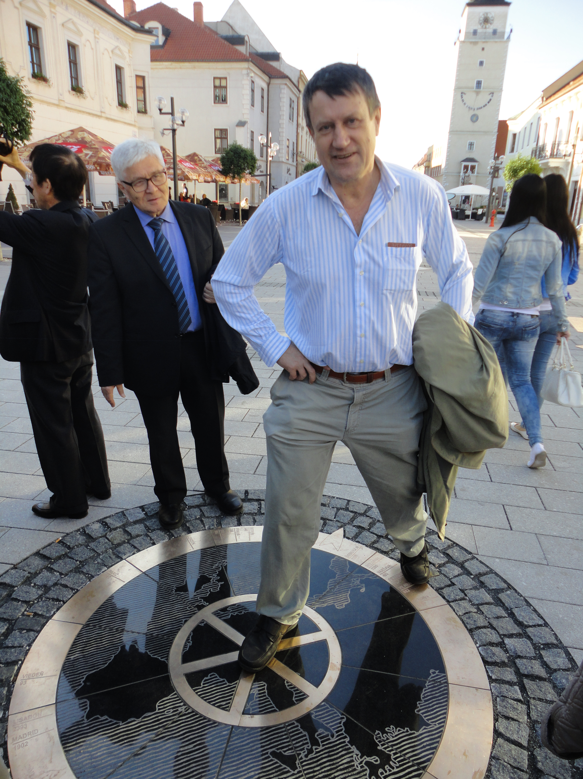
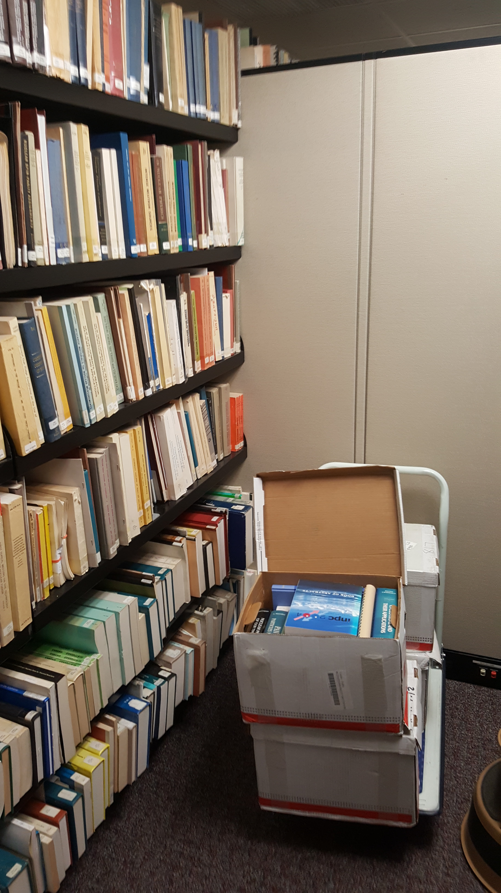
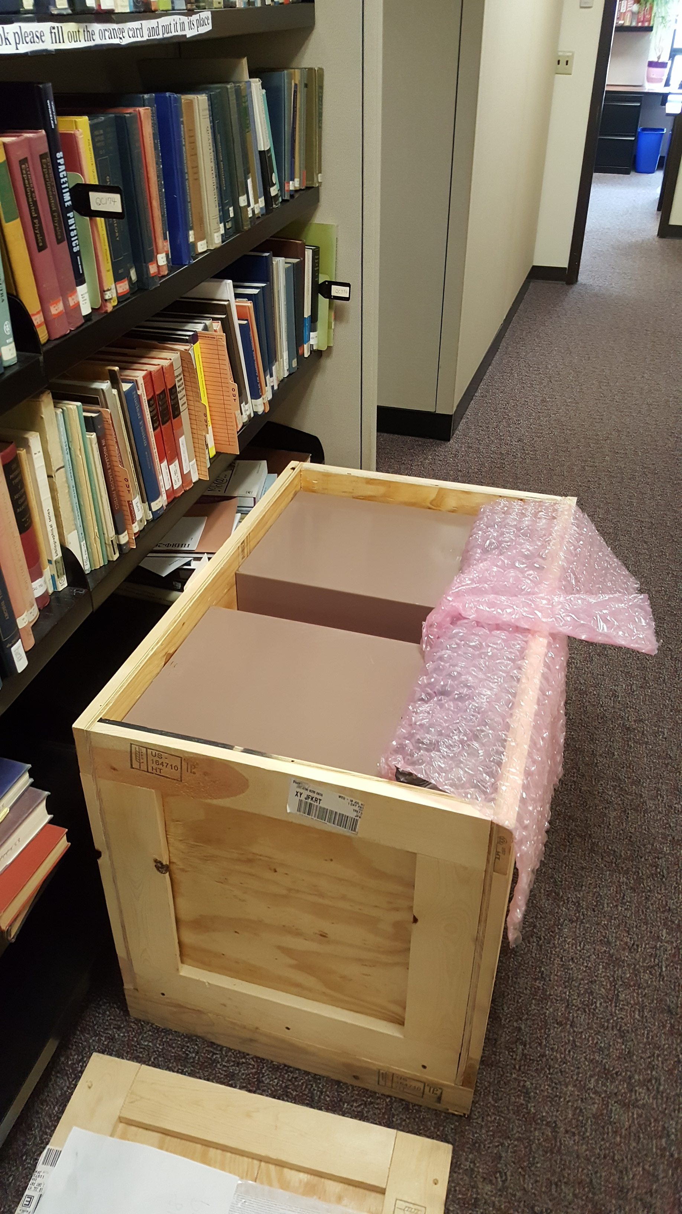
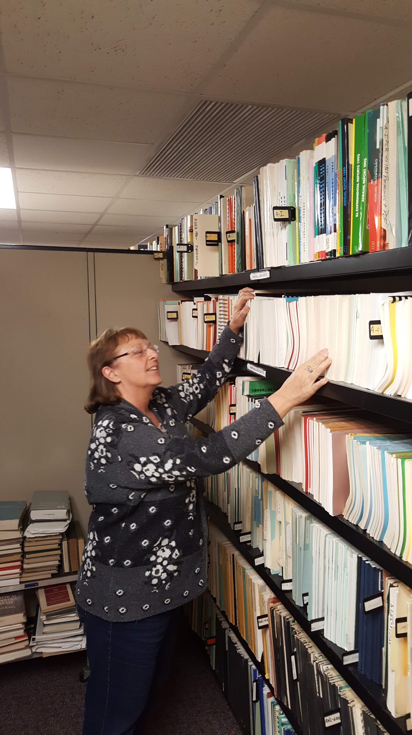
NNDC ``Paper” Library
NNDC collects unique references, we acquired Oak Ridge library, Los Alamos, McMaster U. and many other collections.
NNDC implemented new scanner, mirofiche reader, ... Joann Totans is leading this effort.
Traditional ``paper” library became a bottleneck due to large volume of requests, and change was needed.
Around 2005 Viktor Zerkin (Nuclear Data Section, IAEA) suggested to extend EXFOR database with published articles (PDF files).
He started to store PDFs in the EXFOR relational database.
Complete, Documented Data Sets.

Slide 9
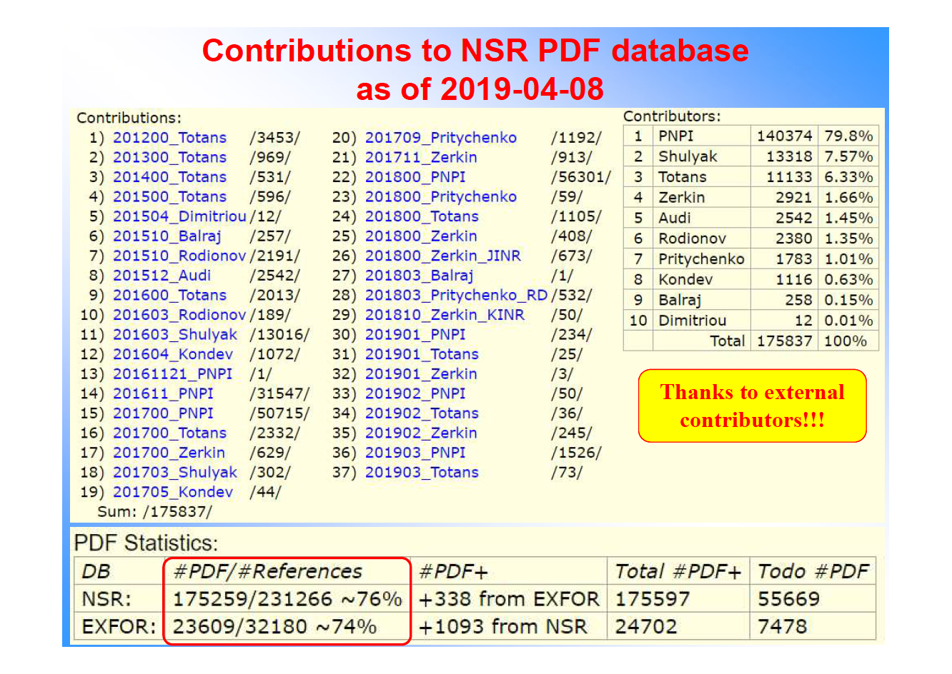
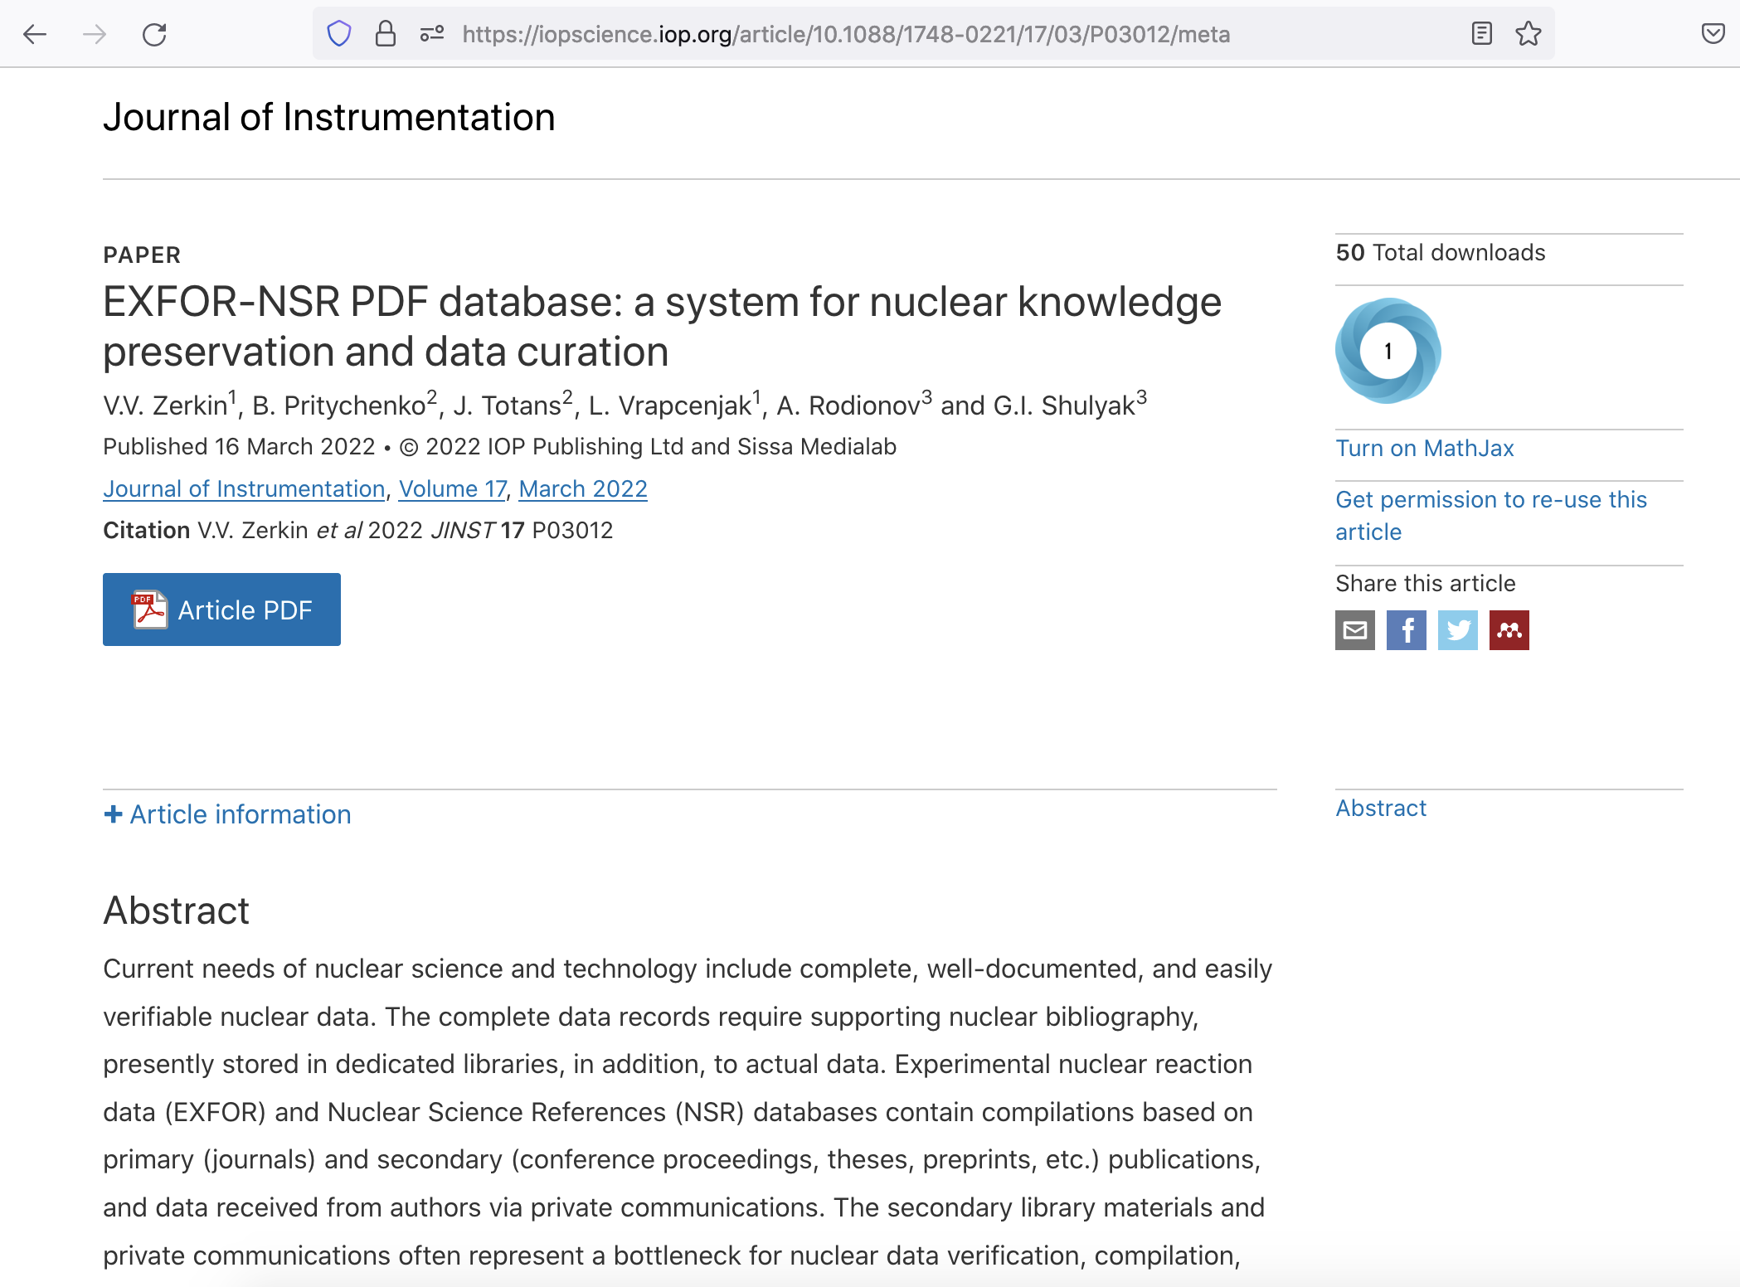
Portable Document File (PDF) Database
Regular updates of EXFOR and NSR databases extended to PDF files.
Private collections for existing entries.
Authorized Web access only due to major publishers restrictions.
Continuing PDF scanning effort at NNDC.
Future contributions from LBNL and other labs are more than welcome.
The database description was published in Journal of Instrumentation (2022).
NDS-IAEA: Viktor Zerkin

Slide 10
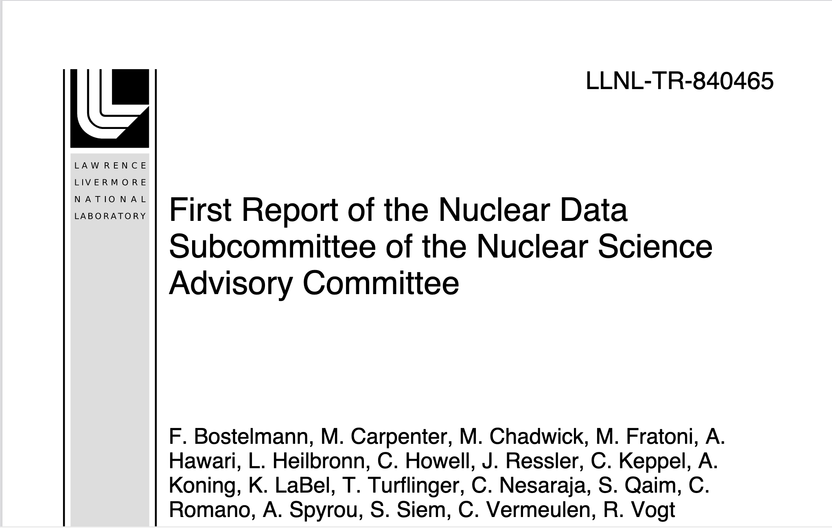
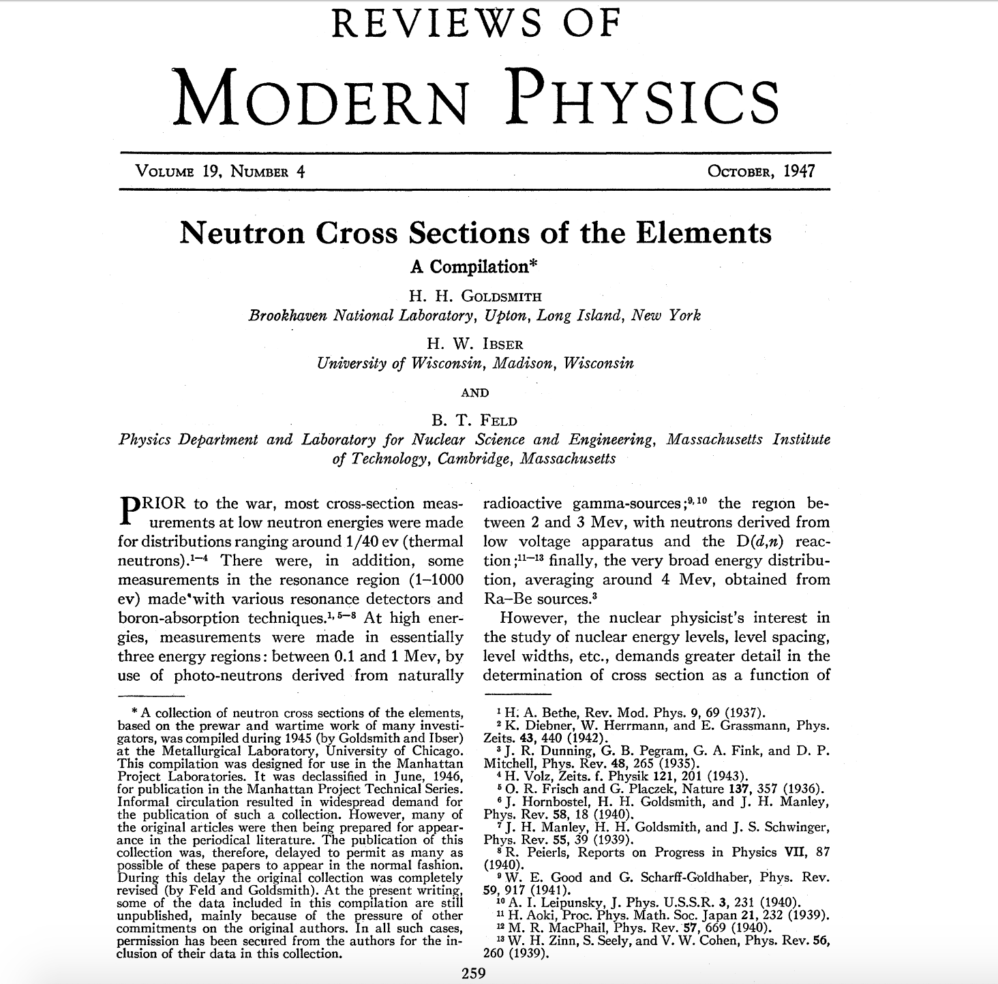
Takeaways
NNDC EXFOR compilation efforts are complex and well-organized: B. Pritychenko (BNL), O. Schwerer, S. Hlavac, O. Gritzay (Under contract with BNL), V. Zerkin (IAEA).
NNDC NSR compilation efforts are complex and well-organized: B. Pritychenko, J. Totans (BNL), B. Singh, D. Symochko (Contractors), V. Zerkin (IAEA).
PDF database effort of V. Zerkin (IAEA), B. Pritychenko, J. Totans (BNL), L. Vrapcenjak (IAEA), A. Rodionov, G.I. Shulyak (PNPI, Gatchina).
EXFOR-NSR PDF effort was reported to NSAC.
75th anniversary of nuclear reaction data compilations in 2021-2022.

