Slide 1
Preliminary fast benchmark testing for ENDF/B-VIII.1
Tim Gaines
CSEWG, November 2022
Tim.Gaines@awe.co.uk
Slide 1 of 9

Slide 2
New evaluated data
Received multiple advanced releases of candidate ²³⁹Pu files ahead of ENDF/B-VIII.1 release
Files received from INDEN, including ENDF/B-VIII.1 Beta 0 release candidates:
Focus on fast metal benchmarks: PMF, HMF and MMF
p10, p17, p29, p38, p39, p55, p57, Beta0 version a (p57), b (LANL), c (ENDL)
Processed locally using NJOY2016.67
MCNP6 calculations using inputs from ICSBEP handbook
Unfortunately I have been time limited, have processed and run calcs but not had chance to perform significant investigation yet. These are a look at differences compared to ENDF/B-VIII.0
Slide 2 of 9

Slide 3
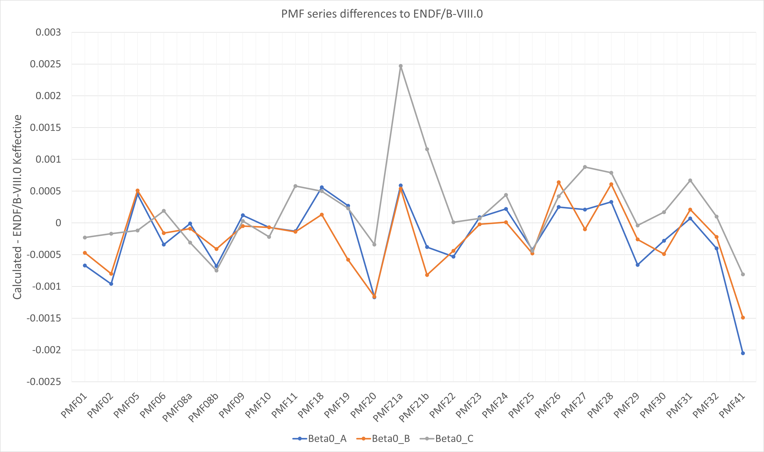
PMF series – VIII.0 against Beta0
Looking at the PMF series, the majority of calculated changes are within their benchmark uncertainties
System fluctuations are typical for any change of evaluation
A couple outliers which require further investigation:
PMF21 which sees a significant increase with Beta0_C
PMF41 shows a significant decrease for all versions
Look at PMF001 in detail next slide
Slide 3 of 9

Slide 4
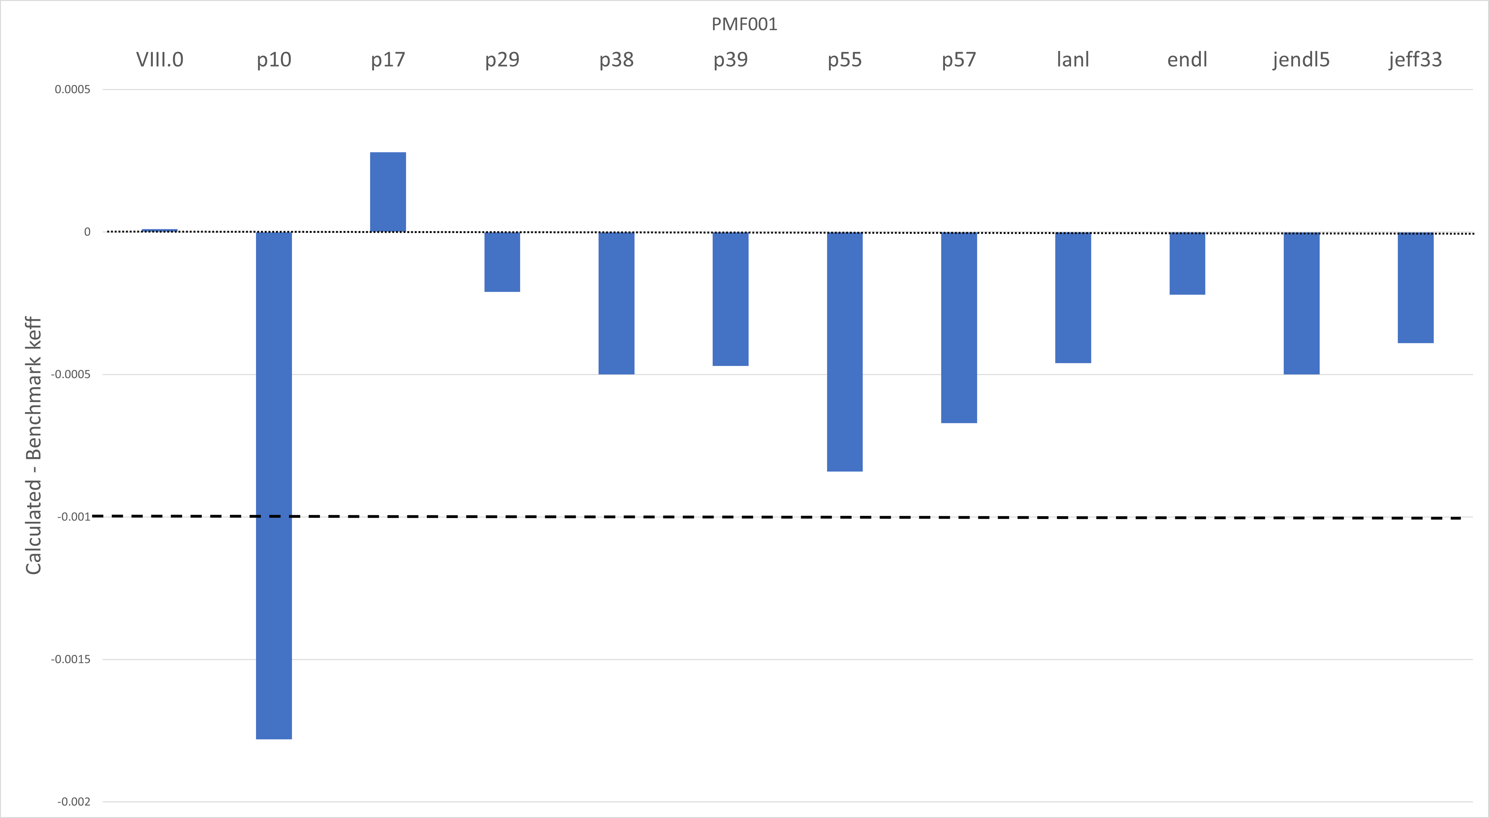
PMF001
After a significant decrease in criticality for p10, later revisions settle with small decrease to criticality within benchmark uncertainty
These calculations were performed using the ‘revision 2’ input
The Beta0 results are more comparable to calculated results using JEFF-3.3 and JENDL-5.0
Library | K_{eff}
VIII.0 | 1.00001
p55 | 0.99916
p57 | 0.99933
LANL | 0.99954
endl | 0.99978
JENDL-5 | 0.9995
JEFF-3.3 | 0.99961
Slide 4 of 9

Slide 5
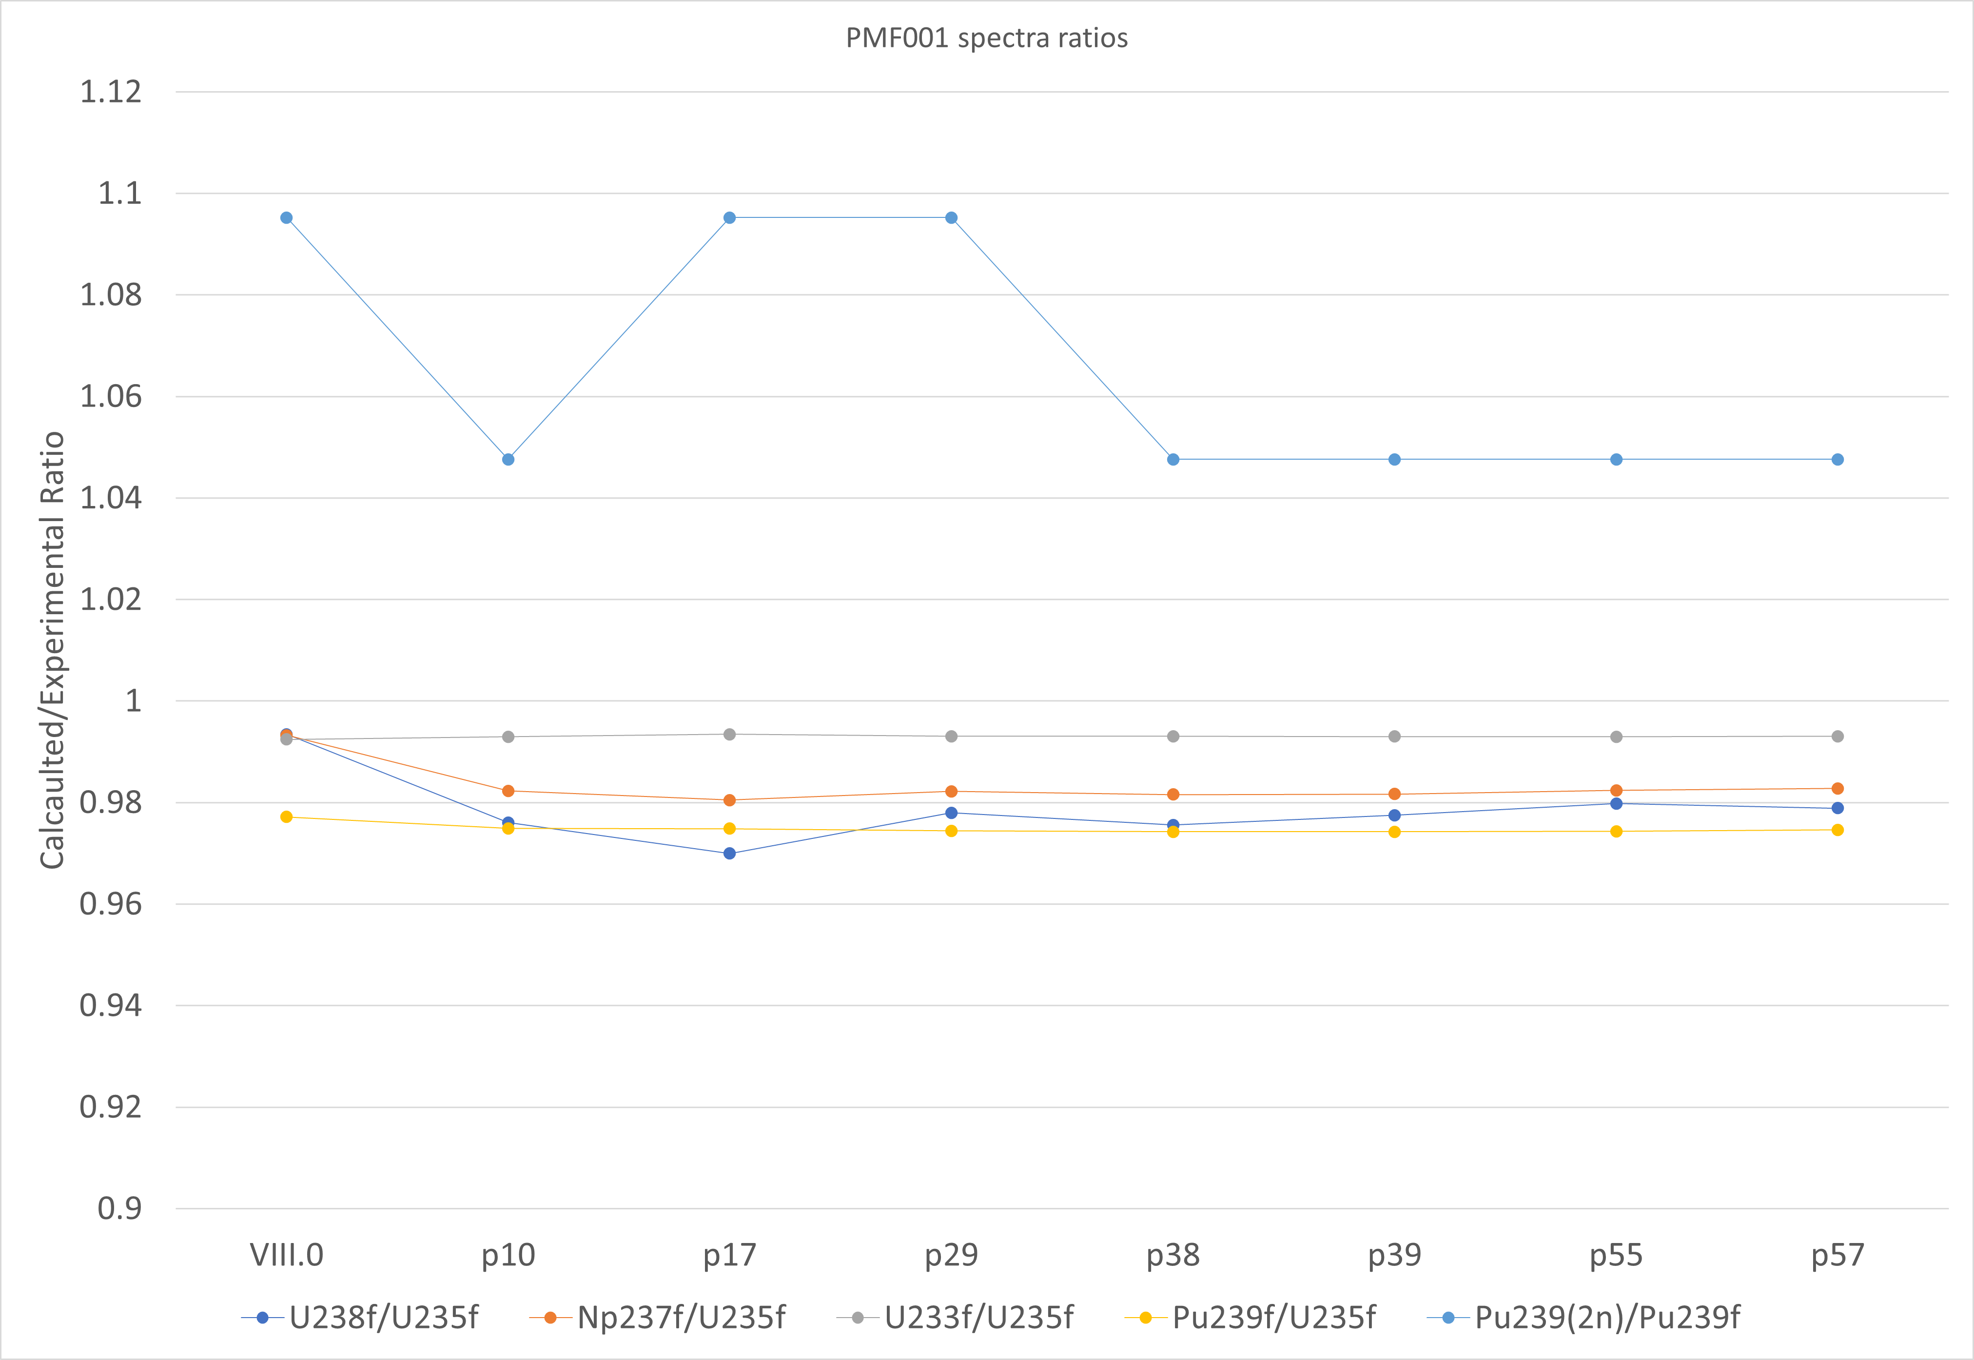
PMF001
Results of calculated spectra (1 cm radius surface tally added to input files)
Plotted as a ratio of: $\frac{Calculated}{Experimental}$
U3f/U5f and Pu9f/U5f have remained consistent with calculated VIII.0 results
There is a consistent undercalculation of the Pu9/U5f ratio: 2.5% low
Small decrease seen for Np237f/U5f and U8/U5f (approximately 1%) compared to VIII.0
The Pu9(2n)/Pu9f ratio is plotted as: $\frac{Calculated}{VII.1 Calculated}$ (no experimental result)
This ratio has decreased compared to VIII.0 calculations
Slide 5 of 9

Slide 6
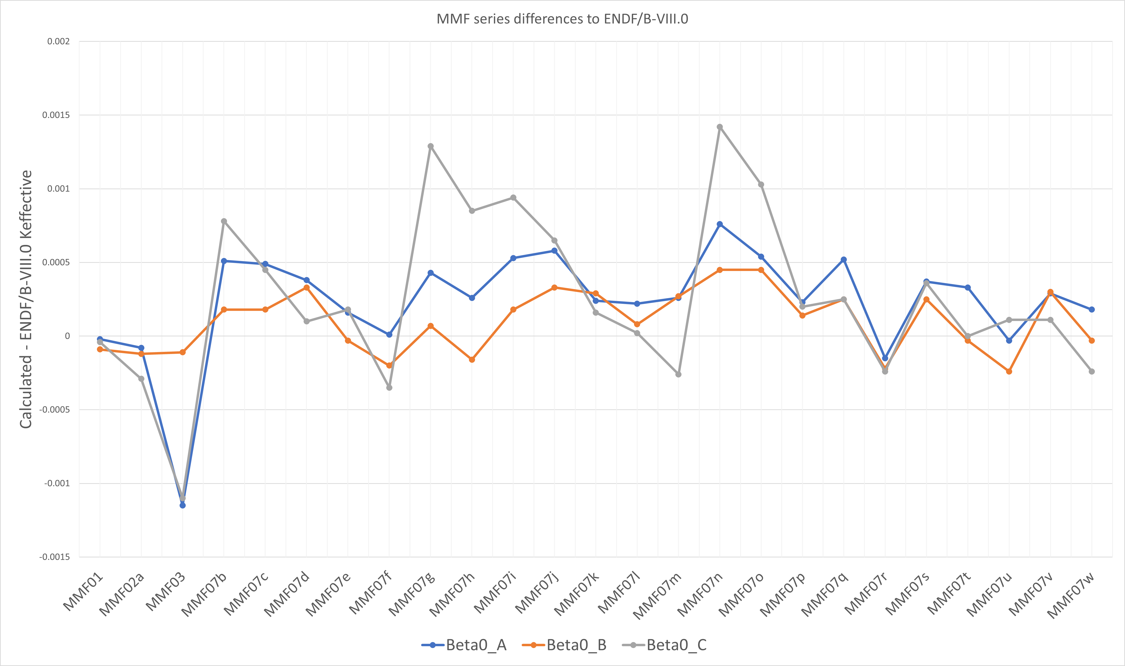
MMF series – VIII.0 against Beta0
Similar story for MMF as PMF, small differences between each evaluation but broadly are in line with each other
Beta0_C seems to be standing out the most in a few cases
Slide 6 of 9

Slide 7
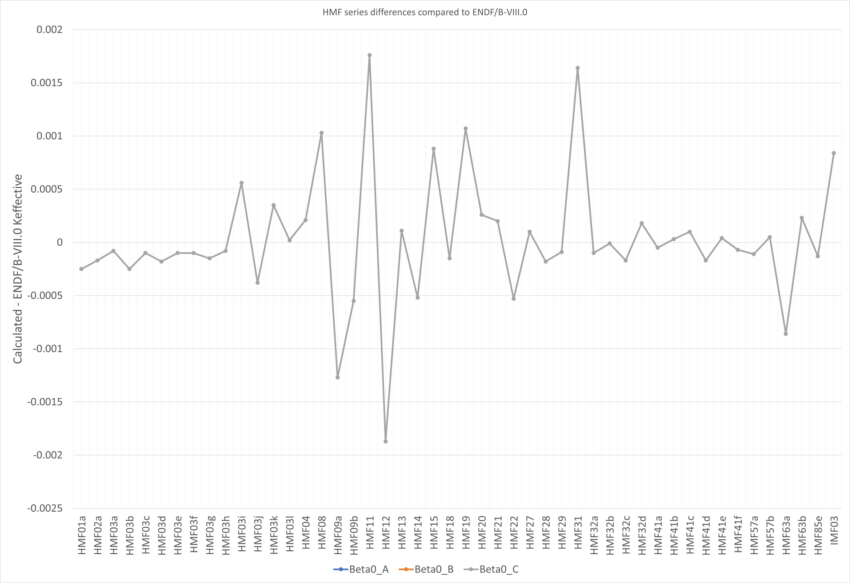
HMF series – VIII.0 against Beta0
No difference in uranium data between the beta versions so each Beta0 should behave identically – they do (phew!)
Certain systems are more sensitive to changes in the data compared to others. Again, we typically see these fluctuations for certain system with ANY change in data.
Look at HMF001 in detail on next slide
Slide 7 of 9

Slide 8
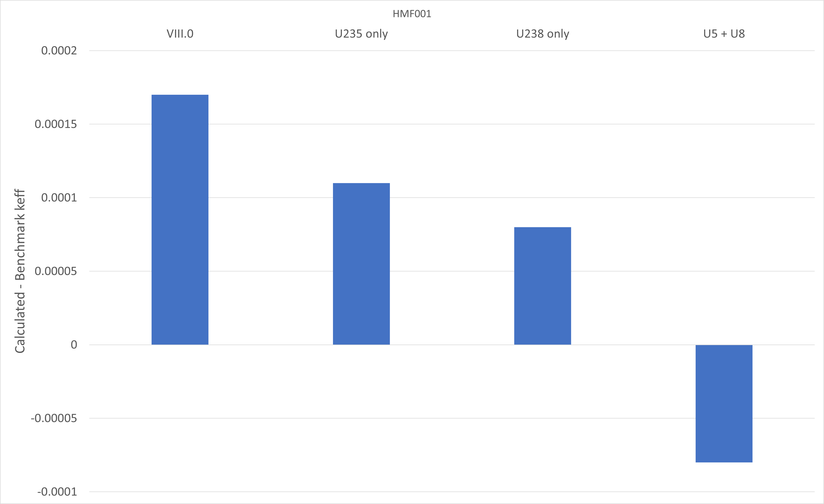
HMF001
With ENDF/B-VIII.0 we calculate Godiva to be slightly high (within benchmark uncertainty)
When updating the U235 or U238 separately, U238 data is having a greater impact on HMF01 (93.7% U235!)
Updating both together we now undercalculate criticality k_{eff} = 0.99992
Using the pre-processed ACE files from INDEN, these files calculate higher
 | AWE | INDEN
VIII.0 | 1.00017 | -
U235 only | 1.00011 | 1.00043
U238 only | 1.00008 | 1.00016
U5 + U5 | 0.99992 | 1.00037
Slide 8 of 9

Slide 9
Summary
Initial testing of ENDF/B-VIII.1 Beta 0 candidates on fast metal systems
Initial modifications made have shown significant impact to Jezebel, but following incremental changes to the INDEN files, each of the Beta0 candidates calculate similar k_{eff} (comparable to JENDL/JEFF)
For Godiva, VIII.1 Beta0 shows a significant decrease when using both U235 and U238 files (all remain within benchmark error of 0.001) compared to VIII.0, changes to U238 seem to be contributing to much of this change
When performing calculations with INDEN processed ACE files of HMF001, calculated results are greater than data processed locally – is it possible to access the NJOY inputs?
Slide 9 of 9

