Slide 1
Implementation of TSL Evaluations Beyond the Incoherent Approximation
B. K. Laramee, N.C. Fleming, A. I. Hawari
LEIP Laboratories
Department of Nuclear Engineering
North Carolina State University
Raleigh, North Carolina, USA
CSEWG Nuclear Data Week
October 31 – November 4, 2022
Notes:
Hi everyone, my name is Bri Laramee. I am a PhD candidate at North Carolina State University, in the Nuclear Engineering Department as a member of LEIP Labs. My presentation today is on producing TSL evaluations that relax the incoherent approximation

Slide 2
Outline
Motivation
Thermal Scattering Theory
Generalized Thermal Scattering Law
Relaxing the Incoherent Approximation
Application & Validation
Summary & Conclusions
Notes:
I will briefly cover the motivation for this work, and give an overview of thermal scattering theory as it is most commonly used today, with all of the typical approximations. I will then walk through the removal of several of these approximations, and the libraries we have generated using this formalism. I’ll finish this presentation by discussing validation of the TSL evaluation data and data formats.

Slide 3
Motivation
Production of TSL libraries that contain high fidelity physics including coherent inelastic effects
  Graphite and beryllium
    Highly non-cubic forces
    Non-negligible structure in TSL
High fidelity TSL libraries are of interest in various application, e.g.
  Neutron scattering instrument response analysis
  Directional biases (reflection) in neutronic analysis
Notes:
The basis of the motivation for this work is that the usual approximations do not fully capture the physics of several crucially important, widely used reactor materials. Namely, these materials are crystalline graphite and beryllium, the evaluations of which will both be discussed. The goal of this methodology is to produce TSL libraries that contain coherent inelastic effects, when applicable.

Slide 4
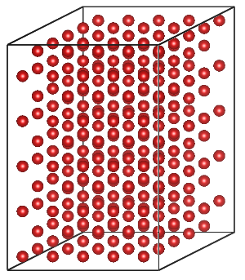
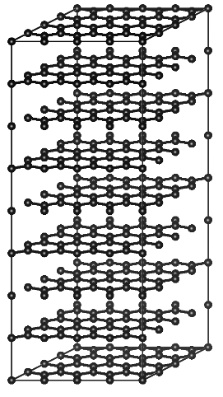
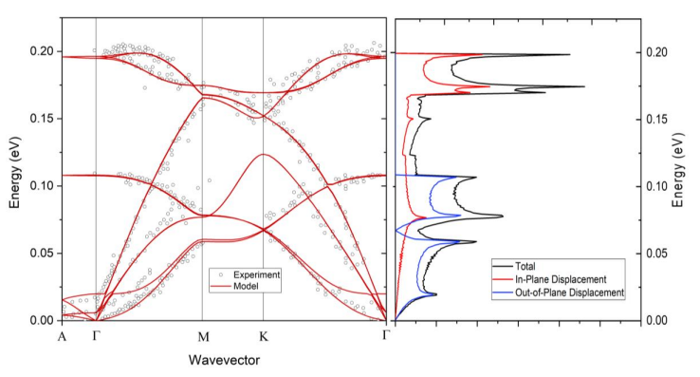
Graphite & Beryllium Structures
HCP crystals
Graphite has highly directional bonding
  Covalent in-plane
  Van der Waals out-of-plane
  Preferred Orientation
Beryllium 5x5x5 supercell (250 atoms)
Crystalline Graphite 4x4x4 supercell (256 atoms)
Phonon dispersion curves and vibrational DOS for crystalline graphite, calculated using ab initio methods.
Notes:
Graphite and Beryllium both have hexagonal close-packed crystal structures, which are non-cubic both in structure and directionality of the forces. Graphite is an especially potent example, with strong covalent bonding in the hexagonal basal plane and weak van der Waals forces out-of-plane. The supercells used in our evaluations of crystalline graphite and beryllium are shown on the right. The directionality of the forces in graphite can be seen in the shown integrated DOS, where all of the out-of-plane displacements are low-energy acoustic modes and the optical modes are primarily localized to the basal plane.

Slide 5
LEIP Evaluation Process
Notes:
This is a diagram of the typical TSL evaluation process used at LEIP Labs. Crystalline models start with ab initio DFT modeling, which captures the quantum mechanics of the system. VASP is used for structure optimization, bulk & electrical property calculations, and generation of the Hellmann-Feynman forces within the material. The HFF are generated using the perturbation method, where the perturbations are performed by PHONON. PHONON also uses the HFF to calculate the phonon DOS based on the dynamical matrix method. The DOS is the primary input for the TSL evaluation, and our code FLASSH is used to calculate both the TSL and associated cross sections.

Slide 6


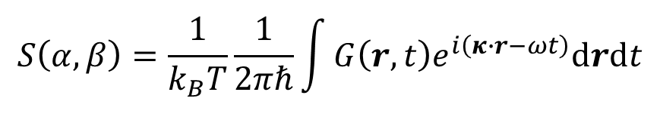
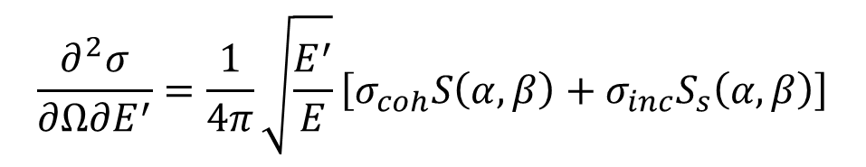
Thermal Scattering Theory
Thermal Scattering Law (TSL)
  Material property
  Energy & Momentum States
  $S\left(α,β\right)=S\left(κ,ω\right)∙k_{B}T$
$$\frac{∂^{2}σ}{∂Ω∂E^{′}}=\frac{1}{4π}\sqrt{\frac{E^{′}}{E}}\left[σ_{coh}S\left(α,β\right)+σ_{inc}S_{s}\left(α,β\right)\right]$$
$$S\left(α,β\right)=\frac{1}{k_{B}T}\frac{1}{2πℏ}\int{{G\left(r,t\right)e}^{i\left(κ∙r−ωt\right)}drdt}$$
$$S\left(α,β\right)=S_{s}\left(α,β\right)+S_{d}\left(α,β\right)$$
Notes:
I will touch on basic thermal scattering theory briefly. The TSL is a material property, which is shown in the middle equation to be the Fourier transform of the time-dependent pair correlation function. The TSL captures the energy and momentum distributions within the material, and can be separated into two components…

Slide 7
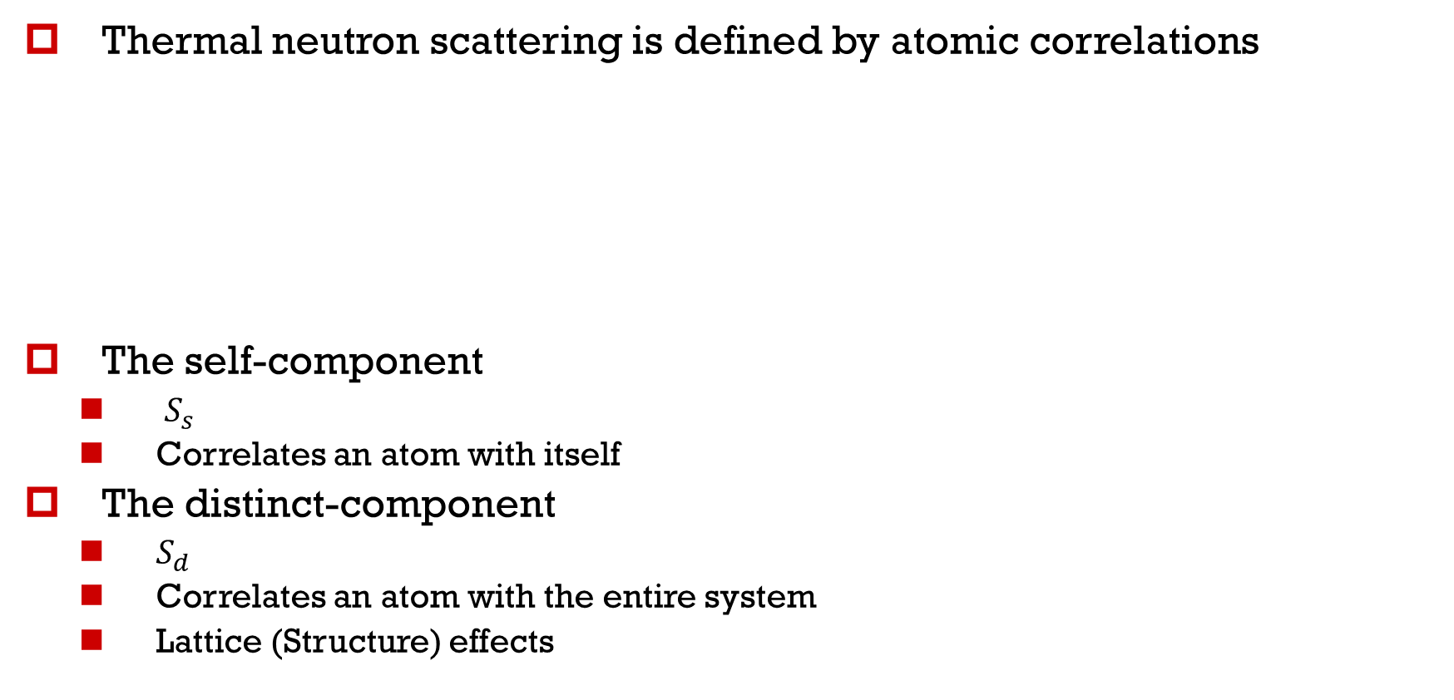

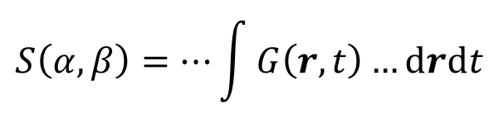
Correlations in Scattering Theory
Thermal neutron scattering is defined by atomic correlations
The self-component
  $S_{s}$
  Correlates an atom with itself
The distinct-component
  $S_{d}$
  Correlates an atom with the entire system
  Lattice (Structure) effects
$$S\left(α,β\right)=…\int{G\left(r,t\right)…drdt}$$
$$S\left(α,β\right)=S_{s}\left(α,β\right)+S_{d}\left(α,β\right)$$
Notes:
The self-component (Ss) correlates an atom with itself at a later time, while the distinct-component Sd correlates an atom with the rest of the system, thereby capturing interference effects due to the structure of the material. The Sd component captures the coherent behavior of the system.

Slide 8
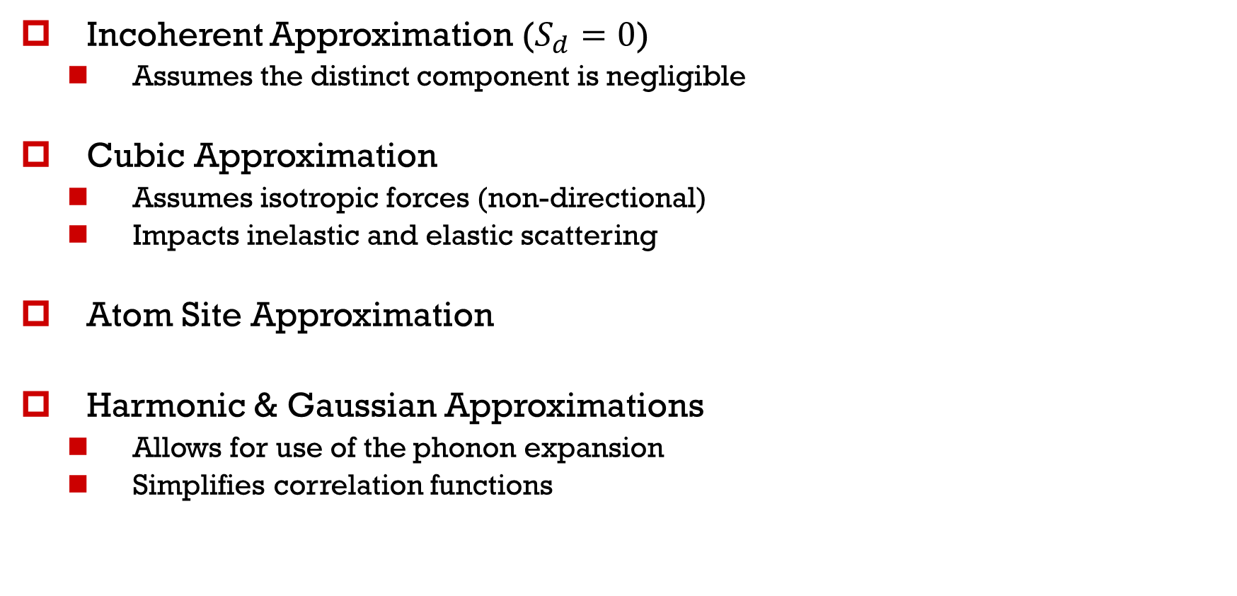
Typical TSL Approximations
Incoherent Approximation ($S_{d}=0$)
  Assumes the distinct component is negligible
Cubic Approximation
  Assumes isotropic forces (non-directional)
  Impacts inelastic and elastic scattering
Atom Site Approximation
Harmonic & Gaussian Approximations
  Allows for use of the phonon expansion
  Simplifies correlation functions
Notes:
These are the approximations used in a typical TSL evaluation. The incoherent approximation assumes that the distinct-component is negligible, ignoring coherent effects in the TSL. The cubic approximation assumes that forces in the material are isotropic, not that the crystal itself is cubic. This impacts both elastic and inelastic scattering. The atom site approximation assumes that each atom in the unit cell is identical, and is the easiest approximation to remove. The harmonic and Gaussian approximations will not be looked at today, but their primary advantage is that they allow the use of the phonon expansion in the calculation of the TSL.

Slide 9
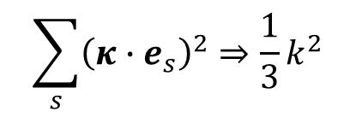
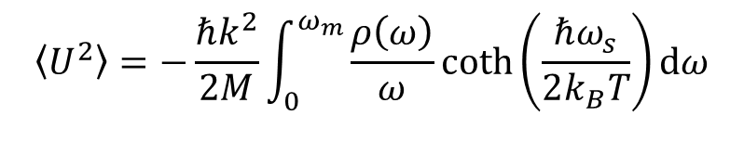
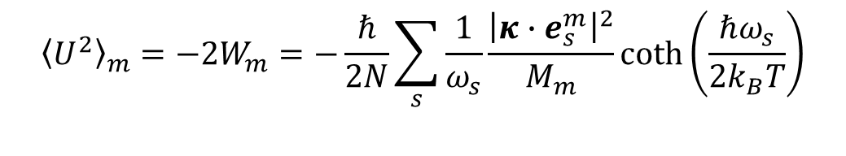
Removing the Cubic
Approximation: Generalization
This approximation directionally-averages the forces in a crystal
  Application of the approximation must be consistent throughout the evaluation (inelastic, elastic)
$$\sum_{s}{{\left(κ∙e_{s}\right)}^{2}}⇒\frac{1}{3}k^{2}$$
$${\left\langle U^{2}\right\rangle }_{m}=−2W_{m}=−\frac{ℏ}{2N}\sum_{s}{\frac{1}{ω_{s}}\frac{{\left|κ∙e_{s}^{m}\right|}^{2}}{M_{m}}\coth\left(\frac{ℏω_{s}}{2k_{B}T}\right)}$$
Generalized (exact):
$$\left\langle U^{2}\right\rangle =−\frac{ℏk^{2}}{2M}\int_{0}^{ω_{m}}{\frac{ρ\left(ω\right)}{ω}\coth\left(\frac{ℏω_{s}}{2k_{B}T}\right)dω}$$
Approximated:
Notes:
First, we will look at loosening the Cubic approximation. As shown in the first equation, this approximation directionally-averages the forces in the material. The impact of this approximation can be seen in the Debye-Waller factor below. It can be seen that the full directionality of the forces are kept in the generalized version. We can also see that the Atom Site approximation has been removed, where the DBW coefficient is now calculated for each atom.

Slide 10
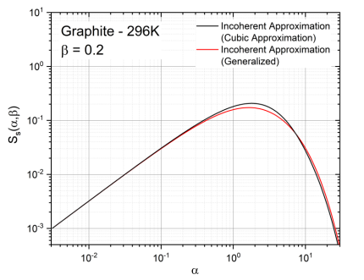
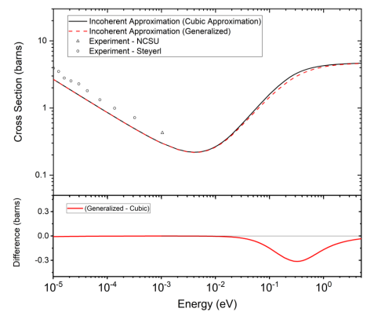
Removing the Cubic
Approximation: Generalization
Self-component of the TSL of crystalline graphite at a specific $β$ value under the cubic and generalized treatments
Inelastic elastic scattering cross section of crystalline graphite under the cubic and generalized treatments
Notes:
These plots show the impact of the Cubic approximation on the TSL and inelastic scattering cross section of crystalline graphite. The largest impact can be seen at higher alpha values in the TSL and at higher energies in the cross section, notably after the Bragg cutoff

Slide 11
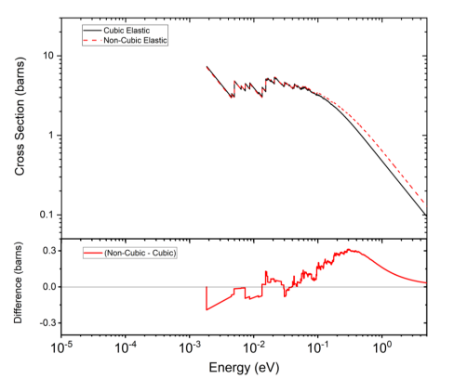
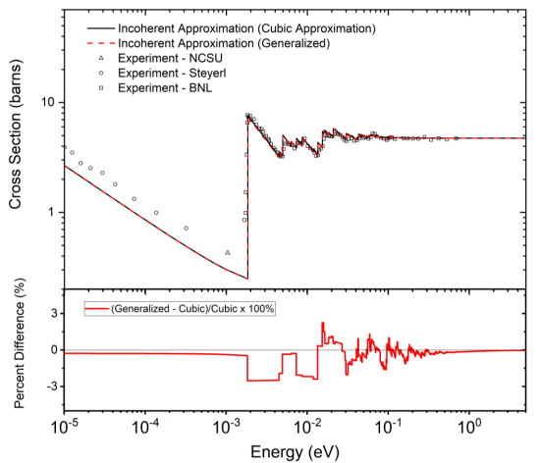
Removing the Cubic
Approximation: Consistency
Coherent elastic scattering cross section of crystalline graphite under the cubic and generalized treatments
Total scattering cross section of crystalline graphite under the cubic and generalized treatments
Notes:
A similar impact can be seen on the coherent elastic cross section of crystalline graphite, also at higher energies past the Bragg cutoff. The total cross section looks as we expect, with an appropriate asymptote to the free atom cross section at higher energies and 1/v behavior at energies below the Bragg cutoff. There is no visible impact on the total cross section, because the generalized methodology is consistent between the inelastic and elastic cross sections. Mixing the generalized formalism with the cubic approximation leads to nonphysical features in the total cross section.

Slide 12
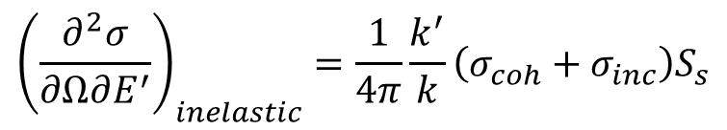

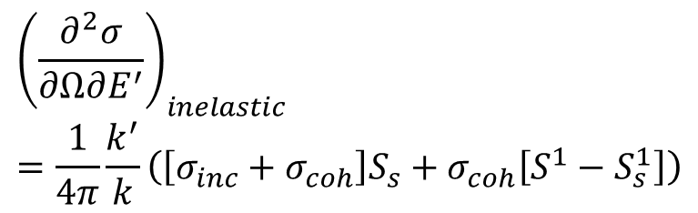

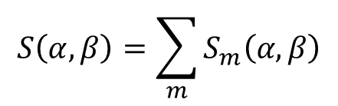

Beyond the Incoherent
Approximation
Incoherent
Atom Site
$$S\left(α,β\right)=S_{s}\left(α,β\right)+S_{d}^{1}\left(α,β\right)$$
1-Phonon / Generalized:
$$S\left(α,β\right)=\sum_{m}{S_{m}\left(α,β\right)}$$
$${\left(\frac{∂^{2}σ}{∂Ω∂E^{′}}\right)}_{inelastic}=\frac{1}{4π}\frac{k^{′}}{k}\left(\left[σ_{inc}+σ_{coh}\right]S_{s}+σ_{coh}\left[S^{1}−S_{s}^{1}\right]\right)$$
$$S\left(α,β\right)=S_{s}\left(α,β\right)$$
Approximation:
$$S\left(α,β\right)=mS\left(α,β\right)$$
$${\left(\frac{∂^{2}σ}{∂Ω∂E^{′}}\right)}_{inelastic}=\frac{1}{4π}\frac{k^{′}}{k}\left(σ_{coh}+σ_{inc}\right)S_{s}$$
Notes:
Next, we will loosen the incoherent approximation. To do this, we added the first term in the phonon expansion of the distinct-component to the self-component. Appropriately, this has been dubbed the “1-phonon” method. Only the first term need to be considered, as it has the most obvious impact on the TSL. The removal of the Atom Site approximation at this step is also shown, where the TSL is calculated per scatterer.

Slide 13
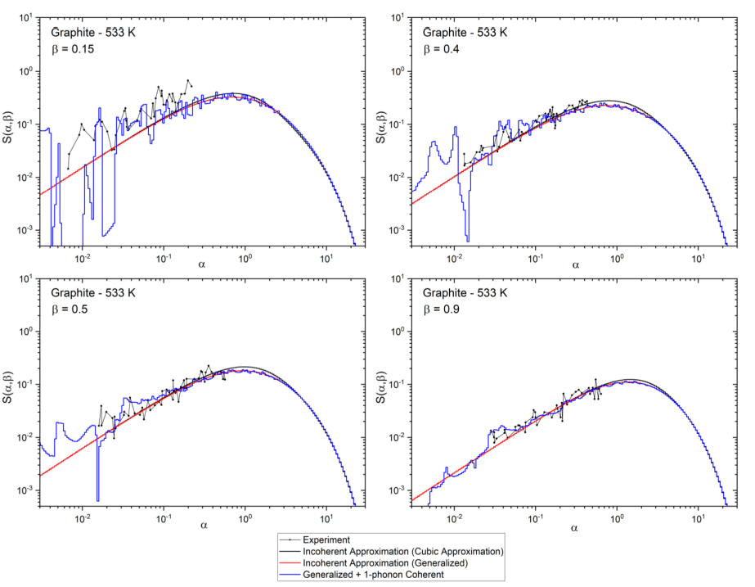

Beyond the Incoherent
Approximation
TSL of crystalline graphite at various $β$ values
Notes:
These are plots of the crystalline graphite TSL, similar to the TSL shown earlier for the Cubic approximation. The combined impact of non-cubic and 1-phonon treatment is highlighted. Significant structure can be seen in the TSL, particularly at low alpha and beta. It is important to note here that all materials have an Sd component, but the incoherent approximation exists for a reason- for many materials, the Sd component, while nonzero, is negligible.

Slide 14
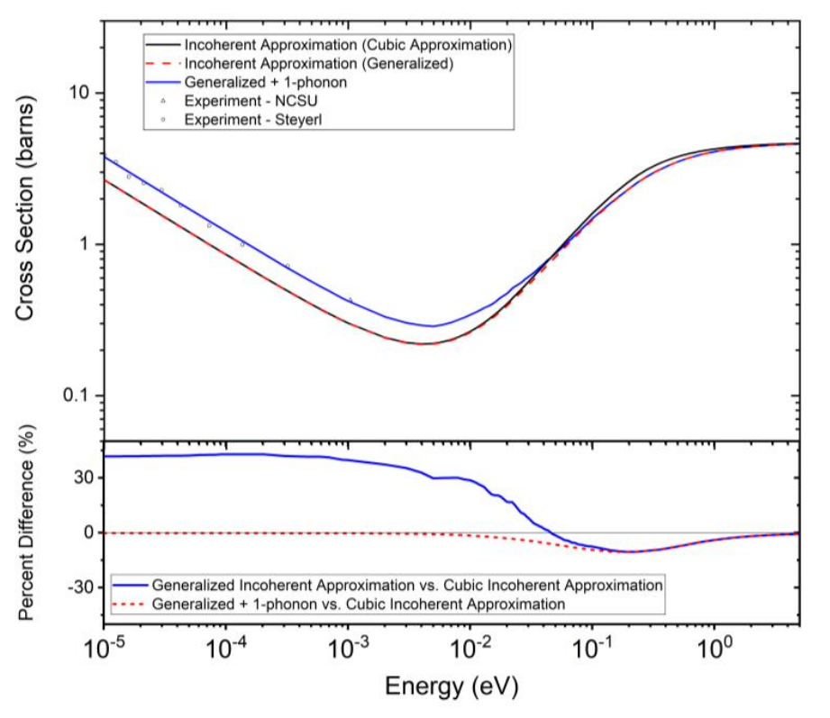
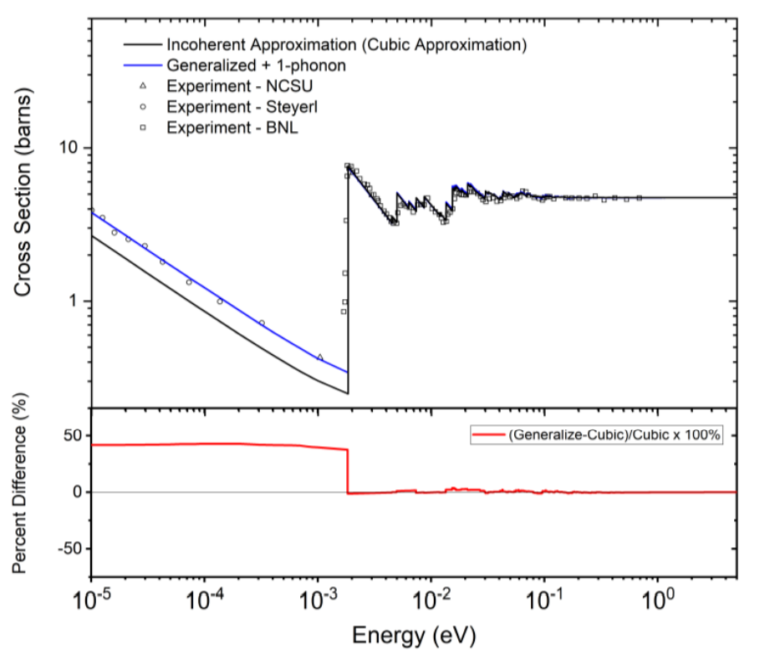
Beyond the Incoherent
Approximation
Inelastic cross section of crystalline graphite under the cubic, generalized, and generalized + 1-phonon treatments
Total cross section of crystalline graphite under the cubic, generalized, and generalized + 1-phonon treatments
Notes:
Finally, we show the combined impact on the inelastic and total scattering cross sections of crystalline graphite. The impact on the energy region above the Bragg cutoff, particularly the asymptote to free atom, is minimal. However, the impact below the Bragg cutoff is significant, and the inclusion of structure in the TSL improves the cross section to match experimental data.

Slide 15
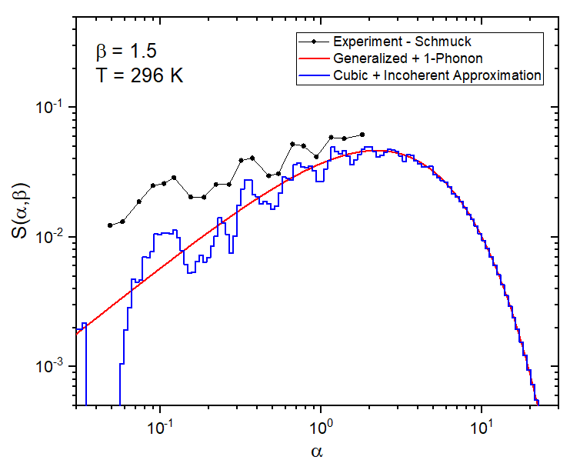
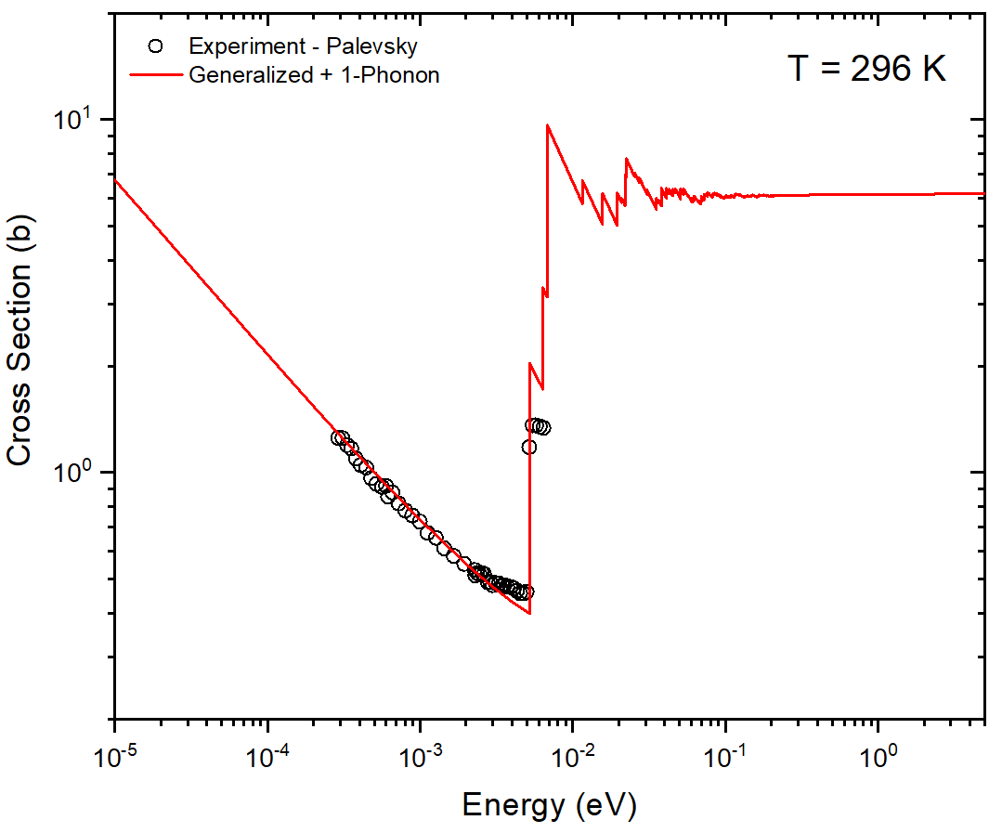
Application to Beryllium
Inelastic cross section of beryllium under the cubic and generalized + 1-phonon treatments
Total cross section of beryllium under the cubic and generalized + 1-phonon treatments
Notes:
Structure is captured by including the Sd component. Total cross section (below Bragg cutoff) is in better agreement with experimental data.

Slide 16
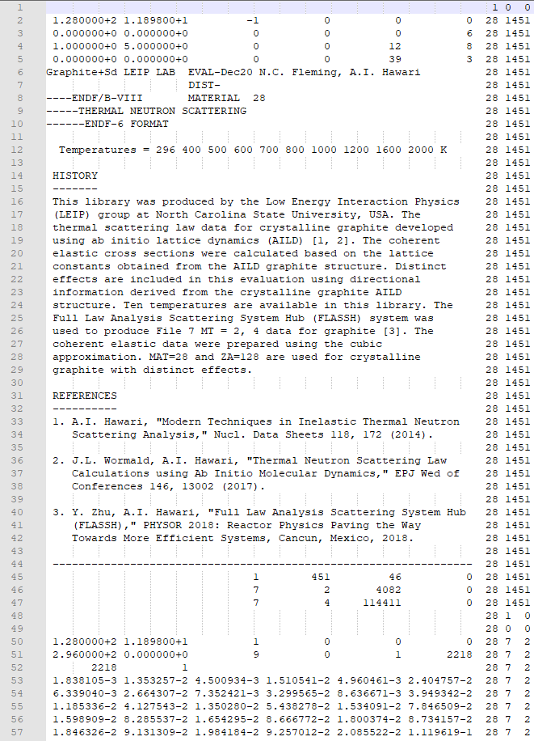
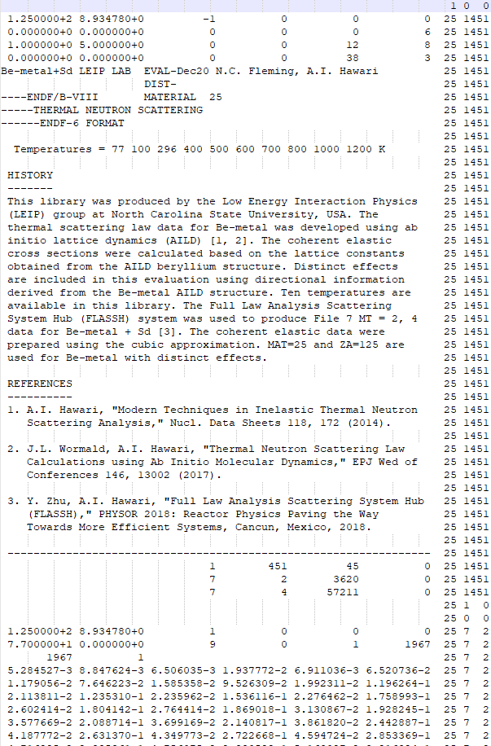


Generation of File 7
File 7 formatting remains the same
  Physics changes embedded in the usual data
    e.g., $S\left(α,β\right)=S_{s}\left(α,β\right)+S_{d}^{1}\left(α,β\right)$
File 7s for beryllium + $S_{d}$ crystalline graphite + $S_{d}$ as submitted to ENDF/B-VIII
Notes:
According to the methodology presented here, File 7s were generated for crystalline graphite + Sd and beryllium + Sd. All of the alterations to the physics are embedded in the usual data, and so the format of the File 7 is completely unchanged. Both of these evaluations have been submitted to the NNDC

Slide 17
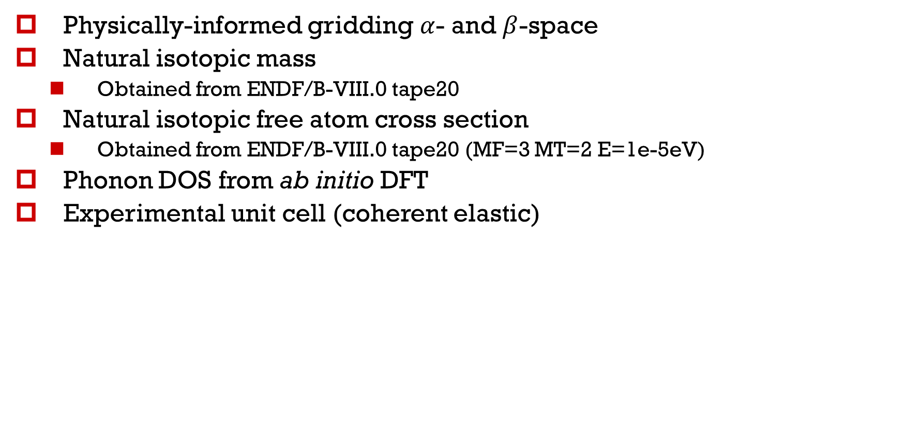
Overall Evaluation Validation
Physically-informed gridding $α$- and $β$-space
Natural isotopic mass
  Obtained from ENDF/B-VIII.0 tape20
Natural isotopic free atom cross section
  Obtained from ENDF/B-VIII.0 tape20 (MF=3 MT=2 E=1e-5eV)
Phonon DOS from ab initio DFT
Experimental unit cell (coherent elastic)
Notes:
The evaluations for crystalline graphite + Sd and beryllium + Sd were generated following the validation methodology used by LEIP labs. Several of these steps are as such: the alpha- and beta- gridding of the TSL are physically-informed based on the material and desired energy range. The grid generation process is automated in FLASSH with these aspects in mind. Both the mass and free atom cross sections used are for the natural isotopic composition, and that data is taken directly from ENDF/B.VIII.0 tape20 files. While the DOS is generated for the equilibrium structure as determined by DFT, the lattice vectors and fractional coordinates used in the calculation of the coherent elastic cross section are the experimental values.

Slide 18
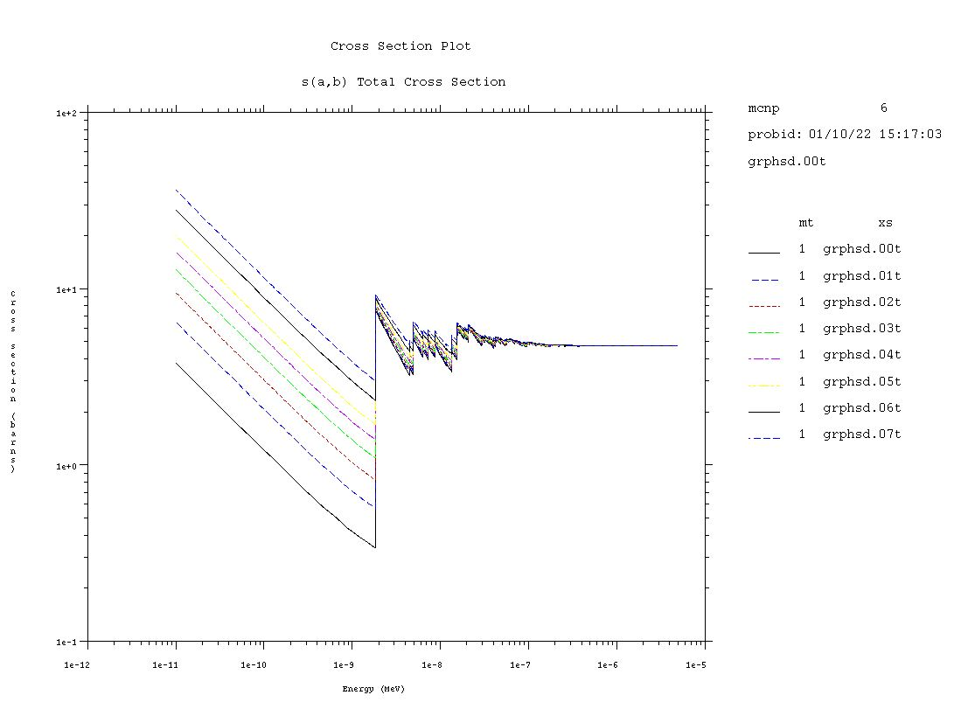
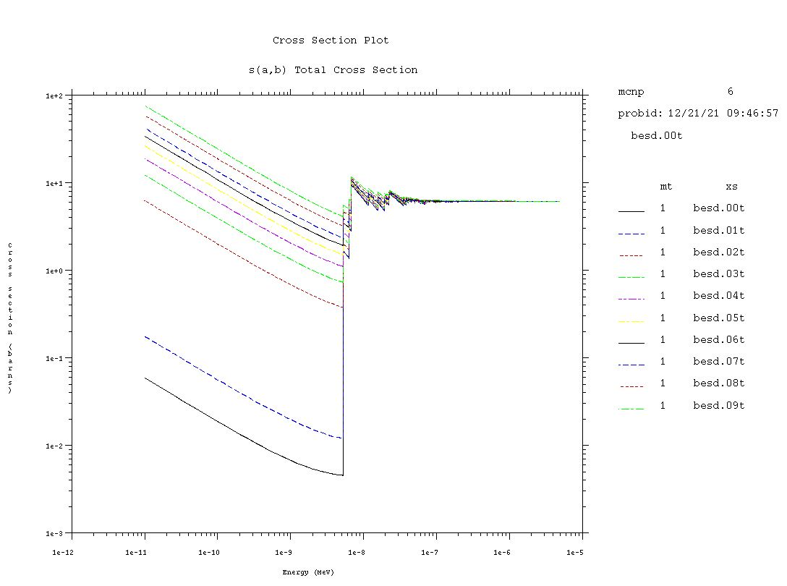

Validation & Impact on File 7
Total cross section plots for beryllium + $S_{d}$ (right) and crystalline graphite + $S_{d}$ (left). Plots generated using MCNP and ACE files
Notes:
I final step in our validation process is to generate the ACE files for the evaluation and plot the cross sections in MCNP. This allows us to qualitatively validate the final cross sections, and serves as an important step to verify the format of our produced File 7s.

Slide 19
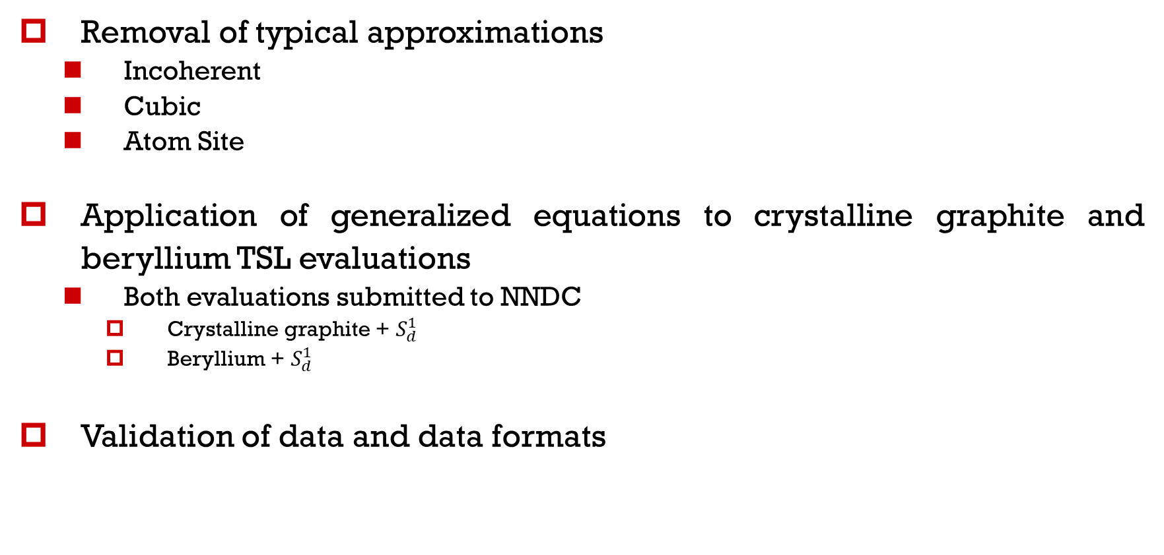
Summary
Removal of typical approximations
  Incoherent
  Cubic
  Atom Site
Application of generalized equations to crystalline graphite and beryllium TSL evaluations
  Both evaluations submitted to NNDC
    Crystalline graphite + $S_{d}^{1}$
    Beryllium + $S_{d}^{1}$
Validation of data and data formats
Notes:
In summary, we looked at the removal of several common assumptions in the evaluation of the TSL, and their impact on common non-cubic materials, graphite and beryllium. The File 7s for these materials have been submitted to NNDC, and the data and data formats have been validated according to the discussed methodology.

Slide 20
Thank You!

