Slide 1
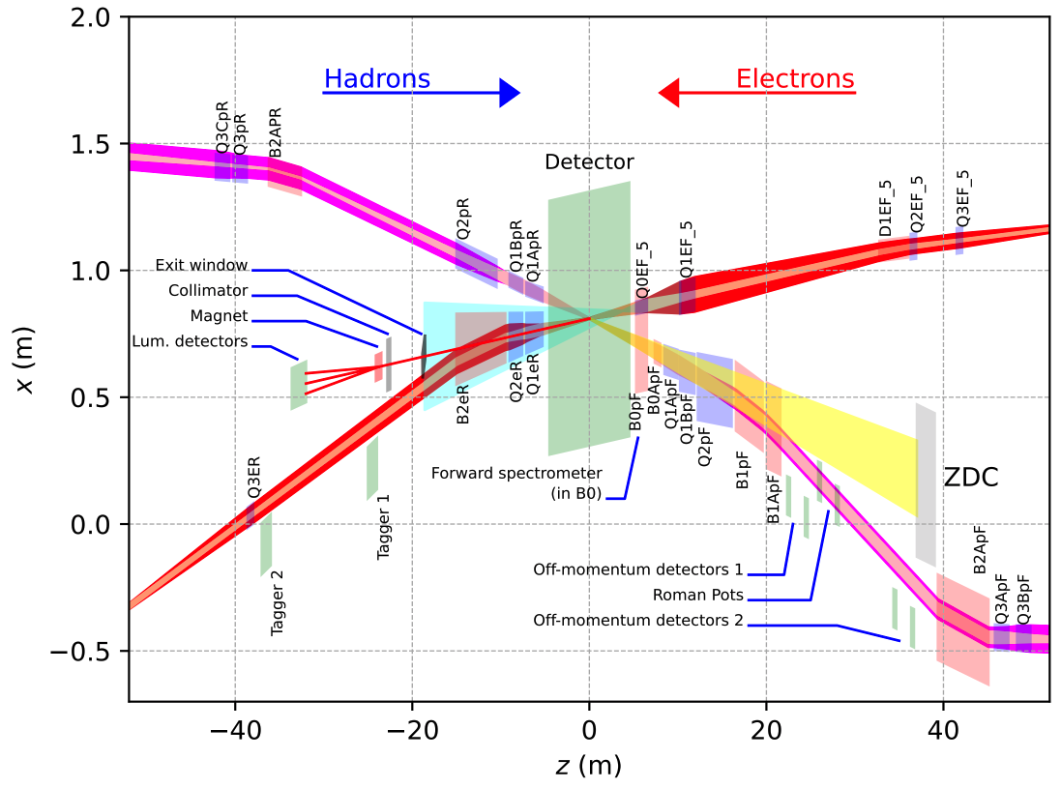
Far Backward Region design: ECCE

Slide 2
Far Backward Region design: ECCE

Slide 3
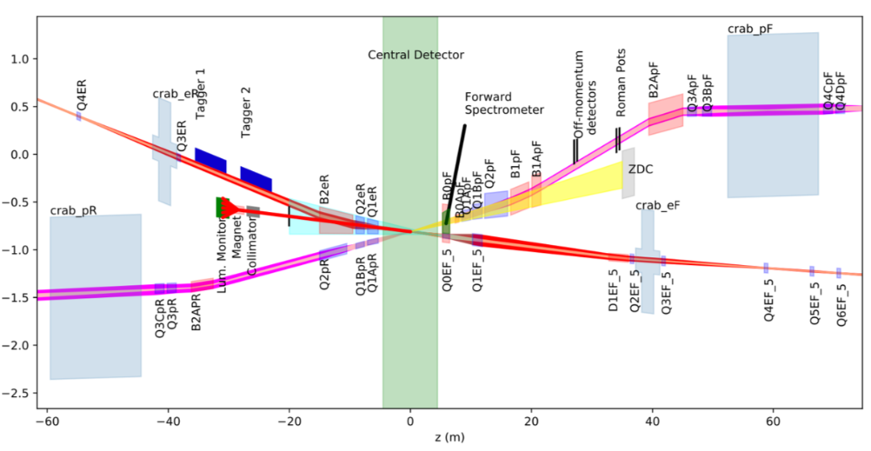
Far Backward Region design: ECCE

Slide 4
Low-Q² tagger
Two station: 24 and 37 m
Low-Q² tagger station
Detection Area:
Tagger 1: 40.5 x 40.5 cm²
Tagger 2: 30 x 21 cm²
Calorimeter crystals: 2x2 cm² 20 cm long
AC-LGAD
tracking Layers
20 cm
PbWO4 calorimeter

Slide 5
The luminosity detectors
UP
Tracking layers:
Two AC-LGAD tracking layers for each section
8x16 cm² detection area
Central
Calorimeter
Dipole
Calorimeters:
2x2x20 cm³ crystal with 8x16 cm² for UP and DOWN
2x2x20 cm³ PbWO4 , 16x16 cm² active area for
photon calorimeter
Down

