Slide 1
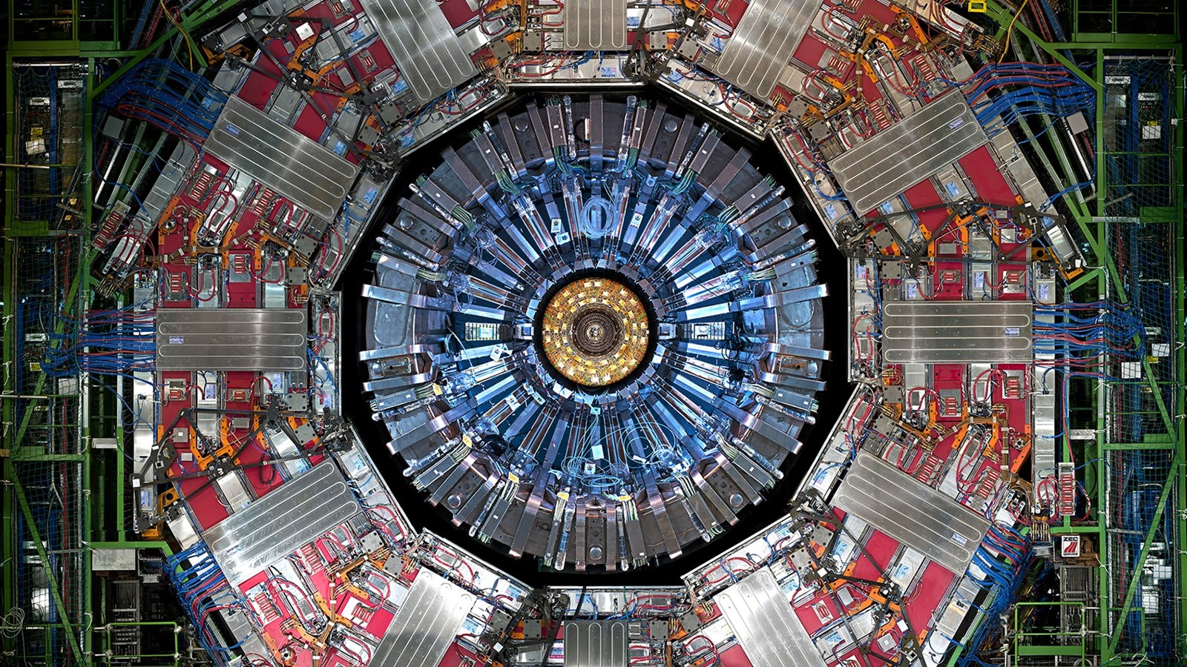
Lambda reconstruction for EIC detector
Enea Prifti (UIC)
with Dr. Olga Evdokimov
and Dr. Anselm Vossen

Slide 2
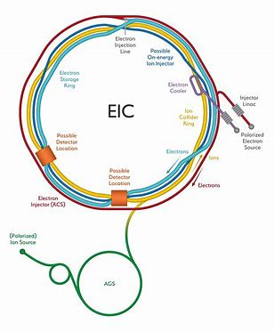
Data Samples
Lambda reconstruction efficiency study:
ep Pythia simulation 18x275
Event filter applied to keep only events with lambda
Full detector simulation
Only primary vertex included/ no explicit secondary vertex reconstruction
Two efficiency evaluation methods used:
Factorize secondary track reconstruction efficiency
Lamba decay reconstruction (invariant mass)

Slide 3
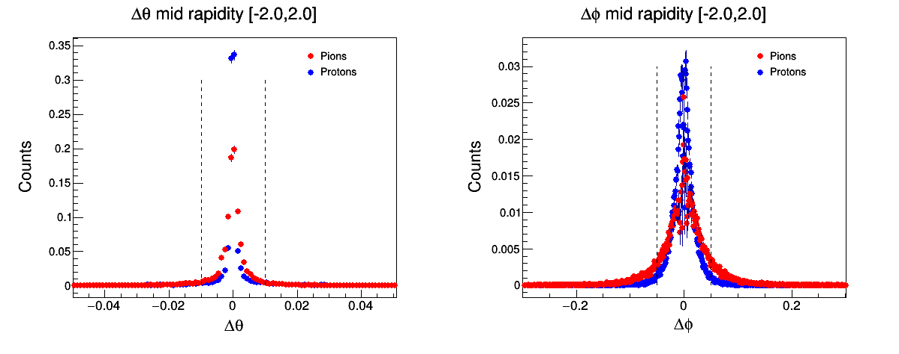
Track Matching
Protons theta: 0.96452
Pions theta: 0.964603
Protons phi: 0.997743
Pions phi: 0.961413
Reco Signal – tracks with closest gen track difference of |∆θ| < 0.01 and |∆Φ| < 0.1

Slide 4
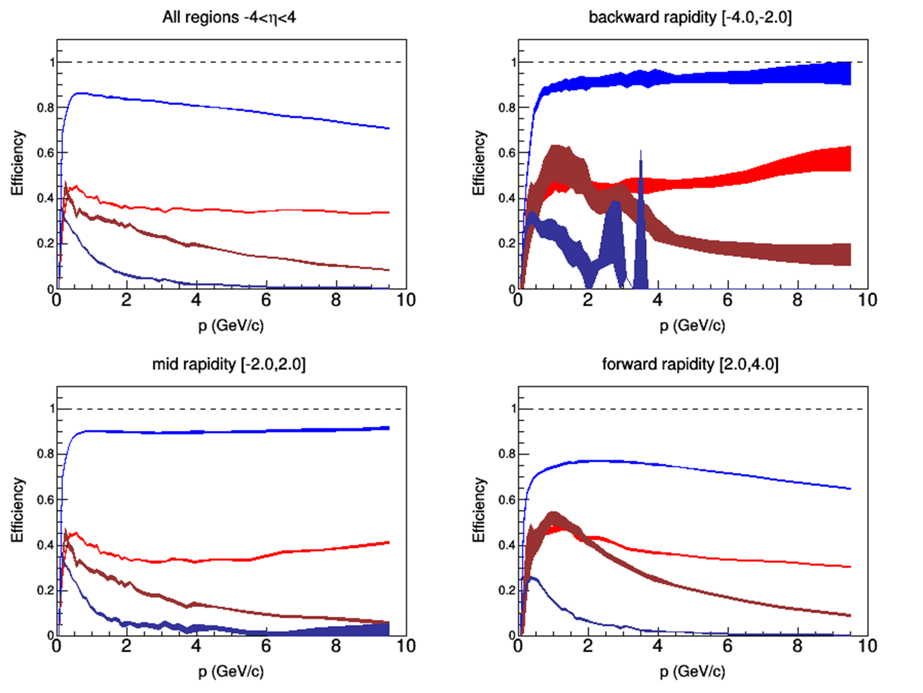
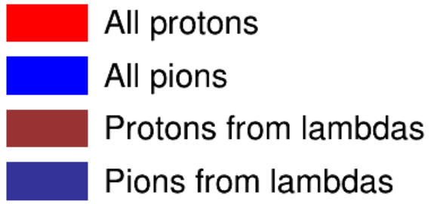
Secondary track reconstruction efficiency
Efficiency of Lambda daughters’ vs all pions (and protons) efficiencies

Slide 5
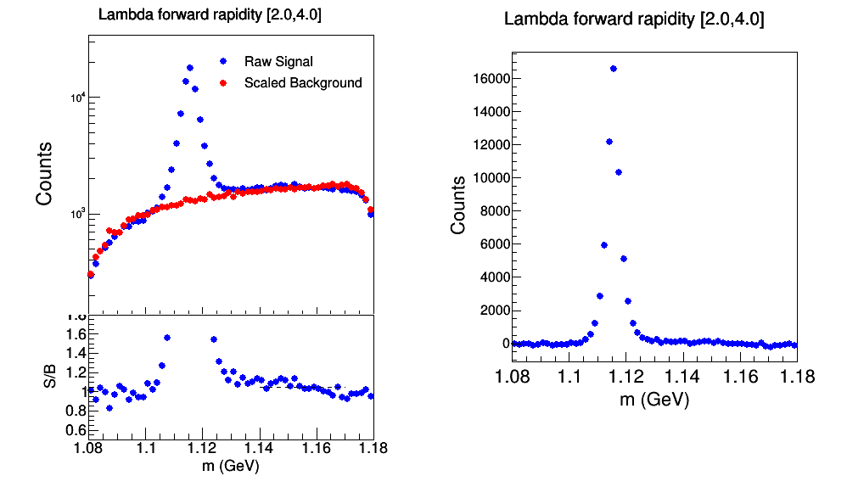
Invariant mass reconstruction
Raw Signal – pairs of protons and pions with opposite charge
Background – pairs with protons and pions of the same charge
The background is scaled using the ratio in a region away from the lambda mass peak

Slide 6
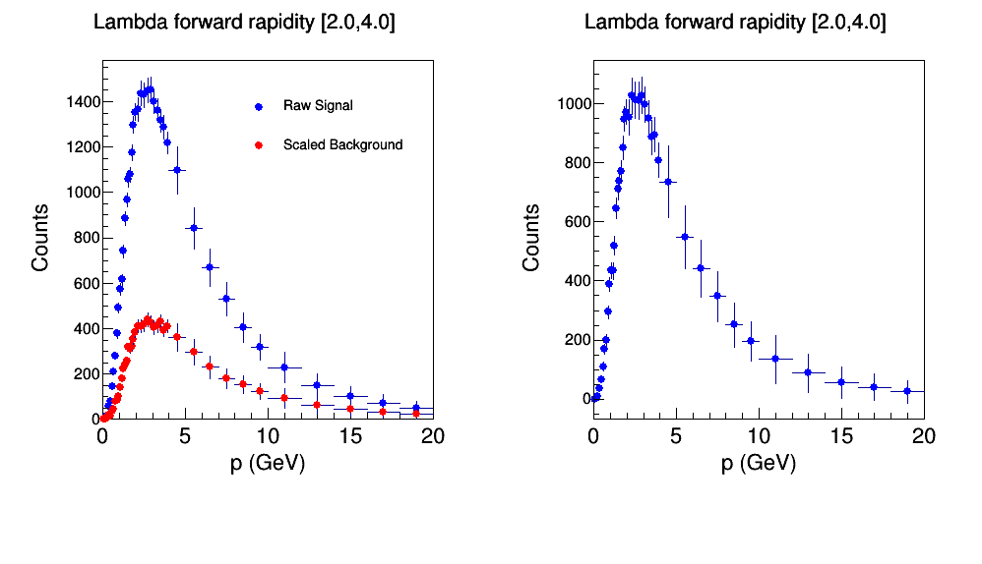
Lambda reconstruction efficiency
Reconstruction for different kinematic bins
The background is scaled using the same factor used in the mass plots
Difference of two distributions yields reconstructed lambda spectrum

Slide 7
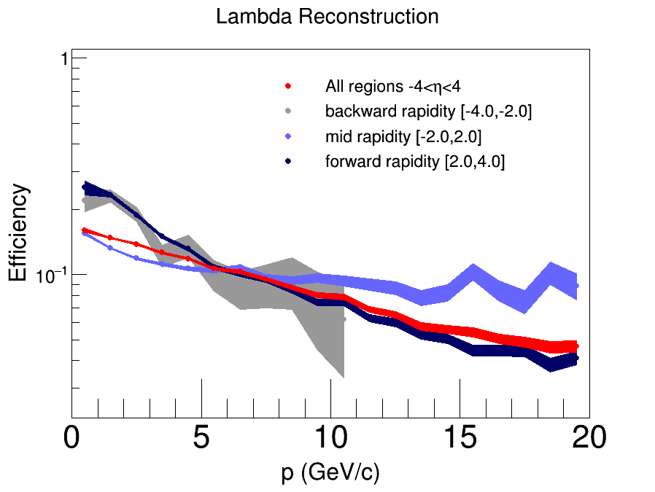
Extracted Efficiencies
Efficiency – Ratio of reconstructed Lambda p spectra over generated Lambda p spectra

Slide 8
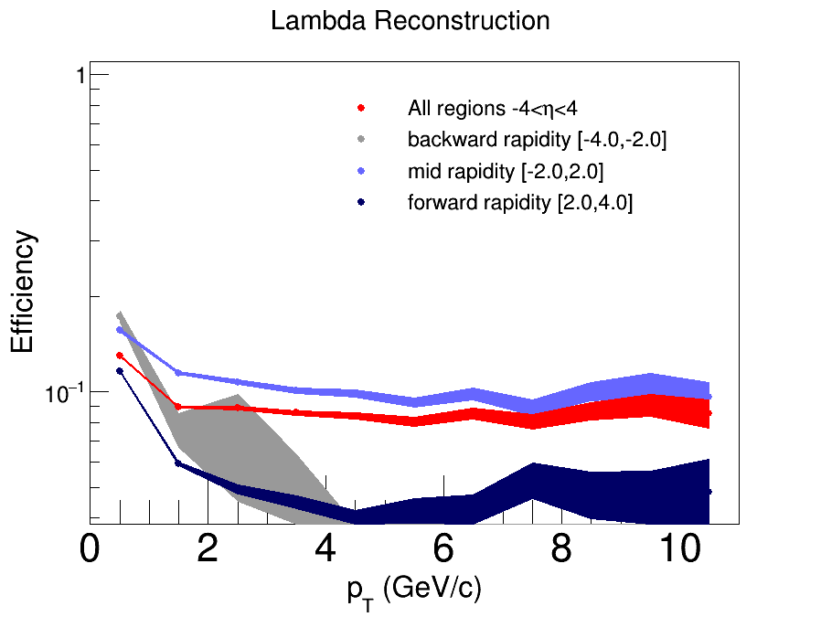
Extracted Efficiencies
Efficiency – Ratio of reconstructed Lambda p spectra over generated Lambda p spectra

Slide 9
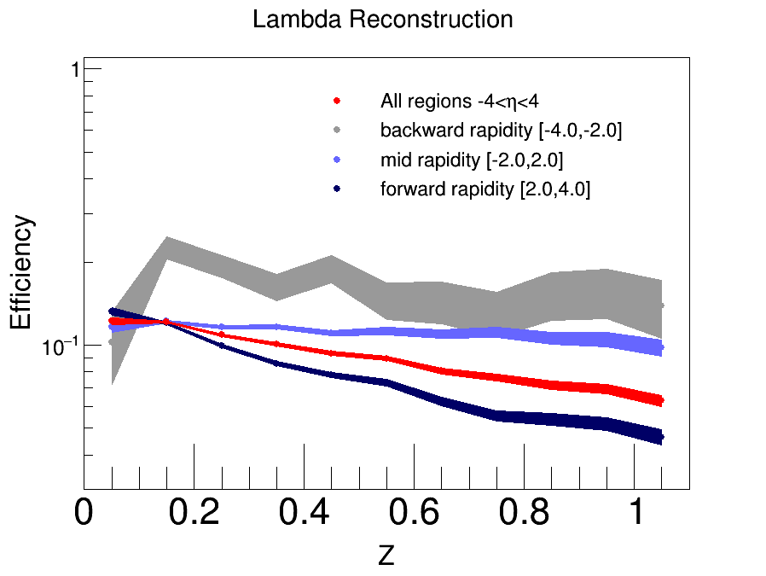
Extracted Efficiencies
Efficiency – Ratio of reconstructed Lambda p spectra over generated Lambda p spectra

Slide 10
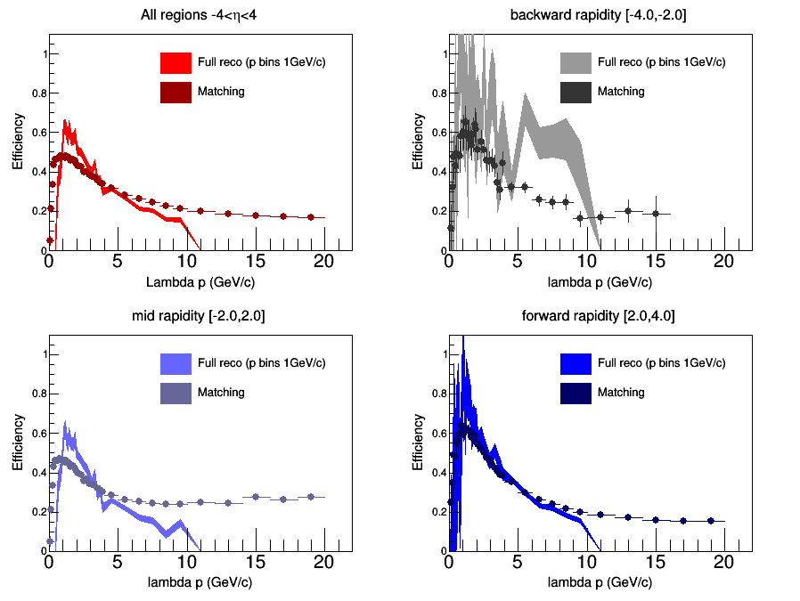
Full Reco vs Matching
Similar reco tracks efficiency and gen matched tracks efficiency results
Better agreement is expected with improvements in invariant mass method

Slide 11
Questions?

