Slide 1
Athena / ECCE comparison
and
summary kick-off meeting
Detector 1 DAQ WG
April 28th 2022

Slide 2
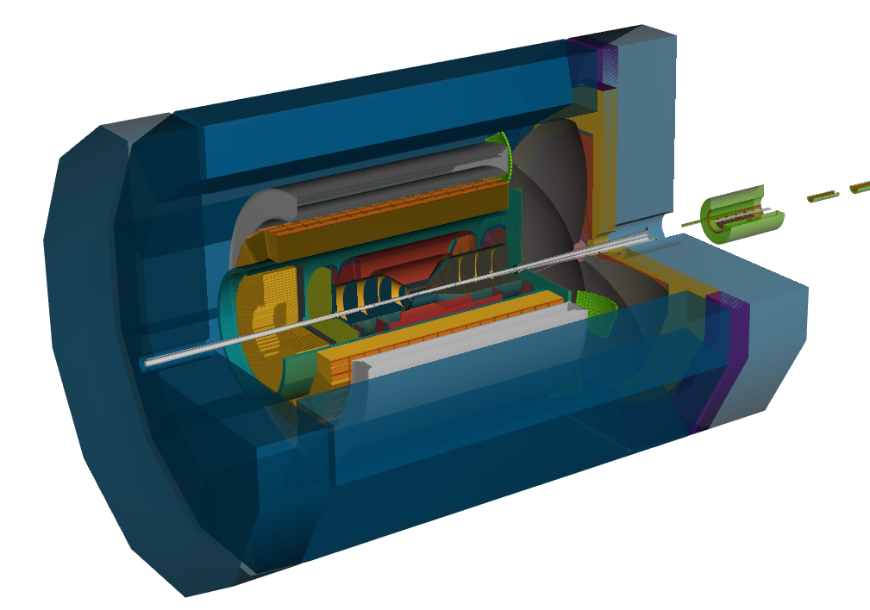
ATHENA Streaming Readout Architecture
Data
Configuration Control
Clock Trigger
Power
O(2.5 Tbps)
Zero-supression
Detector
correlations
O(500 Gbps)
Clustering /
O(150 Gbps)
FEB
(Front End Board)
AGG
(Aggregation)
FEP
(Front End
Processor)
Detector
Sensor
DAQ
(Data Acquisition)
AGG
MAPS
Fiber
>
>
>
>
FEB
Global timing, busy & sync
Beam collision clock input
MGPDs
L ~ 100 m
fiber
ASIC
AGG
Fiber
>
FELIX
Switch / Server / Readout
Switch / Server: Processing
Switch / Server: Buffer
>
Photosensor
(SiPMT,MCP)
ASIC
Or
FADC
>
>
Storage
FEB
Fiber
LGAD
ASIC
AGG
>
>
>
>
Monitoring
FEB
LVDS ~ 5m
Analog ~ 20m
….
Power Supply System
(HV, LV, Bias)
Cooling Systems

Slide 3
ECCE Streaming Readout Architecture

Slide 5
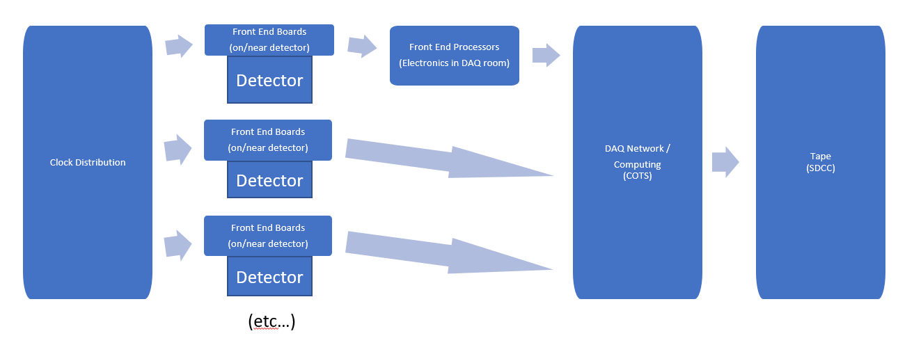
Front End Boards (FEB)
The collider performance:
  ~500KHz of collisions
  ~60-100Gbps zero suppressed data
  ~15 KB/event
  ~100 bytes/bunch crossing
We have an enormous number of channels but the Silicon MAPS readouts test the relevance of the concept of channel.
Challenging data compression scheme
  Noise reduction
  Zero suppression
  Background elimination
Detector | Readout Technology | Channel Count
Silicon Tracking | Si MAPS | 37B
GEM/MMG Layer | GEM | 217K
Cylindrical MPGD * | GEM | 60M
HP-DIRC | MAP/MT | 100-330k
ECAL | SiPM | 1.7K
HCAL | SiPM | 24K
ECAL imaging | Si MAPS | 480M
dRICH | PMT/SiPM | 350K
mRICH | PMT/SiPM | 330K
B0 | Si MAPS | 32M + 320K
Off-Momentum | AC-LGAD (eRD24) | 750K
Roman Pots | AC-LGAD (eRD24) | 500K
ZDC | LGAD + ASIC eRD27 | 225+366
TOF | AC-LGAD | 15M

Slide 6
Side by side ATHENA/ECCE
ATHENA
ECCE
Detector | Readout Technology | Channel Count
Silicon Tracking | Si MAPS | 37B
GEM/MMG Layer | GEM | 217K
Cylindrical MPGD * | GEM | 60M
HP-DIRC | MAP/MT | 100-330k
ECAL | SiPM | 1.7K
HCAL | SiPM | 24K
ECAL imaging | Si MAPS | 480M
dRICH | PMT/SiPM | 350K
mRICH | PMT/SiPM | 330K
B0 | Si MAPS | 32M + 320K
Off-Momentum | AC-LGAD (eRD24) | 750K
Roman Pots | AC-LGAD (eRD24) | 500K
ZDC | LGAD + ASIC eRD27 | 225+366
TOF | AC-LGAD | 15M

Slide 7
Electronics
Summarize in a tabular form the current state of the readout chain. Examples of development stages can include "R&D", "conceptual design", "pre-prototype","full functionality prototype", "integration tests with detector", "ready for production", etc.
Detector | Functionality | Sensor technology | FEE/ASIC | Status (det/asic)
DIRC | Position//Time ( Amplitude) | MCP-PMT | HDSOC | Ready/prototype
dRICH | Time / Time over threshold/position | SiPM * | Updated ALCOR | Ready/prototype
eRICH | Time / Time over threshold/position | SiPM * | Updated ALCOR | Ready/prototype
EcalBarrelScFi | Amplitude | SiPM | Amplifier | Ready/prototype
EcalImgBarrel | Position/Time/Time over threshold | ASTROPIX ( MAPS) | - | Prototype
EcalEndcapN | Amplitude | SiPM | Amplifier | Ready/prototype
EcalEndcapP | Amplitude | SiPM | Amplifier | Ready/prototype
HcalEndcapN | Amplitude | SiPM | Amplifier | Ready/prototype
HcalEndcapP | Amplitude | SiPM | Amplifier | Ready/prototype
HcalBarrel | Amplitude | SiPM | Amplifier | Ready/prototype
Inner Vertex Tracker | Position/Amplitude/Time | ALPIDE 65 nm(MAPS) | - | Prototype
MPGDTrackerBarrel | Position/Amplitude/Time | Micromegas | SALSA | Ready/conceptual*
urWELLTrackerEndcap | Position/Amplitude/Time | uRWELL | SALSA | Prototype/conceptual*
GEMTrackerEndcap | Position/Amplitude/Time | GEM | SALSA | Ready/conceptual*
B0Silicon | Position/Amplitude/Time | MAPS* | ALPIDE ITS2 | Ready/ready
B0preshower | Time / Time over threshold | AC-LGAD | Updated ALTIROC | Prototype/prototype
RP | Time / Time over threshold | AC-LGAD | Updated ALTIROC | Prototype/prototype
OffM | Time / Time over threshold | AC-LGAD | Updated ALTIROC | Prototype/prototype
ffiZDCSi | Time / Time over threshold | Silicon strip detectors - DC-LGADs | Updated ALTIROC | Prototype/prototype
ffiSDCSciFi | Amplitude/Time | PMTs | Amplifier | Ready/conceptual
ZDCSiPb | Amplitude/Time | If silicon used, less if silicon fibers used. | Amplifier | Ready/conceptual
ZDCScint | Amplitude/Time | PMTs; depends on whether two sections are read-out independently. | Amplifier | Ready/conceptual
TOF | Time / Time over threshold | AC-LGAD | Updated ALTIROC | Prototype/prototype
Luminosity monitoring and Low Q tagging | Amplitude/Time | 6 PMT based calorimeters * | Select existing ASIC | Protype/conceptual

Slide 8
ASICs R&D
Provide a summary (e.g., in tabular format) of the specific R&D goals and development timescale for each individual ASIC, including each fallback option. For each ASIC, include estimate of when the decision needs to be taken whether to go with the baseline ASIC or the fallback option.
ASIC proposed | Institution(s) | R&D | Fall back option
ALCOR | INFN | Current version for low rate. Increase data throughput. Test streaming mode | (low risk)
ASTROPIX | ANL in collaboration with NASA | Customization for Imaging calorimeter, improved power and energy resolution | (low risk)
ALPIDE | EIC R&D silicon consortium in collaboration with CERN | 65 nm technology ITS3, lower material budget and lower | 180 nm ITS2
SALSA | CEA SACLAY in collaboration with University of Sao Paulo | Updated version of SAMPA for better performance and better support for streaming | SAMPA or VMM3
ALTIROC | CEA SACLAY/CNRS | Customization for EIC / AC LGAD Streaming
HDSOC64 | NALU | 64 channels version of HDSOC | HDSOC32
Advanced prototype for TDR - start production around 2026 and ASIC choice will be frozen at that date
All ASICs are based on existing design : development of new chip mostly for improved data links for better rate capability and streaming support making the R&D fairly low risk,
SALSA is a new iteration of SAMPA with higher channel density / higher sampling rate / lower power consumption
Other ASICs will be chosen in conjunction with project from available ASICs for better standardization

Slide 9
ASICs timeline
Describe the development plan and timeline for the customization and prototyping of electronics specific to each sub-detector concept.
Detector type | ASIC proposed | R&D | Conceptual design | Preprototype | Full functional prototype | Integration with readout chain and detector | Ready for production | Fall back
MCP PMT | HDSOC 64 channels | done | done | done | 2022 | 2023 |  | HDSOC32
SiPMT | ALCOR | done | done | 2022 | 2023-24 | 2025
Pixel detector Imaging calorimeter | ASTROPIX | 2015 | 2018/19 | March 2020 | 2021 | 2022 | 2023
MAPS | ALPIDE ITS3 | done | 2019 | 2021 | 2023 | 2024 | 2025 | ALPIDE ITS2
MPGD | SALSA | 2021 | 2022 | 2023 | 2025 |  |  | SAMPA or VMM3
AC-LGAD | ALTIROC | done | done | 2022 | 2026 | 2027 | 2028
Rough timeline : final details need to be worked out with different groups after detector selection

Slide 10
Summary of the Athena Streaming Readout Concept:
Characteristics of Athena Streaming Model
Very large number of channels
Very low occupancy
Connection limited rather than throughput limited, so extra throughput capacity in most detectors
No trigger, but FEEs perform aggressive zero suppression
Collision Hit + Background Hit data volumes low enough to be read out to tape
Low Detector Noise expected (except for single photon sensitive SiPM)
Readout time windows near single bunch crossing time expected (except for MAPS with ~200usec readout time expected)
FEEs
Aggregation Chain
Fibers
FEEs
Aggregation Chain
Ethernet
Processing Computer
Buffering Computers
FEEs
Aggregation Chain
FELIX
Readout Computer
Processing Computer
Buffering Computers
Buffering Computers
Processing Computer
Farm
Buffering Computer
Farm
FEEs
Aggregation Chain
Ethernet
FEEs
Aggregation Chain
Fibers
FEEs
Aggregation Chain
FELIX
Readout Computer
Zero Suppression
Cluster Finding
Software Trigger Where needed
Data File Formatting
Event Building
Scalers
QA
DBs / Accounting
Buffer
Transfer
Data Flow
FEEs
Aggregation Chain
FEEs
Aggregation Chain
FEEs
Aggregation Chain
Fiber
FEEs
Aggregation Chain
Fiber
Readout Computer
FEEs
Aggregation Chain
FELIX
FEEs
Aggregation Chain
FELIX
FEEs
Aggregation Chain
Fiber
FEEs
Aggregation Chain
FEEs
Aggregation Chain
FEEs
Aggregation Chain
Fiber
FEEs
Aggregation Chain
FELIX
FEEs
Aggregation Chain
FELIX
Readout Computer
Timing Sync
Slow Controls
CAD
Timing Sync
Timing Sync
Config
Timing Sync
Clock
Bunch patterns
spin patterns
Config/Control
State Model
Configuration Parameters
Active/Disabled channels
Run Modes
Firmware
Config/
Control
DB
Timing System Data Flow
Configuration Data Flow

Slide 12
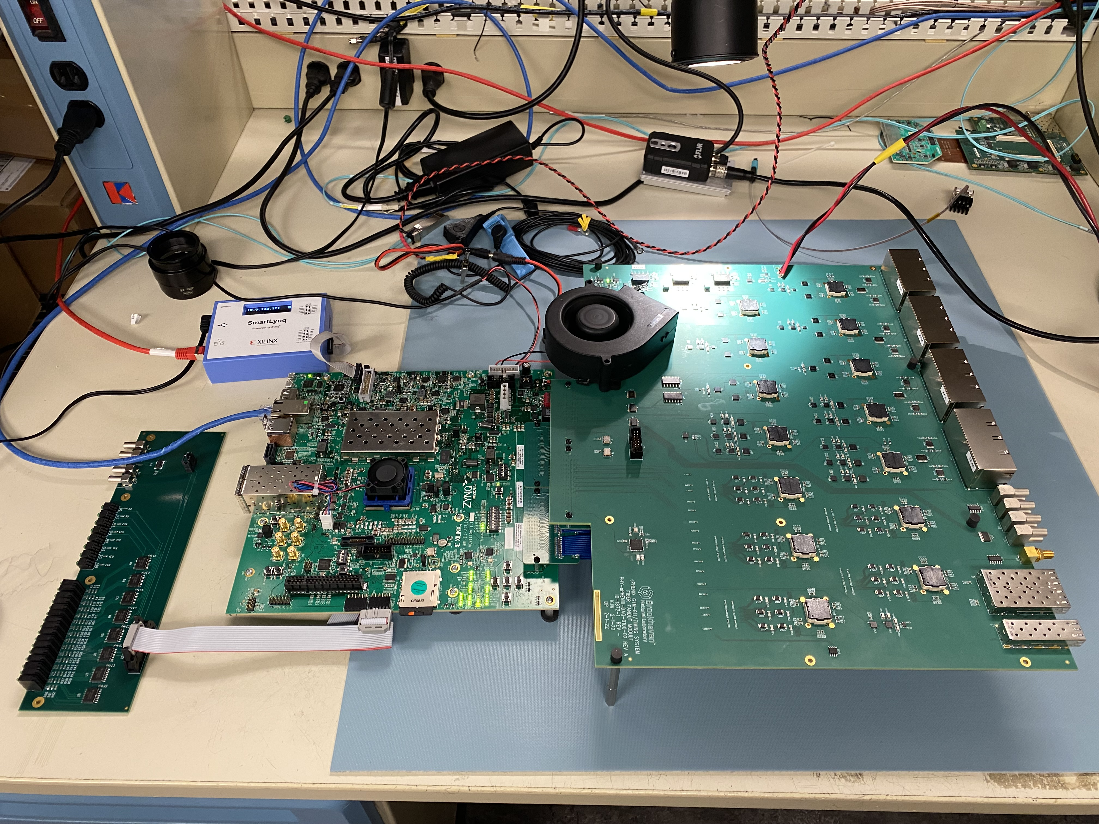
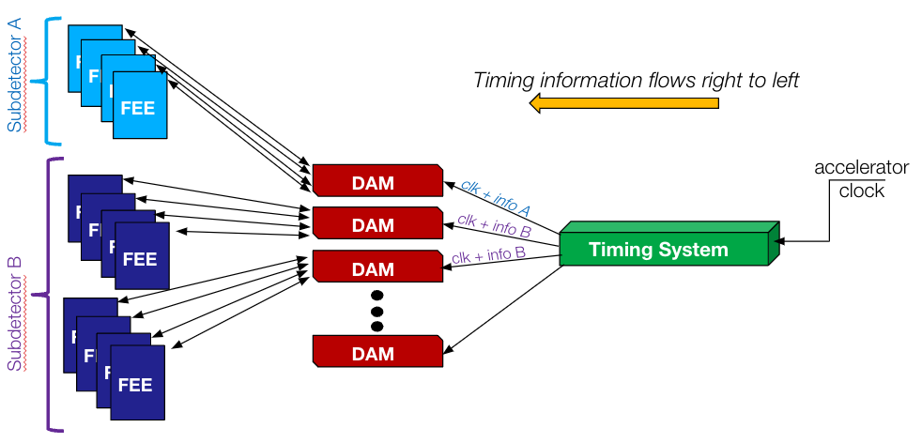
sPHENIX ZCU102 Timing Module

Slide 14
Few items from kick-off meeting
DAQ design pretty close to each other
Not clear can use MCP-PMT or LAPPD for RICHes, if use SiPMT issue of dark-noise remain
Timing / clock distribution : lpGBT vs separate like sPHENIX or JLAB
  Less / no radiation hardness required : can save cost and overhead of lpGBT
  lpGBT sastifies requirements ( if works at required clock frequency )
  Maybe hybrid, with lpGBT for TOF only
Would like to add to all other detector WG charge
  Have on detector WG Point of Contact to set up dialog which each individual detector to define protocols and requirements of readout
  Estimate data rates from detector subsystems from physics, physics background, noise and dark noise, define zero suppression strategy
Early specification of protocols and standards is beneficial
Stay open to other solutions (custom or commercial) which could offer better performance for similar cost without increasing risk
(example FELIX, FERS, ARISTA FPGA for aggregation module )

