Slide 1
sPHENIX TPC Status
TK Hemmick

Slide 2

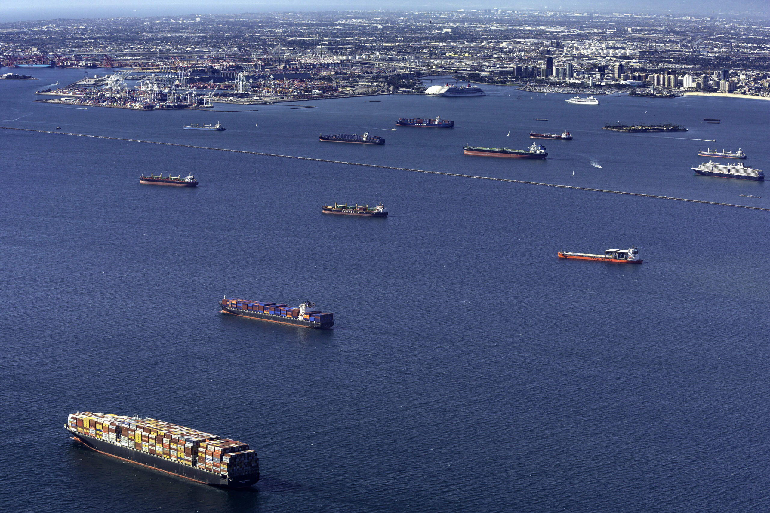

Missing from Our Risk Registry
Worldwide Pandemic
Supply Chain Crisis
War in Europe
All projects attempt to capture cost and schedule risk in a risk registry.
sPHENIX (and the TPC in particular) failed to capture recent world events.
Today’s discussion:
  TPC systems affected by both normal and unprecedented events.
  Today we’ll list items and the mitigation strategies imposed and/or anticipated.
    Module testing & possible change of running gas.
    Diffuse laser and fiber splitter light delivery.
    PLL chip on the TPC FEE
    Final construction & testing to demonstrate TPC KPP’s.

Slide 3
Executive Summary
Delayed module testing from subtle sPHENIX-unique issues solved.
  Mitigation = new software and hardware to speed gain mapping
Neon Supply Issue due to Ukraine War.
  Mitigation = Consult sPHENIX management; ALICE expertise; 1st principal calculations; Backup gas identified; backup gas measured; backup gas validated.
Diffuse Laser Fibers Exhibit Anomalous/Rapid Degradation of Transmission
  Mitigation = fiber source found (tested and works); New light coupling devised (ready for testing)
PLL chip required for FEE card becomes unavailable.
  Mitigation = Alternate version of chip identified/purchased.
Assembly of TPC and testing for KPP validation possible delay:
  Use new working gas alternative to verify that TPC meets KPP specifications
  Assign senior sPHENIX tech to work exclusively on the TPC.
  Devise time-saving construction plan.
Result
  Restored “likely” status for TPC → sPHENIX on current schedule (October 2022)

Slide 4
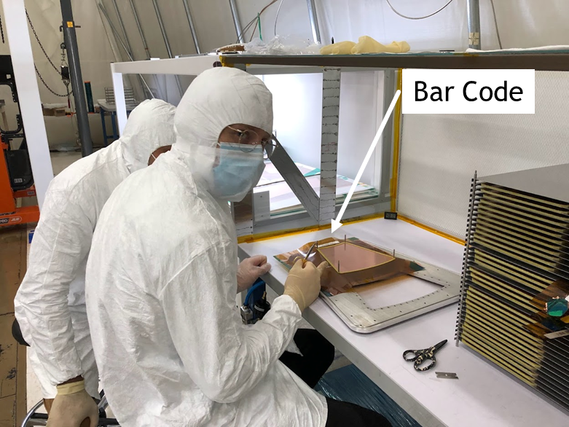
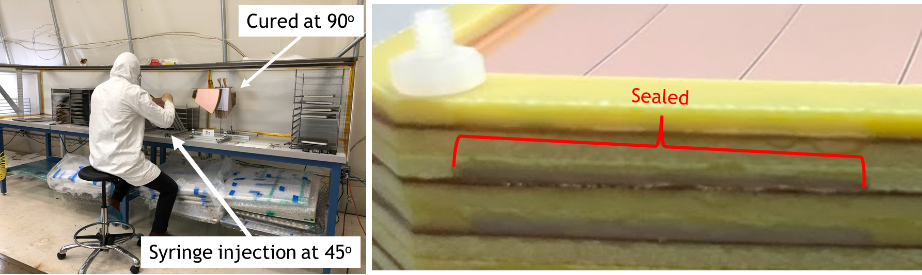
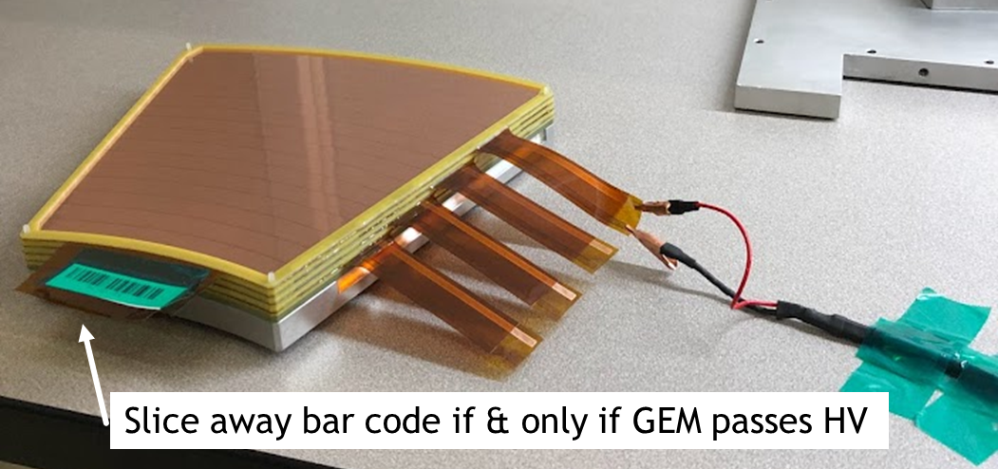
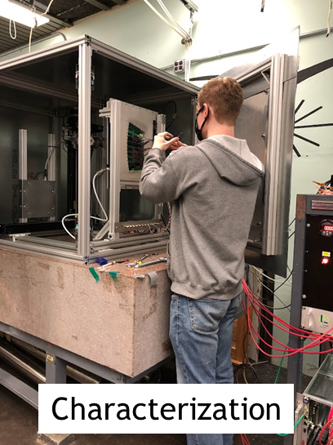
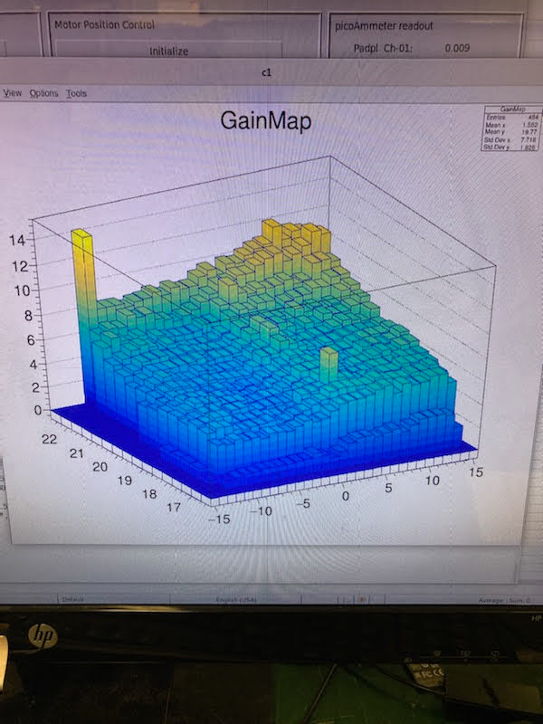
Module Steps & Tests Summary
WTF…cannot be
Status last time we spoke:
  All modules/gems HV tested in air.
  Characterization station 1st results were poor.
  Next step: fix characterization station and complete tests.

Slide 5
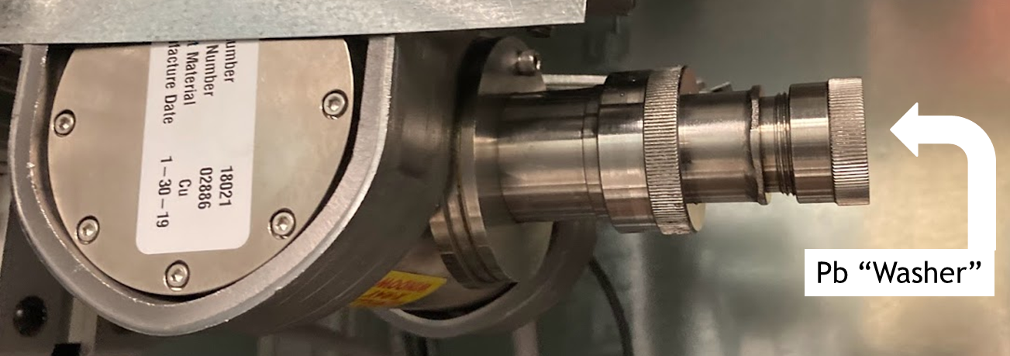
Impossible Slope
Gain map from Xray system showed crazy gain variation across the module.
Played games:
  Non-uniform drift field? --NO
  Gas differences (inlet at high gain, outlet at low gain) --NO
  Drying the GEMs using the gas? --NO
The least likely idea (until then) worked:
  Current = Rate * Gain
  Maybe X-ray source rate changes with position?
  Long Narrow collimator is sensitive to spot.
  Replace with wide collimator and
  high-Z “washer” with a narrow hole.
WTF???

Slide 6
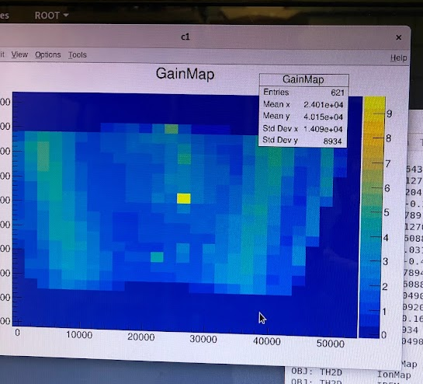
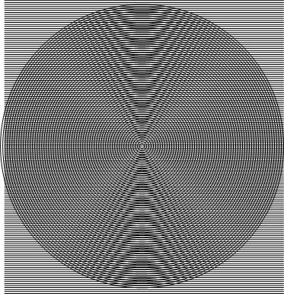
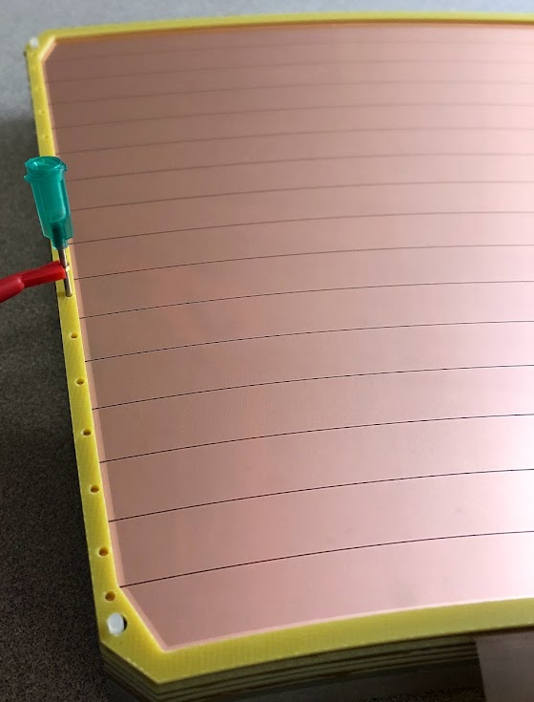
Moire Pattern
After X-ray spot location is irrelevant, a new phenomenon appeared:
Moire Pattern from Lines and Circles!
Lines = cartesian coordinates during X-ray scans
Circles = High Voltage sectors of the GEMs

Slide 7
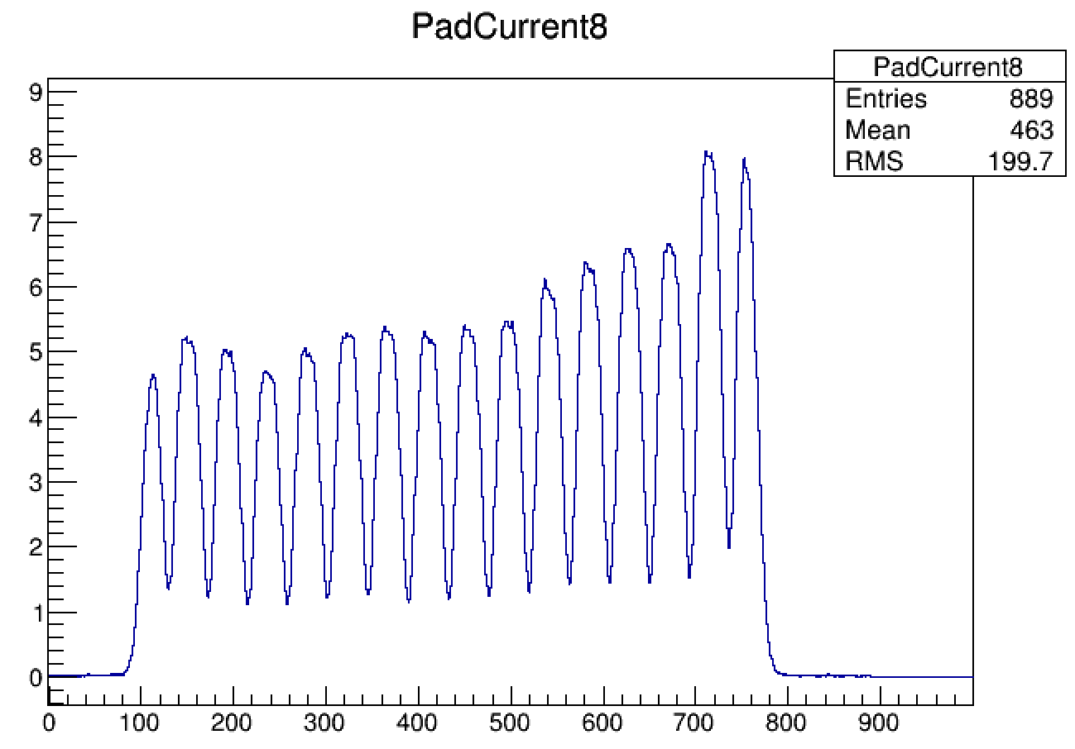
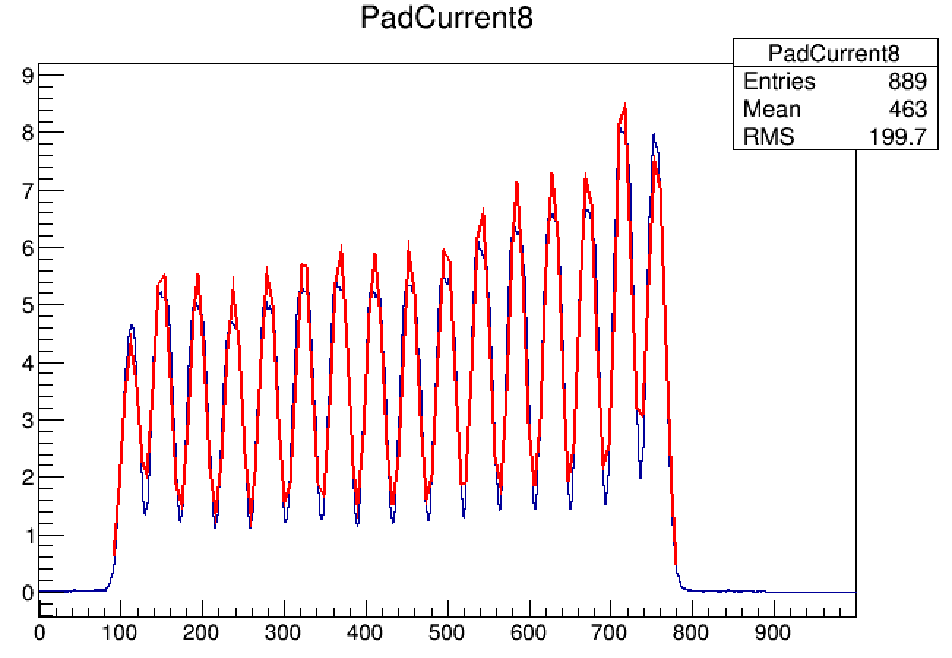

Radial Scan Reveals the “Dips”
Plateau response while Xray is within the HV sector is the true gain reference.
Eliminate cartesian pattern of motor movement.
Take very fine steps in a radial direction at each phi location.
Use “16 Candles” function to locate plateau.
Sample the results only at the plateau.

Slide 8
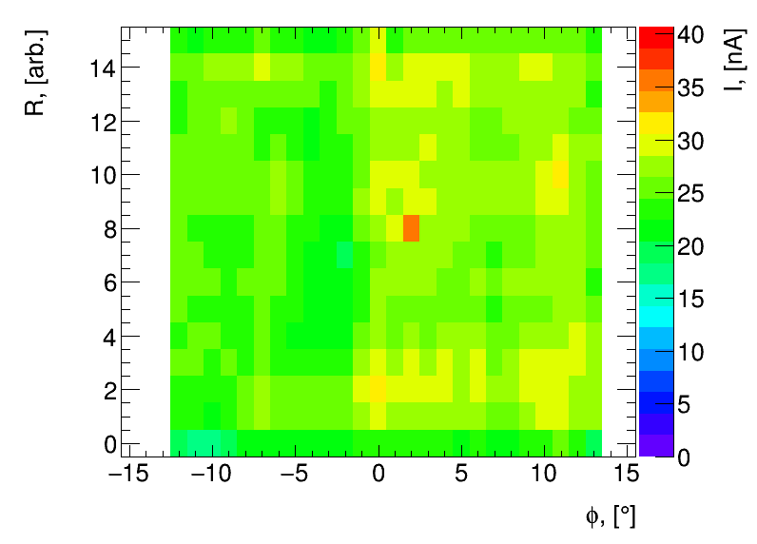
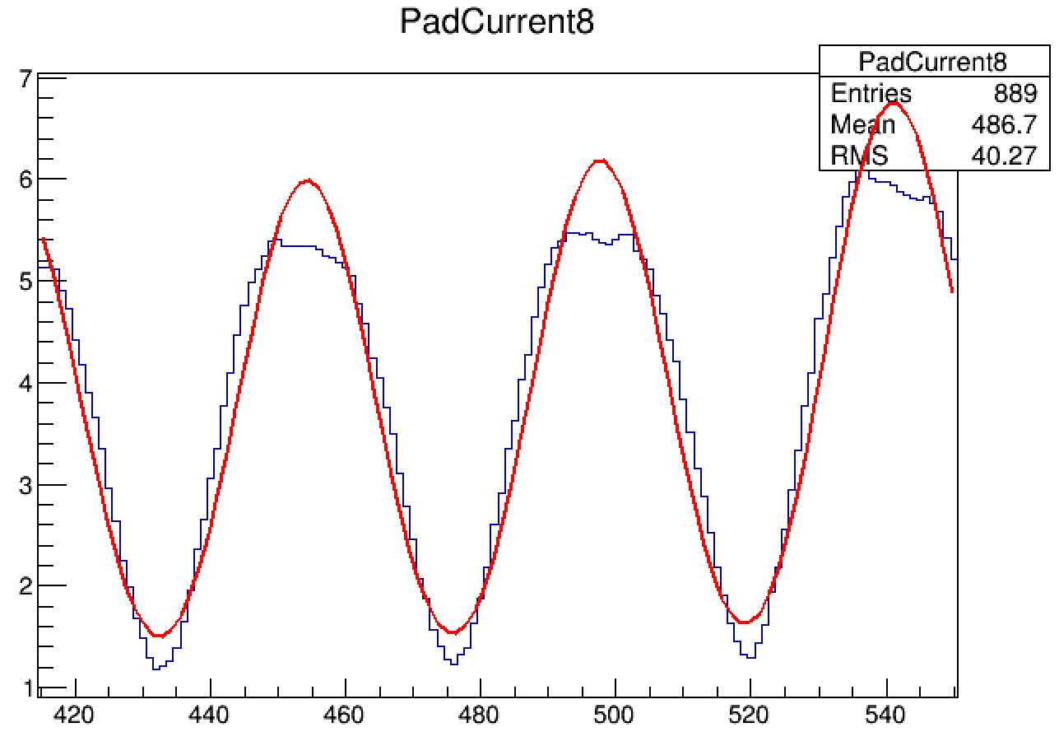
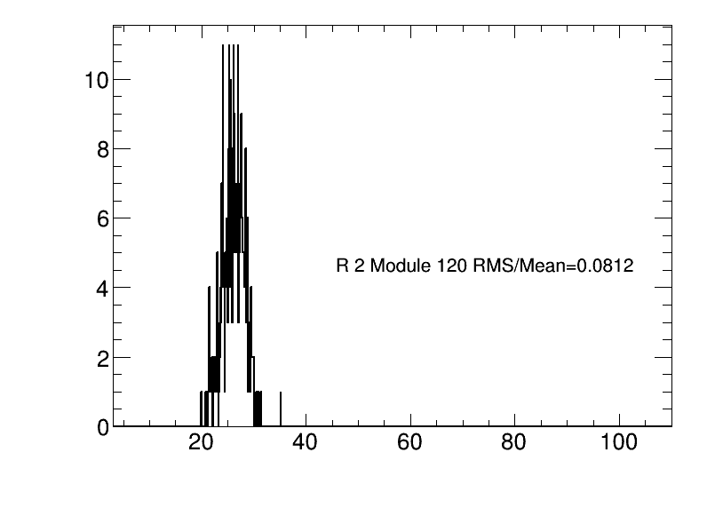
Getting the Gain Map
Hot Spot from Tuneup Xrays (gain vs. HV )
Criterion:
ALICE: RMS/MEAN < 0.20
Our Modules: 0.08-0.11
Use the center of each Gaussian only (not height)
Inspect the original data in the plateau (blue)
at the center (green arrow).
Get the “gain” map.
RMS/MEAN = 0.08 – 0.13 (ALICE typical ~0.15)

Slide 9
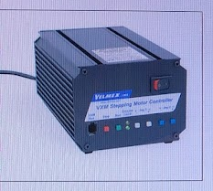
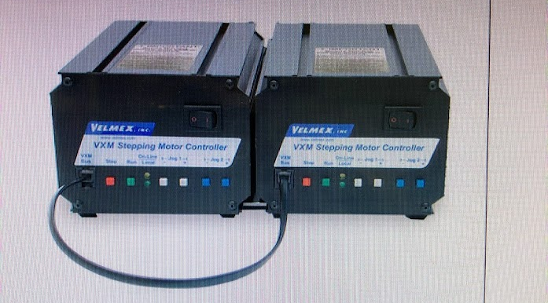
Problem with Speed.
VMX2: One motor at a time.
VMX1-1: Simultaneous Motion
Scan time more than 5 hours.
Motor Motion:
  Motor controller only moved one axis at a time.
  Accelerate → coast → decelerate makes average velocity slow.
pAmmeter readout:
  Shell command: Attach port, read, average, Release port (sloooooow)
  Singleton Server: Continuously attached, TPC/IP communication delivers full dataset (~1 kHz)
Scan time = 20 minutes.

Slide 10
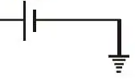
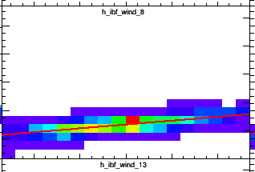
Problem with IBF noise.
HV Power Supply
(read compare adjust)
pAmmeter
Ion Collection Membrane
HV Power Supply
(read compare adjust)
pAmmeter
Ion Collection Membrane
pAmmeter
Spy Capacitor
Grounding, shutting down fans etc.
Final Noise ~0.5 Hz
  Generated by power supply continual adjustment.
  Too slow to be filtered; cannot be turned off.
  MEASURE it.
    Spy capacitor ~10X the capacitance of the cable leading to the IBF membrane
    Spy sees PS induced current at 10X the magnitude. → CANGLES!
Slope ~ 0.1
Membrane
Spy Capacitor

Slide 11
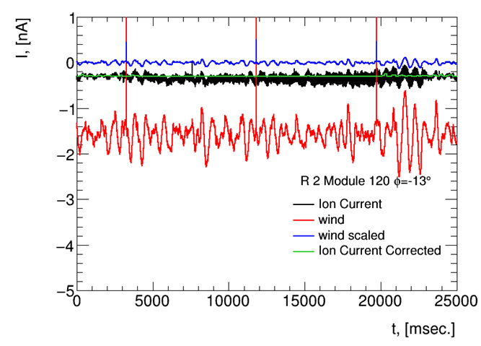
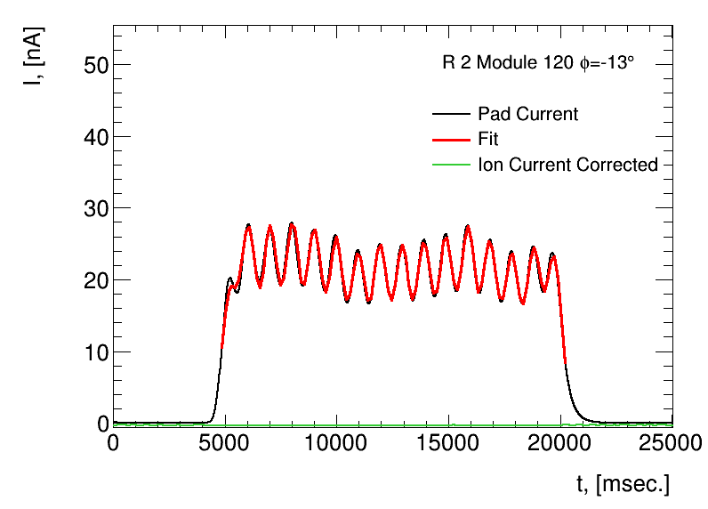
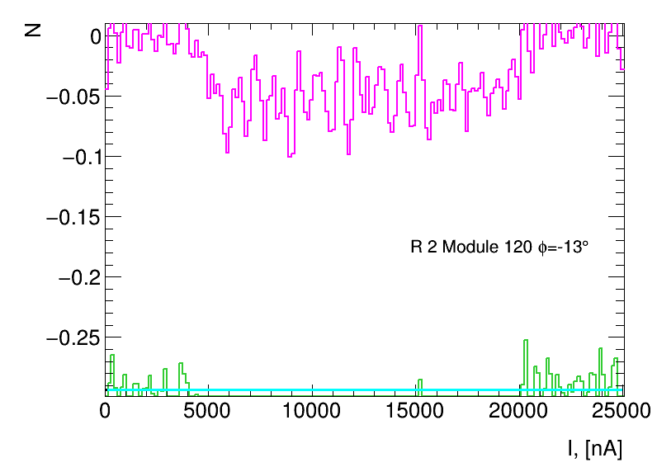
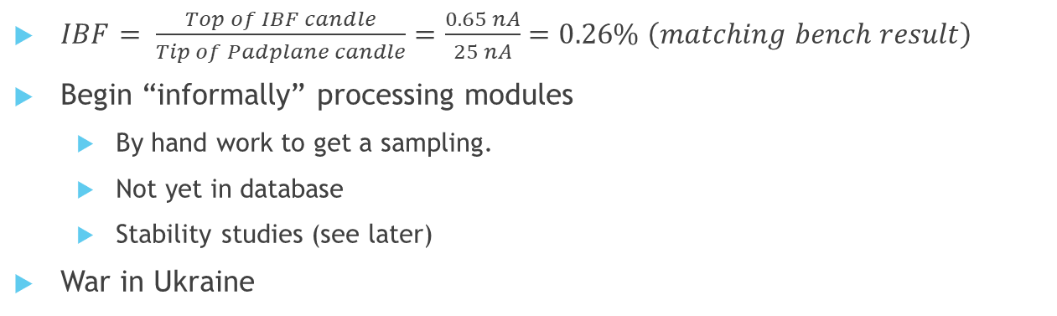
Typical IBF Result
First valid result!
$IBF= \frac{Top of IBF candle}{Tip of Padplane candle}=\frac{0.65 nA}{25 nA}=0.26\% \left(matching bench result\right)$
Begin “informally” processing modules
  By hand work to get a sampling.
  Not yet in database
  Stability studies (see later)
War in Ukraine

Slide 12
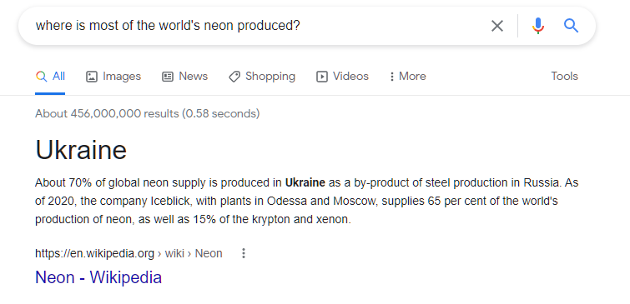
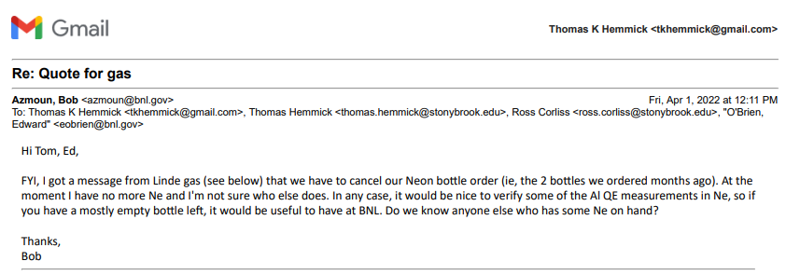
Where is most of the world’s Ne produced?
This is an immediate trouble for module testing.
This is a further trouble for running in the Spring.
  Prakhar will calculate what happens if we use Ar in place of Ne
    Likely fine performance for avalanche/drift/diffusion.
    MUST look at attachment carefully.
    Can increase CF4 a bit to compensate for diffusion(certainly)/attachment(highly likely)
  Ross will need to look at the impact on distortions
    Ionization Up = Gain down (good)
    Ion Velocity Down (bad)
NOTE: Ne:CF₄ 90:10 → 50:50 ~1.4X distortion

Slide 13
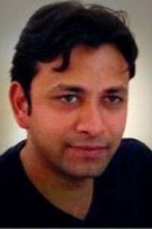


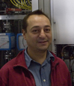
Progress on Calculations (Prakhar Garg)
We investigated a list of alternate gas selections to try to cover the full phase space of reasonable possibilities. These included:
  All possible mixtures of He + CF4 (0:100, 5:95, 10:90, … , 100:0)
    Helium is lighter and will have lower ionization, lower ions, higher diffusion.
  All possible mixtures of Ar + CF4
    Argon is heavier and will have more ionization, higher ions, lower diffusion.
  All possible mixtures of He/Ar + CF4
    An attempt to balance He & Ar to artificially produce a Neon match.
  All possible mixtures of Ar + CF4/CH4
    An attempt to substitute some CH4 for CF4 to improve the ion velocity to compensate for using Ar in the place of Neon.
We found a clear best selection (with caveats since Garfield is not perfect)
Chatted with ALICE (Harry Appleshauser, Piotr Gasik, Chilo Garabatos):
  Their status
  Their plans
  Comments on our gas alternative.

Slide 14
Summary of Conclusions
https://sphenix.physics.sunysb.edu/tpc_gas/HTML_Gases_Argon/split.html
He + CF4
  Failure.
  The use of Helium destroys the transverse diffusion.
  100% CF4 is better than allowing any Helium in the mix.
Ar + CF4
  Success
  Almost perfect match possible with one exception.
  The picture below shows that 60:40 Ar:CF4 is a near perfect match in transverse diffusion, longitudinal diffusion, electron drift velocity, and attachment.
  The Townsend coefficient is a bit lower indicating the need for higher voltages to produce the same gain (cautionary note below).
  The ion mobility is down by 23%...indicating 23% higher space charge.
  Prakhar cautions that Penning ionization, which will be strong in Ne:CF4 will be reduced in Ar:CF4 and that Penning transfer constants are not known in all out gas mixtures. So the amount of required additional voltage in Ar+CF4 has to be determined experimentally.
  Ross will be able to calculate the impact of 23% increased space charge.
He/Ar + CF4
  Failure
  Beyond 10% Helium, diffusion becomes larger than Ne+CF4 and so we cannot use those.
  At 10% Helium, the impact on the ion mobility is negligible and so there is no good reason to go to this kind of mixture.
Ar + CF4/CH4
  Failure
  The idea is to "cut" the heavier CF4 with lighter CH4 to improve the ion mobility.
  We limited the CH4 to 10% in order to have teh mixture as non-flammable for safety concerns.
  This improvement in ion mobility but the damage to transverse diffusion (CF4 is the sole reason for our good transverse diffusion) is too small to justify the use of CH4.
In a nutshell:
Electron transport characteristics drive precision.
Ion transport characteristics drive accuracy.

Slide 15
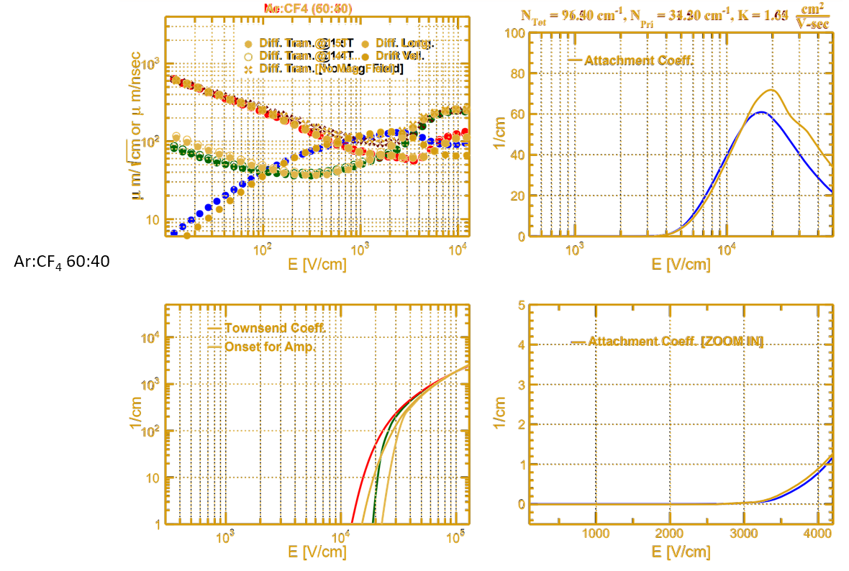
Ar:CF₄ 60:40
Nearly perfect match
Electron transport will be basically same.
GEM voltages will “cautionary” be similar:
  Townsend says more voltage for same gain
  Original ionization higher (roughly same factor)?
  Caution: Penning is unknown in this gas mixture.
Piotr Gasik:
  Calculated stability comparison to old mixture.
  With appropriate caveats looks basically the same.

Slide 16
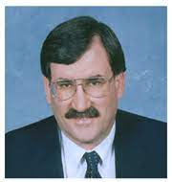

Discussion with sPHENIX Management
Reasons to be prepared for non-Neon running:
  Predicting the future cost is difficult:
    Presently triple.
    Can go down if new players enter lucrative market (you basically just harvest it from air).
    Can go up if new players take time to get running and the world is running low.
  Bottom line: We must be fully prepared to use Ar:CF₄ as a fallback solution
Module characterization & Argon Mixture Development:
  Module characterization can be modified to do req’d R&D on Argon Mixture.
  It is a rapid process to see if the Argon mixture is viable.
  It is an involved process to fully characterize the Argon. Mixture
  Shapes of the gain/IBF are dictated by the module not the gas.
Procedure:
  Demonstrate viability of the Argon mixture immediately.
  Characterize all modules fully with Neon.
  Later characterize a representative sample of modules also with Ar.
  Finish the complete studies of Argon in parallel with TPC assembly.

Slide 17
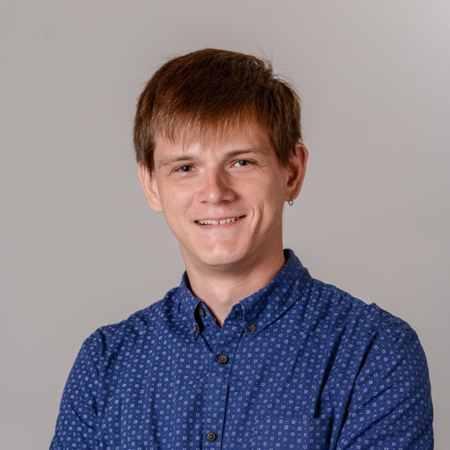
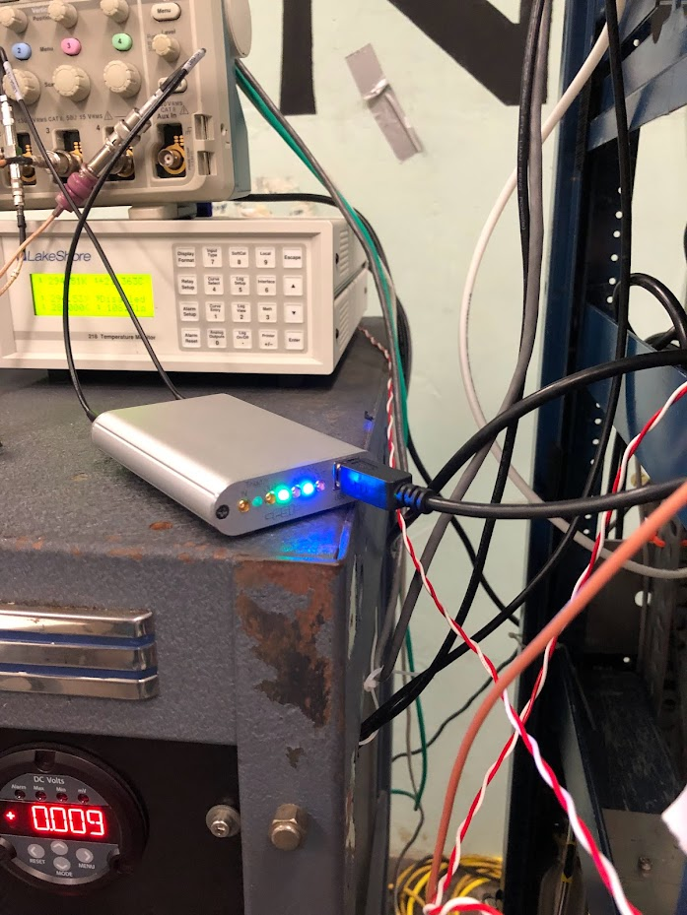
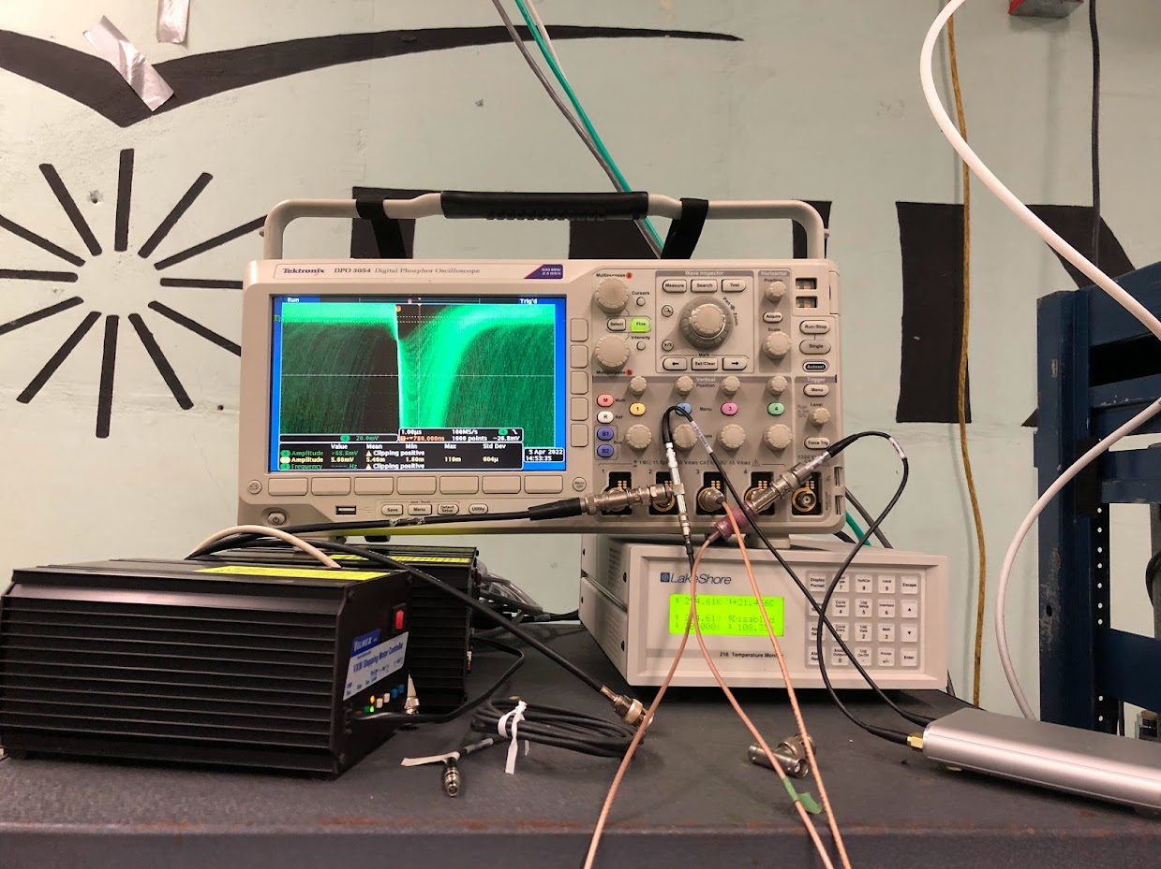
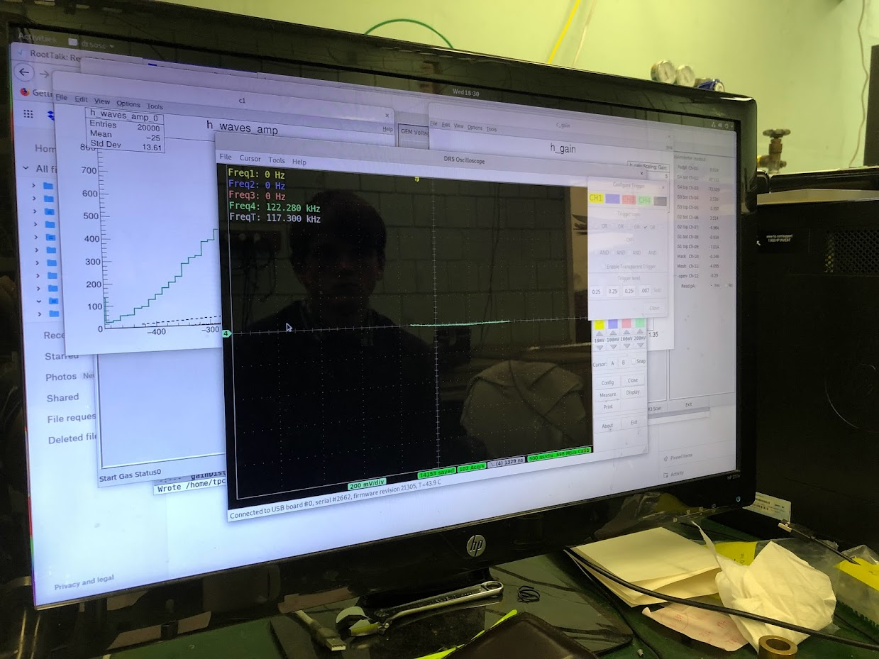
Single Xray Data Acquisition and Analysis
Installed & Debugged readout of DRS4-based data acquisition.
Wrote analysis code to show pulse height of digitized Xrays.
Validated system using Ne+CF₄ to demonstrate known results.
Modified gas system to switch effortlessly from Ne to Ar mixtures.
Measured gain vs. voltage in Ar:CF₄ 60:40
Measured map of module response in Ar:CF₄
Conclusion: Viability of Ar mixture established.

Slide 18
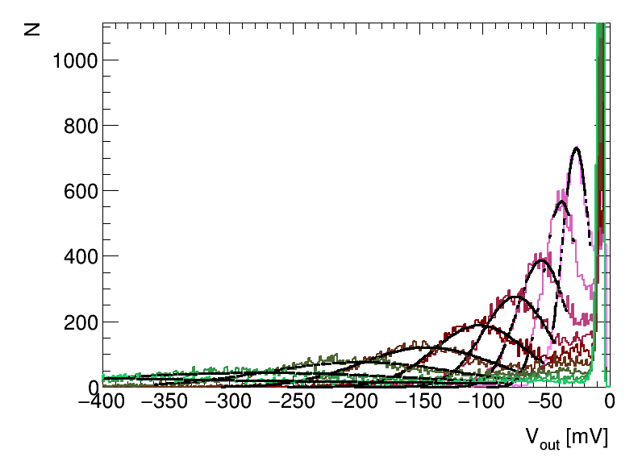
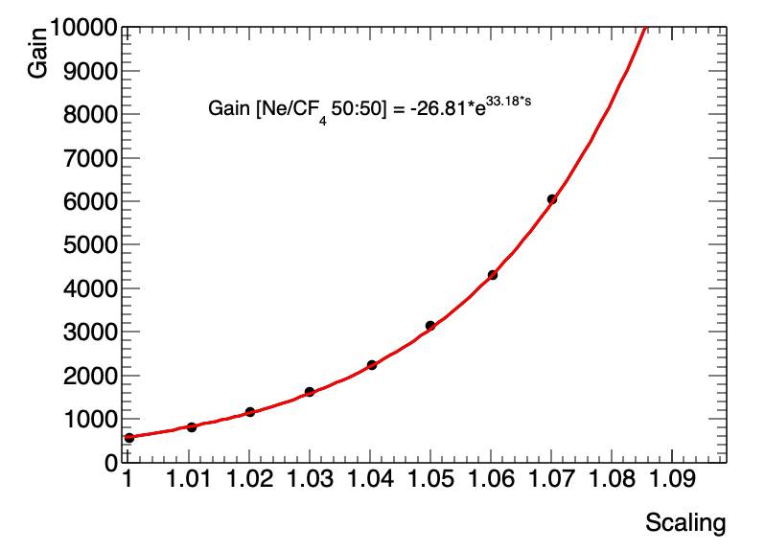
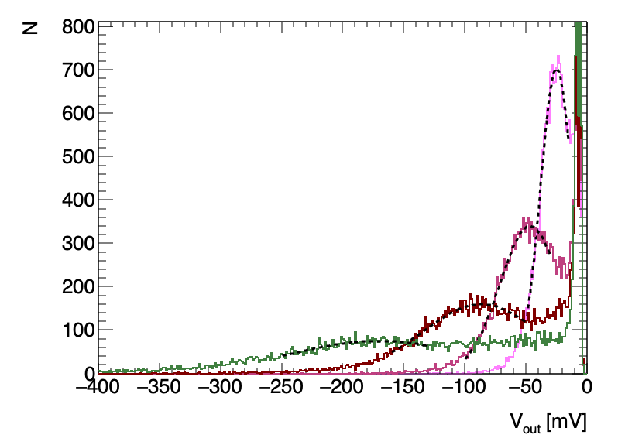
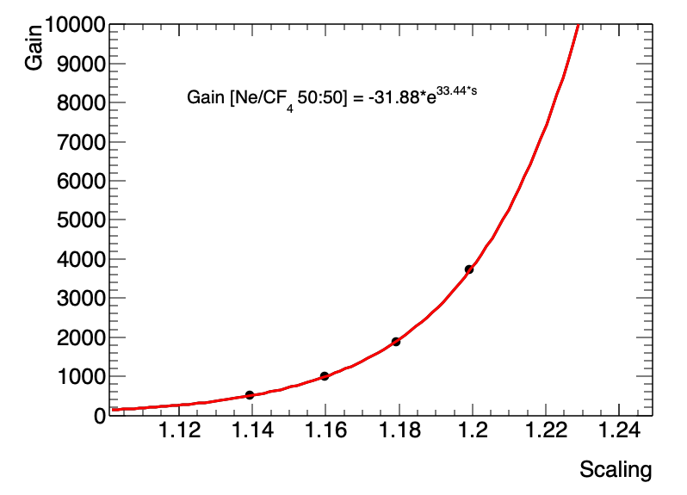
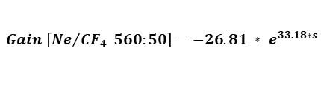
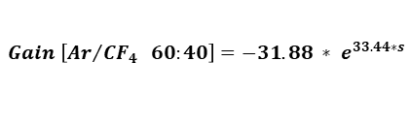
Ne/CF4 50:50 and Ar/CF4 60:40
$$Gain \left[{Ne}/{CF_{4}} 560:50\right]=−26.81 ∗ e^{33.18∗s}$$
Clear Xray peak
Noise very low/signal wide
  Typical for very low IBF
Voltage scale X*(Fermilab)
  Elevation ~600 feet.
  Chambers all run low.
  Very familiar & expected.
2000X gain located.
  Ne = 1.040X Fermilab
  Ar = 1.185X Fermilab
  Expected trend.
$$Gain \left[{Ar}/{CF_{4}} 60:40\right]=−31.88 ∗ e^{33.44∗s}$$

Slide 19
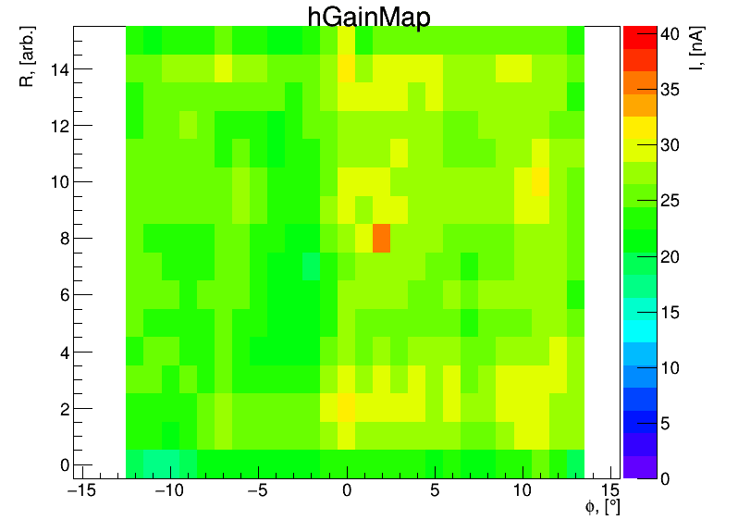
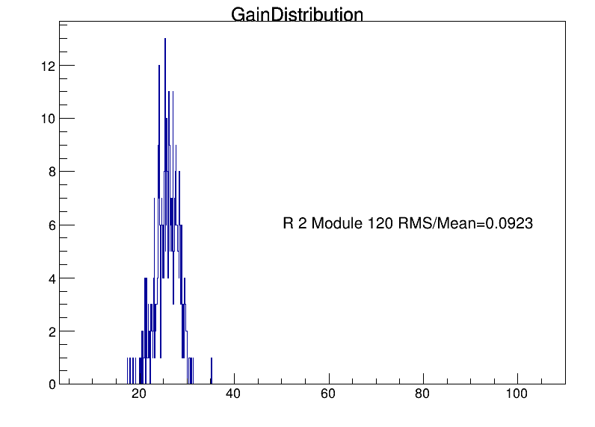
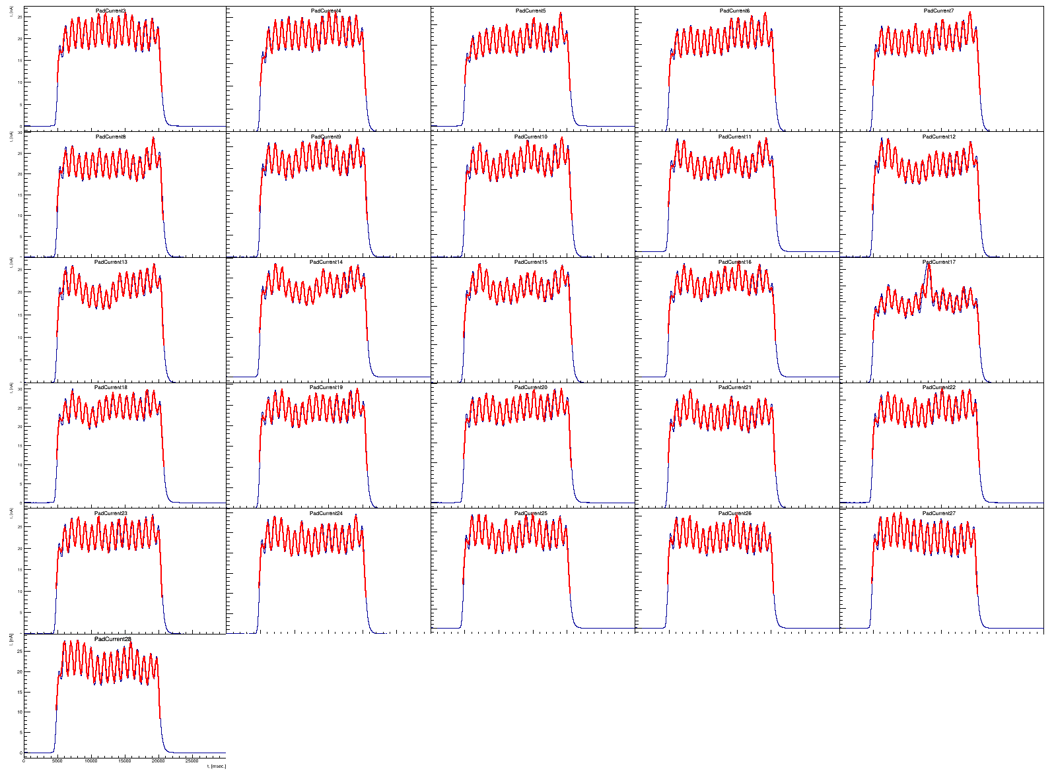
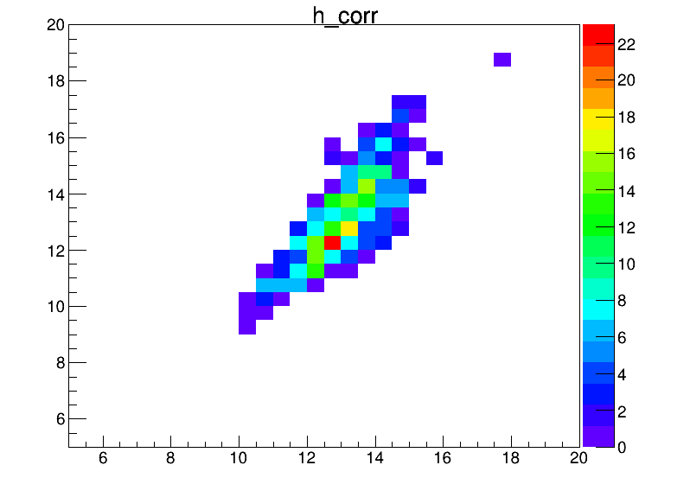
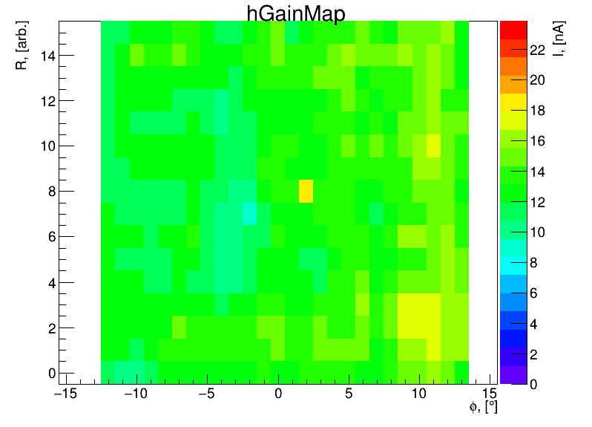
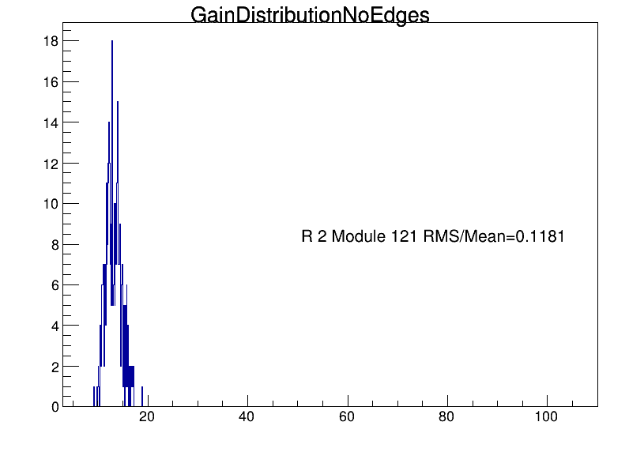
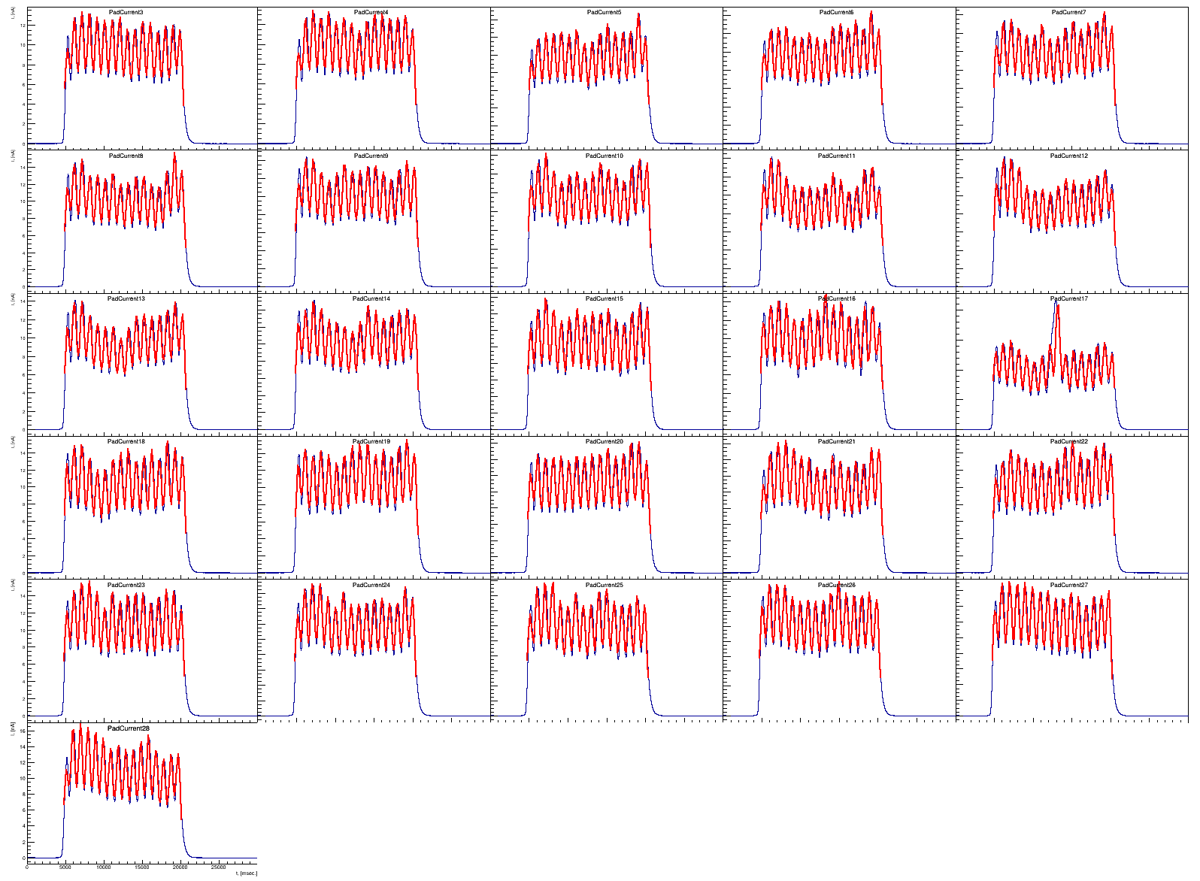
Ne/CF4 50:50
Measured throughput:
6 modules per day
Two weeks = all done.
Ar/CF4 60:40

Slide 20
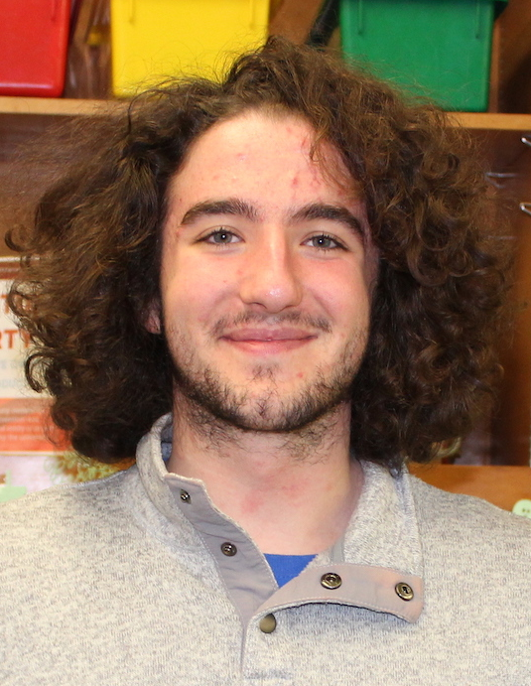
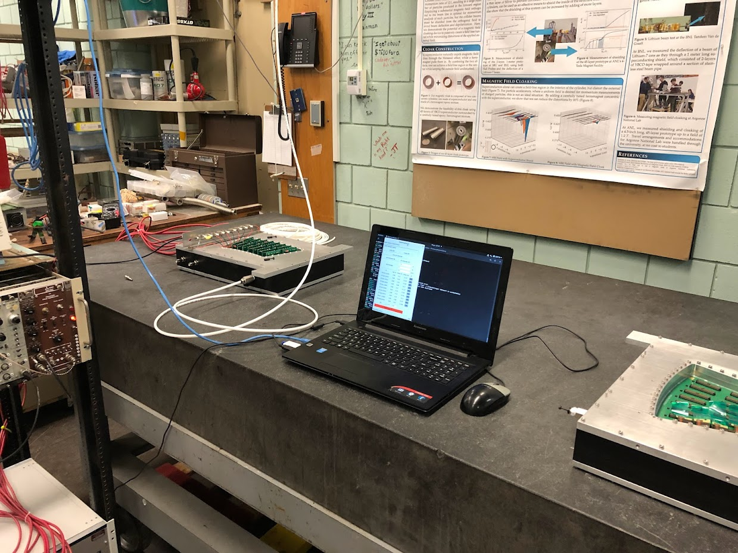
Torture Chamber
The “try to kill it exercise”:
The standard for stress tests is
40 nA/cm²
Even while fighting noise, it was
possible to delve into Xray-based
stress tests.
VERY difficult to make sparks from Xrays so we decided to
push it to an extreme to at least see a few sparks.
What means extreme:
  4000 nA/cm²
  Gain at 2000→15,000
  3 sparks in 20 minutes (no damage, but we got scared)
Xrays are used for stress tests because they are easy to come by.
Alpha particles are a more stringent test (²⁴¹Am provides 5 MeV alpha)
Stress station as second and parallel device.
Side benefit:
  Provides samples of sparks that will be detectable during running
  using the capacitive pickoff from the resistor chain.
Measured throughput:
6 modules per day
Two weeks = characterization

Slide 21
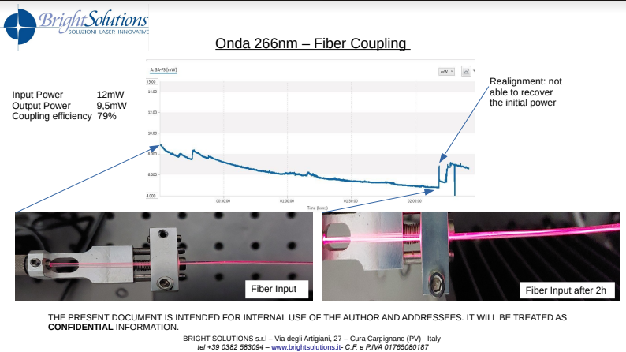
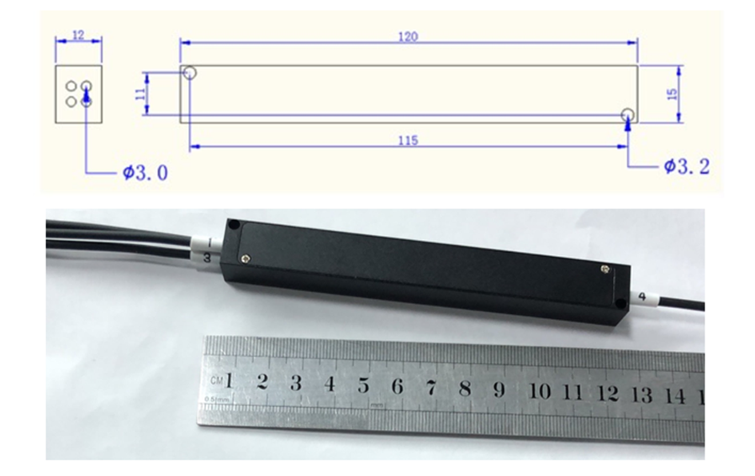


title
fused
Bright solutions showed that another fiber works fine (not to be fused)
Thor Labs offers an alternative to fusing: Hex Fiber Bundle
Hex Fiber Bundle makes collection efficiency acceptable

Slide 22



PLL Issue (now over)
TPC FEE designed with PLL to regenerate RHIC-multiple clock
PLL fine at sPHENIX radiation spec, trouble at ALICE rad spec.
  Fixed crystal is rad hard, but leave PLL as “stuffing option”
  FEE built without PLL.
  Determined February 2022 as unsuitable via failed test.
Rework required for PLL chip:
March:
  Identified 350/700 chips and placed order…hunt for more.
April 25:
  Shipping date pushed to Spring 2023!
  Alternatives:
    Different brand PLL and adapter card
    Use PLL inside FPGA
    Use alternative chip from same manufacturer.
  >1000 on shelf arrives today or tomorrow.
A,B,C

Slide 23


Recouping Lost Schedule
Time saving plan under
discussion with BNL
mechanical engineers.
Original plan:
  Empty wagon wheel on frame.
  Inner/outer field cages
  Central-membrane
  Bottom wagon wheel
  Empty TPC → horizontal for
  module installation.
New concept under discussion:
  Populate wagon wheels with modules first.
    Benefit: Much faster assembly.
    Risk: Heavier to move from vertical to horizontal
    Needs:
      Analysis by engineers (ongoing).
      Experienced technician to oversee.
Discussion with sPHENIX management:
  Need to borrow a top-notch EXPERIENCED tech for TPC project from now until the end.
  Expertise and experience are more helpful than extra hands to the TPC now.
Specific request:
  Carter Biggs
    Lead tech of PHENIX and sPHENIX for many years.
    Now in partial retirement (~60% time).
  Done! Carter is full time TPC starting next week.

Slide 24




Tasks Before Shipping
Slice Test
Recirculate Gas
High Voltage
Chiller from Evaporator
The KPP’s for the TPC that we need to verify are:
  Live channel fraction (test pulser OK for this)
  MIP efficiency (must actually “run” the detector)
Only Argon can be available and affordable so we must use that.
The slice test electronics (or a duplicate thereof) tests one sector at a time.
  No need for a trigger…plenty of cosmic rays in this large of a volume.

Slide 25
Tasks After Installation
Immediate Tasks after installation:
  Celebrate
  Rest
  Code
Shakedown is best only after all services are installed:
  High Voltage
  Gas
  Cooling
  DAQ
Free running mode of the SAMPA will ultimately allow cosmic running:
  No trigger required with SAMPA in “streaming mode”
  Tracks will actually be reasonably high rate.
  Laser firings (both line and diffuse laser) will insert “known” signals.
    Running without B-field will allow 3D map of E-field driven static distortions.
    Running with B-field will allow full map of E & B-driven static distortions.
    Dynamic distortions required collisions.

Slide 26
Summary
Gas Issues
  Consultation w/ sPHENIX management and ALICE experts.
  Theoretical investigation of viable gas yields best result.
  Reconfiguration of gain mapper provides validation.
  Prefer Neon, but know what to do if it is not available.
Laser Fiber Issue
  New fiber & coupling technique highly likely to proceed.
  Need to pull the trigger on the lasers basically immediately.
PLL issue
  Solved.
Cavalry
  Most experienced tech I know of becomes TPC-only tech.
  Vital for moving along big steps like assembly.
  BNL engineers validating new time-saving assembly procedure.
On schedule delivery restored to “likely” status by aggressive/effective action.

