Slide 1
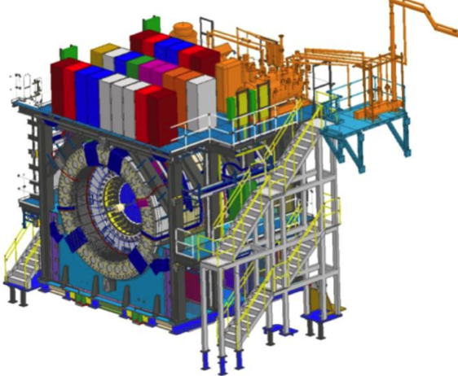
sPHENIX MIE Project Overview
TPC | Project Director | Last CD Achieved | % Complete | CPI | SPI
$27.0M | Edward O’Brien | PD-2/3 | 93.8% BCWP/BAC@ 4/30/2022 | 1.00 | 0.97
Scope
Detector systems produced, tested and ready for installation: Time Projection Chamber w/ electronics, Electromagnetic Calorimeter w/ electronics, Hadronic Calorimeter w/ electronics, DAQ/Trigger, Minimum Bias Detector, Project Management
Not in scope
SC-Magnet, Bldg/Det Infrastructure, Installation and System Commissioning
Schedule
CD-0 received Sept 2016
CD-1/3A received Aug 2018
PD-2/3 received Sept 2019
Early completion in August 2022. Four months of float to PD-4
PD-4 Dec 2022
Cost
$27.0M AY TPC 54.4% contingency on an ETC of $1.9M
Commitments = $2.09 M

Slide 2
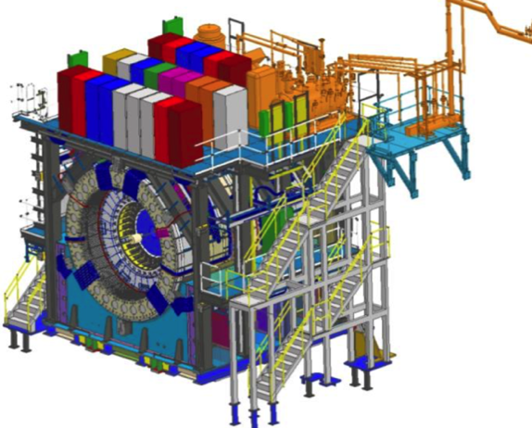
BNL 1008 Infrastructure & Facility Upgrade
TPC | Project Director | % Complete | CPI | SPI
$33.4 M AY | Edward O’Brien | 84.3% BCWP/BAC @ 4/30/2022 | 0.93 | 0.90
Scope
SC-Magnet support including the Flux Return, Cryogenics into Bldg 1008, Detector Carriage/Cradle, other Bldg 1008 Infrastructure improvements
sPHENIX Installation, Integration and Commissioning of each Subsystem is part of the scope
Not in Scope
PreOps prior to RHIC collisions
Schedule
sPHENIX Ready for Operations (Early Completion) 2/22/23
First RHIC run of sPHENIX Feb 2023
No float in schedule between sPHENIX “Ready to Operate” &
nominal start of RHIC-23 run. Looking to recoup schedule contingency
Cost
$33.4 M AY Total Project Cost with 37.4% contingency on ETC of $5.12M
93.6% Costed and Committed
Commitments = $1.04M

Slide 3
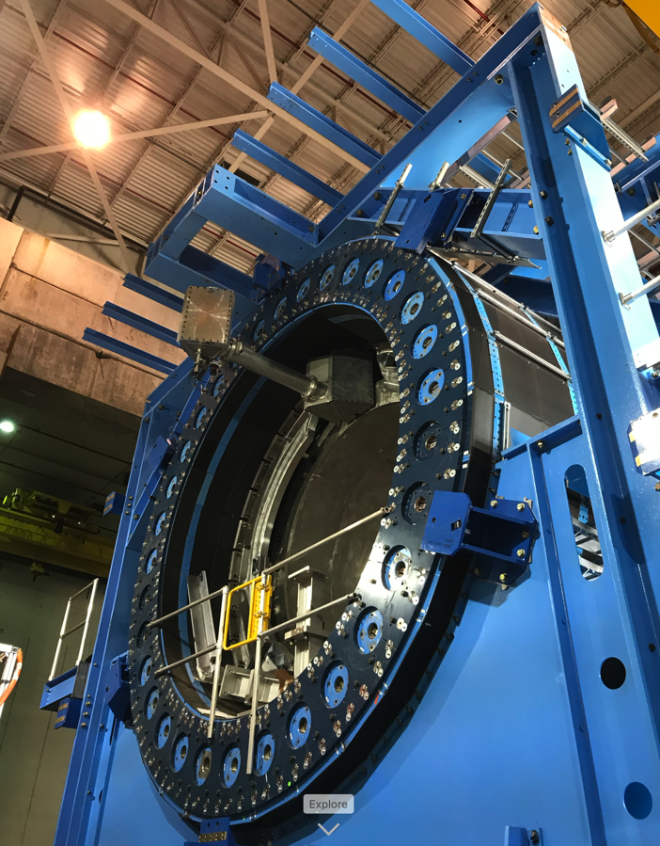
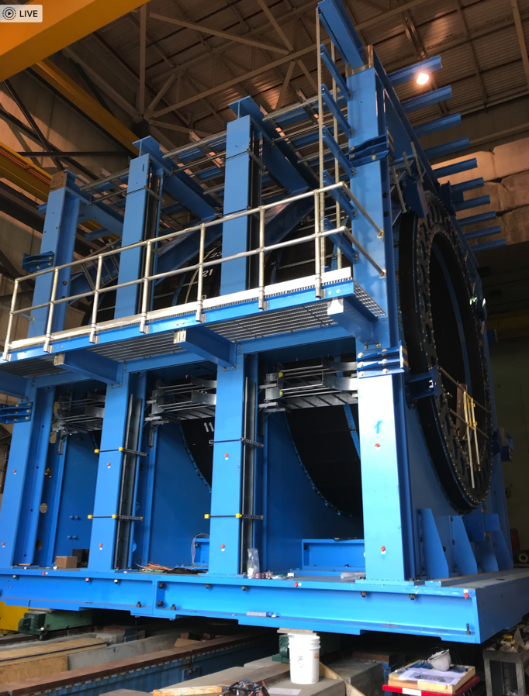
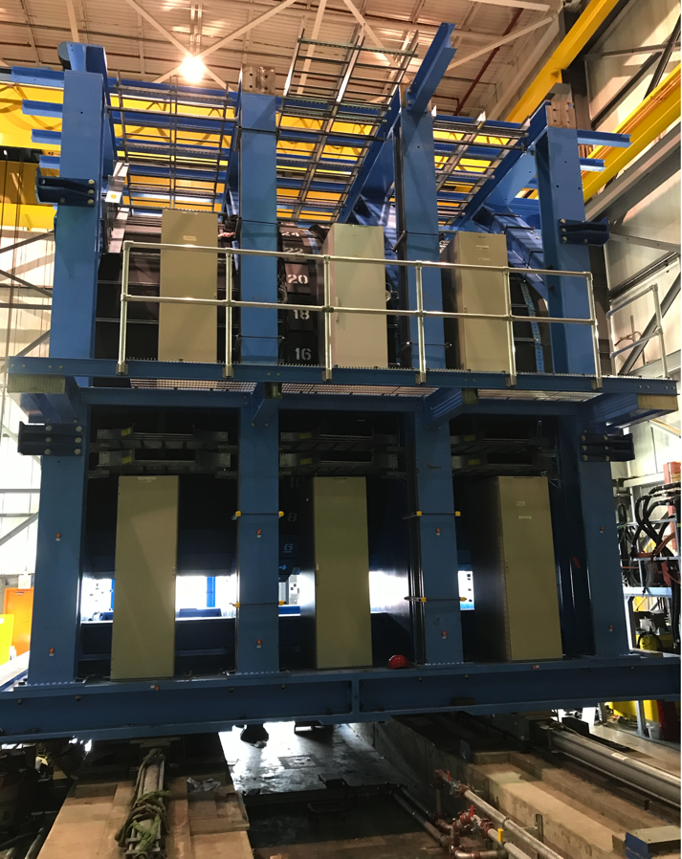
Infrastructure and Facility Progress
East side of Carriage w/ mid-level platform
Carriage w/ Valve Box coupling and Pole Tip brackets
West side of Carriage w/ Racks installed

Slide 4
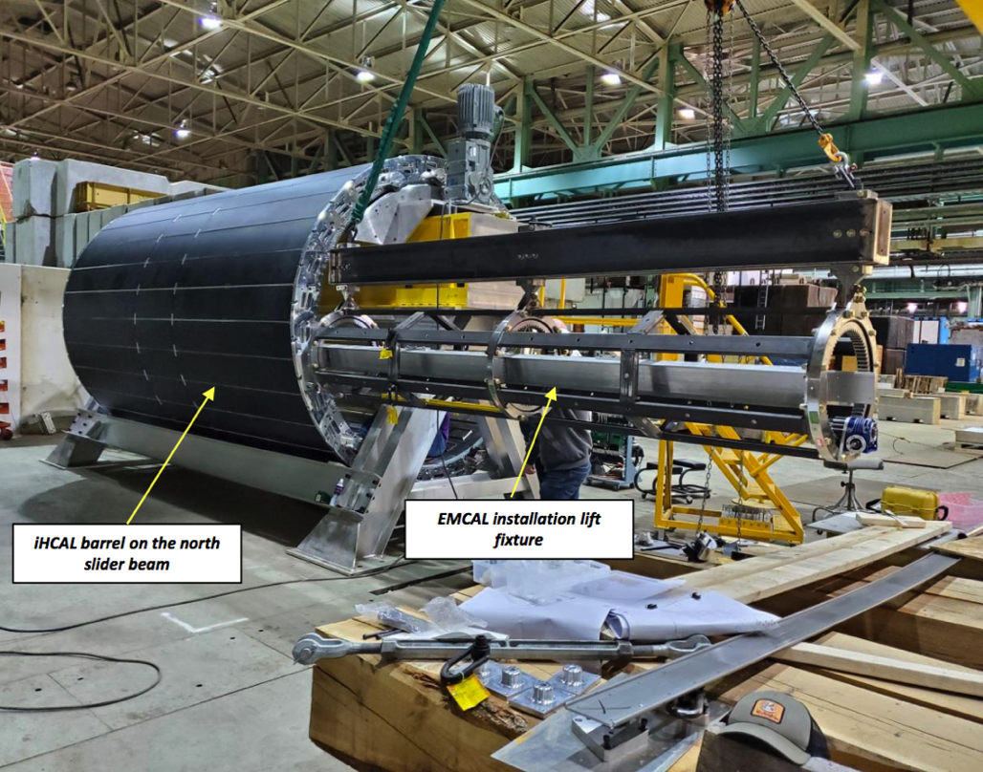
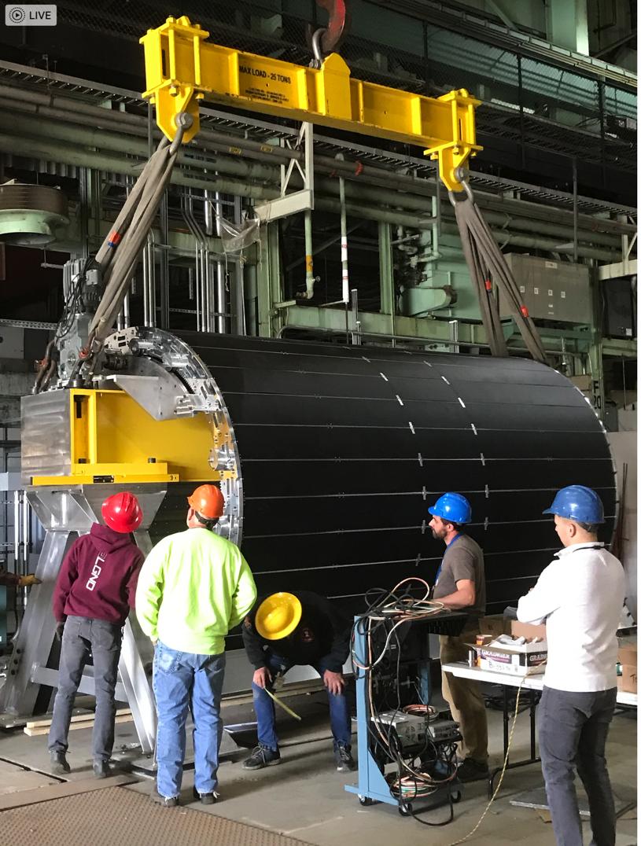
I&F Status - continued
Test installation of EMCal Sectors into IHCal Barrel
Test lift of IHCal with intended lifting equipment . Ready for IHCal install before end of May
Begun practicing the EMCal sector installation into the IHCal barrel. Method looks good. Prepping for lifting fixture load test this week.

Slide 5
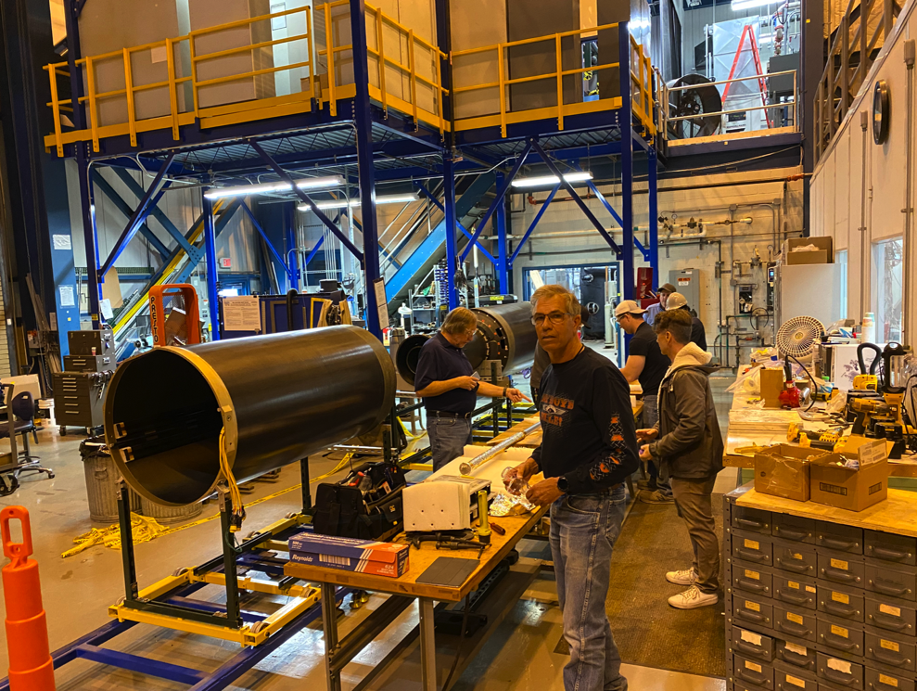
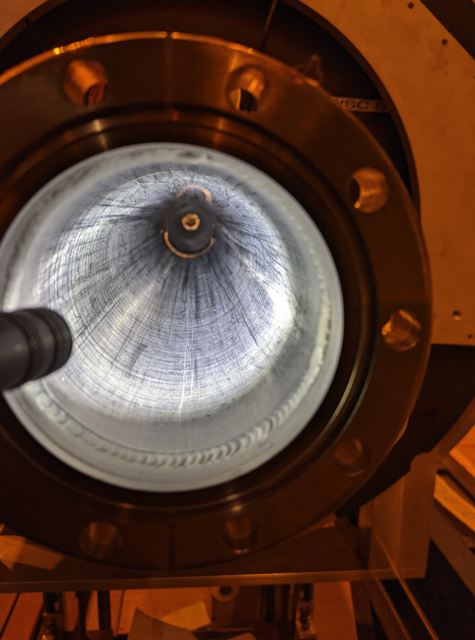
STAR Beam Pipe to sPHENIX
STAR and CAD have successfully extracted the STAR HFT beam Pipe from storage and delivered it to the CAD Vacuum group
The inside of the HFT Beam Pipe was scoped, and passed inspection
STAR + CAD team in 1006 Assembly Hall
Beam pipe NEG coating inspected. It looks good.

Slide 6
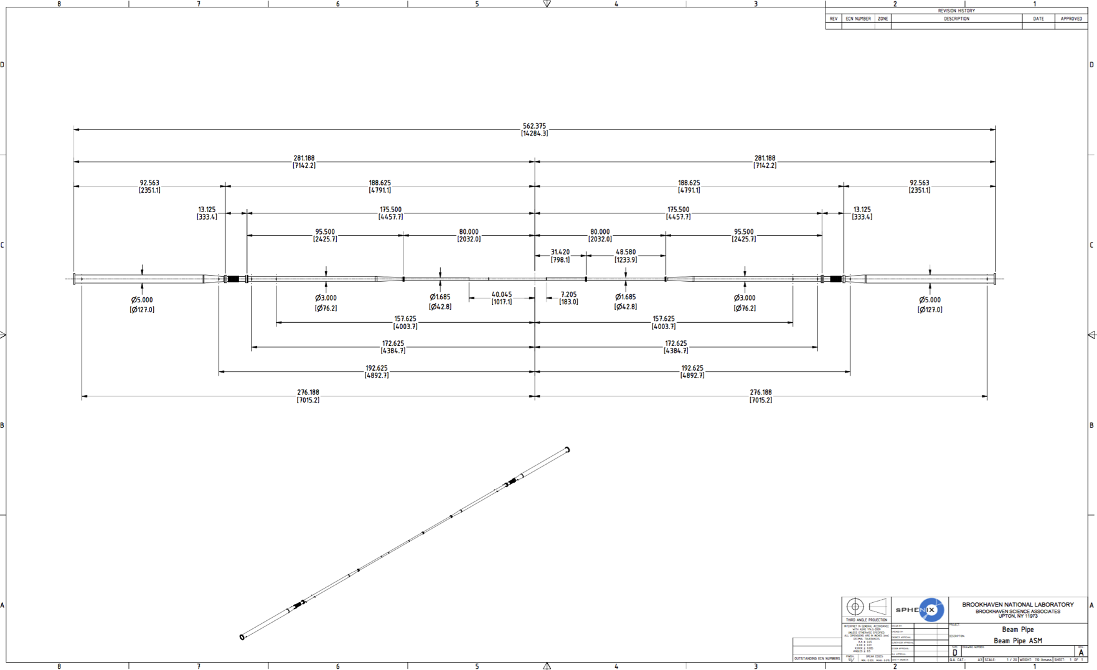
Design of Interface Beam Pipes for sPHENIX
Aluminum transition beam pipes being designed by Sumanta Nayak

Slide 7
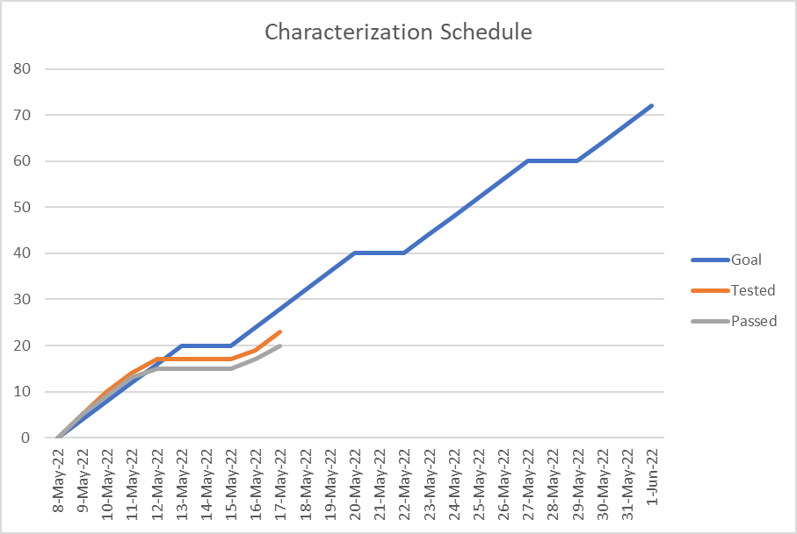
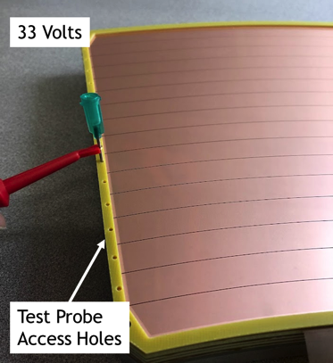
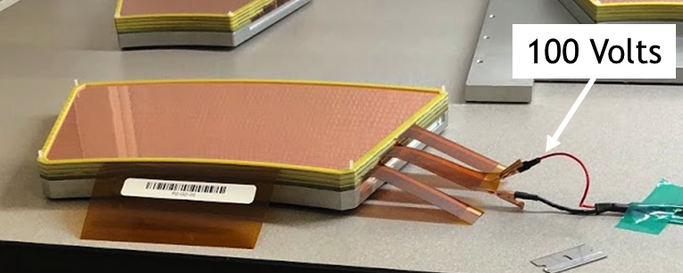
TPC Tests and Characterization
Test | Status
GEM HV Contacts (68/ mod) | Complete
GEM Over Voltage Stress | Complete
Gain Map | 23/72 tested 21/72 passed
IBF Map | 23/72 tested 22/72 passed
Radiation Load | 23/72 tested 23/72 passed
NOTE:
Both gain map failures occurred while struggling with IBF HV issue.
Retest is warranted.
Progress | Goal | Actual
10% | May 10 | May 10
50% | May 19
100% | June 1
Over Voltage Stress
Technical Delay May 12/13:
Standing current on IBF mesh
Cause determined on May 16
SHV tail inside gas holds less voltage than when in air.
Repaired.
Rate 5/day reasonable.
Use weekends to recoup schedule
HV Contact
535 Volts

Slide 8
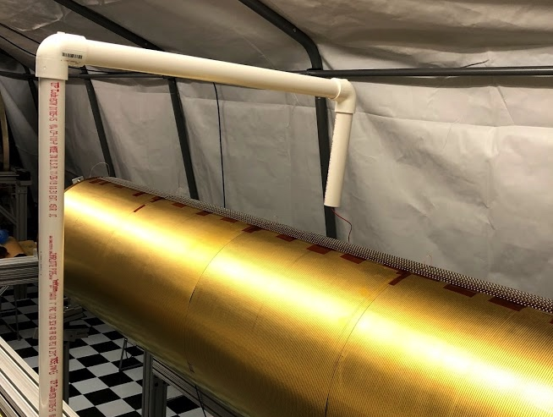
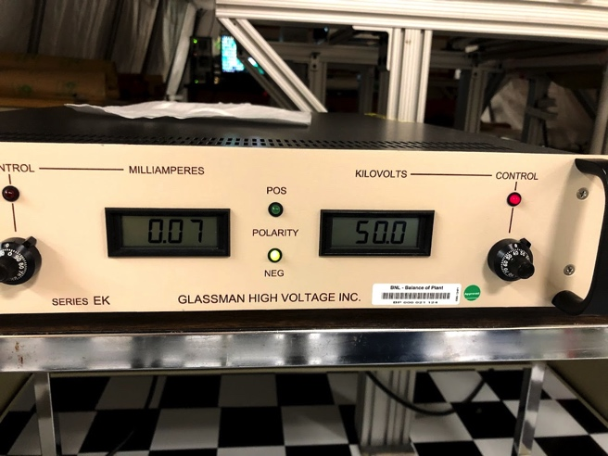
Field Cage Testing
Initial testing can be done in air:
Inner field cage has HV on the outside (in air) and ground on the inside (against mandrel).
Tested in air to 50 kV…passed
Outer field cage has HV on the inside (against mandrel) and ground on the outside (in air)
Must be removed from mandrel for air tests.
Pending.
Final tests are when TPC is fully assembled and under gas flow at SBU (August)

Slide 9
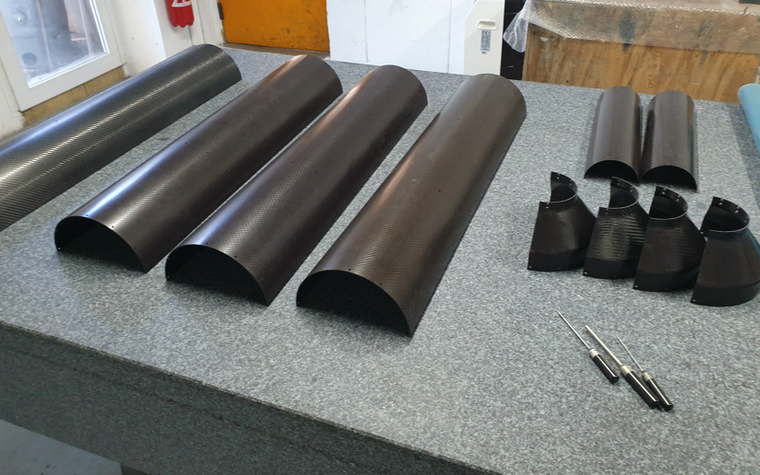
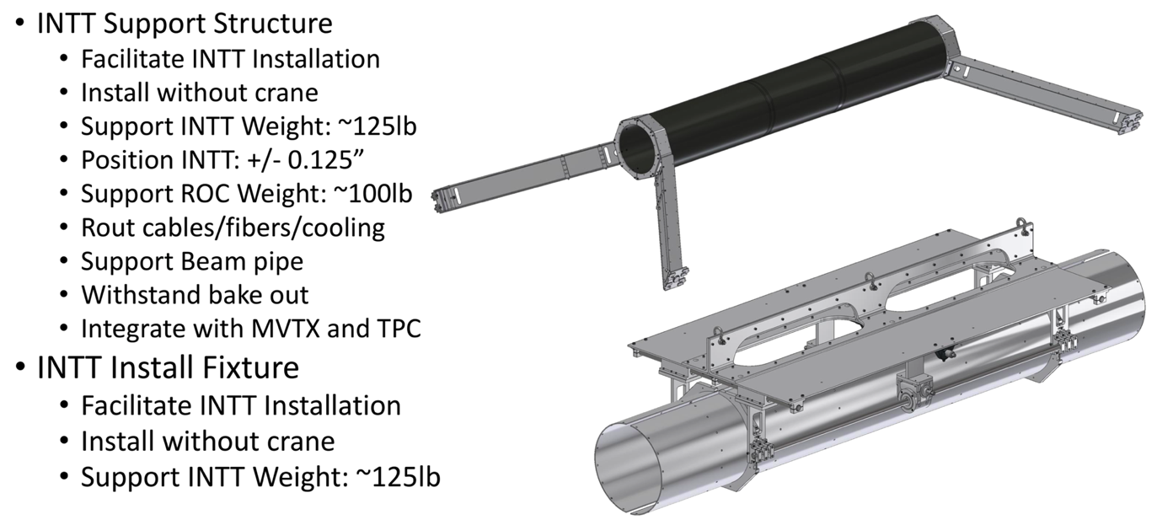
INTT Support Structure and Installation Fixture
All INTT staves complete and pass performance tests.
CF parts manufactured and at BNL
Aluminum support structure and installation fixture being made at vendor
Will begin half barrel assembly in June. On schedule.

Slide 10
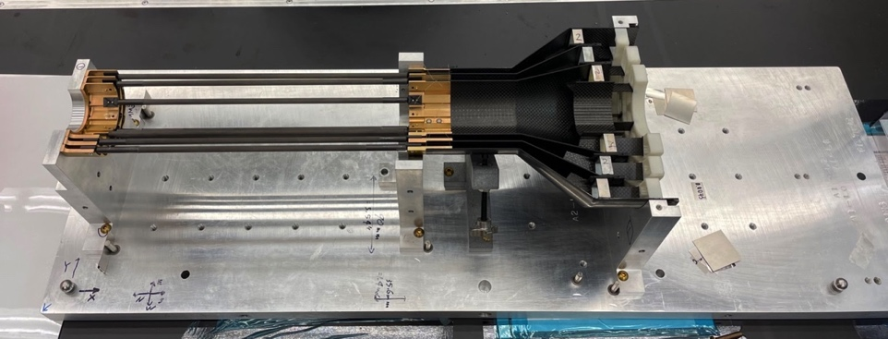
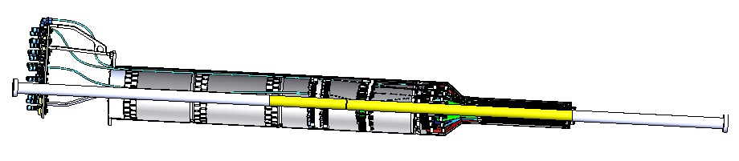
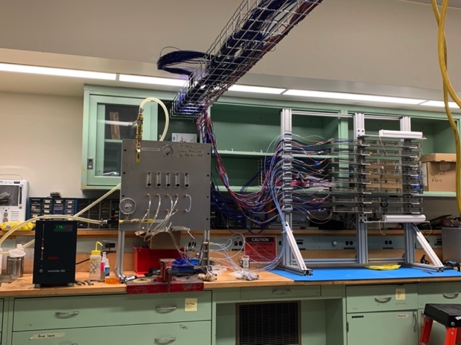
MVTX Status and Plan
MVTX assembly in progress at LBNL
MVTX assembly at LBNL
Updated assembly procedure
new EW/CFC gluing procedure tested
1 more MOSAIC adaptor from CERN for 2nd MOSAIC
Complete 2 half detector assembly by ~mid of June
Half barrels start to arrive at BNL from LBNL mid-June
Cooling system integration test by end of May
Stave cooling system almost done at MIT
Heat load test in progress
Electronics rack cooling system test at LANL in progress
90um filters
Remove flow switches
Ship to BNL for system commissioning in ~June 2022
Readout and control integration
8-stave telescope to setup at BNLL
As initial readout/control system integration
LANL, LBNL sending hardware to BNL: cables, staves etc.
Try to complete full electrical system setup at BNL in ~ late June
Commissioning at BNL
@510 setup in progress at BNL
One MOSAIC system ready ~end of May
Detector QC available for commissioning in June 2022
Full insertion test at BNL late summer
@1008: Full detector pre-installation commissioning Aug – Dec. 2022
MVTX with the new STAR HFT beam pipe
8-stave full readout and
control chain test @LANL

Slide 11
sPHENIX PEMP Notable for 2022
Notable Outcome - BHSO/SC: Effectively plan, execute, and successfully deliver SC projects equal to or less than $50 million that have been delegated to the Laboratory Director by SC under DOE O 413.3B [Super Pioneering High Energy Nuclear Interaction (sPHENIX)]. Clearly demonstrate successful accomplishment of key milestones in FY 2022 (adjusted for schedule impacts created by the COVID-19 pandemic) in accordance with SC guidance. (Objective 7.2)
PEMP notable associated with the sPHENIX MIE L2 completion
IHCal mechanical sectors complete - Jan 1, 2022 ✔ Completed ahead of schedule
EMCal sectors complete - May 15, 2022 ✔ Completed ahead of schedule
DAQ/Trigger GL1/GTM production complete - June 1, 2022 ✔ Completed ahead of schedule
Calorimeter electronics complete - July 1, 2022
The final sPHENIX milestone related to the 2022 PEMP notable remains on schedule

Slide 12
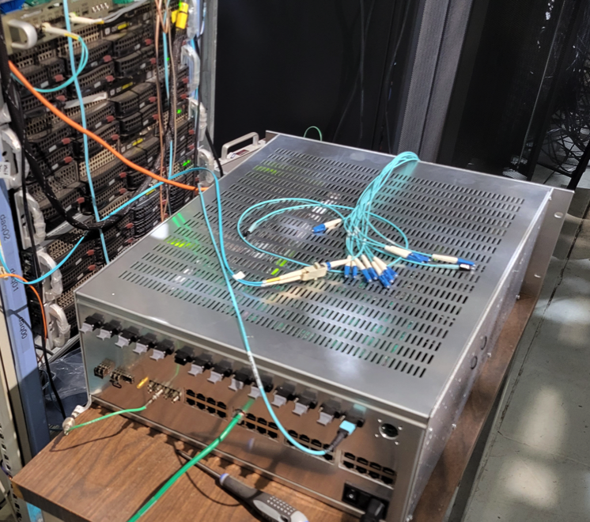
Electronics Status
All on-detector calorimeter electronics delivered and tested
95% of calorimeter digitizers assembled. Testing underway.
All LV and Bias supplies delivered
All FELIX cards for MVTX, TPC, INTT delivered. Firmware development underway.
All TPC Fee boards assembled, however need a PLL chip added and a couple small mods by vendor. Need testing
GL1/GTM built. Testing underway.
All cables (signal, LV, control), fibers, patch panels at BNL or on order and coming in on schedule.
Parts for LL1 available. Need assembly and testing
Missing long lead parts for 16 MBD D/S boards
Missing FPGAs for 6 DCMIIs (DAQ Data Collection Modules)
DAQ: GL1/GTM
GL1/GTM in 1008

Slide 13
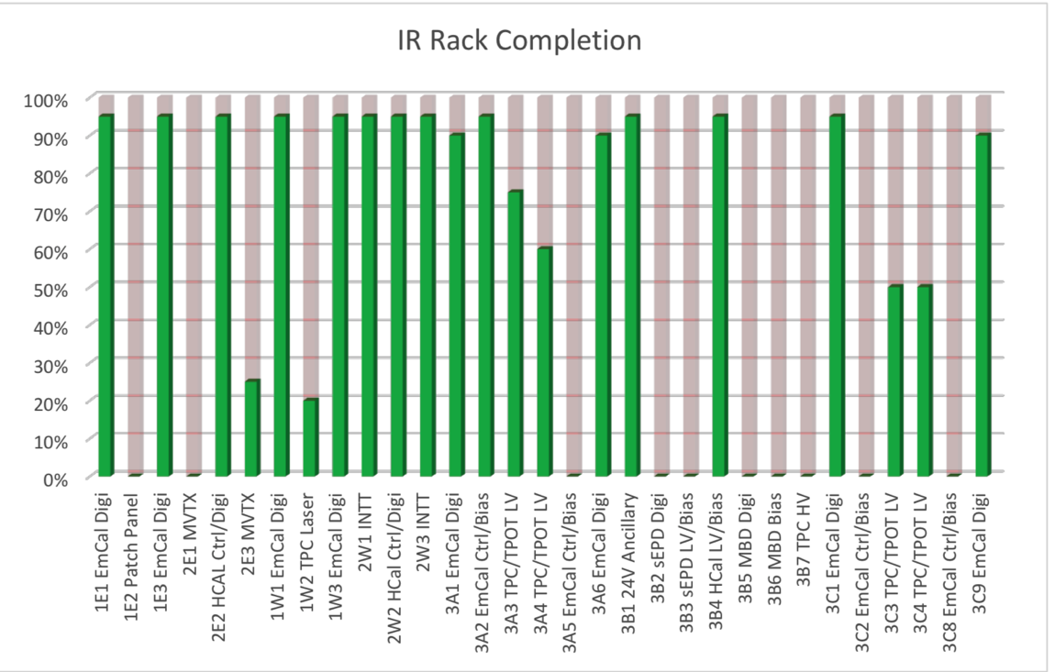
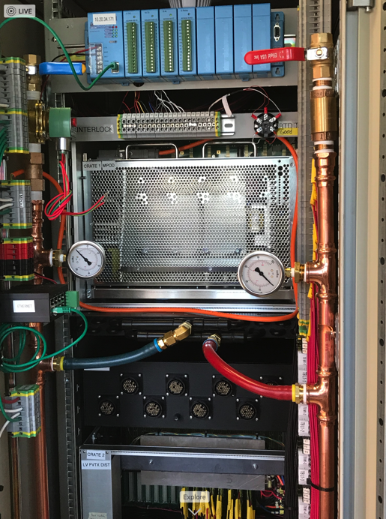
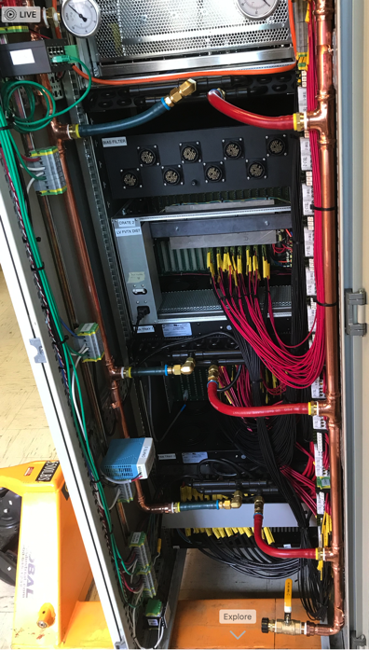
Rack Production Update
Rack plumbing has begun
First 6 Racks installed on carriage.
Need 31 carriage racks total

Slide 14
Risks and Challenges
Maintaining labor force for the next 10 months. Especially important are:
Technicians for fab and assembly and installation
Visiting students, postdocs and scientists for QA, testing and commissioning.
We have been successful in borrowing techs from other parts of BNL.
Global issues may affect the cost and schedule of the project going forward
Significant cost increases have been seen on certain raw material and machine shop work potentially impacting the 1008 I&F remaining costs.
Some items, like electronic chips, have very long lead times. Primarily an MIE issue.
Need BHSO USI approval for Magnet Mapping in Sept-Oct. Need BHSO ASE/SAD approval for sPHENIX Operations in RHIC Run-23 beginning Feb 2023.

Slide 15
Summary
sPHENIX installation is proceeding well.
The OHCal sectors installation is complete. SC- Magnet installation is complete.
Platform assembly is ongoing
IHCal Barrel and EMCal sectors are ready to install.
Magnet pole tips are preparing to install after IHCal
Cryo installation and magnet mapping is on the critical path
Most major 1008 I&F parts are complete or in fab
We have a small but important subset of I&F orders to place including: Magnet mapping contract w/CERN, MBD/sEPD/beampipe bracketry.
Remaining engineering design is nearly done. Transitioning to fab/assembly oversight, installation and integration.
Price increases in raw materials are impacting our remaining budget.
We have been successful in securing technicians and engineers from other parts of BNL: CAD, IO, SMD, NSLSII
Need to maintain this level of technical support until the start of RHIC run 2023.
sPHENIX Collaborators continue to make critical contributions in the factories and home institutions.
We continue to do monthly EV statusing , schedule and hold reviews for safety, final design and procurement readiness

Slide 16
Back Up

Slide 17
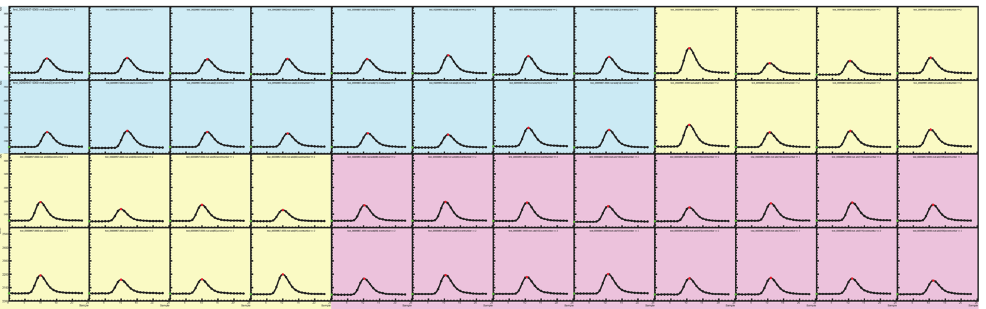
System | Demonstration or Measurement | Threshold KKP’s | Objective KPP’s
Hadronic Calorimeter | Preinstall, Bench tests | ≥ 90% live channels based on LED, cosmics | ≥ 95% live channels based on LED, cosmics
All towers in all sectors were verified with electronics test pulse, LED test pulse, and cosmic rays at assembly.
In addition, all towers in all sectors were verified using an LED test pulse after barrel assembly in 1008.
As of 5/17/2022 all oHCAL towers are fully functional – the oHCAL has 100% live towers.
All sector test data is archived at: https://sphenix-intra.sdcc.bnl.gov/WWW/subsystem/hcal/test/sector/
As an example, below is the LED test data for Sector 12:
ADC (Ped. Subtracted)
Time Sample

Slide 18
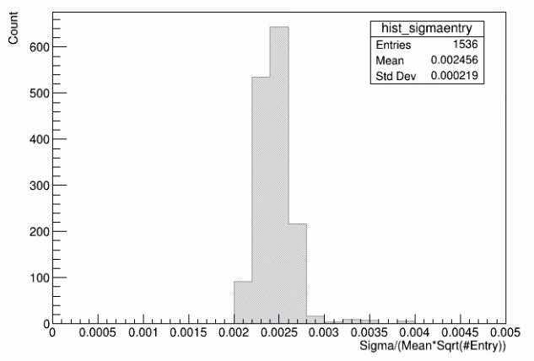
System | Demonstration or Measurement | Threshold KKP’s | Objective KPP’s
Hadronic Calorimeter | Preinstall, Bench tests | Each sector w/ an absolute energy precalibration of ≤ 20% RMS | Same
All towers are precalibrated initially using the Landau peak in cosmic ray data. The location of this peak is used to normalize the gains between the towers and fix the initial absolute energy scale. The accuracy of this precalibration is determined by how well we know the location of the Landau peak.
We estimate this by plotting the ratio of the error on the mean to the mean for every HCAL tower. This ratio is less than a percent for all towers, indicating we have achieved the threshold and objective KPP of <20%.

Slide 19
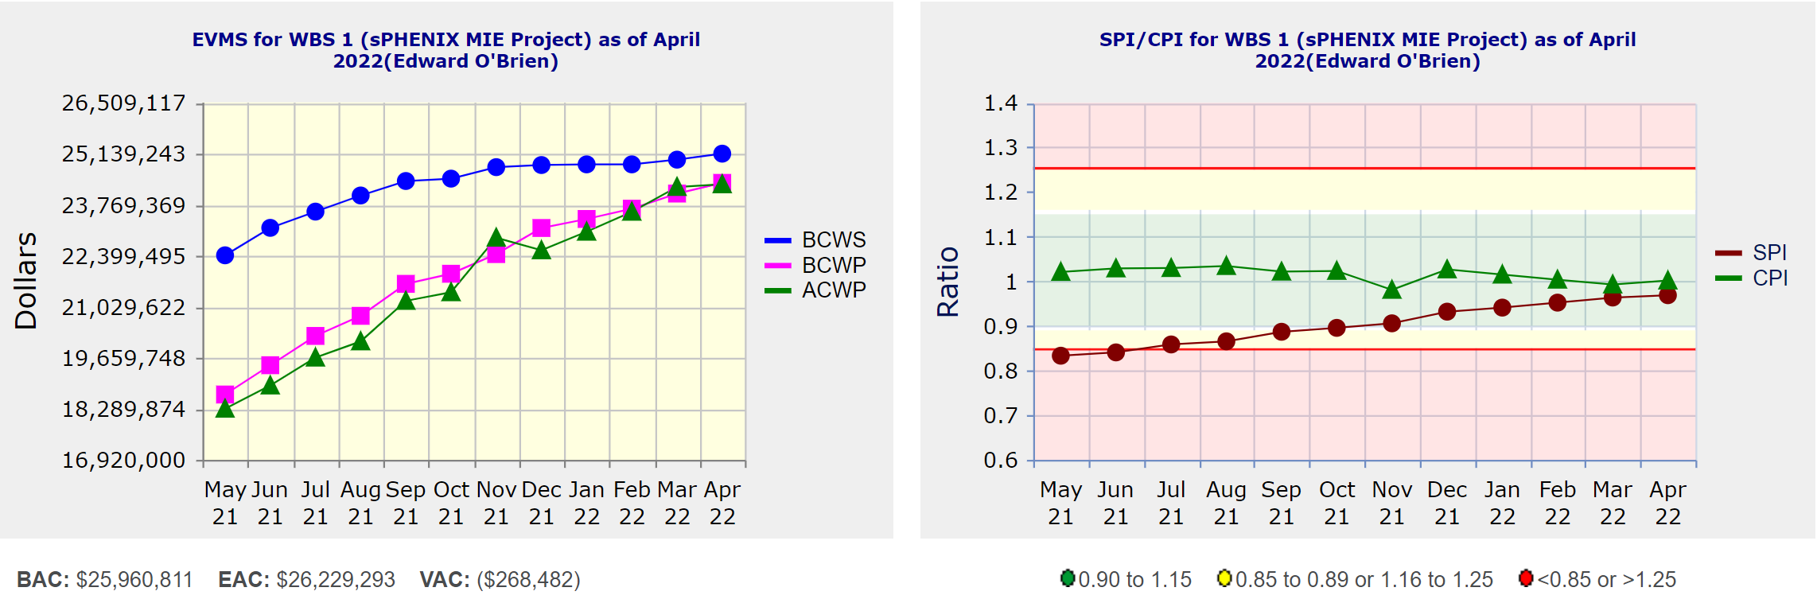
Performance Indices – sPHENIX MIE
Cumulative SPI | Cumulative CPI
0.97 | 1.00
Cumulative BCWS (Scheduled) | $25,141,297
Cumulative BCWP (Performed) | $24,356,468
Cumulative ACWP (Actual) | $24,317,916
DOE SPI or CPI Value Thresholds
0.90 to 1.15
0.85 to 0.89 or 1.16 to 1.25
<0.85 or >1.25

Slide 20
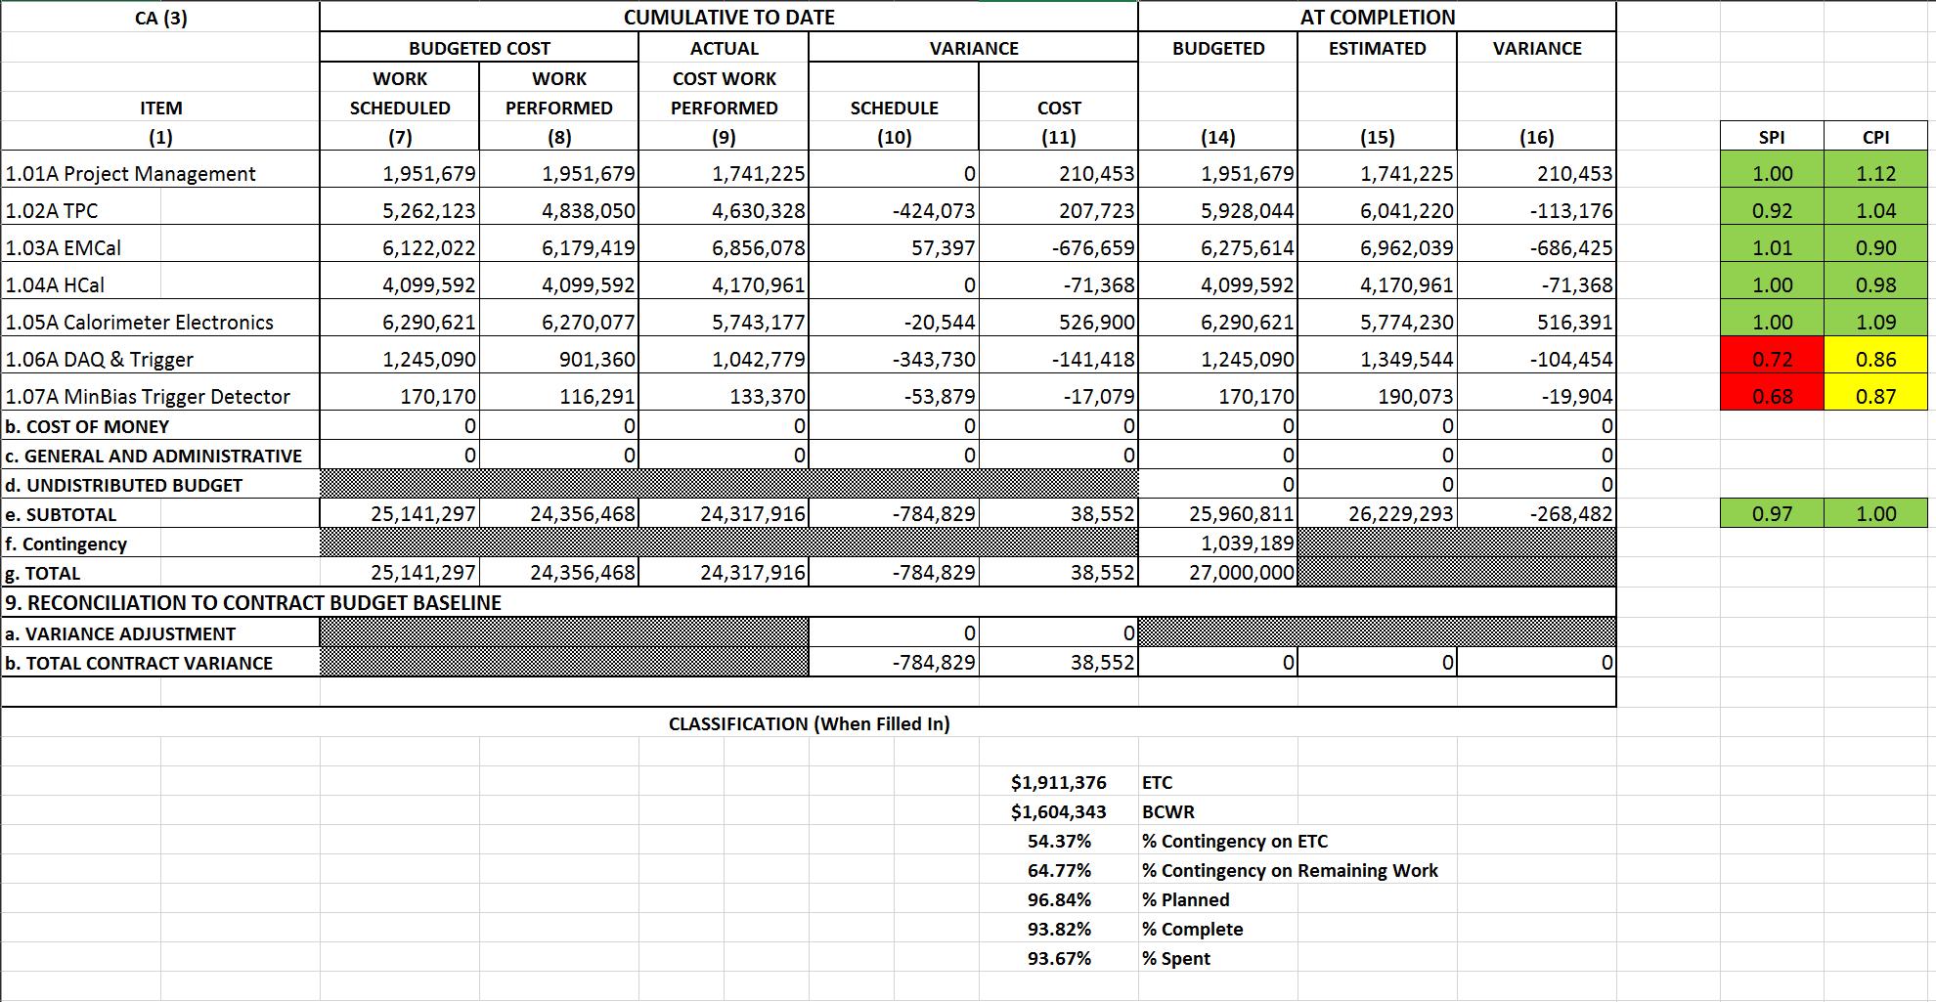
Cost Performance Report (CPR) – sPHENIX MIE
DOE SPI or CPI Value Thresholds
0.90 to 1.15
0.85 to 0.89 or 1.16 to 1.25
<0.85 or >1.25
*Highlights in table above takes variance $ into consideration, not just Indices

Slide 21
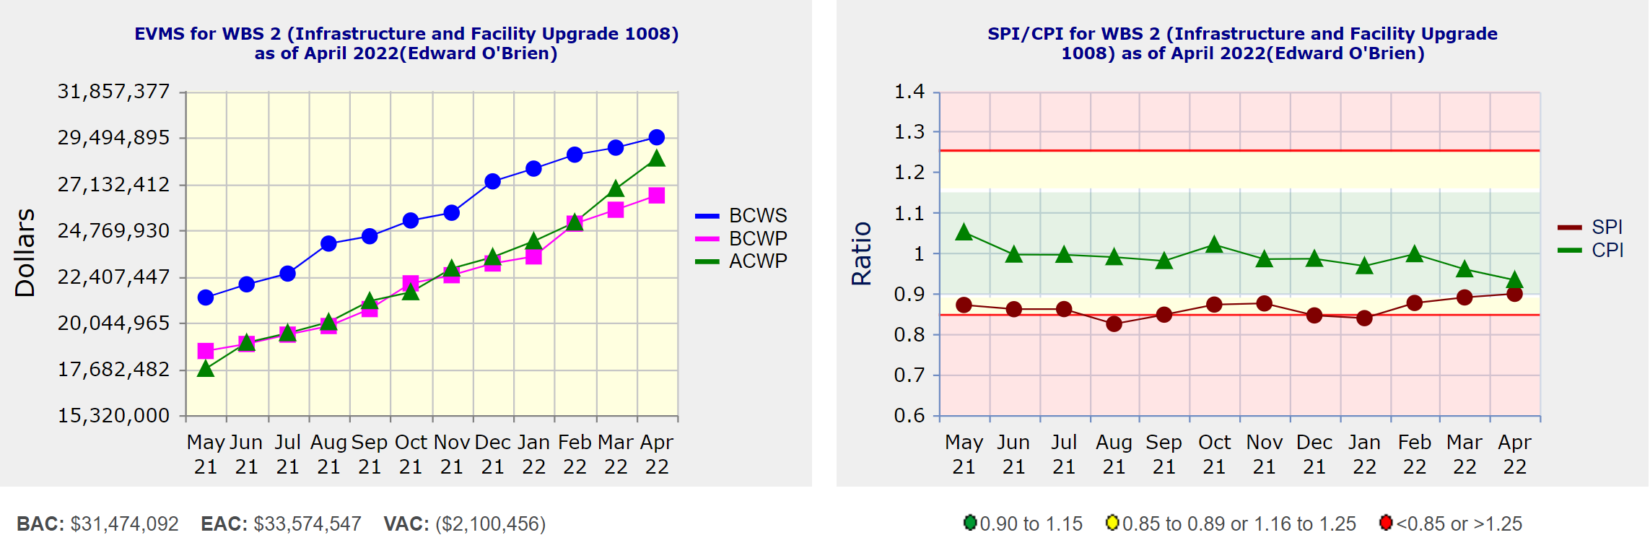
Performance Indices – 1008 Infra and Facility Upgrade
Cumulative SPI | Cumulative CPI
0.90 | 0.93
Cumulative BCWS (Scheduled) | $29,498,526
Cumulative BCWP (Performed) | $26,533,305
Cumulative ACWP (Actual) | $28,418,503
DOE SPI or CPI Value Thresholds
0.90 to 1.15
0.85 to 0.89 or 1.16 to 1.25
<0.85 or >1.25

Slide 22
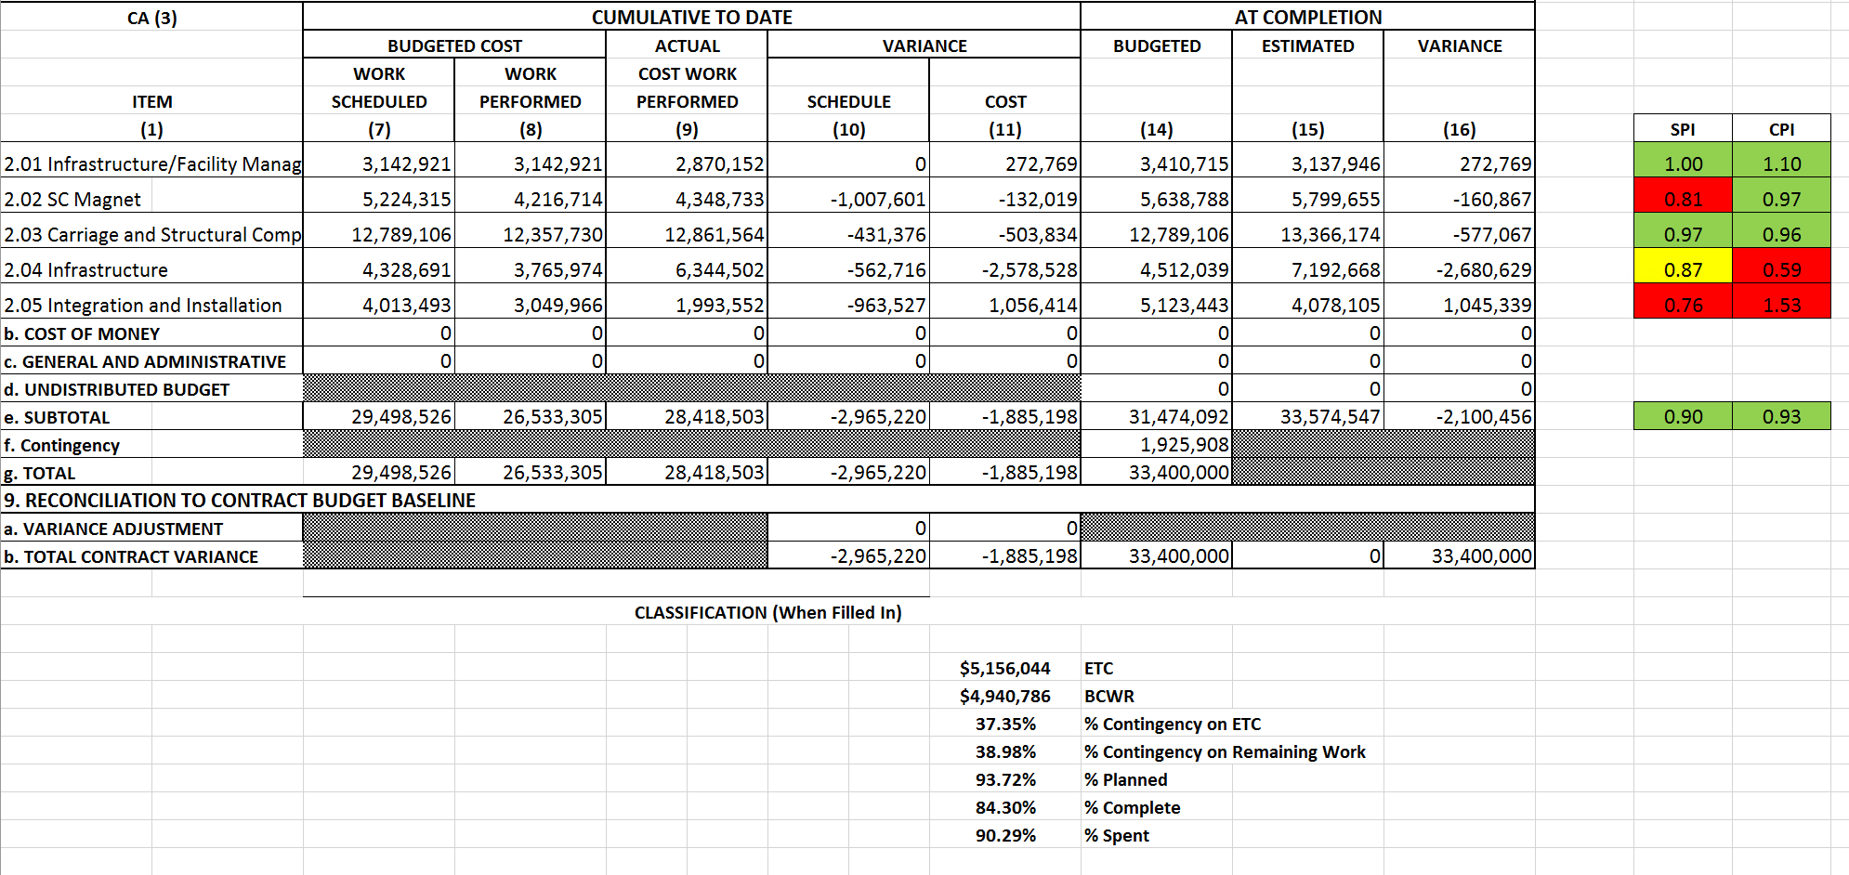
Cost Performance Report (CPR) – 1008 Infra and Facility Upgrade
DOE SPI or CPI Value Thresholds
0.90 to 1.15
0.85 to 0.89 or 1.16 to 1.25
<0.85 or >1.25
*Highlights in table above takes variance $ into consideration, not just Indices

Slide 23
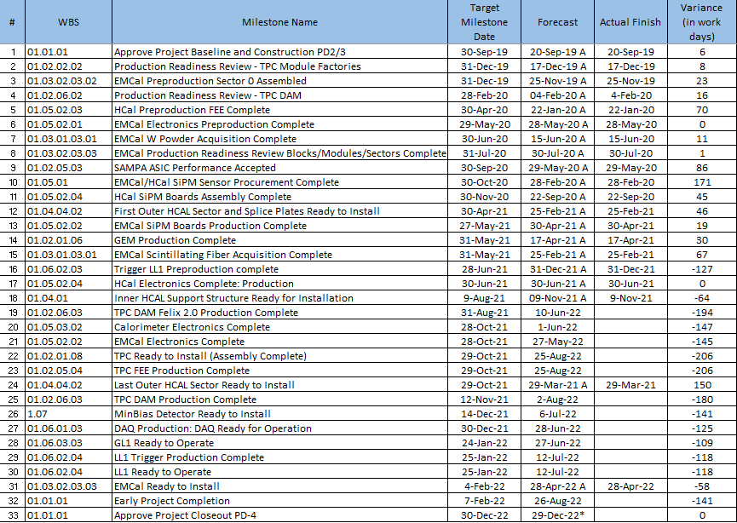
Milestones Status – sPHENIX MIE

Slide 24
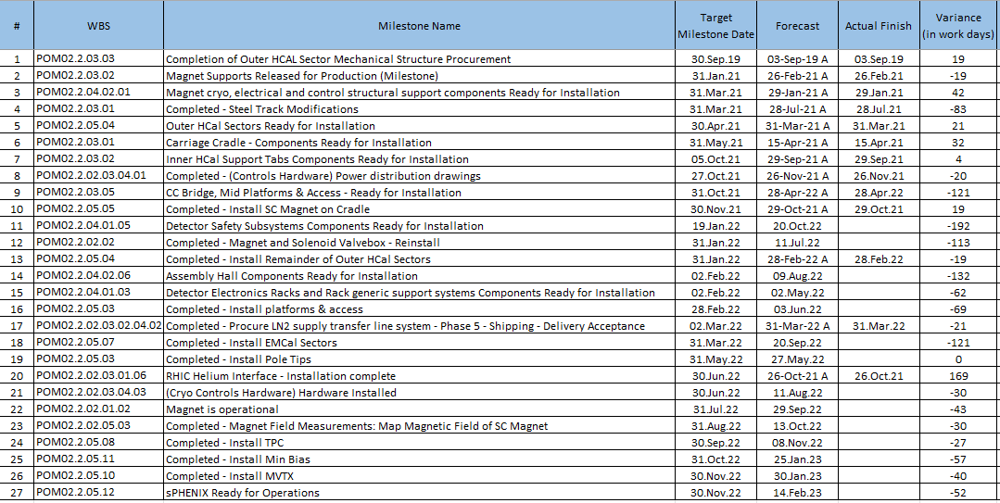
Milestones Status – 1008 Infra and Facility Upgrade

Slide 25
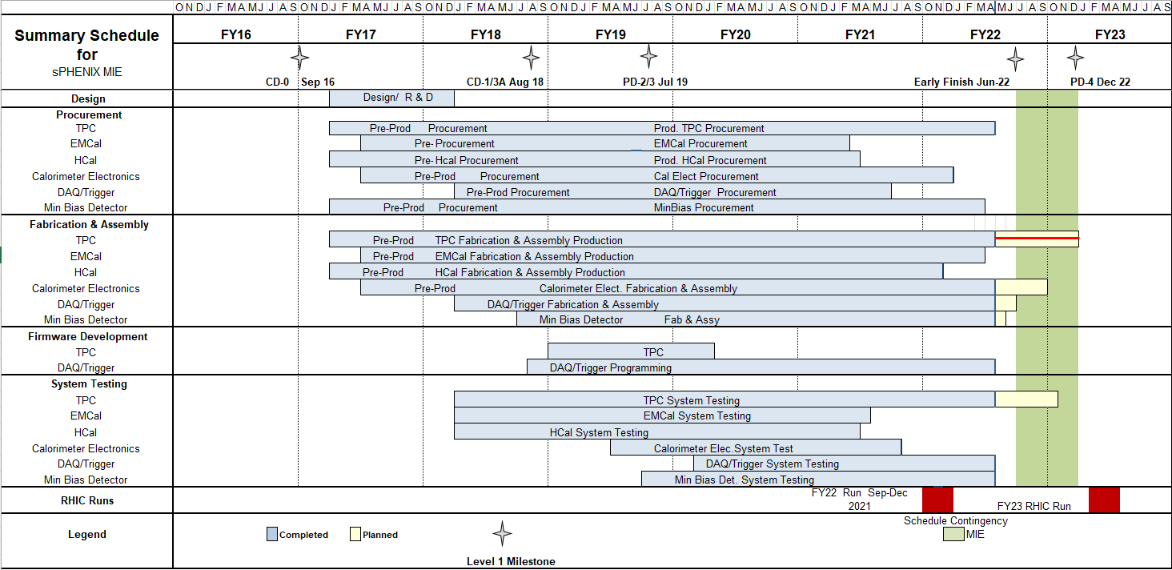
Summary Schedule – sPHENIX MIE

Slide 26
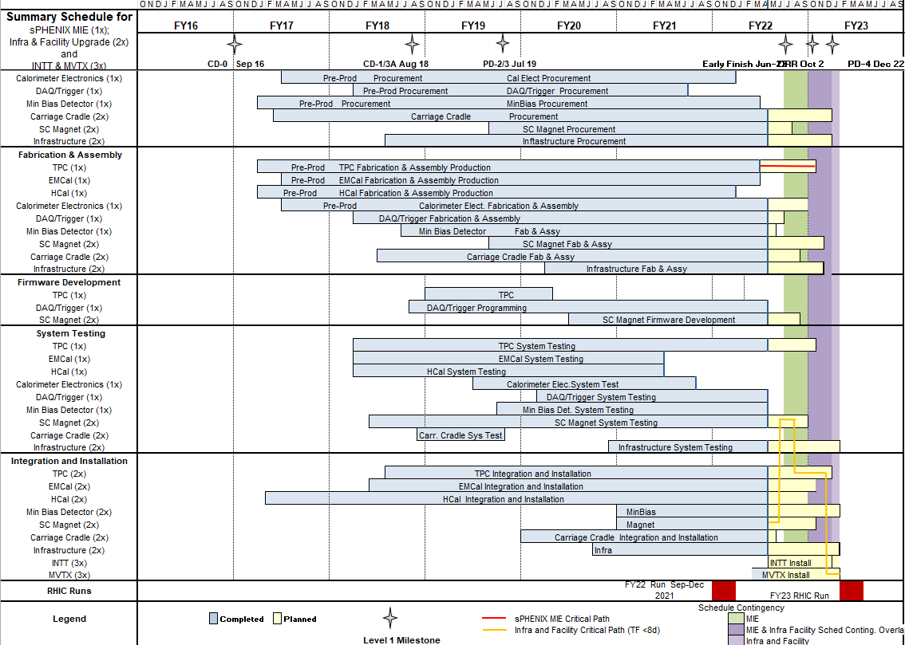
Summary Schedule – sPHENIX MIE and 1008 Infra and Facility Upgrade

Slide 27
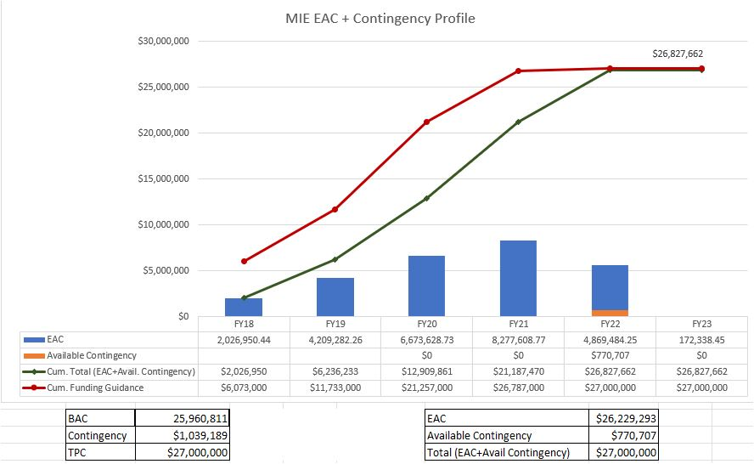
EAC and Contingency Profile – sPHENIX MIE

Slide 28
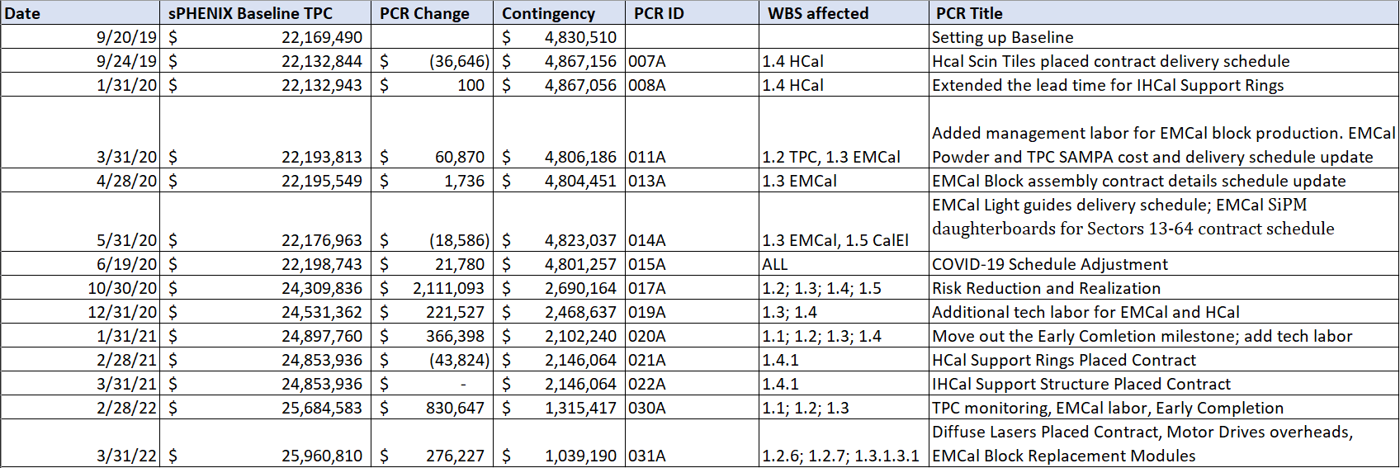
Baseline/Contingency Log and ETC adjustment Log - MIE
ETC Adjustments
Control Account | Aug’21 | Sep’21 | Oct’21 | Nov’21 | Dec’21 | Jan’22 | Feb’22 | Mar’22 | Apr’22
1.02 | 326,377 | 556,377 | 716,238 | 725,089 | 722,064 | 703,567 | 244,065 | 228,272 | 250,324
1.03 |  |  |  | 34,439 | 18,420 | 17,328 | 67,559 | 9,776 | 9,766
1.05 | $22,833 | $22,833 | 219,343 | 414,468 | 250,807 | -6,101 | 87,313 | 11,509 | 10,098
1.06 | $79,352 | $79,352 | $26,259 | -62,490 | -63,278 | -63,278 | -45,001 | -45,001 | -43,839
1.07 | $25,705 | $25,705 | $16,041 | 16,575 | 8,731 | 8,731 | -7,013 | -1,748 | -1,747
Total | 454,267 | 684,267 | 977,880 | 1,128,081 | 936,744 | 660,247 | 346,923 | 202,798 | 224,602

Slide 29
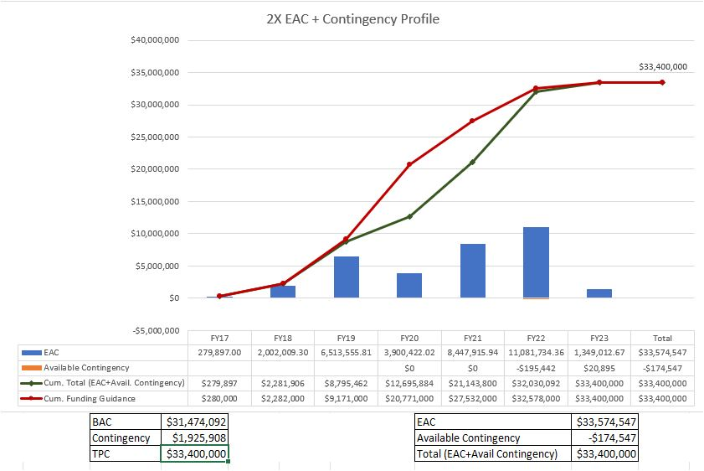
EAC and Contingency Profile – 1008 Infra and Facility Upgrade

Slide 30
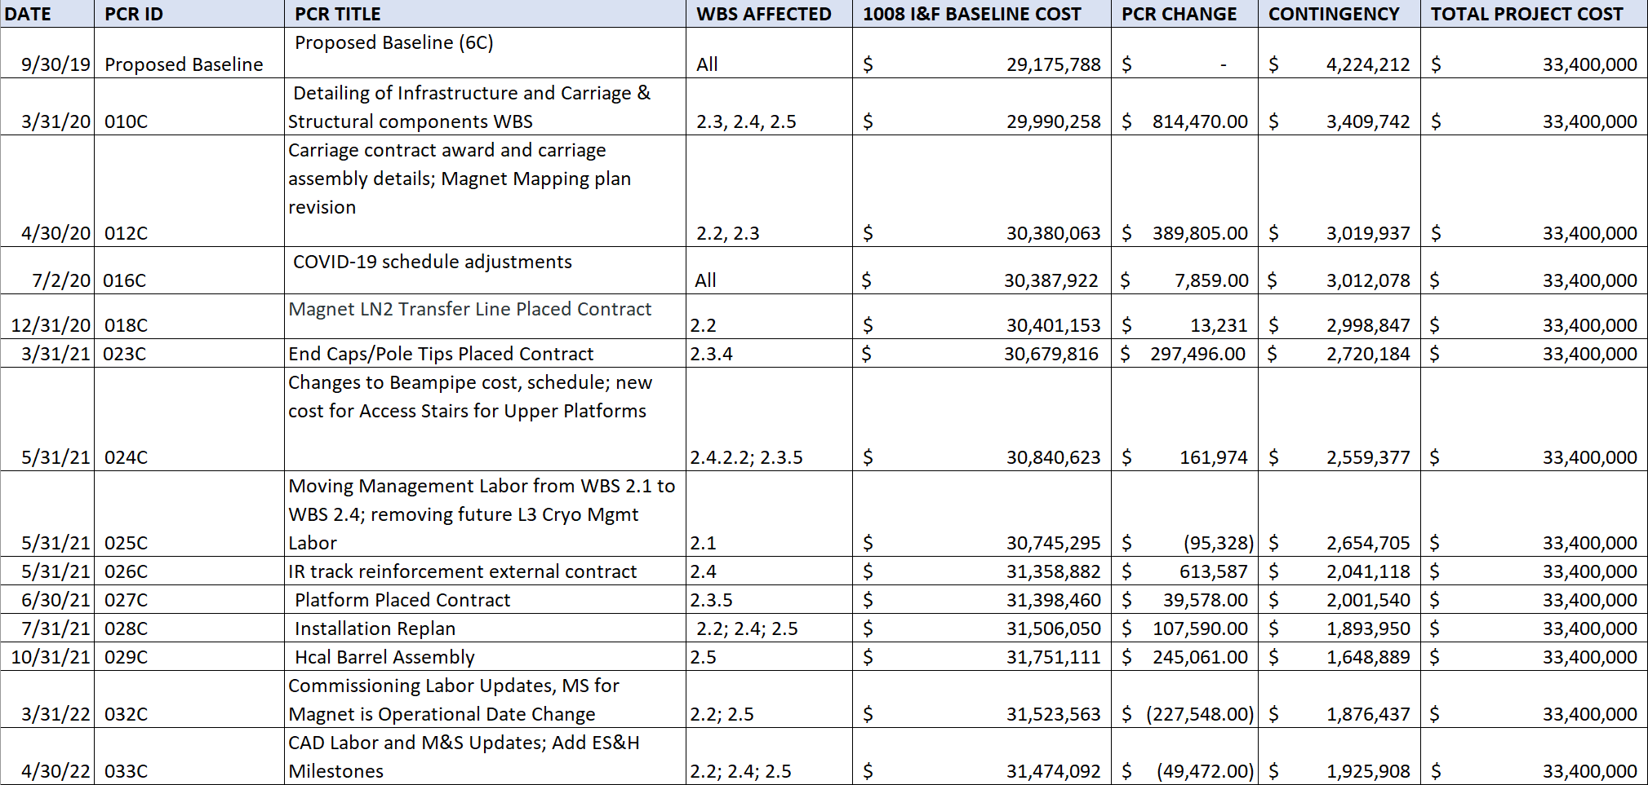
Baseline/Contingency Log and ETC adjustment Log – 2.X
ETC Adjustments
Control Account | Sep’21 | Oct’21 | Nov’21 | Dec’21 | Jan’22 | Feb’22 | Mar’22 | Apr’22
2.2 | - | - | - | - | 20,551 | 14,635 | 8,407 | 15,713
2.3 | 90,775 | 70,349 | 125,472 | 102,957 | 117,533 | 102,161 | 138,461 | 57,622
2.4 | 70,160 | 350,388 | 152,069 | 69,283 | 23,810 | 296 | 52,663 | 92,478
2.5 | - | 73,413 | 63,117 | 161,496 | 208,816 | 136,000 | - | -
Total | 160,935 | 494,150 | 340,658 | 333,737 | 370,709 | 253,092 | 199,530 | 165,812

Slide 31
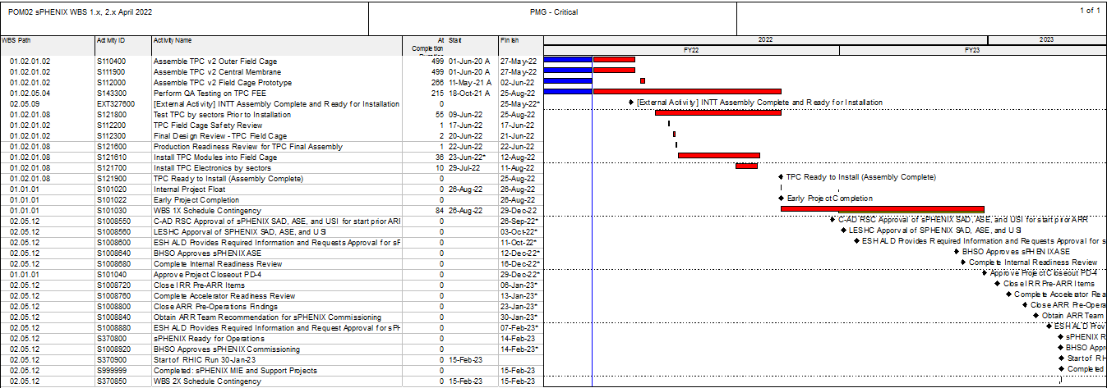
Critical Path (1x, 2x and 3x Combined)

