Slide 1
IRT Reconstruction algorithm and performance studies in ATHENA
Alexander Kiselev and Chandradoy Chatterjee

Slide 2
IRT library

Slide 3
Inverse Ray Tracing: concept
Originally implemented by HERMES Collaboration
Recent re-implementations by Alessio del Dotto (2D), Roberto (2D), Marco (3D), …
detection point
we want to know this angle (and nothing else!)
sensor plane
reflection point
?
emission point
θ
Cherenkov photon trajectory
mirror
charged particle trajectory
radiator

Slide 4
Inverse Ray Tracing: machinery
In case of a single (unknown!) reflection point the task is reduced to a 2D case, a quartic equation follows, can be solved iteratively (e.g. using the Newton method)
The math can be extended to a case with a second (flat!) mirror
For dRICH the refraction on aerogel boundary can be accounted in a more or less consistent way a posteriori
More complicated cases (tilted aerogel tiles, acrylic layer, 2-d spherical mirror) require generalization into 3D space
Some sort of bookkeeping is required when
a single charged particle produces Cherenkov photons detected in different sectors
a pair of [emission, detection] 3D points allows for more than one optical path (like in a dual mirror configuration)
Very important: GEANT geometry should be consistent with the optical setup!

Slide 5
Inverse Ray Tracing: implementation
Repository (as of Dec 15, 2021) : https://eicweb.phy.anl.gov/EIC/irt/-/tree/irt-init-v02
A compact C++ library
Can be used in a standalone GEANT code as well as in the ATHENA environment
Optical geometry ROOT class instance is created in the same code, which creates RICH detector (therefore simulation-vs-reconstruction consistency is guaranteed)
Persistency model: optical setup dump in ROOT format
Newton-Gauss iterative solver for optical path defined by arbitrary sequence of refractive and reflective surfaces in 3D (presently flat and spherical boundaries only)
Absorbtion length accounting (azimuthally-asymmetric shift of emission point)
Emission angle uncertainly calculation (it does depend on the azimuthal angle!)
A wrapper for sampling along the charged particle trajectory (magnetic field case, etc.)

Slide 6
Inverse Ray Tracing: application (standalone GEANT4)
+167cm
Barrel HCal
gap ~ 10cm
gap ~ 10cm
R ~ 230cm
140cm
Cryostat
Endcap HCal
spherical mirror#2 R = 2.9m
sensor plane(s)
θ = 25⁰
Barrel EmCal
recess for the tracker
DIRC
Endcap HCal
Endcap EmCal
spherical mirror#1 R = 2.8m
θ ~ 2-3⁰
aerogel @ 192cm
20-25cm of the
upgrade space
140cm
+350cm
IP
+190cm
+330cm

Slide 7
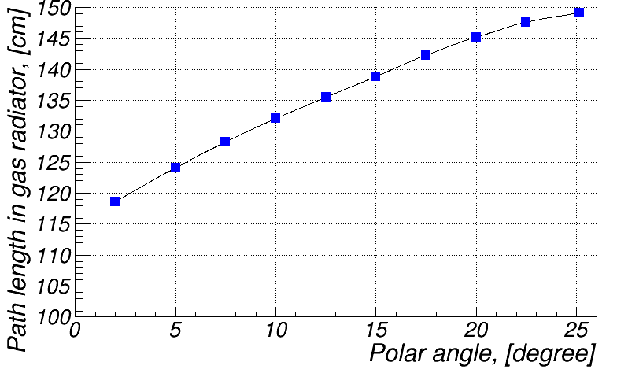
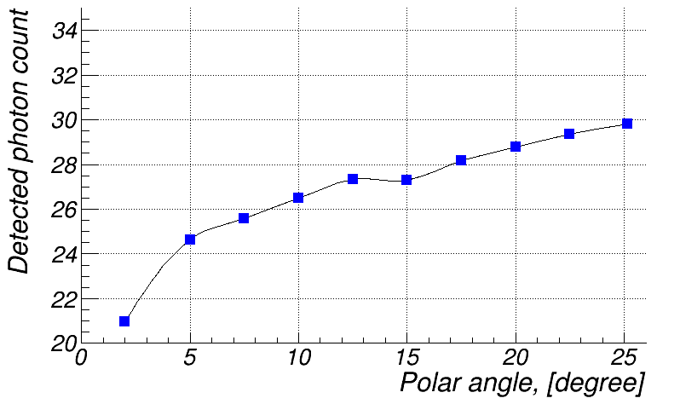
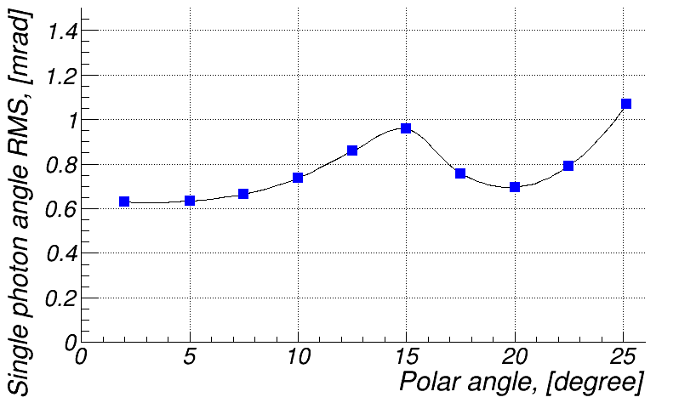
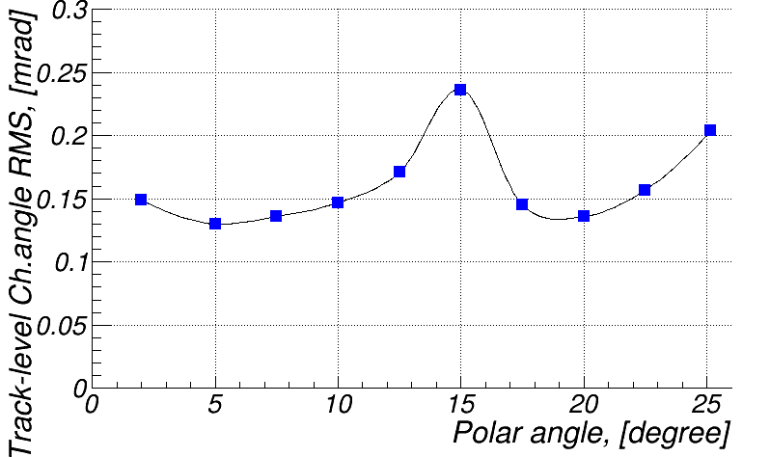
Inverse Ray Tracing: performance plots (C₂F₆, 50 GeV/c π⁺)
120 cm
Stand Alone Geant4
5σ @ 50 GeV/c
1 mrad
η = 4.0
η = 1.5

Slide 8
pfRICH

Slide 9
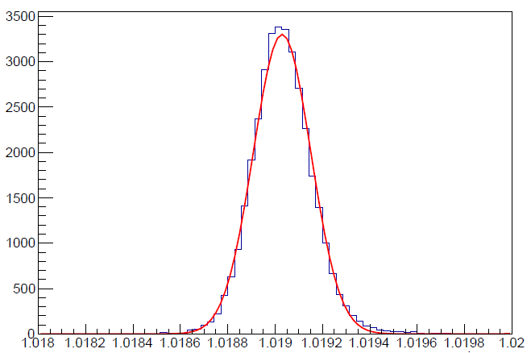
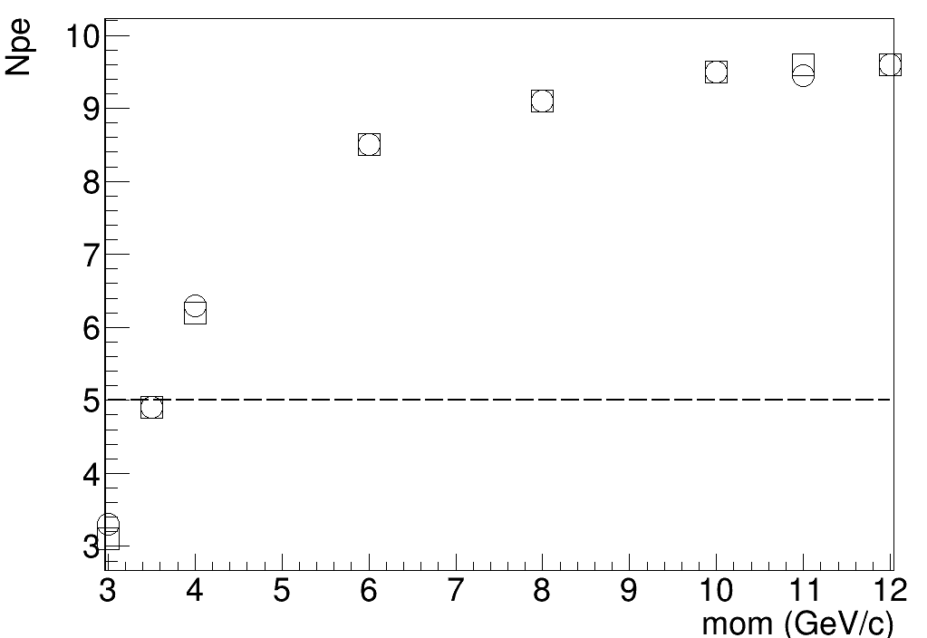
First Consistency Check → Validation of Rec. algorithm
Example pions at eta -1.7; open box exp. Open circle reconstructed
<n> ~ 1.019
N_theta /N_max = sin2(theta)/sin2(theta_max)
0.7 safety factor included
Npe_sat ~ 10
Refractive Index

Slide 10
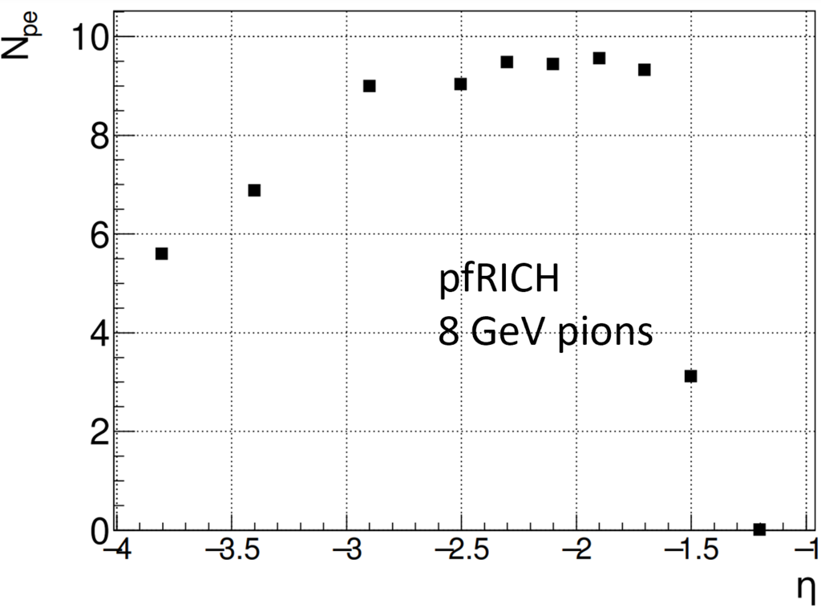
Npe are as expected from estimations.
Acceptance is consistant with YR requirements

Slide 11
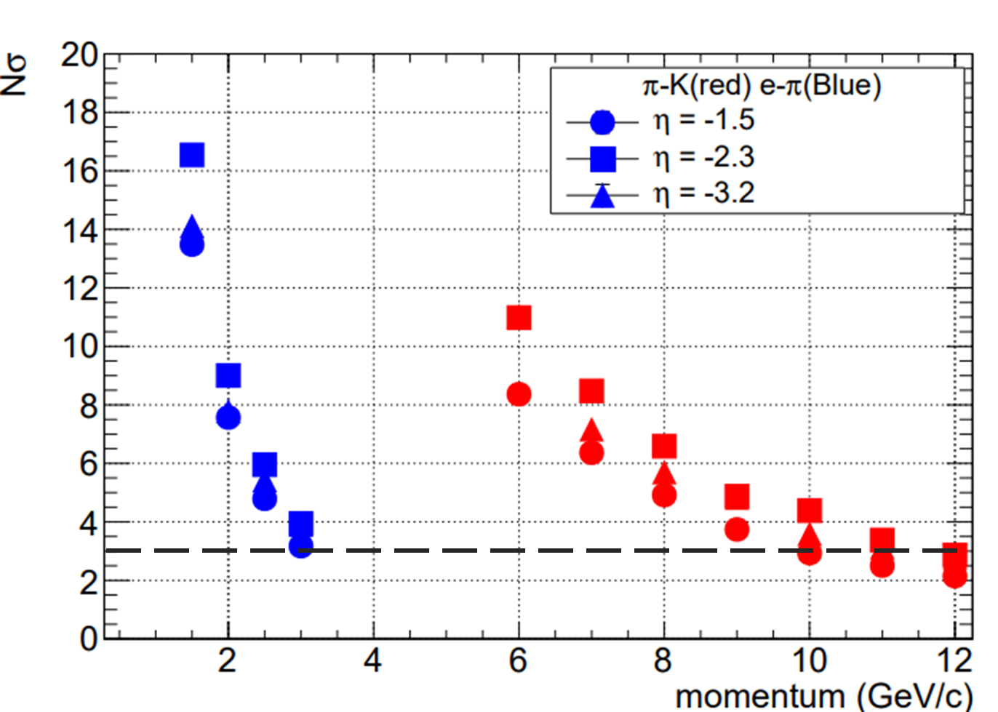
N Sigma Separation
Yellow Report requirement: hadron
PID in the electron-going endcap: better than 3σ π/K separation either
(1) to 7 GeV/c (pp. 21)
(2) up to 10 GeV/c [table 3.1]
We consider the later as a reference!
YR requirement achieveable

Slide 12
dRICH

Slide 13
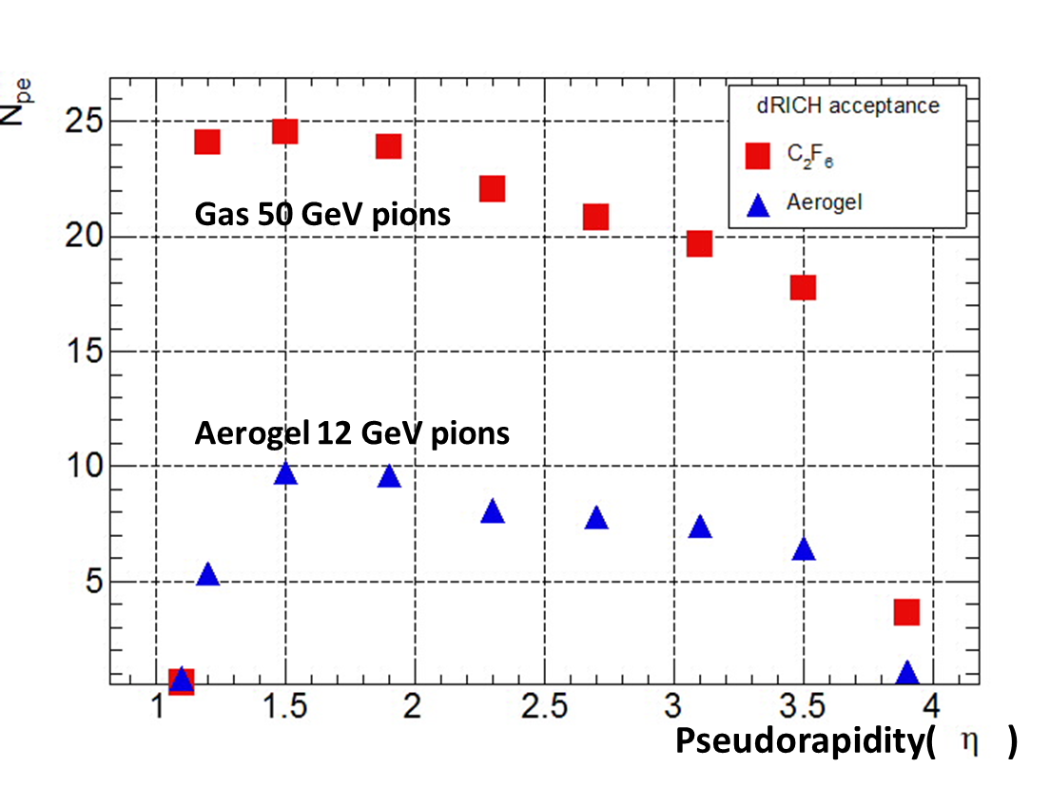
dRICH acceptance as a function of pseudorapidity
YR requirement:
acceptance for the dRICH is 1.0 ≤ η ≤ 3.5. These reference numbers were
taken as a guidance for the ATHENA implementation.

Slide 14
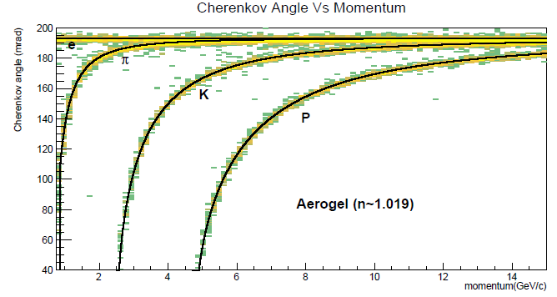
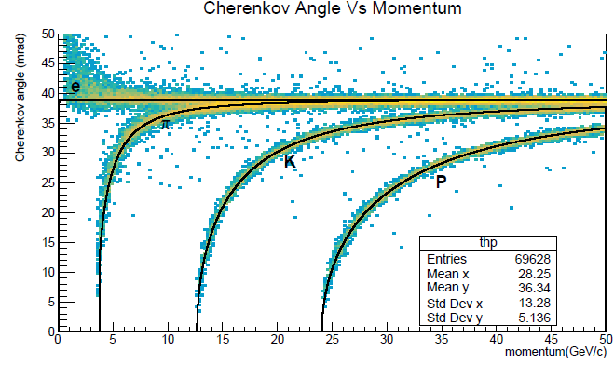
Reconstructed Cherenkov Angle Vs momentum
@ pseudo rapidity = 2.4

Slide 15
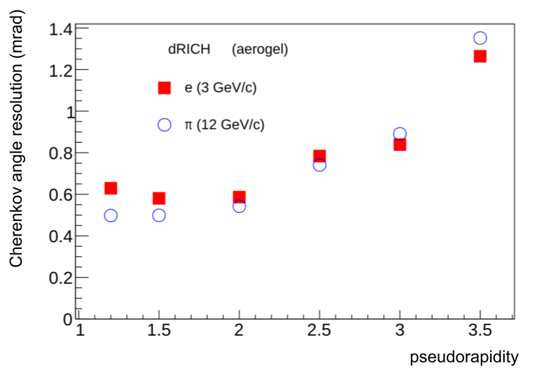
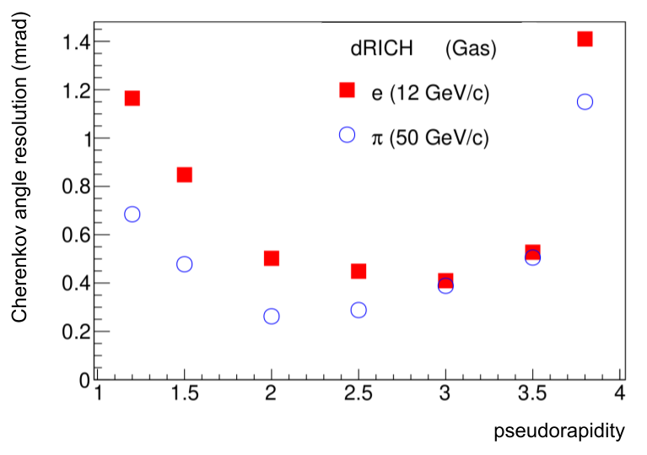
Dependence of ring resolution with pseudorapidity

Slide 16
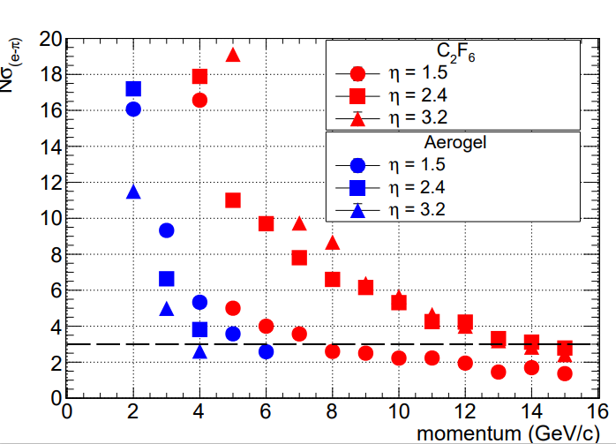
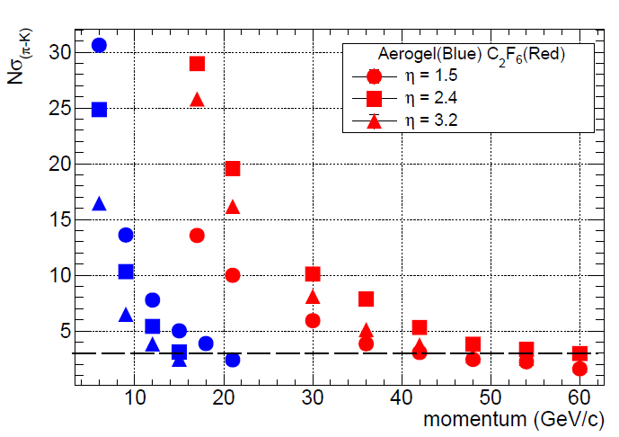
N Sigma Separation

Slide 17
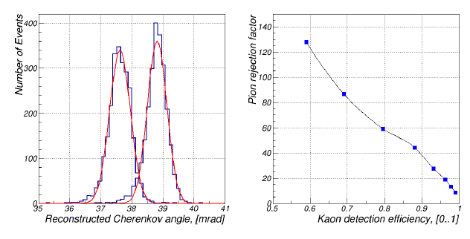
Performance plots
Left: reconstructed Cherenkov angle peaks for a 50:50 mix of 50 GeV/c kaon and pion tracks at η = 2.4 are ∼3σ apart (C2F6 radiator). Right: dependency of pion rejection factor on kaon detection efficiency with the selection cu varying between 37.6 mrad and 38.4 mrad applied to the left hand side plot.

Slide 18
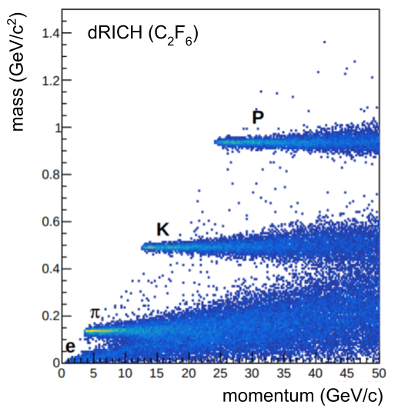
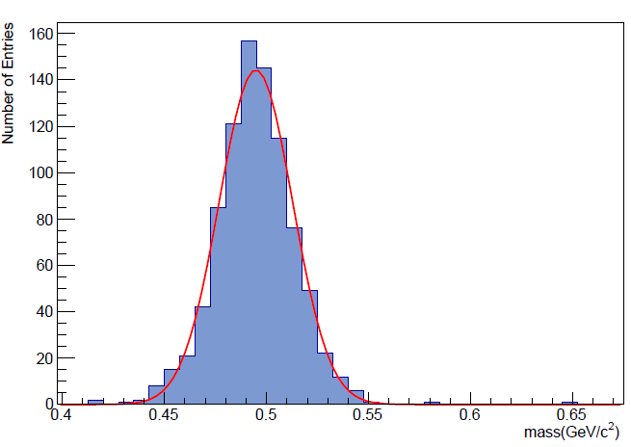
Reconstructed Kaon mass from Cherenkov angle.
~495 MeV/c²
Particle Mass as a function of momentum retrieved from reconstructed Cherenkov angle

