Slide 1
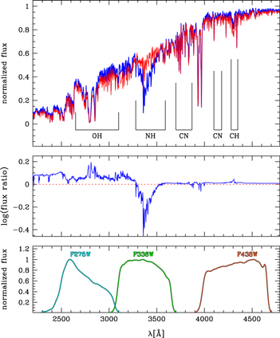
Properties of the different generations in globular clusters
from G. Piotto et al 2015 AJ 149 91
https://iopscience.iop.org/article/10.1088/0004-6256/149/3/91/pdf
1st-generation (1G) stars have a composition that can be ascribed to the proto-galactic interstellar matter out of which they formed, RED curve
2nd-generation (2G) stars can be depleted in C and O, enhanced in N and Na and enhanced in He up to Y = 0.40 Not enhanced in iron and heavy elements, SN processed materials, compared to 1st generation. But has been exposed to proton capture. BLUE curve
Enhanced N
2 G
Depleted O
Depleted C in
2G
Upper panel: in red the simulated spectrum of a star of the first stellar generation (N-poor) RGBa in NGC 6752; in blue the simulated spectrum of a third generation, N-rich, RGBc star (Milone et al. 2010). Middle panel: flux ratio of the two spectra reproduced in the upper panel. Lower panel: bandpasses of WFC3/UVIS with F275W, F336W, and F435W

Slide 2
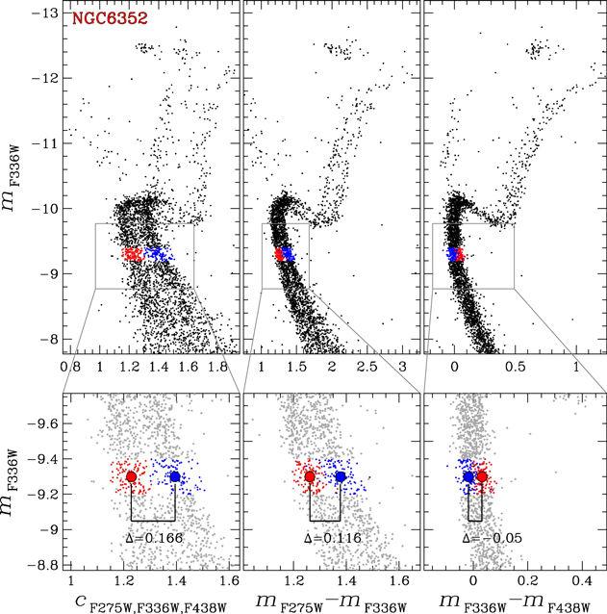
G. Piotto et al 2015 AJ 149 91
The HST Wide band filters in the UV and Blue
encompass
OH
NH
CN, CH
line complexes.
So the following parameter is very sensitive to the composition differences
C_{F275W,F336W,F438W}
= ( m_{F275W}-m_{F336W})
− ( m_{F336W} -m_{F438W})
Figure 2. CMDs of NGC 6352 from GO-13297 data. vs. (left panels), vs. (middle panels), and vs. (right panels). Lower panels show a zoom of the MS. Red dots highlight 2G stars; blue dots 1G stars.

Slide 4
The pseudo color,
C_{F275W,F336W,F438W}
= ( m_{F275W}-m_{F336W}) − ( m_{F336W} -m_{F438W})
was chosen to maximize the separability of the populations of stars, given that there are only a few filter bands available.
Cause of the 1 G , 2 G differences and number of stars? Processing of the interstellar medium in moderate mass stars, or?
The initial number of 1 G stars would have quite a bit larger than the number of 2 G
Different progenitors of the 2G have been proposed. Intermediate-mass asymptotic giant branch (AGB-M) stars (D’Antona et al. 2002), fast-rotating massive stars (FRMS) (Decressin et al. 2007), or interacting massive binary stars (de Mink et al. 2009; Vanbeveren et al. 2012) may eject materials with composition similar to that of 2G stars, i.e., somewhat helium enriched and exposed to proton capture reactions at high temperatures, but with sizable differences from one case to another.
The 2 G stars are generally not enriched in the iron peak, so probably not material processed in supernovae.

Slide 5
This paper displays MANY color magnitude diagrams and the Pseudo-color vs Magnitude diagrams for Globular Clusters
Note that the vertical scale is UV and differs between the upper and lower rows.

Slide 6
Example where the shape of the plot changes greatly going from a Color Magnitude space (upper row) to a Pseudo color vs Magnitude.
Note that the vertical scale is UV and differs between the upper and lower rows.

Slide 7
The rest of this paper (G. Piotto et al 2015 AJ 149 91)
elaborates on the many things that can/will be done with the observational data that will become available.

Slide 8
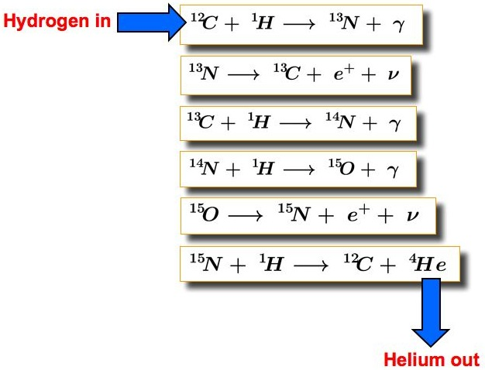
CNO process for H-> He
Occurs in High Mass Stars, not primordial composition
from https://astronomy.swin.edu.au/cosmos/c/cno+cycle

Slide 9
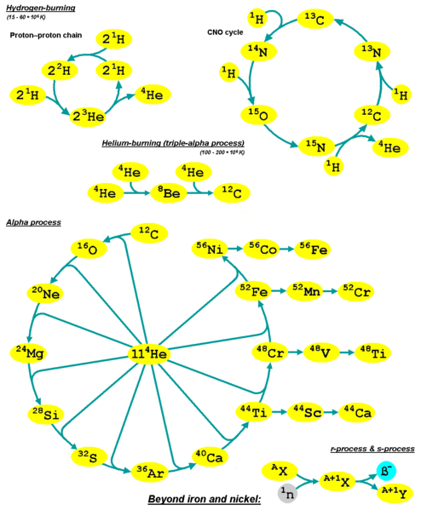
Found on Wikipedia, Credits
Creation of elements beyond carbon through alpha process
Qniemiec - Own work
Creation of elements beyond carbon through alpha process
CC BY-SA 4.0
File:Kernfusionen1 en.png
Created: 9 February 2020
About Media Viewer

Slide 10
From
Multiple Stellar Populations in Globular Clusters
Nate Bastian and Carmela Lardo 1712.01286 in Arxiv and also Annual Reviews of Astronomy and Astrophysics 2018
Globular Clusters show multiple populations, with typical abundance anomalies
Enriched stars (2P): star showing enhanced N, Na, and Al and depleted C and O abundances with respect to field at the same metallicity [Fe/H].
Not enriched stars termed 1P
The individual abundances of C, N, O show large spreads, the sum C+N+O is generally observed to be
constant (e.g. Dickens et al. 1991, see also x 6.2). Anti-correlated Na and O ranges were
found in nearly all the studied clusters, along with variations in Al and (possibly) Mg

Slide 11
Use in astronomy While the total number of "catalytic" nuclei are conserved in the cycle, in stellar evolution the relative proportions of the nuclei are altered. When the cycle is run to equilibrium, the ratio of the carbon-12/carbon-13 nuclei is driven to 3.5, and nitrogen-14 becomes the most numerous nucleus, regardless of initial composition. During a star's evolution, convective mixing episodes moves material, within which the CNO cycle has operated, from the star's interior to the surface, altering the observed composition of the star. Red giant stars are observed to have lower carbon-12/carbon-13 and carbon-12/nitrogen-14 ratios than do main sequence stars, which is considered to be convincing evidence for the operation of the CNO cycle.^{[citation needed]} https://en.wikipedia.org/wiki/CNO_cycle#CNO-III

