Slide 1
Star Clusters as Observational Verification of Stellar Evolution Models
Stellar Evolution (getting born, converting elements, running out of fuel)
Following the stages of the life of a star usually takes too long, so “ground truth” is difficult.
Star Clusters have been thought to consist of “all” stars due to a gas cloud, so all having the same age.
Distribution of stars on the HR or Color Magnitude Diagram is a plot of an ISOCHRONE and can be compared to the positions of stars predicted by theoretical modes.
Diagram from Wikipedia

Slide 2
HST observations of the globular cluster NGC6402 (M14) and its Peculiar Multiple Populations Arxiv 2201.02546
https://en.wikipedia.org/wiki/Messier_14#/media/File:Messier_14.jpg Diameter ~72 ly, Distance ~29,000 ly
https://hubblesite.org/contents/media/images/2002/10/1174-Image.html?news=true
Highly reddened, (E(B-V) ~0.6). The cluster has a moderately high metallicity of [Fe/H]=-1.13 +/-0:05

Slide 4
Star Cluster Color Magnitudes
generally take the form of the
theoretical isochrones, allowing verification
of the models and estimates of cluster ages
Plot is representation of where the observed
stars fall
http://www.southastrodel.com/Page03008.htm

Slide 5
https://ase.tufts.edu/cosmos/view_picture.asp?id=1413
HB Horizontal Branch
AGB Asymptotic Giant Branch
RGB Red Giant Branch
SGB Sub Giant Branch
MS Main Sequence
TO Turn Off

Slide 6
The lines generally follow the positions
that a star of given initial mass and standard
composition will follow as time goes by.
The masses are assumed to stay the same.
IF stars all form from a single episode of star formation, then age of the cluster can be found from comparison of the stars’ distribution on the HR diagram to the prediction of a models of stellar evolution.
https://onwardtotheedge.wordpress.com/2013/03/12/intrinsic-variable-stars/

Slide 7
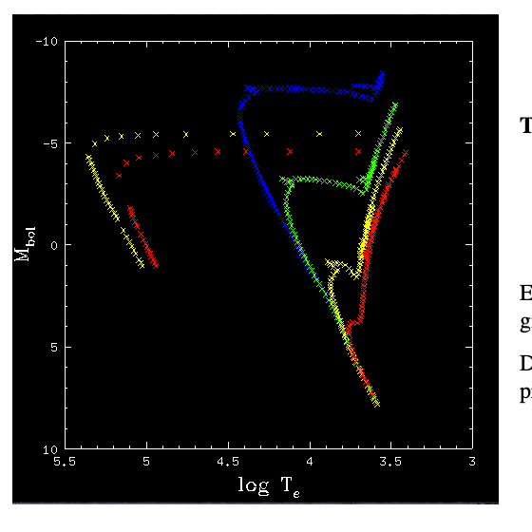
ISOCHRONES
Yellow is 1 Billion years
http://burro.cwru.edu/academics/Astr221/LifeCycle/clusters.html

Slide 8
https://www.rosecityastronomers.net/newsletter-content/2017/2/21/estimating-age-and-distrance-for-open-cluster-m67

Slide 9
HR diagram and friends, vs Color Color
HR diagram, the Y axis is brightness in some sense, the X axis is a temperature proxy
So Y is usually a measured flux, corrected or not for distance, brighter is up
X is normally temperature or a proxy, with hotter to the reader’s left
Color refers to the ratio of flux in different wavelength bands. The measurements are normally expressed as logarithmic qualities. So subtracting the values is forming a ratio.
This becomes a difference in the logarithmic magnitude system. Differences of Log₁₀ quantities are normally indicated with square brackets surrounding a difference.
The central wavelengths for observations and the filter bandwidths are chosen partly by what is possible from detectors and atmospheric transmission
(original B, V were due to photographic emulsion capabilities)
and by what is useful. For this paper the Ultraviolet is available since it is Hubble ST and bandpasses are also useful for sensitivity to composition.

Slide 10
It WAS thought that each star cluster forms more or less at one time from one cloud of gas.
Now it is found that globular clusters are usually composed of stars of several ages and compositions. NGC 6402 (M14) was analyzed via spectra of 41 Red Giant Branch (RGB) stars (Arxiv 1706.02278) and it was found that there are 3 populations distinguished by their composition. The complex of elements is not consistent with any of the usual models of heavy element production from a single source (e.g. core collapse supernova).
The population distribution of red giant stars with spectra was found to be
P1 (1G), 12/35 giants 34%, a very mildly polluted population
P2 14/35 giants 40% which here we will call 2G mild2
E 9/35 giants 26% to a population with `extreme' anomalies
1 G indicates first generation stars

