Slide 1

Jets with a Second Detector at the Electron Ion Collider
Advancing the understanding of non-perturbative QCD using energy flows
CFNS, Stony Brook University
September 19-22, 2022
Charles Hyde
Old Dominion University
Norfolk VA

Slide 2
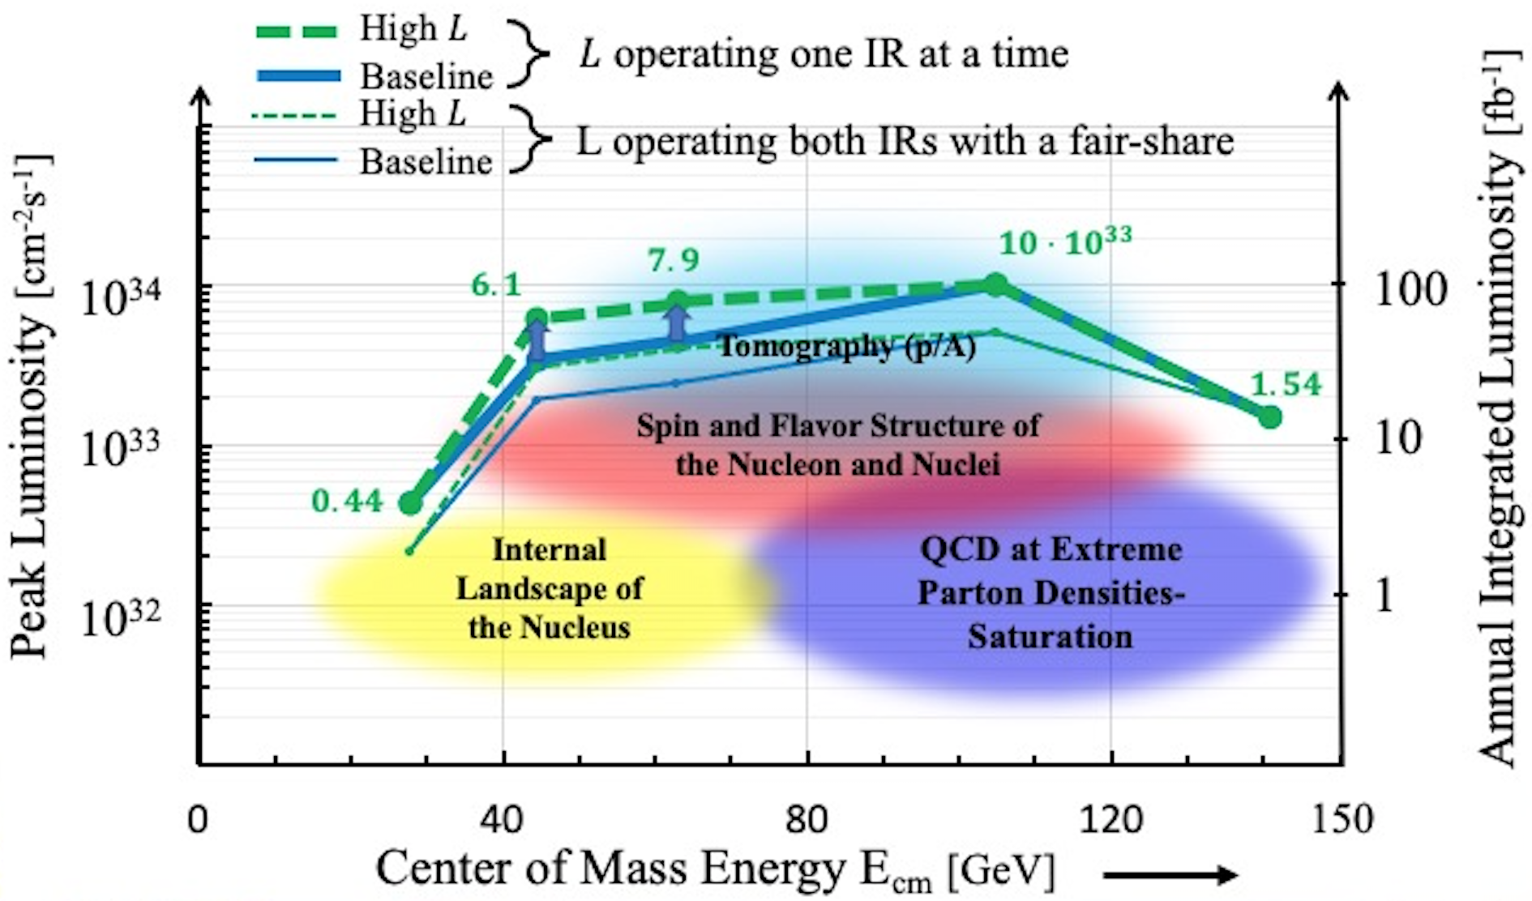
EIC Kinematics and Luminosity
Electrons 5-18 GeV
Protons 41 GeV, 100-275 GeV
Ions from D to U
  D to ⁴⁰Ca:
  Energy per nucleon =
  41GeV/u, 100-137.5 GeV/u
  ^{A}Z ≥ ⁴⁸Ca:
  Energy per nucleon =
  41 GeV/u, 110 GeV/u

Slide 3
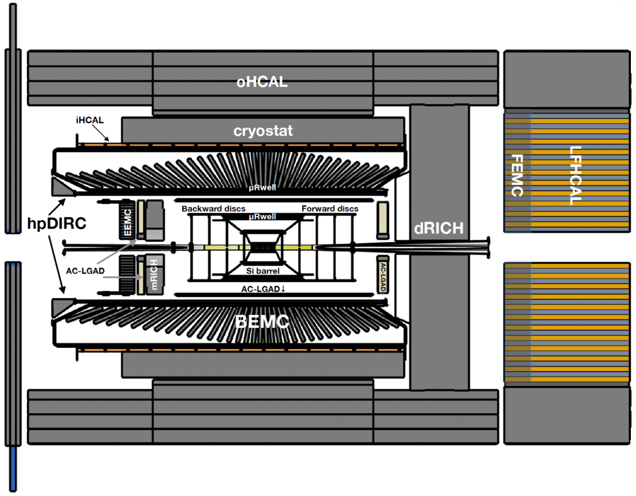
ePIC Detector Design (Current):
See J.Lajoie Talk at QCD Town Hall Tomorrow
Tracking:
  New 1.7T solenoid
  Si MAPS (65nm) Tracker
  MPGDs (μRWELL/μMegas)
PID:
  hp-DIRC
  mRICH/pfRICH
  dRICH
  AC-LGAD (~30ps TOF)
Calorimetry:
  SciGlass/Imaging Barrel EMCal
  PbWO4 EMCal in backward
  direction
  Finely segmented EMCal +HCal
  in forward direction
  Outer HCal (sPHENIX re-use)

Slide 4
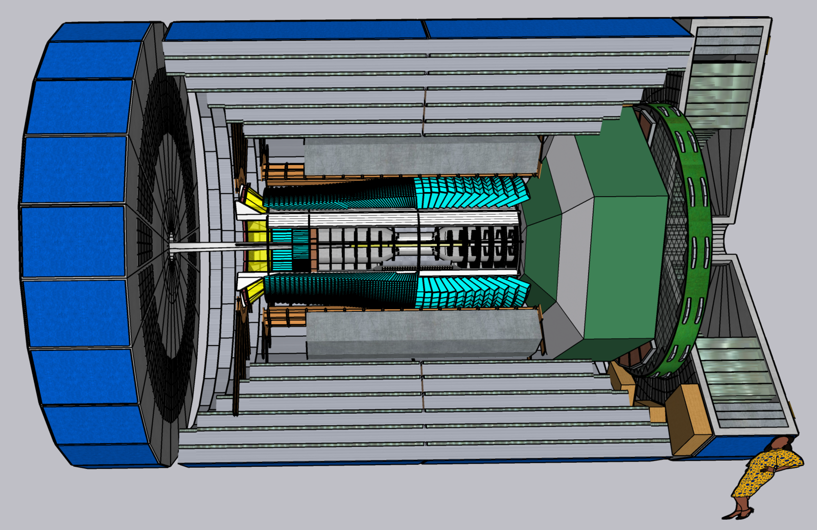
COmpact detectoR for Eic (CORE):
A candidate 2nd Detector
2m bore, 2.4 m long 2.5 T Solenoid
All Si (MAPS) tracker
DIRC, Dual RICH,
AC-LGAD TOF
Forward Hemisphere:
W-Shashlyk EMCal
Backward Hemisphere: PbWO₄
Belle-II style K_{long} Muon HCAL, and Forward HCAL

Slide 5
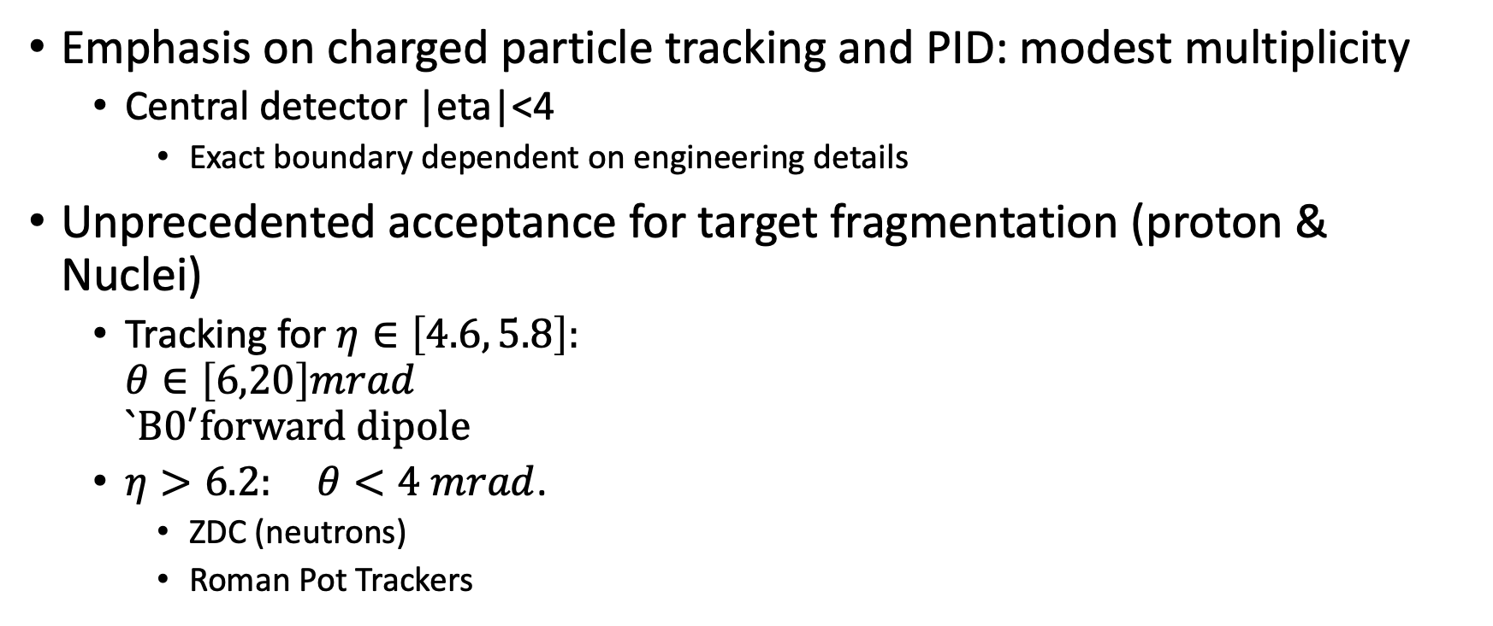
Jet Detection at the EIC
Emphasis on charged particle tracking and PID: modest multiplicity
  Central detector |eta|<4
    Exact boundary dependent on engineering details
Unprecedented acceptance for target fragmentation (proton & Nuclei)
  Tracking for $η∈\left[4.6, 5.8\right]:$
  $θ∈\left[6,20\right]mrad$
  $`B0^{′}forward dipole$
  $η>6.2: θ<4 mrad$.
    ZDC (neutrons)
    Roman Pot Trackers

Slide 6
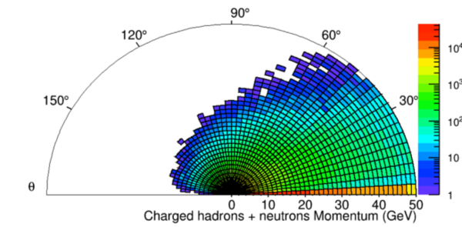

Inclusive Kinematics: ep $18⨂275$ GeV²
Kinematic Limits
  Forward Ion Direction (0°):
  E < Ion Beam (275 GeV)
  Electron-going direction
  Backward (180°):
  E < Electron beam (18 GeV)

Slide 7
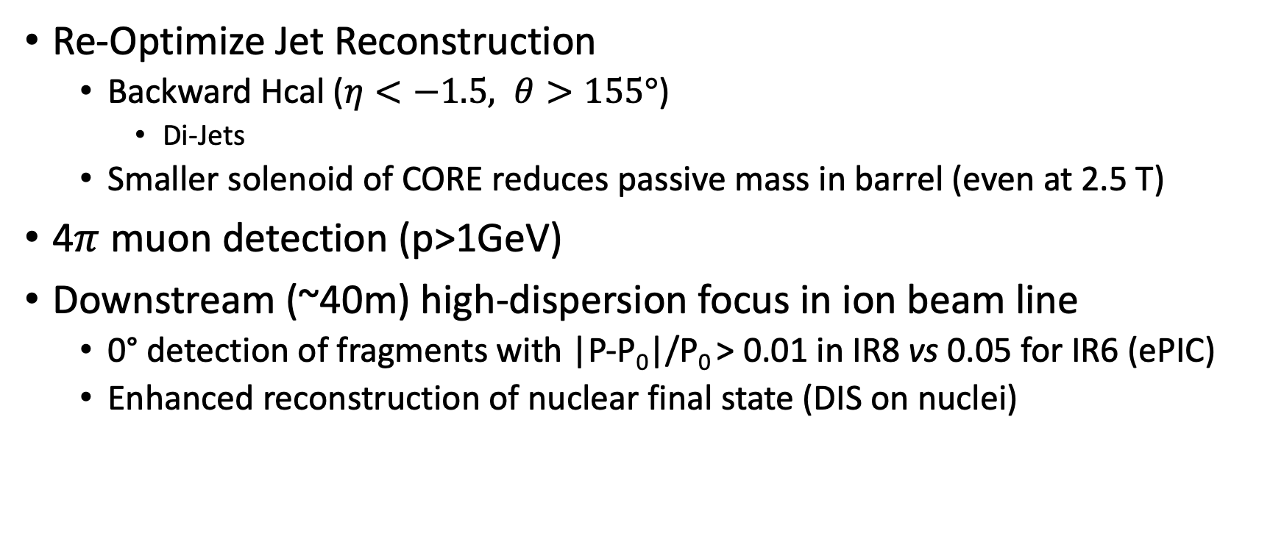
Opportunities with a 2nd EIC Detector
Re-Optimize Jet Reconstruction
  Backward Hcal ($η<−1.5, θ>155°$)
    Di-Jets
  Smaller solenoid of CORE reduces passive mass in barrel (even at 2.5 T)
4$π$ muon detection (p>1GeV)
Downstream (~40m) high-dispersion focus in ion beam line
  0° detection of fragments with |P-P₀|/P₀ > 0.01 in IR8 vs 0.05 for IR6 (ePIC)
  Enhanced reconstruction of nuclear final state (DIS on nuclei)

Slide 8
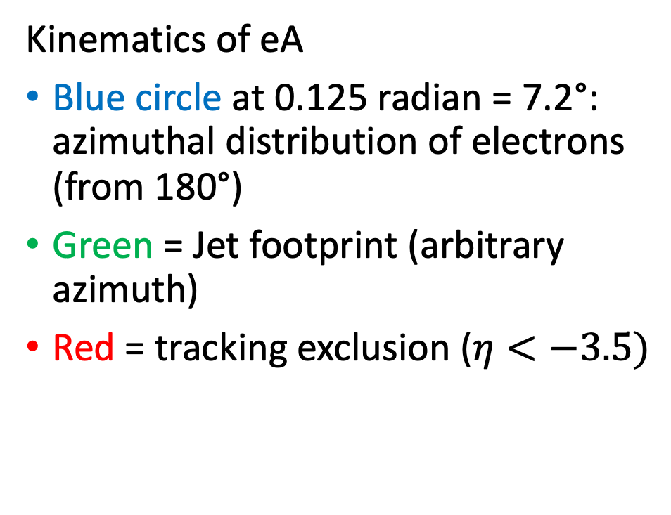
Backward Footprint of a Jet
Kinematics of eA
Blue circle at 0.125 radian = 7.2°: azimuthal distribution of electrons (from 180°)
Green = Jet footprint (arbitrary azimuth)
Red = tracking exclusion ($η<−3.5)$

Slide 9

Searching for Saturation in Current-Jets
18x110 GeV²: Kinematic limit ~ Q²=2.0, x_{B}=0.00026
  Single Current Jet (energy ~17 GeV) is lost in electron beam pipe.
  Di-jet (E=8 GeV, P_{T}=2 GeV each) centered at 165°, or $η≈−2$
There is a significant kinematic range of jets in the backward (electron going) direction.

Slide 10
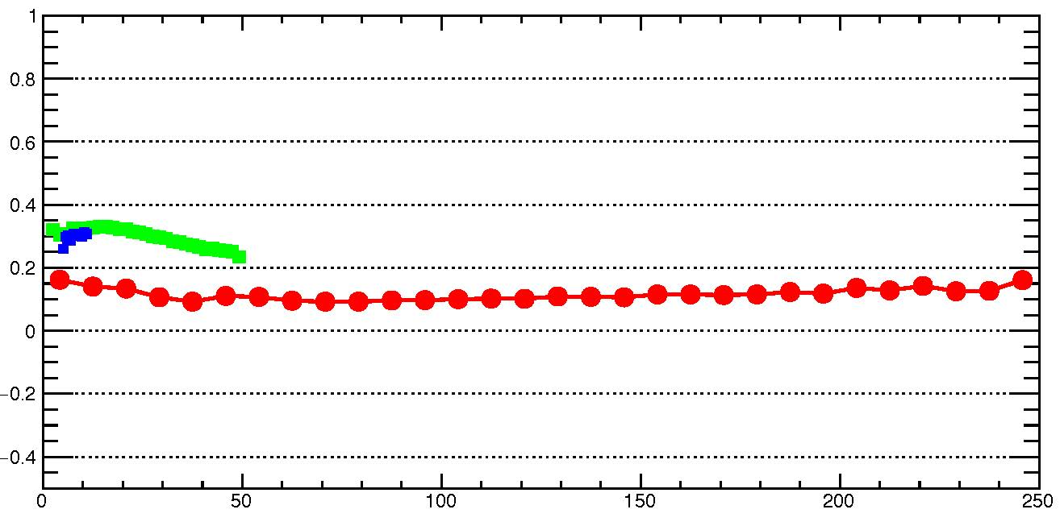
CORE: Jet Energy Resolution
DELPHES simulation
𝛔[(E_{jet,gen}-E_{jet,rec})/E_{jet,gen}]
-3.5<η<-1 -1<η<1 1.2<η<3.5
E_{jet,gen} (GeV)

Slide 11
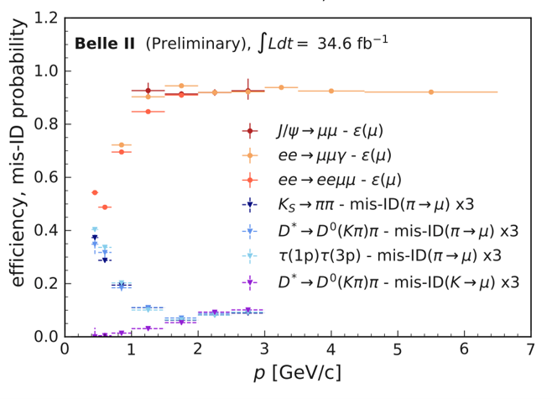
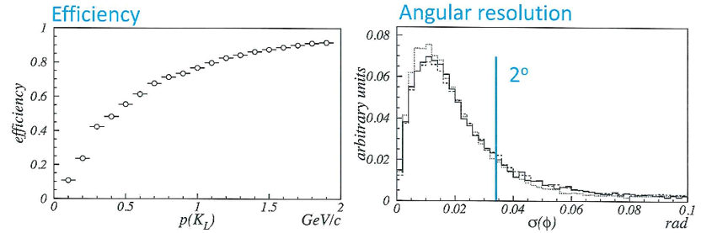
CORE K_{L}Muon ID
Muon Efficiency
Multi-layer FeSci sandwich,
Independent readout of each layer
Modest lateral segmentation
3x Mis-ID
K_{L}⁰
K_{L}⁰

Slide 12
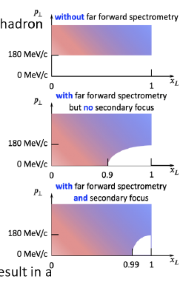
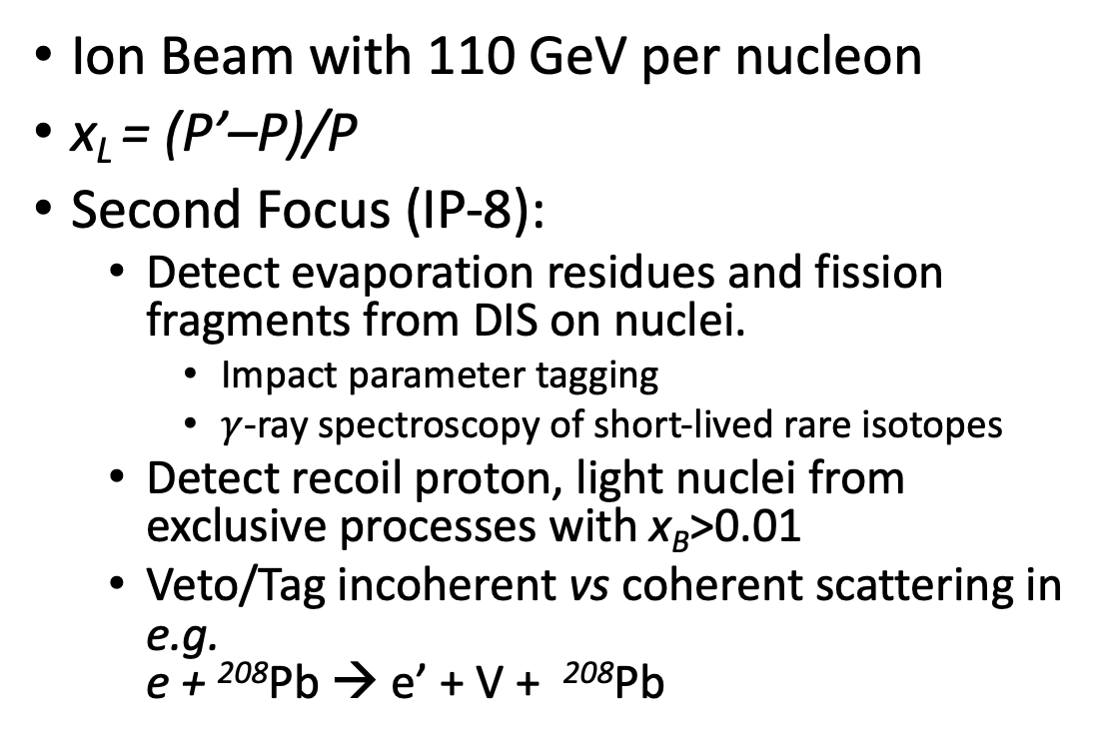
High Dispersion Downstream Focus for IR-8
Ion Beam with 110 GeV per nucleon
x_{L} = (P’–P)/P
Second Focus (IP-8):
  Detect evaporation residues and fission fragments from DIS on nuclei.
    Impact parameter tagging
    $γ$-ray spectroscopy of short-lived rare isotopes
  Detect recoil proton, light nuclei from exclusive processes with x_{B}>0.01
  Veto/Tag incoherent vs coherent scattering in e.g.
  e + ²⁰⁸Pb → e’ + V + ²⁰⁸Pb
IR-6
(EPIC)
P= 275 GeV
IP-8
(concept)
P=275 GeV

Slide 13
Jets at EIC
Much work to do to fully understand physics opportunities and detector capabilities for Jets at EIC.
  Major ePIC simulations starting in October
EICUG “2nd Detector Working Group” (join us!): https://indico.bnl.gov/event/16824/
Renée Fatemi, to QCD Town Hall: “…A natural and efficient way to reduce systematic errors is to equip the EIC with two complementary detectors. Two detectors will expand the scientific opportunities, draw a more complete picture of the science, and mitigate the inherent risks that come with exploring uncharted territory by providing independent confirmation of discovery measurements. ”

Slide 14
Backup

Slide 15
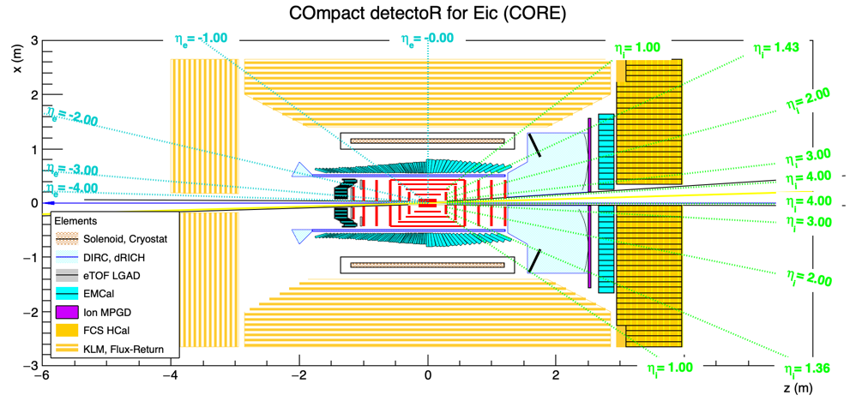
CORE in 2D

