Slide 1
Meeting on Advancing Backward and Barrel EM Calorimeter Designs
May 5, 2022
Electron Ion Collider

Slide 2
Agenda
short recap of earlier attached documents for barrel EMCal support - Rolf/Avishay
further work on round frame (this was to check the limit) - Avishay
flange sketches and frame visualizations - Walt
barrel calorimeter conceptual work - Josh/Tanja
CAD status - Roland
backward EEMCal design status - Carlos

Slide 3
Recap Barrel EM Cal Frame work
Documentation of Avishay submitted – Thanks!!!!
Included as user-provide E&D example in Tanja’s talk last Friday at first General Detector-1 Meeting

Slide 4
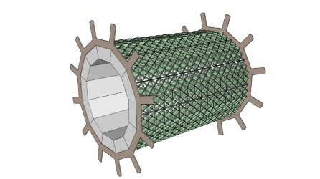
Recap Barrel EM Cal Frame work
Model 15 from STEP file
Notes:
Width here is 6.5 mm but height is ~6.5 cm!
Fabrication will be challenge, but that we did not consider yet at this stage.

Slide 5
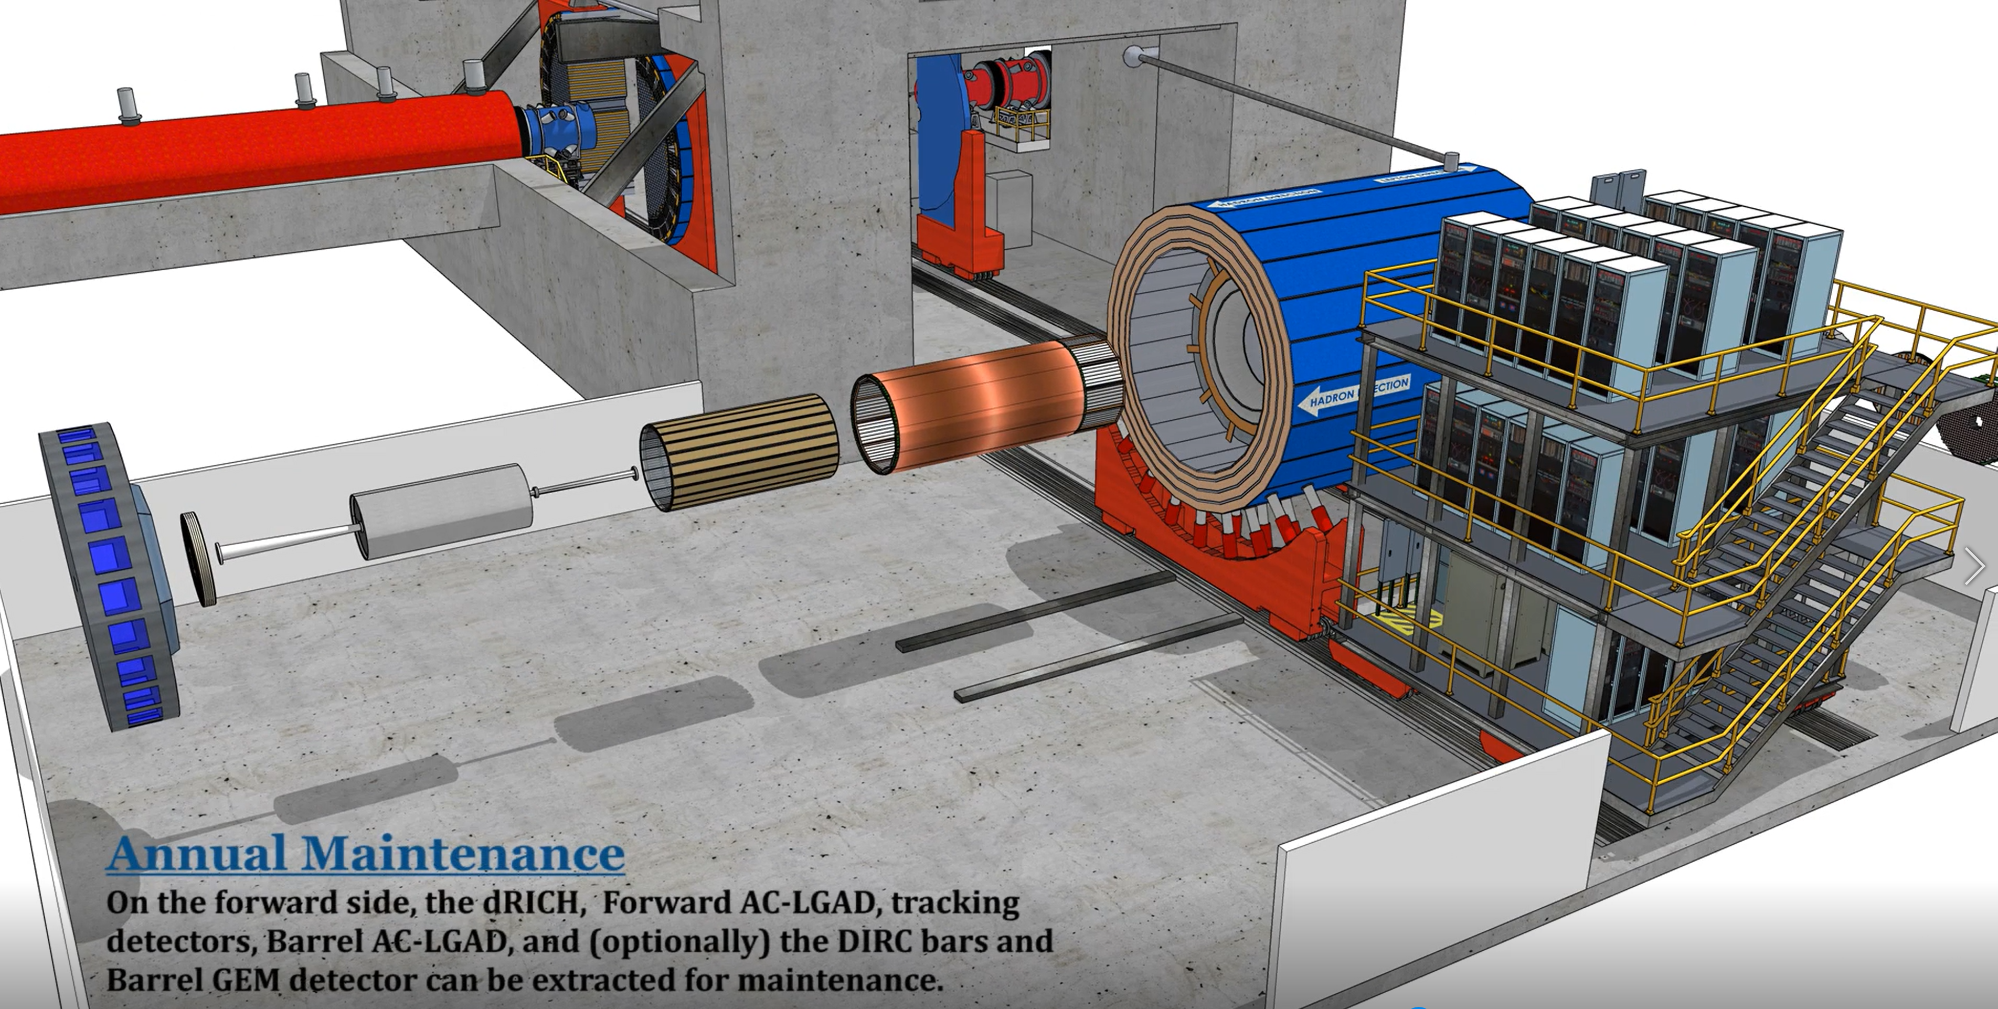
Barrel EM Cal Maintenance First Thoughts
From earlier talk by Walt Akers on detector maintenance
Here we stopped with the barrel EMCal still inside the magnet bore

Slide 6
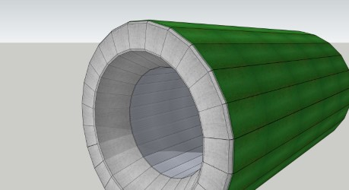

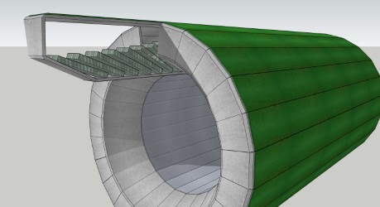
Barrel EM Cal Maintenance First Thoughts
Step One – Move 1 cm radially outward
Step Two – Slide segment out for maintenance

Slide 7
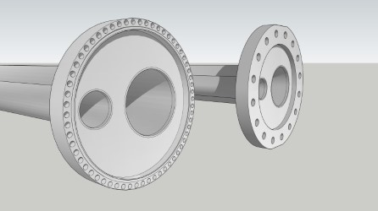
Flange Sketches and Frame Visualizations
Standard (large-diameter) vacuum flange: over one inch material
Minimum size would be special-order flange: ½ inch material (1 mm edge, 3 mm for heliconflex (or special-order copper gasket), 1 mm space, many M6 bolt holes, and 1 mm edge)
> 1 inch
½ inch

