Slide 1
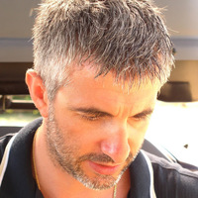
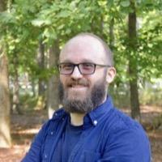
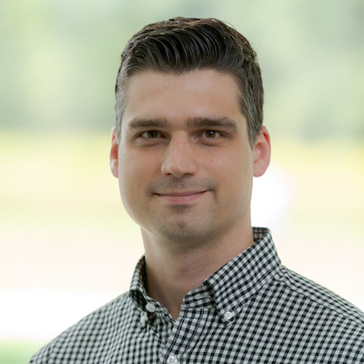
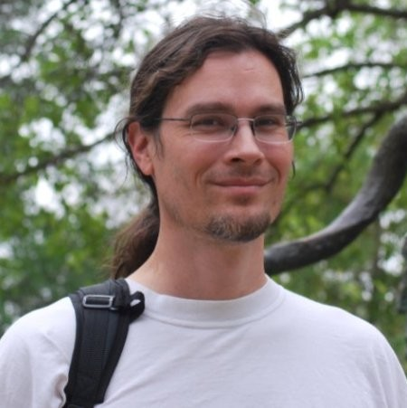
Software and Computing WG (CompSW)
Andrea Bressan (andrea.bressan@ts.infn.it)
Cristiano Fanelli (cfanelli@mit.edu)
Sylvester Joosten (sjoosten@anl.gov)
David Lawrence (davidl@jlab.org)
Meetings Wednesdays @ 11am EDT
Next meeting is May 25, 2022
https://indico.bnl.gov/event/15530/
Mailing list
eic-projdet-compsw-l@lists.bnl.gov
https://lists.bnl.gov/mailman/listinfo/eic-projdet-compsw-l

Slide 2
A Critical Path for EIC Software
Towards a unified software approach for the EIC
Assessment on the software solutions (pro & con list) together with the SimQA and DAQ working groups, guided by the EIC Software Statement of Principles.
Propose conclusion and recommendation to collaboration management and Project by the Summer EICUG meeting.
Software choice treated as any other technology choice? Optional independent review in the Summer.
Once decision is made, all new development should go in the official framework.
Aim to have fully transitioned to the official software by October.

Slide 3
Procedure to Travel the Critical Path
Publicize schedule of topics with dates of discussion and decision
Assign chair for each topic. Chair will be POC for the topic. Responsibilities are:
Organize discussion session agenda
Publish draft list of requirements for the software being discussed at least 1 week in advance.
Form list with at least one choice for the software to adopt to address the topic
Collect suggestions for modifications to the requirements list and/or the software choices list
Lead discussion on topic, starting with requirements list and the list of options
Presentations may be made regarding a specific decision topic, but should be communicated to discussion lead in advance for purposes of scheduling.
Use guiding principles from the EIC Software Statement of Principles
Discussion is required for all topics (formal presentations only as necessary).
Based on the meeting, the joint CompSW and SimQA WG conveners will propose a single option, which will be open for comments and endorsement for one week.

Slide 4
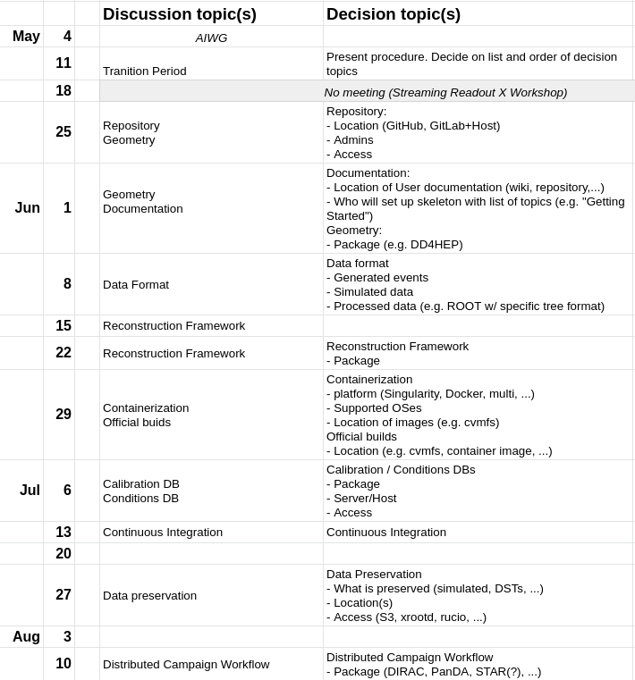
Strawman Critical Path
Exact topics and order are being discussed by both software WGs.
Most stringent timeline for the Critical Path is preparation for TDR, this will inform the order we will take in our meetings.

Slide 5
Towards Full Coverage of All WG Meetings
A commitment from CompSW and SimQA
Draft WG coverage assignment. Work-in-progress, as not all WG meetings have final timeslots yet.

Slide 6
Joint CompSW & SimQA Office Hours
DD4hep-based software stack: Monday, Friday 2pm EDT Wednesday alternating 2pm and 8pm EDT First evening meeting on 5/25.
Fun4all-based software stack: Tuesday alternating 3pm and 8pm EDT
Links will be distributed to through indico.

Slide 7
And a request to the WGs
CompSW and SimQA request a liaison to be appointed from each of the DWGs and PWGs.
This is critical to ensure effective two-way collaboration.
The Liaison ensures that someone from the WGs attends the CompSW and SimQA meetings.
The Liaison does not have to be a WG convener (but of course could be a convener)
Request to have Liaisons identified by the next bi-weekly meeting.

Slide 8
Urgent need for communication tool
CompSW and SimQA drafted a list of requirements for communication tools: https://docs.google.com/document/d/17veqYyAFsaRY2D37rLyVZYA7ERR-x5AVLdl0yMrjZno/edit?usp=sharing
We are working together with the SC to come to a final decision, and hope we can announce this (urgently needed) tool soon.

Slide 9
Simulation availability
More info at SimQA meeting
Ongoing survey of available geometry implementations will help guide short-term implementation efforts, mostly driven by SimQA.
Central detector
fun4All:
Full reference ECCE design
Some work ongoing to implement ATHENA forward calorimetry.
DD4hep (geometry and full reconstruction):
Detectors from ATHENA proposal (including some overlap with the reference ECCE design).
New reference design implementation advanced, tentatively ready by end-of-month (including reconstruction). Current status: Magnet, bECal geometry sone, tracker detector and support almost done.
FF/FB implementation
Available in DD4hep right now (and standalone GEANT4)

Slide 10
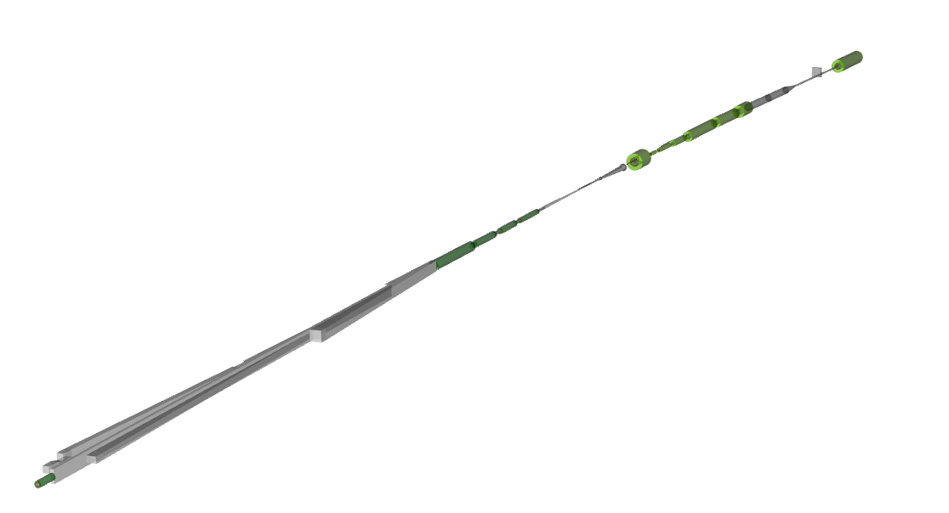

Slide 11
Questions?

Slide 12
CompSW Charge (draft)
Develop and curate a single software stack that will serve all aspects of the detector design and implementation regarding simulation, reconstruction, analysis, and the scientific program.
Identify computing resource requirements to support the EIC program through detector development, construction, and production.
Foster the development of new approaches to software and computing.
Support all software and computing needs of the collaboration.
Detailed draft available here: https://docs.google.com/presentation/d/1aim32XWy6TpDpflK_YWnQhMkIgblOqv2Bh86k7278MM/edit?usp=sharing

Slide 13
Software and Computing Group Web Resources
Software and Computing Working Group wiki (this is the one to bookmark!):
https://wiki.bnl.gov/eic-project-detector/index.php/SC
Indico site for Software & Computing Working Group:
https://indico.bnl.gov/category/410/
Mailing list for Software and Computing Working Group (detector):
eic-projdet-compsw-l@lists.bnl.gov
https://lists.bnl.gov/mailman/listinfo/eic-projdet-compsw-l
EICUG Software Working Group mailing list:
eicug-software@eicug.org
https://groups.google.com/a/eicug.org/g/eicug-software

