Slide 1
Magnetic field impact in Cherenkov angle resolution
Chandradoy Chatterjee

Slide 2
Work done so far in ATHENA dRICH
We created an ideal RICH:
Almost realistic geometry and realistic radiator gas
Ideal sensor and mirrors
No absorption or Rayleigh scattering etc.
Spherical sensor plane in exact focalization (f=R/2)
We reconstructed single Cherenkov photon from inverse ray tracing
And extracted single photon resolution with and without the magnetic field. This we plotted as a function of momentum at different eta values.

Slide 3
Examples at two different eta bins

Slide 4
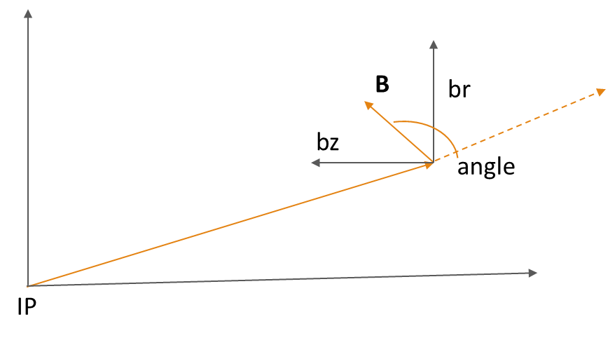
Projectivity of field lines
This projectivity is not a complete picture. Even if non projective field with small B field values will give rise to a small deflection of the track. Resulting to a smaller smearing of the Cherenkov angle lying in the bending plane.
The idea is to study how the ring resolution depends on the phi angles in-plane and off-plane photons for different eta and momentum bins. We can foresee to assign a weight to the photon angle based on their “planarity”.
The goal to generate the projectivity is therefore to have a flavor of the critical regions and if any differences present in terms of the different magnetic fields.

Slide 5
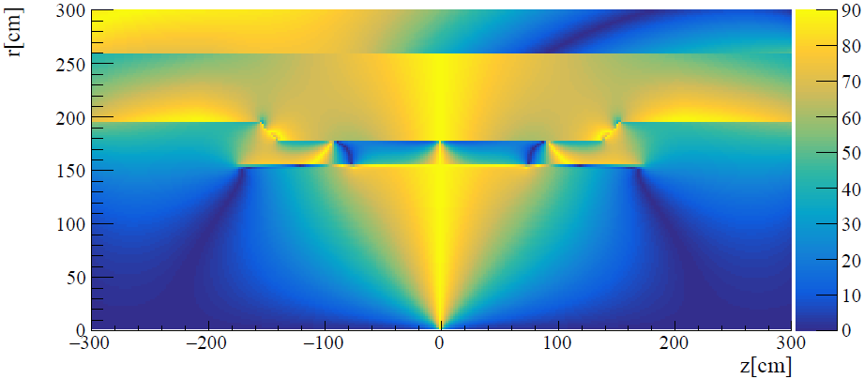
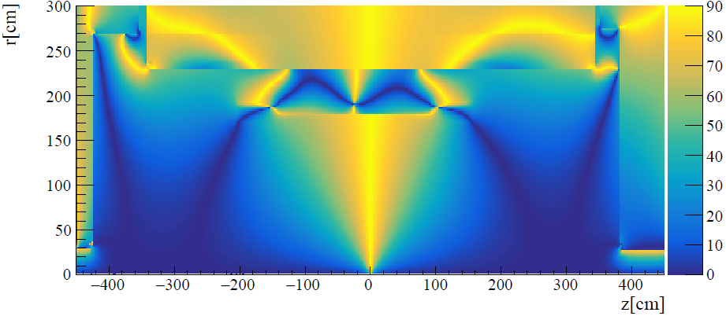
Babar Magnet
No apparent large difference in the projective nature of the field lines
ATHENA Magnet

Slide 6
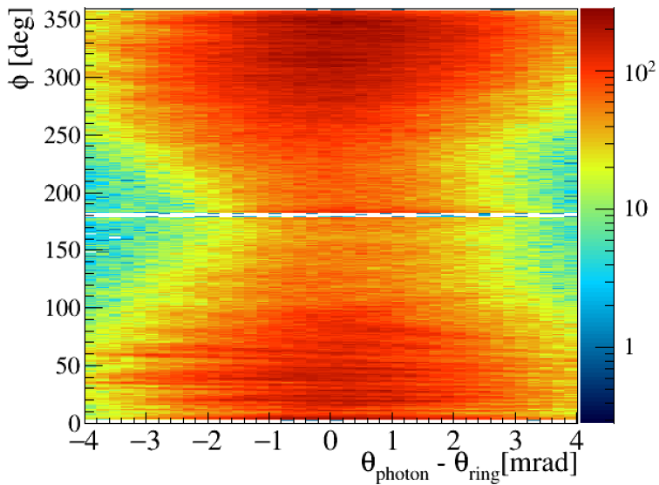
Plans
I contacted and initiated some discussions with Jin, on the further studies that can be done to study the single photon resolution as a function of eta bins with the magnetic field he presented.
The study can be done with the re-scaled dRICH geometry implemented by Chris in dd4hep. The idea is to have instead of the ideal dRICH more realistically implemented dRICH, w/ and w/o the magnetic field in the simulation chain.
To check the effect of the single photon resolution as a function of phi angles.
We can foresee to assign weight to the detected photons based on it its azimuthal angle phi.

