Slide 1
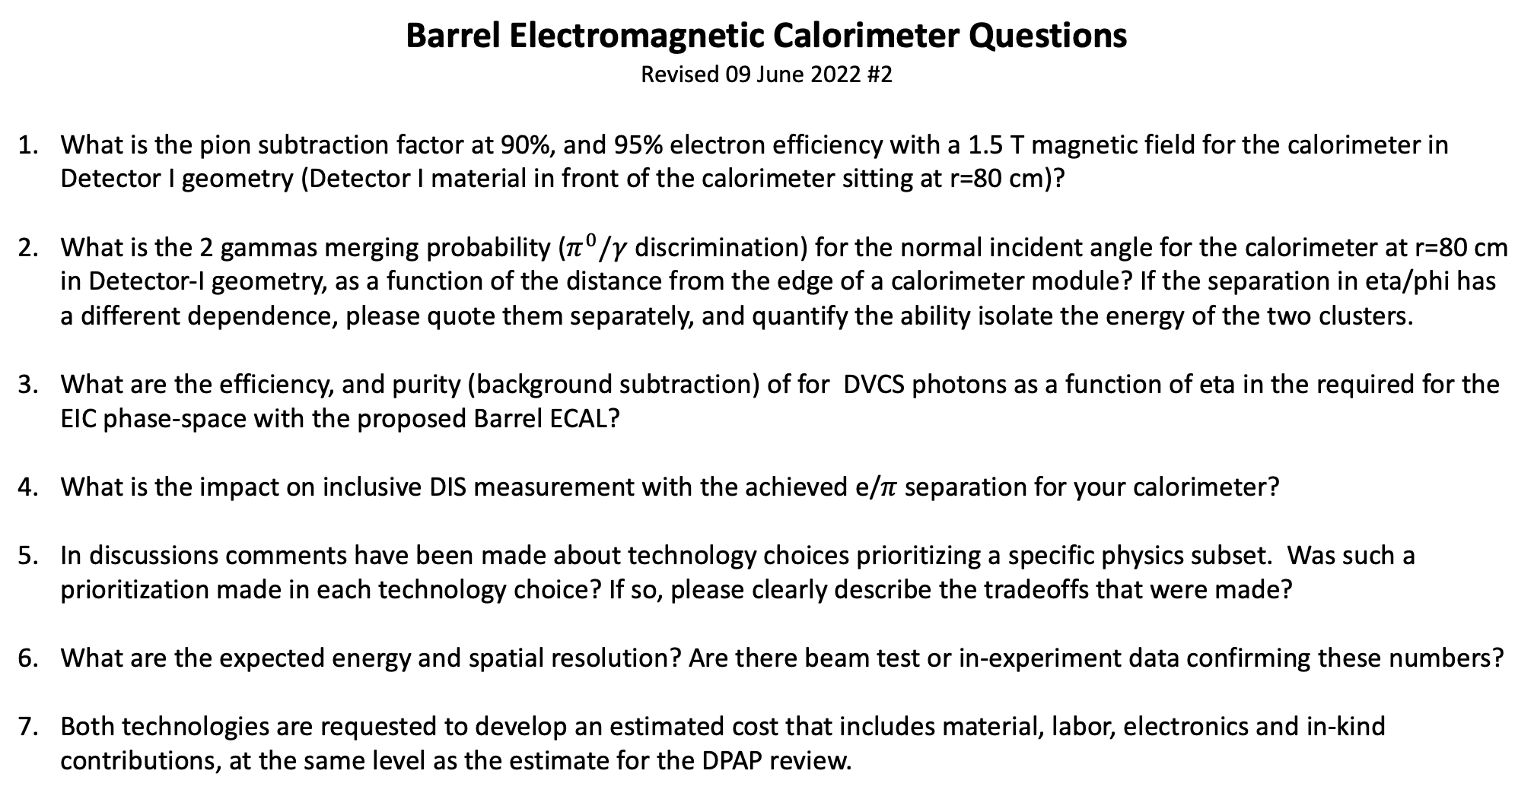
Barrel Electromagnetic Calorimeter Questions
Revised 09 June 2022 #2
What is the pion subtraction factor at 90%, and 95% electron efficiency with a 1.5 T magnetic field for the calorimeter in Detector I geometry (Detector I material in front of the calorimeter sitting at r=80 cm)?
What is the 2 gammas merging probability ($π^{0}/γ$ discrimination) for the normal incident angle for the calorimeter at r=80 cm in Detector-I geometry, as a function of the distance from the edge of a calorimeter module? If the separation in eta/phi has a different dependence, please quote them separately, and quantify the ability isolate the energy of the two clusters.
What are the efficiency, and purity (background subtraction) of for DVCS photons as a function of eta in the required for the EIC phase-space with the proposed Barrel ECAL?
What is the impact on inclusive DIS measurement with the achieved e/$π$ separation for your calorimeter?
In discussions comments have been made about technology choices prioritizing a specific physics subset. Was such a prioritization made in each technology choice? If so, please clearly describe the tradeoffs that were made?
What are the expected energy and spatial resolution? Are there beam test or in-experiment data confirming these numbers?
Both technologies are requested to develop an estimated cost that includes material, labor, electronics and in-kind contributions, at the same level as the estimate for the DPAP review.

