Slide 1
Evaluating barrel ECal options discussion
erhtjhtyhy
This work was partially supported under grant DE-AC02-06CH11357 from the US Department of Energy, Office of Nuclear Physics

Slide 2
Our Task
From the Calo WG’s charge:
For each non-trivial difference working groups will then work to prepare a pro/con list accounting for technical performance, risk and cost. The resolution of non-trivial differences should be discussed in close consultation with the Global detector/integration WG, physics working groups, the EIC project, relevant detector consortia and R&D efforts.
Evaluation of options based on:
Performance
Risk
Cost
Integration

Slide 3
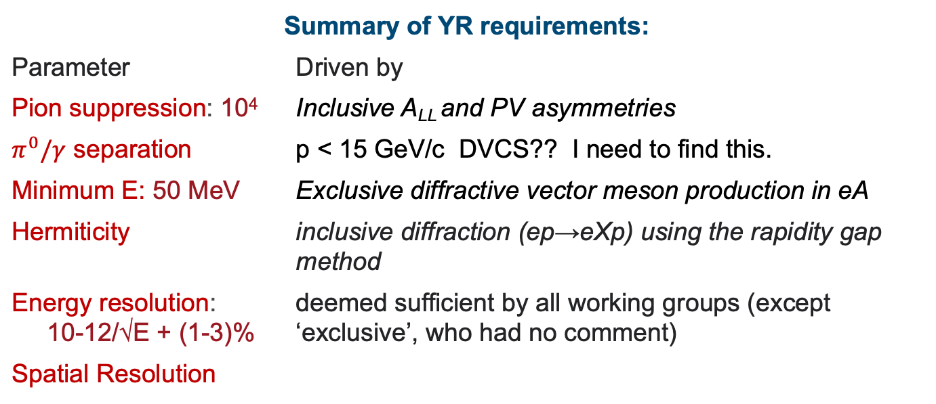
Potential physics channels to benchmark barrel ECAL performance
Summary of YR requirements:
Parameter | Driven by
Pion suppression: 10⁴ | Inclusive A_{LL} and PV asymmetries
$π^{0}/γ$ separation | p < 15 GeV/c DVCS?? I need to find this.
Minimum E: 50 MeV | Exclusive diffractive vector meson production in eA
Hermiticity | inclusive diffraction (ep→eXp) using the rapidity gap method
Energy resolution: 10-12/√E + (1-3)% | deemed sufficient by all working groups (except ‘exclusive’, who had no comment)
Spatial Resolution

Slide 4
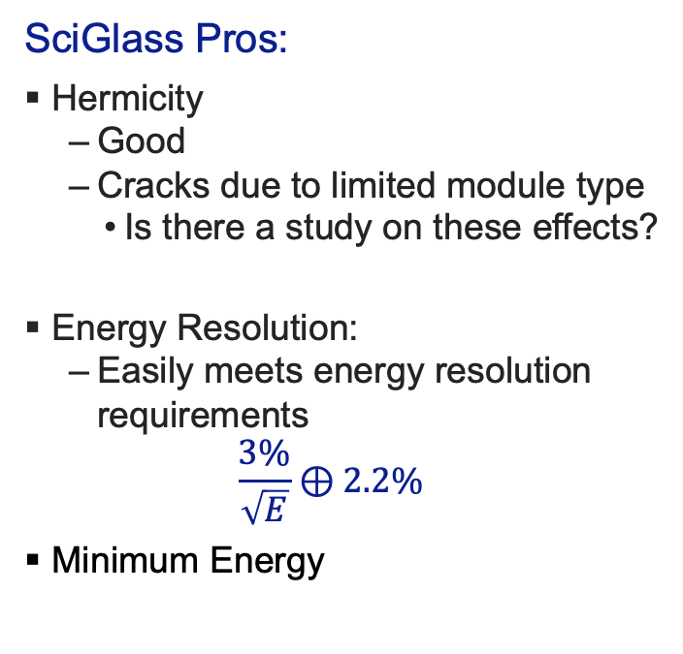
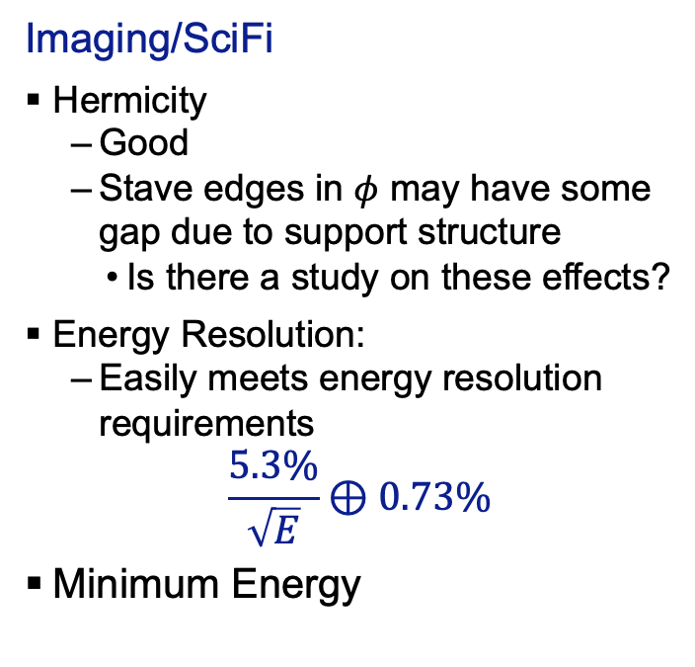
Performance
Imaging/SciFi
Hermicity
Good
Stave edges in $φ$ may have some gap due to support structure
Is there a study on these effects?
Energy Resolution:
Easily meets energy resolution requirements
$$\frac{5.3\%}{\sqrt{E}}⊕0.73\%$$
Minimum Energy
SciGlass Pros:
Hermicity
Good
Cracks due to limited module type
Is there a study on these effects?
Energy Resolution:
Easily meets energy resolution requirements
$$\frac{3\%}{\sqrt{E}}⊕2.2\%$$
Minimum Energy
My Fault, I ran out of time to find this.

Slide 5
Performance
Imaging/SciFi
Pion Rejection
SciGlass Pros:
Pion Rejection
p > 1 GeV/c:
R > 1000 in realistic simulation while maintaining efficiency > 85%. (In ideal case its R > 3000 and eff > 95%)
0.6 < p < 1 GeV/c:
R > 300 with efficiency > 82% in realistic simulation (Ideal: R> 400 and eff > 95%)
My Fault, I ran out of time to find this.
This must be studied as part of an integrated detector simulation as pion rejection can be done with other elements of the spectrometer as well

Slide 6
Performance
Imaging/SciFi
Pion Rejection
SciGlass Pros:
Pion Rejection
p > 1 GeV/c:
R > 1000 in realistic simulation while maintaining efficiency > 85%. (In ideal case its R > 3000 and eff > 95%)
0.6 < p < 1 GeV/c:
R > 300 with efficiency > 82% in realistic simulation (Ideal: R> 400 and eff > 95%)

Slide 7
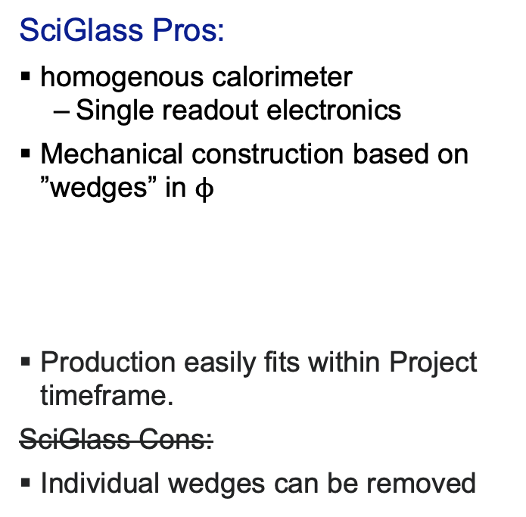
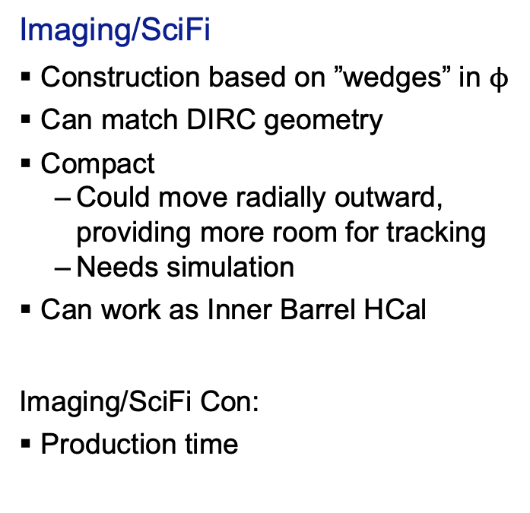
Integration
Imaging/SciFi
Construction based on ”wedges” in $ϕ$
Can match DIRC geometry
Compact
Could move radially outward, providing more room for tracking
Needs simulation
Can work as Inner Barrel HCal
Imaging/SciFi Con:
Production time
SciGlass Pros:
homogenous calorimeter
Single readout electronics
Mechanical construction based on ”wedges” in $ϕ$
Production easily fits within Project timeframe.
SciGlass Cons:
Individual wedges can be removed

Slide 8
Cost
 | In M$ | M&S | Labor |  |  | Totals |  | In M$ | M&S | Labor | Totals
Detector | Pb SciFi Detector | $ 7.7 | $ 4.5 |  |  | $ 12.2 |  | SciGlass | 14.2 | 0.8 | 15
 | Imaging Detector | $ 6.3 | $ 4.8 |  |  | $ 11.1
 | Total Detector | $ 14.0 | $ 9.3 |  |  | $ 23.3
Readout | Pb SciFi Readout | $ 1.8 | $ 0.3 |  |  | $ 2.1 |  | SciGlass Readout | 1.5 |  | 1.5
 | Imaging Readout | $ 0.4 | $ 1.8 |  |  | $ 2.2
 | Total Readout | $ 2.2 | $ 2.1 |  |  | $ 4.3
Totals | Total Pb/SciFi | $ 9.5 | $ 4.7 |  |  | $ 14.2 |  | Total SciGlass | 15.7 | 0.8 | 16.5
 | Total Imaging | $ 6.7 | $ 6.6 |  |  | $ 13.3
 | Grand Total |  |  |  |  | $ 27.5 |  | Grand Total |  |  | $ 16.5
Notes on readout | Notes on readout | PbScifi | includes SiPMs, Digitizer and FEE.
 |  | Imaging | readout include up to first aggregator
 |  | SciGlass | readout includes only SiPM.
Additional Notes | Additional Notes | PbScifi | budget is for 410 cm long. This could be reduced to 360 cm.
 |  |  | can use 1 or 4 SIPMs/channel \delta = $0.8M
 |  |  | Budget can vary based on density of sampling and commodity (Pb or W) prices
 |  | Imaging | first layer may replace MPGD layer

Slide 9
Labor Rates
Labor Skill Set |  | Cost per hour for each skill set |  | Labor Skill Set |  | Cost per hour for each skill set
Scientist |  | $157.05 |  | Mechanical Tech |  | $101.01
PostDoc |  | $70.99 |  | Electrical Engineer |  | $153.17
PhD Student |  | $20.00 |  | Electrical Designer |  | $116.10
Undergrad |  | $20.00 |  | Electrical Tech |  | $101.01
Mechanical Engineer |  | $153.17 |  | Software Expert |  | $178.24
Mechanical Designer |  | $116.10 |  | Other |  | $0.00

Slide 10
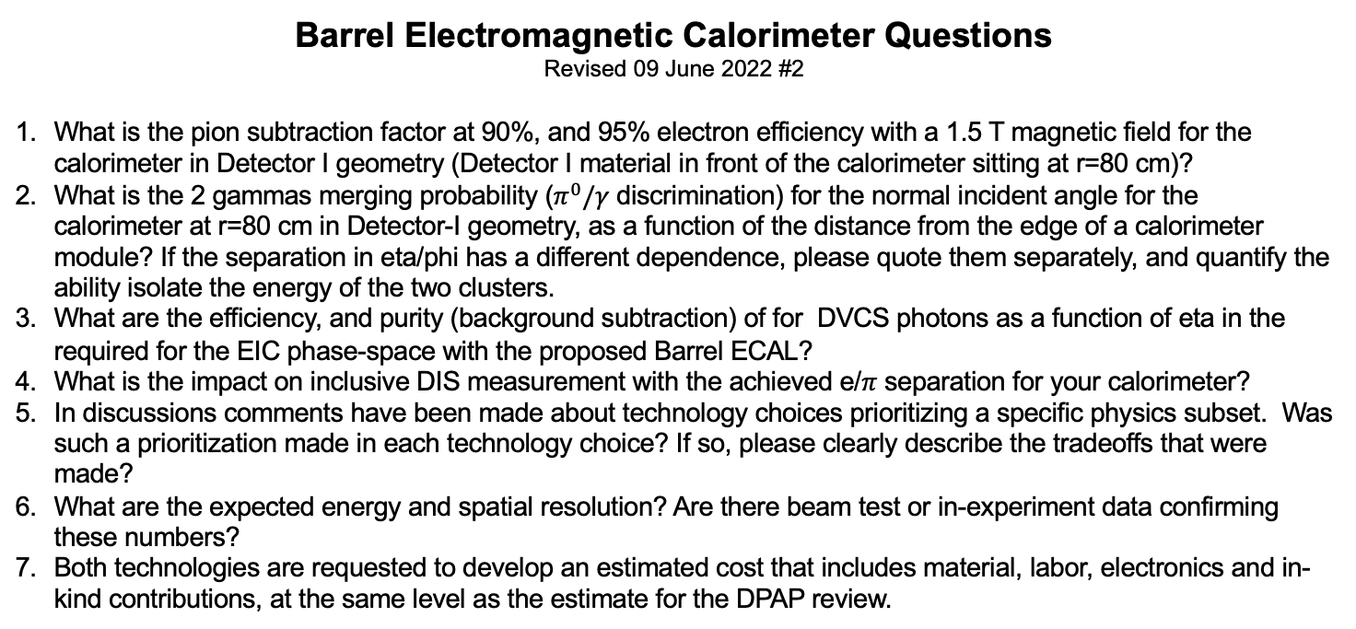
Barrel Electromagnetic Calorimeter Questions
Revised 09 June 2022 #2
What is the pion subtraction factor at 90%, and 95% electron efficiency with a 1.5 T magnetic field for the calorimeter in Detector I geometry (Detector I material in front of the calorimeter sitting at r=80 cm)?
What is the 2 gammas merging probability ($π^{0}/γ$ discrimination) for the normal incident angle for the calorimeter at r=80 cm in Detector-I geometry, as a function of the distance from the edge of a calorimeter module? If the separation in eta/phi has a different dependence, please quote them separately, and quantify the ability isolate the energy of the two clusters.
What are the efficiency, and purity (background subtraction) of for DVCS photons as a function of eta in the required for the EIC phase-space with the proposed Barrel ECAL?
What is the impact on inclusive DIS measurement with the achieved e/$π$ separation for your calorimeter?
In discussions comments have been made about technology choices prioritizing a specific physics subset. Was such a prioritization made in each technology choice? If so, please clearly describe the tradeoffs that were made?
What are the expected energy and spatial resolution? Are there beam test or in-experiment data confirming these numbers?
Both technologies are requested to develop an estimated cost that includes material, labor, electronics and in-kind contributions, at the same level as the estimate for the DPAP review.

