Slide 1
Forward Hadron Calorimetry Integration
Elke-Carline Aschenauer, Roland Wimmer and Rahul Sharma

Slide 2
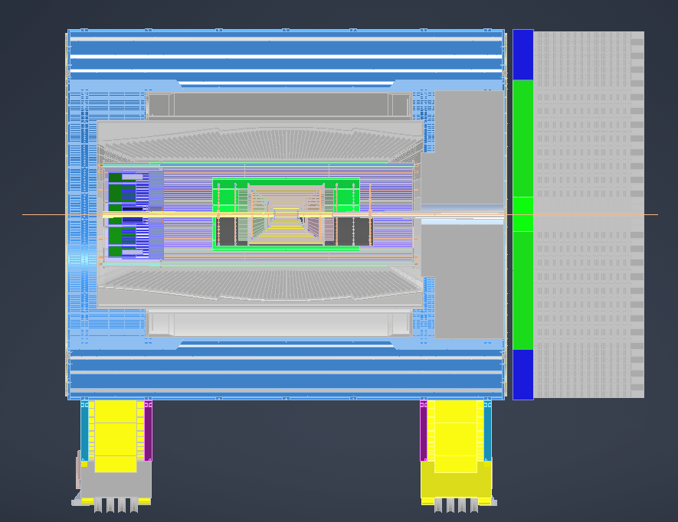
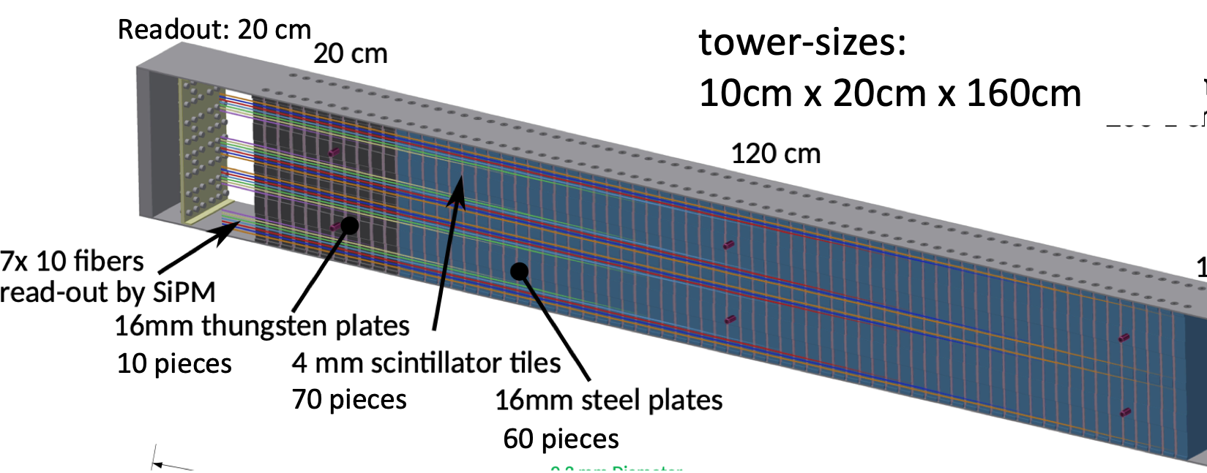
HCAL support
38.1mm thick
center to end bHcal: 3158 mm
total space on forward side: 5 m
absolutely not negotiable
forward ECal - HCal assembly start:
3296 mm
total space available for both:
1703.9 mm
Length of forward Ecal incl electronics:
300 mm
Length of forward HCAL
without electronics: 1400 mm
estimate for electronics: 200 mm
→ forward HCAL 20 cm to long
service gap: 100 mm

Slide 3
Summary
Currently fHCal is to long and interferes with the accelerator stay clear zone
Tim Camarda is looking into a layout for electronics (Readout (SIPM, FEE Digitizer), LV, cooling) to determine how much we need to shorten the towers
Will schedule a meeting with the HCAL group to discuss other concerns we have with the design

Slide 4
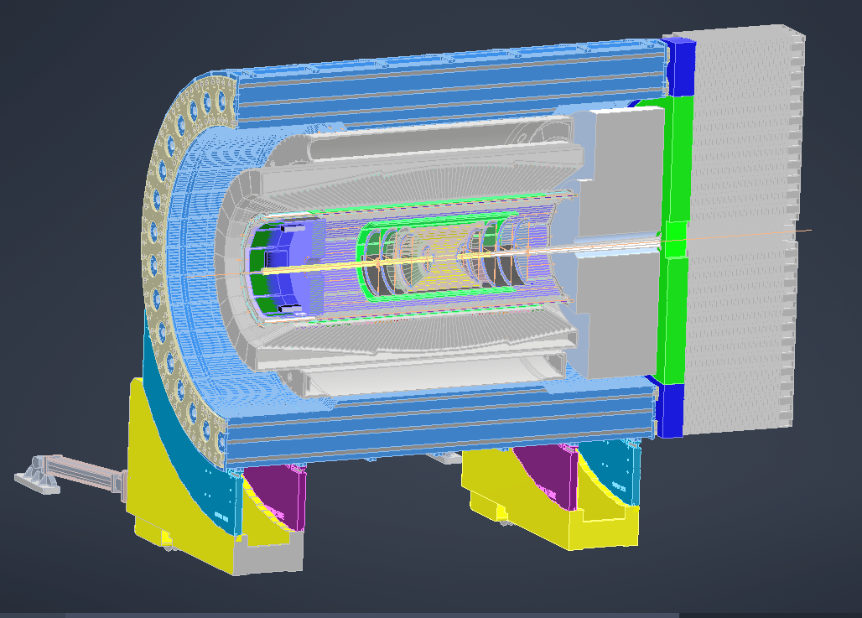

Slide 5
