Slide 1
Beam Backgrounds and Why we should care
Elke-Caroline Aschenauer (BNL)
Co-Associate Director for the
EIC Experimental Program
June 16th, 2022

Slide 2
Why we should care about beam backgrounds
56 layers (r = 168-1111 mm)
56 layers (r=168-1111 mm)
4layers of double-sided silicon strip
sensors (r = 39, 80, 104, 135 mm)
2 layers of DEPFET pixel sensors
(r = 14, 22 mm)

Slide 3
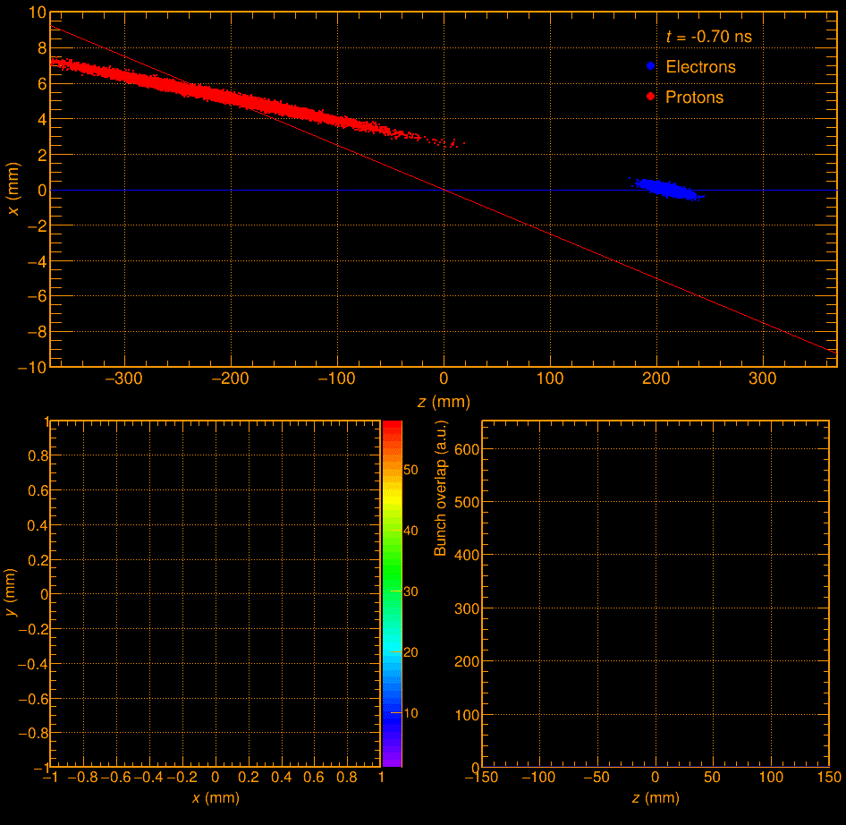
Important particle beam parameters
Angular beam divergence
Angular “spread” of the beam away from the central trajectory.
Gives some small initial transverse momentum to the beam particles
→ impact on p_{T} resolution
Beam Energy spread
beam energy is a gaussian centered on value i.e 5 GeV, with a RMS ~10⁻⁴ GeV
Crossing Angle
Impact on main detector acceptance → beams not back to back → solenoid aligned with electron beam → very small charged particle bending on one side of the outgoing hadron beam line → poor momentum resolution (and a strong functional azimuthal asymmetry of the acceptance at high η)
transverse vertex (x-direction) is depending on what collisions ones has head head vs. tail-tail
Bunch length
both beams have a longitudinal extension hadron beam < 10 cm & electron beam ~1cm
movie courtesy J. Adam

Slide 4
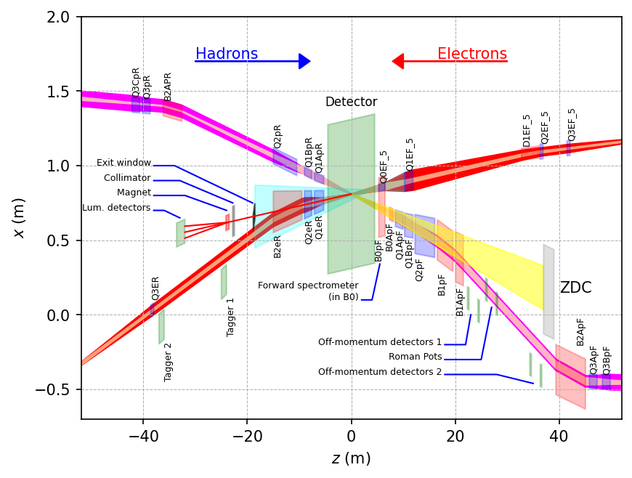
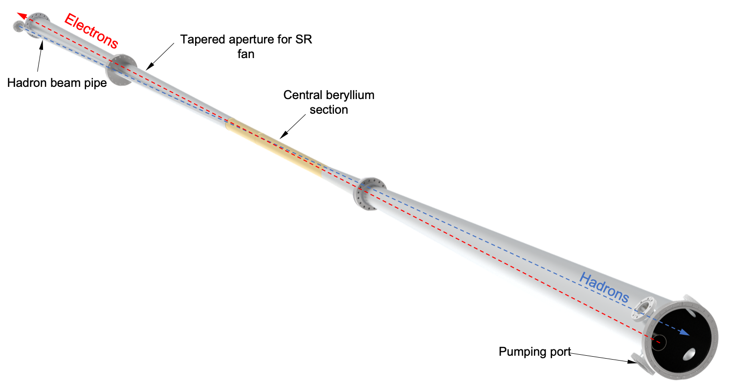
Beam Background / Radiation at IR
The HERA and KEK experience show that having backgrounds well understood, is crucial for the EIC collider and detector performance
There are several background/radiation sources :
primary collisions
beam-gas induced
synchrotron radiation
Note:
different to HERA and KEK the length of beam pipe the both beam share, is thanks to the crossing angle minimized
GEANT4
Ring Inside
Ring Outside

Slide 5
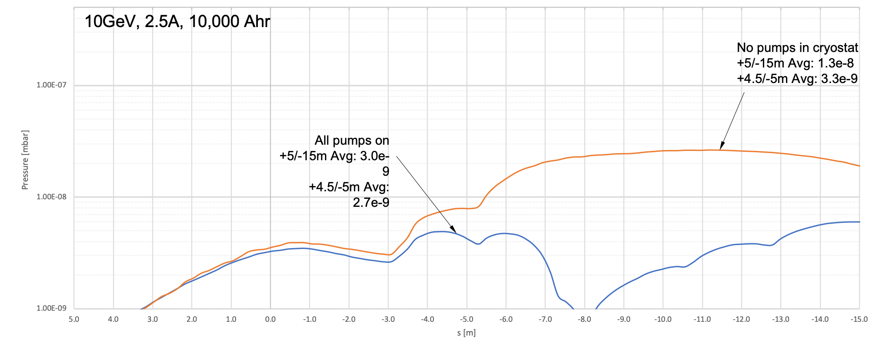
Beam Background / Radiation at IR
Assumptions
all beam effects integrated in simulations
based on vacuum profile for 10000 Ah (blue)
10000 Ah correspond to 5month @ 10³⁴ cm²s⁻¹
Both beams
Touschek scattering is related to intra-beam scattering, leads to particle loss, and hence a reduction in the beam lifetime → simulated by accelerator colleagues → design of momentum collimators
Touschek: Single-scattering IBS, so to speak. Transfer of transverse momentum, from the transverse focusing, into the
longitudinal direction when two electrons scatter off each other. The resulting longitudinal momentum exceeds the bucket height.
Touschek lifetime: from EIC-CDR is 5.27 h @ 10 GeV
and such not a major concern for EIC
GEANT4
$$\frac{1}{τ}=\frac{N}{γ^{2}σ_{x}σ_{y}σ_{z}δ_{acc}^{3}}$$

Slide 6
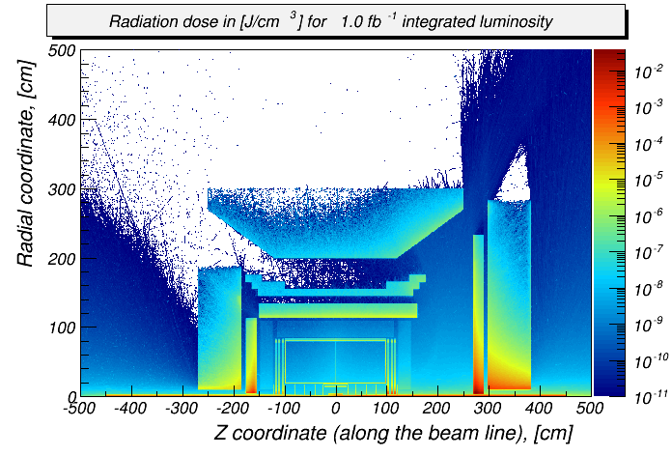
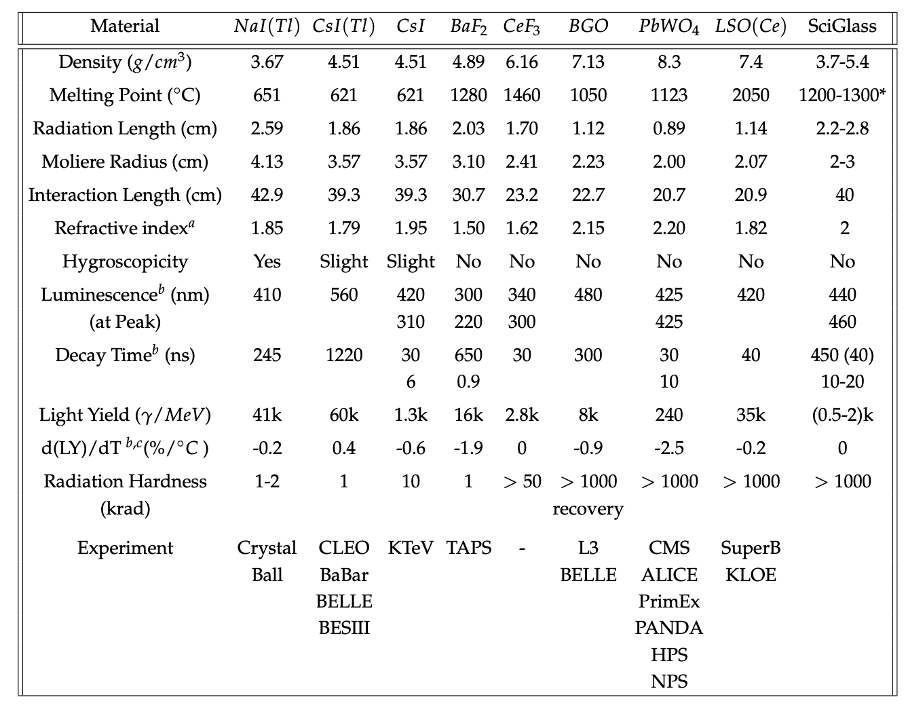
Beam Background / Radiation at IR
Primary collisions contribute a substantial fraction of the ionizing radiation and low energy neutron fluence in the experimental hall
Simulations use Pythia-6 well tuned to HERMES, COMPASS and HERA
rates: “min-bias” DIS data → Q²> 10⁻⁹ GeV²
Ionizing radiation factor 100 lower than at LHC
Reference Detector
→ backward EmCal: ~250 rad/year
(at a luminosity ~10³³ cm⁻² s⁻¹)

Slide 7
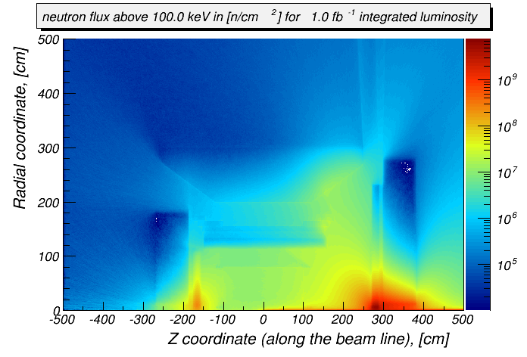
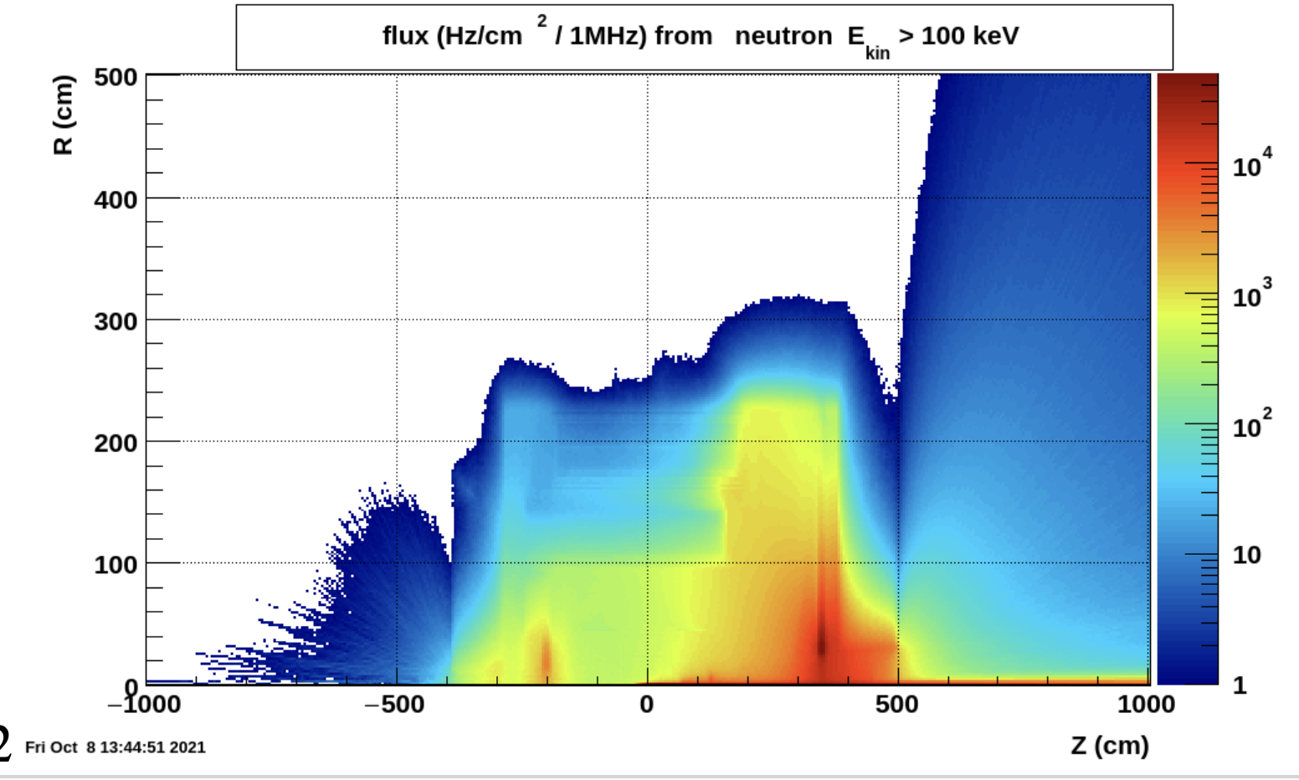
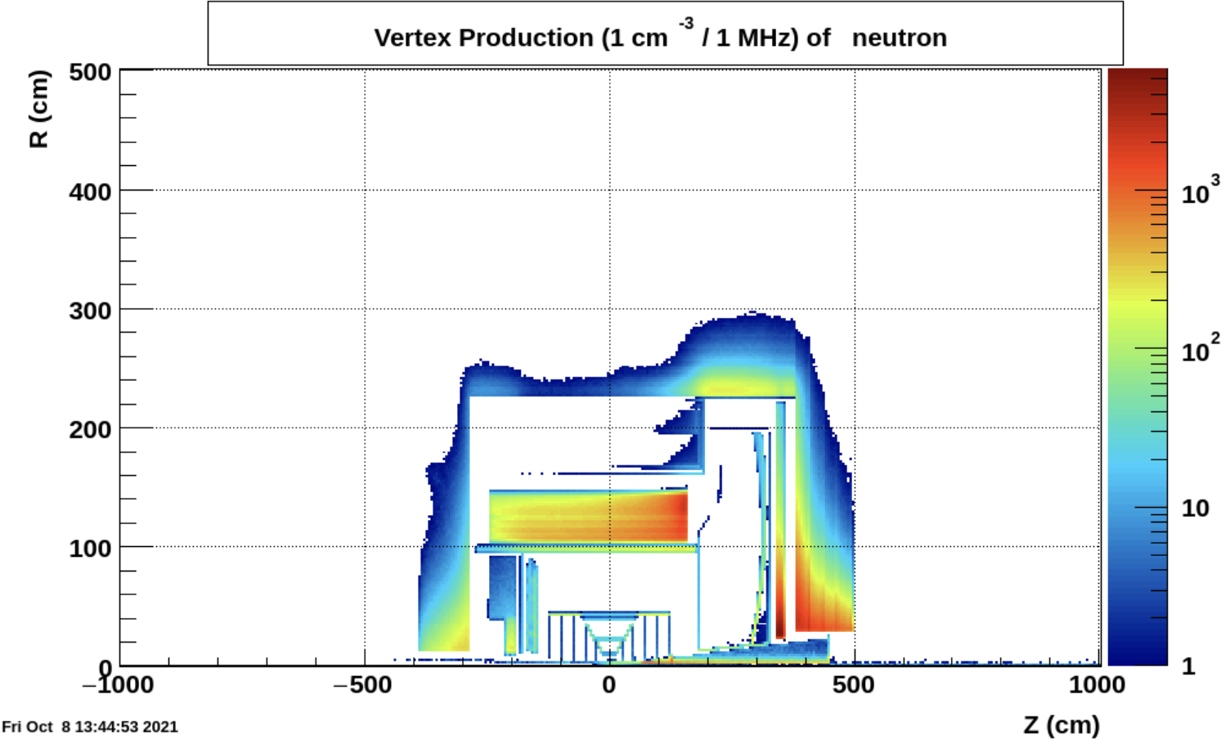
Beam Background / Radiation at IR
Primary collisions contribute a substantial fraction of low energy neutron fluence in the experimental hall → important for SiPMs
Reference Detector
ATHENA
∫L_{ep}: 45 nb⁻¹ x 22000 → 1fb⁻¹
ATHENA
∫L_{ep}: 45 nb⁻¹ x 22000 → 1fb⁻¹
→ forward EmCal: up to ~5*10⁹ n/cm² per fb⁻¹ (inside the towers); perhaps ~5 less at the SiPM location
These studies need to be redone if detector design changes
Validation: Yuri Fisyak et al. NIM A 756 (2014) 68-72, arXiv:1310.2495
be careful with older GEANT-4 version → underestimate low energy neutron production → EIC-UG SW group guidance for best physics lists

Slide 8
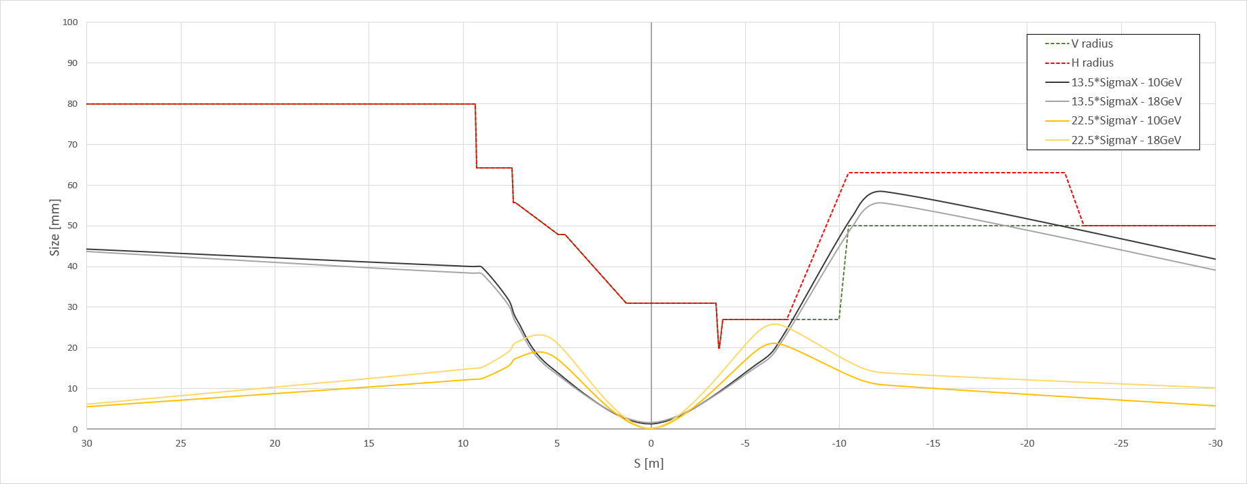
Beam Background / Radiation at IR
Electron beam:
Higher order mode losses
Local heating at injection and ramp (short bunches)
degradation of vacuum
not relevant for EIC as we inject on energy and keep impedance low in the IR
background due to de-excitation of beam if bunches are replaced
Note: 2 electron bunches are replaced per 1 s
There should be “no” background for the experiment as the idea is to shave off the electron tails beyond 6 σ in the transfer line.
Electrons are injected on orbit and on energy (with reasonable errors) in one sigma, this is also required to not impact the proton beam performance
Injection is at IP-12
a 6 σ electron beam would always be well within the aperture limits of of 13.5/23 σ.
GEANT4

Slide 9
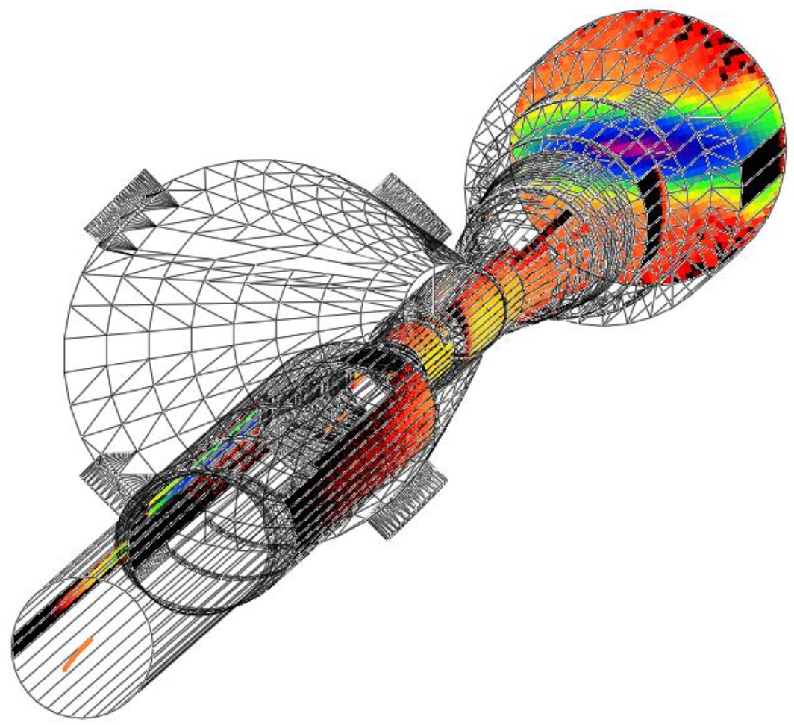
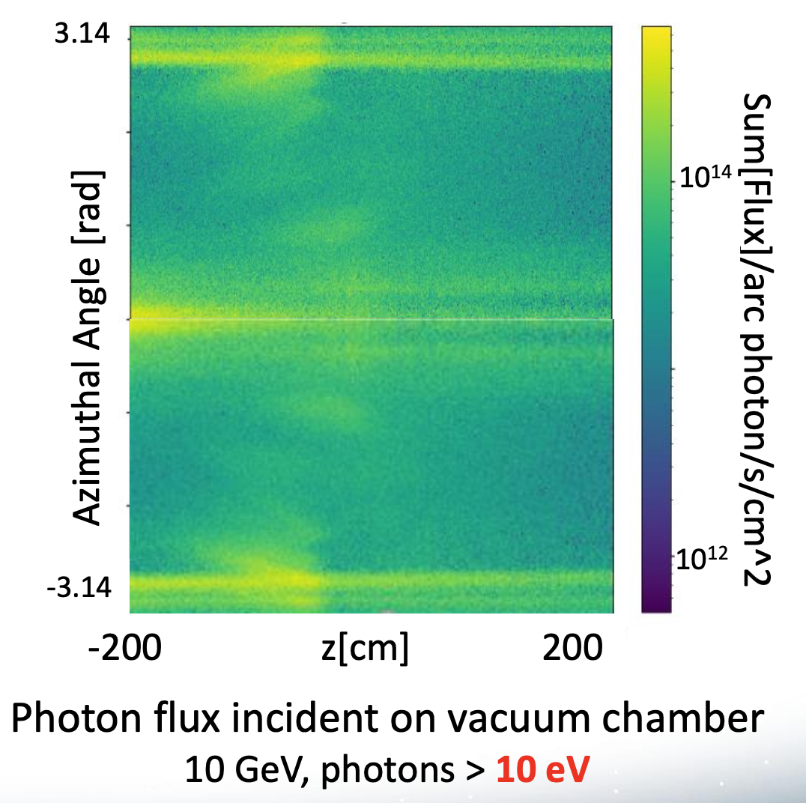
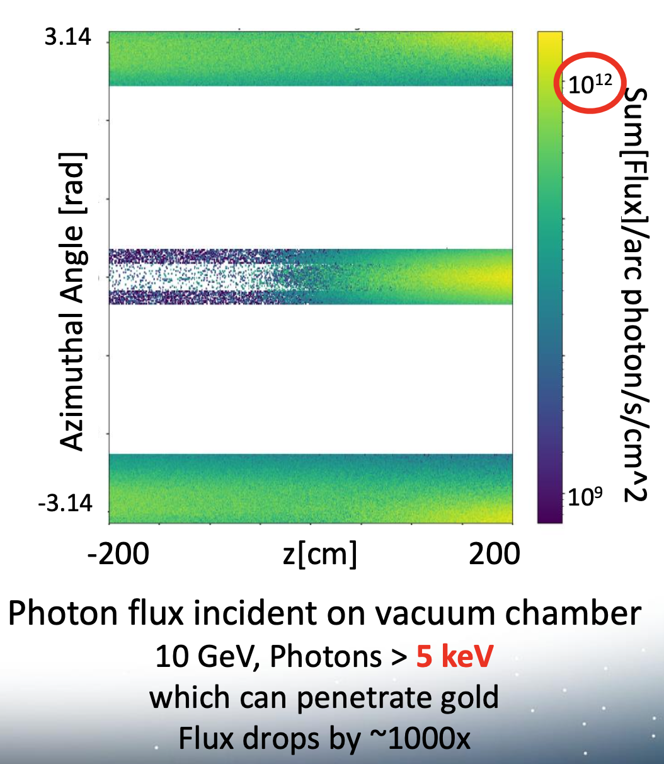
Beam Background / Radiation at IR
Electron beam:
Synchrotron radiation (more details see Rey’s talk)
extensive simulations by of SR by accelerator background WG group
Understanding
SynRad+ modeling software
Input:
3D model of beampipe
Beam emittance, current Magnet locations and fields
Output:
Synchrotron Radiation – Position, Flux, Energy, Direction
Synchrotron Radiation Mitigation:
Photon absorber configuration:
Horizontal plane only
Annular configuration
Length, diameter, position
Beamline dimensions:
Wider beam pipe for
13.5 σ clearance in x
23 σ clearance in y
Beampipe material/structure
2-5 μm Au coding
Sawtooth/ridge texture
for photon absorption

Slide 10
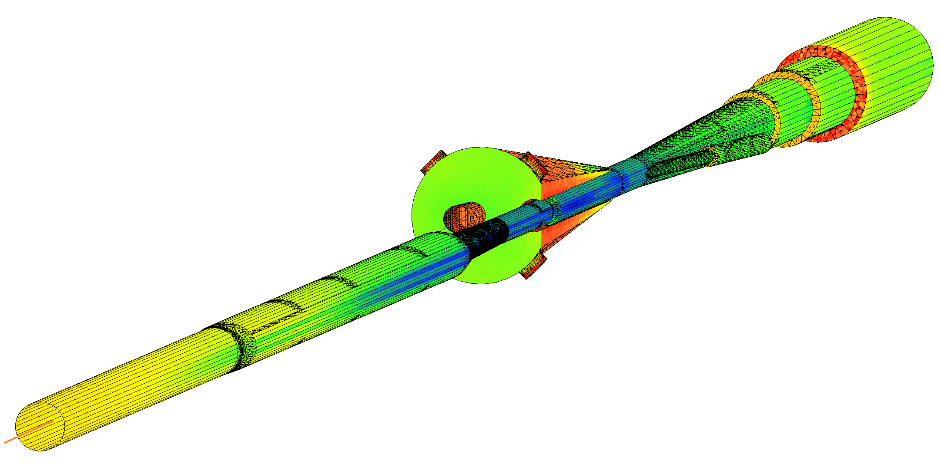
SynRad+/Molflow+ Coupled Simulations
Pump ports
Geometry imported from SynRad+ to Molflow+
Photon flux density on surfaces
Convert to desorption
Pressure profile along beamlines
Applied as surface outgassing

Slide 11
Pressure Profile Inside Forward Cryostat
eR IP1
FPA
eF IP1
eF IP2
eF IP3
eF IP4
eF IP5
Detector
Q0eF
Q1eF
10GeV, 2.5A
100 Ahr, no pumps in cryostat
+5/-15m Avg: 1.5e-7
+4.5/-5m Avg: 3.5e-8
10,000 Ahr, no pumps in cryostat
+5/-15m Avg: 1.3e-8
+4.5/-5m Avg: 3.3e-9
10,000 Ahr, all pumps
+5/-15m Avg: 3.0e-9
+4.5/-5m Avg: 2.7e-9

Slide 12
Beam Background / Radiation at IR
Electron beam:
Beam gas interactions (more details see Jarda’s talk)
generation of non-gaussian tails → accounted in accelerator simulations
Off momentum electrons → will be shielded by collimators → simulations of collimation system underway
Main contribution for detector background
Bethe-Heitler process: e_{Beam} + H²_{restgas} → e’ + γ + H²_{restgas}
proton beam:
Low beam lifetime during injection and ramping → collimator setup → simulation by accelerator colleagues, but ample experience for 21 y of RHIC running
Beam gas interactions (more details see Zhengqiao’s talk)
concern: large hadronic cross section p/A + H²_{restgas}
Secondary interactions with aperture limitations, i.e. magnets, beam pipe, masks
Beam-gas interactions are also one of the main sources of neutrons that thermalize within the detector hall and can cause damage.
GEANT4

Slide 13
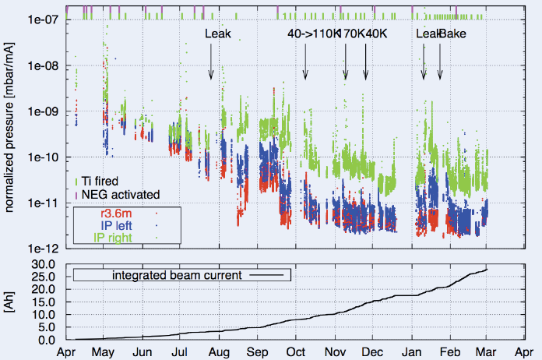
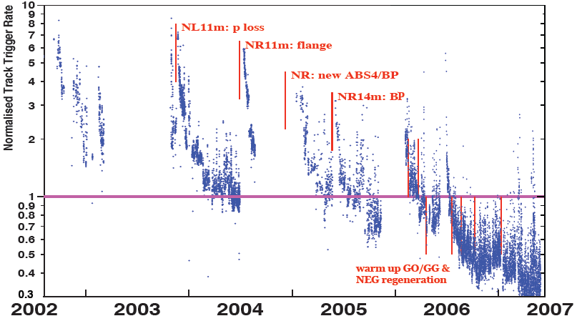
Keeping the Vacuum Level
It is critical to keep vacuum at level after 10000 Ah
→ Lesson learnt from HERA
Pressure vs. integrated electron current 2002 - 03
Proton Beam Gas Background
Two-time constants for vacuum conditioning
Short term after leaks 20 – 30 days
Long term 600 days

Slide 14
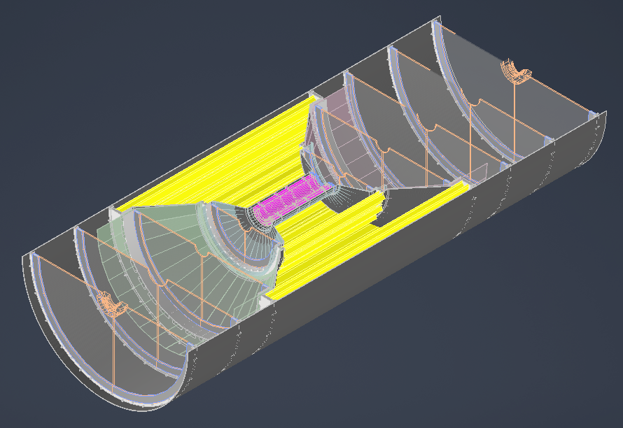
How to Retain Vacuum in IR
Challenges to retain vacuum in IR
for maintenance detector needs to be moved in service position @ Assembly hall
requires to break vacuum
no space for vacuum valves
in detector volume
8m beam pipe will be under air
Mitigation Strategy:
develop procedure how to best break vacuum → vent under dry nitrogen
cannot use the standard bake-out procedure, i.e. neg-pumps
Si will get to hot if too close to the beam-pipe
study currently bake-out with hot gas → need air gap between beam-pipe and 1st MAPS μ-vertex layer (~5mm)
ANSYS-calculations are in full swing
MAPS - Tracker

Slide 17
Lessons from HERA II upgrade
HERA performed an upgrade to increase luminosity by a factor of 5
Mainly by squeezing the beam more at the IP by redesign of the IR
The upgrade increased backgrounds dramatically → Several month shutdown to implement improvements
Main culprits:
no careful simulations prior to the upgrade
Proton beam-gas interactions most severe background
Needed an extremely good vacuum to mitigate this
Synchrotron radiation background
Background to detectors
Excess heating of beam pipe
Can damage flanges, etc.
Can heat beam pipe, decreasing vacuum
Electron beam-gas

Slide 18
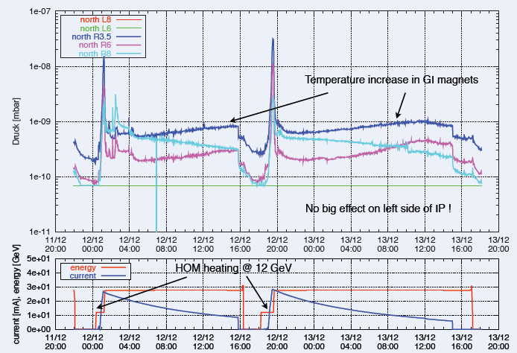
Lessons from HERA II upgrade
Dynamic pressure increase due
to thermal and photo desorption
Pressure vs. integrated electron
current 2002 - 03
Proton Beam Gas Background
Two time constants for vacuum
conditioning
Short term after leaks 20 – 30 days
Long term 600 days

