Slide 1




EICROC0
F. Bouyjou, E. Delagnes, F. Dulucq, M. Firlej, T. Fiutowski, J. Gonzalez, F. Guilloux, M. Idzik, C. de La Taille, J. Moron, L. Raux, K. Swientek, D. Thienpont, D. Marchand, C. Munoz, M. Morenas, N. Seguin-Moreau, L. Serin
20 may2022

Slide 2
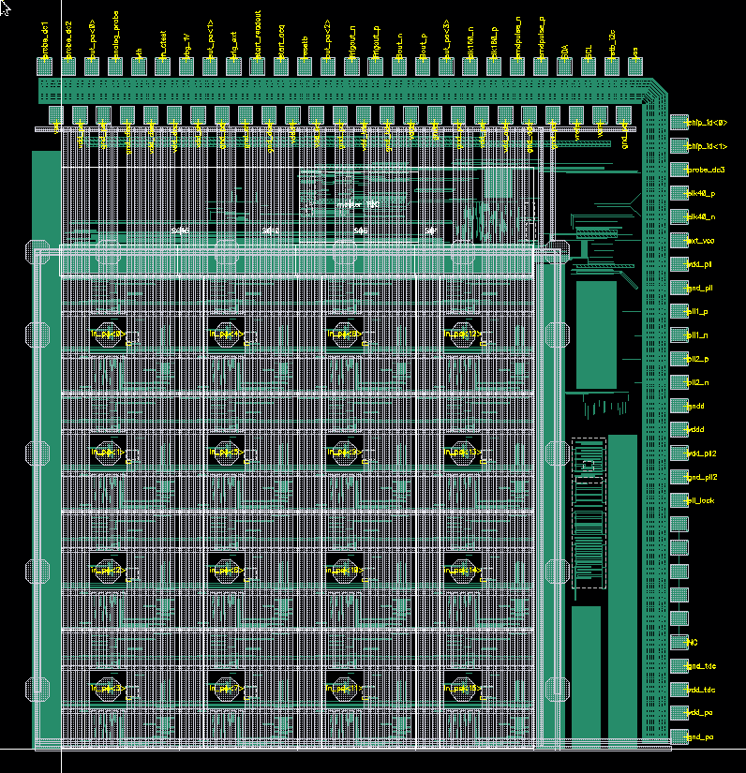
Overview EICROC0
4x4 500 um pixels matrix
  Notice bump pad slightly off-centered by 50um (x=200,y=250)
  Wire bonds on top only
    Double row with 100 um pitch. 80um pads
    50 um effective pitch
    Right side pads for PLL test structures for ATLAS and CMS
Send to fabrication march 2022
  Expected back end june/beg july

Slide 3

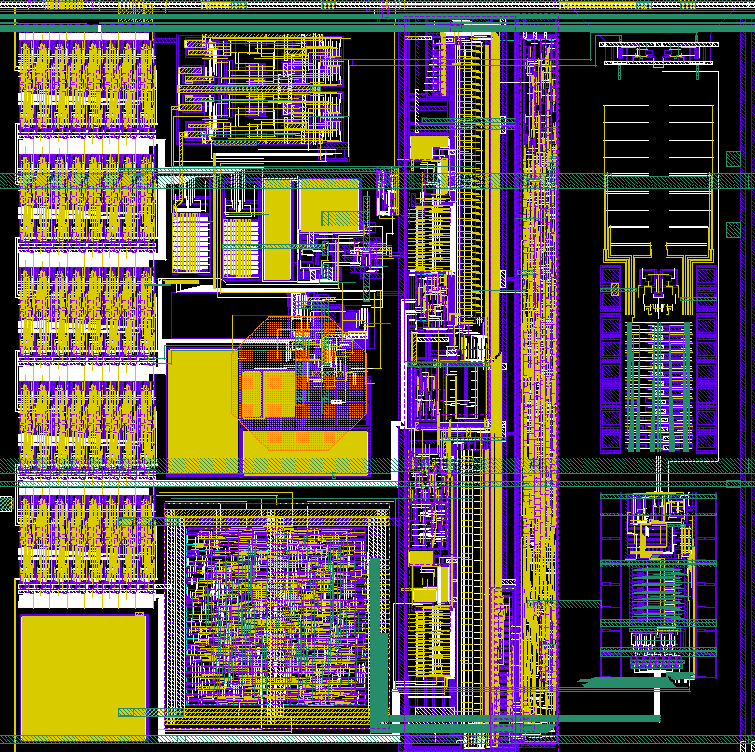
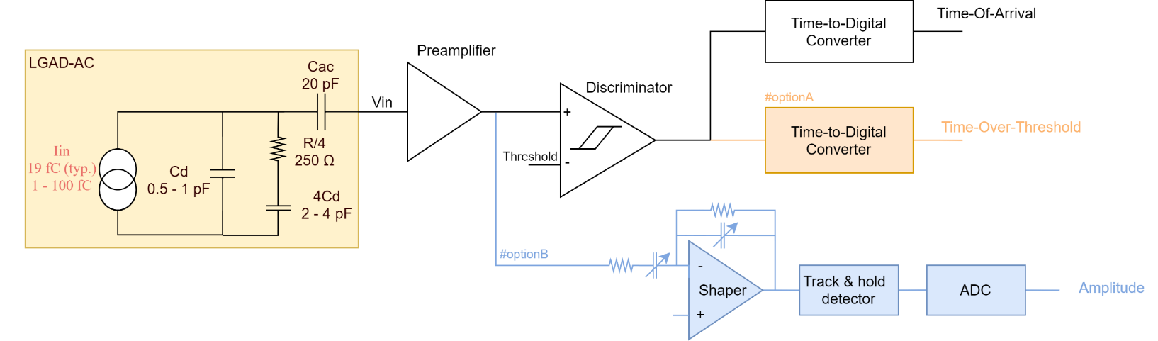
One pixel
One pixel design
  Preamp, discri taken from ATLAS ALTIROC
  I2C slow control taken from CMS HGCROC
  TOA TDC adapted by IRFU Saclay
  ADC adapted to 8bits by AGH Krakow
  Digital readout : FIFO depth 8 (200 ns)
5 slow control bytes/pixel
  6 bits local threshold
  6 bits ADC pedestal
  16 TDC calibration bits
  Various on/off and probes
Slow control
PA +discri
TOA TDC
8b 40M
ADC

Slide 4
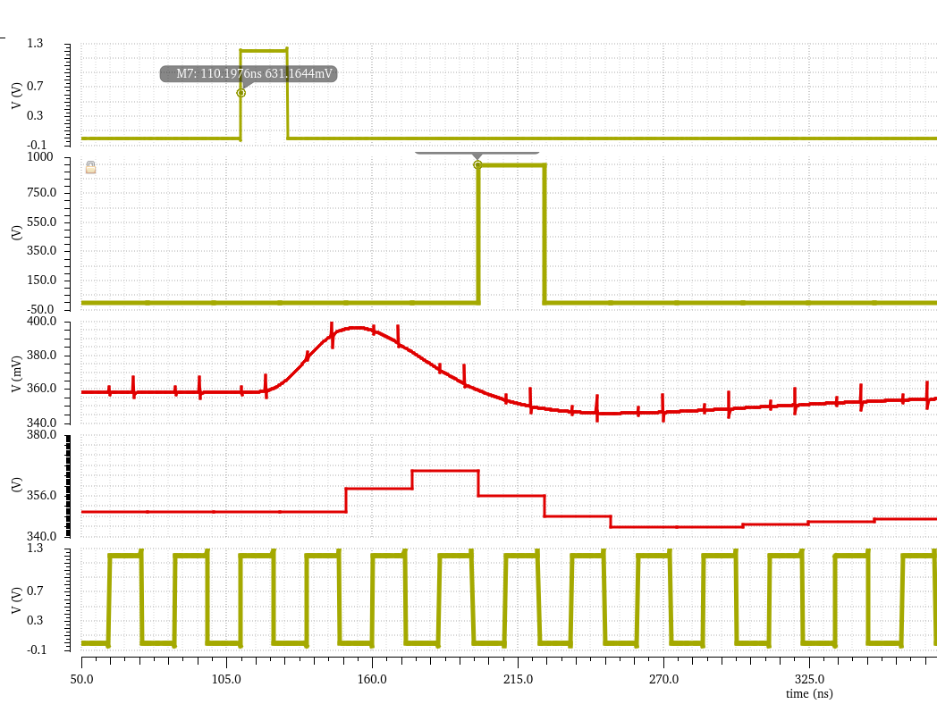
waveforms
Illustration from another (similar) chip
TOA discriminator
100ns
TOA digitized value
1 pe
ADC digitized value
clock

Slide 5
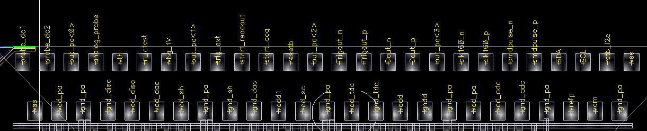
pinout
1

Slide 6
Analog in/out
Analog signals
  16 inputs. Input impedance ~1 kOhm. Possibility to disable preamp and clamp to gnd.
  4 probe_pa : preamp output for each column. Row selected by slow control
  2 probe_dc : 32 DC bias points selected by SC
  Analog-probe : channel_wise selectable to visualize preamp/shaper/threshold values
  In_ctest : test pulse amplitude (DC) from 6bit DAC
    can also be used to inject an analog pulse in 50 fF
  Vth : threshold value (from internal 10bit DAC)

Slide 7
Digital I/Os
Digital inputs
  CLK_160p/n : differential CLPS 160 MHz clock. Divided by 4 internally to make the 40 MHz
  Cmd_pulsep/n : differential CLPS to trigger the calibration pulse.
  Trig_ext : CMOS 1.2V pulse to calibrate TDC
  Start_acq : CMOS 1.2V level to start/stop acquisition
  Start_readout : CMOS 1.2V rising edge to start the readout.
  I²C SDA/SCL open drain I/O (1.2 V) external pull-up required
  Resetb : 1.2V asynchronous reset for state machines. Does not reset I²C registers.
    Should be used to select the phase of the 40 MHz at initialization.
Digital outputs
  Dout_p/n : differential CLPS data stream out at 40 MHz
  Trig_out_p/n : differential CLPS trigger output. Wired OR16 of all discriminators (maskable by SC)
CLPS : +/- 100-200 mV centered on 600 mV

Slide 8
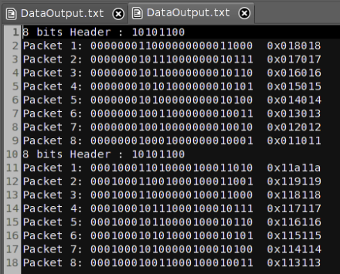
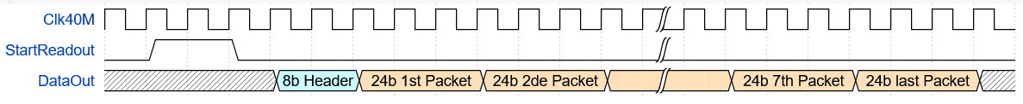
Readout
2 control signals : start_acq and start_readout
  Start_acq==1 => continuous 40 MHz writing in digital circular buffer (depth = 8 = 200 ns)
  Start_acq == 0 => stop writing : « freeze » event in buffer
  Start_readout == ↑ => initiate readout : stream out the 16 pixels data

Slide 9
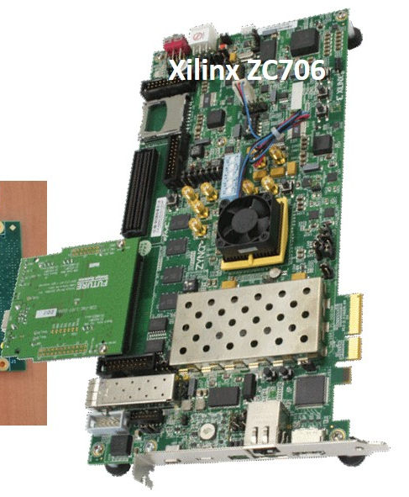
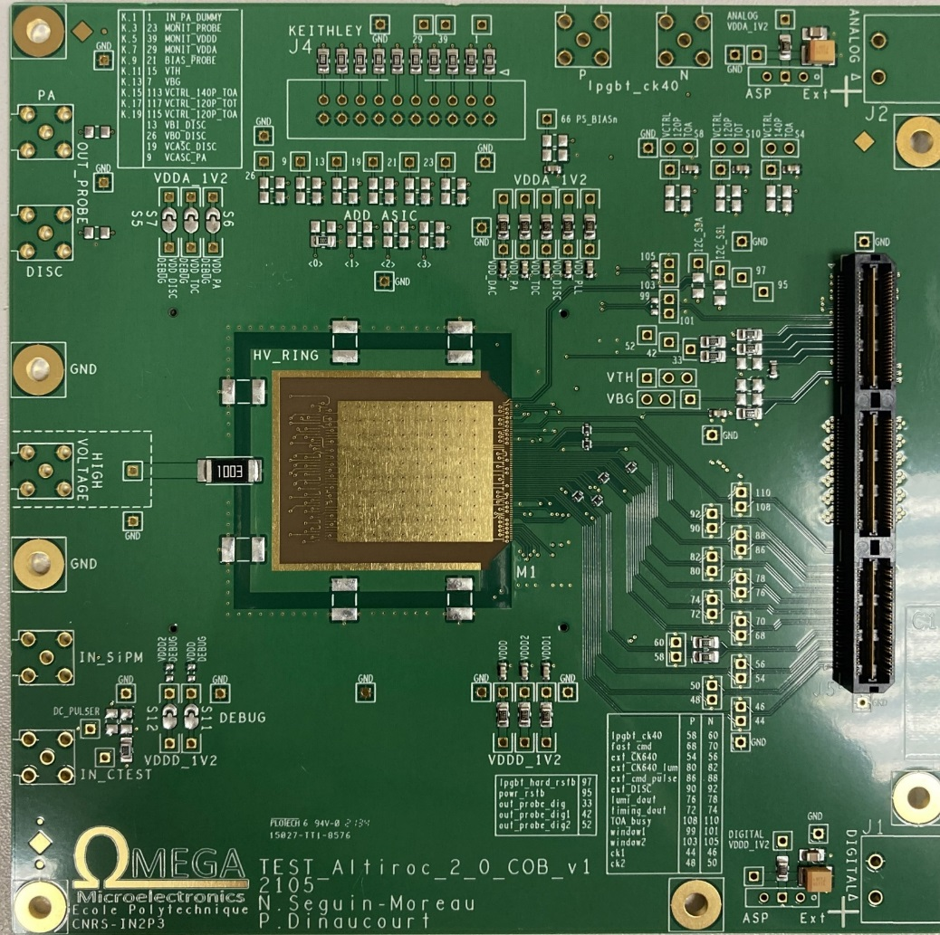
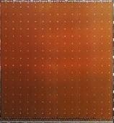
testboard
Connect to KCU via FMC connector
Level translators 1.2V – 2.5V
Space near chip to accomodate sensor
4 SMAs for preamps outputs
On-board regulators for LV
Wirebonds in 4 rows 200um pitch
Schematic/layout in progress
Fabrication mid june
Becomes FMC

