Slide 1
IR Laser test bench at IJCLab
Ana Torrentó
EIC meeting – 20/05/2022

Slide 2
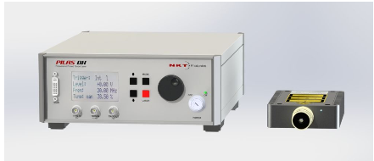
Laser informations
Model PILAS (picosecond pulsed diode laser) from NKT Photonics
1056.4 ± 7.4 nm
7 nW av. Power
150 mW peak intensity
0 – 40 MHz
35 ps pulse width (FWHM)
Jitter RMS = 10.8 ps
Fiber MFD: 5.3 – 6.4 μm @ 980 nm

Slide 3
Optical setup scheme
Laser head
Beam splitter
75%
Optics (lenses, mirrors, attenuators)
Detector PCB
XYZ table
Laser
25%
Photodiode
Driving signal
Synchro signal
Data signal
PC
Electrical connexion
Laser controller
Synchronisation signal
Detector ACQ
Detector / PCB power supply

Slide 4
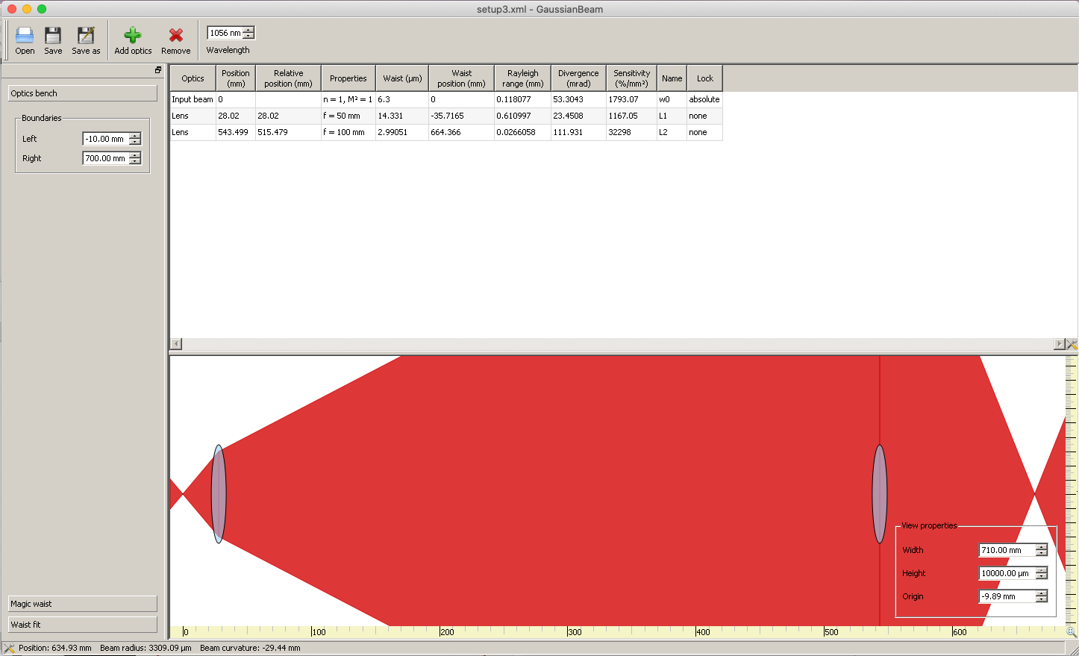
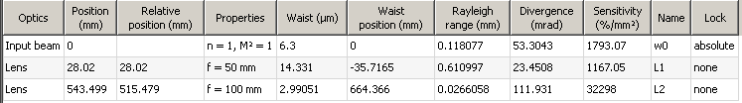
GaussianBeam Optical calculations – spot size
Distance lens – detector
Spot size (no difraction)
Airy disk size (difraction)
= 2.44*1.056 μm*(100mm/50mm)
= 5.15 μm
Theoretical Spot size :
∼ 3 + 5 = 8 μm
Distance last lens – detector :
664.4 mm – 543.5 mm= 121 mm

Slide 5
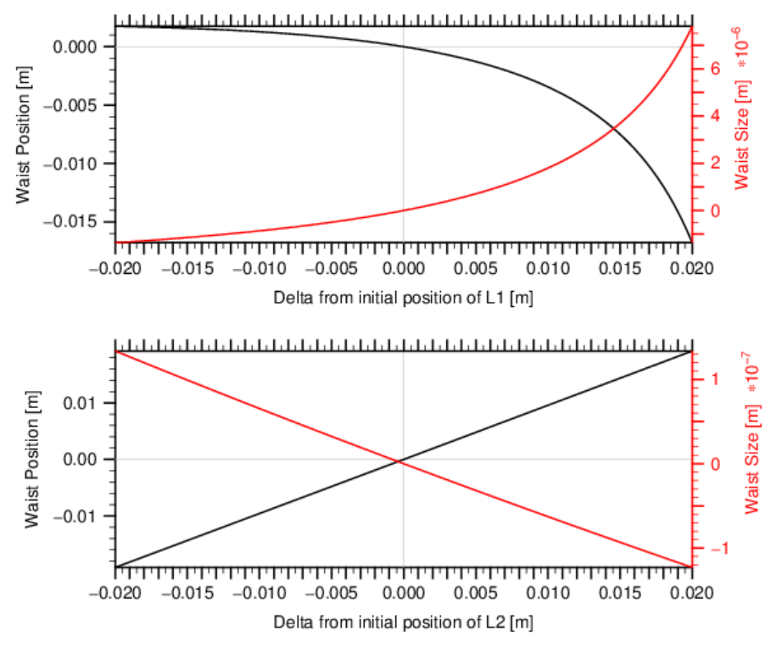
OptoCAD optical system optimisation
First lens : f = 50 mm, d = 25 mm
Very sensitive to position (non-linear)
Small displacement far from initial position
gives big increase of waist diameter and position
Second lens : f = 100 mm, d = 50 mm
Not sensitive to position (linear)
A displacement of 2 cm from initial position
gives a 0.1-μm increase on waist diameter and
waist position follows displacement linearly
Great !! We have more tolerance in position on the detector side ⇨ easier to adjust

Slide 6
Still ongoing
Purchase of alignement laser and IR camera
Alignement laser: fiber test device (laser which can be fiber coupled)
IR Camera:
  Borrow first a Color CMOS camera to play with and test if sensitivity to 1056 nm is ok
  Use it for system alignement
  For determining spot position probably detector signals are much more precise (it will also allow for vertical tilt correction)
Maybe in the future buy an automatic remote-controlled Z stage? (the one we have is manual – micrometer)

