Slide 1



Update on Silicon Design Work
23/05/22
Notes:
The abstract pattern can be removed or repositioned if required. Be careful to ‘Send to Back’ so that it does not obscure any important information.

Slide 2
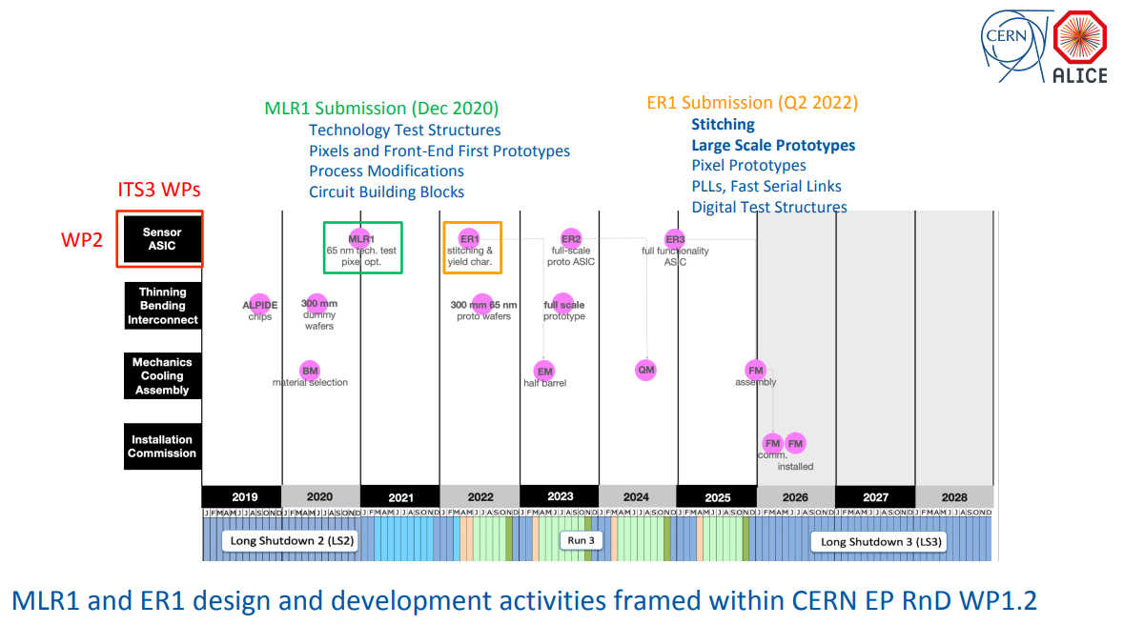
Timeline
Silicon Design
Very closely tied to ITS3/CERN EP R&D WP1.2
Next submission ER1
Critical part is to demonstrate stitching (CERN)
But also other small blocks
Section 1
Section 2

Slide 3


MLR1
Notes:
The abstract pattern can be removed or repositioned if required. Be careful to ‘Send to Back’ so that it does not obscure any important information.

Slide 4
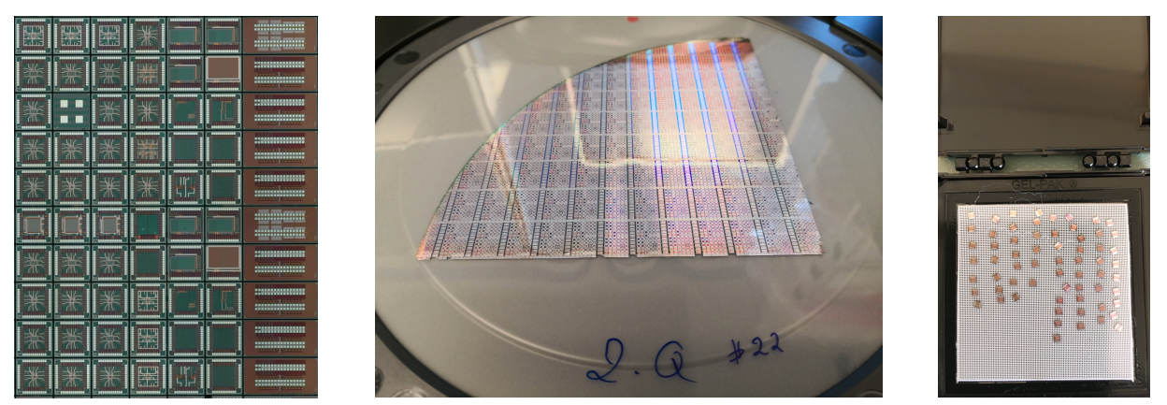
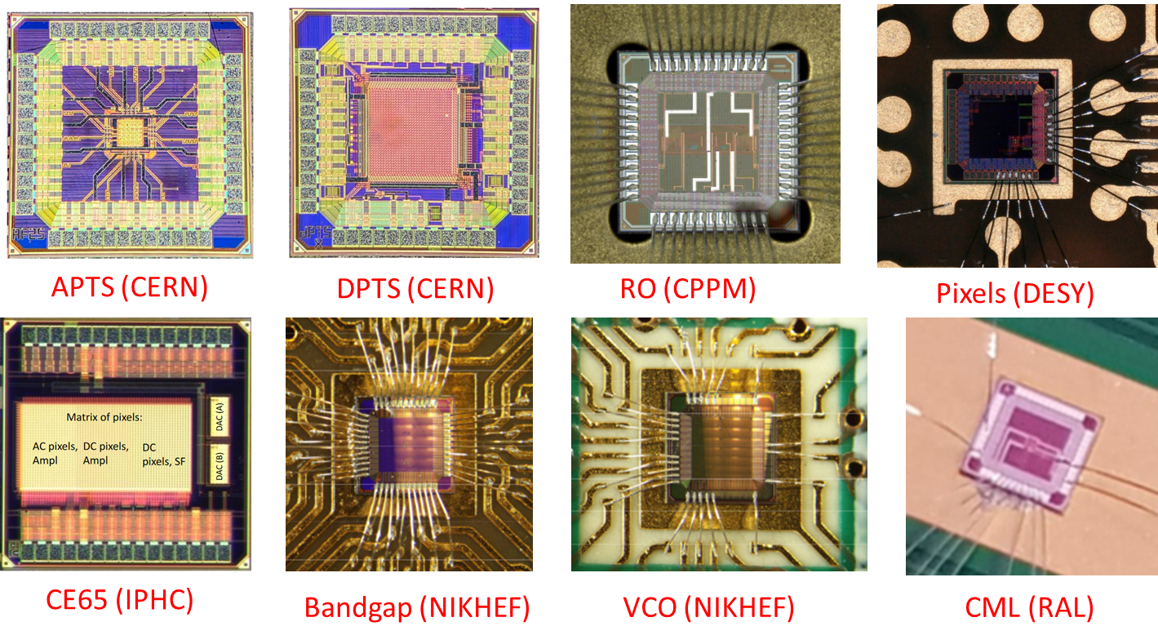
MLR1 Tests - General
Introduction
Update on MLR1 tests generally
More detail can be found in Latest WP1.2 Update: https://indico.cern.ch/event/1157236/contributions/4859440/attachments/2436938/4173788/2022_05_04_WP1_2_f.pdf
Update on testing from the UK

Slide 5
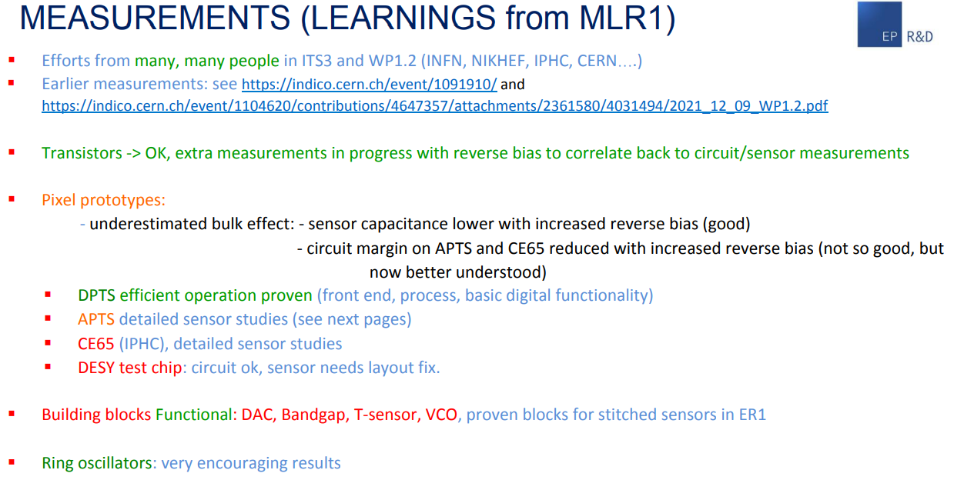
MLR1 Tests - General
https://indico.cern.ch/event/1157236/contributions/4859440/attachments/2436938/4173788/2022_05_04_WP1_2_f.pdf

Slide 6
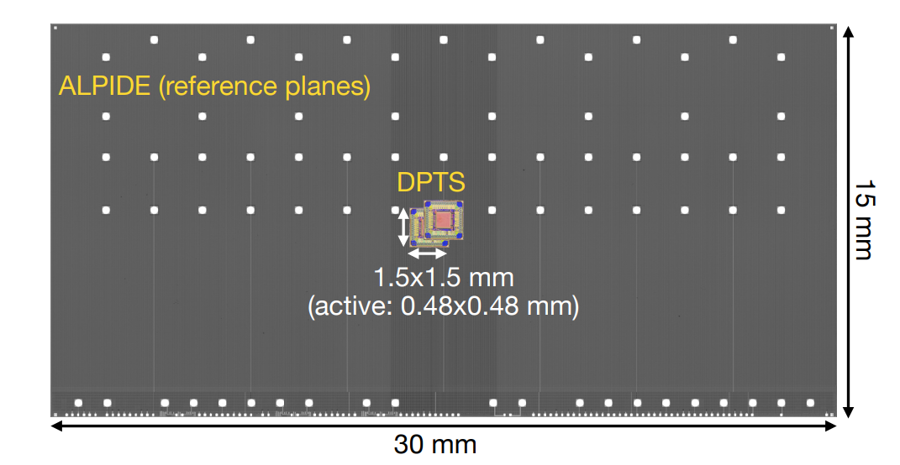
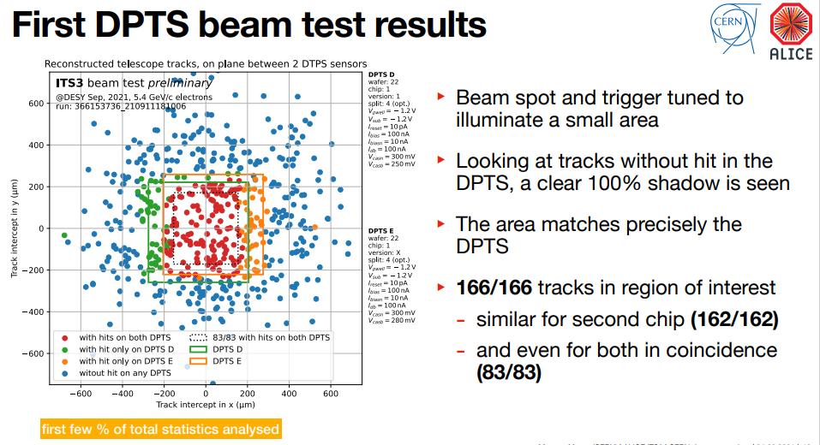
MLR1 Tests - General
Digital Pixel Test Structure (DPTS)
Key result after transistors probably performance of DPTS
High efficiency demonstrated
Detail here - https://indico.cern.ch/event/1084123/contributions/4558291/attachments/2323088/3956324/2021-10-06_EPRD12-ITS3-testbeam.pdf

Slide 7
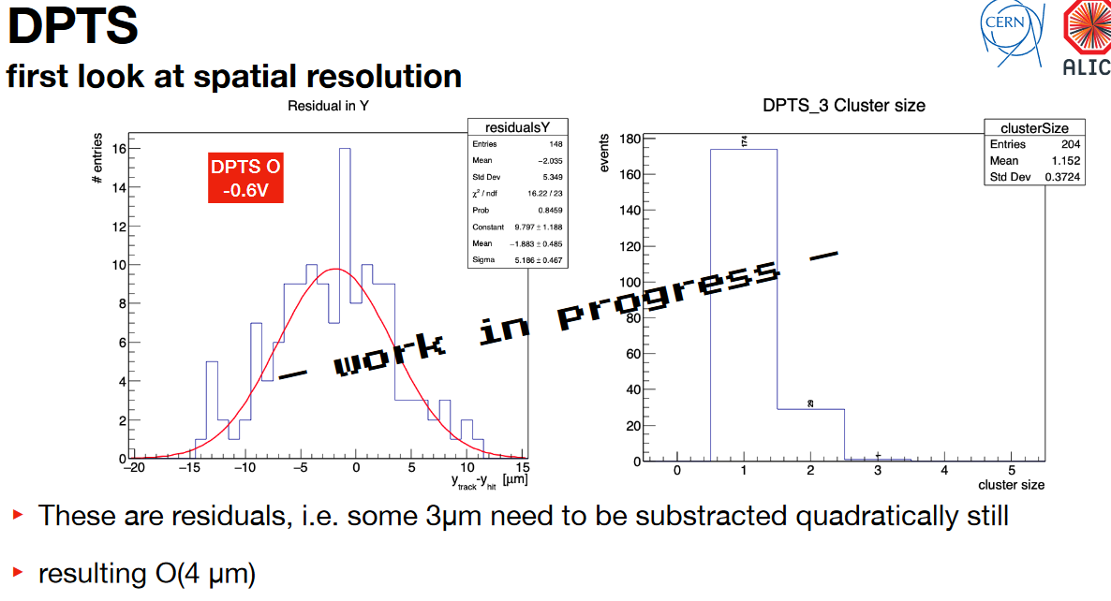
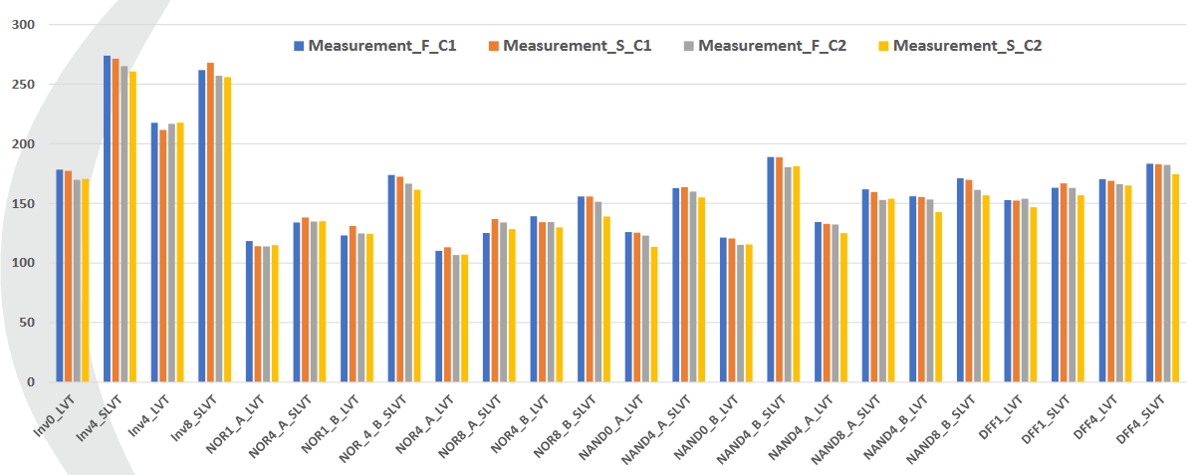
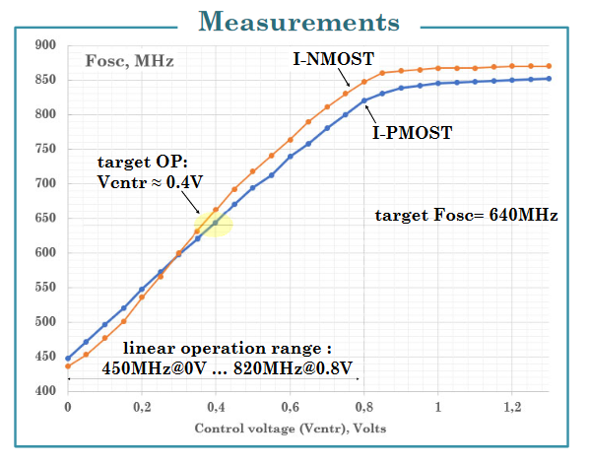
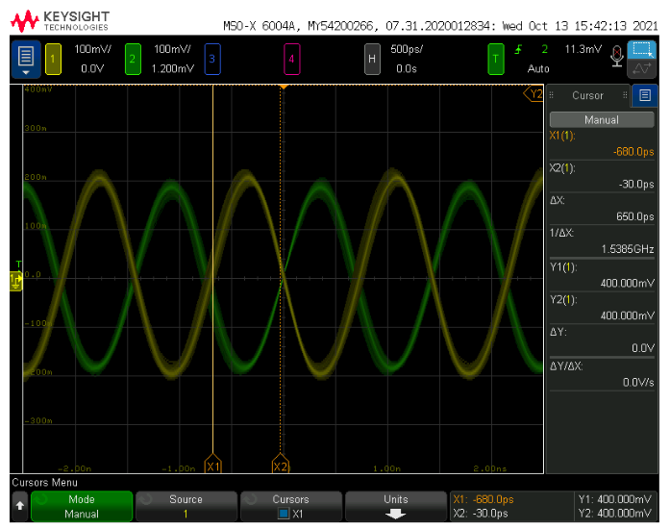
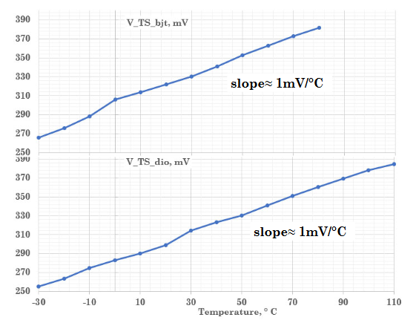
MLR1 Tests - General
Some results already presented at VCI2022:
https://indico.cern.ch/event/1044975/contributions/4663696/
https://indico.cern.ch/event/1044975/contributions/4663650/
https://indico.cern.ch/event/1044975/contributions/4663684/
DPTS and APTS both in beam test
RO shows good agreement with simulation. Irradiation planned.
Also many, many more. Transistor test structures, pixels, etc, etc…
https://indico.cern.ch/event/1091910/
Temperature sensor and VCO fully functional
CML driver fully functional. More advanced test system planned.

Slide 8
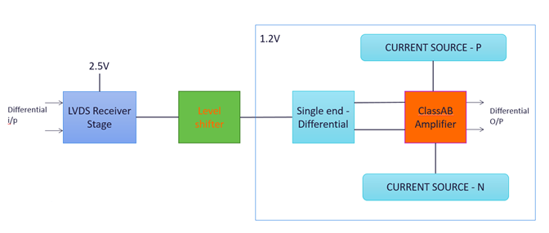
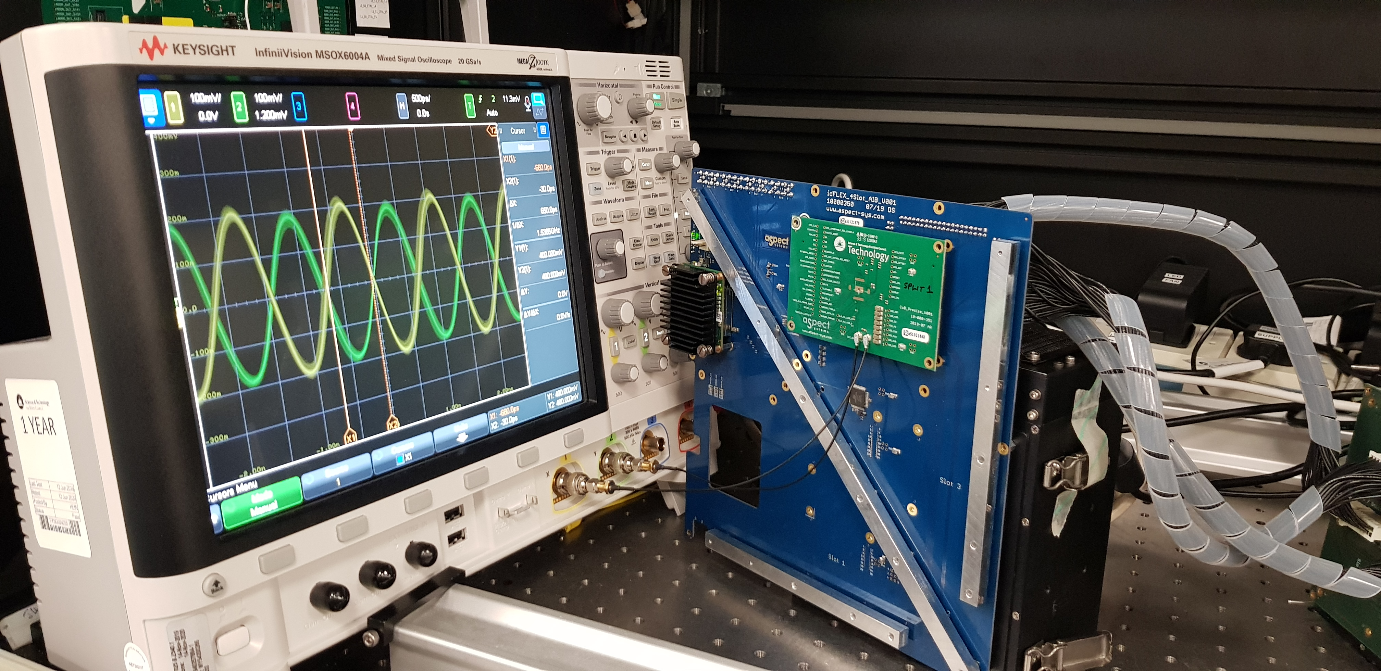
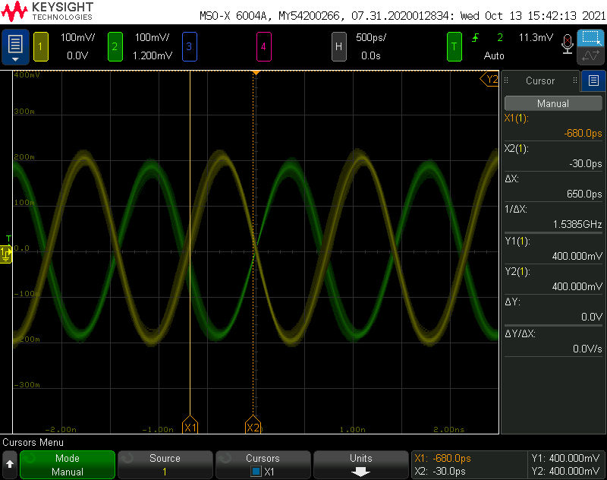
MLR1 Tests - Reminder
Testing
LVDS-CML Loop
Tested in existing system up to 700MBit/s
Functional, but needs more detailed characterisation

Slide 9
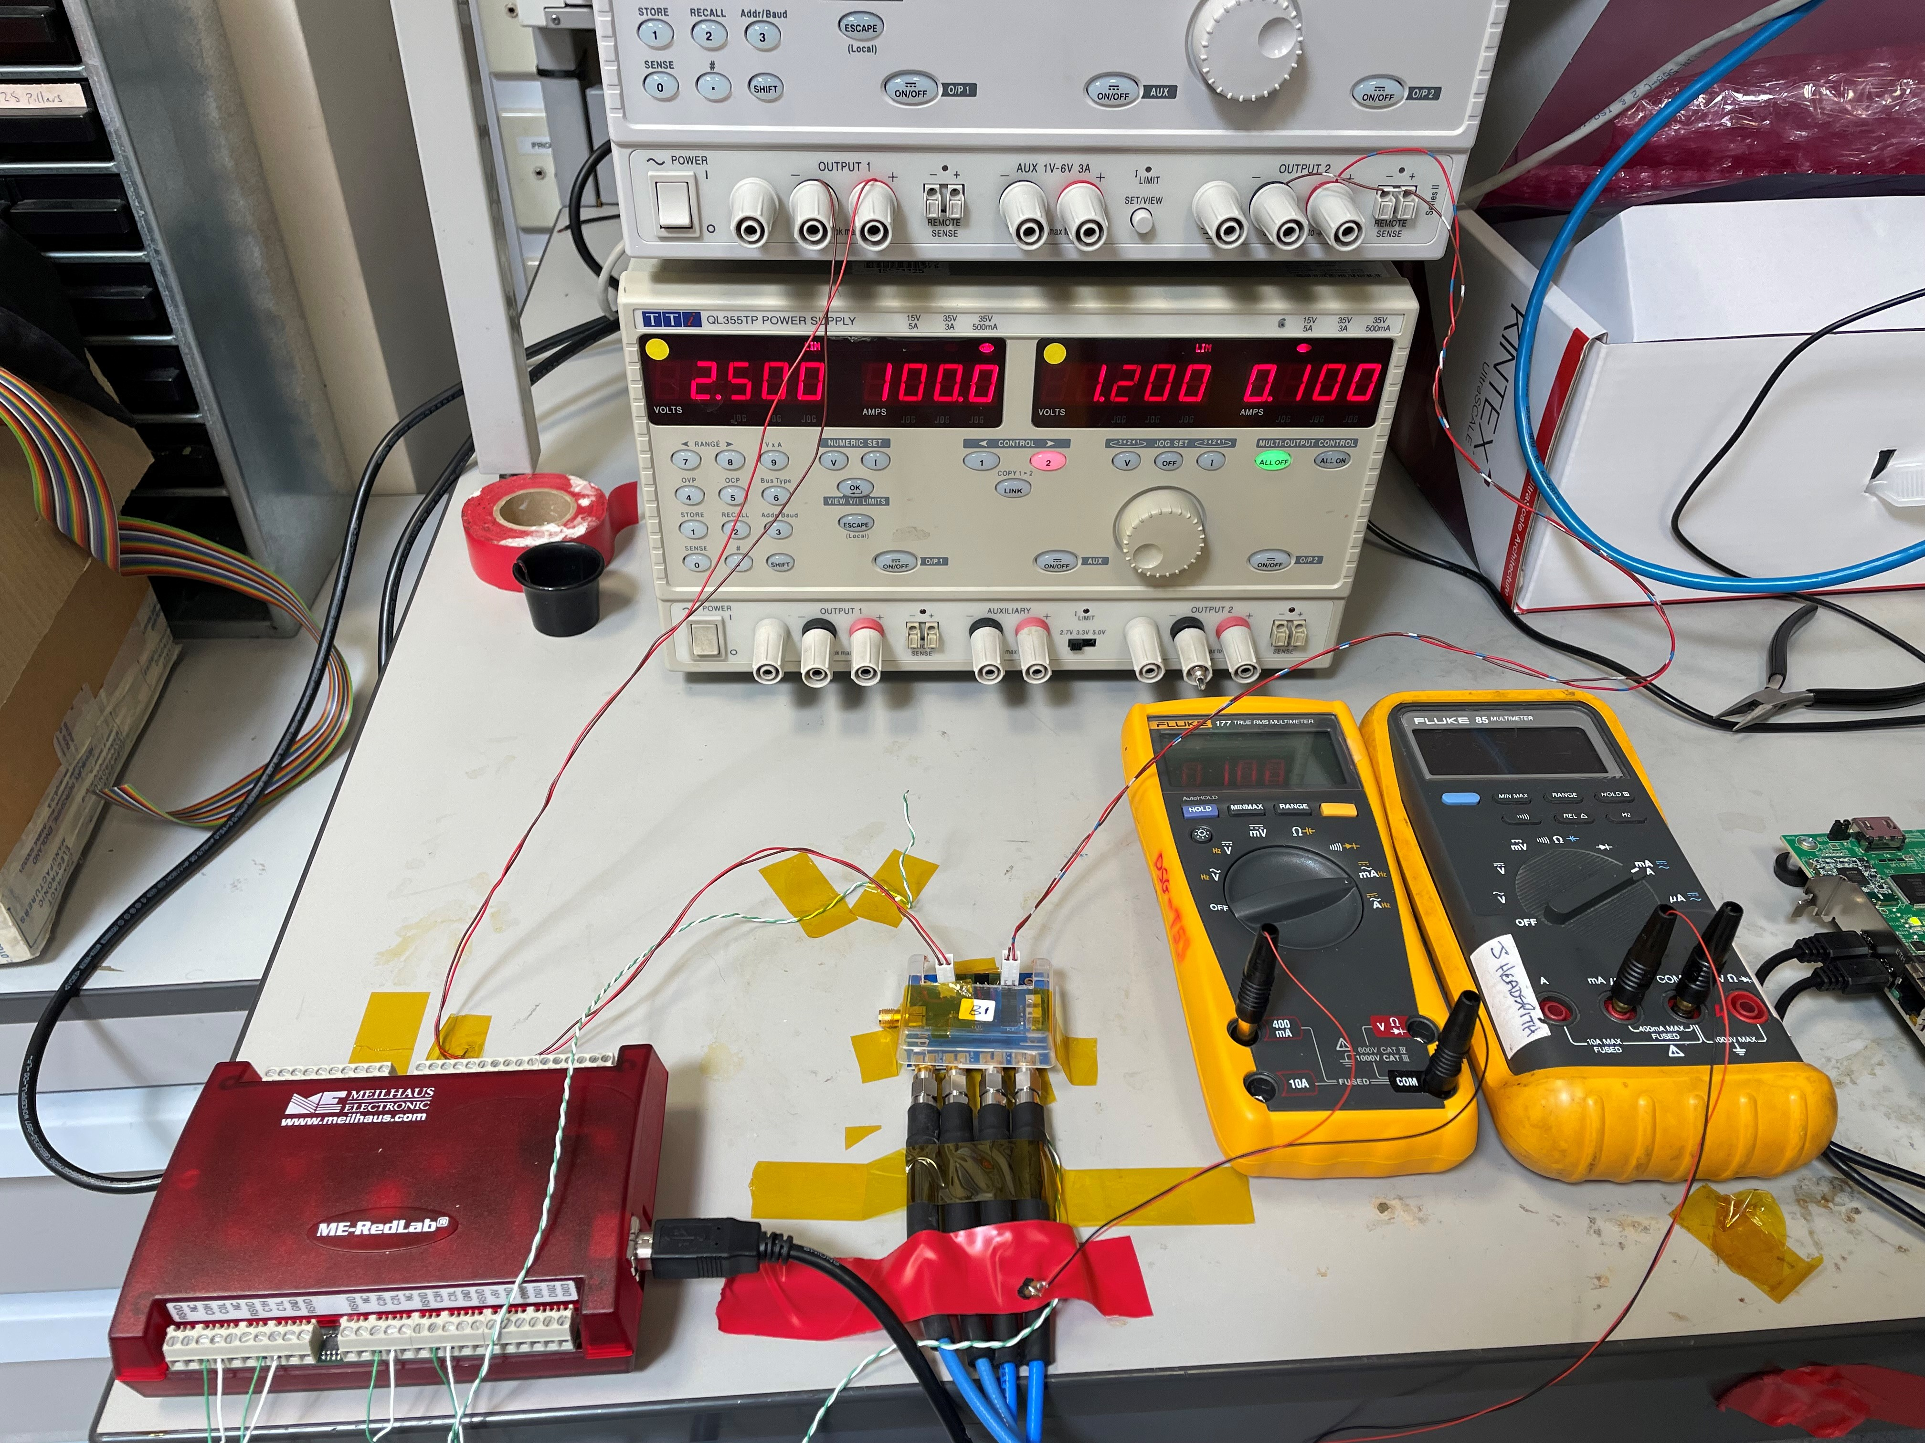
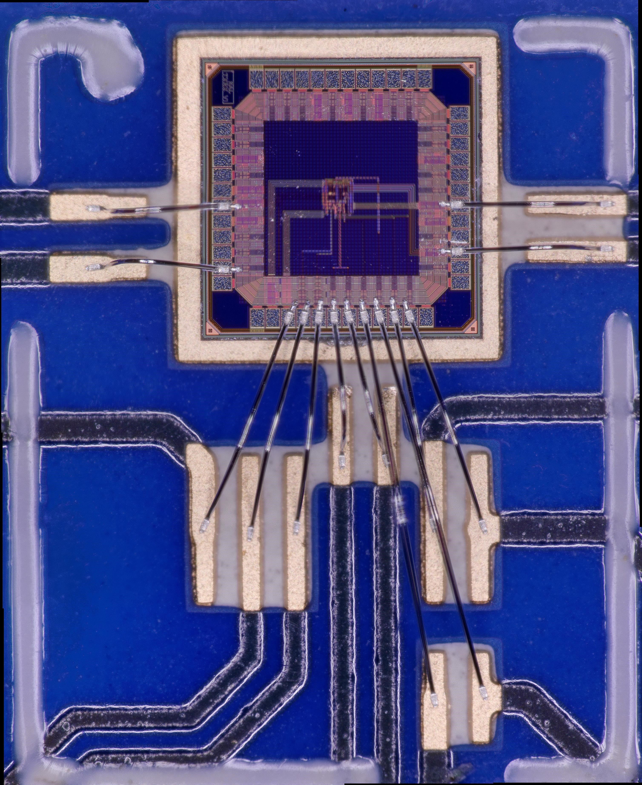
MLR1 Tests – New System

Slide 10
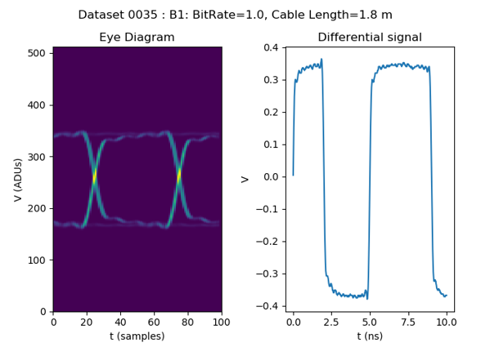
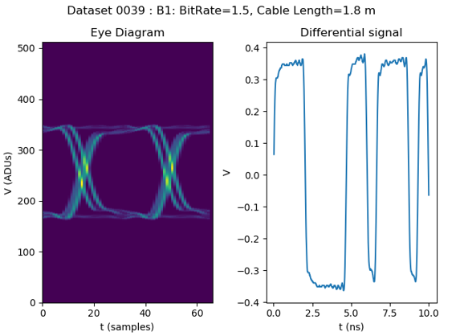
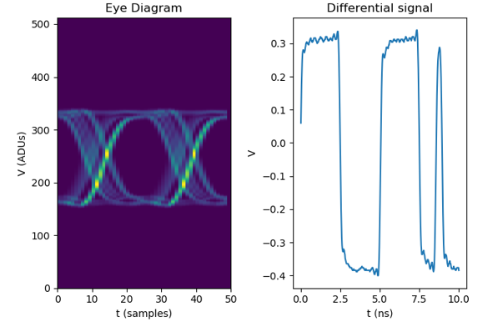
MLR1 Tests – New System
Seems limited by input driver as expected

Slide 11
ER1
Notes:
The abstract pattern can be removed or repositioned if required. Be careful to ‘Send to Back’ so that it does not obscure any important information.

Slide 12
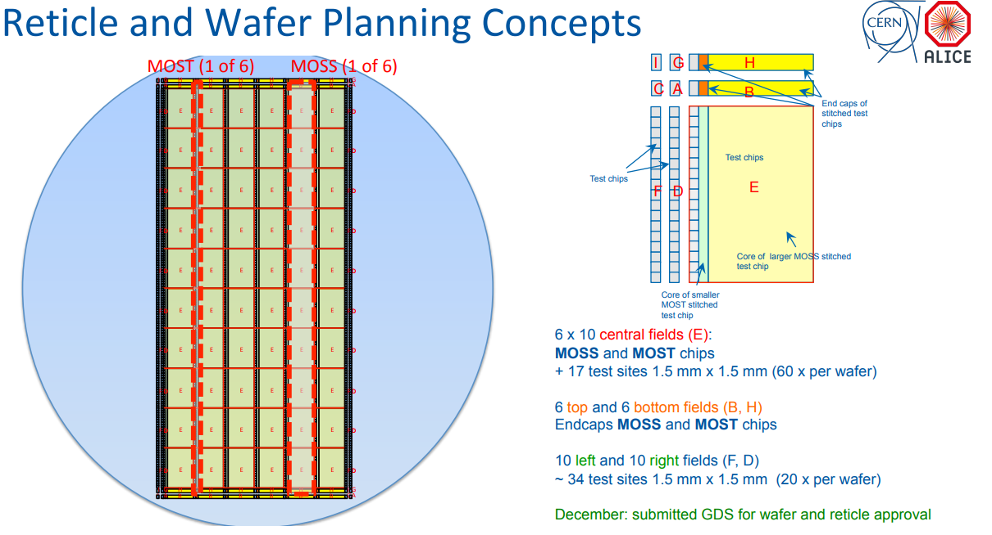
ER1 Stitched Sensors
Stitched Chips
MOSS: Investigate yield. Study power, leakage, spread, noise, speed
MOST: Yield with local density preserved

Slide 13
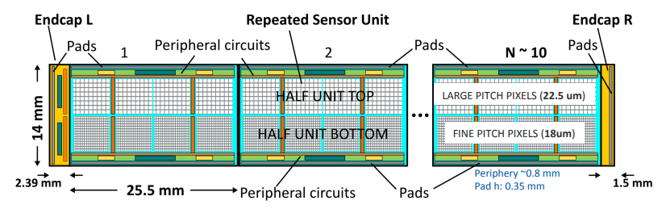
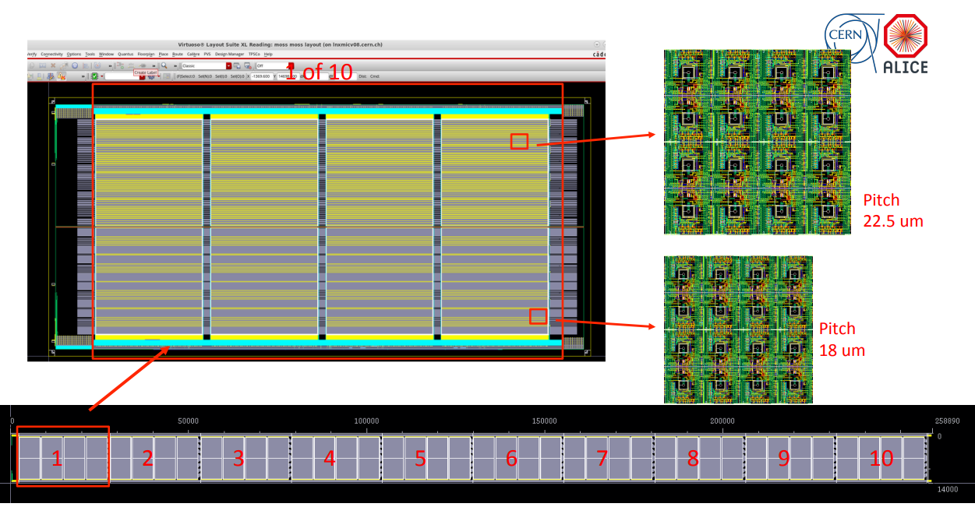
ER1 Stitched Sensors
MOSS
Try maximise yield
Separate power domains’
Loose design rules
18um and 22.5um pixels
https://indico.cern.ch/event/1157236/contributions/4859440/attachments/2436938/4173788/2022_05_04_WP1_2_f.pdf

Slide 14
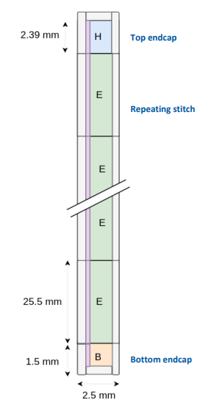
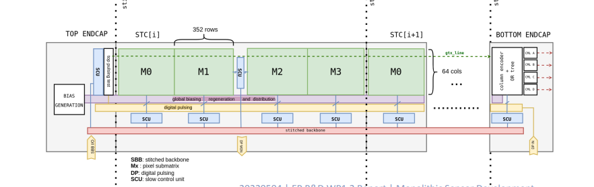
ER1 Stitched Sensors
MOST
Study yield when local density preserved
Higher granularity in power domains
https://indico.cern.ch/event/1157236/contributions/4859440/attachments/2436938/4173788/2022_05_04_WP1_2_f.pdf

Slide 15
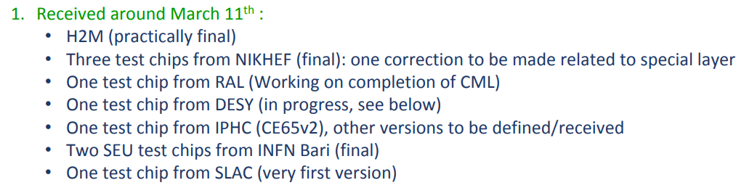
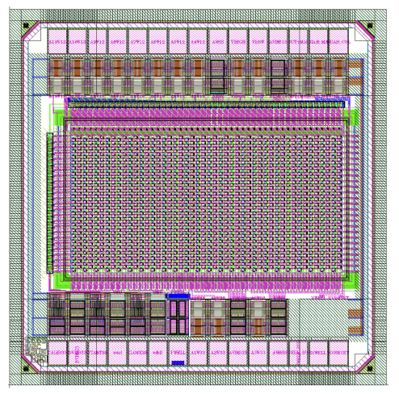
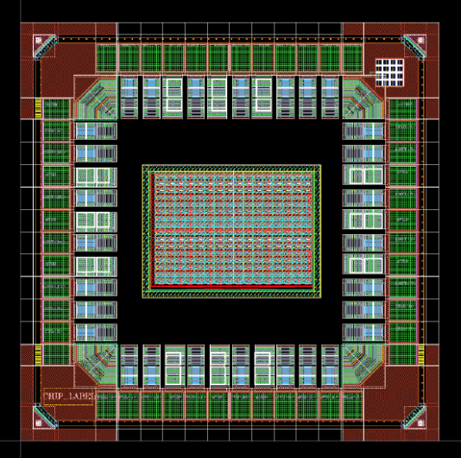
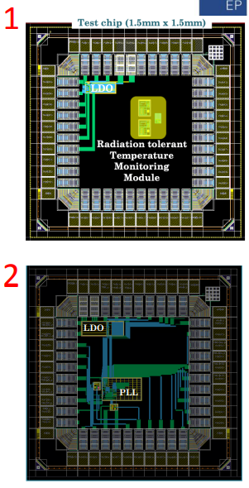
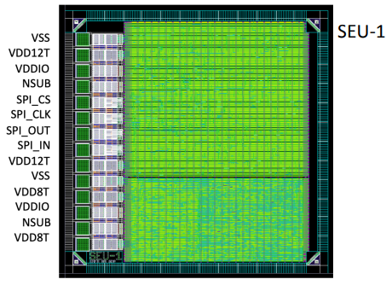
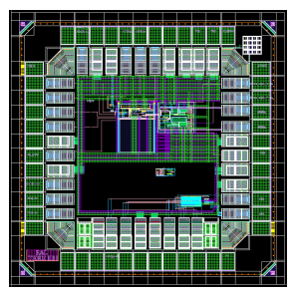
ER1 Other chips
Other Chips
Quite a few from many groups
Also assisting with DFM cells
CE65 (IPHC)
H2M (CERN)
PLL/CML/I2C (RAL)
PLL/LDO (NIKHEF)
SEU(INFN)

Slide 16
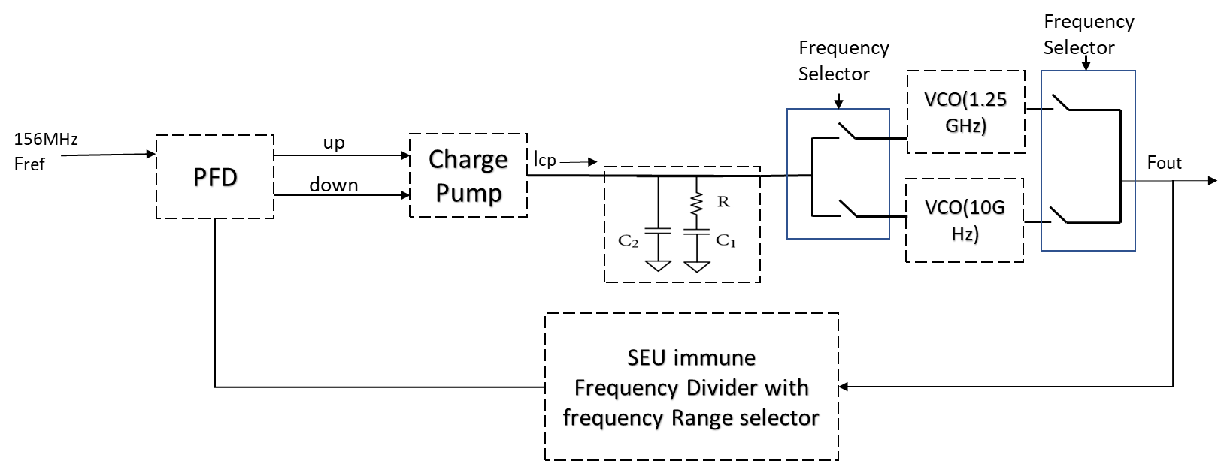
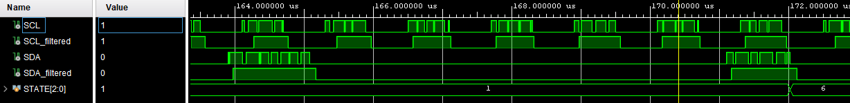
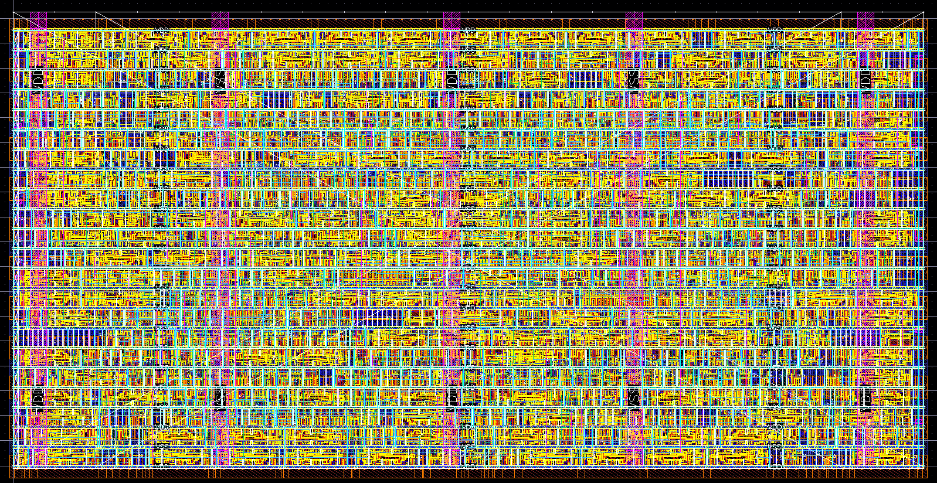
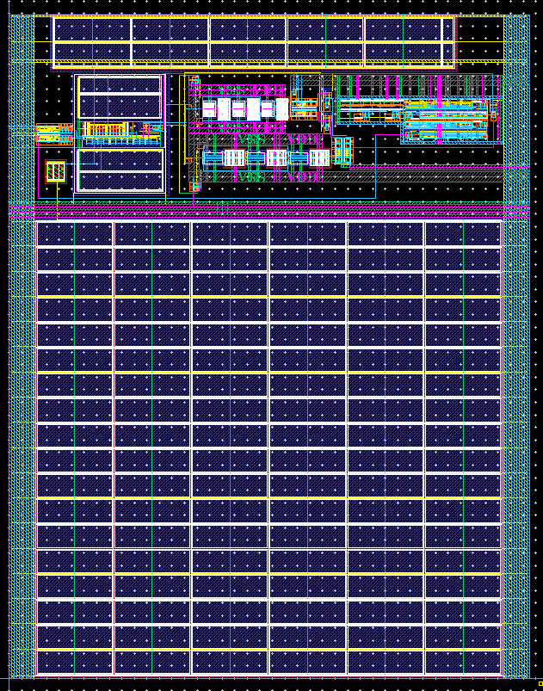
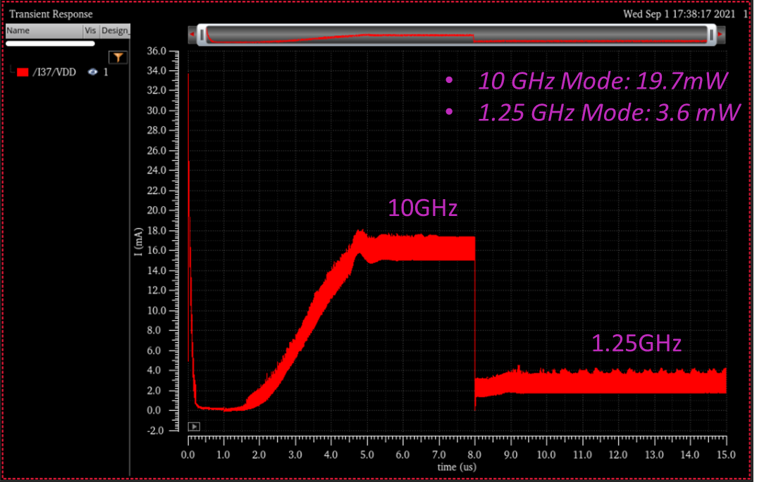
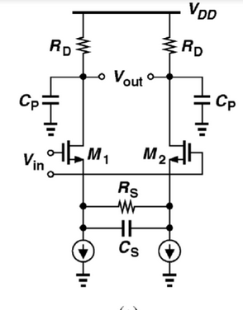
I2C Interface
Configurable soft-IP (variable number of registers)
Fast mode plus (1Mbit/s), 20MHz control clock
TMV config registers
Current example 110 x 55um
ER1 – RAL/EIC
PLL
Dual range operation: 7GHz -10GHz and 500MHz-1.25GHz
SEU Immune frequency divider
CML Receiver/Driver Loop
To increase speed of LVDS-CML loop from ER1
Simple design, including CTLE

Slide 17
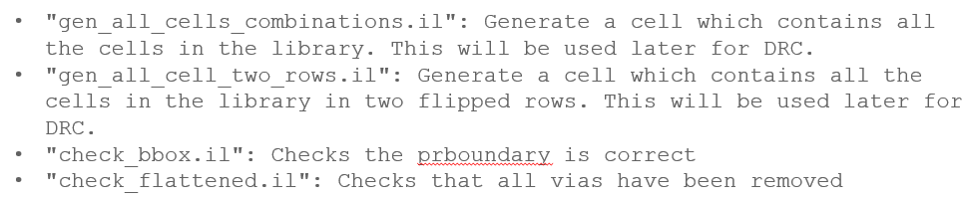
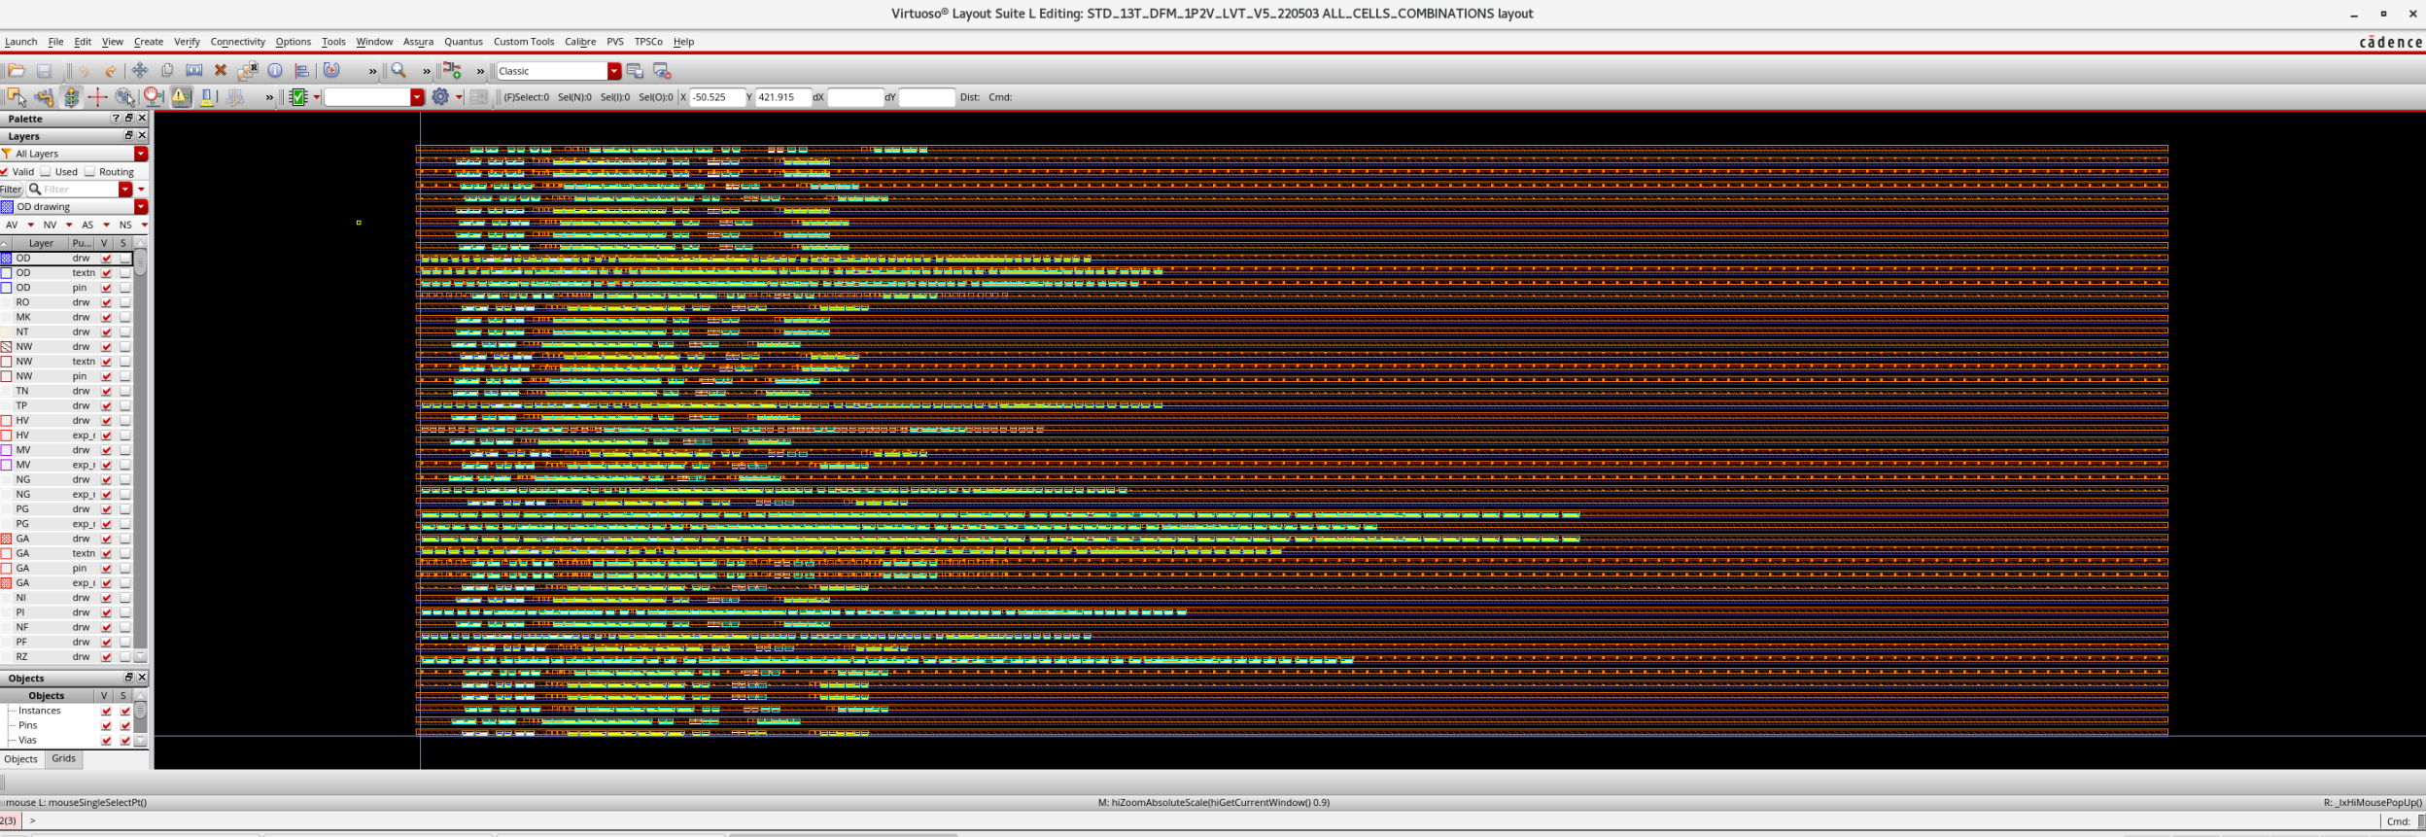
ER1 – Yield
DFM Cells
Need to improve yield of standard cells – increase spacing, contacts etc…
Process:
List required cells
Divide work amongst available groups
Recombine into one library
Abstract and LEF generation
Liberty model generation
Lots of layout work and scripting

Slide 18

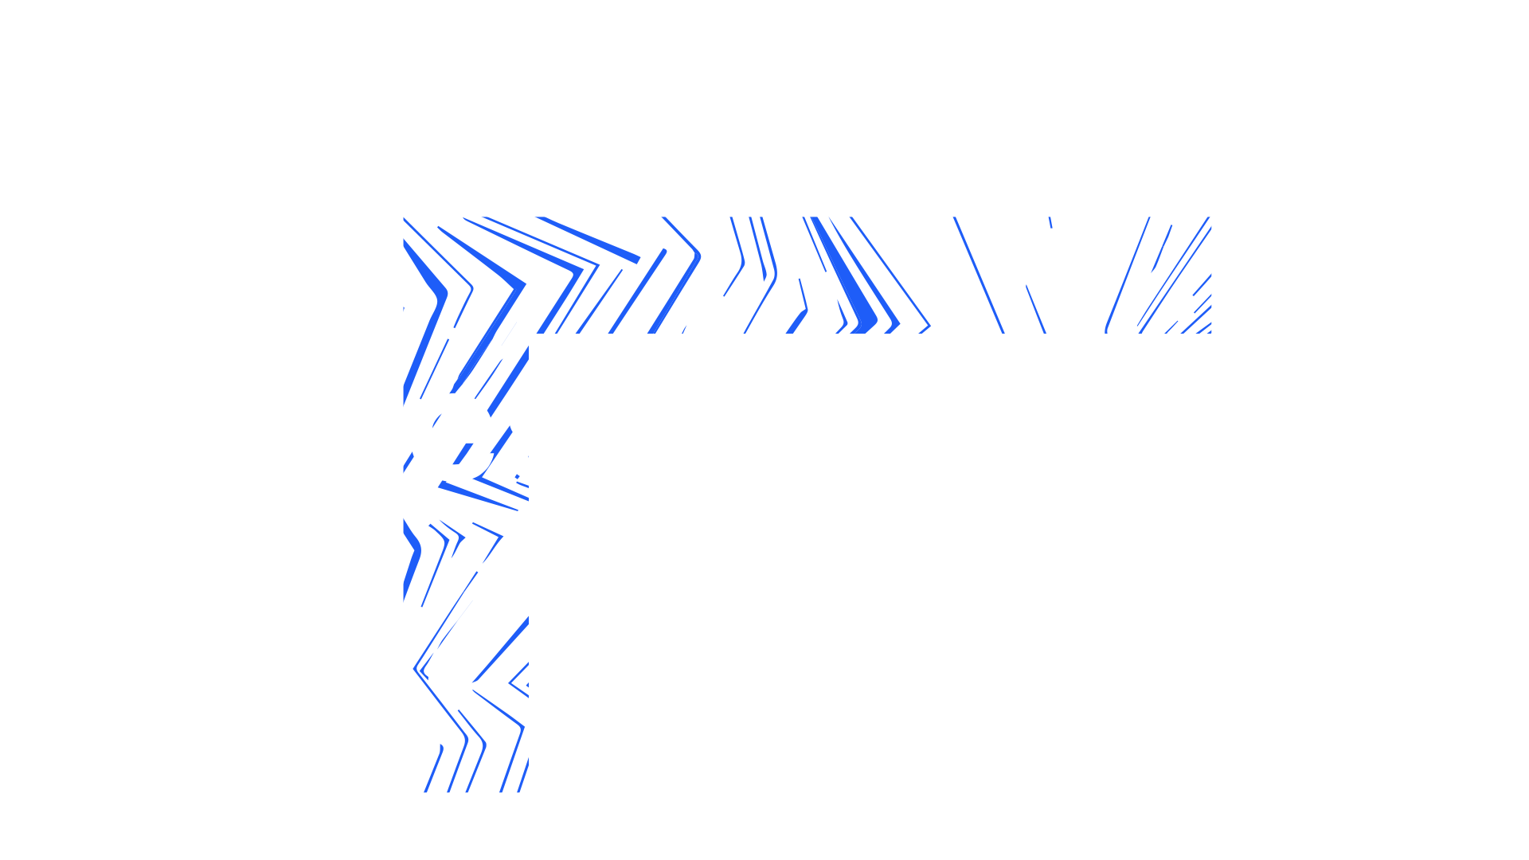
Notes:
The abstract pattern can be removed or repositioned if required. Be careful to ‘Send to Back’ so that it does not obscure any important information.

