Slide 1
EIC Project Update
Elke Aschenauer and Rolf Ent
Co-Associate Directors for the Experimental Program
Detector-1 General Meeting
May 27, 2022

Slide 2
Timeline – What is Coming
CD-0 approval December 19, 2019
Community-wide Yellow Report effort Dec. 2019 – Feb. 2021
CD-1 review (includes CDR) January 26-29, 2021
Call for Collaboration Proposals for Detectors March 6, 2021
CD-1 approval June 29, 2021
DOE/OPA Status Review October 19-21, 2021
Status Update to Federal Project Director June 28-30, 2022, @BNL
Cost and Schedule Event(s) May-June 2022
Technical Subsystem Reviews January – December 2022
OPA Status Review January 2023
Preliminary Design Complete & Review May 2023
Final Design/Maturity Readiness for CD-3A Items May 2023
CD-2/3A review (expectation), requires pre-TDR ~October 2023
CD-2/3A (expectation) ~January 2024
CD-3 review (expectation) ~January 2025
CD-3 (expectation), requires TDR ~April 2025

Slide 3
Pre-TDR outline
Work model will be similar as we used to create the CDR, a mix of the project CAMs and some users, and use where we can input from the CDR, YR, proposals, technical notes, etc.
2. Physics Goals and Requirements (should be short, < 50 pages)
2.1 EIC Context and History (like CDR 2.2 or YR section 1)
2.2 The Science Goals of the EIC and the Machine Parameters (like CDR 2.3)
2.3 The EIC Science (follow YR structure)
2.4 Scientific Requirements
3. Accelerators (contribution to IR)
8. Integration and Commissioning (Elke contributor)
10. Experimental Systems (Can be 200 pages to use for standalone detector TDR)
10.1 Experimental Equipment Requirements Summary (like CDR 8.2)
10.2 General Detector Considerations and Operations Challenges (YR 10, CDR 8.3)
10.3 EIC Detector
10.4 Detector R&D Summary
10.5 Detector Integration
10.6 Detector Commissioning and Pre-Operations
Appendix B Integration of a Second Experiment

Slide 4
Integration Process
We try to use the geometry database to keep SketchUp and CAD in phase (at different levels of detail).
This is used to ensure system integration, assembly and installation sequences, etc.
This is also used by the engineers to perform FEA calculations based on weights, frame dimensions and various material choices to ensure sufficient safety factor – this can lead to an iteration to make supports stiffer.
Service needs (cabling, LV, cooling) are required to provide sufficient space for them, we need these in the next iteration of information provided of the detector designs – for now we base service space needs on examples of sPHENIX and STAR.
Recent example 1 given in global detector and integration meeting of Monday:
Integration of DIRC bar boxes in support frame that also needs to support “detectors inside” (backward EMCal, outer tracker layers, TOF) – this meant a back and forth on the exact radius where the DIRC bar boxes reside – balance between φ-coverage and frame engineering strength need
Further iteration to integrate the outer MPGD-layer and slots for service needs.
Will define outer radius of backward EMCal → EEEMCal consortium
Next up: similar integration of barrel EMCal and hpDIRC extension/readout
Recent example 2:
Assembly and integration of Si tracking detector
Likely further illustrated in GD/I talk today

Slide 5
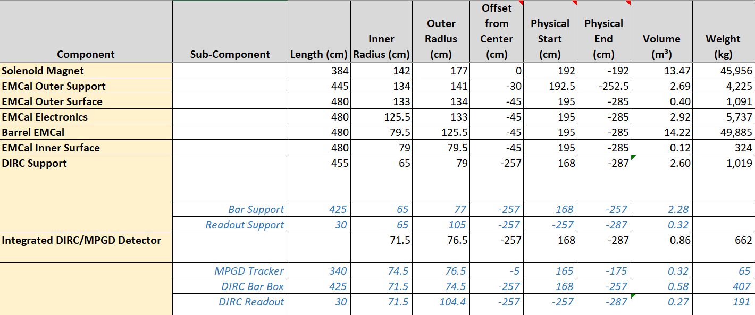
Geometry Database – Process “Early Test Run”
Done: Fixed (small) inconsistencies in DIRC frame, hpDIRC and MPGD
Iterated hpDIRC position as balance between φ-coverage and frame engineering strength need
Added 2-cm space for MPGD tracker (muRWELL or MM) right on top of DIRC bar boxes → now 5 cm slots for both together
Added slots for service needs in frame
Work done by Roland Wimmer (BNL) → Elke → first meeting Elke/Rolf with Tanja, Brian, Kondo, Walt → next meeting Roland/Elke/Rolf → input to Tanja, Walt

Slide 6
Detector Sub-System Reviews
Sub-System Reviews are an expectation on the way to DOE OPA Reviews.
We will do these for ALL detector L3 subsystems.
Magnet Incremental Design and Safety Review – Preliminary 30% Design
February 23, 2022 (6.10.07 CAM: Renuka Rajput-Ghoshal)
IR Integration and Ancillary detectors
April 27, 2022 (6.10.11 CAM: Yulia Furletova)
Upcoming over this calendar year:
Integration/Installation Subsystem Status Review – mainly review logic/scope
EM Calorimetry Subsystem Status Review (6.10.05)
Tracking Detectors Subsystem Status Review (6.10.03)
Electronics/Computing Subsystem Status Review (6.10.08 & 6.10.09) – ~July 2022
Hadronic Calorimetry Status Review (6.10.06)
Particle Identification Detectors Status Review (6.10.04)
Detector Magnet - 60% Design Complete for Vendor Contract Review (6.10.07)
Detector Infrastructure and Installation Status Review (6.10.10) – one of last reviews
Polarimetry & Luminosity Detector Status Review (6.10.14) – one of last reviews
Reminder: Slide shown at 05/13/22 meeting

Slide 7
Next: Integration/Installation Subsystem Status Review
In June timeframe (but…)
Mainly review logic and scope – does not rely on collaboration input
Review topics
R&R plan IP-6 – detailed plan exists
Removal BaBar magnet from IP-8 – reverse sPHENIX schedule – TBD
IP-6 infrastructure – much has been collected already
Electrical, Grounding
Mechanical
LCW, Cryogenics
Tie in with Accelerator, time sequencing
Detector installation sequences and maintenance modes
Main charge to committee (one engineer each from BNL, JLab and other?) will be to check plans are in place and we did not forget anything
…
July: Electronics/Computing Subsystem Status Review (6.10.08 & 6.10.09)
Early July at request of CAMs
Plan to complete documentation folding in discussions at this week’s Streaming Readout X workshop

Slide 8
Costing Update – Actions
Completed an update of 6.10 detector cost in P6 last week
some WBS have not yet been touched
6.10.01 Detector Management
6.10.02 Detector R&D and Physics Design
6.10.10 Detector Infrastructure (but we did assume already some in-kind (reuse) here)
6.10.12 Detector Pre-OPS & Commissioning
hadron and electron polarimetry are basically the same
Last weekend/yesterday: validate Long-Lead Procurement items are same or changes
WBS areas with largest changes:
Magnet became cheaper → offsets many of the other increases
Tracking: cost shifted from materials to labor
Particle Identification: increase because of the TOF/AC-LGAD addition
Notes for costs and in-kind
The maximum in-kind for any system we assumed to be 90% of the estimated cost
We included the backward HCAL but it is either in-kind (90%) or scope contingency
We treated the magnet as an opportunity, i.e., we for now included costs for a new magnet but took in-kind credit for the CEA Saclay labor contribution in E&D

Slide 9
Costing Update – High-Level Summary
Total material cost nearly same as was assumed at CD-1
This is a balance of magnet cost going down, detector sizes a bit smaller than in the reference detector, yet on the other hand also some additions (TOF/AC-LGAD is “new”, forward calorimetry more costly/segmented, etc.).
Labor cost went up, some of this was “known” and is appropriate
e.g., $2M+ labor during magnet construction phase was missing at CD-1
For the Si tracker we now have a better split of material and labor
Labor seemed low anyways at CD-1
Compared to CD-1 assumptions in-kind went down and falls a bit short
In-kind follows what was provided to us by the detector-1 contacts folding in the ATHENA & ECCE proposals
More conservative than what was done at CD-1
Will revisit after the survey is in
Of note: currently hardly in-kind to ToF (AC-LGAD) and forward ECal, and none to forward HCal
Also, there may be NSF opportunity

Slide 10
Computing Coordination Group
Charge
Coordination of resources among EIC computing efforts
Assure computing infrastructure follows DOE and host lab mandates and guidelines
Keep record of required and available resources as well as their usage
Access point for institutions that intend to contribute computing resources
Propose level to include representatives of major resource provider contributors
Start infrastructure assessment to fold in international computing resources
Pursue and develop in-common data flow and management (for detector-1 and potential detector-2).
Membership – next slide
Timeline
Regular meetings of CCG this year to accompany detector-1 consolidation and path to detectior-2 process, and preparations towards pre-Technical Design Report
Structure and responsibilities to be revisited early 2023 after formal Detector-1 Collaboration is formed and governance structure is defined
Also posted on:
https://eicug.github.io/content/wg.html

Slide 11
Computing Coordination Group
Charge – previous slide
Membership
Contact persons/liaisons for EIC computing resources from labs (2)
Jerome Lauret (BNL) and Graham Heyes (JLab) – co-chairs
Contacts for EIC Project Detector, also listed as contacts at EICUG web pages: http://eicug.org/web/content/electron-ion-collider-users-group-eicug
Links to EICUG Software/AI Working Group (2)
Andrea Bressan, Cristiano Fanelli
Computing/Software Detector-1 Working Group (+1)
(Andrea Bressan, Cristiano Fanelli,) David Lawrence
Simulation, Production and QA Working Group (1)
Wouter Deconinck
Once formalized, representatives of detector-2 and major resource provided contributors
Timeline
Regular meetings of CCG this year to accompany detector-1 consolidation and path to detectior-2 process, and preparations towards pre-Technical Design Report
Structure and responsibilities to be revisited early 2023 after formal Detector-1 Collaboration is formed and governance structure is defined

Slide 13
What is Needed for the Detector
Between now and CD-2
Form collaboration and define subsystem responsibilities
→ in-kind contributions need to be identified and agreements need to be in
an advanced state (draft but not final)
Integrate collaboration in WBS – structure of detector
Define scope of EIC Project Detector → need to know all subsystem technologies
All subsystem requirements and interfaces need to be defined
Refine cost, schedule and labor needs for each subsystem
basis – of – estimates need to be well documented
Agree on the Long Lead Procurement (LLP) items of the detector
Bring level of design on average to 50-60%, with LLP items needing to be at final design stage (~90%)
Produce pre-TDR*: 1st version of by May 2023
→ final version by October 2023
*TDR is needed by CD-3, about one year later

