Slide 1
FE_DAQ Meeting
ASICs & FEE
Fernando Barbosa, JLab
EIC Project L3 CAM
WBS 6.10.08
14 June 2022

Slide 2
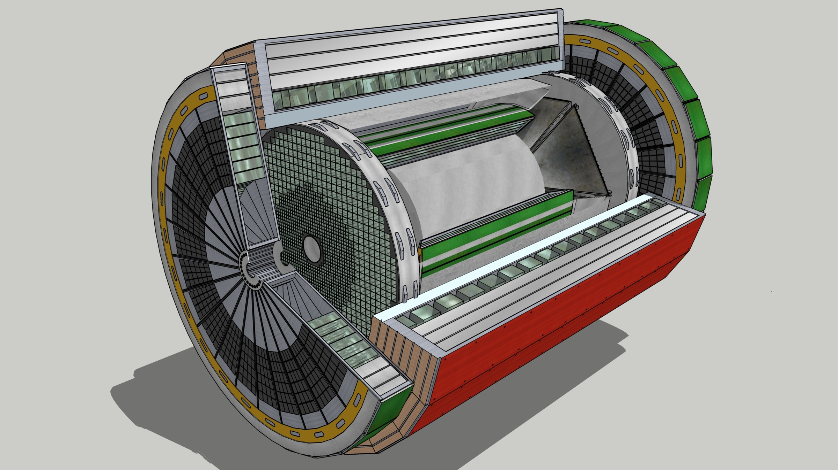
Streaming Readout Architecture
EIC Project Reference, YR, CD-1
Data
Configuration & Control
Power
Detector
FEB
(Front End Board)
FEP
(Front End Processor)
DAQ
(Data Acquisition)
Total
BW: O(100 Tbps)
BW: O(10 Tbps)
Global timing, busy & sync
Beam collision clock input
L ~ 100 m
fiber
ASIC
Goal: O(100 Gbps)
Fiber
Switch / Server / Link-Exchange:
Readout
Switch / Server: Processing
Switch / Server: Buffer
FEB
Storage
FPGA
Fiber
Monitoring
FEP
FEB
LVDS ~ 5m
Analog ~ 20m
Power Supply System
(HV, LV, Bias)
Cooling Systems
w/ Jin and Kai

Slide 3
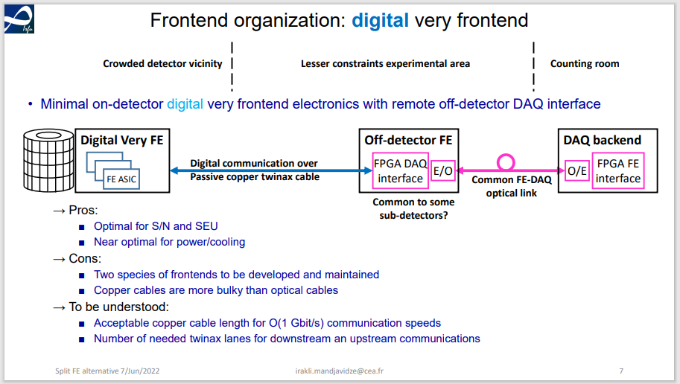
Streaming Readout Architecture
Reference proposal and Irakli’s “digital very frontend” similar.
Also consider lpGBT/fiber and/or Firefly twinax.

Slide 4
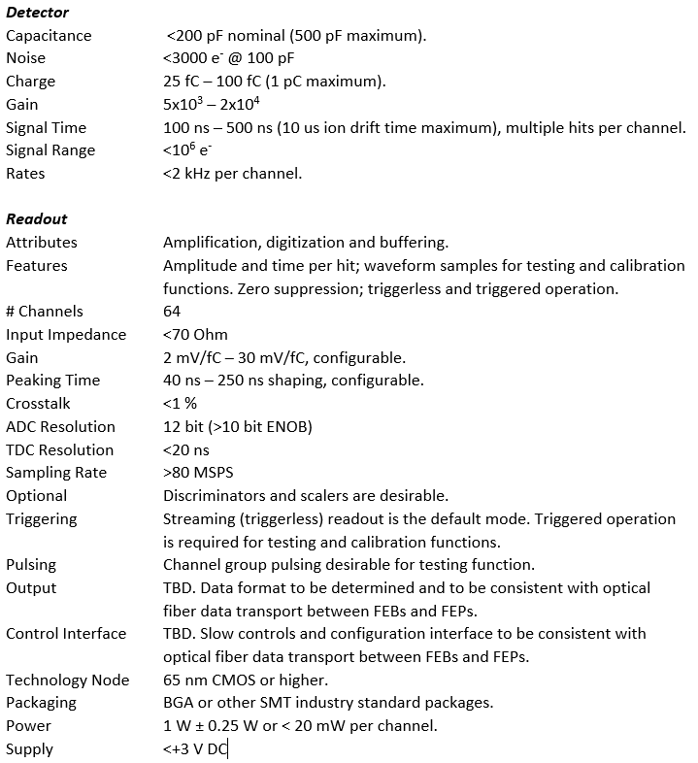
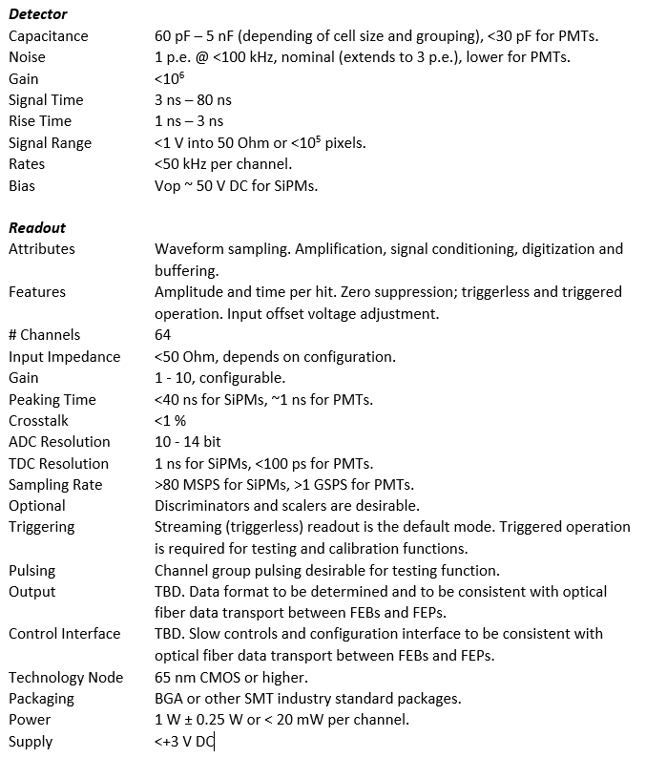
EIC Project Specifications
Need to finalize FE specifications for MPGD & Photonic Sensors.

Slide 5
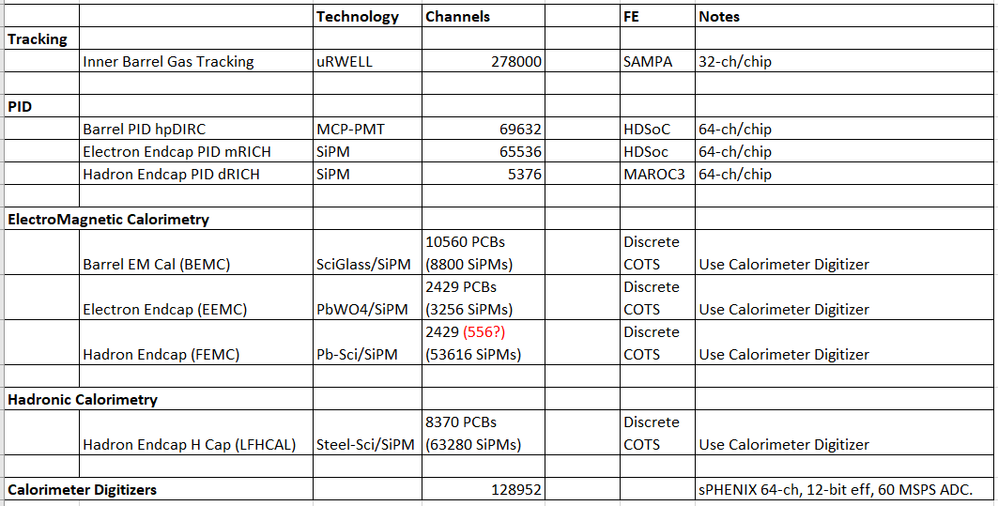
ECCE Proposal Summary WBS 6.10.08 w/ updates
Si, AC-LGAD FEE development (e.g., ALPIDE, ALTIROC) under eRD112, closely coupled to detector.
NOTE: sPHENIX digitizer has 14-bit ADC chips but system has been validated as 12-bit.

Slide 6
SAMPA – 32ch, 160 ns peaking, up to 20 MSPS, 130 nm CMOS.
- Does the 160 ns shaping satisfy the detector/physics requirements?
If Yes, FAB run needed <1 year.
If NO, upgraded design in 65 nm CMOS could yield a new SAMPA with ~40–50 ns
peaking – ~3.5 years of development (SALSA?)
HDSOC – 64ch, 1-3 GSPS, 12-bit, 250 nm CMOS - NALU, distrib. by CAEN.
V2 Under development, should be available within ~1 year. NALU is receptive to
further refinements.
MAROC3A – 64ch, 350 nm SiGe, 102 usec, WeeRoc, distributed by CAEN.
Older technology but still available, new version with different package within
~2 years. Wilkinson ADC requires ~102 usec conversion (12-bit @ 40 MHz).
- Does the long conversion (<10 kHz/ch) satisfy the detector/physics rate
requirements?
      No, consider an alternative.
      Replace w/ HDSOC? Less # of ASIC designs.

Slide 7
A closer look at the calorimeters’ readout, from sPHENIX:
64 ch ADC Module
16ch/cable
X4
1 ch discrete COTS FE
128,952 channels
  8,060 cables (16 ch diff/cable).
  2,015 ADC modules (64 ch/ADC).
  168 crates (12 ADCs/crate).
Cannot fit 8,060 cables for the calorimeters’ readout.
Need alternative.

Slide 8
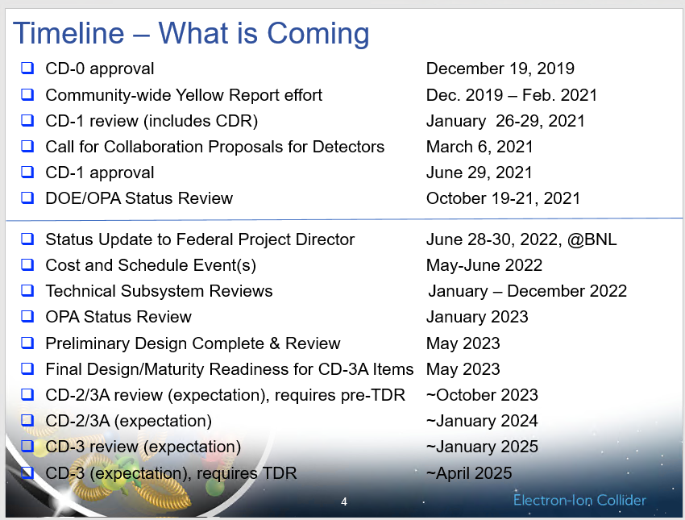
Timeline
All WBSs in P6 have been updated with information from the ECCE proposal and with additional revisions:
  Informs management of the overall impact on budgets from proposal.
From Elke,
Path to CD-2/3A
5/13/2022
Settle on readout by January 2023

Slide 9
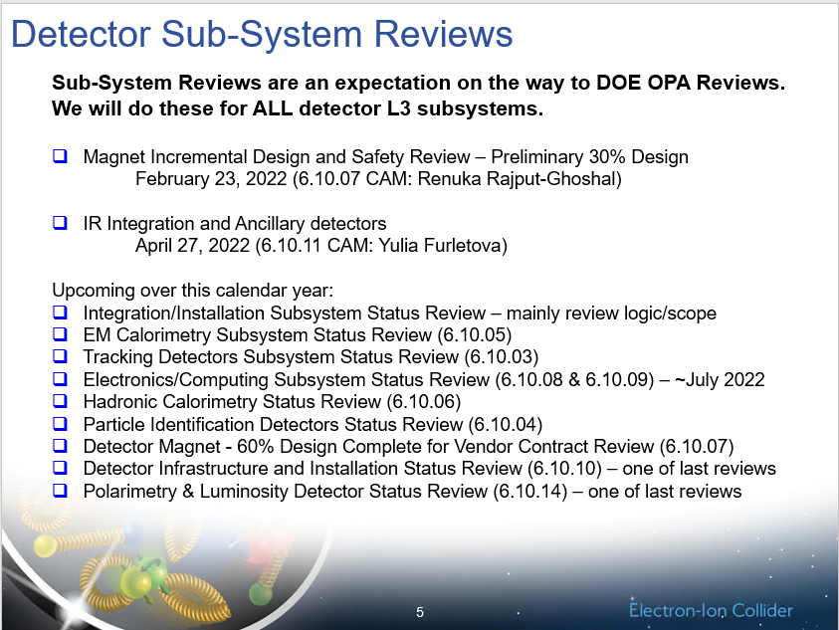
Electronics/Computing Subsystem Status review ~July 2022.
  Assess maturity of design and identify immediate needs.
  Charge, committee, date to be announced soon.
From Elke,
Path to CD-2/3A
5/13/2022

Slide 10
Planning
Project
(BNL, Jlab)
Sub-Detector WGs
Electronics/DAQ WG
We need:
  Overall system/block diagram
    to understand implementation approach and inform P6 activities listing.
  Assess/review/verify applicability and feasibility of proposed readout elements.
    (SAMPA, HDSOC, MAROC3A, 64-ch ADC, cables, …).
  Assess # channels (detector and readout) for each sub-detector and their partitioning or grouping, for example:
    #SiPM cells/units grouped - #readout chs - #readout channels per PCB.
    Distribution of HV, BIAS, LV channels, sensor aggregation.
  Identify Activity Groups – distribute tasks/responsibilities to groups/institutions, with technical representatives, which will perform and deliver the various required tasks and products.
  ~July 2022 - capture all major updates and initiate any needed R&D initiatives.
  ~May 2023 - finalize input into P6.

