Slide 1
Development of ECRIS for Astatine-211 production
Masahiro Okamura
June 1, 2022

Slide 2
FY2023 NPP LDRD Type A Proposal
Proposal title: Development of ECRIS for Astatine-211 production
Primary Investigator: Masahiro Okamura
Other Investigators: Sergey Kondrashev, Takeshi Kanesue, Daniel Xie (LBNL)
Indicate if this is a cross-directorate proposal. Yes _X_ No___
If yes, identify other directorates/organizations:
Program: NP and IP
Proposal Term: 3 y From: Oct. 2022 To: Sep. 2025
Total funding per year in FY23 , FY24 and FY25: $ 446K, $ 487k, $475k

Slide 3
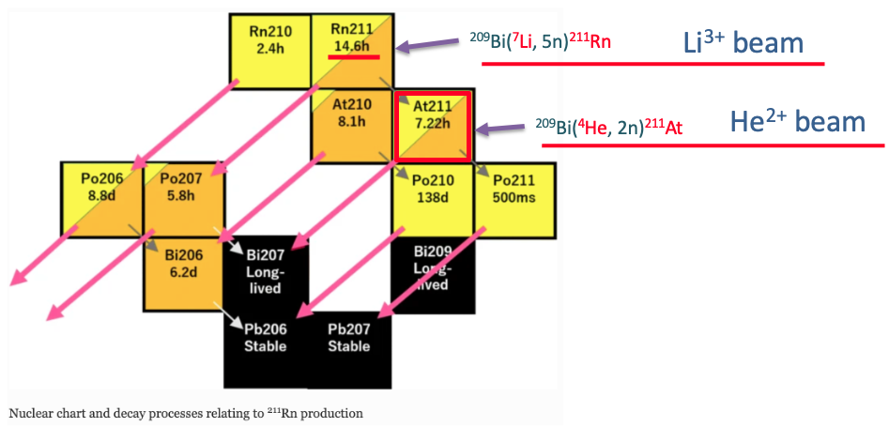
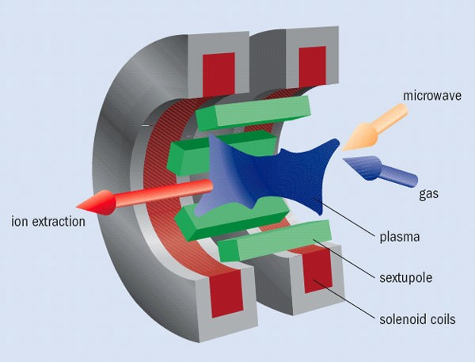
LDRD Overview/Alignment to the Lab’s Strategy
This proposal can be applied to a new facility CLIP = Center for Linac Isotope Production
Part of CLIP is a Light Ion Linac (d, He, Li) that enables unique isotope production and R&D
No ion source presently exists for this Light Ion Linac – topic of the proposed LDRD
One application of the Light Ion Linac is the production of At-211
Cut view of ECRIS
Propose to build a prototype ECRIS (Electron Cyclotron Resonance Ion Source)
for Li and He beams for high current and robust operation.
Notes:
An overview of the proposed research and development (R&D) that describes the rationale for the proposed R&D and its alignment to the Lab’s strategy.

Slide 4
Why Brookhaven
BNL is a DOE center for accelerator-based isotope production
BNL has and will increase processing capabilities for alpha emitters
BNL has a world-leading group for hadron beam sources
  High-intensity H⁻, laser ion sources (LION), Electron Beam Ions Sources (EBIS), polarized sources
  Three sources won Brightness Awards
  Have experiences with providing pulsed Li beam with LION/EBIS to NSRL
  Now plan to develop a continuous wave (CW) Li beam source
US lab capabilities for the development of a lithium beam ion source
 | BNL | LBNL | LANL | MSU | Texas A&M | ORNL | FNAL | ANL
Hadron linear accelerator | ✔️ |  | ✔️ | ✔️ |  | ✔️ | ✔️ | ✔️
Isotope program | ✔️ |  | ✔️ |  | ✔️ | ✔️ |  | ✔️
Multi species beam | ✔️ | ✔️ |  | ✔️ | ✔️ |  |  | ✔️
Intense Li beam handling | ✔️
ECR knowhow |  | ✔️ |  | ✔️ | ✔️ | ✔️
Builds on our experience in isotope production and will add new capabilities
Notes:
A competitive analysis: why the proposed R&D needs to be conducted at Brookhaven
competitive analysis

Slide 5
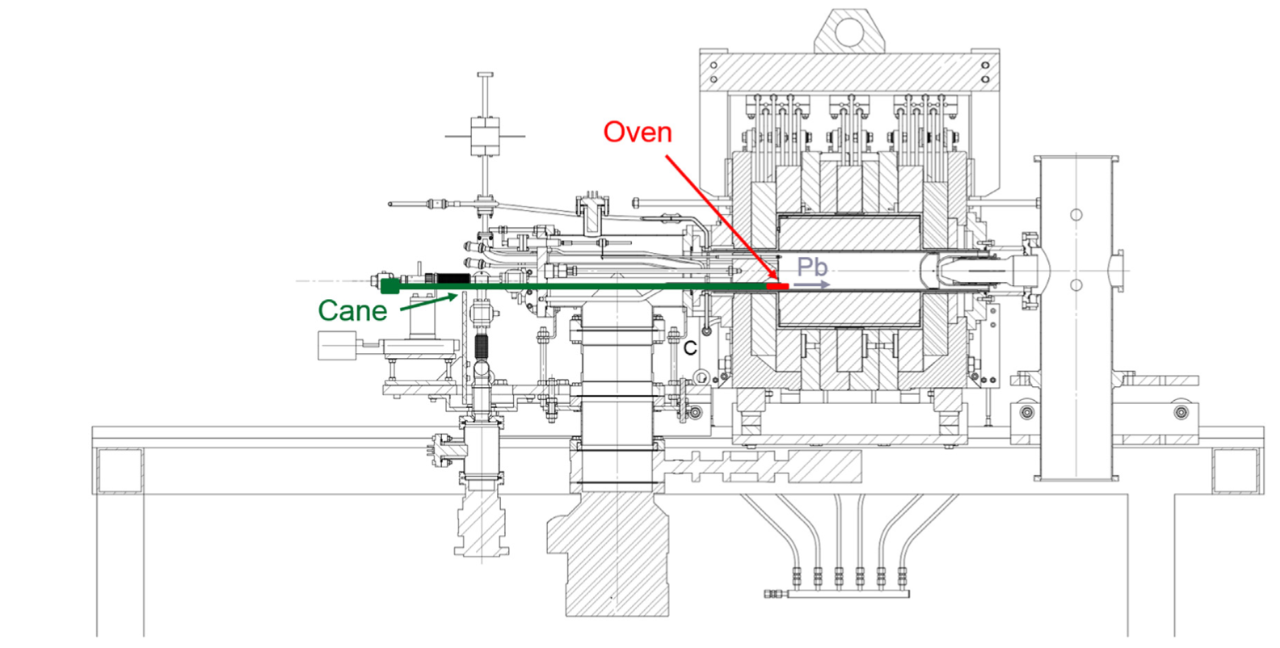
Proposed Budget/Accomplishments in Year 1
Selection of microwave
Design of lithium vapor production and supply sub-system
Assembling, testing and optimization of lithium vapor production and supply sub-system
Milestone 1: completion of lithium vapor system
4. Design of magnet and ions source assembly
5. Fabrication of magnetic system
Milestone 2: Measuring and verify the fields if the magnets are completed
Budget for Year 1
Material Costs | PM hexapole | $40K
 | Li vapor supply line | $25K
 | Solenoid magnets | $70K
 | Source chamber | $40K
 | Ext. Insulator | $7K
Labor | 6 months Postdoc | $47K
 | 6 months Scientist | $107K
 | 3 months Engineer | $60K
 | 3 months Tech | $50K
Total |  | $446K
Laser
Notes:
What will you be able to accomplish in the first year, since the projects will begin on October 1st. If you believe you are able to complete the first year scope as written in the proposal, present that budget. If not, scrub your budget and show how they differ.

Slide 6
Impact of Delaying the Project by a Year
A delay by a year will delay the technology readiness for the CLIP proposal, and may delay project approval
The detailed accelerator design of the new facility will depend heavily on the performance of the ion source. Therefore, the specifications of the entire facility cannot be determined.
The start of production of At-211 and other radionuclides will be delayed.
Currently not enough material is available for clinical trials, and the start of clinical trials will be delayed.
Notes:
The impact of delaying the project by a year.

Slide 7
Potential Financial Return on Investment
This LDRD addresses a critical component of BNL’s proposed large transformative isotope production facility CLIP. The CLIP facility
  Integrates proton beam, light ion beam and processing capabilities, and
  Has a total estimated cost of several hundred million dollars.
The Light Ion Linac part of CLIP, for which this ion source will be developed,
  Has an estimated cost of several $10M to $100M.
Domestically, At-211 and other radionuclides are currently not available in amounts to support clinical trials or applications. Development of these new routes will enable them to be supplied through DOE IP.
The developed accelerator technology can also be used in future commercial applications as the short half-life of At-211 (7.2 h) requires local production.
Notes:
Potential financial return on investment: the Agencies and the specific program/office, which may be interested in supplying future funding and some indication of the time frame.

