Slide 1
AI/ML Directed and Facility Integrated Informational Distillation and Feature Extraction for High Throughput Streaming DAQ for EIC Detector 2
Jin Huang (PO)
6/1/2022

Slide 2
FY2023 NPP LDRD Type A Proposal
Proposal title: AI/ML Directed and Facility Integrated Informational Distillation and Feature Extraction for High Throughput Streaming DAQ for EIC Detector 2
Primary Investigator: Jin Huang (PO)
Other Investigators:
Yihui Ren, Yi Huang, Shinjae Yoo (CSI/ML)
ByungJun Yoon (CSI/Math)
Adolfy Hoisie (CSI/ACL)
Chris Pinkenburg, Martin Purschke (PO/sPHENIX)
Torre Wenaus (PO/NPPS)
Indicate if this is a cross-directorate proposal. Yes _X__ No___
If yes, identify other directorates/organizations: CSI, with strong support
Program: NP
Proposal Term: 3 year From: Oct 2022 To: Sept 2025
Total funding per year in FY23, FY24 and FY25: 300k, 500k, 500k

Slide 3
Targeted Topical Areas in FY23-A call
Research and Development towards the Second Detector at the Electron-Ion Collider
Discovery Science Driven by Human-AI-Facility Integration
1) AI enhanced Detectors, Accelerators and Sensors
Notes:
Research and Development towards the Second Detector at the Electron-Ion Collider
BNL will continue to be the leading laboratory in the world for nuclear physics research in the coming decades with the construction of the Electron-Ion Collider (EIC). The EIC will be the tool for resolving fundamental science questions about how the structures of the nucleons and atomic nuclei emerge from the dynamics of quarks and gluons, how gluons generate nearly all the mass of visible matter in the universe, and whether a new state of matter forms when gluons are highly packed inside nuclei. The EIC project, which is funded by the Office of Nuclear Physics in the Department of Energy’s (DOE) Office of Science, includes significant funding for a single project detector. The recommendation of the EIC project detector was made in March 2022 by the EIC Detector Proposal Advisory Panel (DPAP) https://www.bnl.gov/dpapanelmeeting/ after a long and careful process to review three outstanding proposals (ATHENA, CORE, and ECCE). Members of the international EIC scientific community have presented a compelling case that a second detector, which is not in the scope of the EIC project, is needed to take full advantage of the unique capabilities of the EIC. The DPAP also supports the idea of a second EIC detector enthusiastically. The LDRD proposal(s) should focus on R&D activities towards the second EIC detector that are complementary in technologies and/or science to the EIC project detector. POC: Jamie Dunlop: dunlop@bnl.gov.
Discovery Science Driven by Human-AI-Facility Integration
As a Lab at the forefront of experimental facilities design and Artificial Intelligence (AI) research, BNL has developed the concept of discovery science driven by the deep integration of humans, AI, and facilities. The idea is that this integration allows the whole to “think scientifically,” incorporating scientific goals into the operation of the facilities and enabling new discoveries. The BNL vision for human-AI-facility
2
integration is to automate routine processes and to create layers of nested, intelligent systems that can strategize together with their users and operators about the best experimental design, execution, and analysis.
Such a radical shift in facilities design and operation will necessitate changes at all levels – accelerators, choice of technique, detectors, sensors, controls, data acquisition, and analysis – and an integrated infrastructure to support this vision. BNL LDRD investment will therefore focus both on pushing the boundaries of the state-of-the-art in various domains and on overcoming operational deployment challenges in highly constrained environments. Initial research topics are: 1) AI enhanced detectors, accelerators, and sensors; 2) optimal experimental design and steering; and 3) migration to operation.
1) AI enhanced Detectors, Accelerators and Sensors
Against the backdrop of exponentially increasing data rates, this technical area requires more powerful, lower-level processing capabilities to produce the best possible value of information within stringent constraints of power, reliability, and accuracy, and operation in harsh conditions. The scientific workflows that the detectors, accelerators (including computational accelerators) and sensors contribute to are complex hardware-software architectures including computational elements of varied characteristics (e.g., GPU and TPU, neuromorphic, optical), memory and storage throughout the pipeline from the detector to the analysis stages, advanced algorithms (including AI), networks, and specialized software for control and optimization. Best tools and practices of co-design, management, and optimization need to be developed and applied to maximize the scientific output from these experiments. Required is rational co-design, including dynamic optimization throughout the workflow from data collection to analysis and the requisite feedback loops.

Slide 4
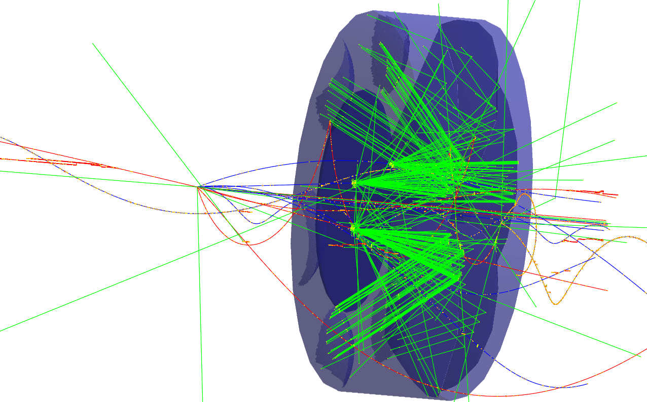
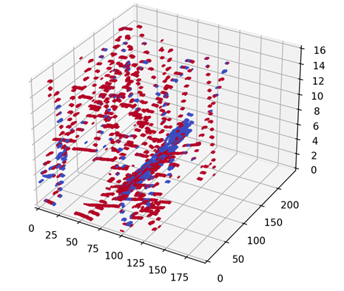
Motivation
FELIX-type Streaming DAQ is well accepted in EIC (CDR, three detector proposals), reasonable to assume so for EIC detector 2
A unique challenge to NP streaming DAQ: keep all collision signal while reliably filter out background and noise
Driven by physics requirement of low bias, and discovery potential
Especially so for detector 2, possibly operating at higher luminosity and background
Streaming data from various subsystem can be presented to an AI algorithm in a consistent manner
Zero-suppressed 3-4 dimension sparse matrix of time-framed data, containing patterns of signal and background + noise
Technical requirement
Requirement for high throughput: O(1)Tbps collision signal after zero suppression
Stringent bias control (systematical uncertainty control for )
Not much requirement for low latency (unlike triggering in LHC)
EIC SIDIS event on a dRICH detector, whose data can be presented in 3D zero-suppressed sparse matrix data frames of pixel X-Y, and time bin
sPHENIX TPC streaming data frame, also presented in 3D zero-suppressed sparse matrix (R-phi-time) marked with signal/background hits

Slide 5
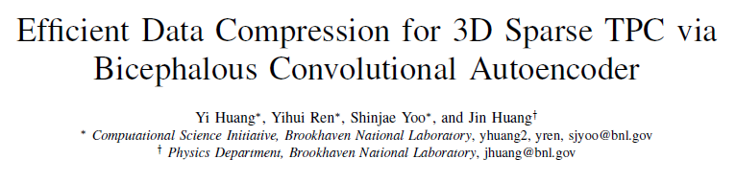
Our methods and deliverables
Algorithm based on bicephalous (and multi-headed) convolutional autoencoder
Data reduction/information distillation: noise filtering, feature extraction, and lossy compression;
Provide uncertainty quantification and real-time robustness-aware
Test and deploy using cutting-edge AI accelerators
Non-von Neumann Architecture processor optimized for efficient and high throughput computing for large scale neutral networks
On the cusp of commercially availability; undergoing testing via our vendor relationships;
Promising to meet timeline for conceptual design of EIC D2
Deliverables
AI-based data reduction and knowledge distillation algorithm designed for high-throughput real-time inference
Robust AI models with uncertainty quantification, out-of-distribution detection and periodical validation
Algorithm performance evaluation integrated through simulation, raw data, and reconstruction
Demonstrate throughput on multiple novel dataflow AI accelerators
Budget request mainly for two postdocs (PO and CSI each) support: 300k, 500k, 500k
Initial exploration on compression stage alone published in IEEE ICMLA arXiv:2111.05423
https://github.com/BNL-DAQ-LDRD/NeuralCompression

Slide 6
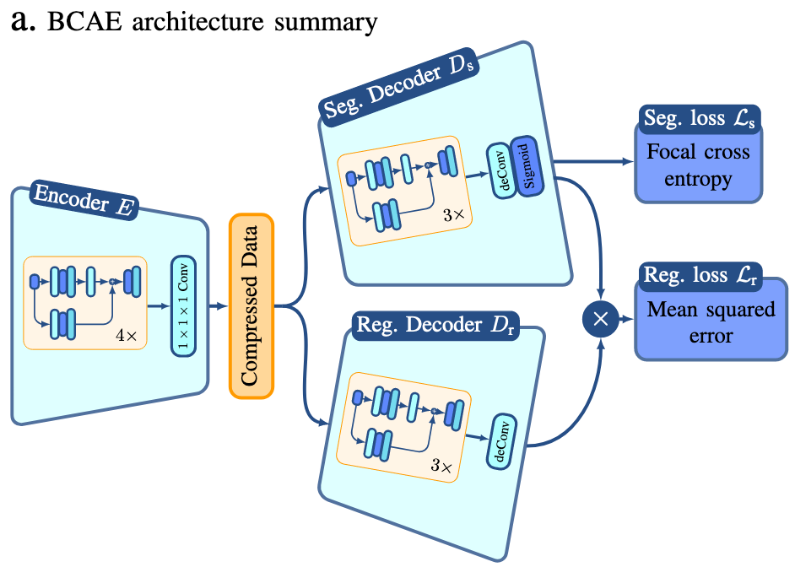
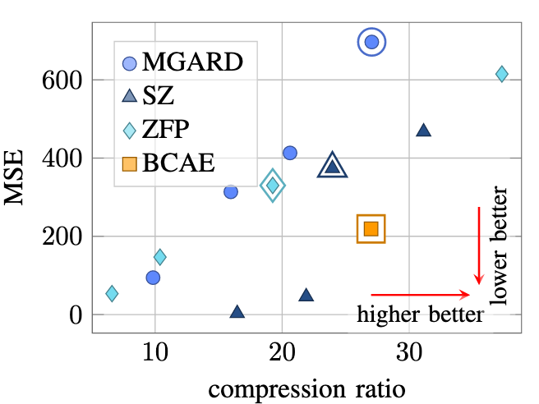
Intellectual merit 1 Strategy of the algorithm design
Neural network-based data compression and information distillation has better inference throughput, reconstruction fidelity and leading-edge hardware support.
Fixed latency execution, favored by real-time computing application at EIC
Extend the model to take sparse-encoding data directly to mitigate communication bottleneck.
Extend to probabilistic models for uncertainty quantification and real-time robustness-aware.
Branch-free and dataflow hardware-friendly neural network optimization for fast deployment on and integration with advanced hardware
IEEE ICMLA, arXiv:2111.05423

Slide 7
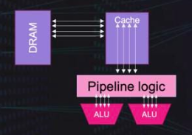
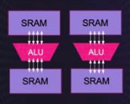
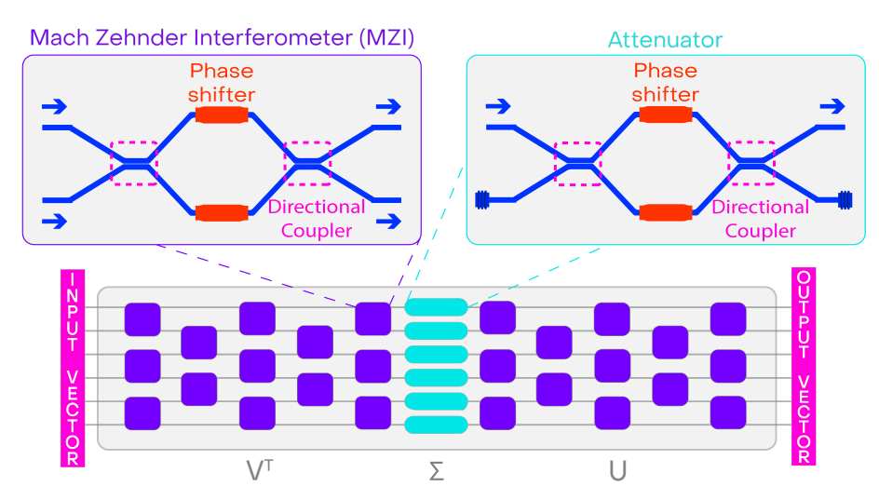
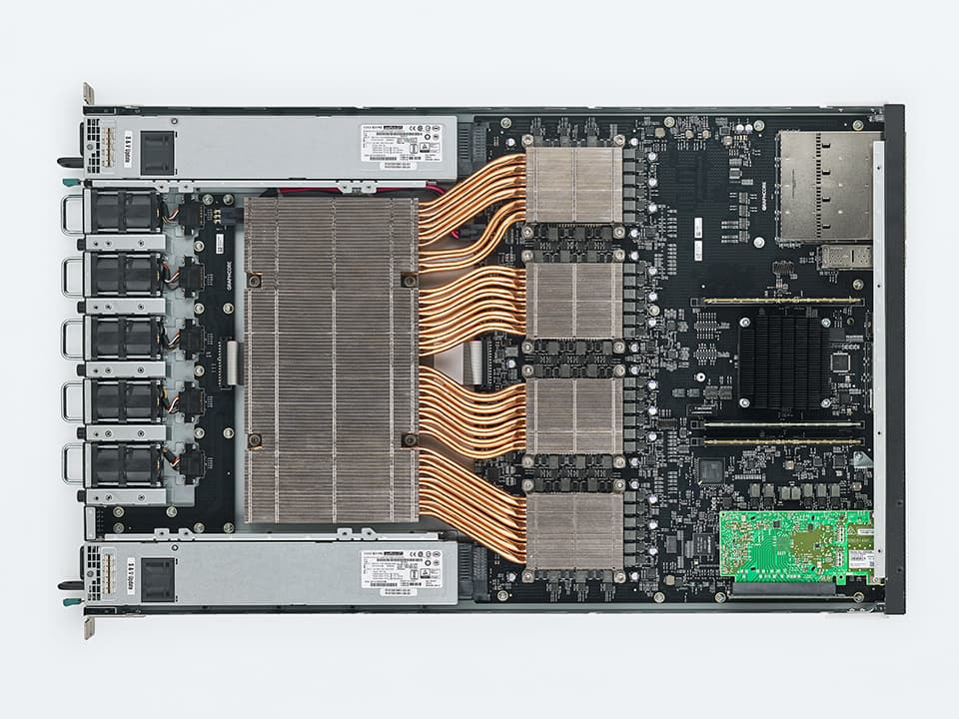
Intellectual merit 2 - Why Dataflow AI accelerators?
CPU/GPU
von Neumann Architectures
IPU
Dataflow Architectures
Comparing with von Neumann Architectures (CPU/GPU), Dataflow processors are
Designed for NN computing
Massive on-chip activation/weight storage on sRAM
Good integration with popular AI tools
Energy efficient and high throughput
Two family of accelerators under eval and benchmarked against GPUs:
Dataflow architecture digital processors, such as GraphCore IPUs
GraphCore tested our network [arXiv:2111.05423] on 2nd gen IPU showing x(10) improvement of speed comparing to GPUs (A6000/LHCb Alan like)
Electro-phontoncs processor, such as LightMatter Envise
On-going, network and data shared
Electro-Photonics
Our recent test based on second generation IPU from GraphCore, TSMC 7nm, 1GB sRAM
See also LHCb sim/reco tests arXiv:2008.09210

Slide 8
Why this team? Why now?
The team
Jin Huang (PO/sPHENIX) + Postdoc hiring: Domain integration and evaluation. Co-convener EIC Detector1 global integration; manager-sPHENIX TPC readout; expertise in simulation and performance evaluation and HF physics
Yihui Ren, Yi Huang, Shinjae Yoo (CSI/ML): Lead AI/ML algorithm development on noise reduction, data compression, and network optimization.
ByungJun Yoon (CSI/Math): AI Uncertainty Quantification; PI for ASCR award for data reduction
Adolfy Hoisie (CSI/ACL): advisor, leading Advanced Computing Lab (ACL), connection to cutting-edge hardware vendors
Chris Pinkenburg, Martin Purschke (PO/sPHENIX): advisor; coordinators for sPHENIX computing and DAQ
Torre Wenaus (PO/NPPS): advisor; co-convener EIC UG software group, leadership roles in NP/HEP computing
Productive team
Five invited talks since starting last year
First paper published in IEEE ICMLA: arXiv:2111.05423
Coming talk/paper accepted: IEEE RealTime 2022

Slide 9
Why fund now?
Keep and expand the momentum for the research, currently supported under LDRD19-028 (ending in one month)
Keep and enhance the connection with novel hardware vendors, who are testing our network/data
At the end of LDRD: bring real-time application of dataflow AI accelerator to the maturity that meets the conceptual design stage of EIC detector 2
Address the FY23 LDRD-A topical areas of Human-AI-Facility Integration and EIC detector-2

Slide 10
Return of investment
Demonstrate a working prototype, as a ladder to external FOA for construction of production system for
EIC Detector 2 construction project for online computing ($O(10) M)
Opportunistic upgrade of EIC Detector 1 and sPHENIX (few M$)
Saving in tape storage and offline computing need for reaching same physics goals $O(1M)

Slide 11
Broader impact for BNL
Building expertise on AI/ML directed data reduction algorithm and the corresponding high throughout computing system
Directly supporting and enhancing high priority BNL research in nuclear physics
Direct support for the BNL AI strategy, in particular the components on real-time experimental application, and Human-AI-Facility Integration
Testbed with AI accelerators for broad use cases at BNL
Put BNL at a leadership role in application of novel AI accelerator in real-time NP/HEP experiment (next slides)

Slide 12
BNL positioned to lead novel AI-accelerator in NP/HEP real-time computing
sPHENIX : data stream most resembles EIC
Streaming readout for full tracking system
60M charge particle per second ~ EIC upgraded to 10³⁵ /cm/s << LHC
TPC present high throughput data as 2+1D zero suppressed data stream, a generic data representation for streaming detectors from algorithm development point of view
BNL leads recent ASCR award on data reduction
Focusing on generic algorithms and uncertainty quantification, with early application focus on cryo-EM and climate science applications.
Synergy to our application at EIC
Connection to AI Hardware vendors through Advanced Computing Lab @ BNL
Connection to multiple vendors with wide range of technology maturity. (details availability under NDA)
Allow for evaluation of our algorithm on multiple vendor hardware

Slide 13
Summary
Neural network-based data compression and information distillation with high throughput, reconstruction fidelity, and aimed to run on leading-edge AI hardware.
Addresses real-time computing need for EIC Detector-2 streaming DAQ
Backed by a productive team: multiple invited talks and publications
Synergize well with multiple CSI research activities
Position BNL to lead novel AI-accelerator in NP/HEP real-time computing
Deliverables :
AI-based data reduction and knowledge distillation algorithm designed for high-throughput real-time inference
Robust AI models with uncertainty quantification, out-of-distribution detection and periodical validation
Algorithm performance evaluation integrated through simulation, raw data, and reconstruction
Demonstrate throughput on multiple novel dataflow AI accelerators
Budget request mainly for two postdocs (PO and CSI each) support: 300k, 500k, 500k
Notes:
AI-based data reduction and knowledge distillation algorithm designed for high-throughput real-time inference.
Robust AI models with uncertainty quantification, out-of-distribution detection and periodical validation.
(Branch-free neural network optimization methods and fast deployment on dataflow hardware)

