Slide 1
Examining Novel Isotope Production Pathways for a Medium to High Energy Cyclotron
Jasmine Hatcher-Lamarre​
C-AD/Medical Isotope Research and Production
June 1, 2022

Slide 2
FY2023 NPP LDRD Type A Proposal
Proposal title: Examining novel isotope production pathways for a medium to high energy cyclotron.
Primary Investigator: Jasmine Hatcher-Lamarre
Other Investigators: Dohyun Kim, Dmitiri Medvedev, Vanessa A. Sanders
Indicate if this is a cross-directorate proposal. Yes ___ No_X__
If yes, identify other directorates/organizations:
Program: (Multiprogram) DOE IP and Early career research application(s)
Proposal Term: From: FY23 To: FY25
Total funding per year in FY23 490K, FY24 491K and FY25 489K

Slide 3
Description of the LDRD Proposal
The DOE Isotope Program intends to site a 30 MeV cyclotron at one of the national laboratories.
The purpose of this proposal is to examine potential production pathways for radionuclides using existing BNL facilities which can be easily translated to a 30 MeV cyclotron.
We intend to investigate the production of the following much needed radionuclides to increase the national supply: cobalt-57, palladium-103, yttrium-86, lead-203, and cadmium-109.
The development of these pathways will position BNL as the prime location for this investment

Slide 4
Potential Benefits and Impact
Benefit – Demonstrate that BNL is the prime location for a new cyclotron
Return on Investment – DOE-IP Investment of $30-$50 million for new cyclotron facility coming to BNL.
Impact – The use of the 30 MeV cyclotron will allow development of a source for new radionuclides, and to benefit the nation by reducing reliance on foreign sources of current radionuclides.
The use of the 30 MeV cyclotron will allow production of higher purity radionuclides due to variable energy capabilities
Total Effort (FTE)
Scientific 2.35
Post Doc 1.5

Slide 5
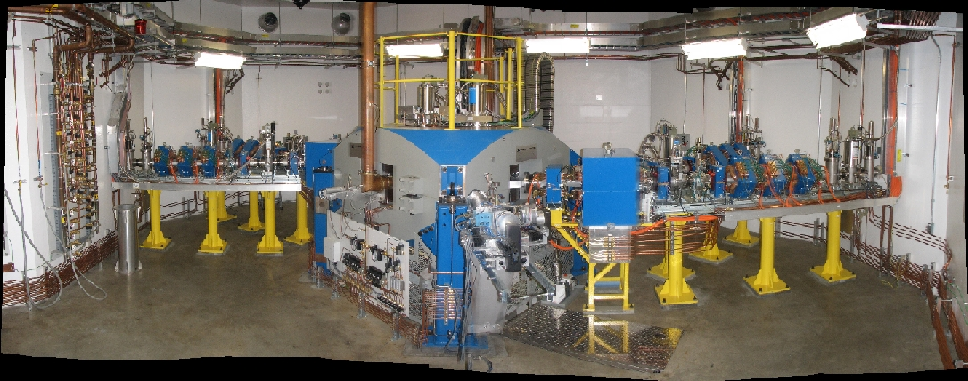
Goal
To fully develop novel methods of producing much needed isotopes for industry, medicine and research using a 30 MeV Cyclotron with multiparticle capabilities.

Slide 6
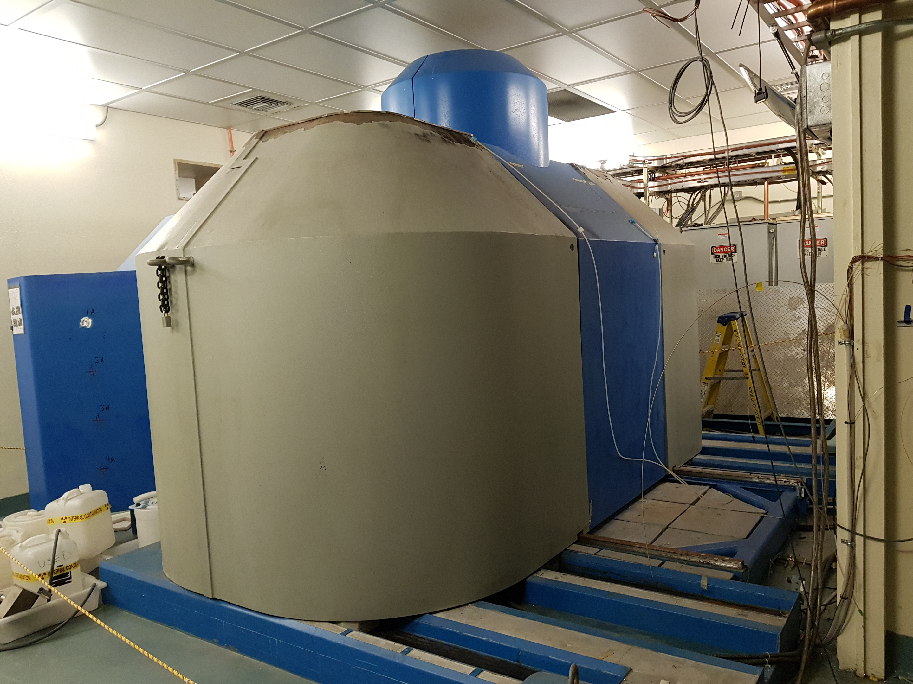
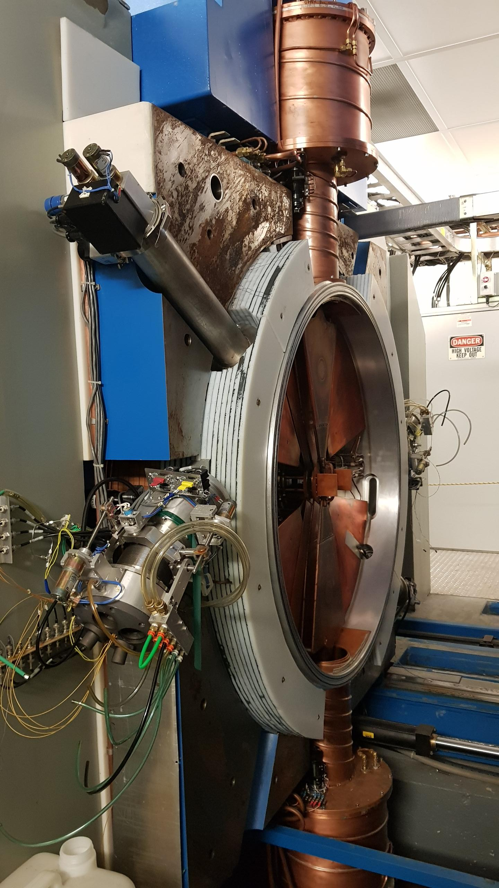
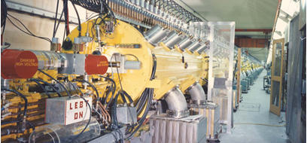
Current Isotope Production at BNL
Brookhaven
19 MeV Cyclotron
Brookhaven
Linac

Slide 7
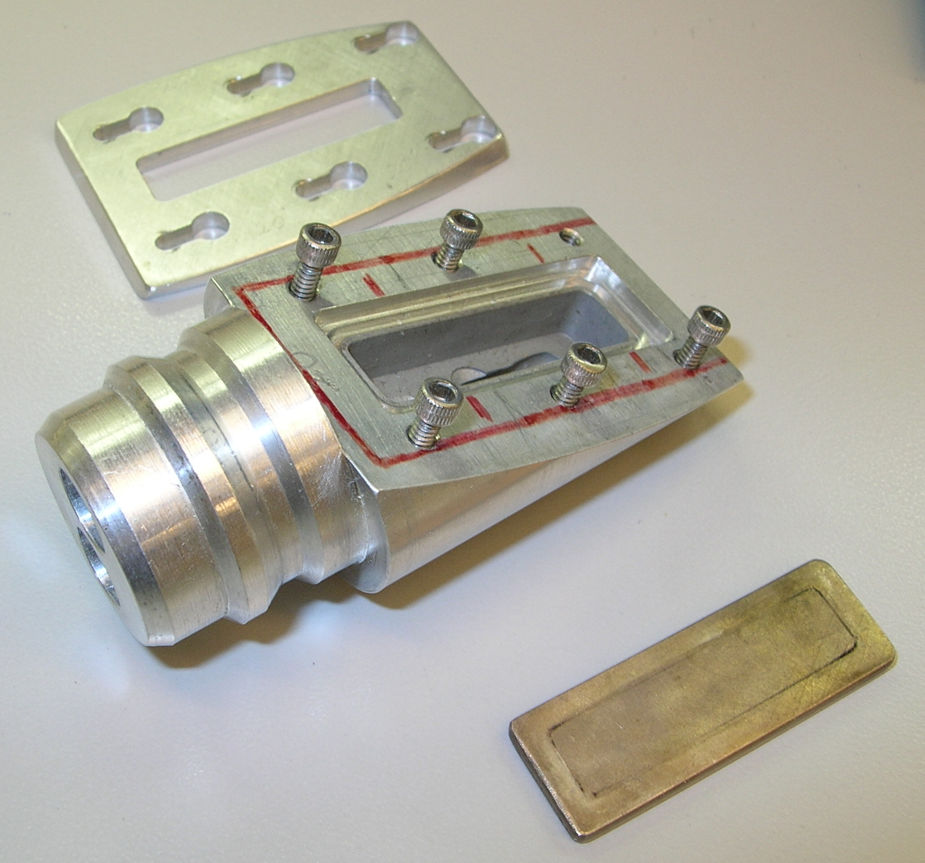
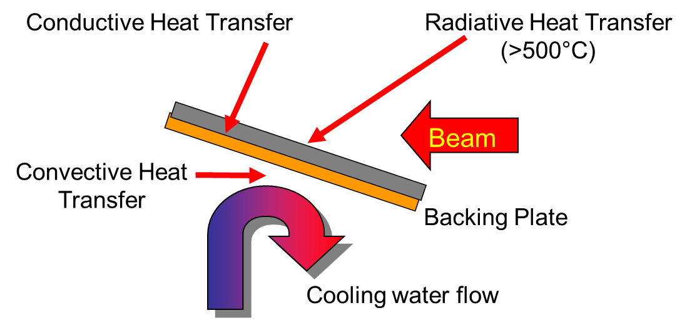
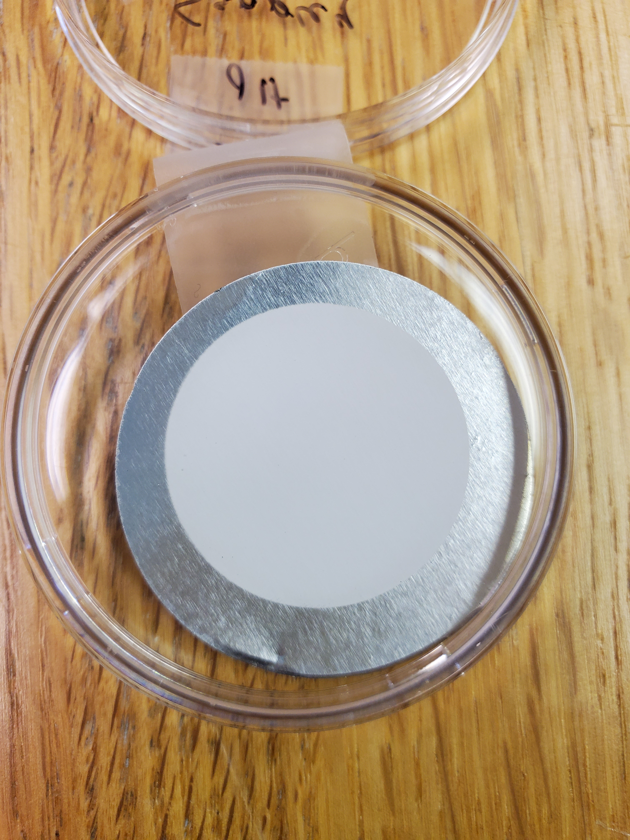
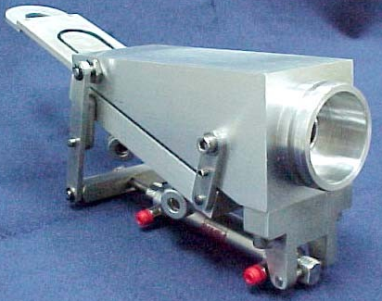
Methods
Develop New target designs for a 30 MeV cyclotron
  Development of solid target holders
  Target cooling at higher beam currents
  Target mounting and dismounting
Test the approaches using BLIP and 19 MeV cyclotron
  Identify appropriate starting material
  Irradiate foils and films to evaluate impurities
Evaluate separations methods
  Chromatography
Determine quality control requirements
  Radioanalytical methodology

Slide 8
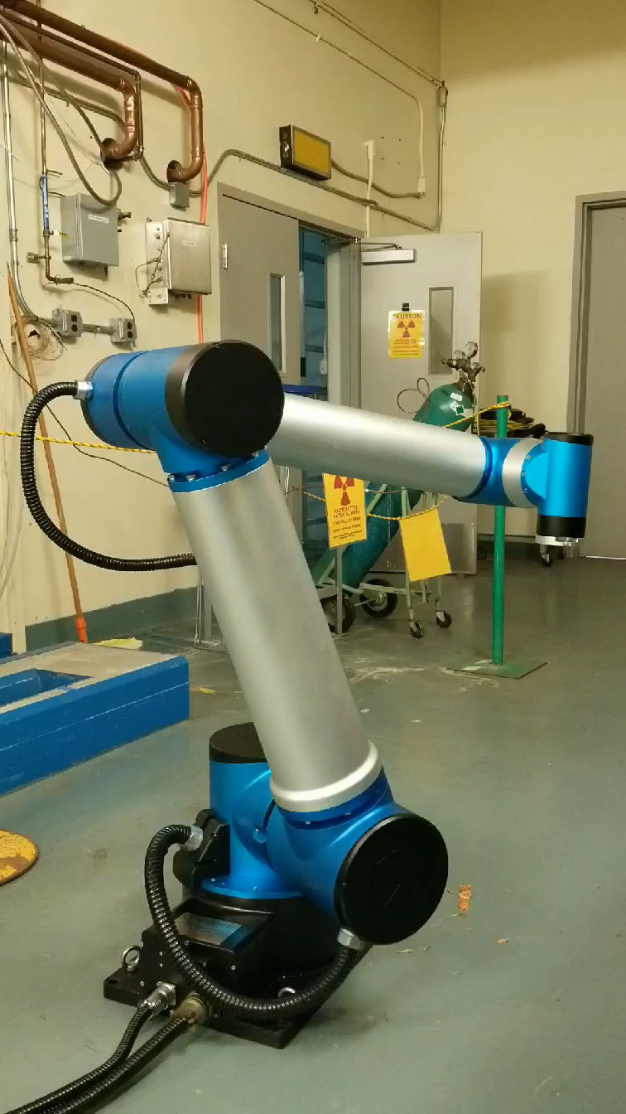
Required Procurement
Target Body materials
Vacuum Isolation and Cover foils
Target materials including enriched isotopes
Chromatography resins
Chemical supplies
Ligands for labelling studies

Slide 9
Deliverables
Milestone | Start | End
Identify potential target materials for desired isotopes | Y1Q1 | Y1Q2
Irradiate test foils using the BLIP and/or Cyclotron | Y1Q2 | Y1Q4
Develop separations methods for each desired isotope | Y2Q1 | Y2Q3
Develop radioanalytical methods to determine quality of BLIP/Cyclotron produced isotopes | Y2Q4 | Y3Q2
Develop solid target design, cooling, and handling procedures for actual 30 MeV cyclotron | Y3Q2 | Y3Q4

Slide 10
Personnel
Dohyun Kim - Physicist-Target body design, Simulations
Dmitri Medvedev –Nuclear Engineer- Simulations, Target fabrication
Jasmine Hatcher-Lamarre –Inorganic Chemist -Target fabrication, separations
Vanessa A. Sanders - Radiochemist- Separations, Quality assessment

Slide 11
Summary
The Isotope Program is committed to siting a new 30 MeV cyclotron at a National Laboratory
The facilities that currently exist at BNL will allow us to demonstrate feasibility and design targets that will be compatible with the new cyclotron and easily transferable.
The personnel at BNL have extensive experience in the production, separation, purification and labelling of radionuclides for medicine, industry and research, and are internationally recognized for their expertise.
Funding this LDRD will position BNL as the prime location for this new facility with the substantial funding that accompanies the siting of this facility. It will also allow BNL to continue as the leader in the development of new radionuclides at the National Labs.

