Slide 1
Particle Accelerator Self-Evaluation by Machine Learning
Principle Investigators:
Georg Hoffstaetter (C-AD and Cornell, Presenter)
Kevin Brown (C-AD and Stony Brook)
LDRD Pre-review June 1, 2022

Slide 2
FY2023 NPP LDRD Type A Proposal
Proposal title: Particle Accelerator Self-Evaluation by Machine Learning
Primary Investigator:
Georg Hoffstaetter (C-AD and Cornell), Kevin Brown (C-AD and Stony Brook)
Other Investigators: Timur Shaftan (NSLS-II), Thomas Robertazzi (Stony Brook),
Natalie Isenberg (CSI), Yuan Gao (C-AD), Vincent Schoefer (C-AD), Yongjun Li (NSLS-II), Reid Smith (NSLS-II), David Sagan (Cornell)
Indicate if this is a cross-directorate proposal. Yes _X_ No___
If yes, identify other directorates/organizations: C-AD, NSLS-II, CSI, Cornell, SBU
Program: Specify which program: Multiprogram
Proposal Term: From: 10/01/22 To: 09/30/25
Total funding per year in FY23, FY24 and FY25: 2.6FTE per year

Slide 3
Context
Large accelerators have thousands of measured parameters that describe their state, e.g., field strength, magnet alignments, etc.
These parameters are used to make a virtual accelerator model (VAM). An accurate model is needed for operations, e.g., to run feedback systems, to optimize luminosity.
Today, human intervention and dedicated beam study times are often required to find system parameters.
Time consuming dedicated studies
Sensitivity to human errors.
An accurate VAM (existing or from ML) can provide a digital twin to the control system that controls the twin just like the physical accelerator. Prototypes (CBETA-V & CESR-V) have led to enormous operational simplifications and optimizations, to virtual detectors, and to early fault detection.

Slide 4
Main Goal
Provide a control system procedure that evaluates the main parameters of an accelerator automatically and parasitically to user operation.
As a first example, establish this procedure initially by means of the Orbit Response Matrix. Afterwards add other measurables, e.g., parasitically evaluate injection oscillations.
The ORM method:
N corrector magnets produce beam orbit changes at M beam-position monitors.
These N*M values can be used to determine many of the accelerator’s parameters, e.g., magnets strength and alignments.
1st Goal: Establish the ORM automatically and parasitically, without dedicated study time in the AGS, RHIC, and NSLS-II.

Slide 5
Deliverables
Machine Learning routines, connected to the control systems, that provide the ORM and other dynamic accelerator functions automatically and parasitically during accelerator operation for AGS, RHIC, and NSLS-II.
Determine accelerator parameters from the ORM.
Provide a virtual accelerator model with these parameters.
Make these routines generic so they can easily be transferred to other ring accelerators.
Connect the virtual accelerator model to the control system to form a full digital twin.

Slide 6
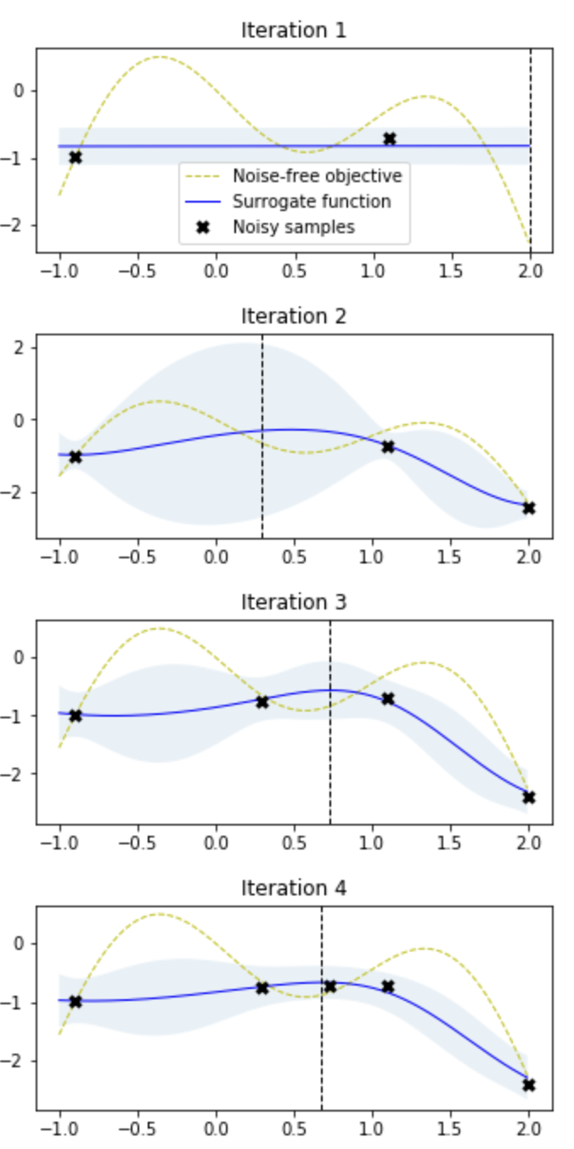
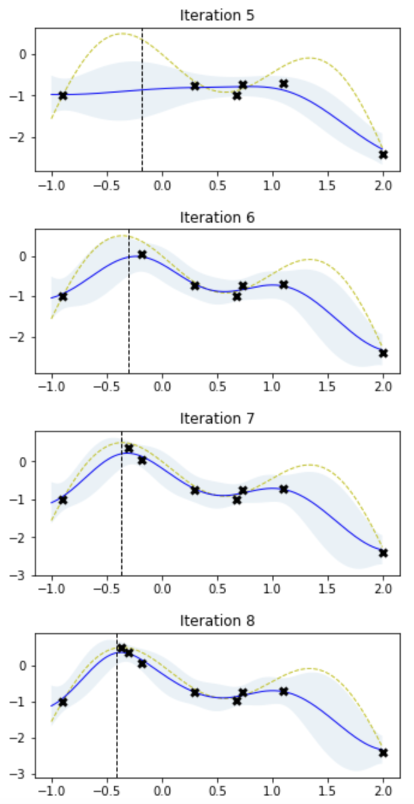
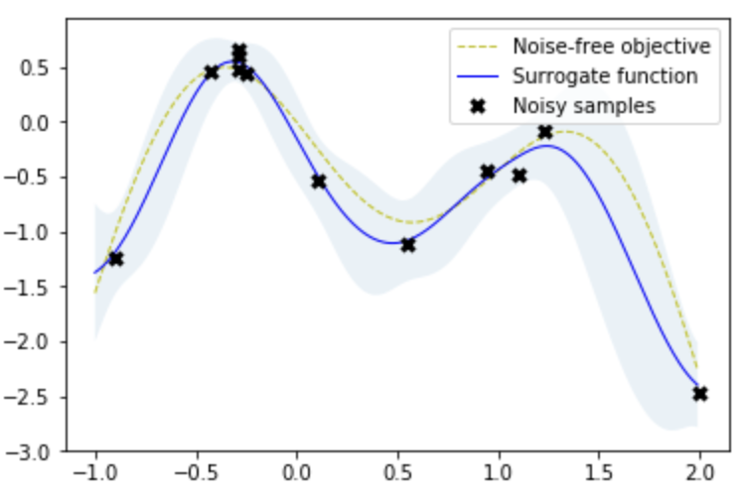
Methods to achieve the goals
Bayesian optimization
Functions are successively approximated, with diminishing uncertainty.
Detector noise can be included.

Slide 7
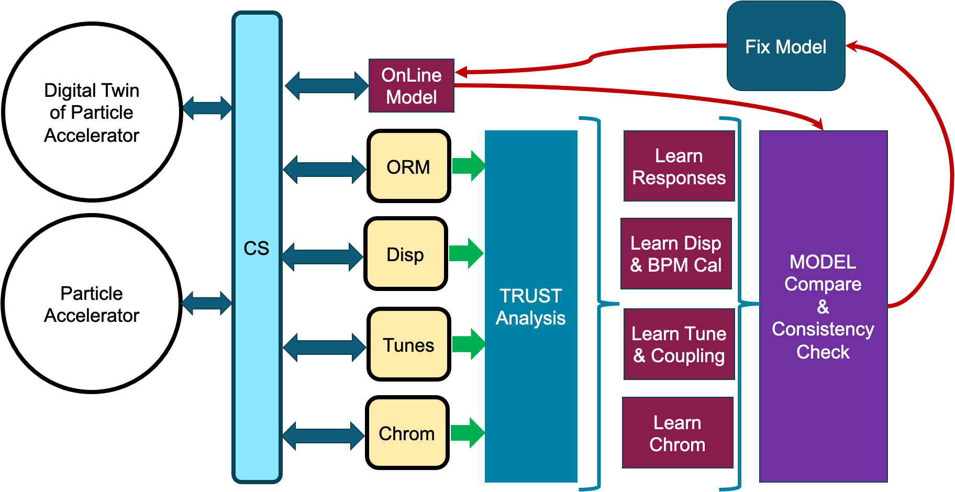
Methods to achieve the goals
Control system implementation and the Digital Twin
The Digital Twin is based on the Virtual Accelerator Model and can be addressed from the control system just like the physical accelerator.

Slide 8
Personnel involved
Georg Hoffstaetter (C-AD and Cornell) – Accelerator physics
Kevin Brown (C-AD and Stony Brook) – Controls implementation
Timur Shaftan (NSLS-II) – NSLS-II implementation
Natalie Isenberg (CSI) - ML with uncertainties
Yuan Gao (C-AD) – ML applications
Vincent Schoefer (C-AD) – Controls implementation
Yongjun Li (NSLS-II) - Operation implementation
Reid Smith (NSLS-II) – Operation implementation
Thomas Robertazzi (Stony Brook) – ML with uncertainties
David Sagan (Cornell) – Bmad accelerator modeling

Slide 9
Required procurements
Computational tools and control system interfaces are available.
No procurements are needed.

Slide 10
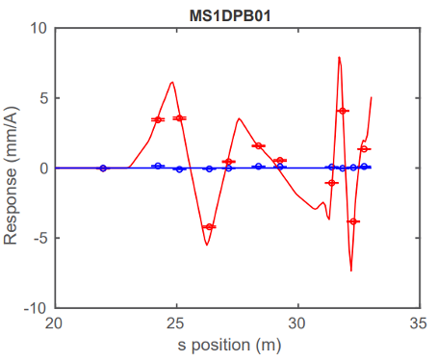
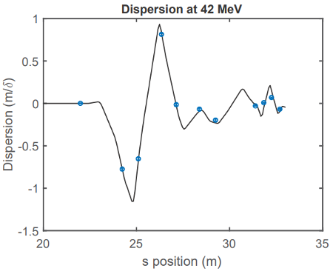
Potential Benefits
Continuous update of the virtual accelerator model.
Savings in dedicated study time.
Early warnings about component deterioration.
Confidence estimates for detectors.
Availability of a VAM for feedbacks and optimizations.
Virtual detectors from the digital twin.
Ease of operation and controls developments.

Slide 11
Selection criteria
Intellectual merit
Accelerator applications of Bayesian optimization, Neural Networks, and AI/ML.
A new paradigm for accelerator control.
Quantitative confidence analysis on predictions with ML.
Construction of digital twins for a large accelerator control system.
Return on Investment
Savings in costly accelerator study time.
Reduction of human error in dedicated data taking.
The broader impacts on the Laboratory
Improved operation at the AGS, RHIC, and NSLS-II.
Flexible implementation that can be used for EIC rings and beyond.
Extendibility to BNL’s linacs.

Slide 12
Summary
Accelerator optimization and feedback systems need an accurate accelerator model.
Obtaining the parameters for that model often requires human interaction and dedicated study time.
AI/ML provides techniques to successively improve the knowledge of accelerator parameters during user operation.
The Virtual Accelerator Model can therefore be continuously updated, providing: (a) accurate optimizations and feedback, (b) early fault detection, (c) virtual diagnostics.
Why it has to be supported ?
There is large and growing interest in AI/ML applications in accelerators, manifested in papers and invited presentations.
All BNL accelerators will benefit, as well as new international accelerators.
The investment will be returned amply in reduced accelerator study times.

Slide 13
Methods to achieve the goals
The Orbit Response Matrix
Each monitor reading is a function of N corrector coils.
Bayesian optimization can successively learn this function.
N correctors
M monitors
Closed orbit
The N*M ORM data can be used to
Measure the optics functions (β, ψ).
Determine quadrupole strength, sextupole alignments, etc.
Direct closed orbit control.

