Slide 1
Target Station for Low-Current Nuclear Reaction Studies at the BNL Linac
Michael Skulski (MIRP/CA-D), Dmitri Medvedev (MIRP/CA-D), Deepak Raparia (CA-D)
Date

Slide 2
FY2023 NPP LDRD Type A Proposal
Proposal title: Target Station for Low-Current Nuclear Reaction Studies at the BNL Linac
Primary Investigator: Michael Skulski (MIRP/CA-D)
Other Investigators: Dmitri Medvedev (MIRP/CA-D), Deepak Raparia (CA-D)
Indicate if this is a cross-directorate proposal. Yes ___ No_X_
If yes, identify other directorates/organizations:
Program: MIRP
Proposal Term: From: October 1, 2022 To: September 30, 2025
Total funding per year in FY23, FY24 and FY25: $335k, $460k, $475k

Slide 3
Project Description
The capabilities of in-beam measurements at the full range of proton energies available at the BNL Linac are not available at other facilities
We propose the installation of a low-current target station on the Linac beamline to enable these types of measurements for applications including nuclear data efforts for isotope production
  Energies: 10 – 200 MeV
  Currents: 1 nA – 1 µA

Slide 4
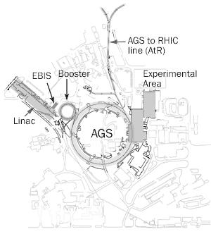
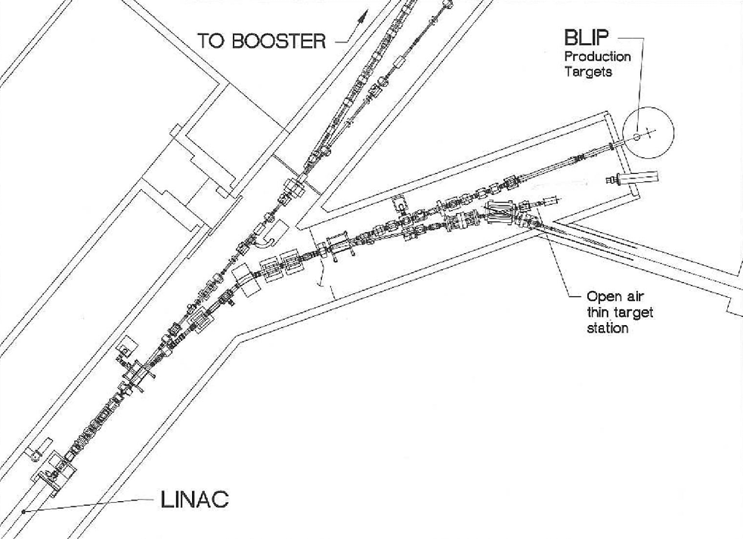
Proposed Location
Target
Station

Slide 5
Research Goals
In-beam measurements of the prompt gamma rays and secondary particles emitted from proton-induced reactions give insight for isotope production research and development and understanding the mechanisms of nuclear reactions
  The energies available for protons at the Linac provide access to the direct, compound, and pre-equilibrium stages of nuclear reactions
These measurements complement the foil stack method performed at BLIP for isotopes whose production rates cannot be measured through post-irradiation analysis
Measurements of secondary neutrons provide information for nuclear data efforts but also can be used to help predict secondary-neutron-generated products in target stack configurations

Slide 6
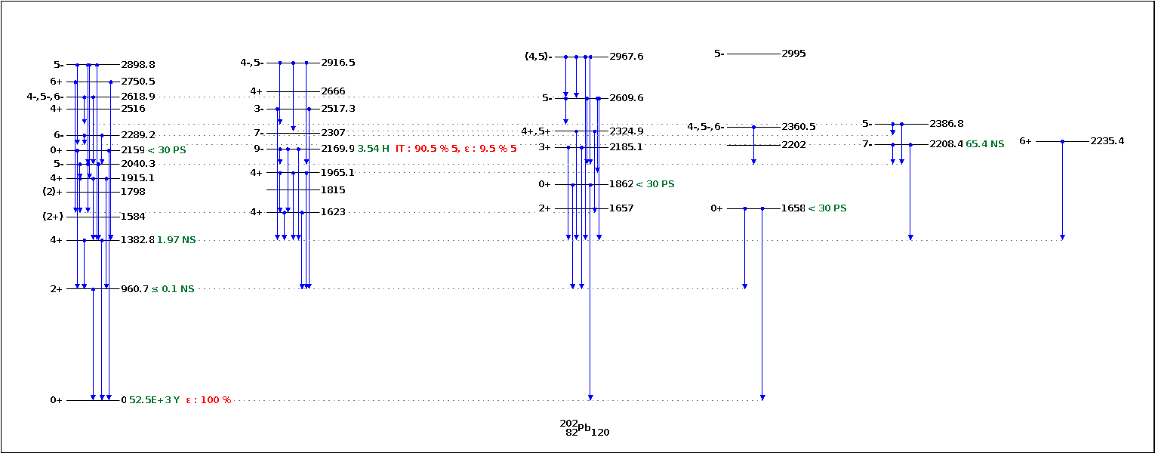
Measurement of gamma ray cascades

Slide 7
Deliverables & Benefits
This project will provide a facility for:
  Research and development for planning isotope productions
  Generating nuclear data for constraining theoretical models
  Measuring secondary-neutron spectra from targets during irradiation
Benefits (and ROI) include:
  Opportunities for funding:
    The DOE Isotope Program may contribute funding for these types of studies, better positioning BNL to receive funds through the initiative
    Bringing users for studies requiring low currents and up to 200 MeV proton energy
  Local facility for optimizing isotope productions and investigating isotope production using secondary neutrons at BLIP

Slide 8
Funding
FY23 | FY24 | FY25 | TOTAL
$335k | $460k | $475k | $1.27M
Required procurements:
  Vacuum chamber and vacuum equipment (valves, pumps)
  Sample and degrader holders
  Beam diagnostic equipment (Faraday cup, BPM)
  Stands for detector setup and shielding support
  Data Acquisition system
Non-equipment costs:
  Salary for 0.5 postdoc, 0.25 staff scientist for 3 years
  Beam time for commissioning experiments
  Time for engineering and machining pieces for beamline
  RadCon/Waste Disposal for commissioned targets

Slide 9
Summary
We propose a target station for low-current in-beam irradiation studies that would add a unique facility at the BNL Linac
This station would allow experiments that can provide information critical for isotope production planning but can also produce nuclear data for theoretical models
  Data will complement work performed at BLIP for optimization of isotope production
This facility provides the low current and energy range required for several types of experiments that would be attractive to outside users, and invites funding from the DOE Isotope Program where critical for progress

