Slide 1
AC-LGAD sensor R&D status and plan eRD112/LGAD consortium meetings
Gabriele Giacomini
June 1st 2022

Slide 2
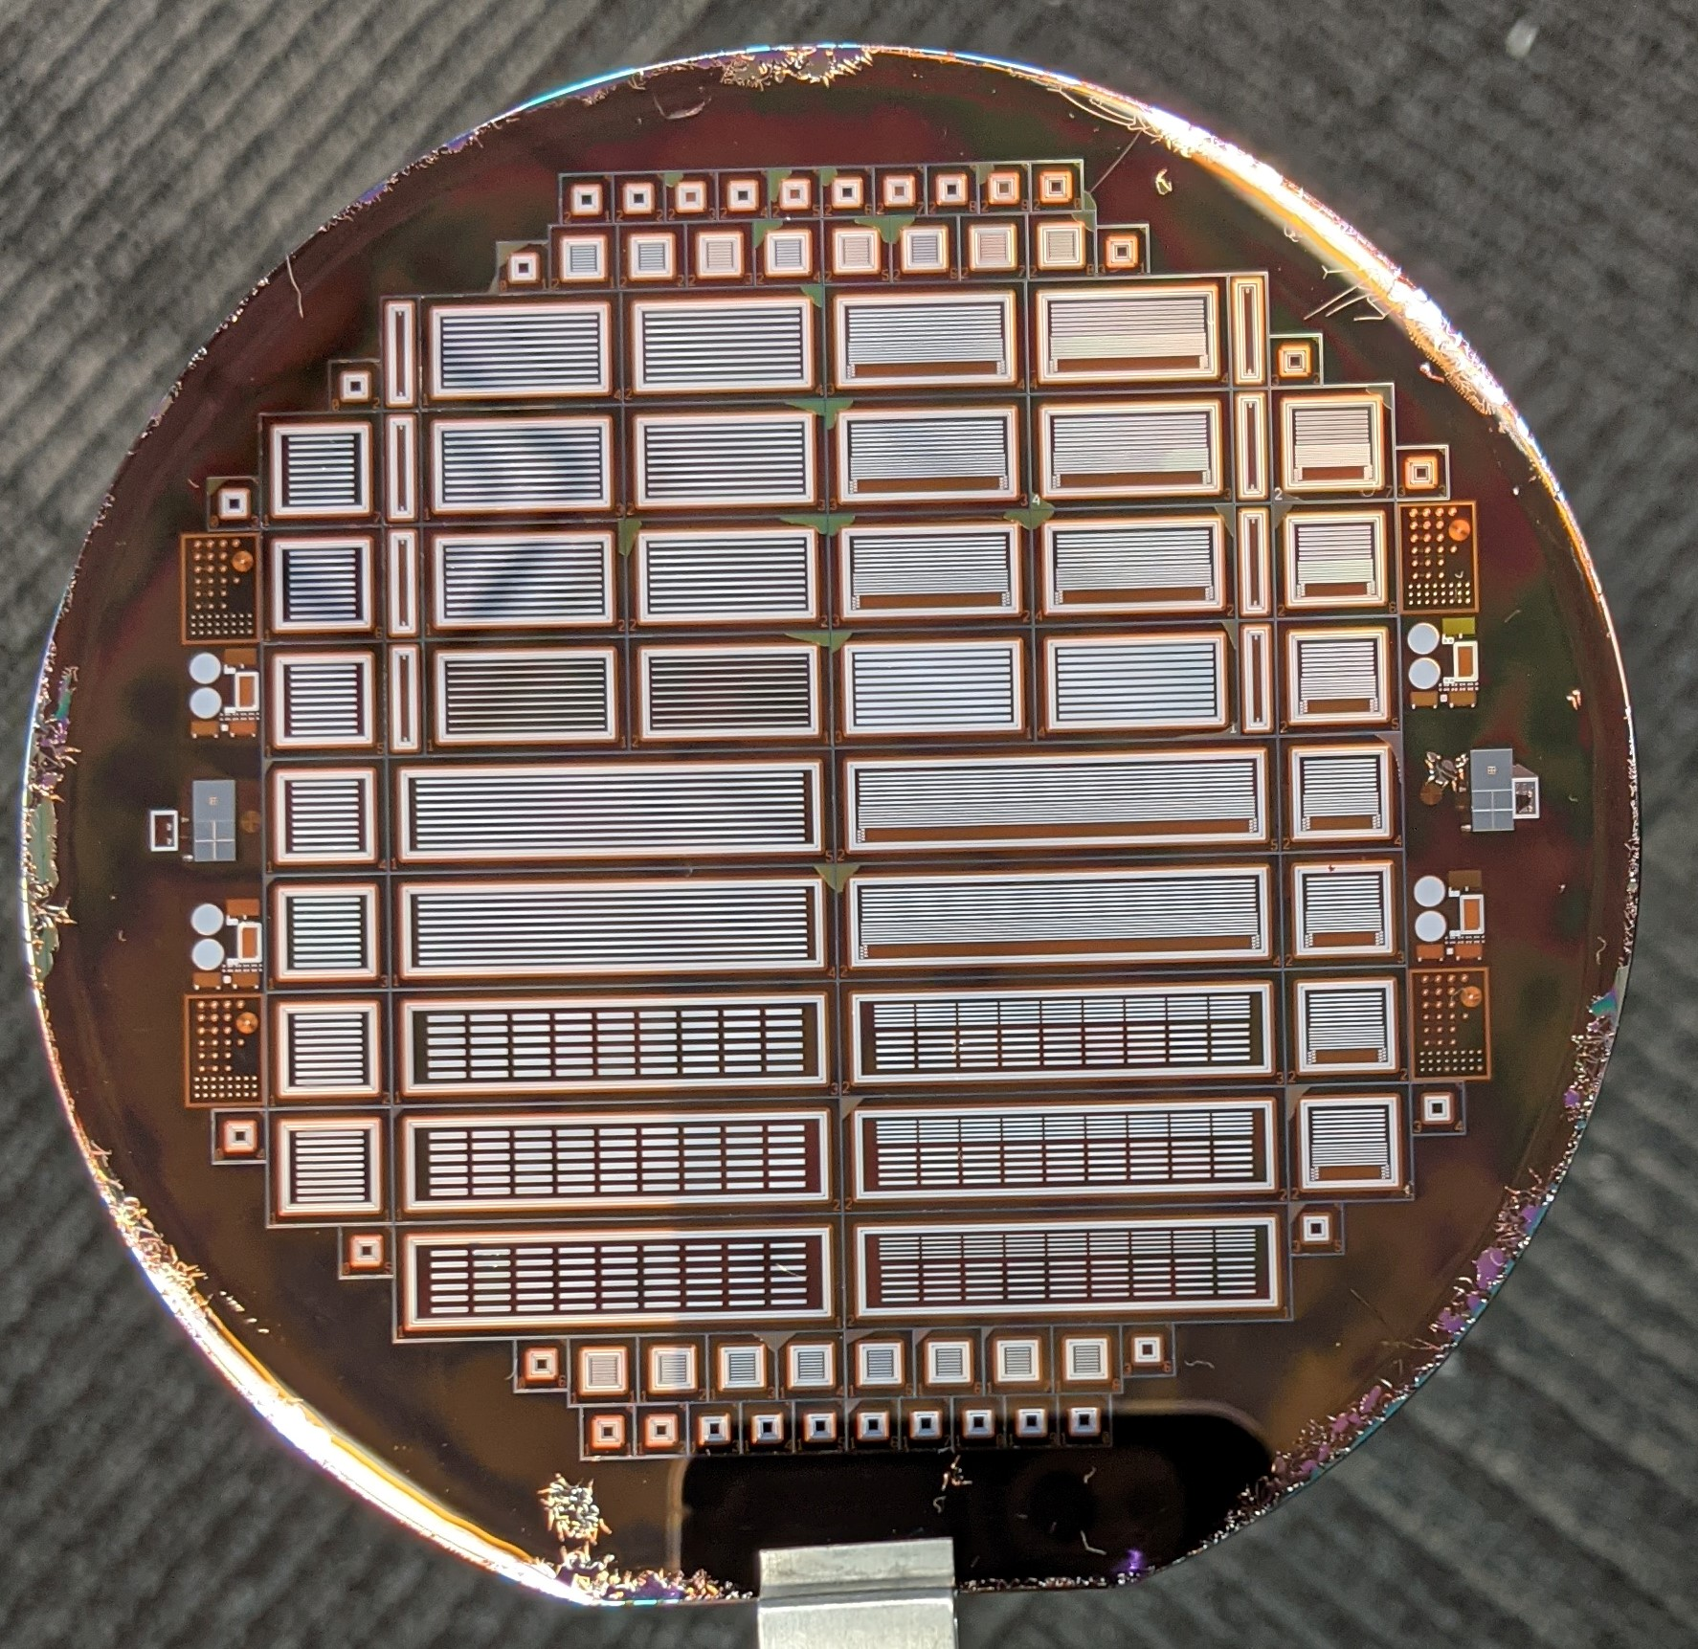
ACLGAD strip
A few wafers fabricated: 0.5cm, 1cm, 2.5 cm long strips
Beam tests done.
Another batch can start now:
p-spray (uniform) already done on 3 20-um and 3 50-um thick wafers
Plan to do 2 + 2 wafers
Optimization of the process
Aiming at high yield
Uniformity of the gain

Slide 3
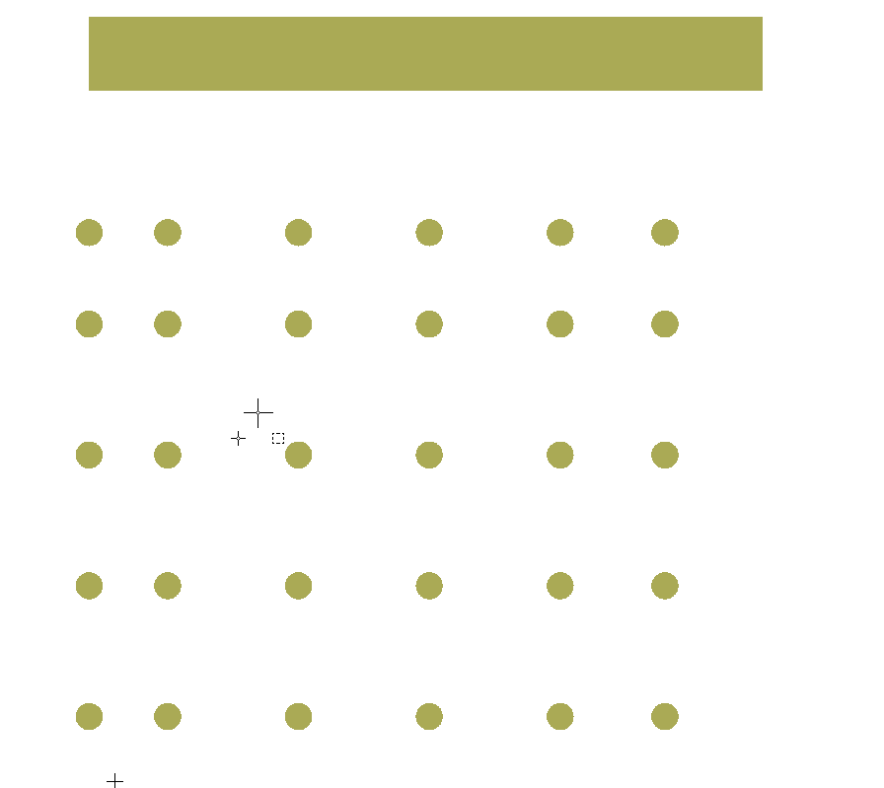
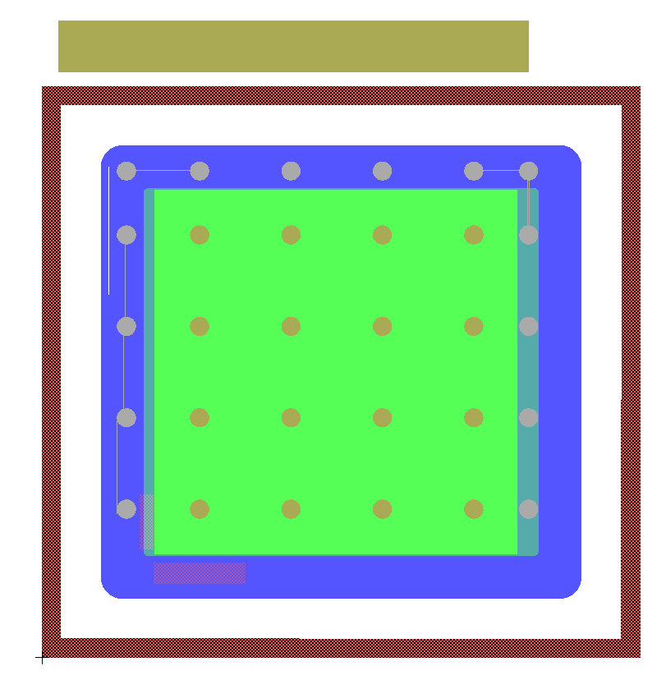
New layout for EICROC
Pads mirrored and placed on the sensor
Two sides to ground the GR
One side to ground the pad
300um
400um
350um
500um
500um

Slide 4
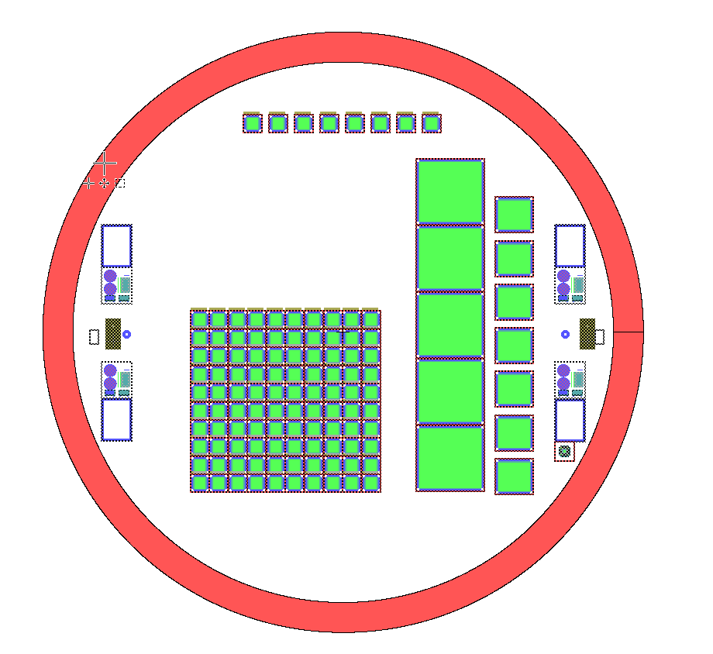
Population of the 4” wafer
A lot of 4x4 pad sensors
can explore different metal layouts considering learnt lessons
No need to wait to define the metal to start batch
Aggressive/more conservative layouts
Large area device to test yield
This can start in a month or so

