Slide 1
Some comments to Detector 1 tracking /PID optimization discussion
N. Smirnov
Physics Department, Yale University
June 23, 2022.

Slide 2
Does current “EIC Detector 1” proposal fit the YR guidance?
“Detector 1 Collaboration Proposals: Experiments must address the EIC White Paper and NAS Report science case. The collaboration should propose a system that meets the performance requirements described in the EIC CDR and EICUG YR.”
Barrel setup (+/- 1.5 pseudo-rapidity): reconstruct ALL charge particle tracks with PID and requested momentum resolution performance for P in 0.1 – 10. GeV/c limits.

Slide 3
To start the discussion connected to BARREL tracking / PID setup.
Are all statements / request in YR correct ?
If YES:
-- all charge particles with P (0.1 - 10.0) GeV/c should be reconstructed with PID known
-- spectrum of charge particles are correct ones.
-- primary and secondary vertexes should be reconstructed (s- and c- Physics)
If NO:
What should be used for the tracking and PID optimization?

Slide 4
Track finding, momentum reconstruction performance
Realistic detector setup, support structure, FEEs, cables, Alignment, … Hits finding / reconstruction (noise, efficiency, “dead” channels, …) Response in B-field and realistic track angles (in space)
Number hits per track. Track finding with all background included.
Primary and secondary vertexes finding / reconstruction.
Are all these steps in a progress?
What is the conclusion of the performance using today optimistic parameters for a fast simulation?

Slide 5
ECCE Tracking momentum resolution
Track momentum dependent momentum resolution.
dp / p VS p in 0 <η < 1 dp / p VS p in 1 < η < 2.5 dp / p VS p in 2.5 <η < 3.5
0.025 0.08
Track � p / p
0.014
ECCE MC: Single ⁻
Track � p / p
ECCE MC: Single ⁻
Track � p / p
ECCE MC: Single ⁻
0.012
EIC YR 0 < 1
0.02
1 < 1.5
1.5 < 2 2 < 2.5
EIC YR 1 < 2.5
0.07
EIC YR 2.5 < 3.5
0.5 < 1
0.06
2.5 < 3
0.01
0 < 0.5
0.05
3 < 3.5
0.008
0.015
0.04
0.006
0.01
0.03
0.004
0.005
0.02
0.002
0.01
0
0
8 10 12 14 16 18 20
Track p (GeV/c)
0
8 10 12 14 16 18 20
Track p (GeV/c)
0
2
4
6
8
10 12 14 16 18
20
0
2
4
6
0
2
4
6
Track p (GeV/c)
dp / p VS p in -1 <η < 0
dp / p VS p in -2.5 < η < -1
dp / p VS p in -3.5 <η < -2.5
Track � p / p
0.014
Track � p / p
0.025
ECCE MC: Single ⁻
Track � p / p
0.1
ECCE MC: Single ⁻
-1.5 < -1
-2 < -1.5
-2.5 < -2
0.09
ECCE MC: Single ⁻
0.012
-1 < -0.5
EIC YR -1 < 0
0.02
EIC YR -2.5 < -1
0.08
-3 < -2.5
EIC YR -3.5 < -2.5
0.01
-0.5 < 0
0.07
-3.5 < -3
0.008
0.015
0.06
0.05
0.006
0.01
0.04
0.004
0.03
0.002
0.005
0.02
0.01
0
0
14 16 18 20
Track p (GeV/c)
0
10 12 14 16 18 20
Track p (GeV/c)
0
2
4
6
8
10 12 14 16 18
20
0
2
4
6
8
10 12
0
2
4
6
8
Track p (GeV/c)
Xuan Li (LANL)
5

Slide 6
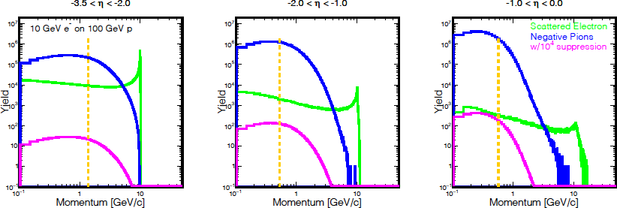
η = -ln(tan(θ/2))
B. Schmookler
1

Slide 7
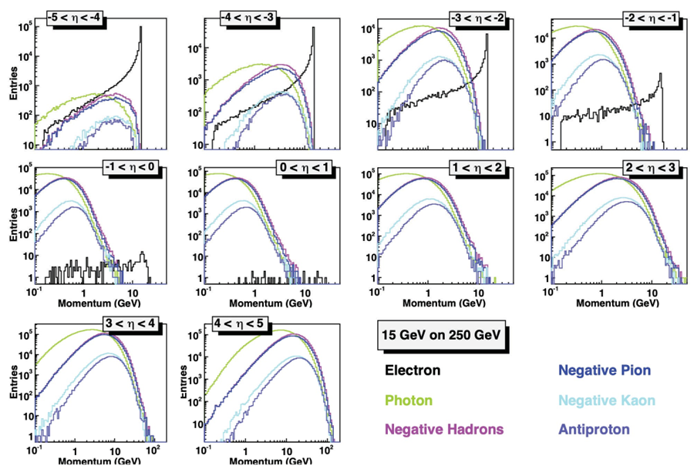

Slide 8
Tracking – PID -- EMCAL: optimization together
DIRC team “promised” perfect PID started 0.6 GeV/c
So, it is crucial to “cover” 0.1 – 0.6 GeV/c part of the spectrum. (where practically all particles are; see YR simulation data).
It was proposed to consider AC-LGAD as (fantastic) 4D detector.
But is it optimal option for Detector 1?
-- it needs a lot of R&D, see last presentation of the ToF team. It is unclear that pre-production detector will be ready at TDR presentation time.
-- it is extremely expensive.
R position ?
-- for R=63 cm position there is probability that it is no PID for particles with momentum up to 0.3 GeV/c.
Is it acceptable !?

Slide 9
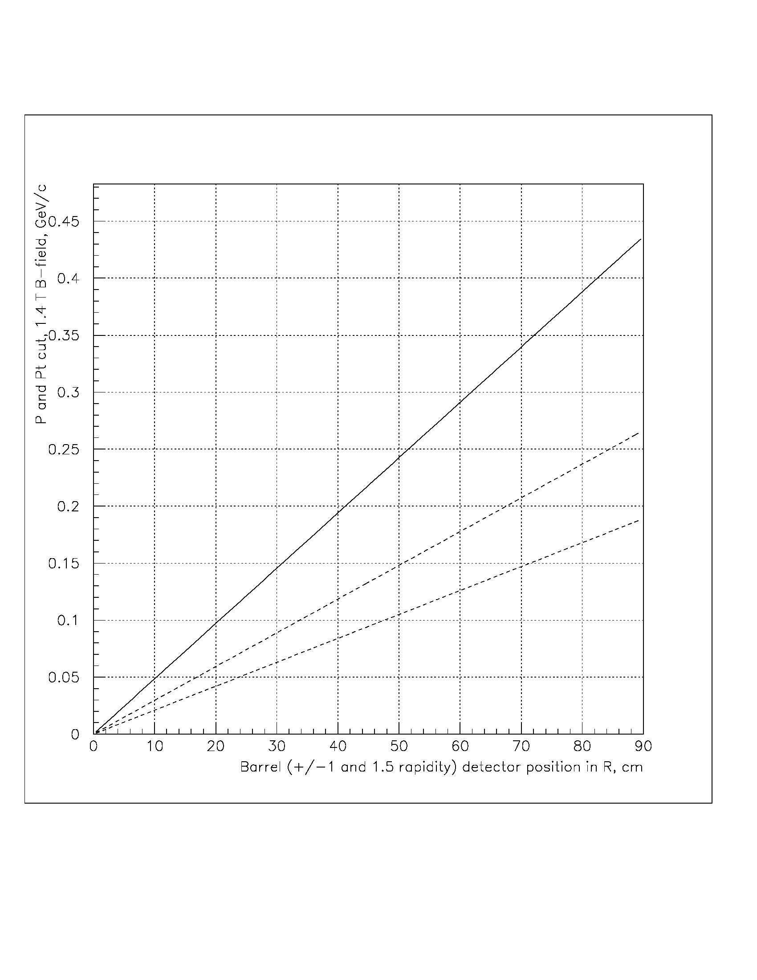
-- Change R to ~35 cm position? But keep In mind: beams crossing timing, clock distribution precision, and 8-12% of X0 material.
P cut. +/- 1.5
P cut, +/- 1.0
Pt cut
ToF
Si
MPGD
MPGD
MPGD

Slide 10
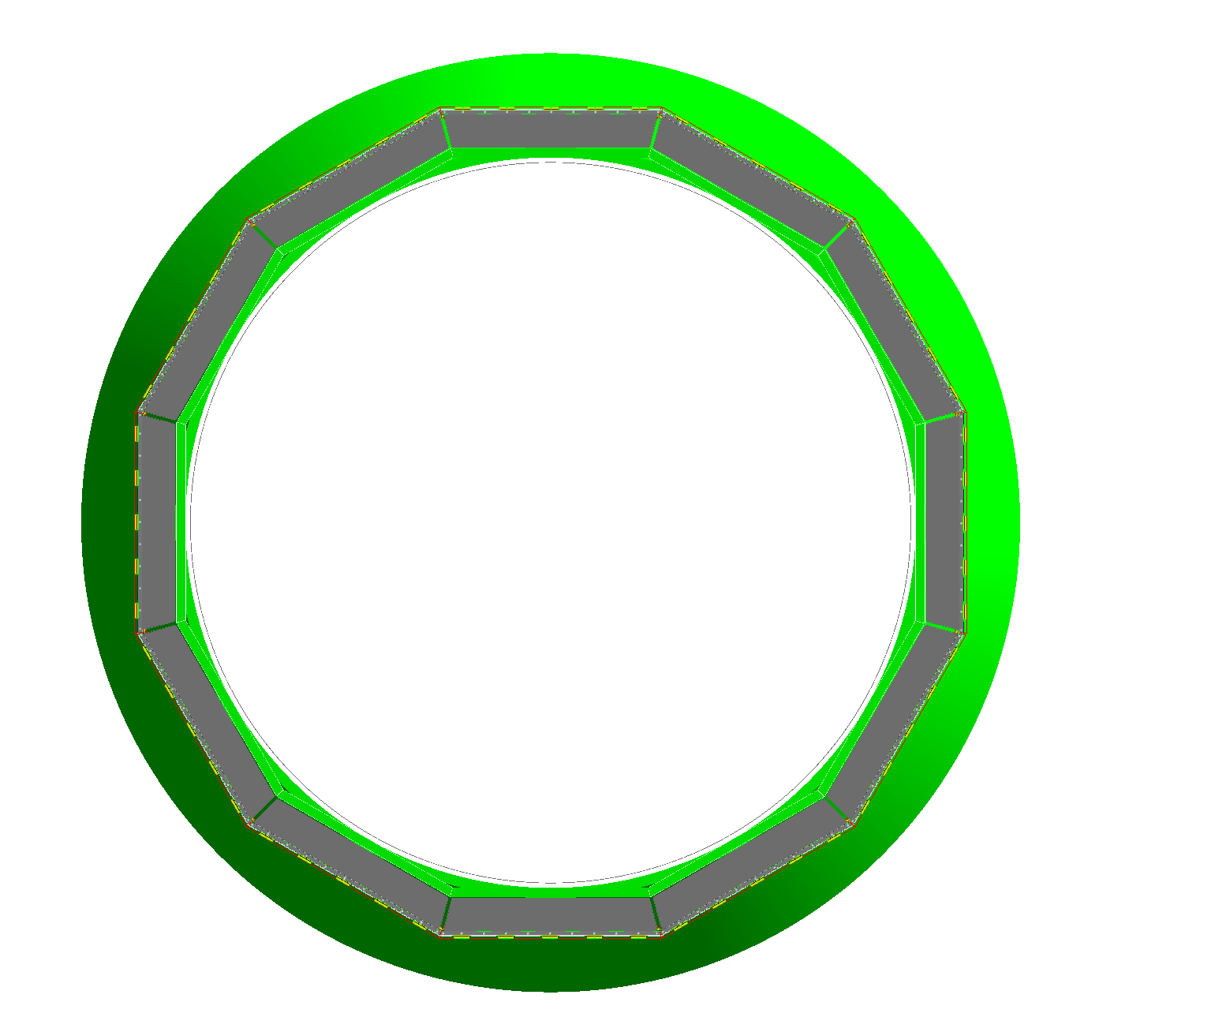
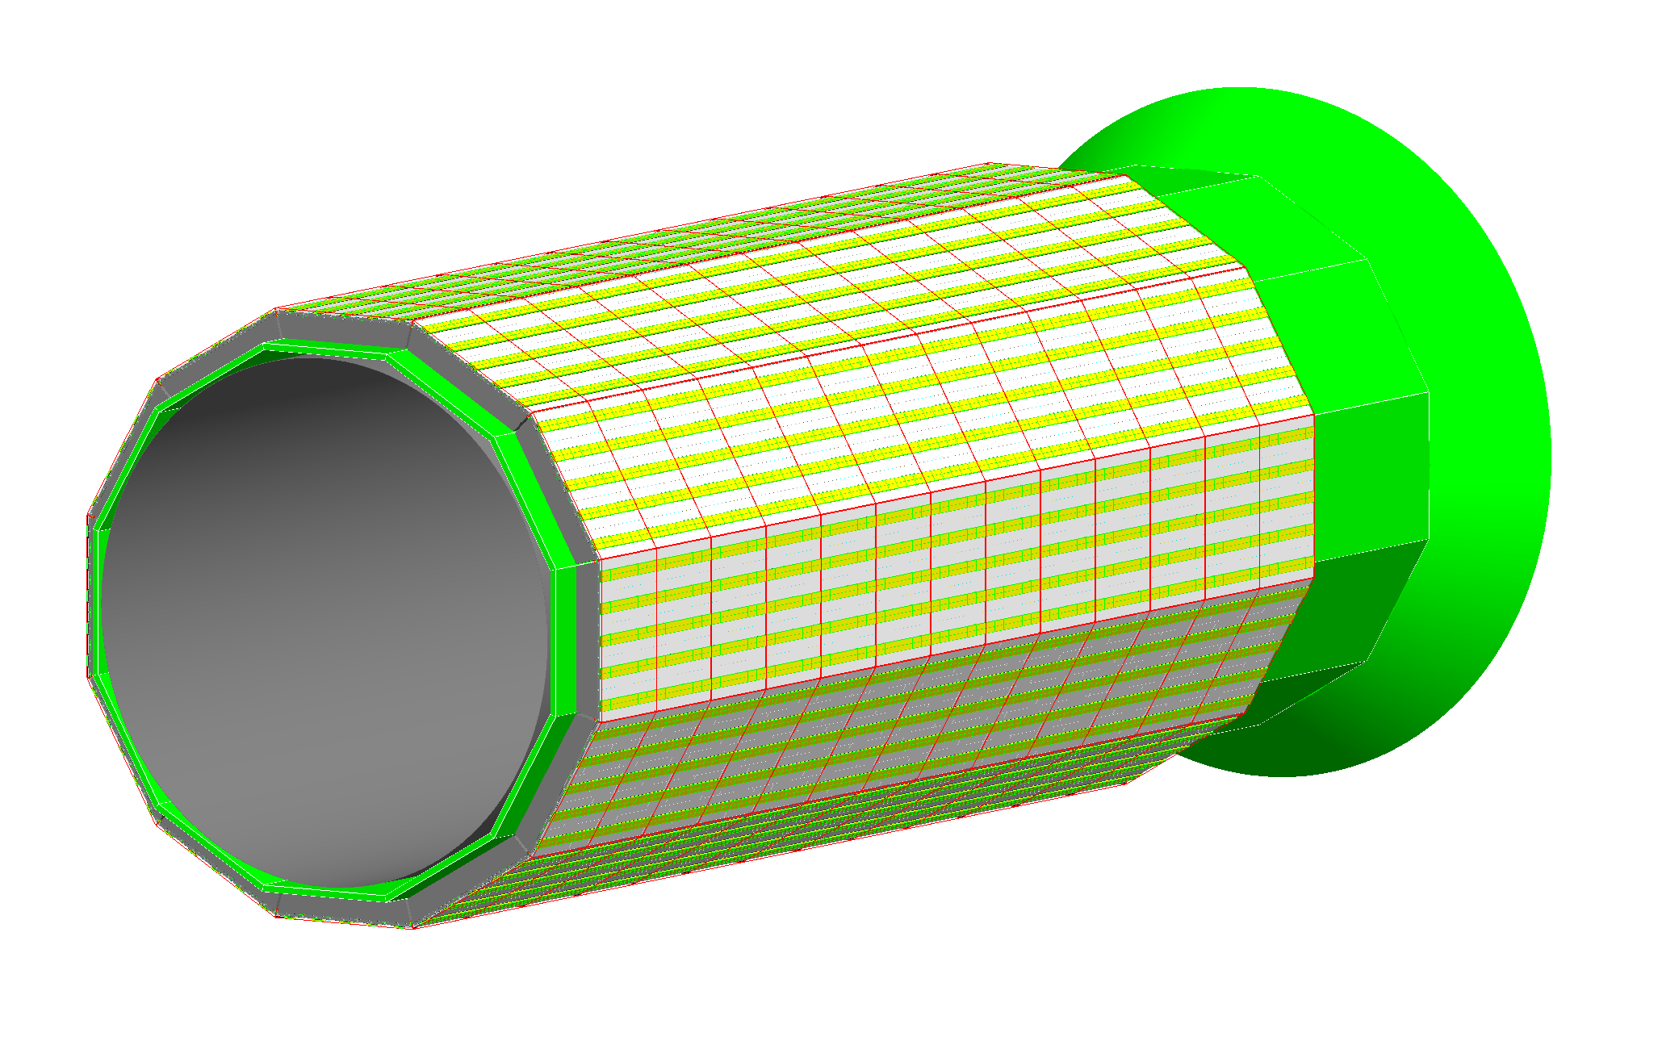
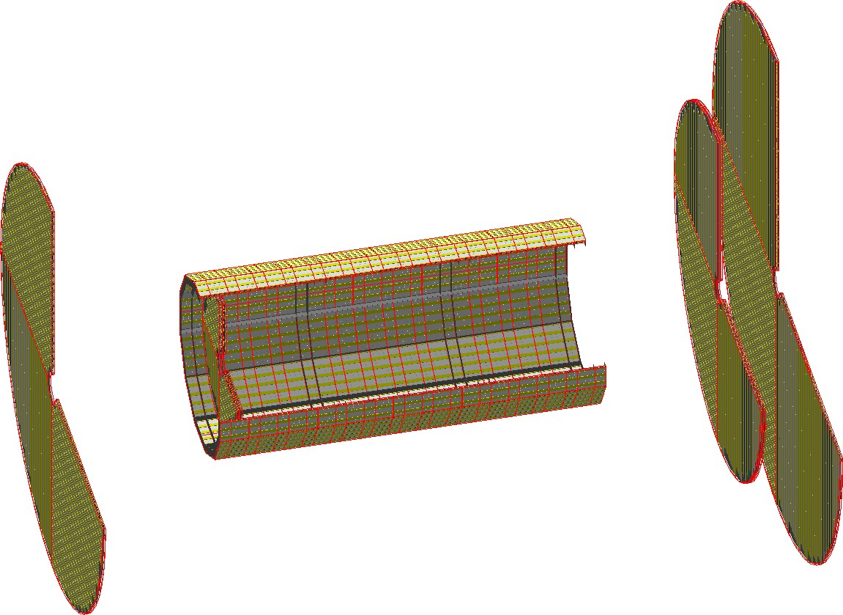
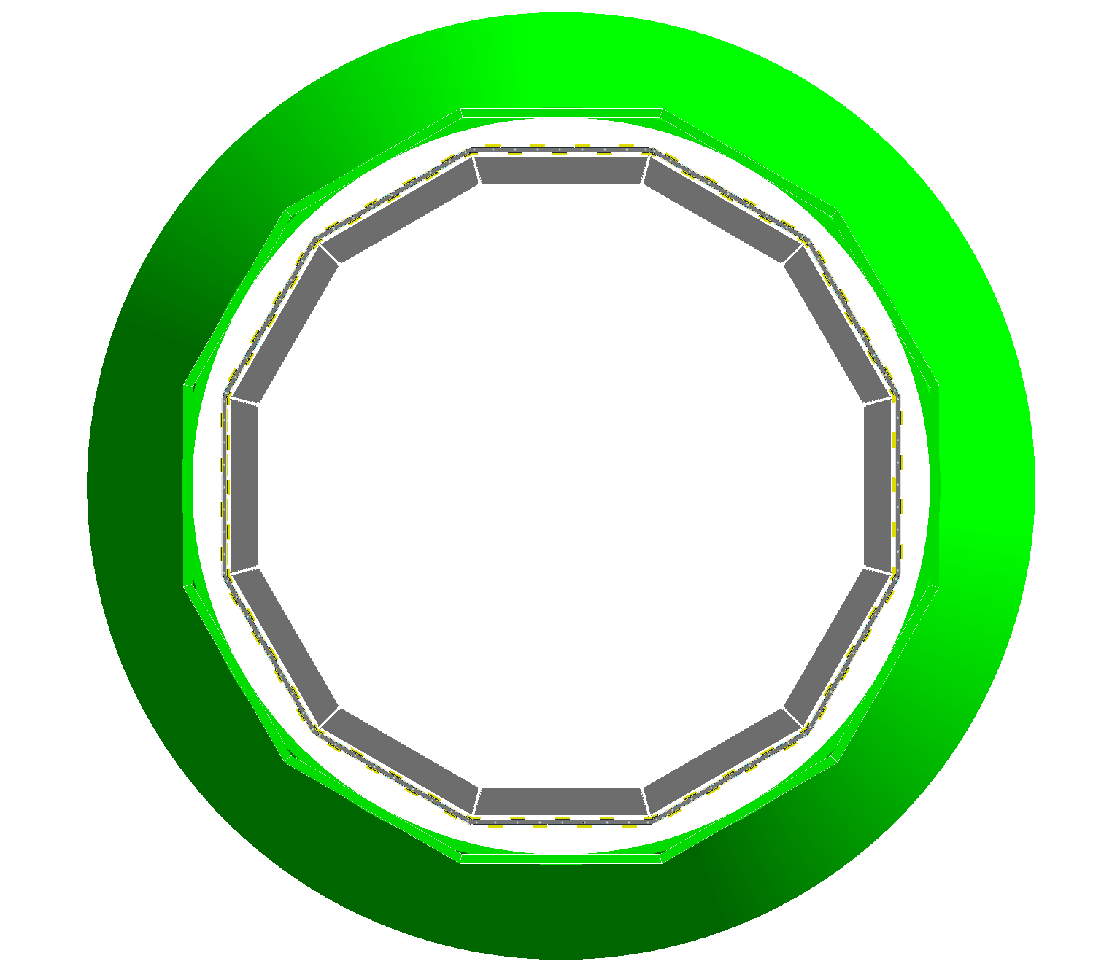
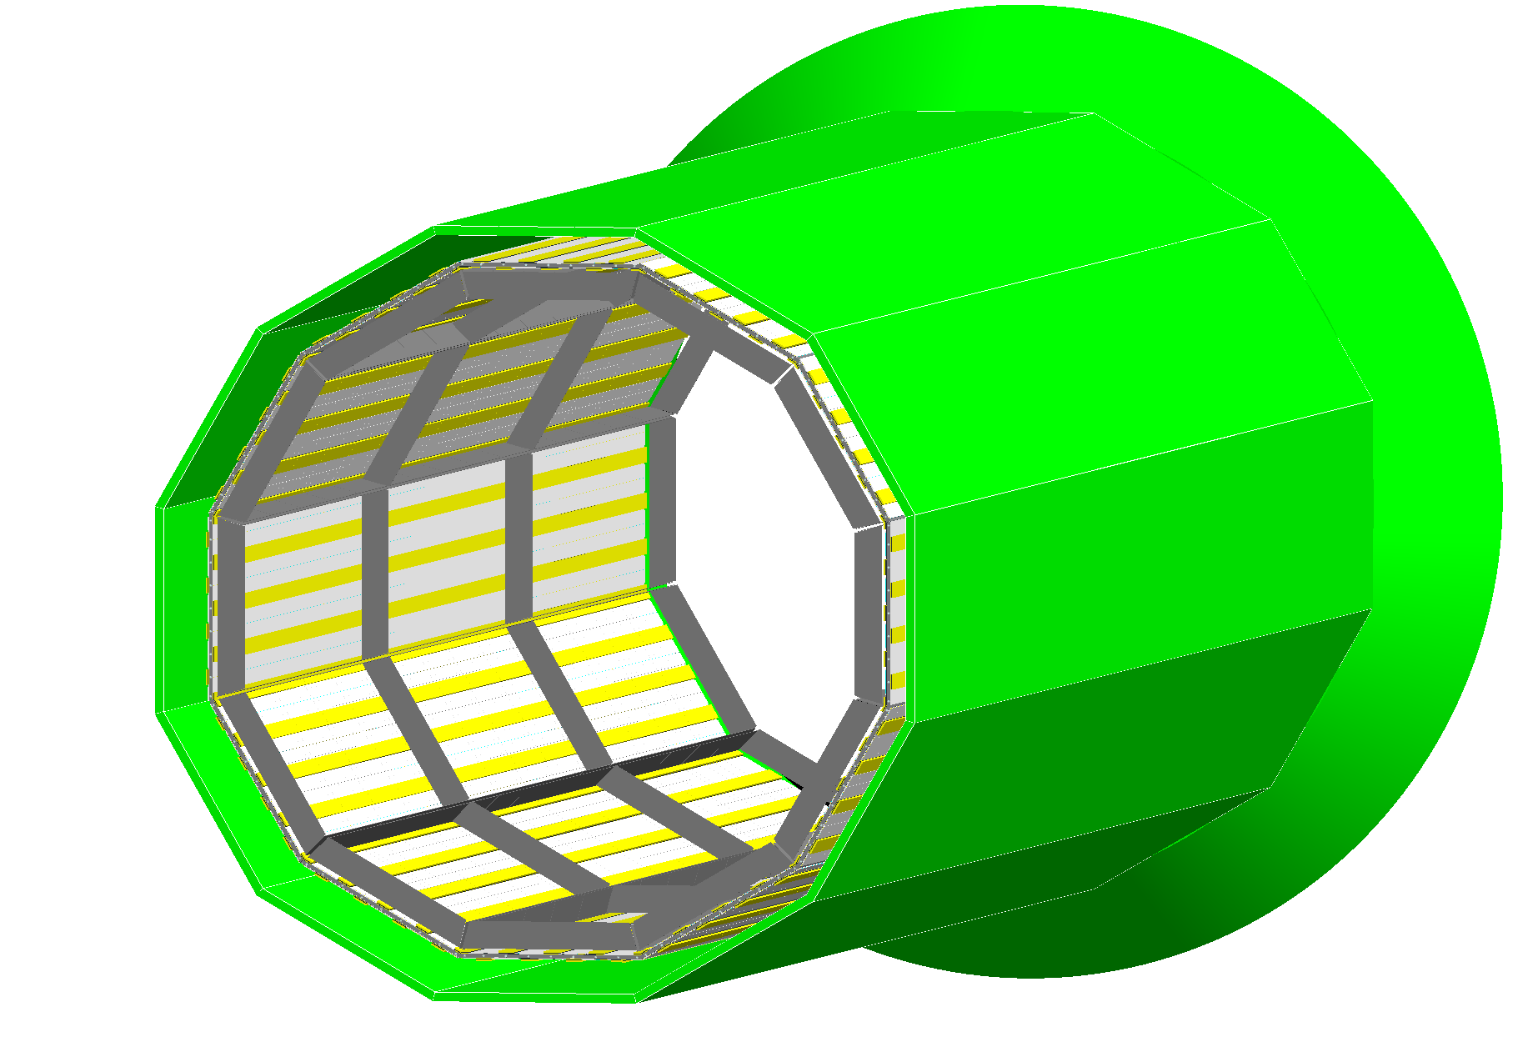
New Layers in Geant4 - 3
Implemented barrel radial positions: 50 cm, 80 cm, 89 cm (other radii possible, but not optimized!)
Forward layers can be at any z position and with any radius
Barrel layer outside DIRC
New TTL layers in default ECCE configuration
Barrel layer inside DIRC
N. Schmidt (ORNL)
EIC discussions
June 13, 2022
11 / 11

Slide 11
There is a sense to consider other options
-- miniTPC for the Barrel
-- LAPPD for Forward-Backward. And check the progress with ~30 ps MMG.
-- keep AC-LGAD as a possible upgrade and the option for the Detector 2
-- spend money for more Si detectors.

Slide 12
PID (dN/dX) for P < = 0.6 GeV/c
~3000 hits / track with precision (60-120 µm)
Cost effective (~4.0 M$).
Minimum R&D (cooling (X0), gas mixture optimization)
Main question:
Realistic response simulation,
All background included.
P cut. +/- 1.5
P cut, +/- 1.0
miniTPC
With GridPix readout.
One drift direction
Pt cut
Si
Si
MPGD
MPGD

Slide 13
Repeat once more ( in some extent trivial) statements
Tracking optimization in the barrel setup.
By the way, the ECCE proposal was done for +/- 1.5 rapidity as the barrel.
1. The optimization should be done ONLY for (0.1 – 10.) GeV/c particle momentum.
An average of particle momentum is (0.3 -0.4) GeV/c, but a lot of analysis’s results / histos were “stopped” on 1. GeV/c.
It is clear that “analytical” estimations don’t work for low momentum particles in B-field, but why GEANT MC data are not presented!?
2. The optimization should be done ONLY together with PID performance.
3. ONLY all backgrounds included.
ONLY (!?) all support materials, FEEs, cooling, “dead” zones”, alignment approach and precision, … are included.
(See, as an example, support and cooling structures for ToF).
5. ONLY for realistic detector response: hit reconstruction, efficiency, track angles, Lorenz angle, …
Realistic track finding / reconstruction. Number hits per track is the crucial parameter.
In all previous experiments using high intensity electron (positron) beam the track finding was done utilized gas detectors (drift chambers) with the next step – matching with vertex detector hits.
Think please, why it was done in such way?
7. The reconstruction performance of primary and secondary vertexes was not demonstrated so far.

Slide 14
.
Controversial points:
-- MPGDs space resolution degradation for particle angle > 45 deg ( |rapidity|>1. and barrel position) → small drift gap option (Xe, n-pentane) or maybe change the “geometry” (!?).
– Expedite the production of the “spare” magnet with 2. – 2.5 T B-field and consider the option to use it as a Detector 1 from a “Day One”.
-- Purchase all needed “F-gases” ASAP, to be sure that dRICH can be constructed and utilized.

