Slide 1
General Considerations for Electronics Work at UCSC
Originally designed a single channel amplifier using discrete components, was very useful for studying sensors but not practical for sensors with many channels. Now working on several options aimed at VLSI amplifiers.
We are working with 3 VLSI projects for AC-LGADs (details to follow). All use trans-impedance front end amplifiers. These have low input impedance, resistive feedback, and moderate gain to try to maintain as much as possible the short rise time of the LGAD signal. Typical output signals are about 40-120 mVolts and noise of 1-2 mVolts. So signal-to-noise is about 30 to 60, depending partly on the input capacitance. Power typically 0.7-2 mWatts per channel.
The AC-LGAD strip detector behaves like a ladder network of distributed R’s (from the n++ sheet) and C’s (from the metal readout strip) driven by a current source of the detector. The signal sharing is determined by the impedances of these elements and to minimize the sharing we would like a large sheet resistance for the n++ and a large capacitance of the readout strip to the n++ so a thin oxide separating the n++ and the metal strip. Would however like to minimize the strip capacitance to the back plane. Also would like to minimize the resistance of the metal strip itself. These are design considerations for the sensor, which then impact its performance when combined with the electronics.

Slide 2
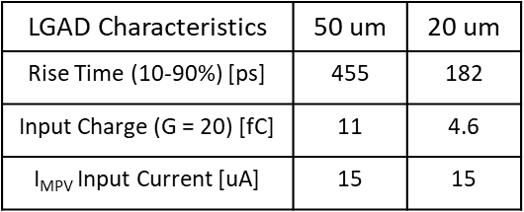
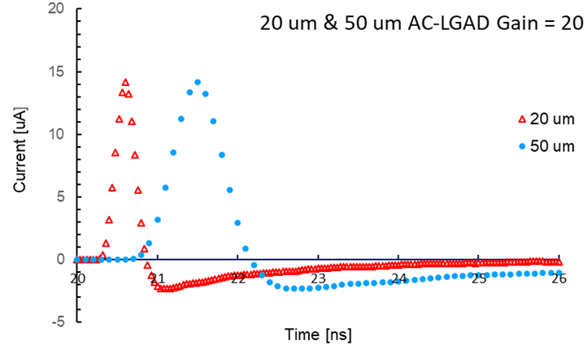
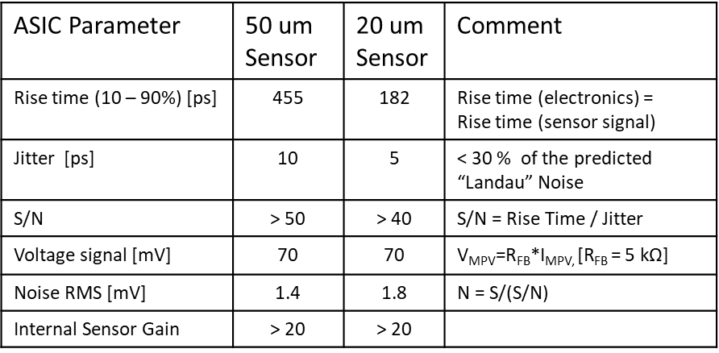
Fast LGAD Read-out ASICs at SCIPP
The development work of LGAD sensors was/is based on high-speed readout boards with discrete components introduced by SCIPP.
The crucial characteristics of LGAD signals were mapped out.
Measured Pulse shapes of AC-LGAD
Design Goals
It allowed to come up with specifications for different applications in terms of temporal and spatial resolution and the double pulse capability and translate them into required performance parameters for ASICs (“Design Goals”).

Slide 3
ASICs under Test at SCIPP
Based on the Specifications, three ASICs are being produced which will emphasize different performance goals.
Here we leverage our partner’s familiarity with the technology and our experience with sensors and readout systems.
Institution |  | Technology | Output | # of Chan | Funding | Specific Goals | Status
INFN Torino | FAST | 110 nm CMOS | Discrim. & TDC! | 20 | INFN | Large Capacitance TDC | Testing
NALU Scientific | HPSoC* | 65 nm CMOS | Waveform | 5 (Prototype) > 81 (Final) | DoE SBIR | Digital back-end | Testing
Anadyne Inc | ASROC** | Si-Ge BiCMOS | Discrim. | 16 | DoE SBIR | Low Power | Simulations final Layout Board design
* HPSoC : High Pitch digitizer System on a Chip,
(L. Macchiarulo et al.: “Design of HPSoC - a 10GSa/s Waveform Digitizer for Readout of Dense Sensor Arrays”, submitted to IEEE NSS-MIC 2022)
** ASROC: A custom amplifier/discriminator IC designed for AC-LGAD readout,
(G. Saffier-Ewing et al., “ASROC: A custom amplifier/discriminator IC designed for AC-LGAD readout “ , TWEPP 2021)

Slide 4
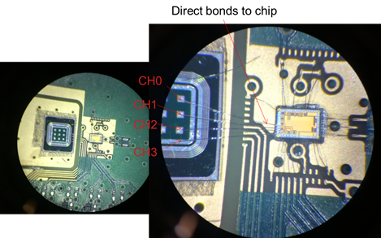
Preliminary Test Results with HPSoC (NALU Chip)
HPSoC
The HPSoC was tested with fast calibration
pulses to verify the performance of the first stage, the Trans-Impedance Amplifier (TIA).
It was then mounted on a test board and wire bonded to a 60 um thick AC-LGAD pad sensor and tested with β.
The expected analog performance of the ASIC can be derived from the analysis of the pulse shapes.
The contribution to the time resolution due to the electronics is the jitter
Jitter = rise time / (S/N)
Its parameters can be measured pulse-by-pulse and then extrapolated to the final ASIC – sensor combination.
Most important is the short rise time and the very low noise which allows to predict a jitter of the order 10 - 15 ps for the final ASIC version and 50 um thick AC-LGAD.
Abstract & Summary submitted to TWEPP 2022

Slide 5
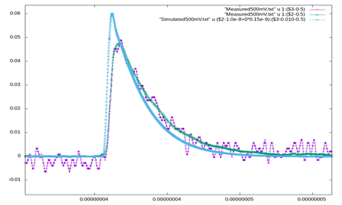
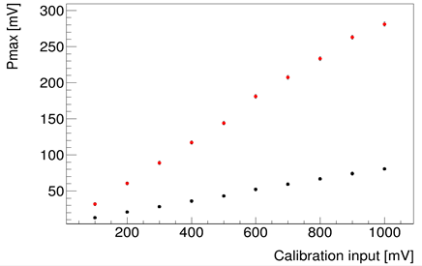
Preliminary Test Results with HPSoC
Measured and simulated behavior
with a fast Calibration Input Pulse.
Calibration Curve with (red)
and without( black) 2nd gain Stage
Note there are two versions of the amplifier,
a single stage (black) and two stage (red).
Abstract & Summary submitted to TWEPP 2022

Slide 6
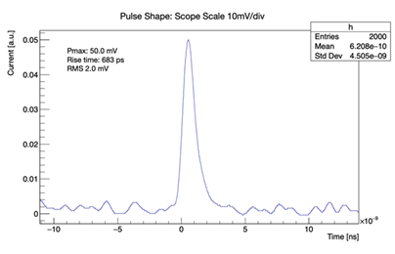
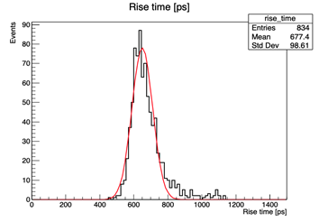
Very Preliminary β Test Results with HPSoC
Trise (60 um thick detector) = 677 ps
-> Trise (50 um detector) = 564 ps
Noise = Sqrt(RMS²-ScopeNoise²) =1.7 mV
(RMS = 2 mV
Scope Noise = 1mV)
Abstract & Summary submitted to TWEPP 2022

Slide 7
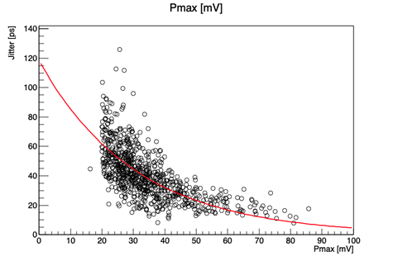

Very Preliminary β Test Results with HPSoC
$_{Jitter}$= $\frac{Noise}{dV/dt}$≈ $\frac{T_{rise}}{SNR}$
Results for single stage amplifier. Note, signal is shared since an AC-LGAD but signal shown is on one electrode only.
Tests on a channel with 2nd amplifier stage ongoing. Indications are that performance is better, that is smaller jitter and larger signals.
Abstract & Summary submitted to TWEPP 2022

Slide 8
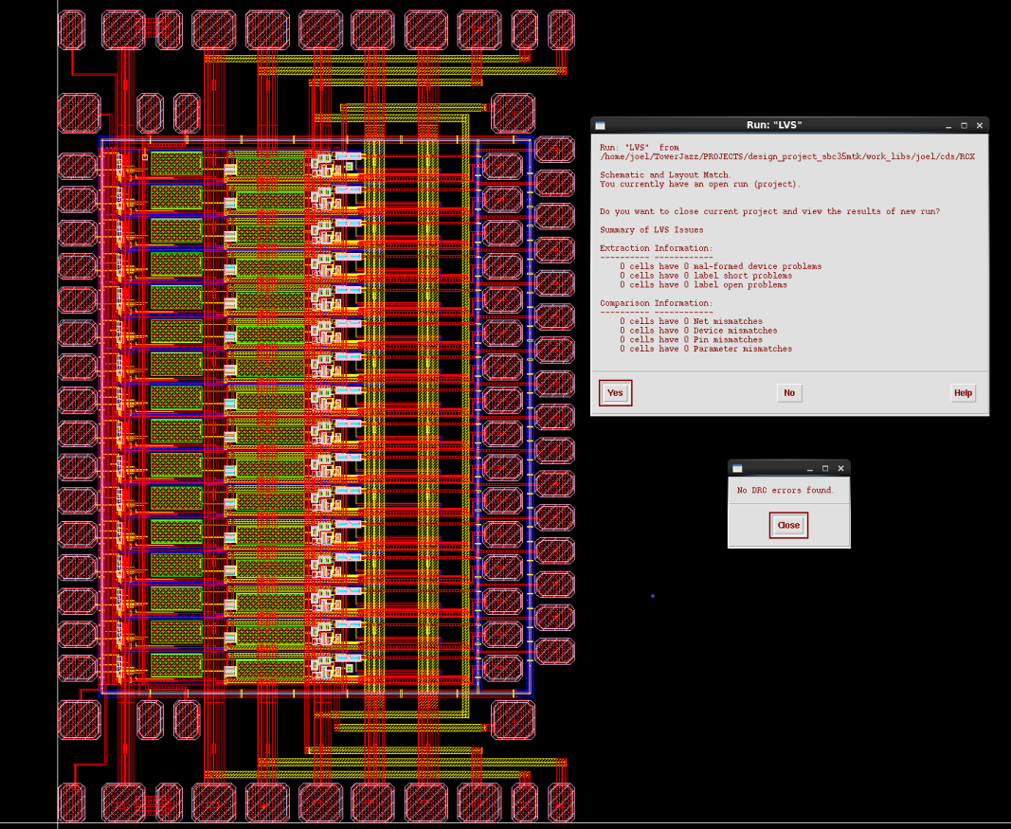
Layout of SiGe Amplifier (Anadyne)

Slide 9
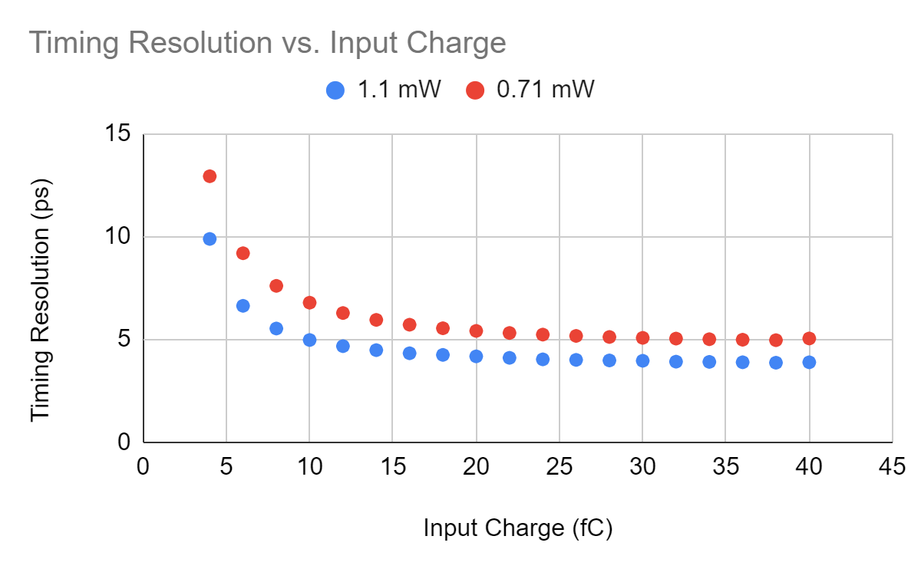
Anadyne ASROC Simulated Performance
Input capacitance increases noise and rise time.
Signal-to-noise for 10 fC pulse and 710 uW/channel
is very large for pad detectors with low input capacitance. Signal simulated is for 20 micron thick sensor.
Jitter vs input Q for two Power Settings
(preamp + discriminator) (C_{in} = 200 fF)
 | Power @ R.T. [mW/channel]
Input Q [fC] | 0.71 | 1.1
4 | 13 ps | 10 ps
5 | 11 ps | 8 ps
10 | 7 ps | 5 ps
At low signals, trade-off of Time resolution and power?
(The power/performance tradeoff is entirely in the preamp)
Gabe Saffier-Ewing, TWEPP 2021

Slide 10
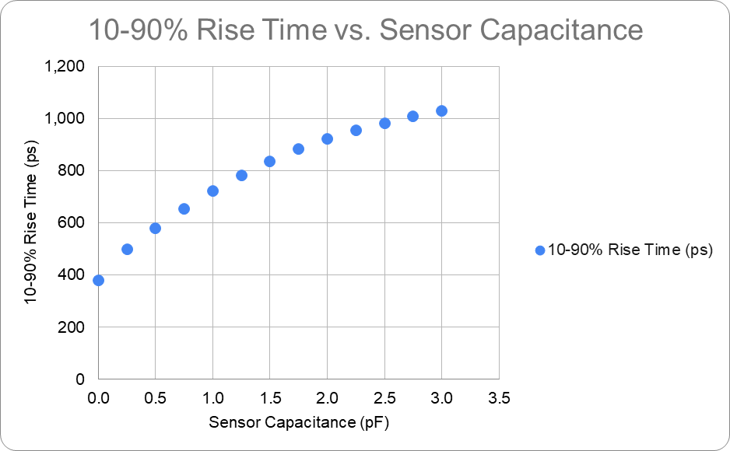
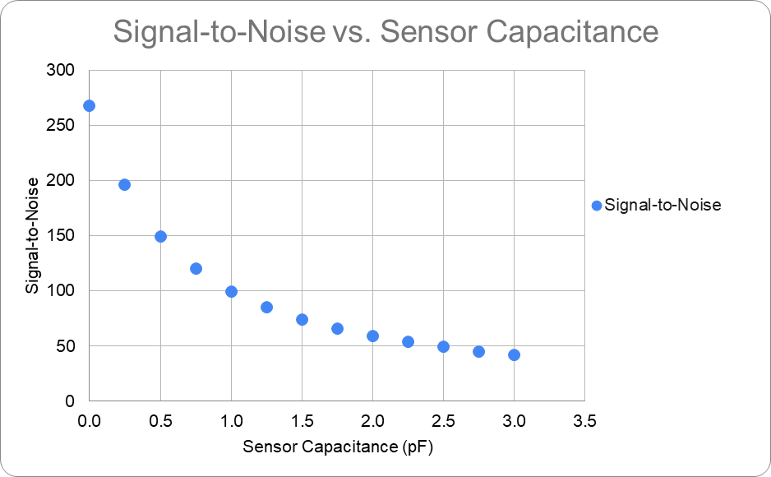
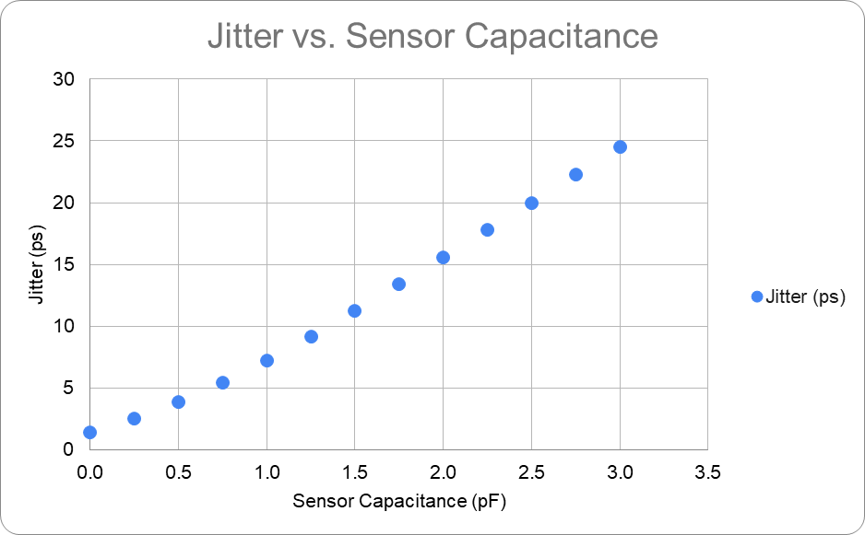
What about Strip sensors with “Large” Capacitance?
Anadyne Simulation (Low-power Option):
Capacitance reduces dV/dt and increases Noise (can be partially mitigated with larger power).
Jitter
< 10 ps requires Capacitance < 1.5 pF
< 20 ps requires Capacitance < 2.5 pF

Slide 11
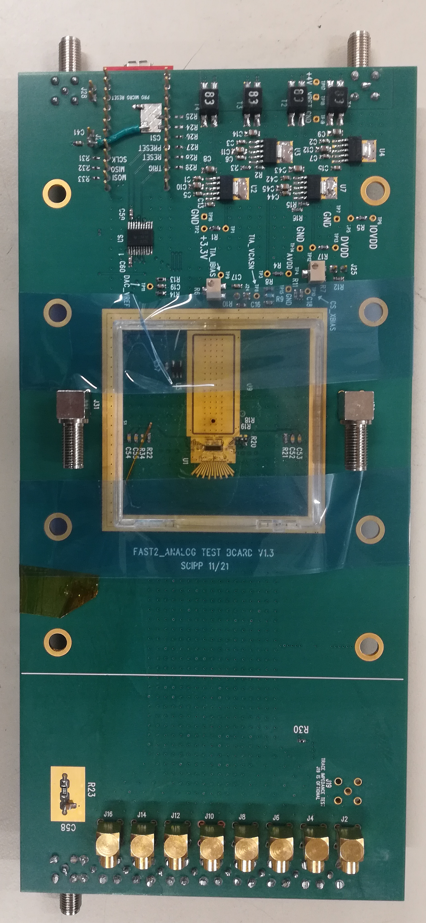
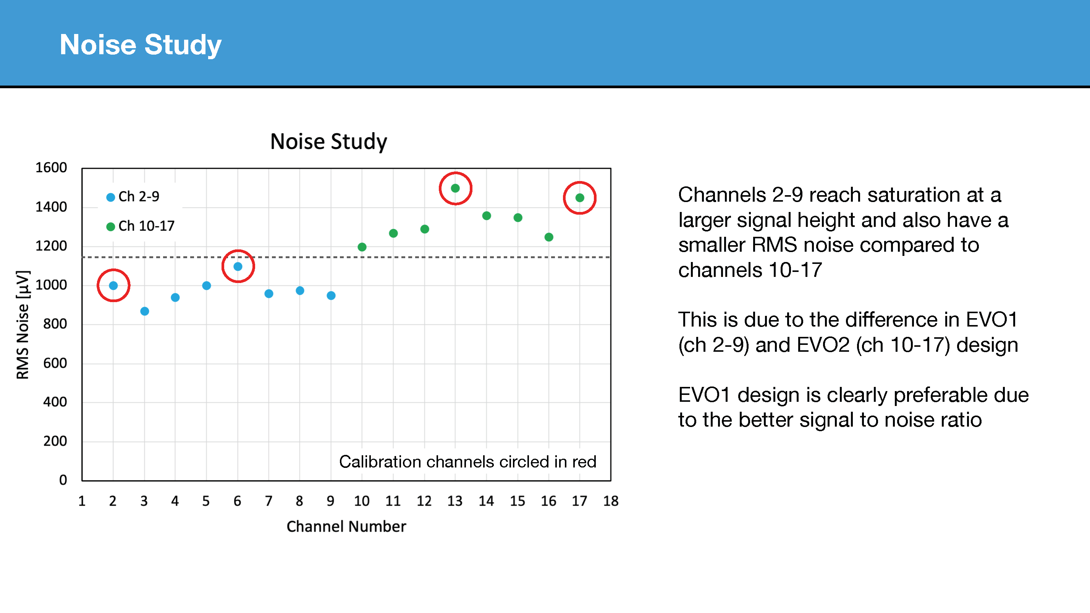
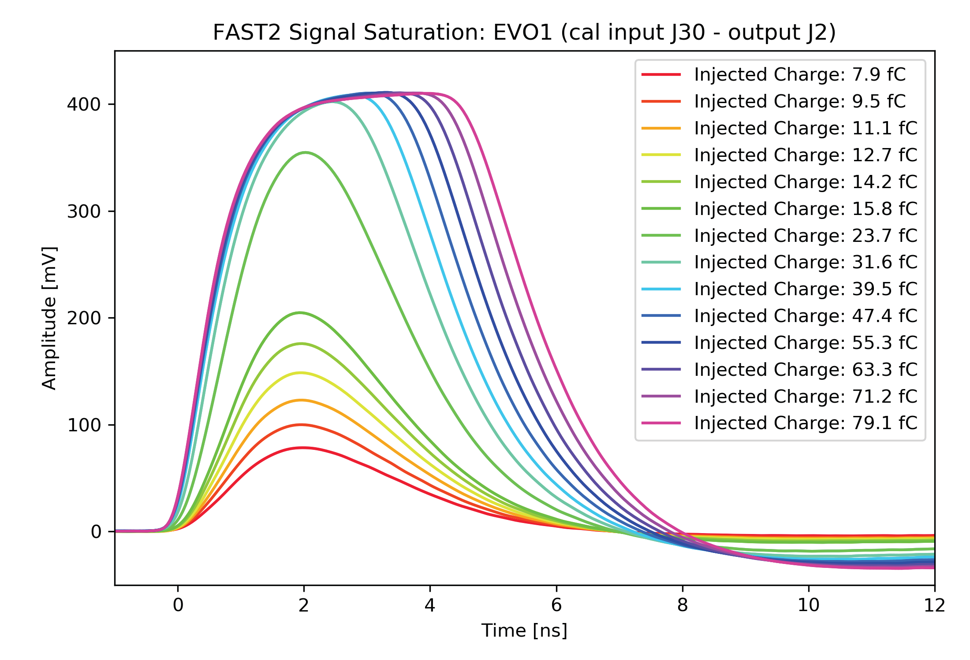
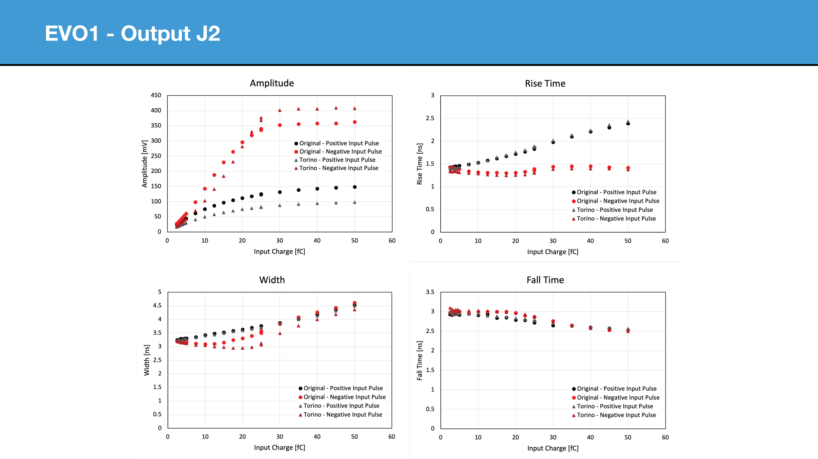
What about ASIC with larger Risetime: FAST2
With C ~ 400 fF:
Jitter @ 20 fC: 1.26/(281/0.95) = 4 ps
Jitter @ 10 fC: 1.3/(150/0.95) = 8 ps
Chip has two amplifier designs (Called Evo1 and Evo2), both have two stages of amplification, give different noise values measured above.

Slide 12
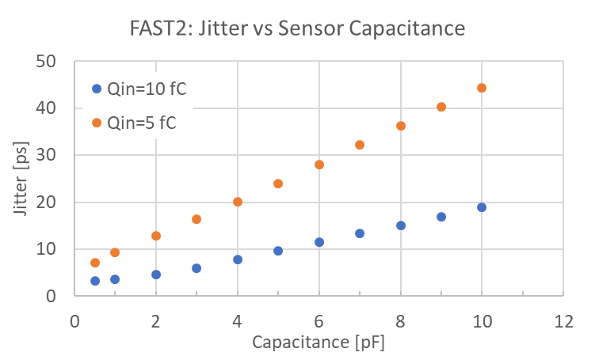
FAST2 Simulation

Slide 13
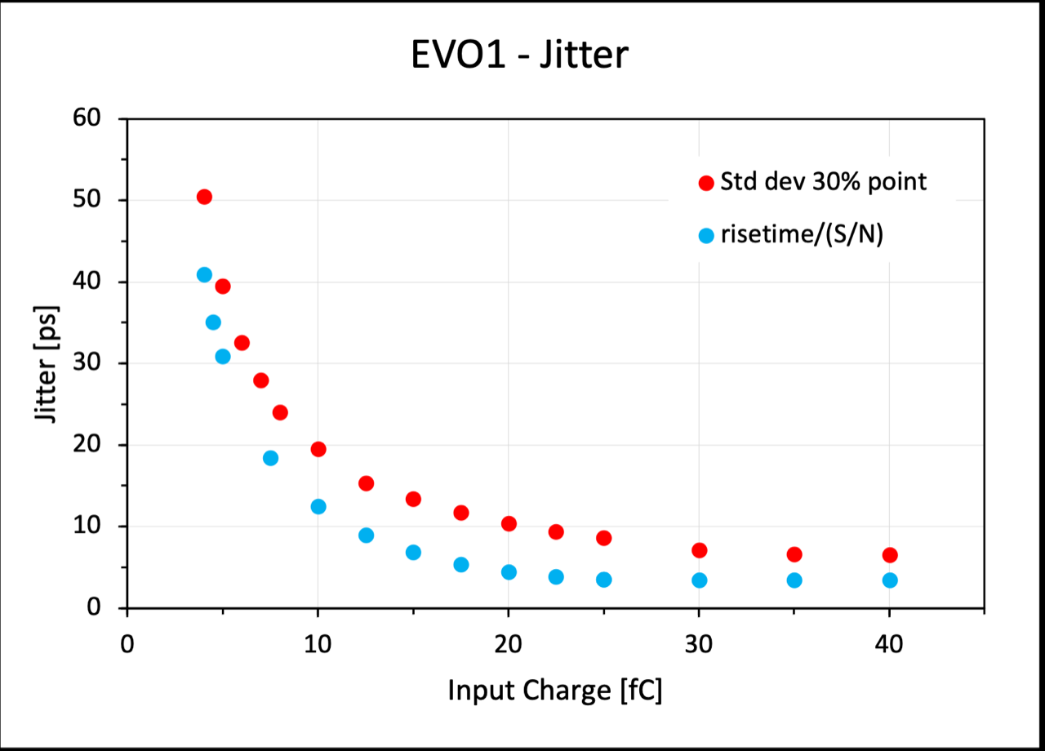
FAST2 Measurements – Calibration Pulses
Two methods to determine jitter, jitter formula and measurement on scope at 30% pulse height. Need further work to understand differences.

Slide 14
Conclusions:
Have in hand the NALU and FAST chips. We plan to map out performance with sensors and various capacitance and power values. For NALU chip we expect next year to have also the backend readout of the full waveform. Would like to see if we can use the full signal information to improve the resolution limitation coming from the Landau fluctuations.
Almost ready for submission of the Anadyne chips (will be two, a low power and high power version). Next year map out performance with sensors and various capacitance values. Want to verify the simulated performance advantages in power and signal-to-noise for the Si-Ge technology.

Slide 15
Backup Slides:

Slide 16
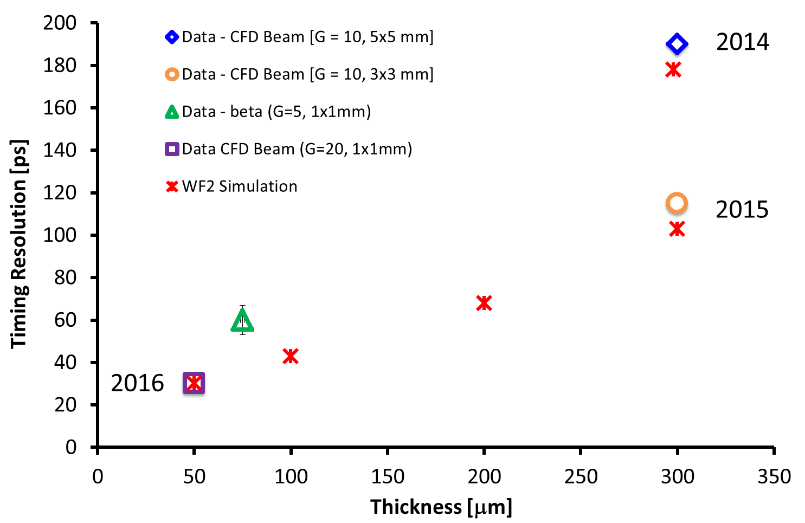
Trend of Time Resolution
Smaller C
Low noise
Thinner sensors
2017
2020
The temporal resolution as a function of LGAD thickness is well simulated by WF2.
F. Cenna, et al., “Weightfield2:”, NIM A796 (2015) 149

Slide 17
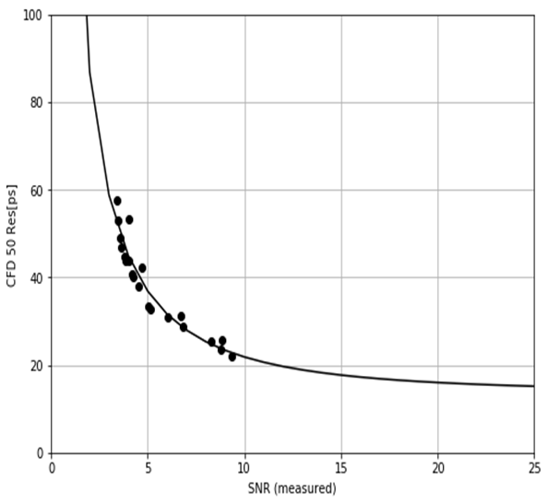
Phase II: 20 µm LGAD offer good Time Resolution
Averaged Pulse for 20 micron thick LGAD
Temporal resolution vs. Signal-to-Noise Ratio
Gain = 8.
Signal much larger than baseline fluctuations indicating very good signal-to-noise even with a gain of only 8.
Rise-time (10-90%) about 150 ps compared to about 500 ps for the 50 micron sensor.
Contribution to the time resolution from Landau fluctuations is proportional to the detector thickness so smaller for thinner detectors (expected to be ~ 15 picoseconds for the 20 micron thick sensor).
A. Seiden, et al, “Potential for Improved Time Resolution Using Very Thin Ultra-Fast Silicon Detectors (UFSDs)”,
https://arxiv.org/abs/2006.04241

Slide 18
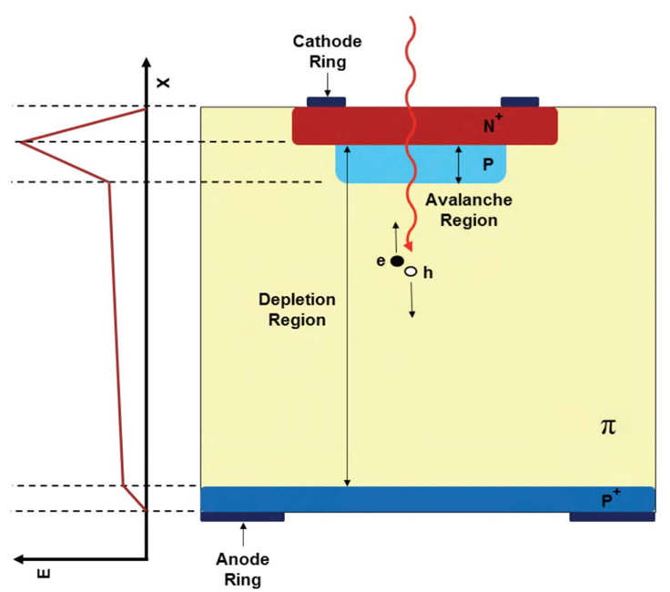
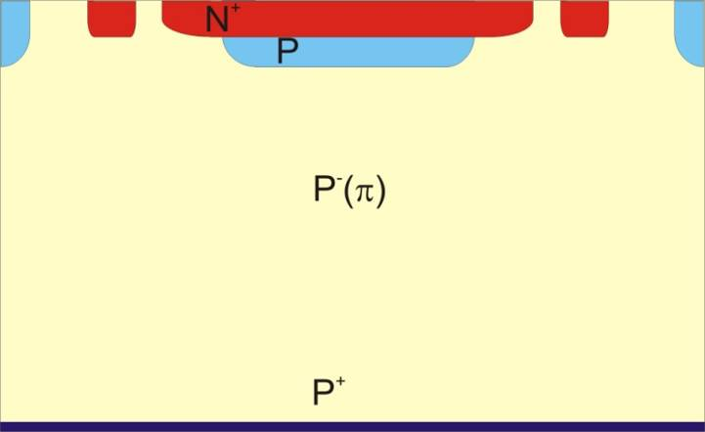
Low-Gain Avalanche Detectors (LGAD)
“Simple” extension of silicon detector results in perfect sensor for timing
N-in-p PIN
LGAD
Create high field
by introducing
gain layer
to increase signal
285 um
< 50 um
Reduce thickness
to decrease
rise time
LGAD have large and fast signals
G. Pellegrini et al., Technology developments and first measurements of LGAD for high energy physics applications, Nucl. Instrum. Meth. A765 (2014) 12 – 16.
H.F.-W. Sadrozinski, A. Seiden and N. Cartiglia, 4D tracking with ultra-fast silicon detectors, 2018 Rep. Prog. Phys. 81 026101.

Slide 19
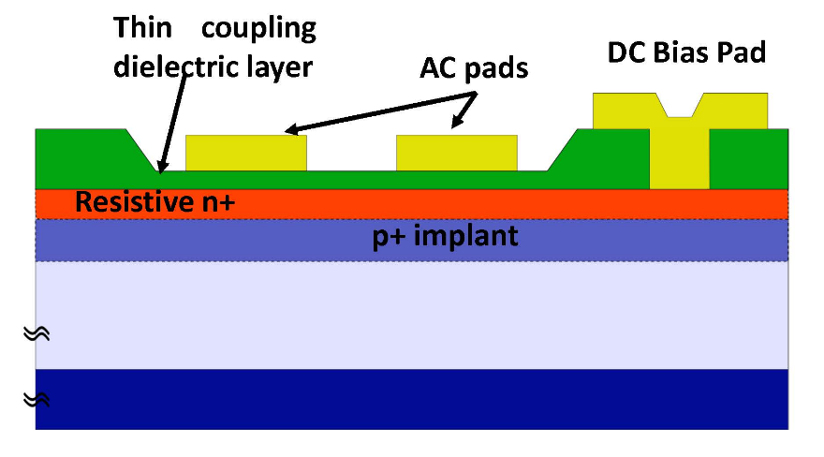
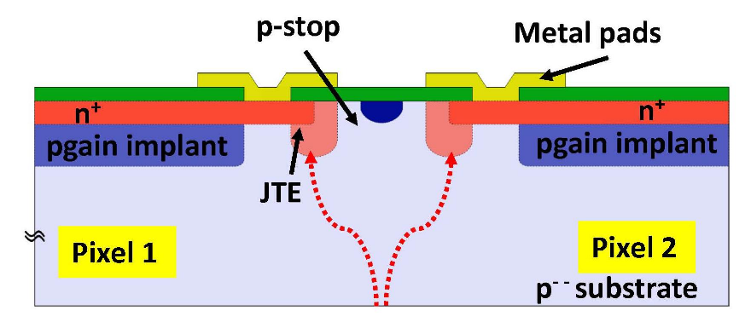
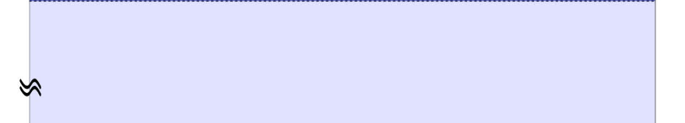
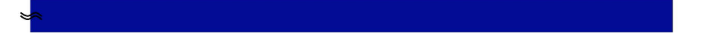

Extension of LGAD : AC-LGAD (aka RSD)
Difference between LGAD and AC-LGAD appears to be small:
make n++-implant at the junction slightly resistive and extend it as a continuous sheet across the entire sensor-> resistive silicon detector RSD
add di-electric layer for isolation and AC-coupling into pads of optimized size and position
              Result:
              Simplification of design and production (no p-stop, JTE, inter-pad gap)
              100% Fill-factor
              Sparse readout (power savings)
              AC-coupling affords ease of testing (like usual silicon strip sensors, which are AC-coupled)
M. Mandurrino et al., "Demonstration of 200-, 100-, and 50- micron Pitch Resistive AC-Coupled Silicon Detectors (RSD) with 100% Fill-Factor for 4D Particle Tracking“, IEEE Electron Device Letters, vol. 40, no. 11, pp. 1780-1783, Nov. 2019.
US patent No.: 9,613,993 B2 “Segmented AC-coupled readout from continuous collection electrodes in semiconductor sensors”, H. Sadrozinski, A. Seiden (UC Santa Cruz) and N. Cartiglia (INFN Torino), granted on April 4, 2017

