Slide 1
Reinforcement Learning Tutorial
Hands on Reinforcement Learning
Kishansingh Rajput
Data Science Department
Thomas Jefferson National Accelerator Facility
Kishan@jlab.org

Slide 2
Outline
Introduction to Reinforcement Learning (RL)
Types of RL algorithms
Q functions and Bellman Equation
Introduction to Double Deep Q Networks (DDQN)
Exploration vs Exploitation
OpenAI gym, and stable-baseline
CartPole OpenAI gym environment
FNAL Booster GMPS regulator OpenAI gym environment
Hands on code:
DDQN agent code
Train DDQN on Benchmark OpenAI CartPole Environment
Training DDQN to regulate GMPS (Simplified Env)

Slide 3
Machine Learning

Slide 4
Reinforcement Learning
Learning from interaction with an environment to achieve/maximize a long-term goal related to the state
The goal is defined by the reward function
The agent needs to be able to observe the environment and take actions to modify it’s state in order to achieve the goal
Reinforcement Learning Example – KDNuggets
Notes:
Learning from interaction with an environment to achieve some long-term goal that is related to the state of the environment
The goal is defined by reward signal, which must be maximised
Agent must be able to partially/fully sense the environment state and take actions to influence the environment state
The state is typically described with a feature-vector

Slide 5
Reinforcement Learning
Agent learns a Policy
Agent
State $(s_{t})$
Reward $(r_{t})$
Action $(a_{t})$
State $(s_{t+1})$
Environment

Slide 6
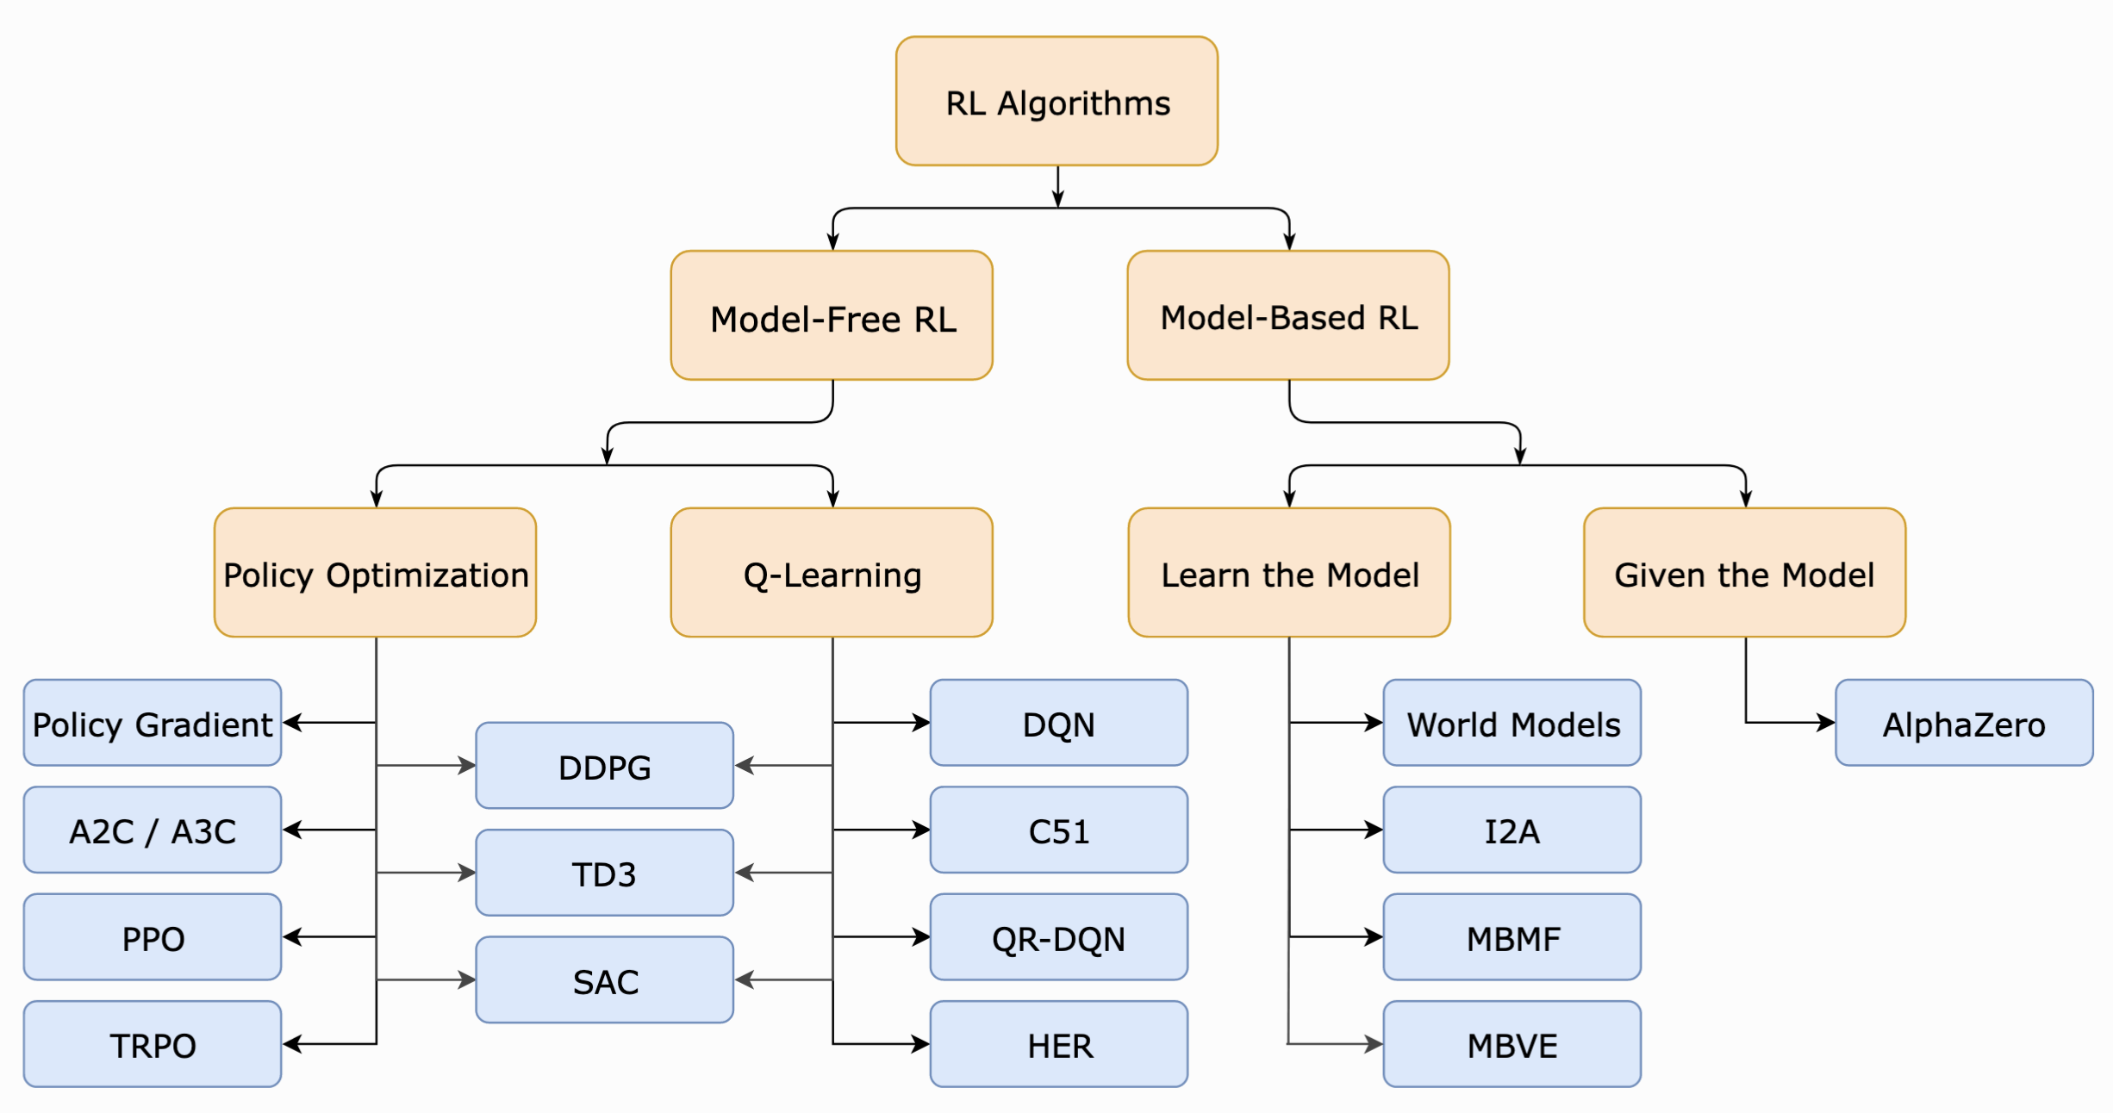
RL algorithms
Model-Based RL: The agent can predict the reward for some action before actually performing it thereby planning what it should do.
Model-Free RL: The agent needs to carry out the action to see what happens and learn from it.
Notes:
Learning from interaction with an environment to achieve some long-term goal that is related to the state of the environment
The goal is defined by reward signal, which must be maximised
Agent must be able to partially/fully sense the environment state and take actions to influence the environment state
The state is typically described with a feature-vector

Slide 7
Q function and Bellman Equation
Optimal Action-value function $Q^{∗}(s,a)$, which gives the expected return if you start in state $s$, take an arbitrary action $a$, and then forever after act according to the optimal policy in the environment.
Q function and optimal action
Bellman equation
$Q^{∗}\left(s, a\right)=r\left(s_{t}, a_{t}\right)+ γ×r\left(s_{t+1}, a_{t+1}\right)+ γ^{2}×r\left(s_{t+2}, a_{t+2}\right)….+$ $γ^{n}×r\left(s_{n}, a_{n}\right)$
$$Q^{∗}\left(s, a\right)={}_{s\sim P}^{E}{[r\left(s_{t}, a_{t}\right)+ γ×{}_{a_{t+1}}^{max}{Q^{∗}}\left(s_{t+1}, a_{t+1}\right)] }$$
The $Q^{∗}(s, a)$ is the return value starting at state s’ and taking action a, plus the value of wherever you land next
$r(s, a)$ is the immediate reward for s, a combination
$γ$ is the discount factor
Notes:
Learning from interaction with an environment to achieve some long-term goal that is related to the state of the environment
The goal is defined by reward signal, which must be maximised
Agent must be able to partially/fully sense the environment state and take actions to influence the environment state
The state is typically described with a feature-vector

Slide 8
Key point
Bellman equation
r(s, a) is an immediate reward for action $a_{}$ at state $s_{}$
This indicate how good the action $a_{}$ is at state $s_{}$
The goal of the agent is to maximize the cumulative reward
Actions may have long term consequences, reward may be delayed
Sometimes better to sacrifice immediate reward to gain more long term reward

Slide 9
Double Deep Q-Network (DDQN)
A neural network is used to learn the Q-values corresponding to different actions at a given state
Q_net
Action (a)
batch(s, a, r, s’, d)
Q_target_net
Training Q network (update weights)
State (s)
Environment
(s, a, r, s’, d)
Buffer
$Y_{t}^{Q}$ comes from Bellman equation as
We use a second network (Q target network) to estimate the target Q values. The weights of this network ${θ′}_{t}$ are updated by copying the weights of Q network every X steps.
Q(s, $a_{1}$)
State vector
(s)
Hidden Layers
Q(s, $a_{2}$)
:
:
:
Q(s, $a_{n}$)
https://arxiv.org/pdf/1509.06461.pdf

Slide 10
Exploration vs Exploitation
Exploit previous experiences
Store (s, a, r, s’, d) tuples to a Buffer to build dataset (D)
Train the agent on the dataset (D)
Explore new actions/states (make agent more robust)
To explore new actions add small noise to the actions
With new exploration the reward might decrease temporarily during training
Slowly decrease the amount of noise as training progress

Slide 11
RL Environment
OpenAI Gym standards
https://github.com/openai/gym/blob/master/gym/core.py
Env base class
class Env(Generic[ObsType, ActType]):
def __init__()
def step(self, action: ActType) -> Tuple[new_state, reward, done, info]:
def reset(self, *) -> Tuple[state, info]:
def render(self) -> Optional[Union[RenderFrame, List[RenderFrame]]]:
def close(self) [Necessary cleanup]

Slide 12
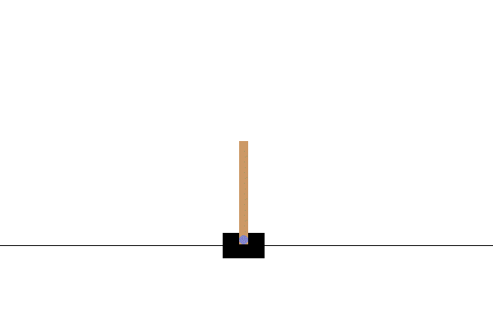
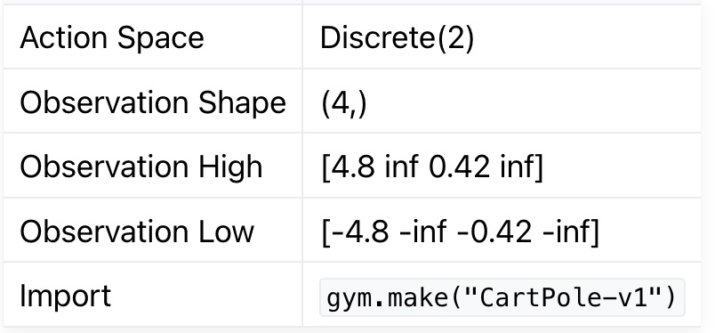
CartPole OpenAI gym environment
The action is a ndarray with shape (1,) which can take values {0, 1} indicating the direction of the fixed force the cart is pushed with.
The observation is a ndarray with shape (4,) with the values corresponding to the following positions and velocities:
Termination: Pole Angle is greater than ±12°
Termination: Cart Position is greater than ±2.4 (center of the cart reaches the edge of the display)
Truncation: Episode length is greater than 500 (200 for v0)
Since the goal is to keep the pole upright for as long as possible, a reward of +1 for every step taken, including the termination step, is allotted.

Slide 13
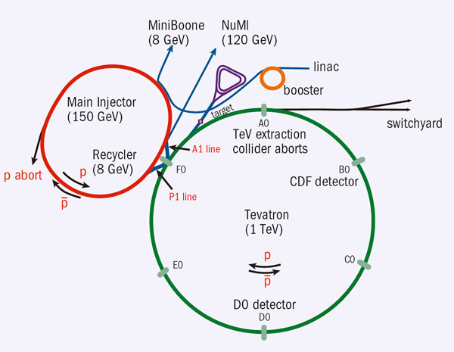
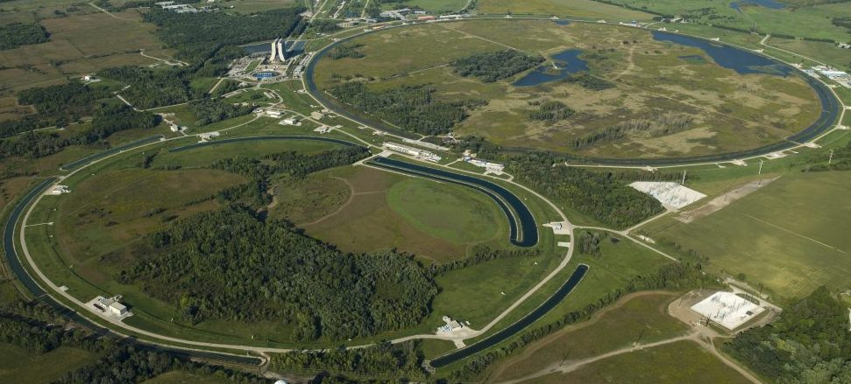
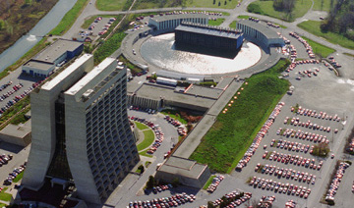
GMPS Regulator environment
Fermilab Site
The Booster receives the 400 MeV (kinetic energy) beam from the Linac
It is then accelerated to 8GeV with the help of booster cavities and Combined-function bending and focusing electromagnets known as gradient magnets.
These magnets are powered by the gradient magnet power supply (GMPS)
Booster ring
Courtesy: Christian Herwig
Other high-current, high-power electrical loads near GMPS varies in time
Causing unwanted fluctuations of the actual GMPS electrical current and thus fluctuations of the magnetic field in the Booster gradient magnets
Spread in B-field degrades beam quality, degrades repeatability, & contributes to losses
A GMPS regulator is required to calculate and apply small compensating offsets in the GMPS driving signal
A RL agent can be trained to learn an optimal regulator, focusing on reducing the errors
Variables considered to construct env states
B:LINFRQ = 60 Hz line frequency error [mHz]
I:IB = MI lower bend current [A]
I:MDAT40 = MDAT measured MI current [A]
B_VIMIN = Setting to achieve*
B:VIMIN = Prescribed remedy from PID regulator circuit
B:IMINER = 10*(Setting - obsMax)

Slide 14
GMPS Regulator environment
LSTM Surrogate Model
B:IMINER
B:LINFRQ
B:VIMIN
B_VIMIN
I:IB
I:MDAT40
Last 150 timesteps
next
B:IMINER
Next Timestep
Agent adjusts B:VIMIN
(Other variables continue to draw from data)
Environment Setup
Environment uses LSTM surrogate model to predict next IMINER using last 150 timesteps on all 6 variables
Agent updates VIMIN (Action: delta VIMIN)
To build next state the time series is shifted by one and VIMIN, and IMINER are updated as per action and surrogate prediction respectively
Reward is (-1 * IMINER) since the goal is to minimize IMINER
https://arxiv.org/pdf/2105.12847.pdf

Slide 15
Resources
Make your own custom environment https://www.gymlibrary.dev/content/environment_creation/
Agent libraries
Stable-baseline
https://stable-baselines.readthedocs.io/en/master/
TF-agents
https://www.tensorflow.org/agents
Readings
Deep Reinforcement Learning with Double Q-learning
Tutorial code: https://github.com/JeffersonLab/jlab_datascience_tutorial

Slide 16
BACKUP

Slide 17
Deep Deterministic Policy Gradient (DDPG)
Actor
Critic
batch(s, a, r, s’, d)
Target Actor
Target Critic
Policy learning $μ_{θ}$
State (s)
Environment
(s, a, r, s’, d)
Buffer
Action (a)
Critic is used to approximate the value function, trained using the following loss function
Target network is used to approximate
As both critic and target critic networks depends on same parameters $φ$, target network is updated with a time delay as
0 < $ρ$ < 1

Slide 18
State: one timestep
Agent
Action: next VIMIN
Update VIMIN
Shift by one, update IMINER
Next State
Surrogate Model
Next IMINER
Last 150 timesteps

