Slide 1
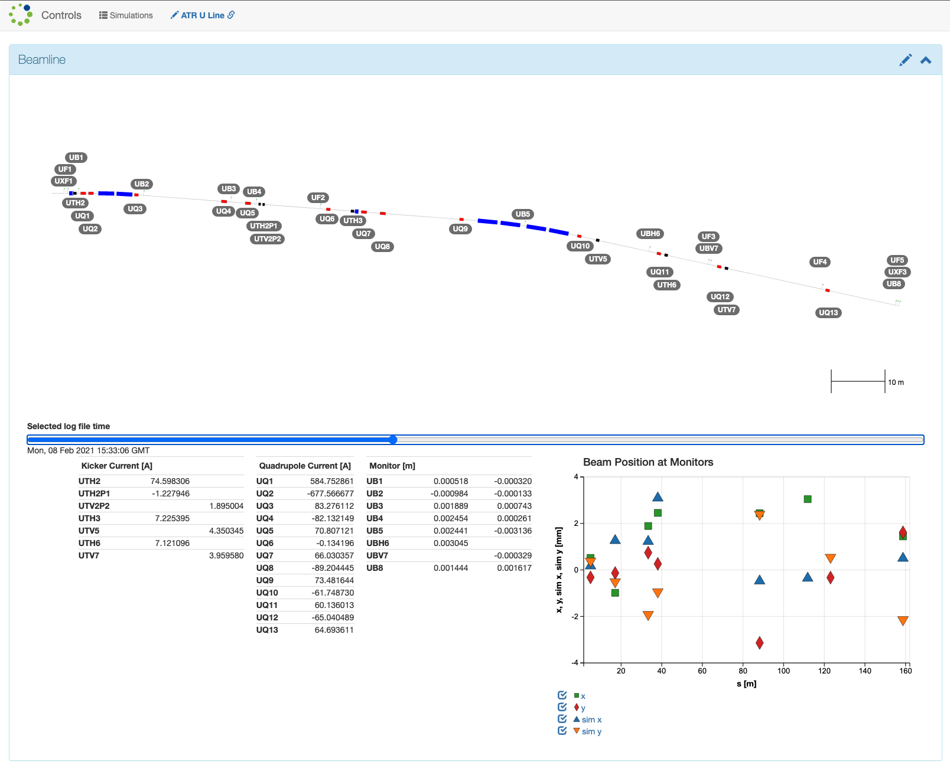

RadiaSoft Tools for Online Optimization
Maintain modularity for all components
  Software (optimization / sampling)
  Evaluation method (codes)
  Execution method
User provides:
  YAML input for rsopt
  Supporting files: Python modules, simulations inputs, etc.
Running rsopt
  Parses inputs
  Configures workers
  Passes data between codes / software
  Monitors code execution
  Logs results
libEnsemble
  Provides unifying framework
  Runs generators and simulations and handles communication
  Handles system-dependent simulation execution
Sirepo Controls Application: automatically generated UIs that interface optimization libraries with the machine
www.sirepo.com/controls#
  https://github.com/radiasoft/rsopt
  https://rsopt.readthedocs.io/
https://github.com/Libensemble/libensemble

Slide 2
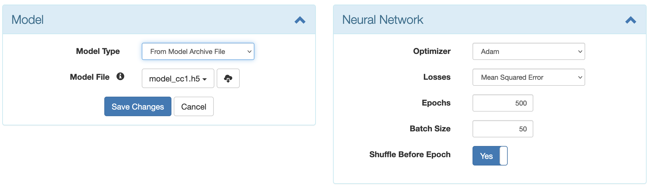
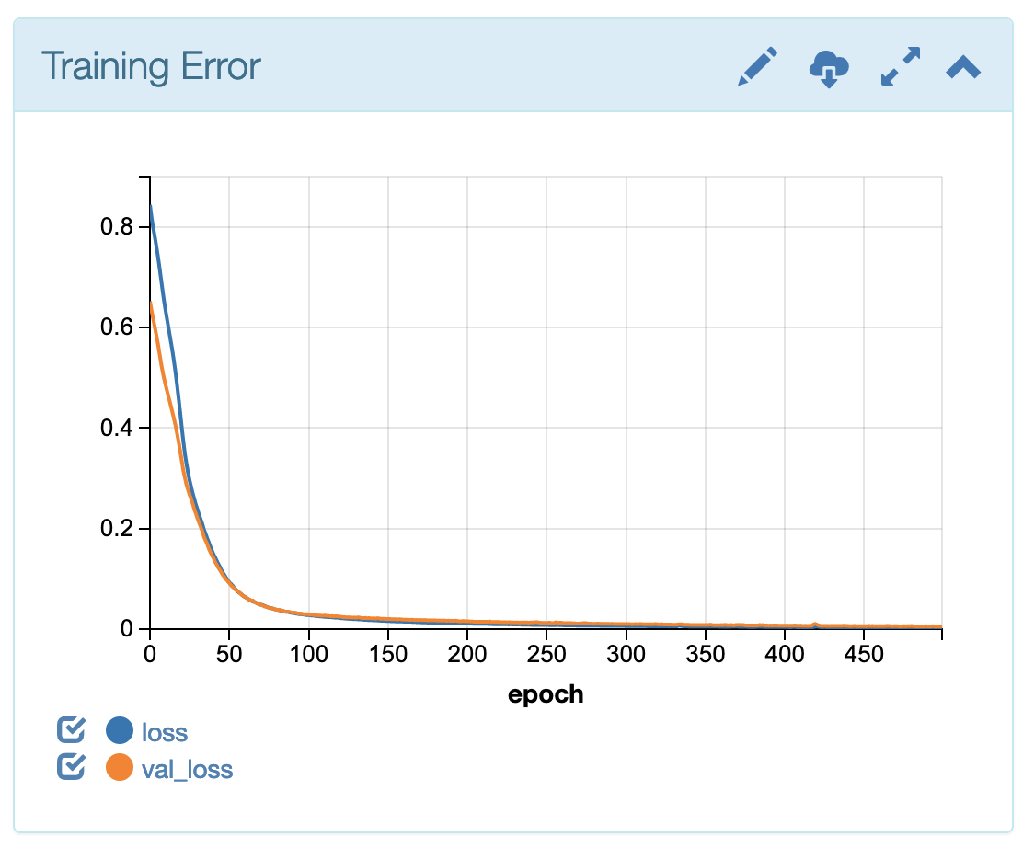
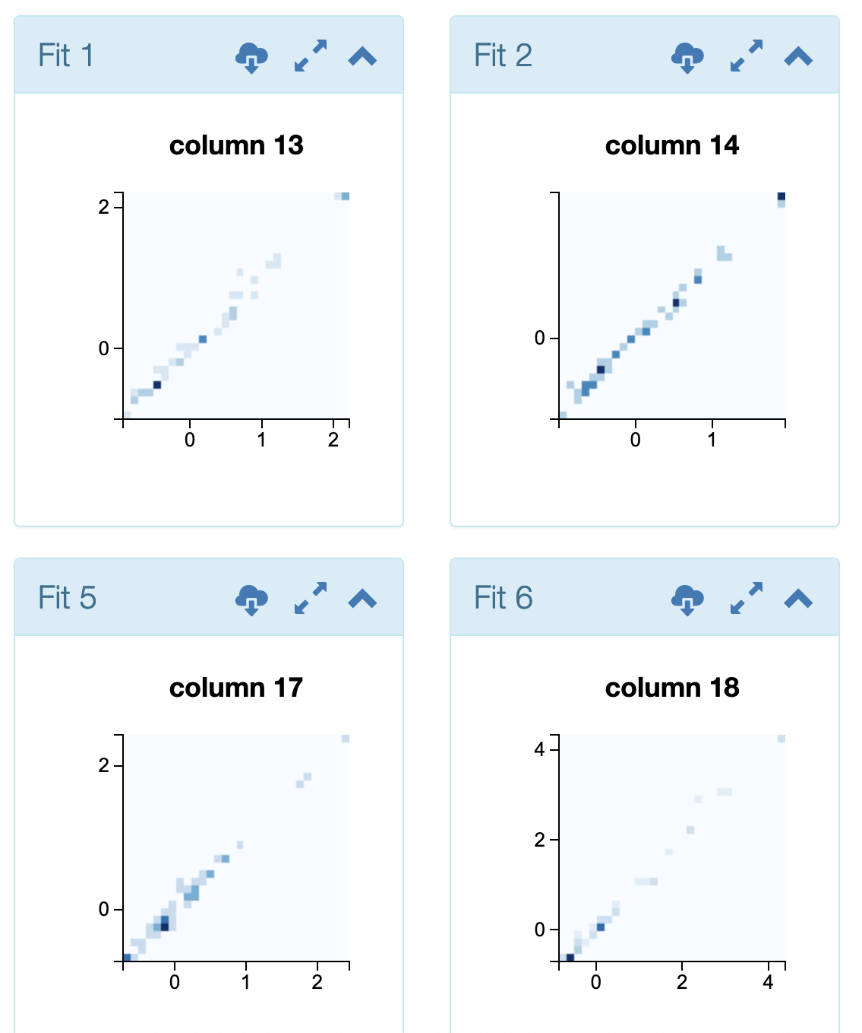
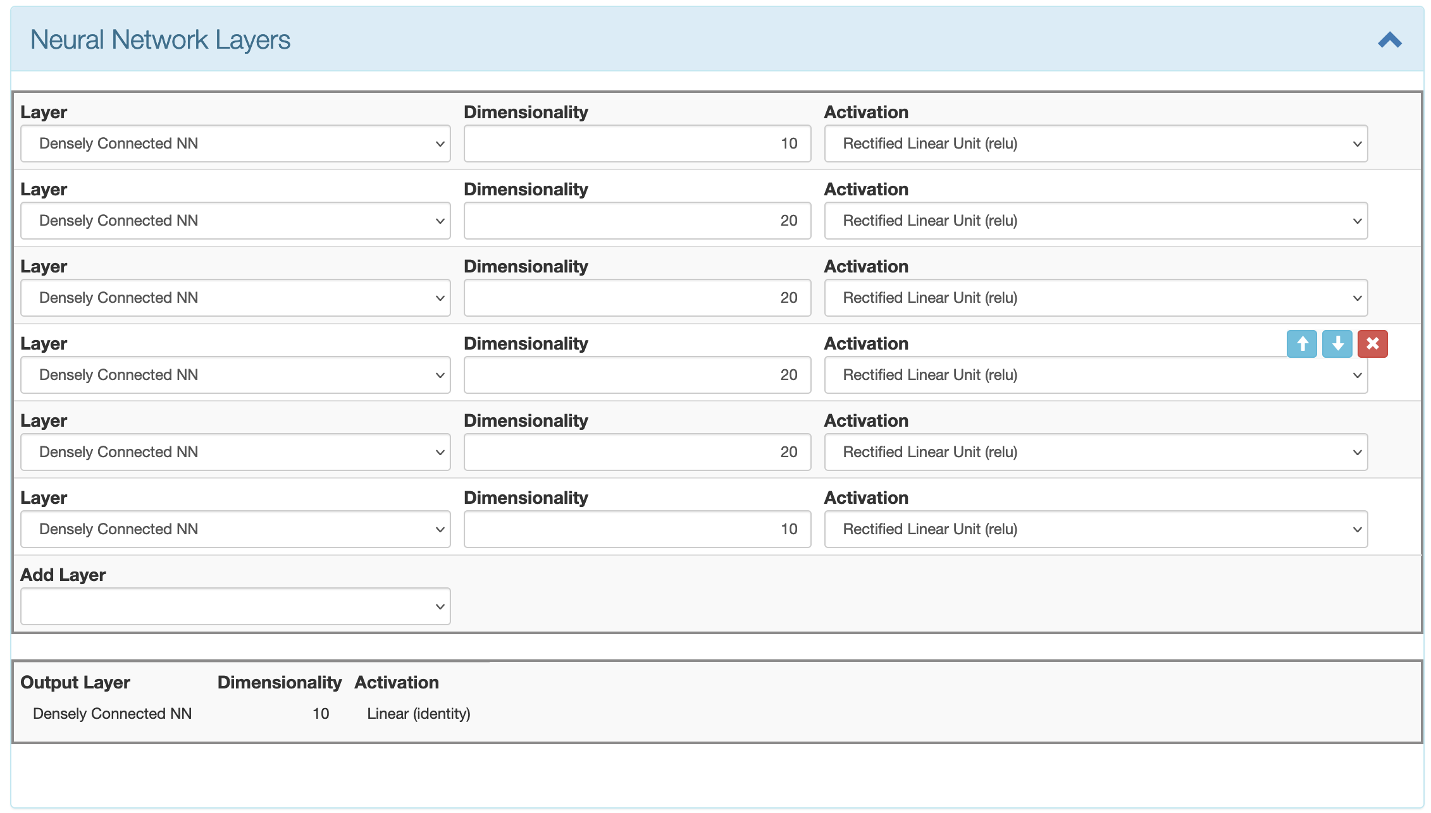
RadiaSoft tools for Online Models
Sirepo Activait: UI for developing and sharing ML models / datasets.
Sirepo Controls Application: automatically generated UIs that connect simulation tools with the accelerator
www.sirepo.com/controls#

Slide 3
rsopt: Chris Hall, chall@radiasoft.net
Sirepo Controls: Jonathan Edelen, jedelen@radiasoft.net

