Slide 1


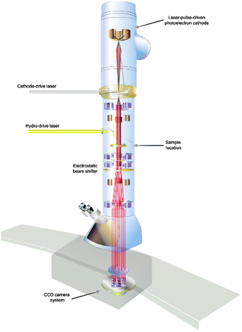
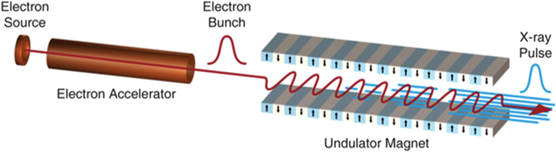
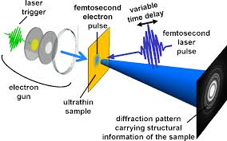
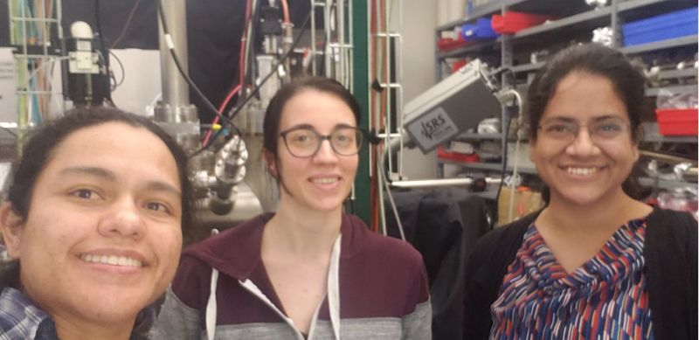
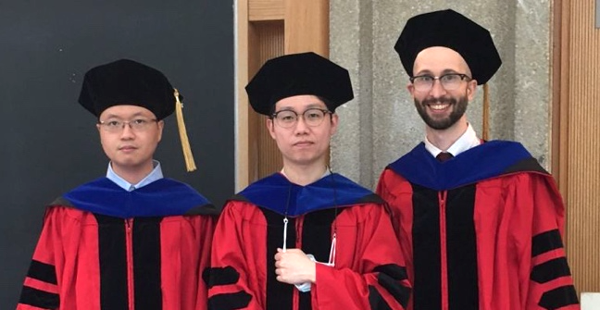
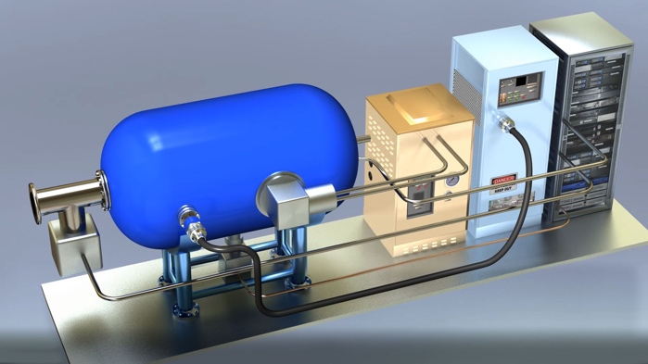
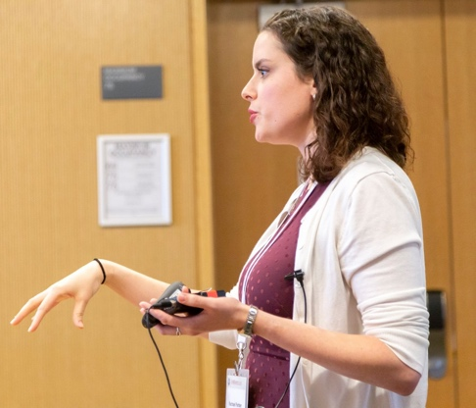
X-ray FELs
Ultrafast electron
diffraction
Electron microscopes
Colliders
Beams for industry and the environment

Slide 2
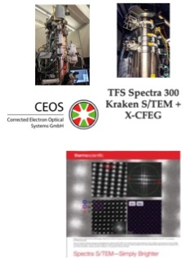
Center for Bright Beams - CBB
Gaining the fundamental understanding needed to transform the brightness of electron beams
Research themes:
      Photoemission sources
      Superconducting RF acceleration
      Beam dynamics and Control
This workshop
Training students and postdocs in accelerator science and related disciplines
To meet the demand at DOE labs and in industry
Transferring our knowledge
Notes:
Report of the HEPAP Subcommittee for Review of USPAS (2015), p 13. In 2015, US produced only 40% of need at DOE labs, which is 40 new PhD accelerator scientists per year. US unifversties produce 15-20.

Slide 3







CBB institutions
CBB brings togethers experts in
chemistry, surface science, condensed matter physics,
ab initio physics, electron microscopy, and accelerator science

Slide 4
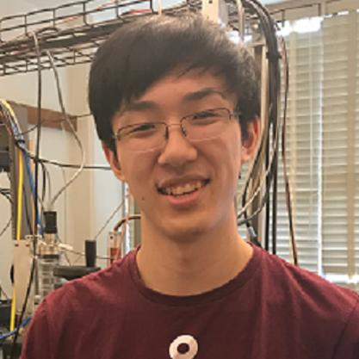
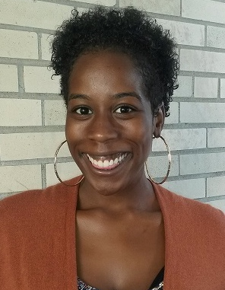
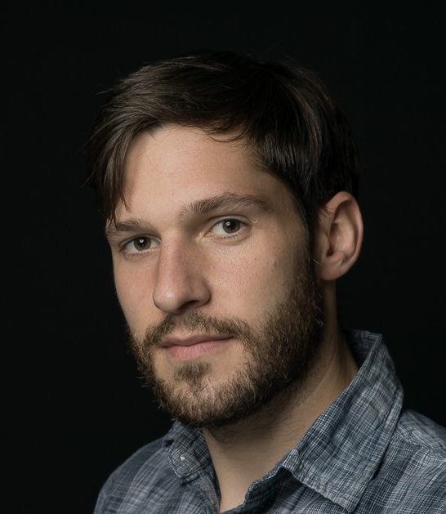

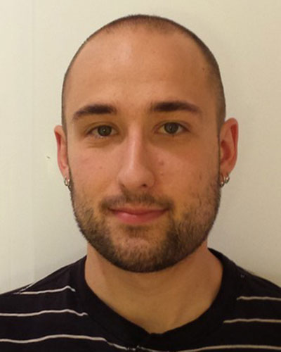
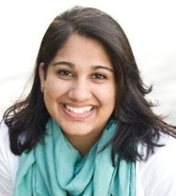
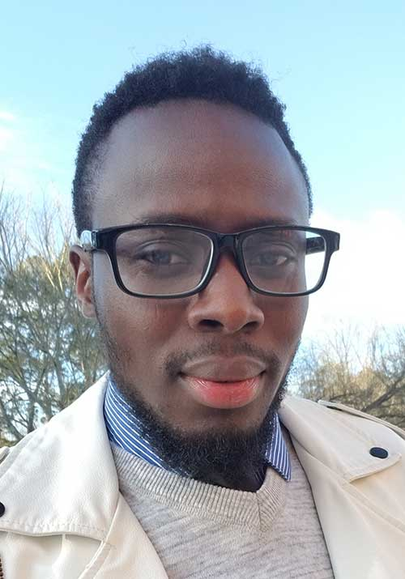
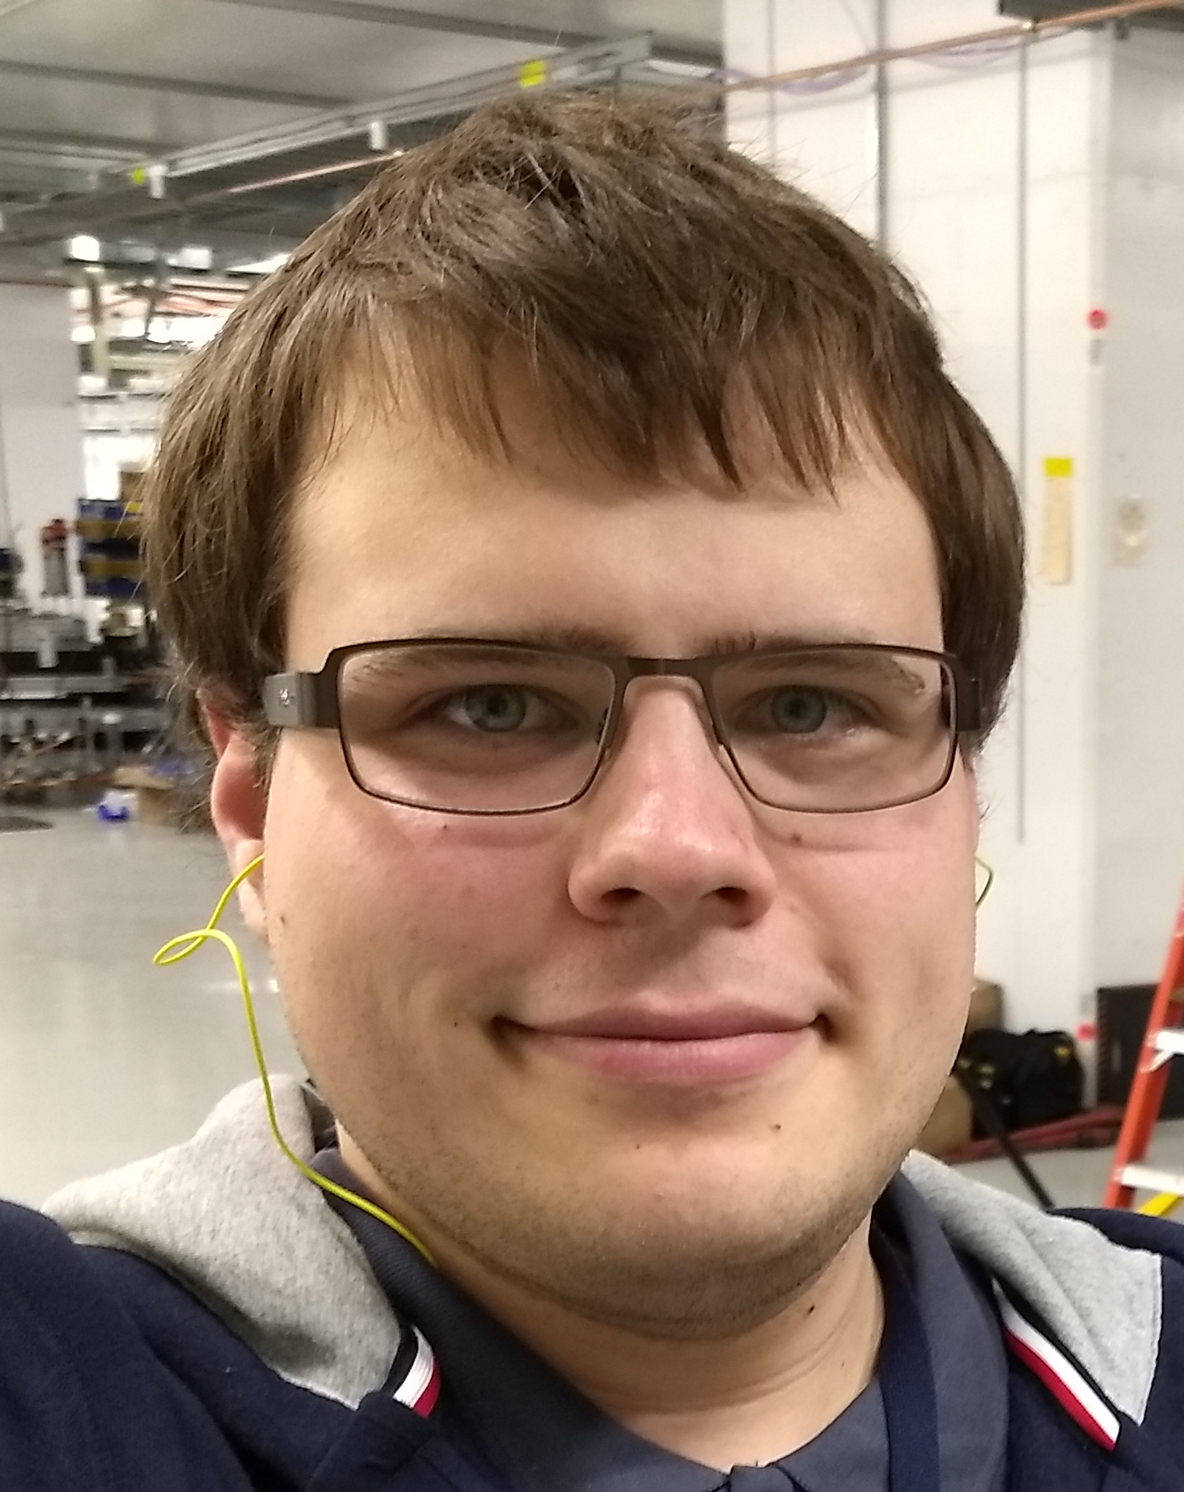
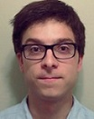
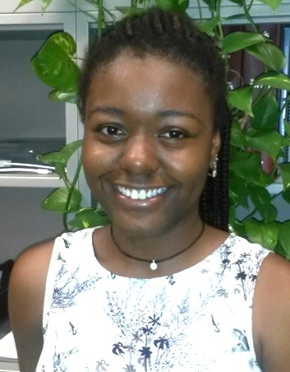
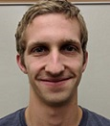
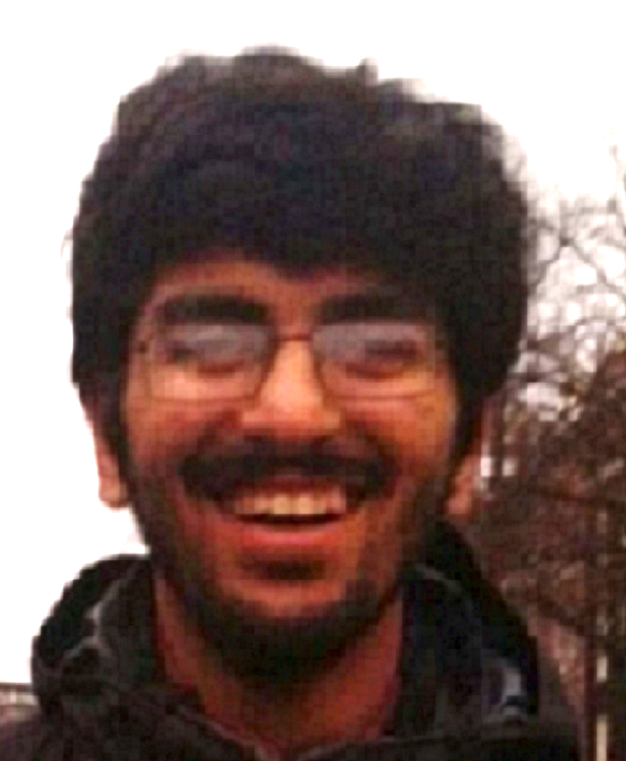
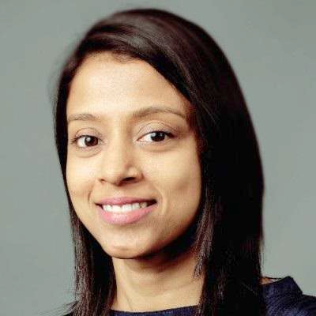
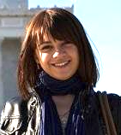
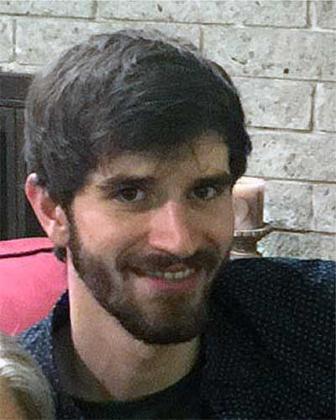
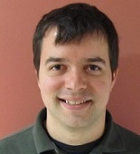
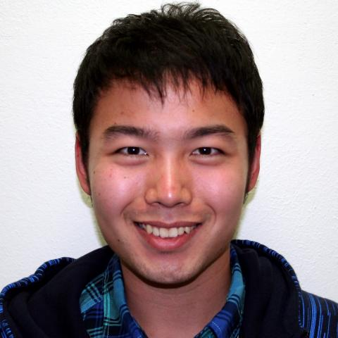
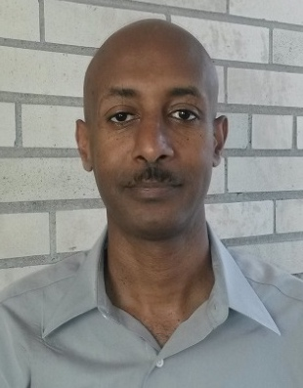
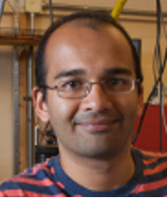
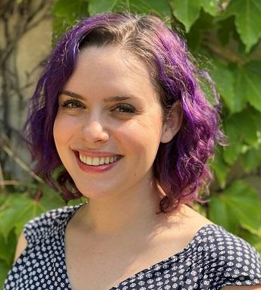
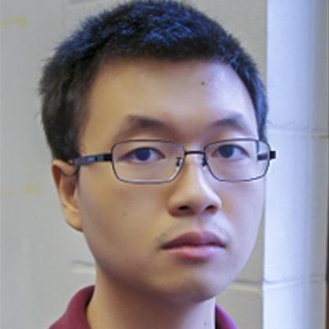
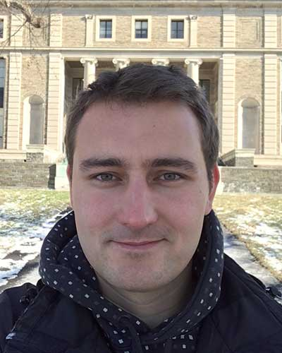
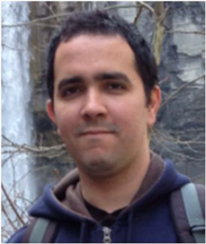
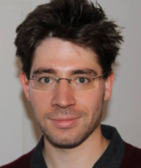
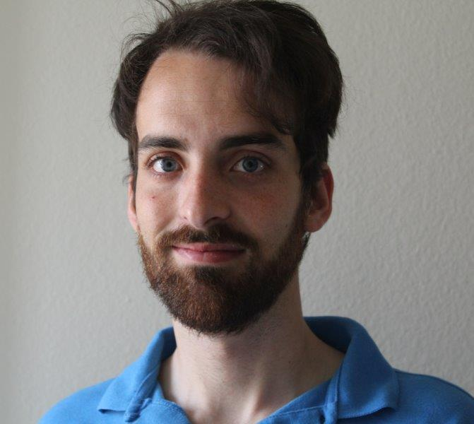
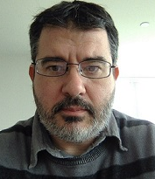
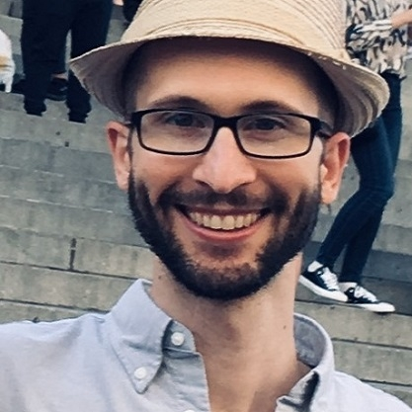
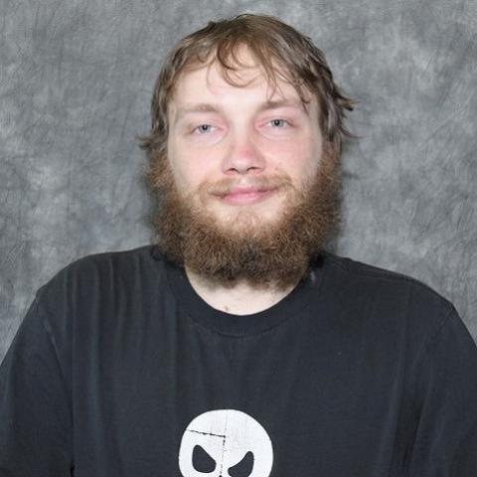
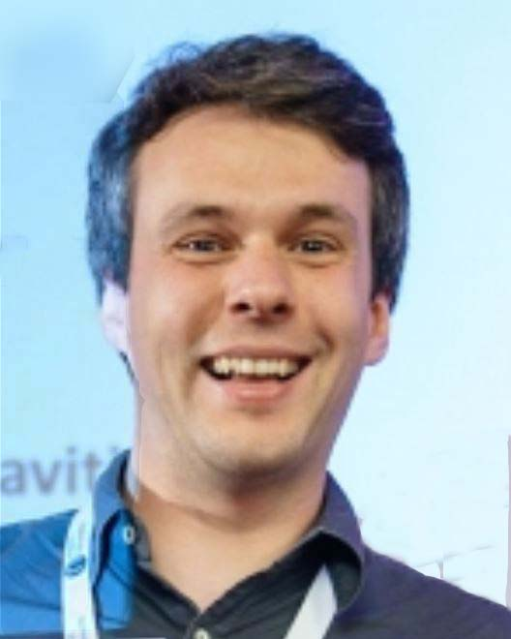
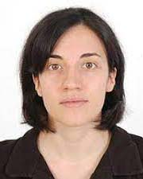
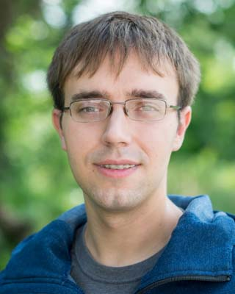
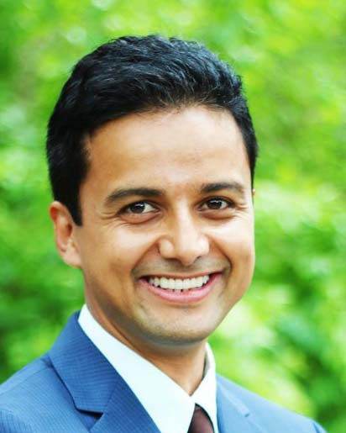
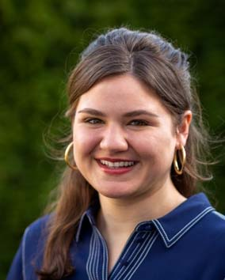
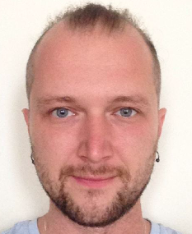
Student Training
41 highly-trained scientists by the end of year 5 Interdisciplinary team science, plus training in entrepreneurship, communication, ethics, mentorship, diversity & inclusion....
CBB priority: Diversity Accelerator Division of the American Physical Society has the lowest female representation of all 16 APS units except one (10%)
20% URM and 22% female
Aron Tesfamichael*
Unknown
Allison McMillan
Interviewing
Dulanga Somartne
Unknown
Notes:
8/41 URM (19.51%)
9/41 Female (21.95%)
1/41 Disability (2.44%)
1/41 First Gen (2.44%). We didn’t start tracking first generation college student status until late in year 4.

Slide 5
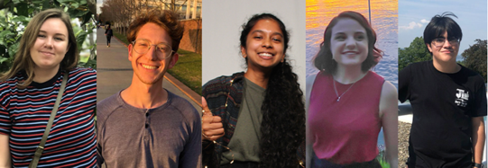
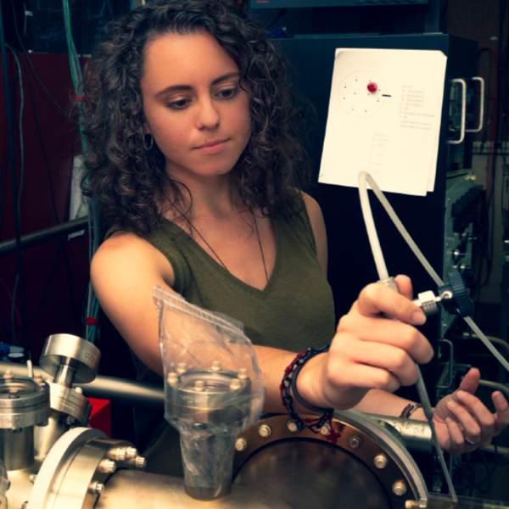
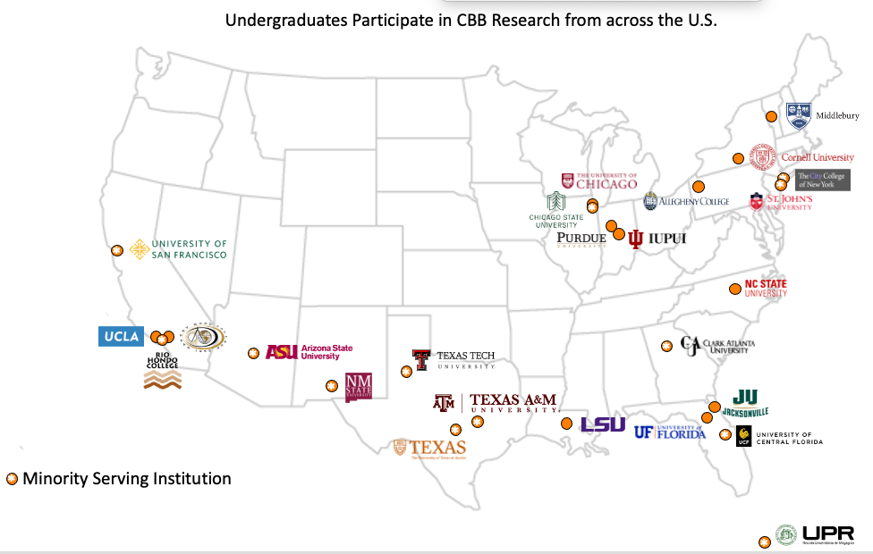
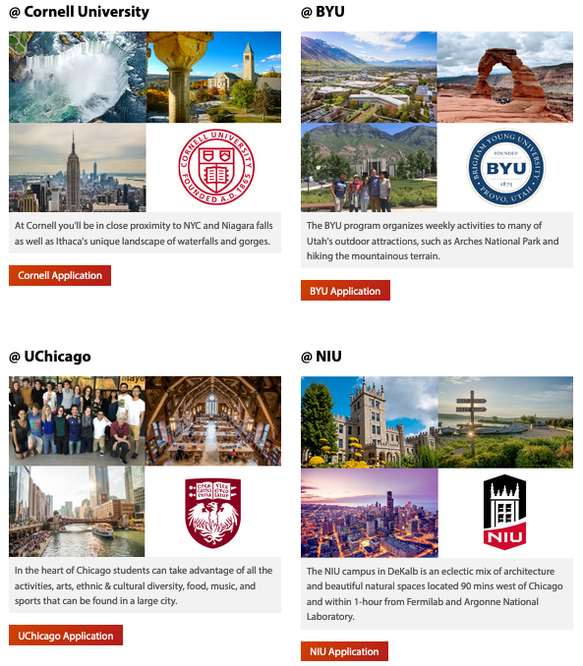
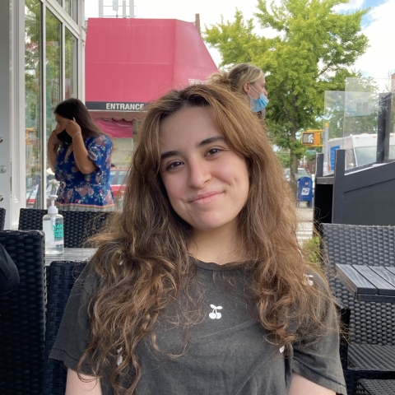
Undergraduate Research
69 undergrads have participated in
CBB research
They are attracted by on-campus,
faculty-led research
Participants in the
virtual 2020 REU
CBB recruits at URM conferences such as SACNAS and NSBP
Grace Mattingly, REU 2019
Zeinab Ismail, REU 2021
Notes:
Include what universities have REU

Slide 6
CBB is proud to support student participation
in the 3rd ICFA Beam Dynamics Mini-Workshop
on Machine Learning Applications for Particle Accelerators.
Best wishes for a productive week!
Center Vision: Gain the fundamental understanding needed to transform the brightness of beams available to science, medicine and industry.
For more information, including ways to collaborate, see cbb.cornell.edu or email cbbinfo@cornell.edu

Slide 7
CBB Research Themes
Beam
Production
Methods for better photocathodes
Beam Dynamics and Control
Methods to conserve, cool and control beams
Beam Acceleration
Methods for high performance superconducting RF accelerating cavities
Gaining the fundamental understanding needed to transform the brightness of electron beams available to science, medicine and industry.

Slide 8
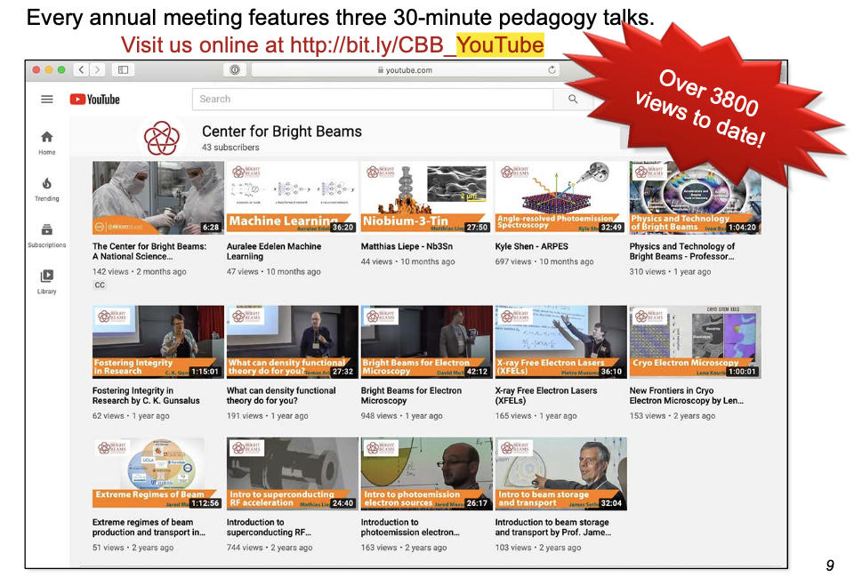
CBB Workforce Development
CBB Young Scientists
30 grad students
9 postdocs
20 undergraduates
includes ~8 in REU programs
Accelerator Education
Accelerator and related lectures
on YouTube
Hands-on accelerator training
Cornell Cryo DC gun, CESR,
Advanced Photon Source (ANL),
IOTA (FNAL), Pegasus (UCLA),
HiRES (LBNL), CBETA,
MEDUSA (Cornell).
University courses
Last year: U Chicago, UCLA
USPAS and NAPAC schools
Over 12,100 views!
Developing the path to DOE labs:
Lab affiliates (SLAC, FNAL, ANL, BNL, LBNL)
SCGSR
DOE lab speakers and poster judges at CBB Symposium
DOE lab career panel
Student co-mentors from DOE labs

