Slide 1
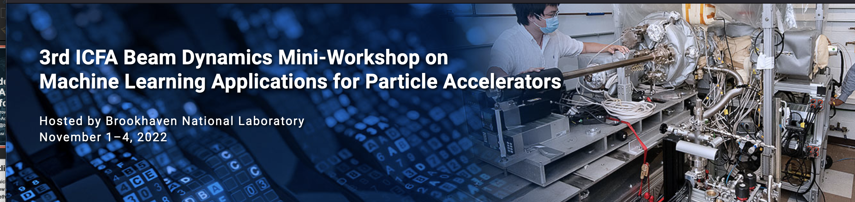
Welcome from LOC
Sandra Biedron, Christina Blas, Kevin Brown, Linh Nguyen, Anna Petway, Bryan Callaghan, & FNAL help from Tia Miceli
3rd ICFA MLAPA November 1-4, 2022

Slide 2

Special Thanks!
The Center for Bright Beams with support from the National Science Foundation (NSF) is sponsoring eight scholarships for graduate students to cover registration fees.
RadiaSoft is an industry leader in high-level research & design and scientific consulting for beamline physics and machine learning. RadiaSoft is sponsored Meet and Greet as well as the poster session (featuring an assortment of light refreshments).

Slide 3
Brookhaven National Laboratory
Brookhaven National Laboratory was established in 1947 on the eastern end of Long Island at the former site of the U.S. Army’s Camp Upton. Originally built out of a post-World War II desire to explore the peaceful applications of atomic energy, the Laboratory now has a broader mission:
to perform basic and applied research at the frontiers of science, including
nuclear and high-energy/particle physics
physics and chemistry of materials
nanoscience
energy and environmental research
national security and nonproliferation
neurosciences; structural biology
and computational sciences
Over its history, Brookhaven Lab has housed three research reactors, numerous one-of-a-kind particle accelerators, and other cutting-edge research facilities responsible for discoveries leading to many advances for science and society as well as seven Nobel Prizes.

Slide 4
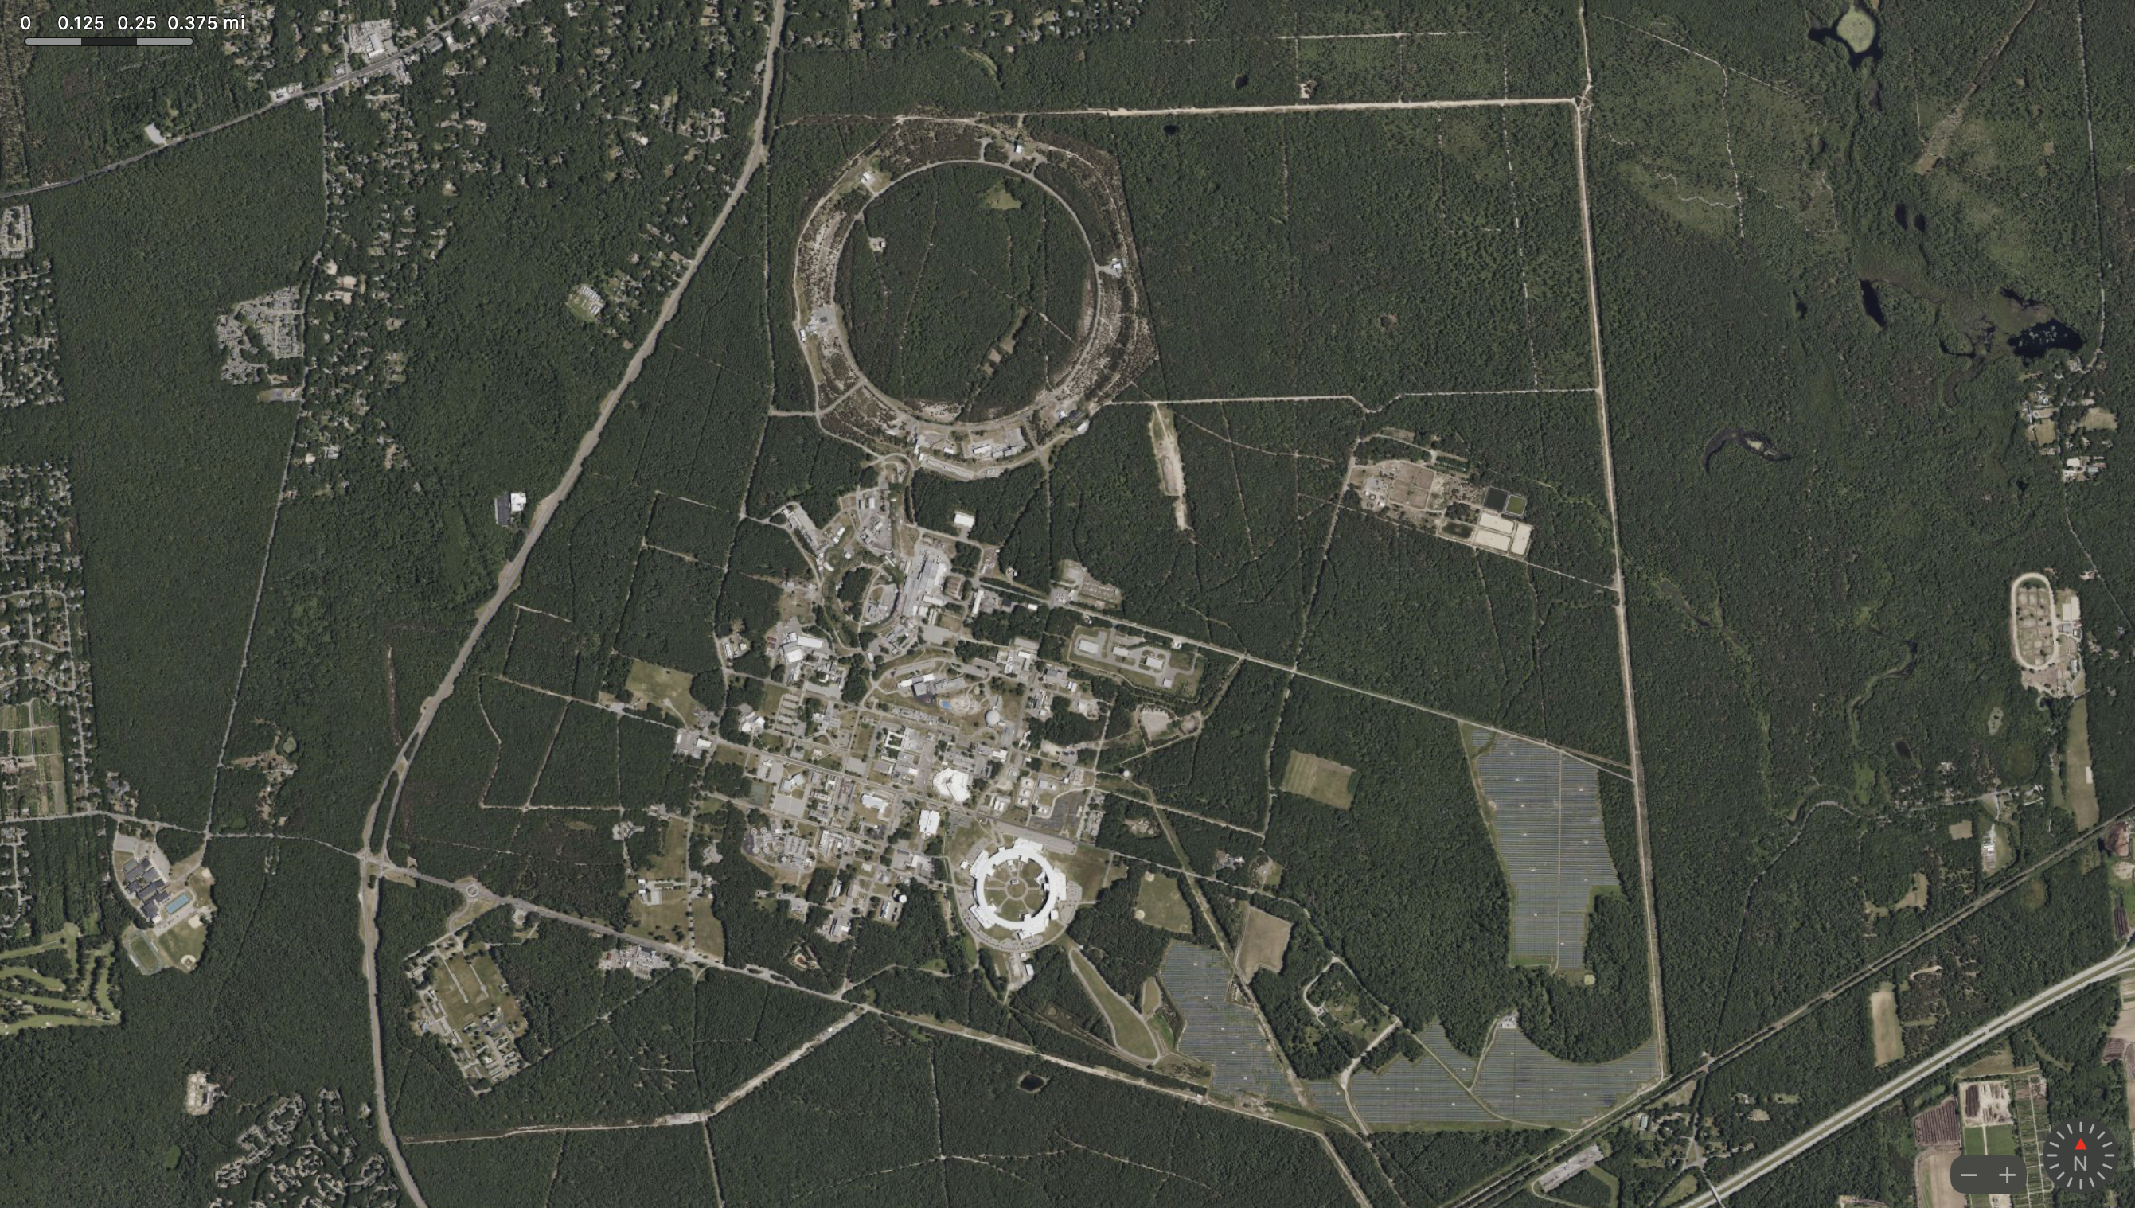
2πR = 3.8 km
RHIC -> EIC
2πR = 0.8 km
AGS
NSLS II
2πR = 0.8 km

Slide 5
Why are we in Chicago?
Thank you, Sandra! ⭐️ ⭐️ ⭐️ ⭐️
Covid-19 changed many things
  We learned we can work productively from home, but only with the help of technology
    Zoom, Teams, Slack, Discord, Box, Trello, SharePoint, High speed home internet, etc.
  Although not everybody
    Hotels learned they could rent rooms as personal offices
    Not everyone can do their job from a computer
2. Stony Brook Wang Center was booked ☹️
3. NYC Venues were way out of our price point 🤬

Slide 6
Chicago sit on several traditional homelands
Chicago is the traditional homelands of Hoocąk (Winnebago/Ho’Chunk), Jiwere (Otoe), Nutachi (Missouria), and Baxoje (Iowas); Kiash Matchitiwuk (Menominee); Meshkwahkîha (Meskwaki); Asâkîwaki (Sauk); Myaamiaki (Miami), Waayaahtanwaki (Wea), and Peeyankihšiaki (Piankashaw); Kiikaapoi (Kickapoo); Inoka (Illini Confederacy); Anishinaabeg (Ojibwe), Odawak (Odawa), and Bodéwadmik (Potawatomi). Seated atop a continental divide, the Chicago region is located at the intersection of several great waterways, leading the area to become the site of travel and healing for many Tribes.
The region has long been a center for Indigenous people to gather, trade, and maintain kinship ties. Today, one of the largest urban American Indian communities in the United States resides in Chicago. Members of this community continue to contribute to the life of this city and to celebrate their heritage, practice traditions, and care for the land and waterways.
We acknowledge our presence on these native lands and advocate for the progress, dignity and humanity of the many diverse Native Americans who still live and practice their heritage and traditions on this land today.

Slide 7
3rd ICFA Beam Dynamics Mini-Workshop on Machine Learning Applications for Particle Accelerators
The goal of this third workshop is to continue to work on building a world-wide community of researchers and engineers interested in applying artificial intelligence and machine learning technologies to particle accelerators.
The workshop will consist of four topics:
Tuning/optimization/control
Prognostics/alarm handling/anomaly-breakout detection
Data analysis
Simulations/modeling
Talks will be given by practitioners from various accelerator facilities around the world.
The workshop aims to:
Collect and unify the community’s understanding of the relevant state-of-the-art ML techniques.
Provide a tutorials of machine learning for accelerator physicists and engineers.
Seed collaborations between laboratories, academia, and industry.

Slide 9
Sessions & Moderators (Thanks!!)
Wednesday
Opt-B Andrea Santamaria Garcia
Opt-RL Christrine Sweeney
Prognostics Verena Kain
Thursday
Modeling Chris Tennant
Facility Francesco Maria Velotti
Optimization Hirokazu Maesaka
Analysis Raimund Kammering

Slide 10
Posters are an opportunity!
We encourage poster presenters to embrace a better poster design process and feature your core take away and maximize the insight transmitted. While your posters are made and ready to present, it is still a chance to take a new approach in how you tell the story of your work.
For Everyone:
What is the core message of each poster?
What insights can you glean from each poster?
For Future presentations check out these two videos from Mike Morrison, How to create a better research poster in less time,
Generation #1: https://youtu.be/1RwJbhkCA58, and
Generation #2: https://youtu.be/SYk29tnxASs

