Slide 1
Reinforcement Learning applied to Optimization of LHC beams in the CERN Proton Synchrotron
Acknowledgements: A. Lasheen,
CPS operation crew
Special thanks to the Center for Bright Beams for the student grant to attend this event
Presenter: Joel Wulff
Date of presentation: 2/11/2022

Slide 2
Part 1: Introduction and motivation

Slide 3
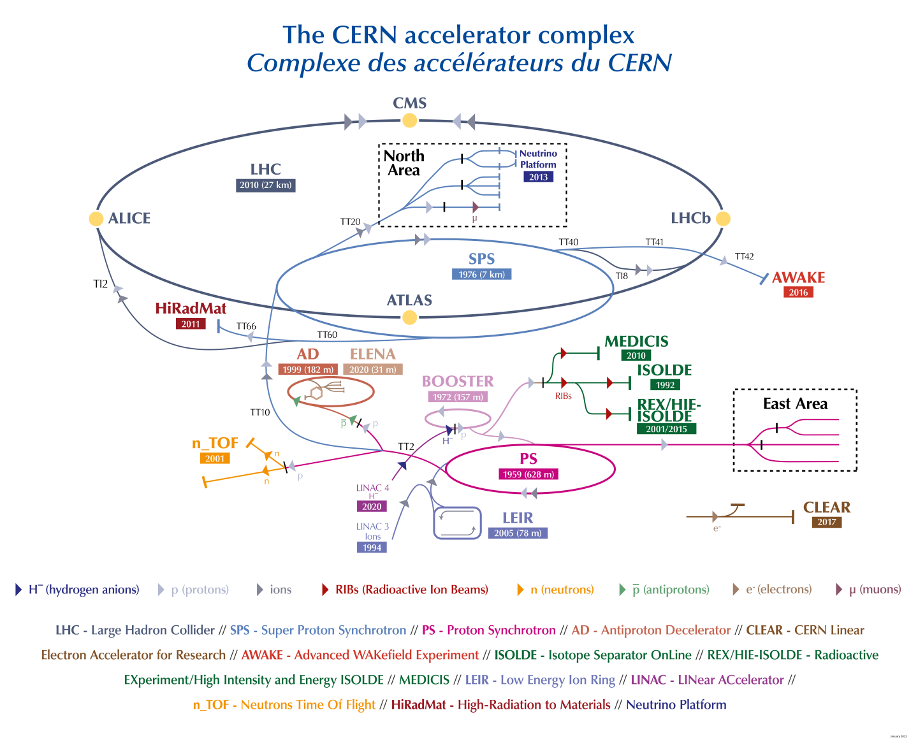
The CERN accelerator complex
A complex combination of accelerators and experiments.
Particles used for the LHC go through a cascade of 4 separate accelerators before injection.
The nominal bunch spacing of 25 ns is created in the Proton Synchrotron (PS) through a series of RF manipulations.
These manipulations need to be carefully optimized to create good quality beams for the LHC.

Slide 4
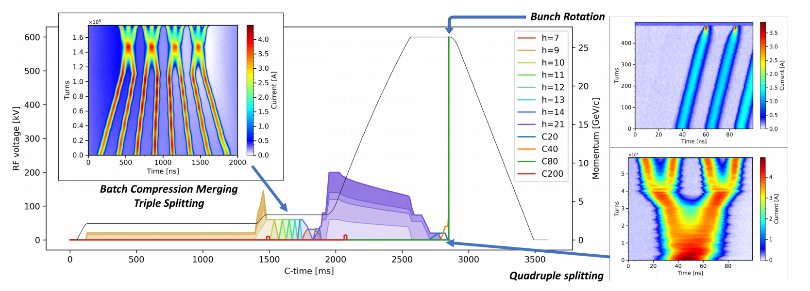
RF manipulations in the PS
All RF voltage programs and RF manipulations for the BCMS cycle, an LHC type beam.
The PS has a large number of RF systems covering a wide range of RF harmonics, allowing for plenty of RF manipulations.
The relevant parameters are the RF amplitude and phase, that can be adjusted for each harmonic to produce the desired bunch characteristics.

Slide 5
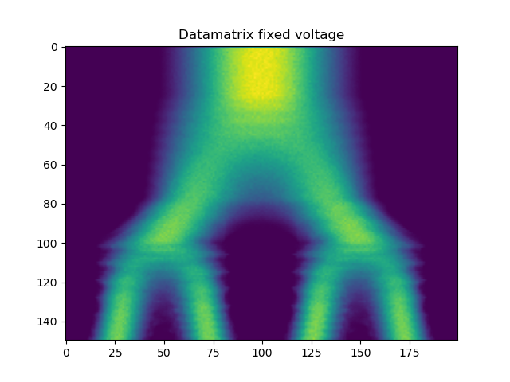
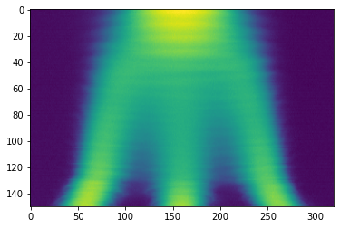
RF manipulations in the PS
Bunch evolution, Quad. splitting
Ongoing project at CERN: automate setup and optimization of RF manipulations in the PS
Presently, settings are adjusted manually, which
Takes time,
Relies on operator experience,
Risks performance inconsistency due to qualitative judgements of when the beam is “good enough”.
turn/400
t [0.5ns]
Bunch evolution, triple splitting
Promising results in both cases, however focus on triple splitting for this presentation!
Initial focus on RF splittings,
Quadruple splittings
Triple splittings
turn/185
t [ns]

Slide 6
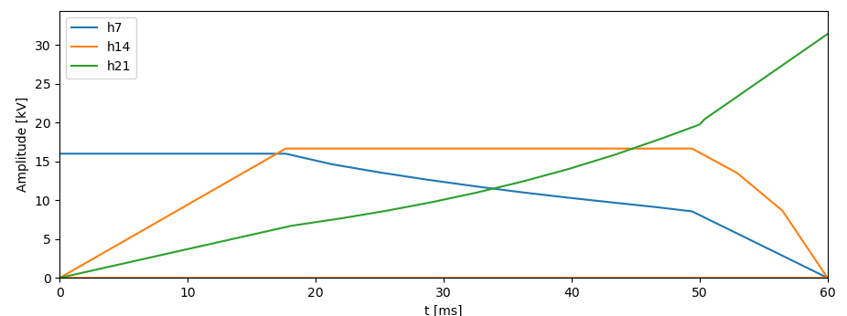
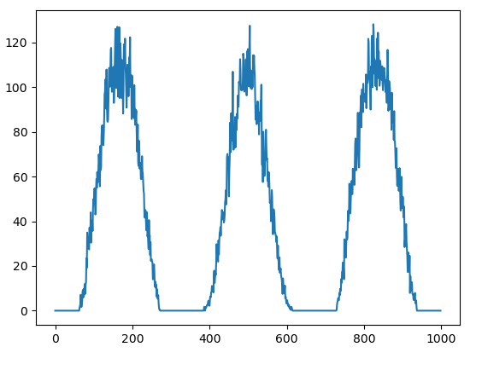
The triple splitting: Parameters, Observables and Goal
RF voltage program
Three main parameters to optimize (chosen):
Phases and voltage,
, and .
Observables:
Final bunch profiles,
final bunch-by-bunch length + intensity.
Goal:
All bunch-by-bunch observables equal after splitting.
Quality measured through Mean Square Error (MSE) between bunches after splitting.
+ : Single metric that judges overall splitting quality.
- : Many local minima…
Final profile
Three simultaneously active cavities with different voltages
→ Non-linear interactions, difficult to optimize...
Bunch evolution
turn/185
bins
Figures from simulations
t [ns]

Slide 7
Part 2: Automation through ML
Applying Reinforcement Learning to efficiently optimize the triple splitting

Slide 8
Overview of the setup: Two main ML components
Feature extractor (CNN)
RL-Agent(s)
Based on supervised learning and computer vision approach to process more information and downscale it to simple, actionable parameters.
Based on deep reinforcement learning to train an agent to complete a task by taking correct actions, i.e. actually optimizing a splitting.

Slide 9
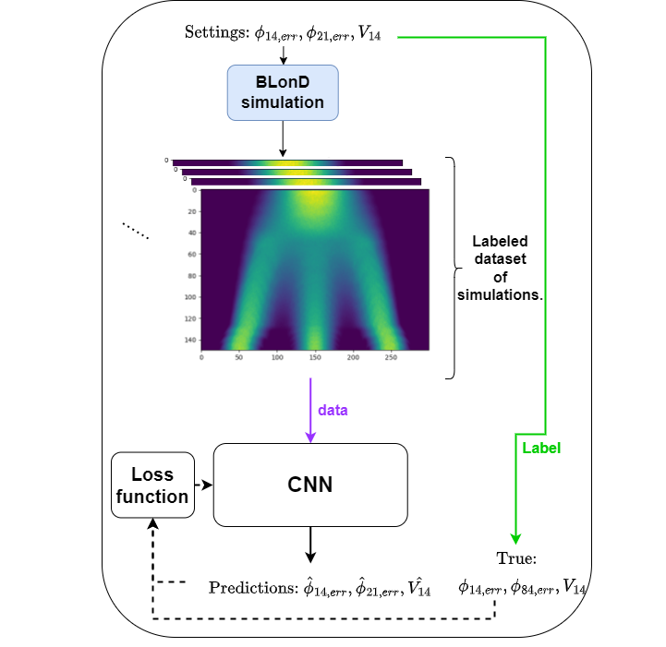
The feature extractor
A supervised Convolutional Neural Network (CNN)
Simulated dataset using the BLonD tracking code
→ Necessary to acquire enough labeled data
Data: series of bunch profiles over time. Similar to an image.
Predicts .
Works in simulation, with small prediction errors!
Notes:
For quadsplit around ~14.6k different settings simulated.
For triple splitting, ~ 55k different settings.

Slide 10
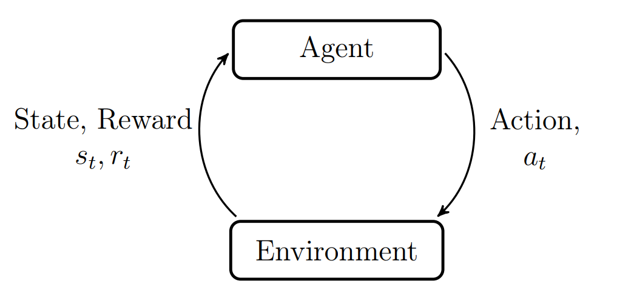
The RL-agent
Model-free: Soft-Actor Critic (SAC)
Implemented through stable baselines 3.
Trained in an environment of simulated data
Acting on .
Several versions tested.
In this presentation only the final triple splitting setup is presented.
Based on end bunch by bunch profiles
Example
Adjust
phase/volt
For training,
simulation.
Bunch profile, or final bunch-by-bunch length/intensity
NOTE: all models (CNN/RL Agents) used have been trained on simulated data only!
Agent-environment interaction loop
Notes:
For quadsplit around ~14.6k different settings simulated.
For triple splitting, ~ 55k different settings.

Slide 11
Trial and error: different attempted approaches
Final profile
Extract final bunch lengths/intensities
1. Optimize directly
Sim.
Input:
BLs, Int.
RL Agent,
{𝝓₁₄ , 𝝓₂₁, V₁₄}
Failed already in simulation. Why?
Perhaps not enough information…
Final bunch lengths/intensities
Feature extractor not accurate enough on real data…
2. Provide more info.
Input:
Sim.
Op.
Feature extractor (CNN)
RL Agent,
{𝝓₁₄ , 𝝓₂₁, V₁₄ }
✔
Optimize sequentially, phase → voltage
3. Simplify through segmentation
RL Agent,
{𝝓₁₄ , 𝝓₂₁, V₁₄ }
RL Phase Agent,
{𝝓₁₄ , 𝝓₂₁}
RL Volt Agent,
{V₁₄ }
Required decoupling of phases and voltages in loss function…

Slide 12
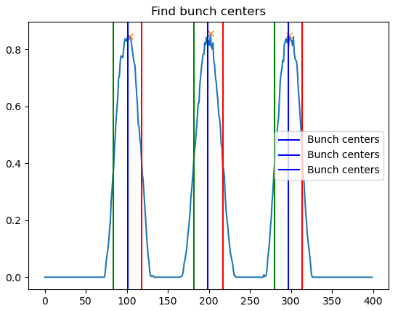
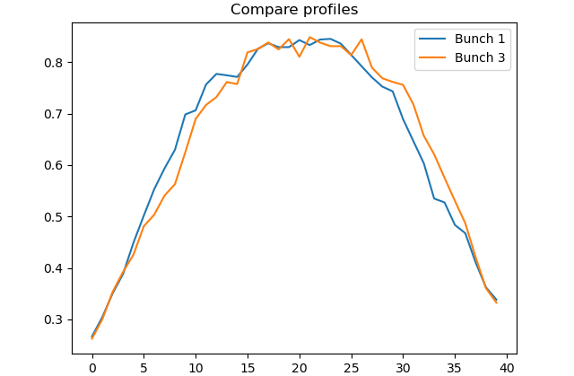
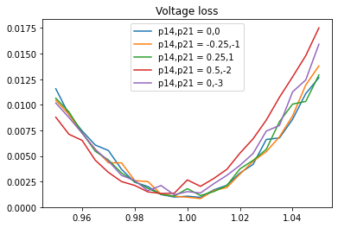
The phase and voltage losses
Figure: Illustration of phase loss. Isolated outer bunches are compared through MSE.
1. Phase Loss:
Compare only the outer two bunches. From beam dynamics, we know that for almost all combinations of phase offset and voltage factor we will observe a difference in their shapes.
With optimal phase, they should always be identical! Gives a semi-voltage agnostic loss.
2. Voltage Loss: Assume phase is already optimized,
→ Optimization reduced to a univariate problem.
Reuse original three-bunch comparison,
→ Provides a nice, approximately parabolic loss curve!
Figure: Scan of profile loss as a function of voltage factor for small residual phase errors.
Note: See the extra slides for a scan of phase losses for phase errors at different fixed voltages.

Slide 13
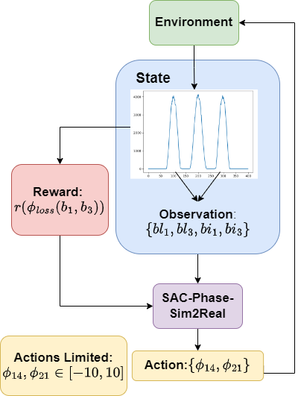
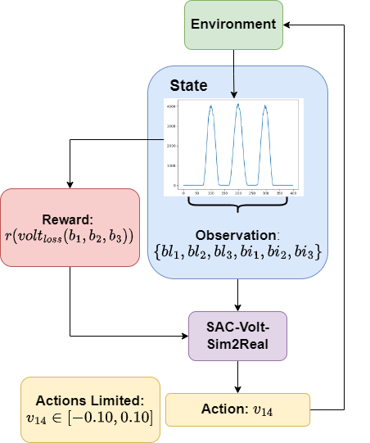
Segmented RL-Agents: Setup and sim. results
Phase Agent
Voltage Agent
Training: ~20k steps (60k to best performance)
Performance: ~3 steps in simulation
Training: ~2k steps
(20k to best performance)
Performance: ~1-2 steps in simulation
Work great in simulation, what about operation?

Slide 14
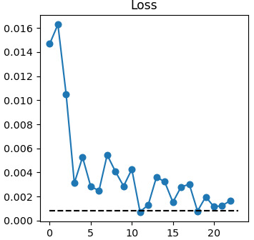
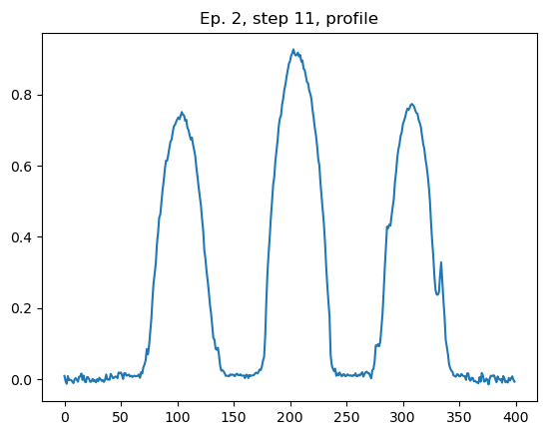
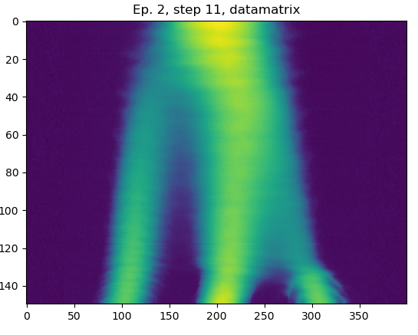
Segmented RL-Agents: direct application
Initial test: Apply the pre-trained RL-Agents directly to the output from the PS, optimizing
Phase → Voltage.
Unreliable → Succeeded most of the time, but not always. Why? An example…
Phase loss looks good on step 11,
Final profile looks in phase
Bunch evolution shows large phase error!
In few special cases, the information contained in final profile sometimes not enough to solve the problem. Could more information be leveraged to find a better initial condition?
→ Yes, by using the pre-trained feature extractor!

Slide 15
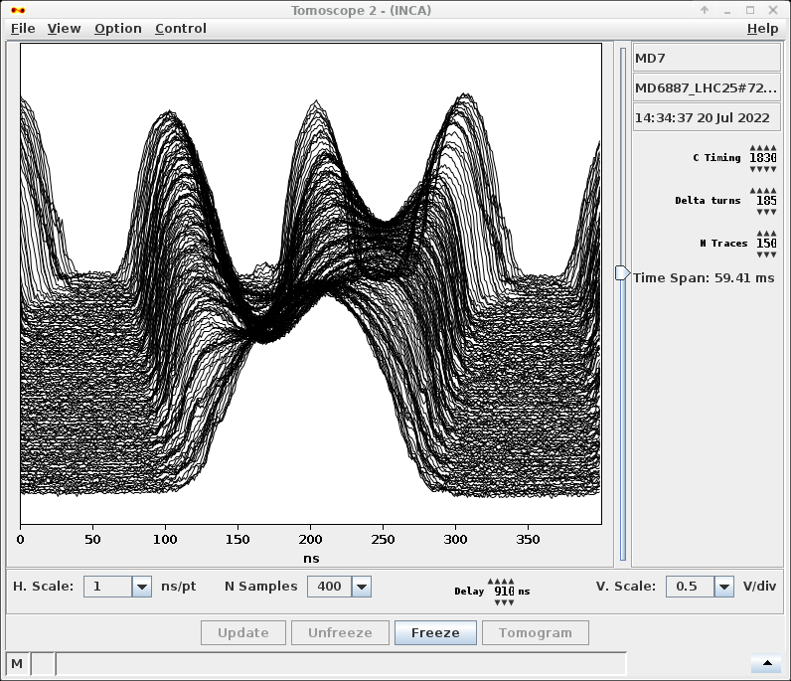
Segmented RL-Agents: Add initial guess from CNN
Feature extractor predicts phases from bunch profiles over the entire splitting (more info.)
→ can identify errors earlier in the bunch splitting otherwise not visible in the final profile,
→ is usually within 3-10 degrees of the true offset when predicting phase,
→ can provide an initial guess leading to a better initial condition for the RL agents!
First acquisition: Initial phase guess based on CNN
Feature extractor (CNN)
Prediction,
Action,
Adjustments through RL agents
RL Phase Agent,
{𝝓₁₄ , 𝝓₂₁}
RL Volt Agent,
{V₁₄ }

Slide 16
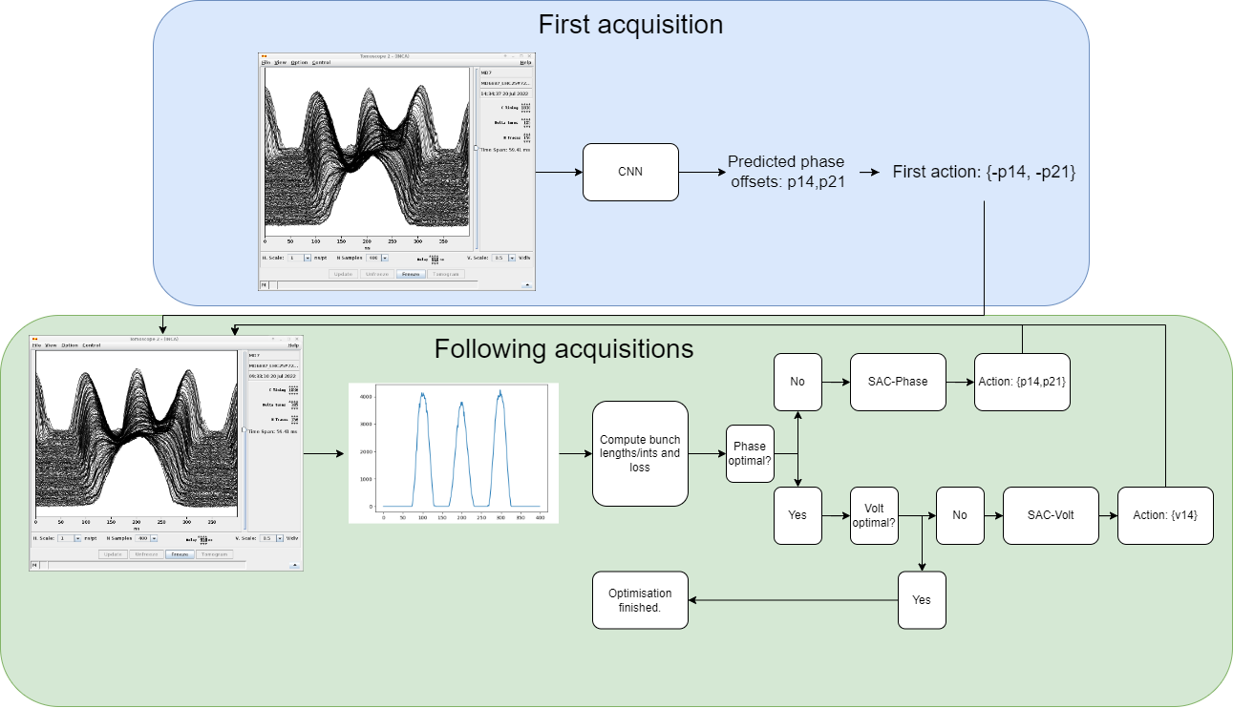
Segmented RL-Agents: Final setup
CNN
First:
→ Initial phase step from feat. extr.
Provides good initial condition.
Followed by:
→ SAC-phase optimizes phase
→ SAC-Volt optimizes voltage.
Does it work?
Reinforcement Learning

Slide 17
Part 3: Operational results
Applying simulation trained agents to the PS

Slide 18
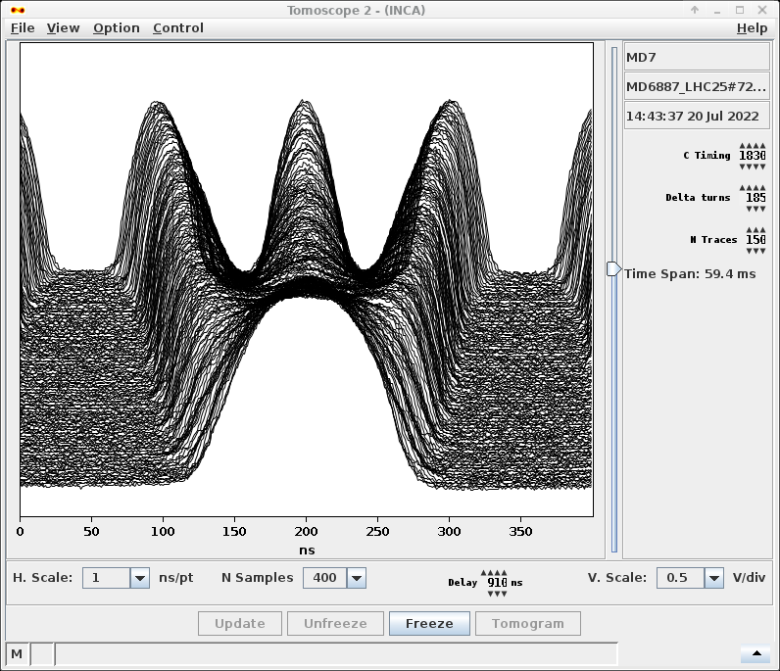
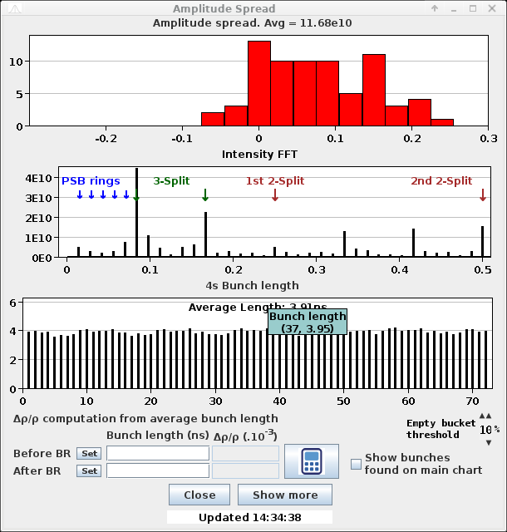
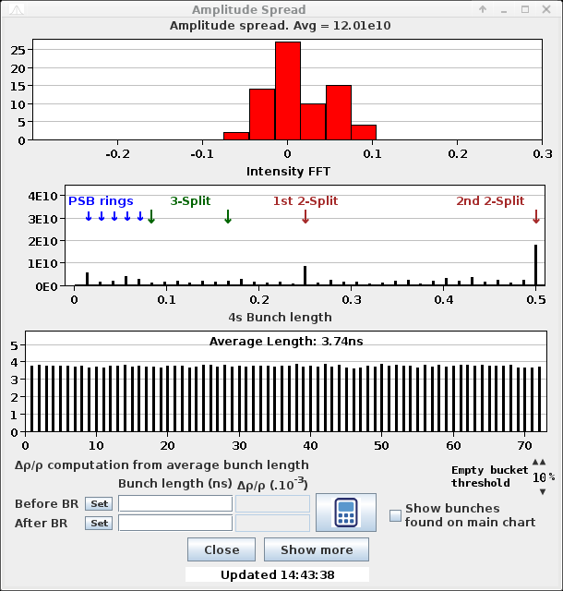
Results: SAC-Phase/Volt-Sim2Real + Feat. extr.
Example episode:
Approx. initial offset: 𝝓₁₄ = 10, 𝝓₂₁ = -20, V_{f} = 1.08
Final
Init
Phase opt. steps: 3
Volt opt. steps: 4
Total iterations required: 7

Slide 19
Results: SAC-Phase/Volt-Sim2Real + Feat. extr.
26 Full episodes collected
15 using LHC25ns 72b beam at 1.3e11 int/bunch (nominal beam),
2 using LHC25ns 72b beam at 1.6e11 int/bunch (higher intensity),
4 using LHC25ns 72b beam at 2.6e11 int/bunch (intensity for HL-LHC),
5 using BCMS 48b beam,
All episodes successful!
Steps required for optimization:
Minimum: 2
Maximum: 18
Mean: 8.46
Note: number of steps required influenced heavily by initial state and restrictions on actions by agents.

Slide 20
Conclusion: Triple splitting agents
Super agent?
Consistent good performance for
varying bunch intensities (1.3e11-2.6e11)
different beam types (72b, BCMS)
Consistently rivals operators/experts in optimization steps
Averaging ~8.5 steps per optimization (with difficult initial conditions).
Future work
Inclusion of multi-bunch information.
Finetune/retrain on real data
Other RF manipulations?
Investigate Hierarchical RL
Current setup:
Three networks + ext. logic
Other optimizations?
Feature extractor (CNN)
RL Phase Agent,
{𝝓₁₄ , 𝝓₂₁}
RL Volt Agent,
{V₁₄ }
Optimized
beam

Slide 21
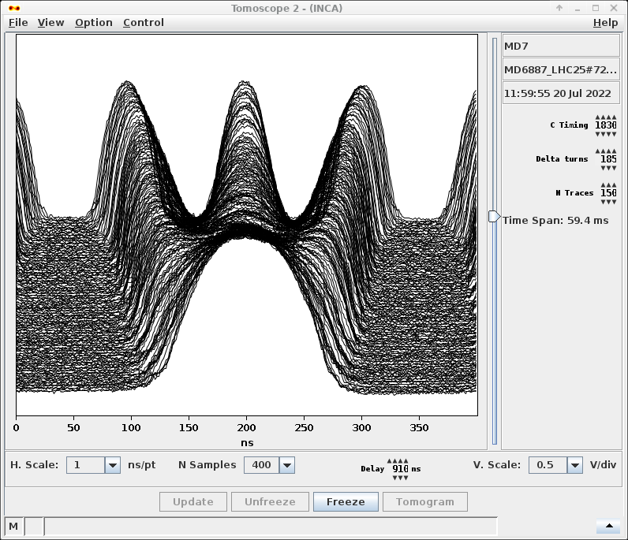
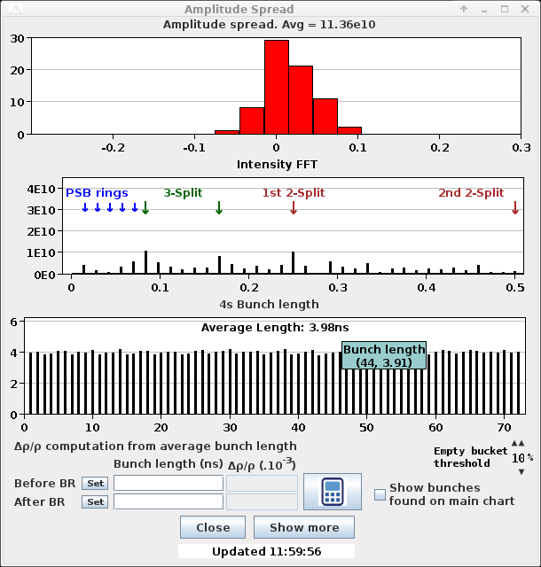
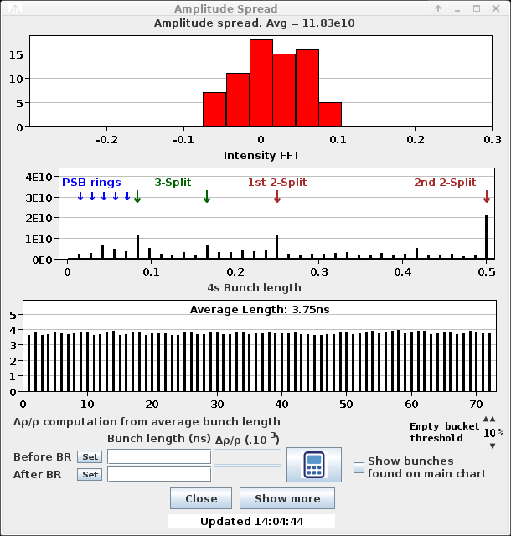
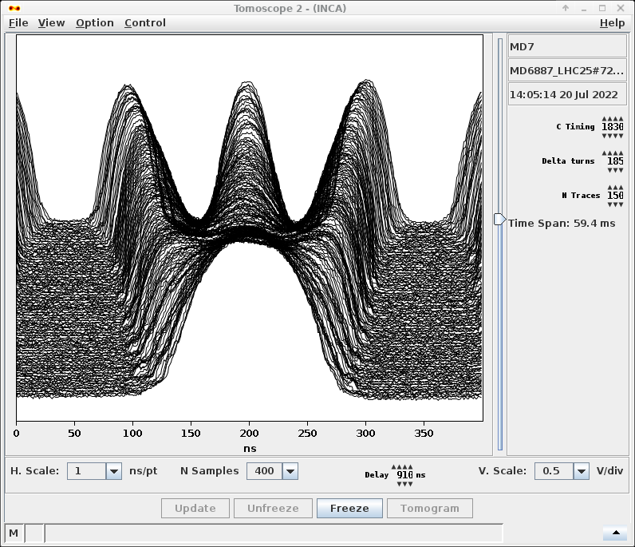
Thank you for listening! Questions?
More examples of splittings after optimisation:
Trisplit episode: Init {15,-5,0.96}. Optimised in 10 steps.
Trisplit episode: Init {10,-5,1.04}. Optimised in 8 steps.

Slide 22
Links and contact information
Additional information available in:
Progress with RL for controlling RF manipulations in the PS, J. Wulff, 2022 ML community forum
Reinforcement learning applied for RF manipulations in the PS, J. Wulff, 2021 ML Coffee
Summer student technical note
Optimization of RF manipulations in the PS, A. Lasheen and S. Johnston, 2020 ML Coffee
Contact information
Authors: Joel Wulff, joel.wulff@cern.ch or joel.wulff@hotmail.com,
Alexandre Lasheen, alexandre.lasheen@cern.ch

Slide 24
Extra slides
Following this slide you will find many extra slides containing additional information for the interested individual. The order of them may be a bit confusing, but they could contain some interesting information for those of you who are extra interested.
For example, you can find some results from the agents used on the more simple quadruple splitting.
Cheers,
Joel Wulff

Slide 25
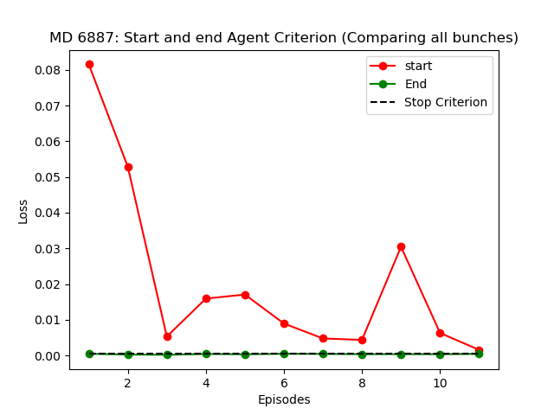
Extra results: 11 sample episodes
Episode | Init settings [p14,p21, v14_offset] | Phase opt. | Voltage opt. | Success
1 | 20, 20, -0.08 | 5 | 7 | Yes!
2 | -20, -20, 0.10 | 8 | 3 | Yes!
3 | -20, 20, 0.10 | 8 | 3 | Yes!
4 | 20, -20, -0.01 | 9 | 5 | Yes!
5 | 15,-5,-0.05 | 3 | 6 | Yes!
6 | 15, -5, 0.05 | 1 | 1 | Yes!
7 (2.6e11) | 10, -10, -0.10 | 8 | 10 | Yes!
8 (2.6e11) | -10, 10, 0.10 | 2 | 2 | Yes!
9 (2.6e11) | 10, 10, -0.05 | 5 | 10 | Yes!
10 (BCMS) | 10, -10, 0.05 | 3 | 2 | Yes!
11 (BCMS) | -10, 10, -0.05 | 2 | 3 | Yes!
Figure: Start and end criterion for episodes 1-11. Computed using full profile loss, i.e. comparing all three bunches.
Notes:
Only mention the figure and that the data is available for future reference

Slide 26
Extra: Examples of poor/optimized triple splitting
Poor splitting:
Uneven bunch characteristics, large variations along final bunch train
Optimized splitting:
Even bunch characteristics, small variations along final bunch train

Slide 27
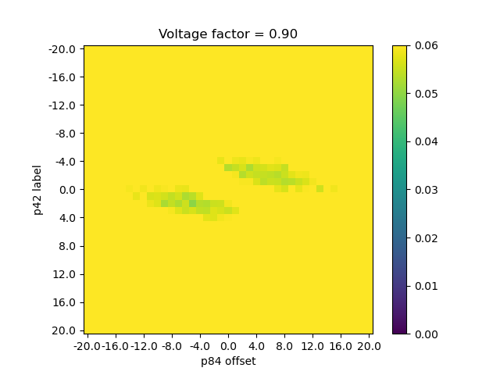
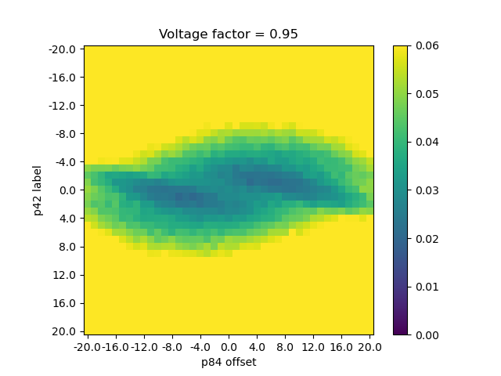
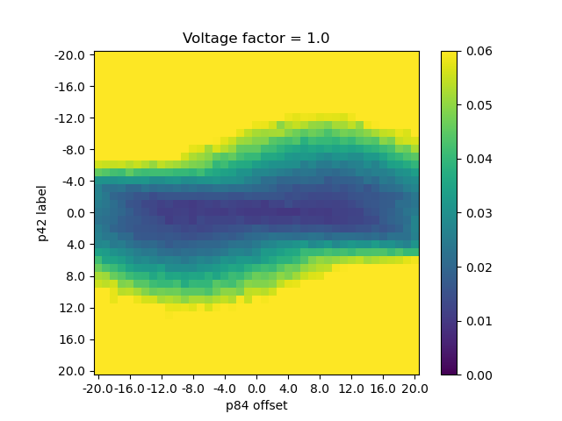
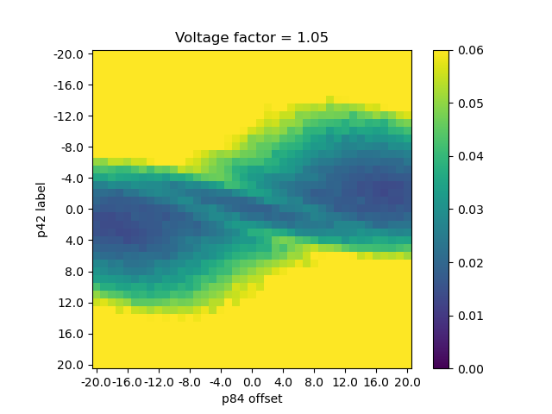
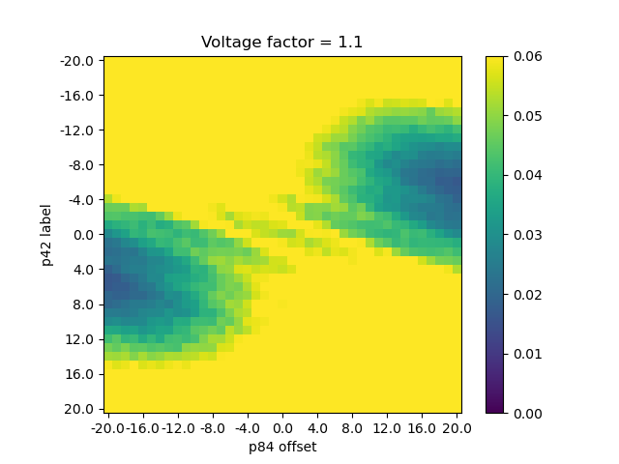
Extra: Judging splitting quality, the loss function
Voltage factor = 0.90
Voltage factor = 0.95
Voltage factor = 1.0
Voltage factor = 1.05
Voltage factor = 1.10
Figure: Clipped losses for different fixed voltages: when voltage is changed, optimal phase also changes.
Scan of the three-bunch loss values while varying phase errors at fixed voltages
Shows how the “optimal” phase varies with the voltage setting.
Compare with phase loss on next slide!
Note: the “true” minimum over these different settings is still located in voltage factor 1.0 and phases 0, 0, as expected.

Slide 28
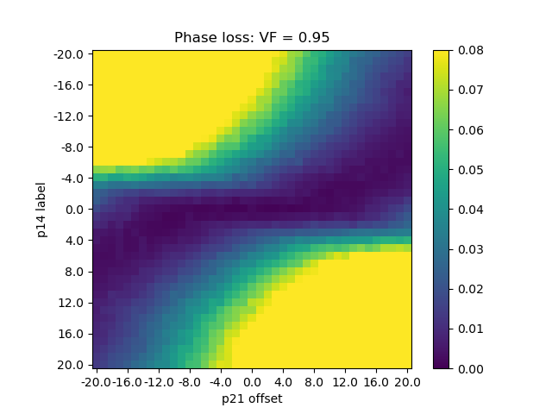
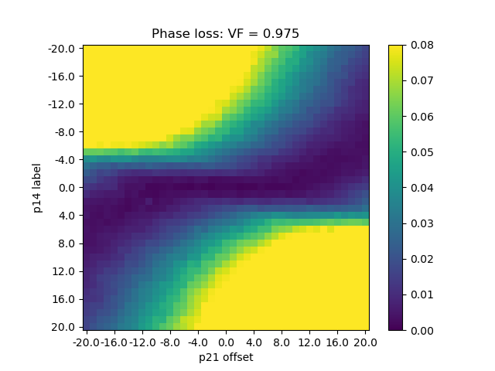
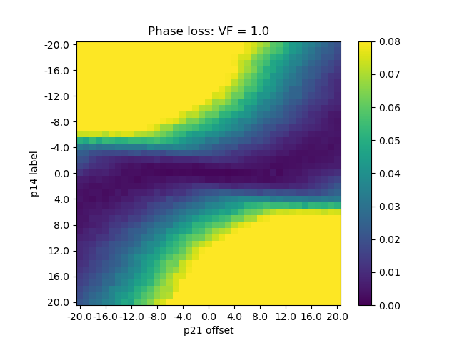
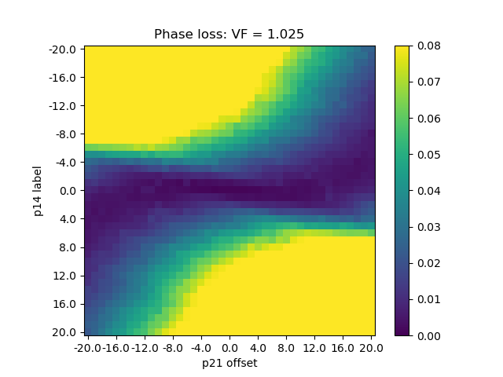
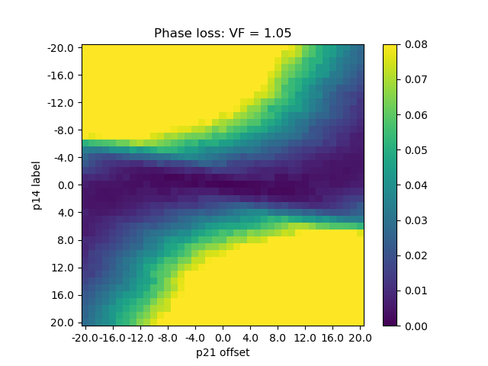
Extra: The phase loss, scanning phases for set voltages
Voltage factor = 0.95
Voltage factor = 0.975
Voltage factor = 1.0
Voltage factor = 1.025
Voltage factor = 1.05
Figure: Clipped phase losses for different fixed voltages: when voltage is changed, optimal phase also changes.
With the phase loss function, we no longer see the same variation in the loss landscape when varying voltage: as expected, the loss is (semi-) voltage agnostic.
Note: The quality of the triple splitting is much more dependent on the p14 phase setting than the p21.

Slide 29
Extra: Plots of phase/voltage optimization in example episode
Logbook entry with some initial/final states: http://elogbook.cern.ch/eLogbook/eLogbook.jsp?shiftId=1120696
Example episode:
Approx. initial offset: p14 = 10, p21 = -20, vf = 1.08
Phase path: actions taken
Phase optimisation
Voltage path:
actions taken
Voltage optimisation
NOTE:
First step no action taken.
Phase loss during steps
Volt loss during steps
Final parameters after volt opt. : tomo/profile/relative bunch lengths/intensities
Final parameters after phase opt. : tomo/profile/relative bunch lengths/intensities

Slide 30
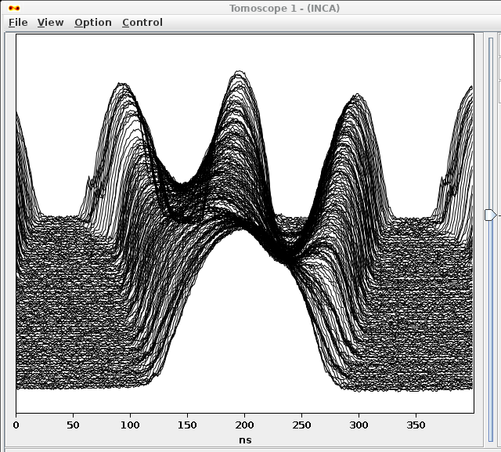
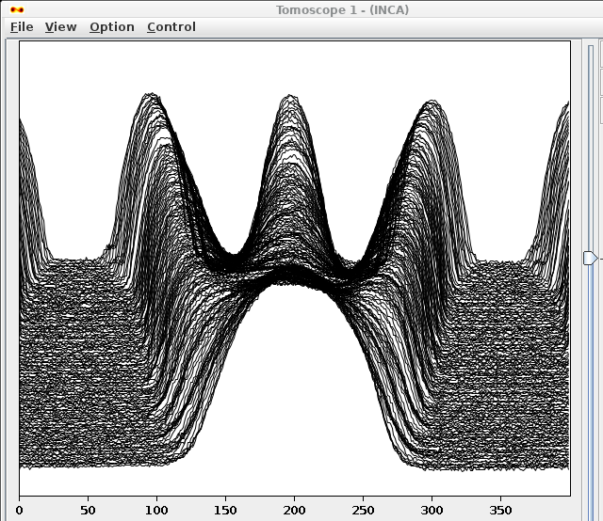
Example: Segmented RL-Agents only (no init. guess from CNN)
Figure: Init and end tomoscope acq. of ep. 1.
Three initial episodes ran with the setup described in slide __
Two successes, one failure.
Generally slower than desired (>10 steps).
Episode | Init settings [p14,p21, v14_offset] | Phase opt. | Voltage opt. | Total steps | Comment | Success
1 | -15,5, -0.07 | 12 | 3 | 15 |  | Yes!
2 | 20,-20,-0.10 | 22+ | - | n/a | Did not finish. Failed to optimise phase to a good degree. | No.
3 | 10,-10,-0.10 | 10 | 12 | 22 |  | Yes!
Why did the agents fail in this episode?
→ Explored in next slide

Slide 31
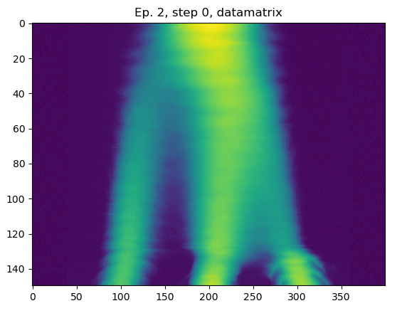
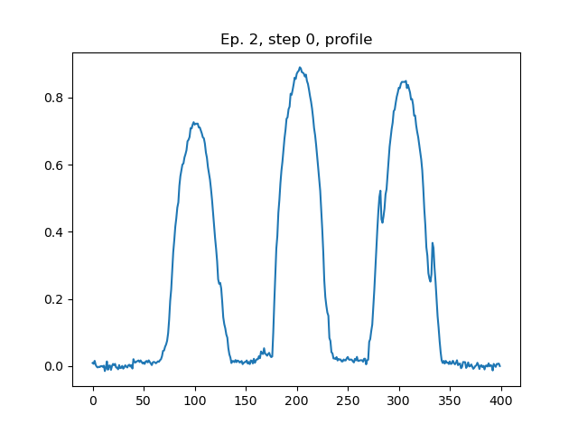
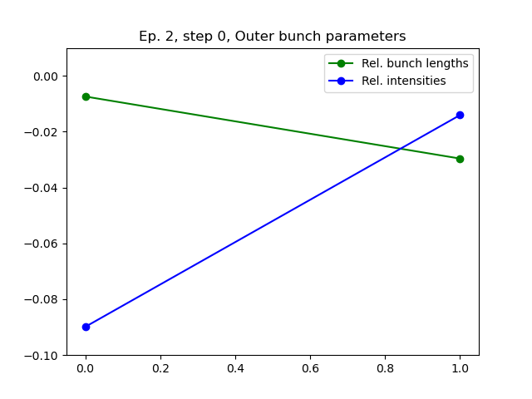
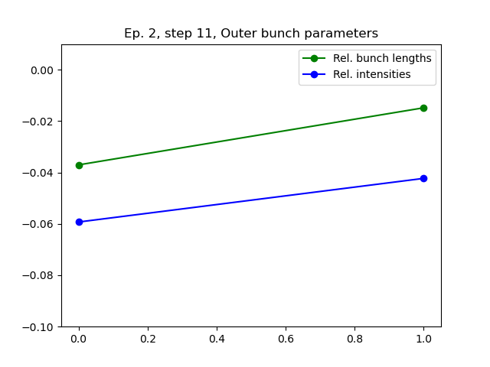
Example: Segmented RL-Agents only (no init. guess from CNN)
Initial acquisition: Start offset 20, -20, -0.10. Initial tomo looks very poor, final profile looks less poor.
Phase loss during optimisation: We will look closer on steps 0 and 11.
Step 11: Phase loss below criteria, final profile has similar outer bunches. Rel. bunch lengths/intensities also similar. But, tomo acquisition shows large phase error remains → Error in observable!
Agent believes it is close to the minimum, but is actually far from it. A special case where the agent can get stuck!

Slide 32
Example: Segmented RL-Agents only (no init. guess from CNN), conclusion
From this example, we know that the phase loss is not perfect:
If the initial condition is too poor, the information contained in the final profile may not be enough to solve the problem → The Agents may converge to a local minima.
Could we exploit the information in the full tomoscope acquisition in some way to achieve a better initial condition, where the final profile contains adequate information for the agents optimisation?
→ Yes, by using the pre-trained feature extractor!

Slide 33
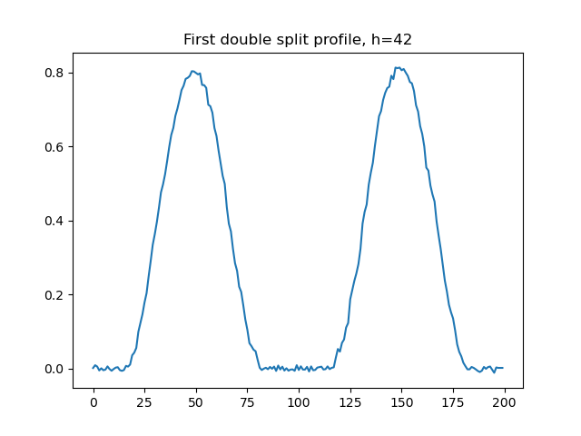
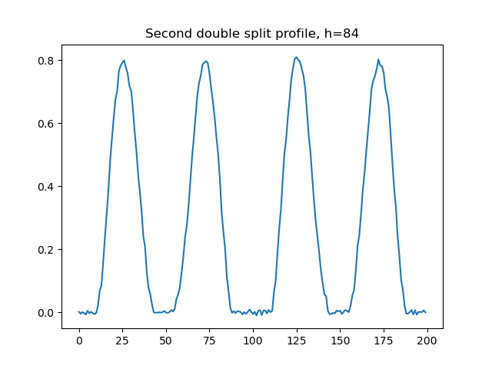
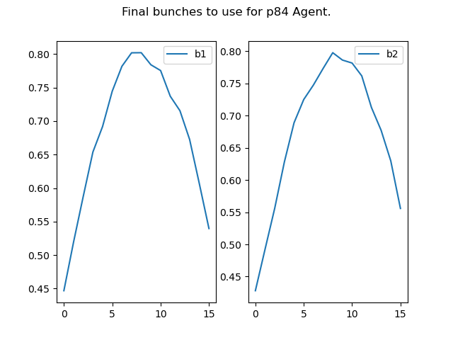
Extra: Approach for
Quadruple splitting
The inputs were designed to be taken from a tomoscope acq. (as the simulated data for this was already available).
Calculates inputs and losses from profiles at different timings
h=42 agent uses the profile after the first splitting is complete, but the second has yet to start.
h=84 uses the final profile. We only care about differences caused by the second splitting, so we average together the first + third and the second + fourth bunches respectively to get only two bunches, representing the quality of the second double split.

Slide 34
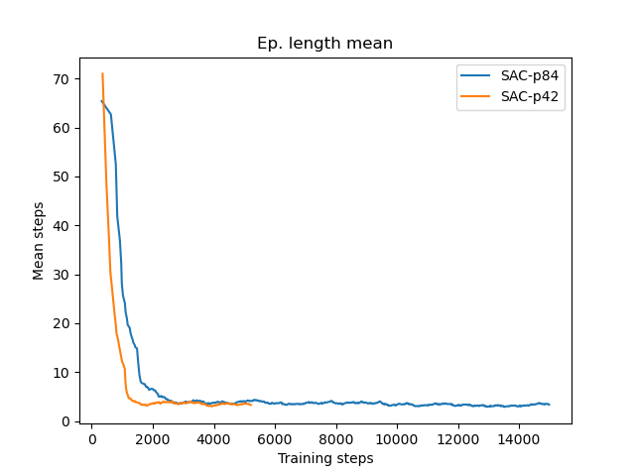
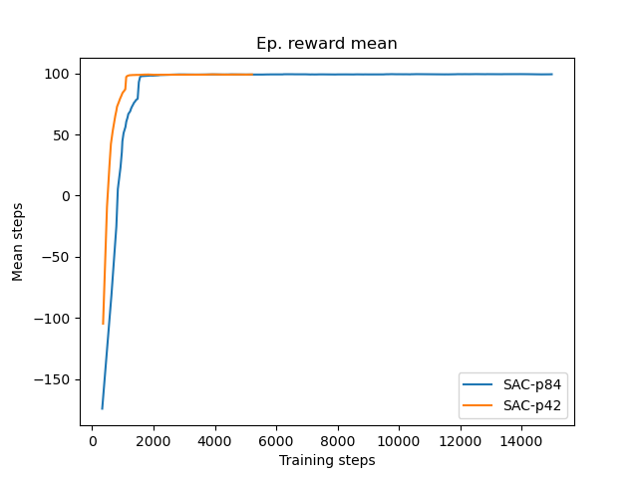
Extra: Quadruple splitting: Training and simulation results
Both new models perform well in simulation
SAC-p42 converged to good policy in ~1.5k steps (3k before best model)
Optimising splitting in ~ 3.2 steps
SAC-p84 converged to good policy in ~2k steps (6.5k before best model)
Converging splitting in ~ 3.01 steps
Two positives about new setup:
Training fast enough to potentially train directly in the PS during MDs.
No intrinsic need for full tomoscope acquisition (if the two profiles can be collected in some other way).

Slide 35
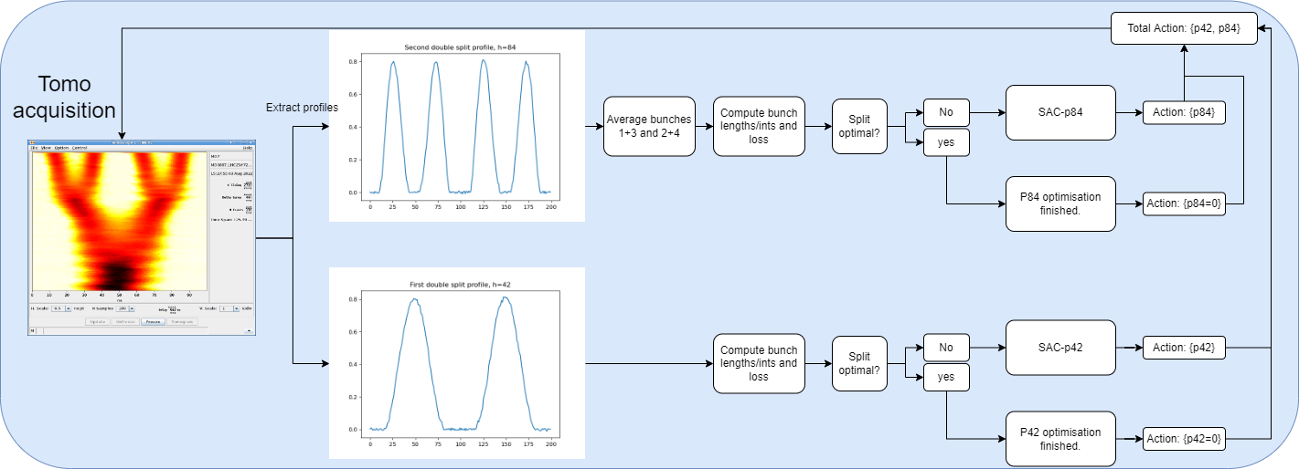
Extra: MD setup: Quadsplit, SAC-p42/p84
Figure: Flowchart of MD setup. Optimisations of p42 and p84 run in parallel. Optimisation finished when both splittings are optimal (at the same time)

Slide 36
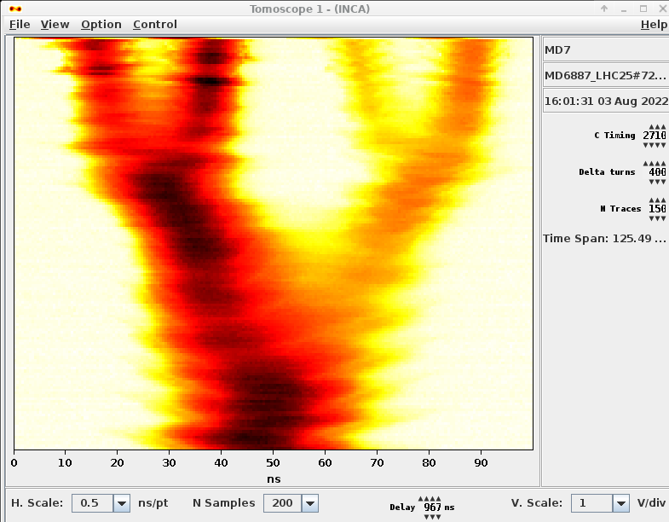
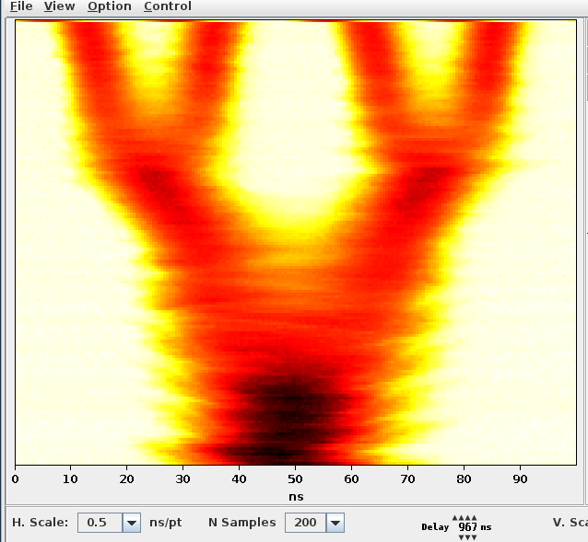
Extra: MD Result: SAC-p42/p84 (Quadsplit)
Example episode
Approx. initial offset: p42 = -30, p84 = 20
Init
Final
Phase 42 opt. steps: 6
Phase 84 opt. steps: 8
Total supercycles required: 8

Slide 37
Extra: MD Result: Quadsplit, SAC-p42/p84
Phase path: actions taken
Example episode:
Despite a very large initial error, optimised in < 10 steps.
No need for feature extractor
→ No need for tomoscope!
Loss p84
NOTE:
First step no action taken.
Final parameters after phase opt. : tomo/profile/relative bunch lengths/intensities

Slide 38
Extra: MD Result: SAC-p42/p84 (Quadsplit)
11 Full episodes collected
All using LHC25ns 72b beam at 1.3e11
9 episodes reached criterion, 2 failed
During the two failures the agents did not manage to reach the preset loss criterion. However, in both cases the splitting looked close to perfect on amp. spread → Criterion may be set too low, not the agents!
Mean steps required for optimisation:
SAC-p42: 4.0 steps.
SAC-p84: 4.64 steps.
Number of supercycles required (for both phases to be optimised):
Mean: 5.27
Min: 2
Max: 9
Note: Steps required influenced heavily by initial state and restrictions on actions by agents.
Maximum step size for the agents is 20 degrees.

Slide 39
Extra: MD Result: SAC-p42/p84 (Quadsplit)
Episode | Loss criterion | Init settings, [p42, p84] | p42 opt. | p84 opt. | Success
1 | 0.0008 | -10, 10 | 3 | 4 | Yes!
2 | 0.0008 | 10, -10 | 2 | 2 | Yes!
3 | 0.0005 | 15, -15 | 1 | 2 | Yes!
4 | 0.0005 | -15, 15 | 3 | 3 | Yes!
5 | 0.0005 | -10, -10 | 4 | 3 | Yes!
6 | 0.0005 | -10, -10 | (3) n/a | (2) n/a | No.
7 | 0.0005 | 20, -5 | (2) n/a | (4) n/a | No.
8 | 0.0005 | -12.5, 30 | 6 | 9 | Yes!
9 | 0.0005 | -30, 20 | 5 | 8 | Yes!
10 | 42: 0.0006 84: 0.0008 | 5, -5 | 3 | 5 | Yes!
11 | 42: 0.0006 84: 0.0008 | -5, 5 | 5 | 9 | Yes!
Reached criterions after (_) steps, but forced to continue until 5 steps. Then, did not reach criterion within 10 steps. Splitting looked good.
Figure: Start and end criterion for episodes 1-11. P42 and P84 losses shown separately.

Slide 40
Extra: Conclusion: Quad splitting agents
Init {15,-15}. Optimised in 2(!!) steps.
Good performance so far
Investigate criterion value for optimal splitting
Test consistency across beams/intensities
Averaging ~5.27 steps per optimisation (of both phases, depending on initial conditions).
Future work
Test using feature extractor
Benchmark against mathematical optimisation
Setup constructed simple enough for easy implementation in GeOFF.
Is RL overkill in this case?
Offline RL?
Collection of labeled data
Hyperparameter tuning of RL agents.

Slide 41
Feature extractor performance on real trisplit data
Problem: CNN fails to generalise and is not accurate on real data.
Error is however most often only ~3 degrees, which means it can improve on large phase errors.
However, finetuning of phase becomes difficult. The agent is pre-trained with an almost perfect CNN, and trusts it too much.
Compare with simulation accuracy <1 degree.

Slide 42
Extra: Feature extractors, gathering data
No dataset of real labeled acquisitions with available
→ One had to be simulated. Cern developed code BLonD was used.
When creating this simulated data, much care was taken to resemble live acquisitions to reduce the sim/real domain gap:
Adapting the resolution (ns/pt), number of traces, and timings to match those of the normal Tomoscope references for the quadsplit/trisplit.
Updated voltage programs of simulation by acquiring the latest ones from the LSA settings (quadsplit) or acquiring a reference of the design voltage (trisplit).
Added several data augmentation steps during training to:
Normalise the data: the absolute values of the simulation and the detectors don’t line up, so the data is normalised before being used as input.
Add noise to the data. This is done by approximating the noise of the machine by adding some Gaussian noise to the simulated data.
Moving the initial injection center of the bunch +- a few ns. This is done as sometimes the beam jitters slightly compared to the tomoscope position, and we want the feature extractor to be agnostic to this.

Slide 43
Extra: Feature extractors, the datasets
The Quad dataset:
Scan of absolute phase errors in range
𝜙_{h=42}, 𝜙_{h=84} = [-30,30].
A total of 14641 samples in dataset.
The Tri dataset:
Scan of absolute phase errors in range
𝜙_{h=14}, 𝜙_{h=21}, = [-20,20], and voltage factors for h=14 in range v_{h=14} = [0.95, 1.05].
A total of 59541 samples in dataset.
Each sample stores the entire datamatrix of traces along with the label of the offset used to simulate it.
A 9:1 training/validation split was used.
Note: These same datasets are used for training of RL agents later, but then only extracted features such as end bunch-by-bunch length/intensities are given to the agents.
Datamatrix (150x200)
Datamatrix (150x400)
Label = [0, 0]
Label = [0, 0, 1.0]
Train
Val

