Slide 1
Machine Learning for Improved SRF
Operation at CEBAF
Chris Tennant | Jefferson Lab

Slide 2
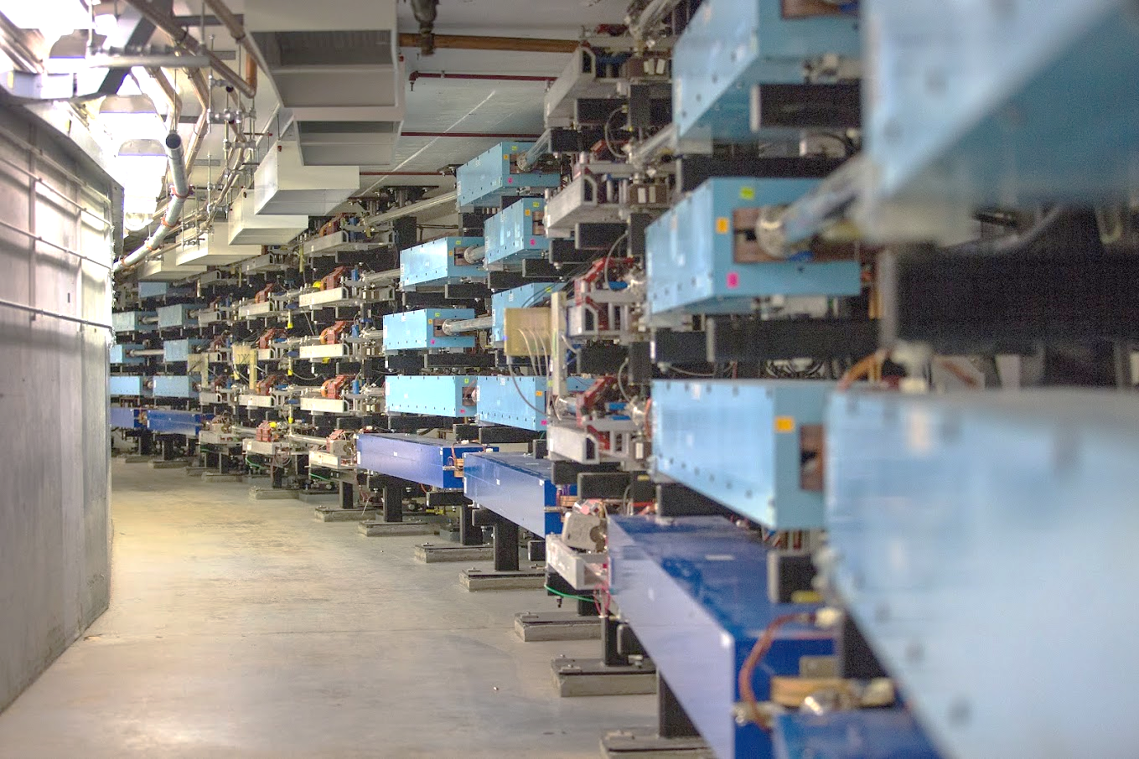
Outline
Introduction and Motivation
C100 Cavity Fault Classification
C100 Cavity Fault Prediction
Other
Field Emission Management
Legacy Cavity Instability Detection
Data Sources
Summary

Slide 3
Acknowledgements
A. Carpenter, R. Suleiman, D. Turner, L. Vidyaratne*
Jefferson Laboratory
K. Ahammed, H. Ferguson, Md. M. Rahman, K. Iftekharuddin, J. Li
Old Dominion University
*now at Hitachi USA

Slide 4
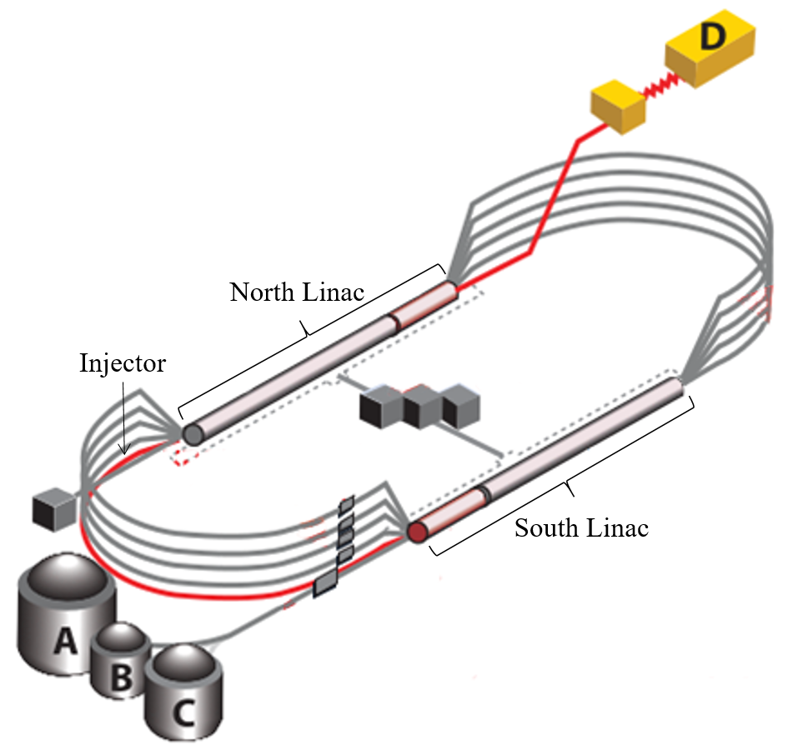
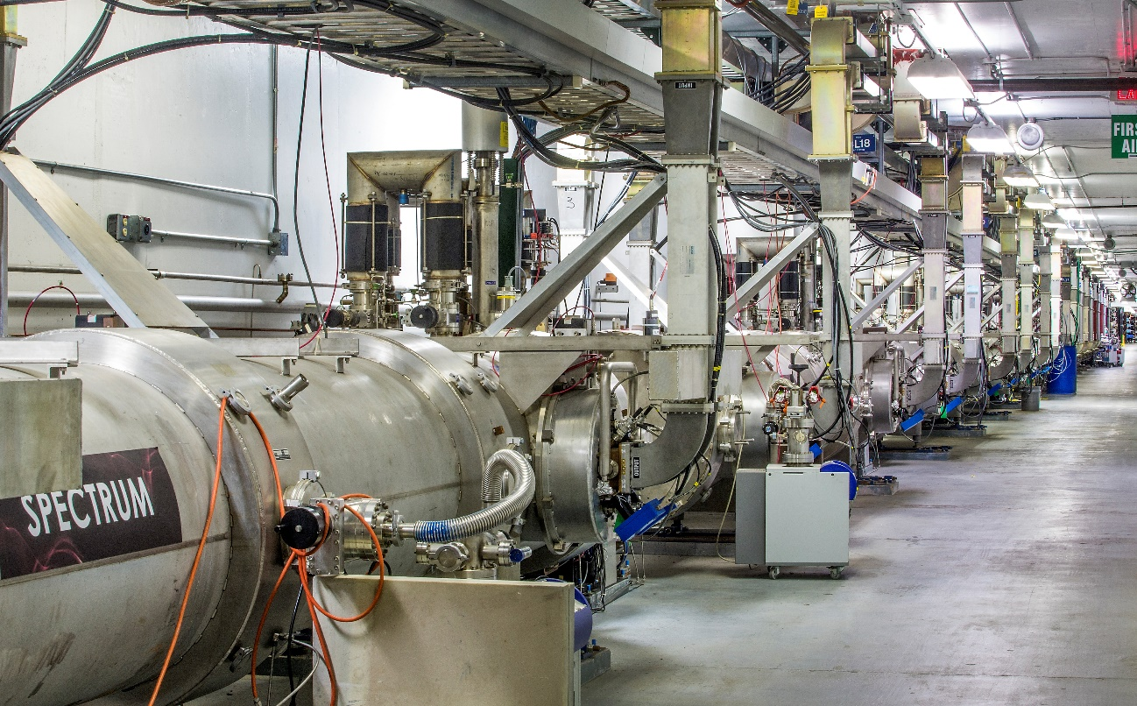
Continuous Electron Beam Accelerator Facility
CEBAF is a CW recirculating linac utilizing 418 SRF cavities to accelerate electrons up to 12 GeV through 5-passes
it is a nuclear physics user-facility capable of servicing 4 experimental halls simultaneously
the heart of the machine is the SRF cavities

Slide 5
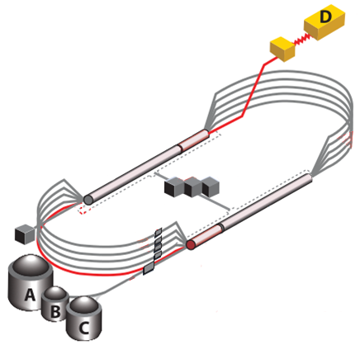
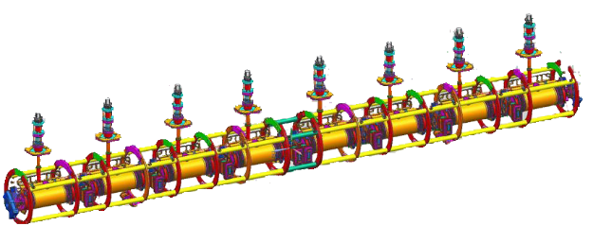
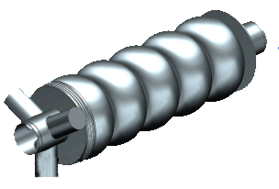
Fault Classification: Defining the Problem
we have the ability to record high-fidelity data from 12 cryomodules
Question #1
Which of the 8 cavities faulted first?
Question #2
What kind of trip was it?
1 cryomodule = collection of 8 cavities
17 signals/cavity × 8 cavities = 136 signals
17 signals
5
1
5
train a model to correctly classify the cavity and type of RF fault given waveform data

Slide 6
Motivation for Machine Learning
laborious for subject matter expert to hand label thousands of events
Post-Run Analysis
use aggregate statistics for data-driven guidance for maintenance and/or upgrade activities
analysis of fall 2018 data indicated three cryomodules in the South Linac were prone to microphonic-based faults → provided justification to perform microphonics hardening (installing tuner dampers) → reduced microphonics-based trip rates → gradients could be increased in those cryomodules
Post-Fault Analysis
provides critical feedback to control room operators
fault types get mapped to actions for the operators
“if Trip A happens X times within Y minutes, drop gradient in the cavity by Z MV/m”

Slide 7
Data: Waveform Harvester
waveform harvester was developed to capture RF time-series signals after a fault and write them to file for later analysis
each of the 17 harvested waveform signals is 8,192 points long
trigger set such that 94% of the recorded data precedes the fault and 6% after
pre-fault data provides valuable information about the root cause of the trip
fault event
streaming data
…
…
8,192 samples × 0.2 ms/sample = 1.64 seconds

Slide 8
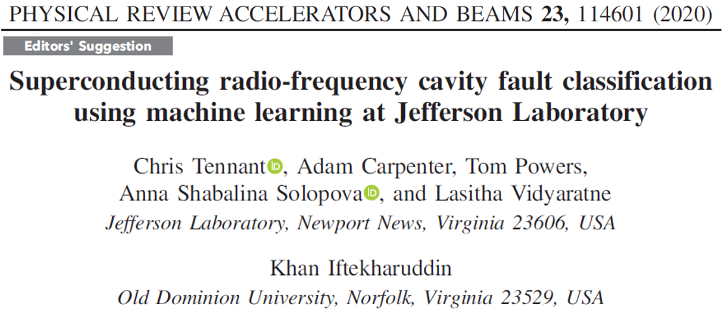
ML Model Performance
models were applied to data collected from March 10-24, 2020
physics run was prematurely ended due to COVID-19
312 fault events were analyzed by the models
summary of model performances compared to labeled data
cavity model accuracy: 84.9%
testing accuracy: 87.9%
fault model accuracy: 78.2%
testing accuracy: 87.7%
 | Agree | Disagree | Total
Cavity Model | 265 | 47 | 312
Fault Model | 244 | 68 | 312

Slide 9
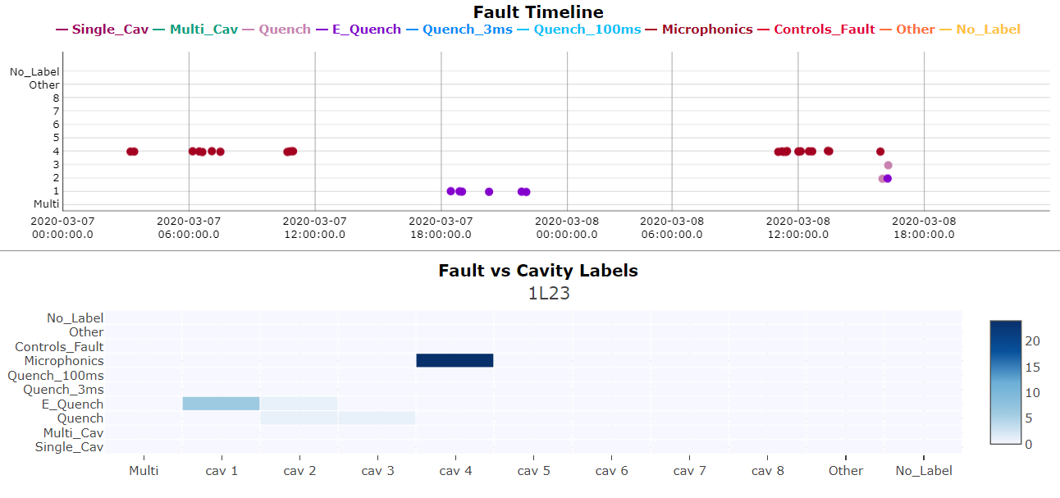
Visualization and Communication
for ML models to be effective, information must be communicated clearly and concisely
visualize spatial and temporal nature of model predictions
operator’s attention

Slide 10
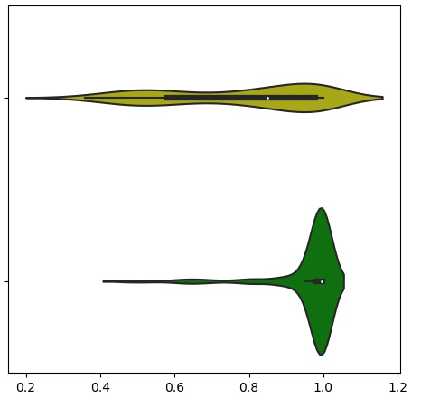
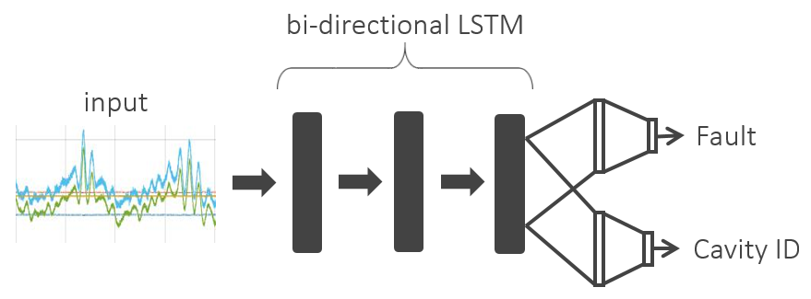
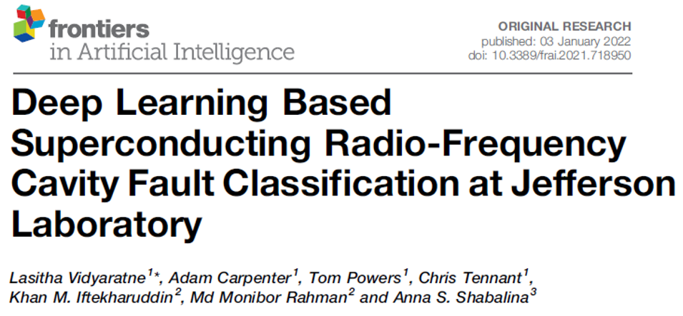
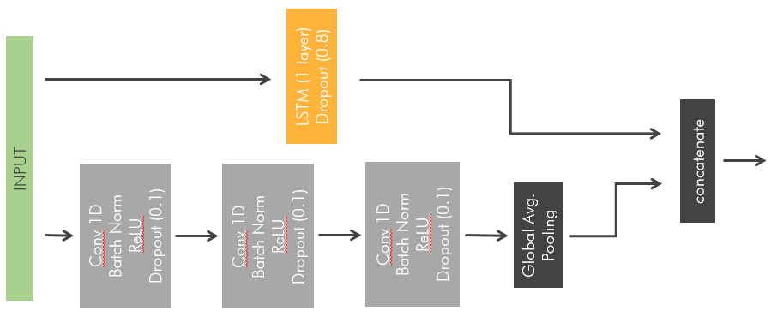
Machine Learning → Deep Learning
benefits
avoid feature extraction
computationally faster (needful for fault prediction)
allow for uncertainty quantification
architectures explored
recurrent NN
CNN
LSTM + CNN
incorrect
correct

Slide 11
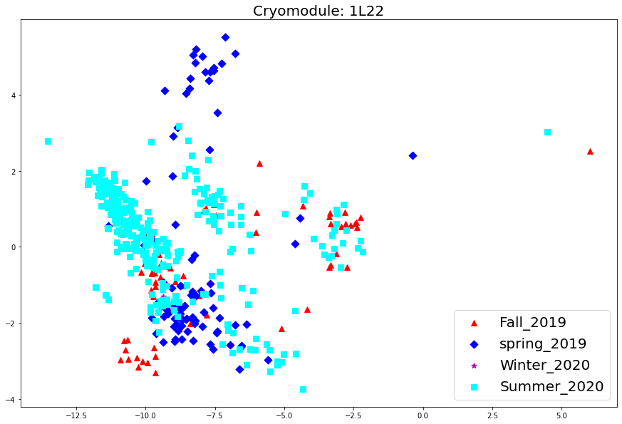
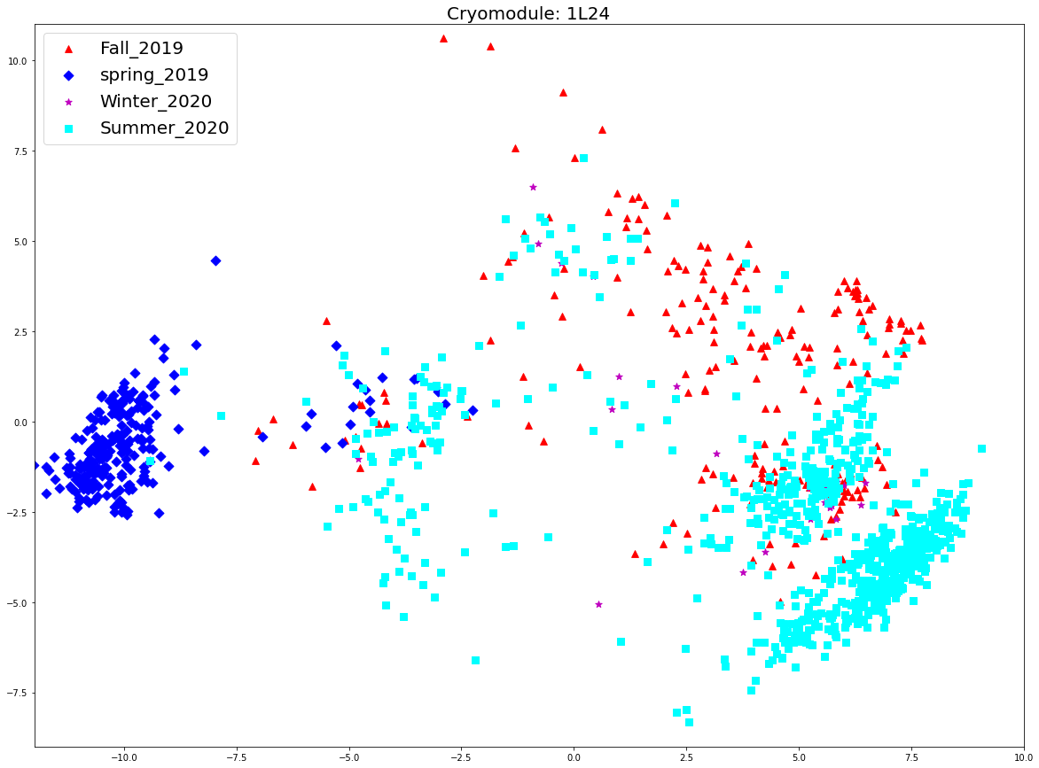
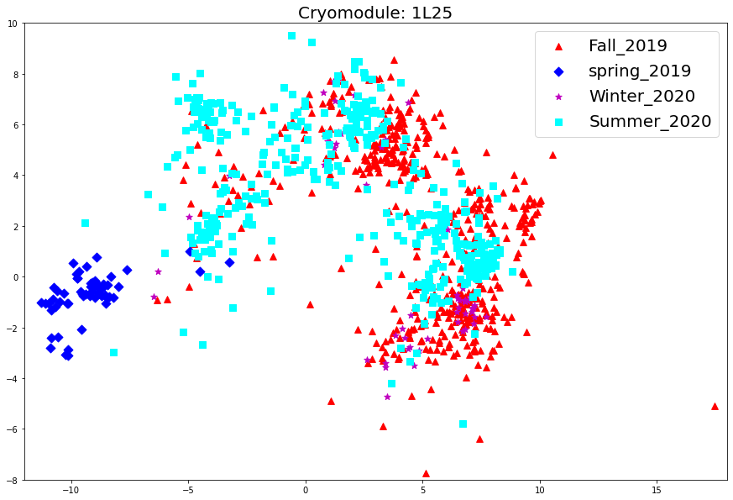
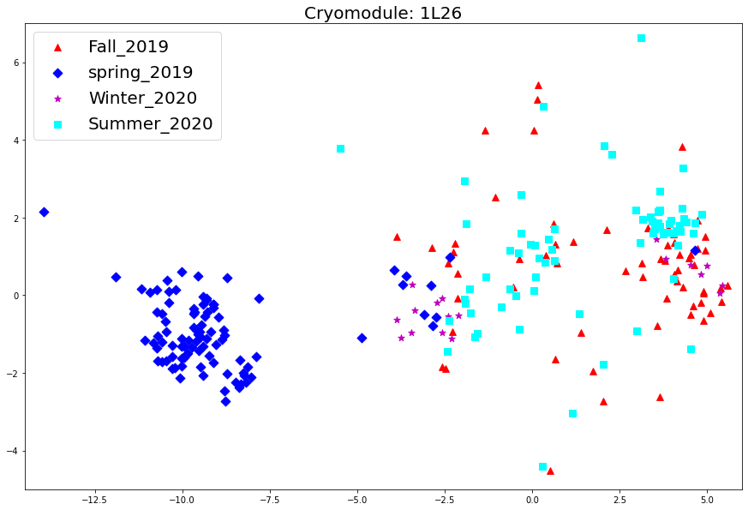
Dimensionality Reduction: Visualize Runs
cryomodule 1L22
cryomodule 1L24
cryomodule 1L26
cryomodule 1L25

Slide 12
Maintaining Model Performance
most critical challenge is to maintain model performance from one operational run to the next (work in progress)
Feature Extraction
Remove the output layer and use the entire network as a fixed feature extractor for the new dataset
Fine-Tune a Pre-Trained Model
Fine-tune the weights of the pre-trained network (all layers)
Train Some Layers While Freezing Others
Freeze weights of earlier layers and fine-tune the weights of later layers
train the model from scratch
fine-tune the pre-trained model
size of dataset
fine-tune lower layers of the pre-trained model
fine-tune the output dense layer of the pre-trained model
data similarity
https://tinyurl.com/yck4kzuk

Slide 13
Fault Classification → Fault Prediction
small portion of waveforms around fault event are used for training classifiers
uses static datasets
modifications to LLRF system will allow us to continuously stream data
investigate if data prior to fault contains enough information to predict event
offline training
partial
storage
LLRF
Model A
Model B
prediction
discard
C100 cryomodule
Model A: fault prediction (discriminate between “stable” and “impending”)
Model B: fault-type prediction (classify fault)

Slide 14
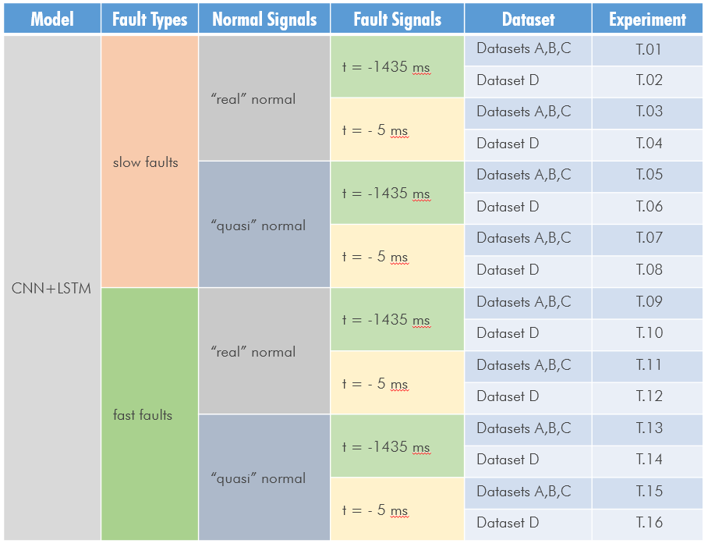
Model A: Binary Classifier
slow vs fast fault types
“real” vs “quasi”-normal
fault signal window
dataset date

Slide 15
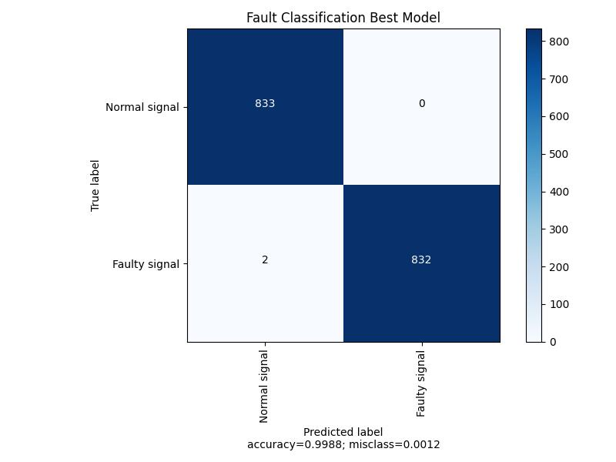
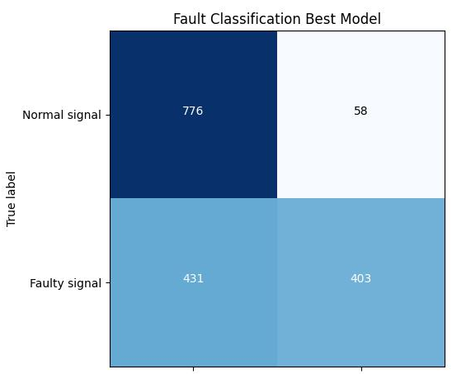
Model A: Binary Classifier
normal
Normal
Normal
faulty
quasi-normal
faulty
Faulty
Faulty
100 ms
-1435 ms
100 ms
-5 ms
-5 ms

Slide 16
Model B: Fault Classifier
can data prior to event accurately predict the fault type?
use saved waveforms
t = -1400 ms
t = -1200 ms
t = -1000 ms
t = -800 ms
t = -600 ms
t = -400 ms
t = -200 ms

Slide 17
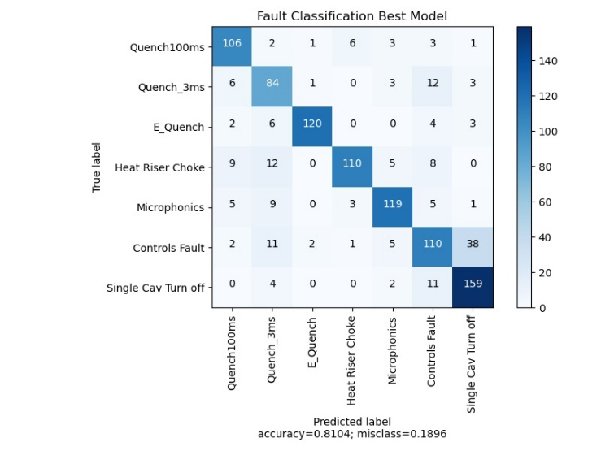
Model B: Fault Classifier
0 ms prior to fault

Slide 18
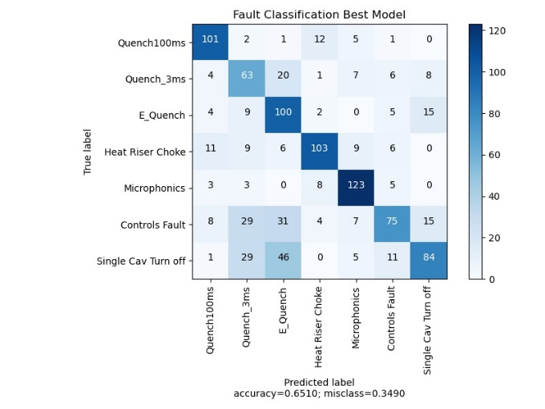
Model B: Fault Classifier
20 ms prior to fault

Slide 19
Model B: Fault Classifier
50 ms prior to fault

Slide 20
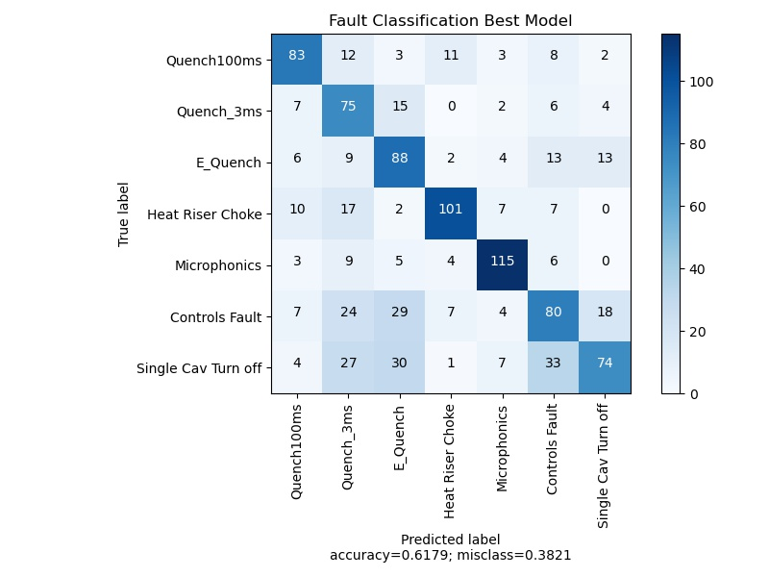
Model B: Fault Classifier
100 ms prior to fault

Slide 21
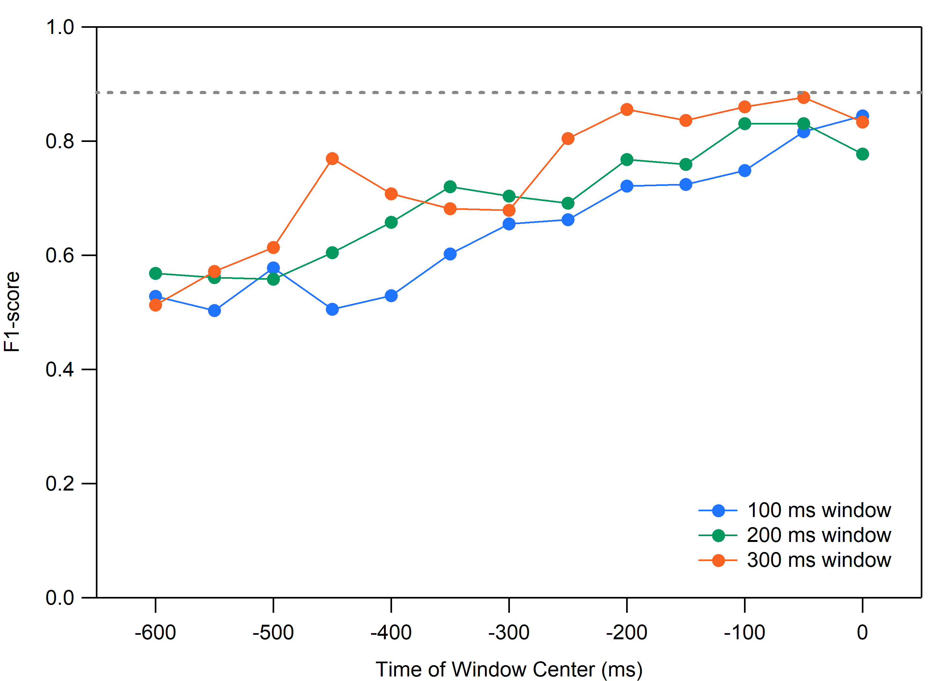
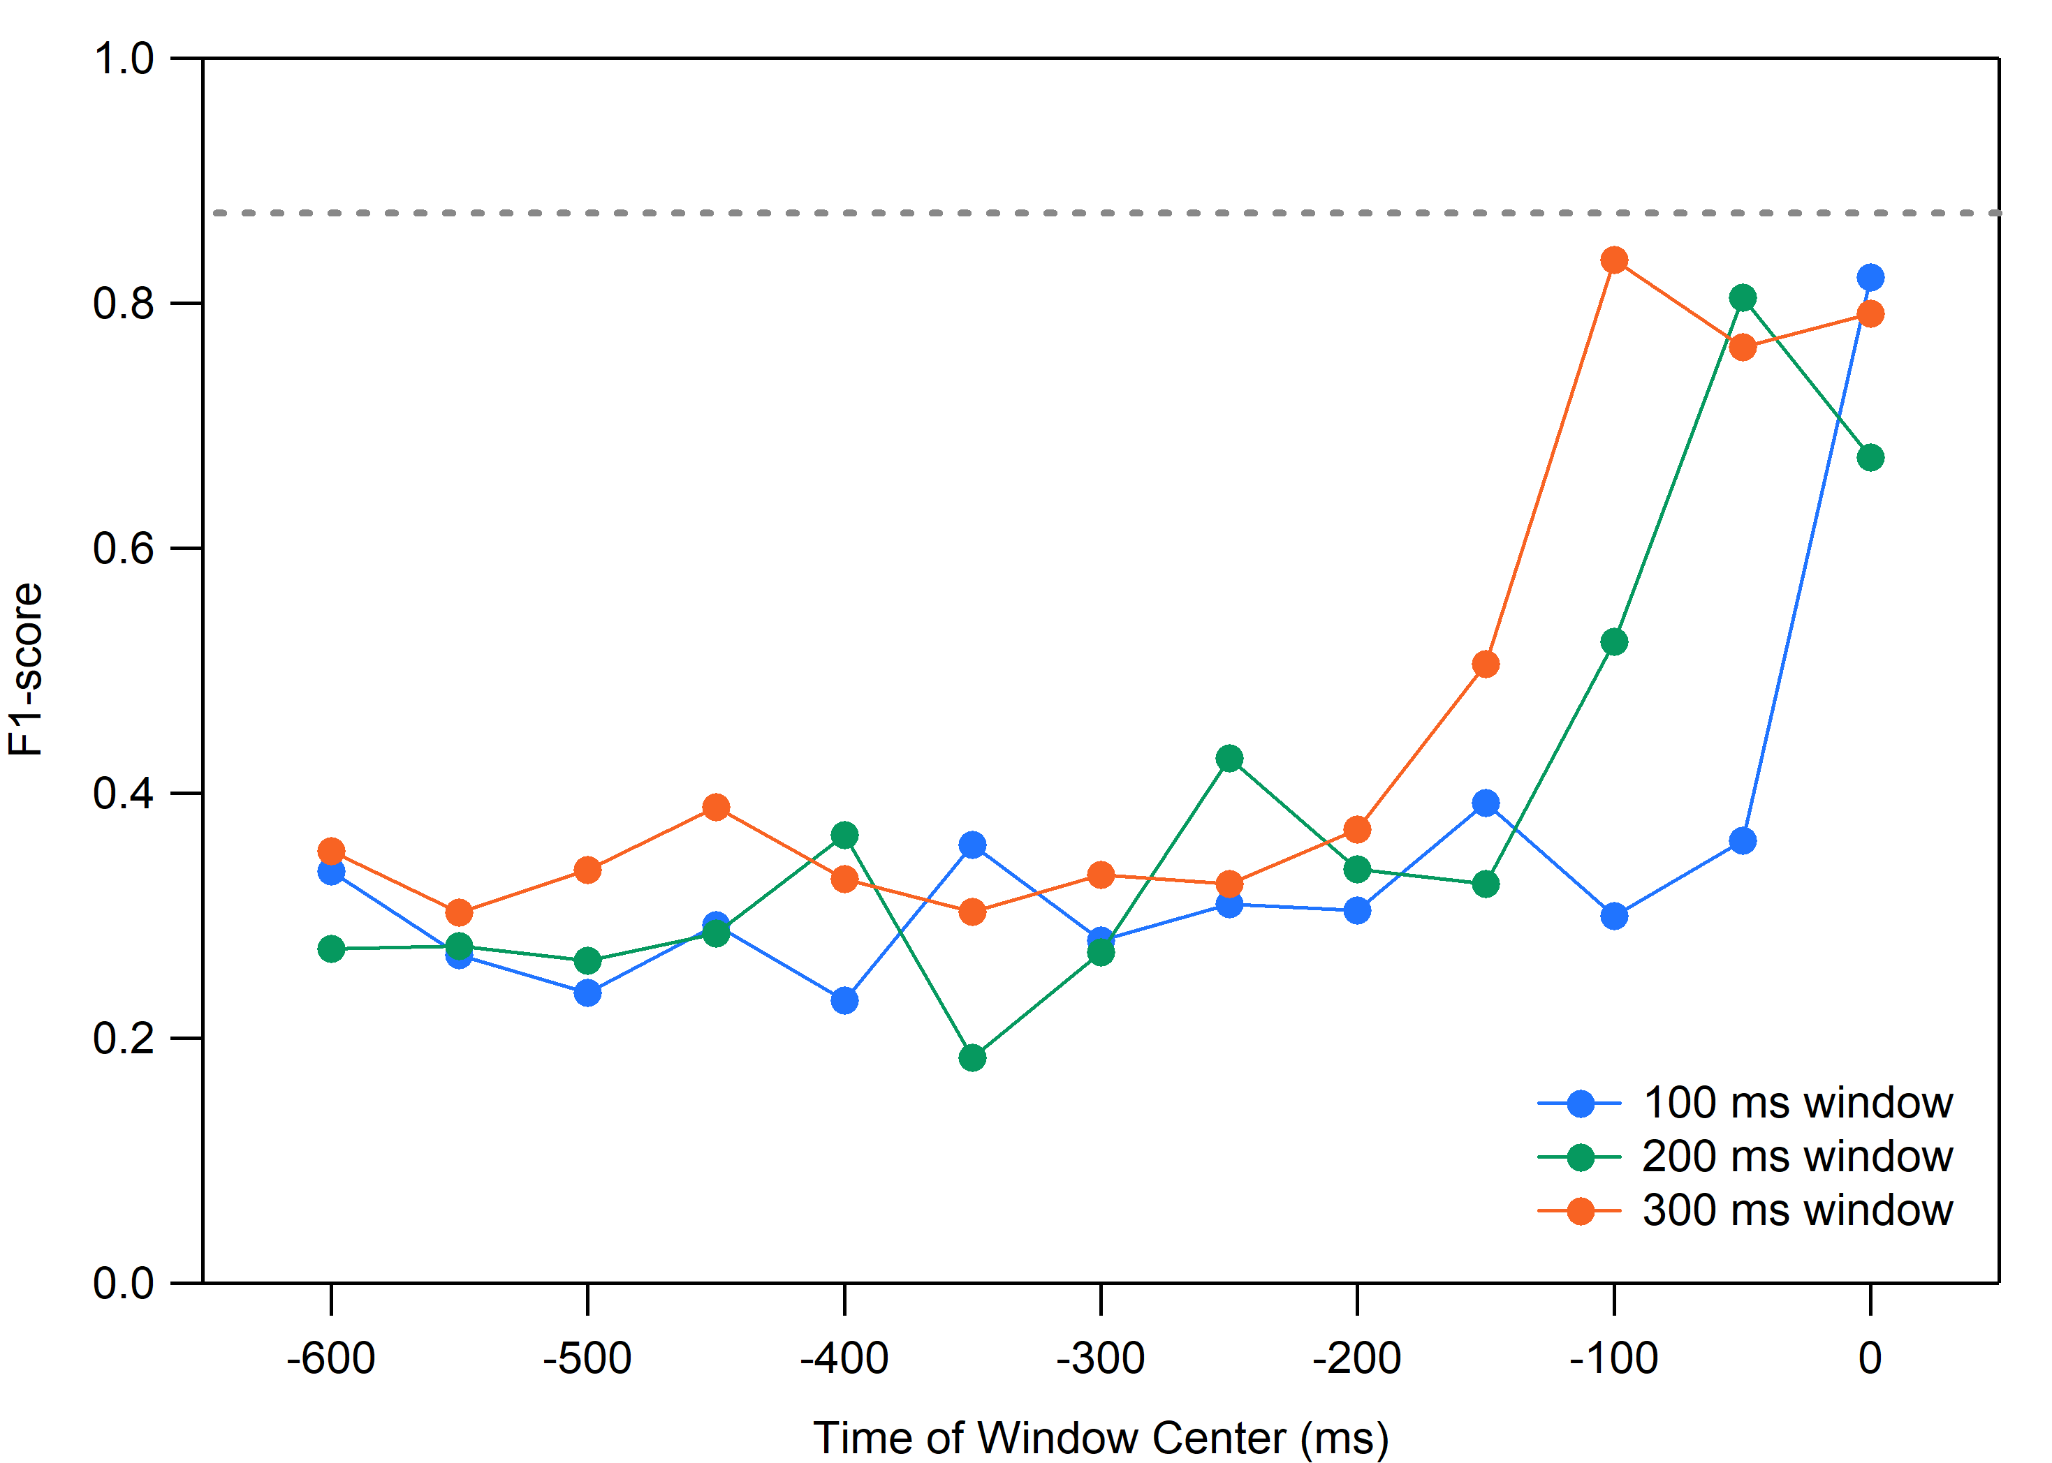
Model B: Fault Classifier
initial results suggests that for some fault types, prediction is possible
Microphonics
Electronic Quench

Slide 22
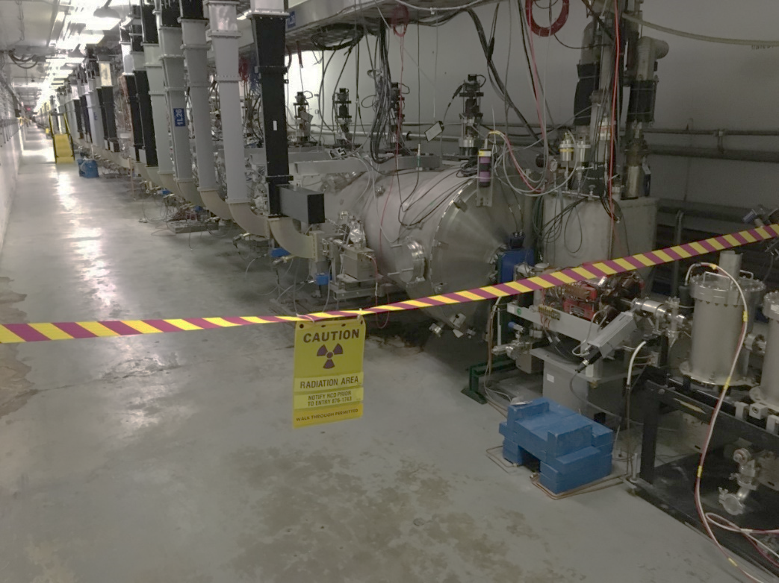
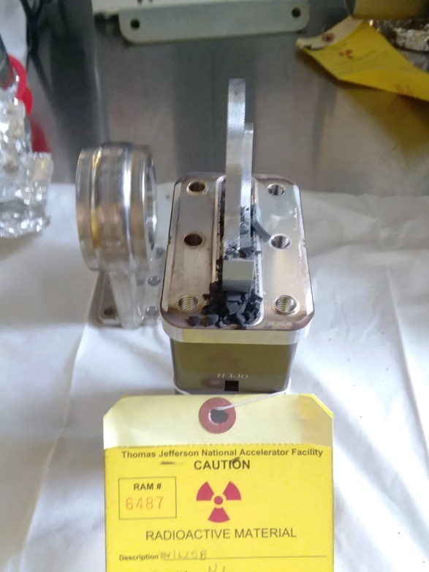
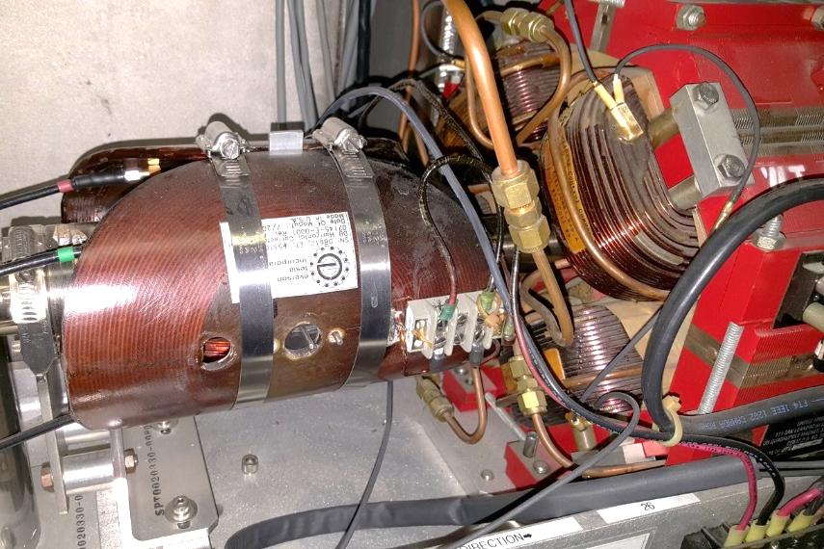
Field Emission Management
Goal: maintain low levels of FE radiation without invasive interruptions to physics
Description: use ML to model radiation levels and allow for off-line optimization of gradient distribution, identify cavities where FE onsets have changed
Solution: optimize surrogate model to minimize radiation via gradient reduction
radiation area
damaged beamline valve
damaged magnet and cables

Slide 23
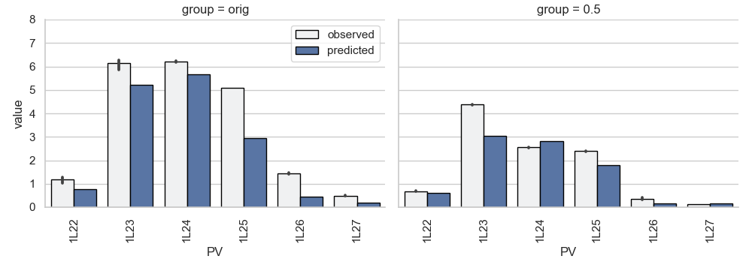
Field Emission Management: Proof-of-Concept Demonstration
set CEBAF to same gradient distribution as September 7 baseline
apply model-based optimized gradients to CEBAF
12 rem/hour decrease for 5 MV/m reduction in gradient
before optimization
after optimization
(courtesy A. Carpenter)

Slide 24
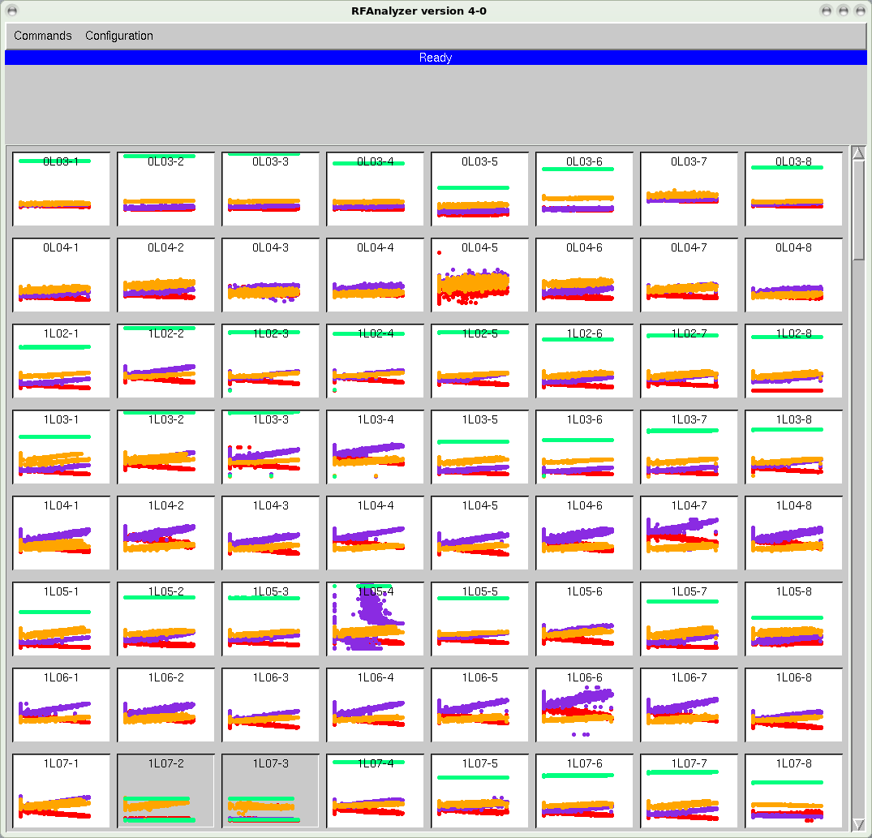
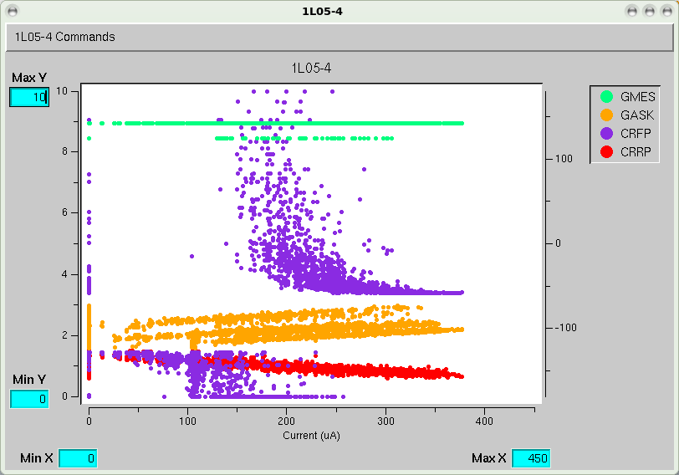
Cavity Instability Detection
Goal: improve beam availability by automating process of identifying unstable RF cavities
Description: SRF cavities can become unstable without presenting faults, identifying these unstable cavities with present diagnostics is difficult and time-consuming
Solution: (1) develop and install a new fast DAQ system for the legacy SRF cavities, and (2) apply ML to identify unstable cavities
RF Analyzer Tool

Slide 25
Importance of Having the Right Data
accelerators produce a lot of data
CEBAF continuously archives 300,000+ signals
however, it’s not all useful for ML applications
ML projects at JLab only possible because of newly available data
C100 cavity fault classification → digital LLRF + waveform harvester
C100 cavity fault prediction → digital LLRF + streaming data
field emission management → NDX detectors*
cavity instability detection → fast DAQ
data reliability is critical!
*P. Degtiarenko, US Patent 10,281,600

Slide 26
Summary
JLab has several active ML projects addressing SRF operation at CEBAF, which are at various stages of maturity
have – or will have – sources of high quality data to enable continued work in this area for the foreseeable future
for systems in place: maintaining reliability of data is a challenge
for systems in production: challenges with supply chain issues
getting buy-in from all groups involved is still a challenge
proof-of-concept
deployed system
maintained system
cavity instability detection
encouraging results on “slow” data
field emission management
how to update model?
fault prediction
encouraging initial results on saved waveforms
fault classification
how to maintain performance over time?

Slide 27
Thank You.
tennant@jlab.org

Slide 28
Mobile Diagnostic for Accelerator Operations
Goal: develop a remotely controlled, semi-autonomous, mobile diagnostic that can be integrated into accelerator operations
the mobile diagnostic system would provide potential benefit by:
reducing accelerator downtime by enabling remote inspection of beamline components and reducing the need for short, controlled accesses to the accelerator tunnel, and reducing the time required to perform standard radiation surveys
reducing machine tuning-time by acquiring dynamic measurements, e.g. beam loss and radiation measurements, under operational conditions at arbitrary locations along the beamline

