Slide 1
Real-Time Edge AI for Distributed Systems (READS)
Disentangling Beam Losses in the Fermilab Main Injector Enclosure Using Real-time Edge AI
Kyle J. Hazelwood
ICFA ML 2022
November 02, 2022

Slide 2
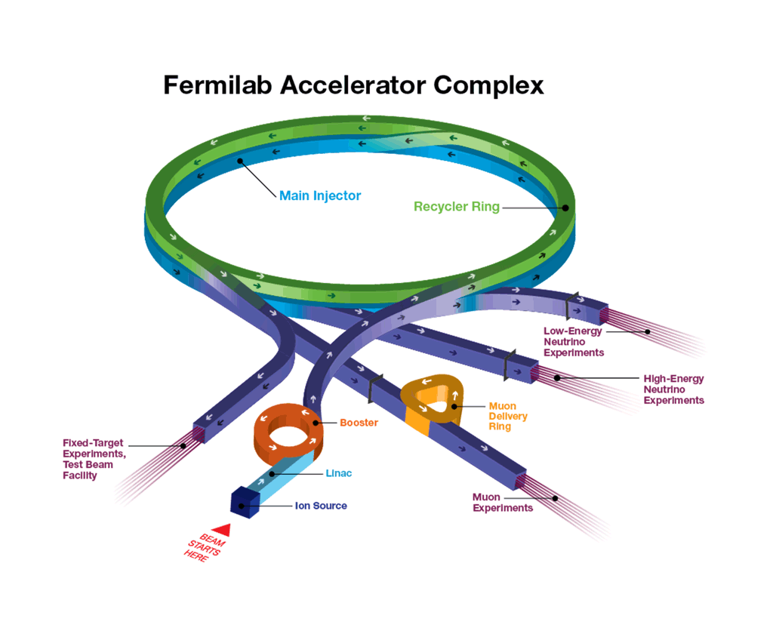
Fermilab Main Injector and Recycler
Main Injector
8-120 GeV (150 GeV) synchrotron proton accelerator
3.3 kM (2.05 mile) machine circumference
Delivers 120 GeV, 1MW beams to NuMI beamline experiments
Delivers 120 GeV resonant extracted beams to Switchyard experiment beamlines
Recycler
8 GeV permanent magnet ring
3.3 kM (2.05 mile) machine circumference
Originally purposed as an antiproton storage ring for TeVatron collider operations
Now used as a proton stacker for high intensity NuMI beams (injecting to Main Injector)
Accumulates and bunches beam for g-2 experiment
Both machines reside in the same tunnel!
11/2/22
Kyle J. Hazelwood | READS: Beam Loss Disentangling for Main Injector and Recycler
Notes:
Talk about Fermilab as a whole
Describe Main Injector
Describe Recycler

Slide 3
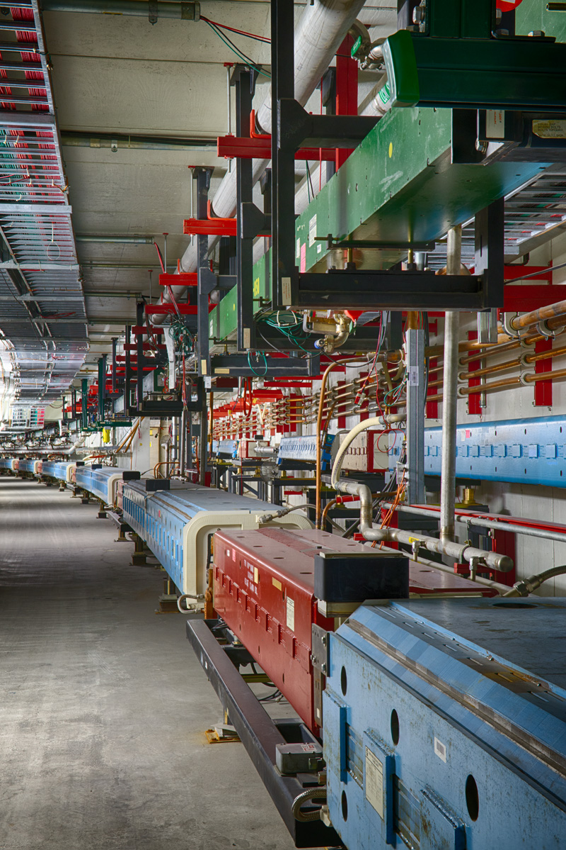
Project Overview
Main Injector and Recycler share an enclosure
Both machines can and do often have high intensity beam in them simultaneous
Both machines can generate significant beam loss
The machine origin of a beam loss is often hard to distinguish
Often losses from one machine end up tripping the machine permit of the other resulting in unnecessary beam downtime
The projects aims to deploy a machine learning model on a FPGA that when fed streamed beam loss readings from around the Main Injector complex, will infer in real-time the machine loss origin
Main Injector tunnel
Recycler (top) Main Injector (bottom)
11/2/22
Kyle J. Hazelwood | READS: Beam Loss Disentangling for Main Injector and Recycler

Slide 4
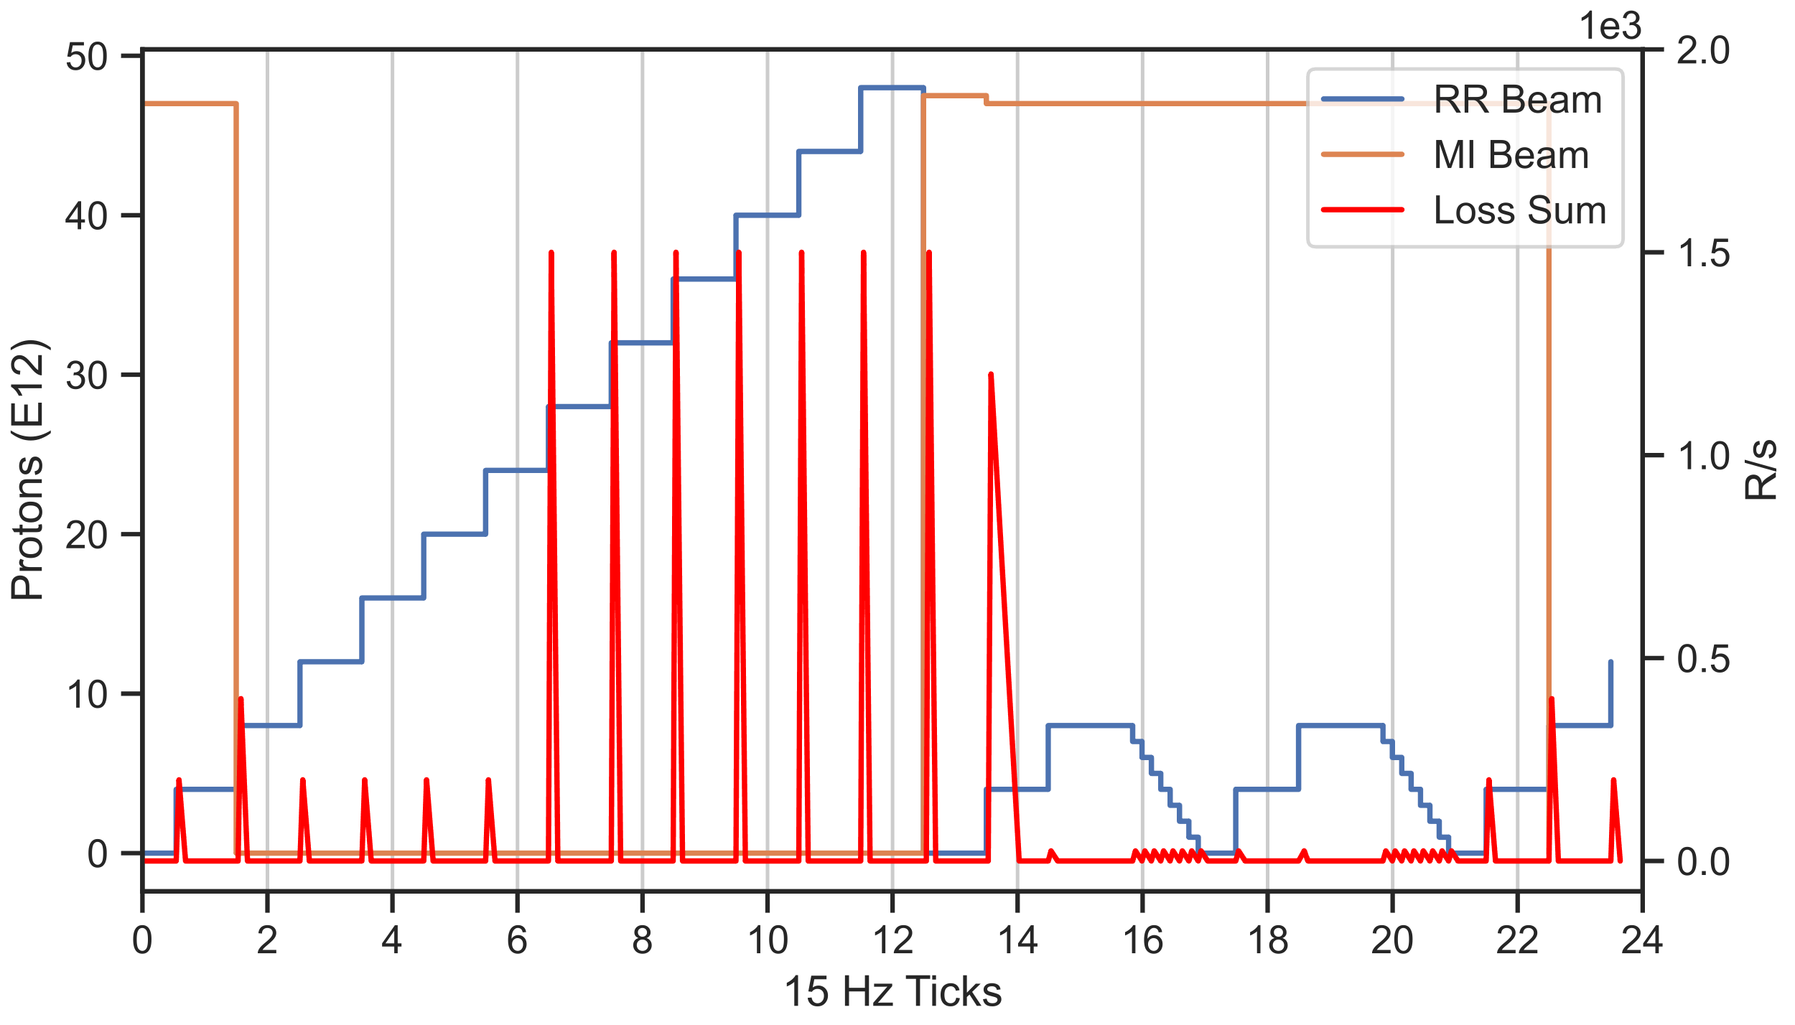
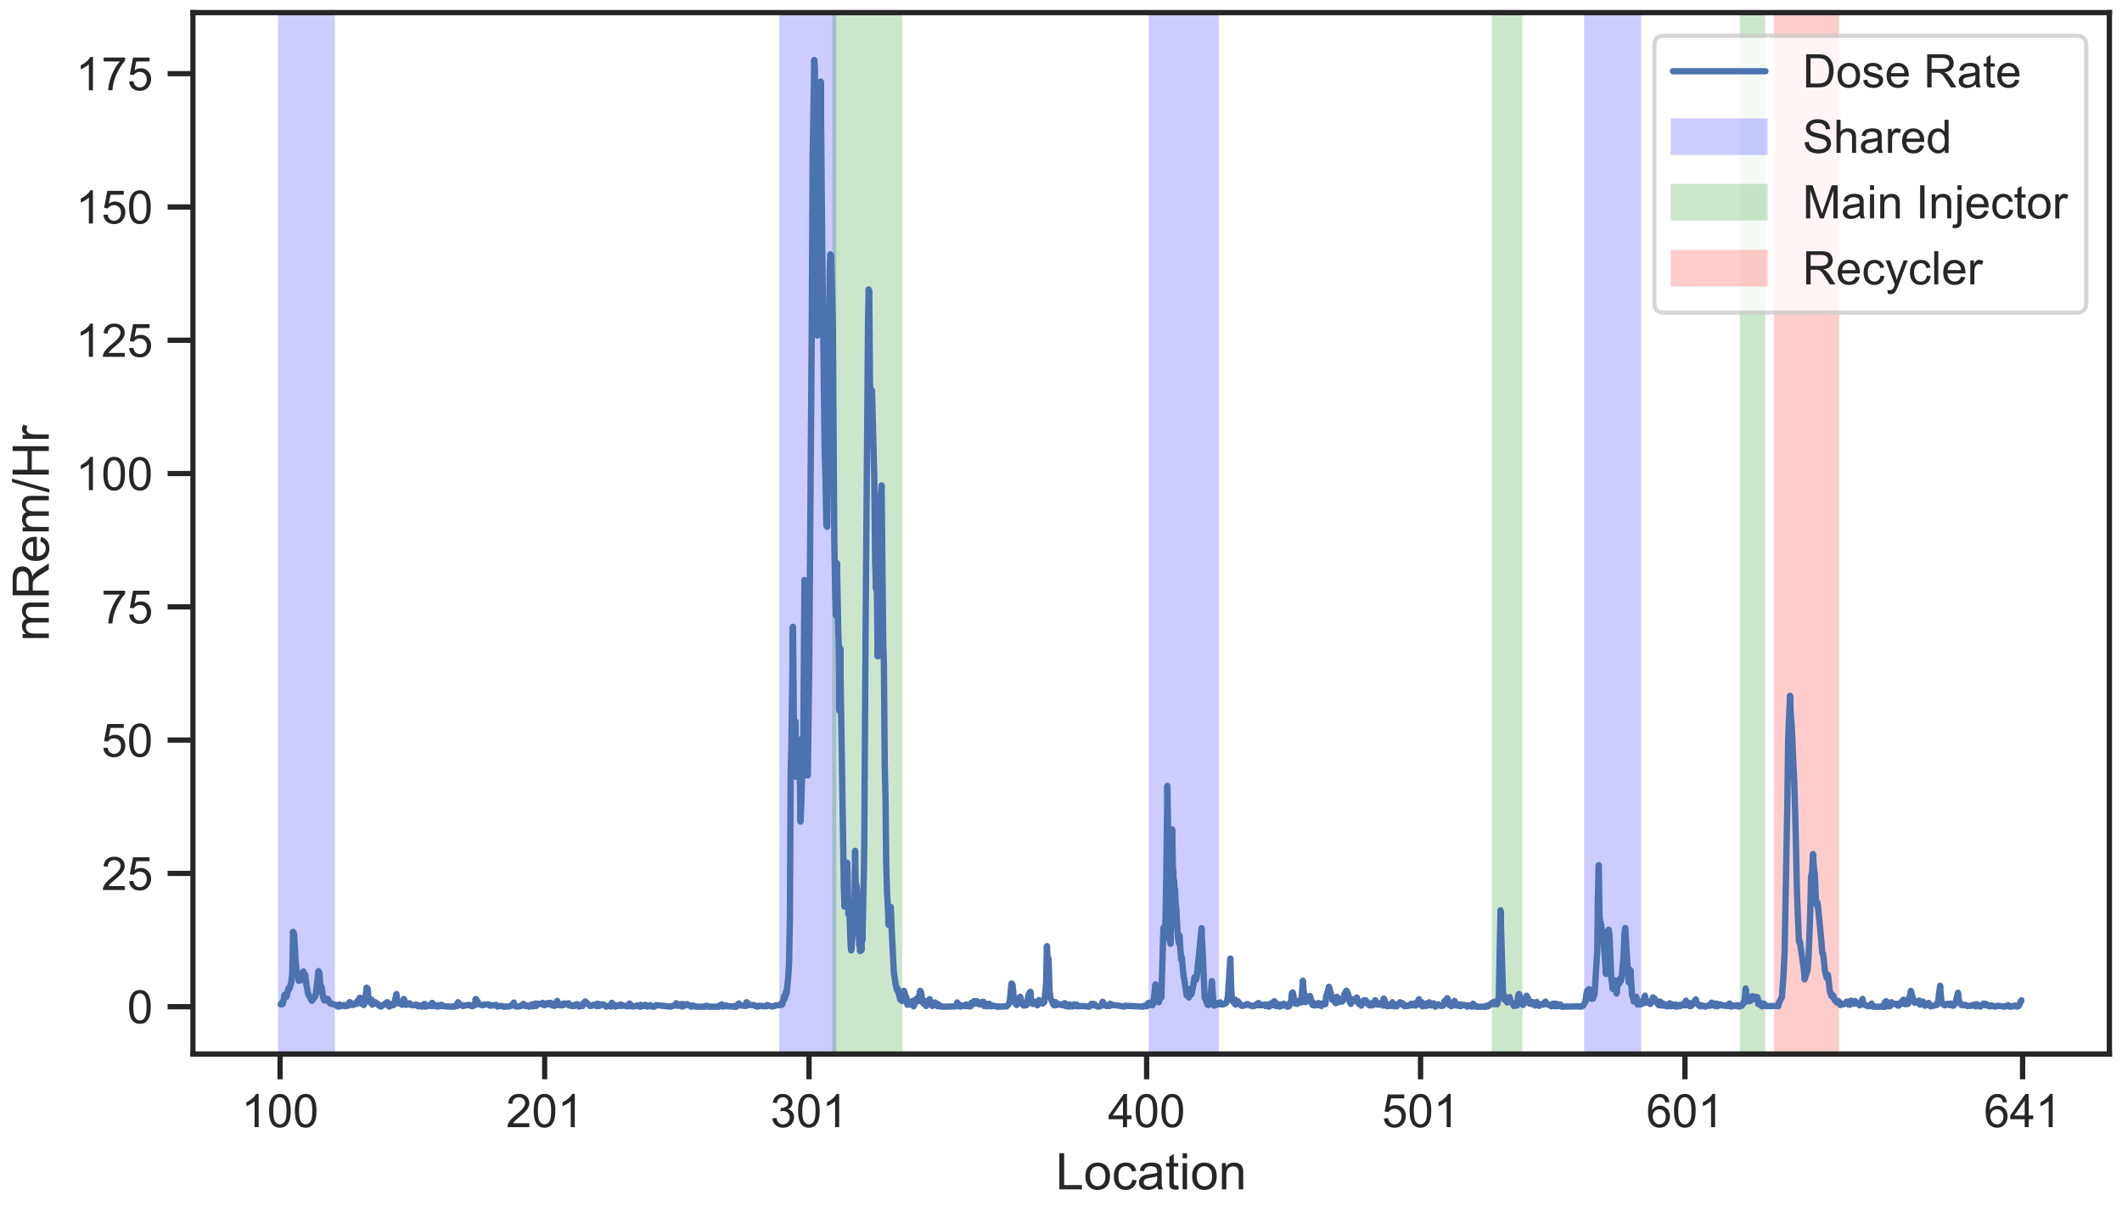
Project Overview
Using time, location and state of the machine, machine experts can sometimes attribute loss to a particular machine
This suggests a Machine Learning (ML) model may be trainable to automatically attribute loss and replicate or improve upon the expert's ability
Example illustration of overlapping beam events and losses in the MI and RR accelerators
Location dependency of MI and RR beam loss as seen from tunnel activation residual doses
11/2/22
Kyle J. Hazelwood | READS: Beam Loss Disentangling for Main Injector and Recycler

Slide 5
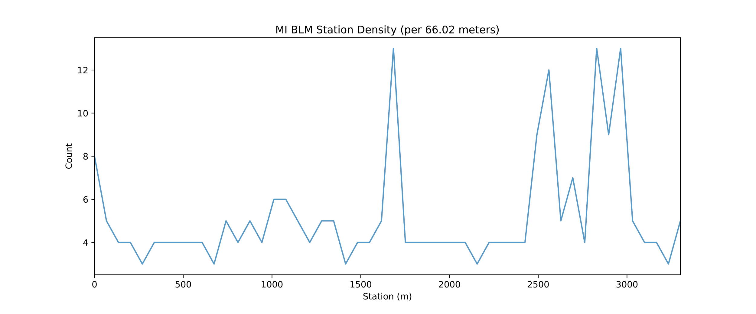
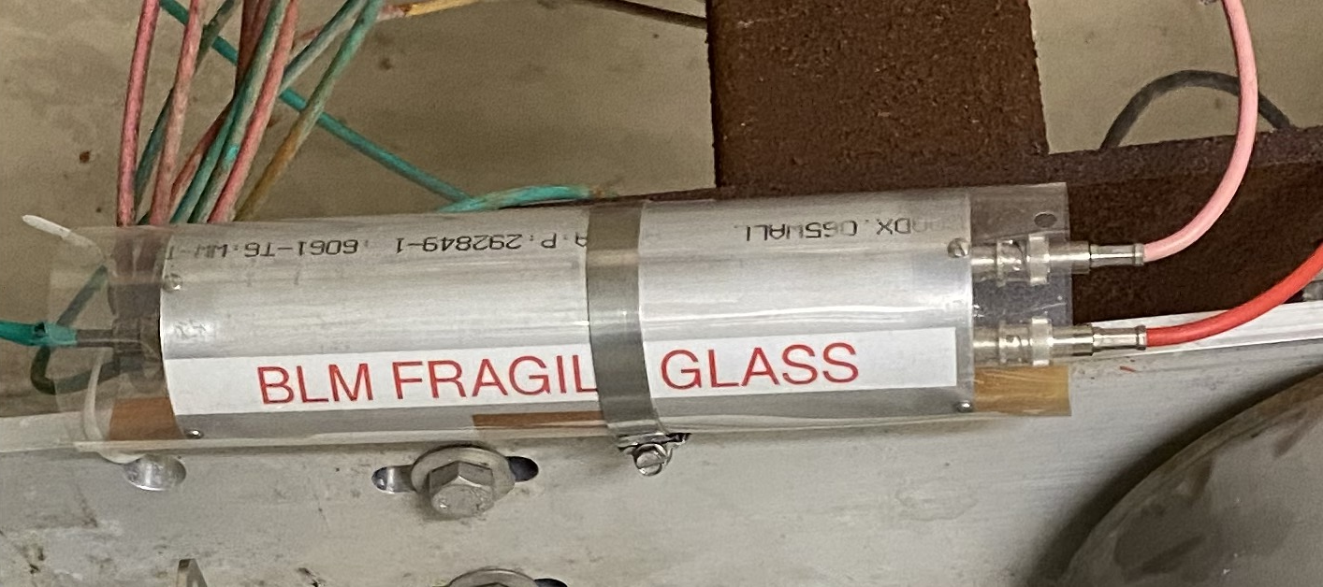
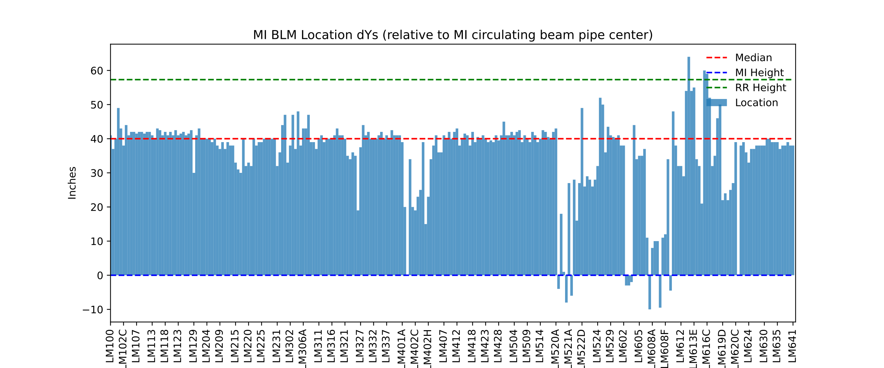
Beam Loss Monitors (BLM)
Glass Ionization Chambers
259+ BLMs, 7 BLM nodes distributed around the MI complex
BLM nodes provide ACNET loss readings
Hardware unable to stream all BLM readings simultaneously at fastest readout frequency
BLM nodes tied into the machine permit
Recorded the location of all BLM in the Main Injector tunnel
Assume BLM locations will have to be controlled once a ML model has been trained, else risk having to re-train
23% of the BLMs exist in ~10% of tunnel
Beam Loss Monitor
11/2/22
Kyle J. Hazelwood | READS: Beam Loss Disentangling for Main Injector and Recycler

Slide 6
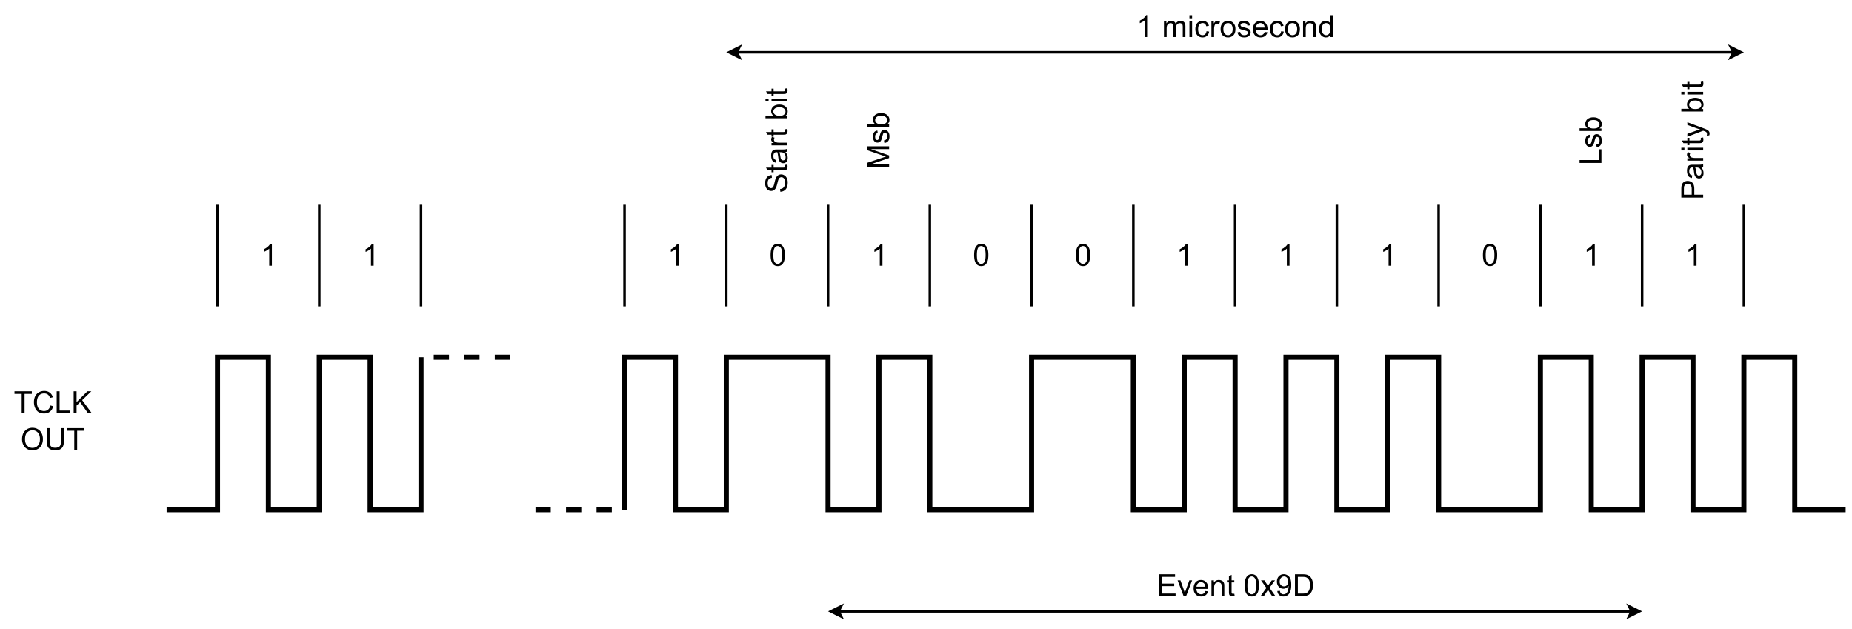
TCLK and MDAT
TCLK (TeVatron Clock)
10 MHz Event Clock
Provides current machine program and status
Originates from Timeline Generator (TLG) hardware
MDAT (Machine Data)
720 Hz
Originates from various hardware around Main Injector Complex
Low Level RF
Beam Current Monitor Front Ends
Main Injector Ramp Regulation Front End (MECAR)
TCLK (10 MHz Clock)
11/2/22
Kyle J. Hazelwood | READS: Beam Loss Disentangling for Main Injector and Recycler

Slide 7
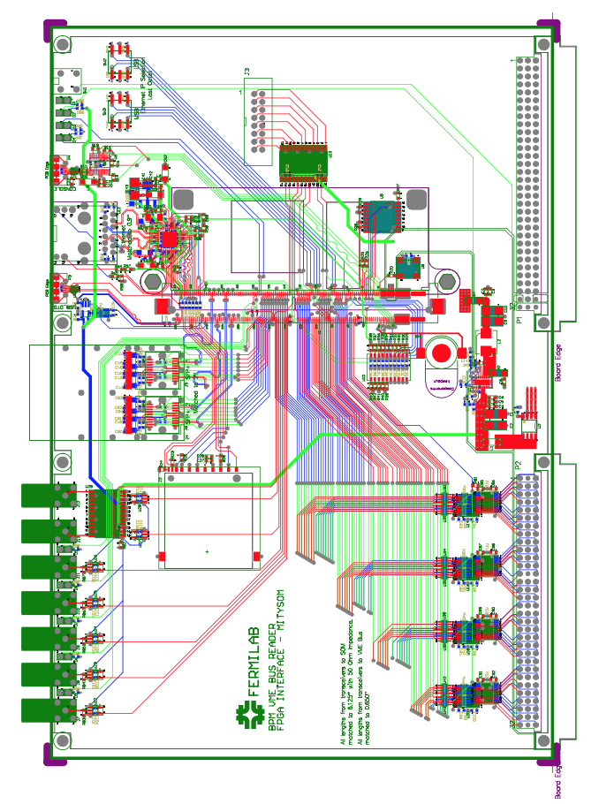
VME Bus Reader (Pirate) Cards
One of the requirements of the project was not to interfere in any way with the normal operation of the existing BLM system
The purpose of the Pirate cards are to monitor BLM digitizer polls and transmit the data over ethernet
Pirate cards are MitySOM Cyclone 5 FPGAs on custom VME carrier boards
Each BLM node has a Pirate card installed in it (7 cards total)
All BLM channels are available to stream simultaneously
Also transmits TCLK and MDAT readings
TCLK and MDAT are monitored to provide microsecond timestamping
Used to synchronize streams across multiple cards
Data is streamed via UDP in DDCP protocol format
Data frequency is 333 Hz (current rate of digitizer polling)
Each card streams 0.4-0.6 Mb/s (dependent on number of BLM channels in crate)
VME Bus Reader (Pirate) card
11/2/22
Kyle J. Hazelwood | READS: Beam Loss Disentangling for Main Injector and Recycler

Slide 8
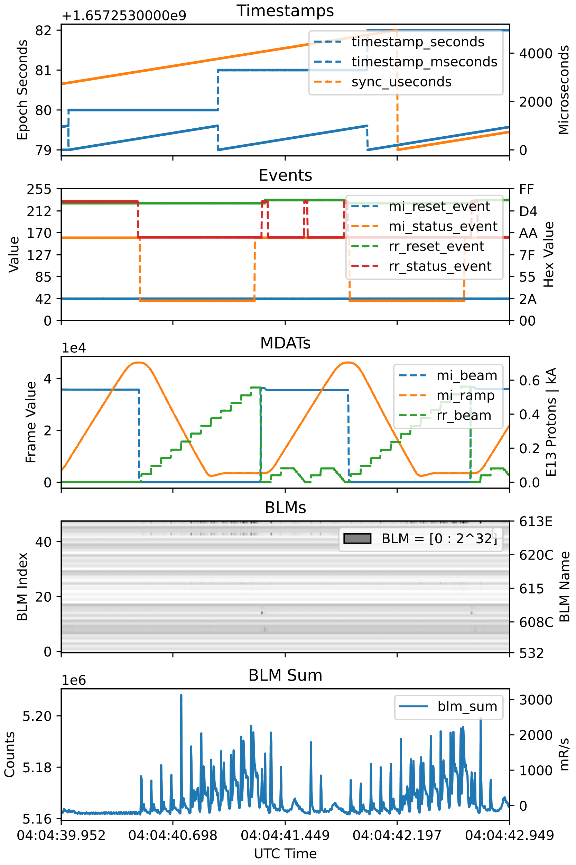
Datasets
Sample Dataset
15/33 Hz
Data taken from machine operations via ACNET
Includes all 259 operational BLMs, TCLK, and MDAT data
Taken throughout the 2020/2021/2022 runs
High Frequency Dataset
333 Hz (BLM node digitizer poll rate)
Data from VME Bus Reader (Pirate) cards commissioned June 2022
Same data as Sample datasets albeit faster
Study Datasets
33/333 Hz
Data taken from 2021/2022 dedicated end of run studies
Includes all the same data as the Sample and High Frequency datasets
Timeline altered so that only Main Injector or Recycler had beam at any time
Beam losses purposefully generated in both machines using various machine miss-configurations to not bias a model towards standard running
All beam loss attributable to a machine
Few second example of Pirate card stream
11/2/22
Kyle J. Hazelwood | READS: Beam Loss Disentangling for Main Injector and Recycler

Slide 9
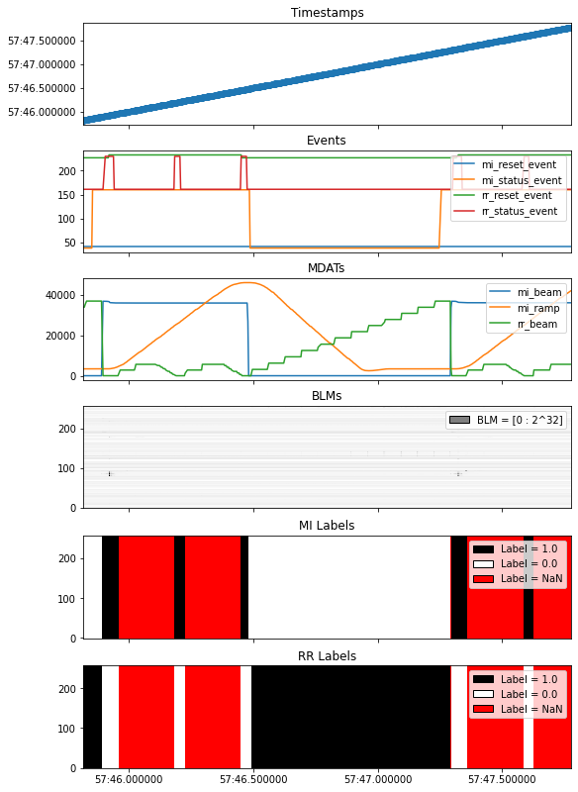
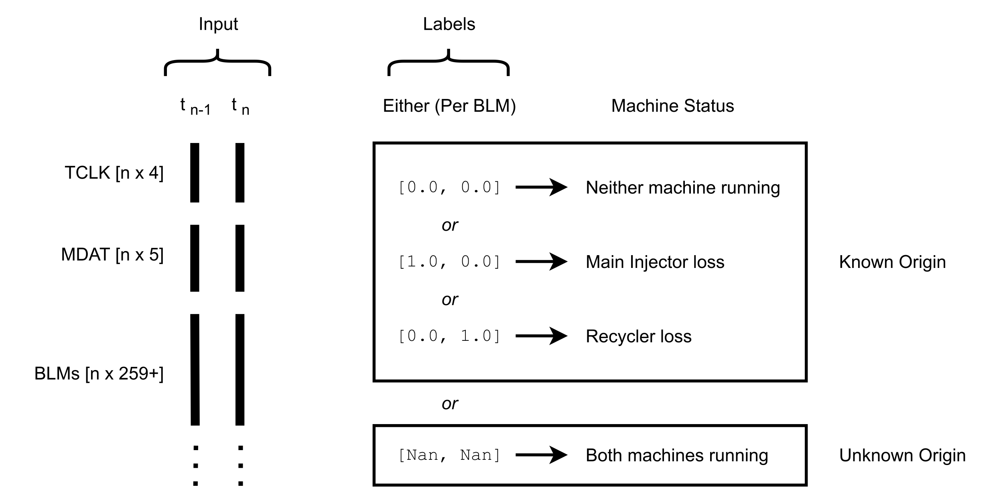
Data Labeling
Data labeling automated using MDAT, and TCLK information
Labeling scheme
Data labeling example
11/2/22
Kyle J. Hazelwood | READS: Beam Loss Disentangling for Main Injector and Recycler

Slide 10
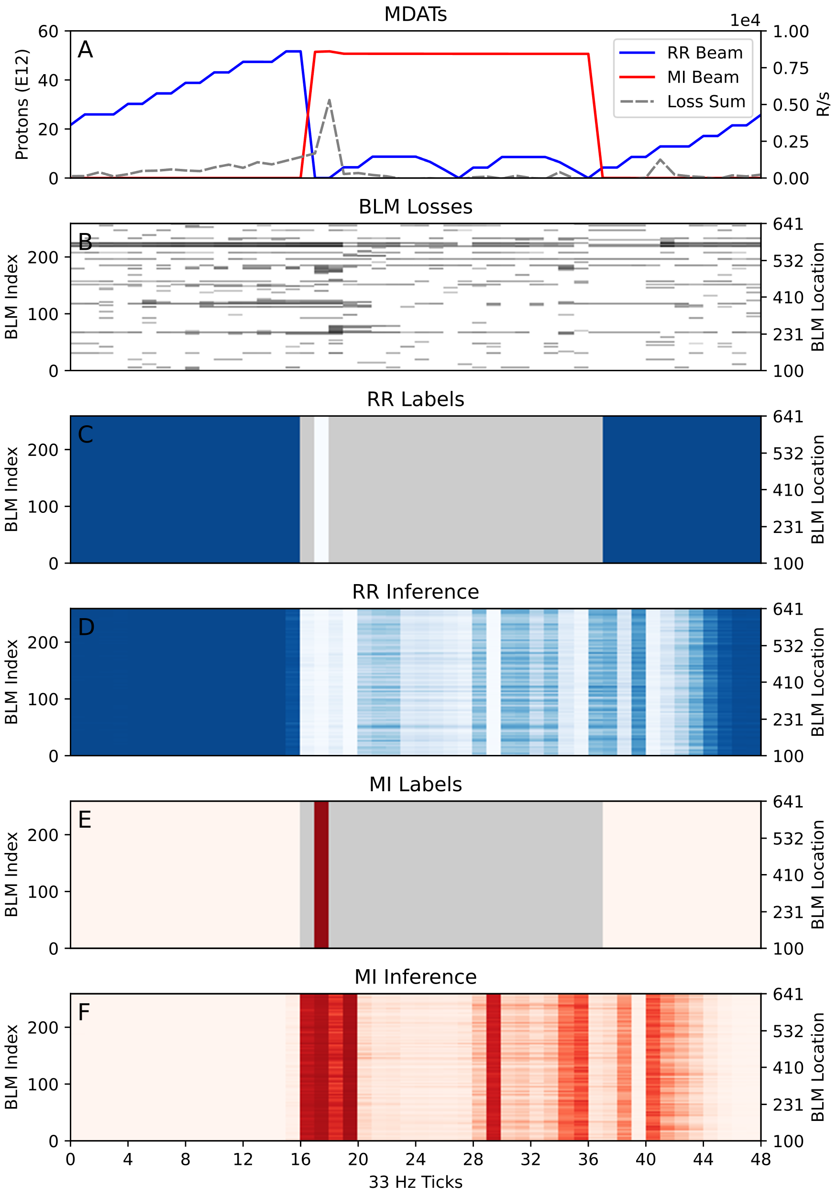
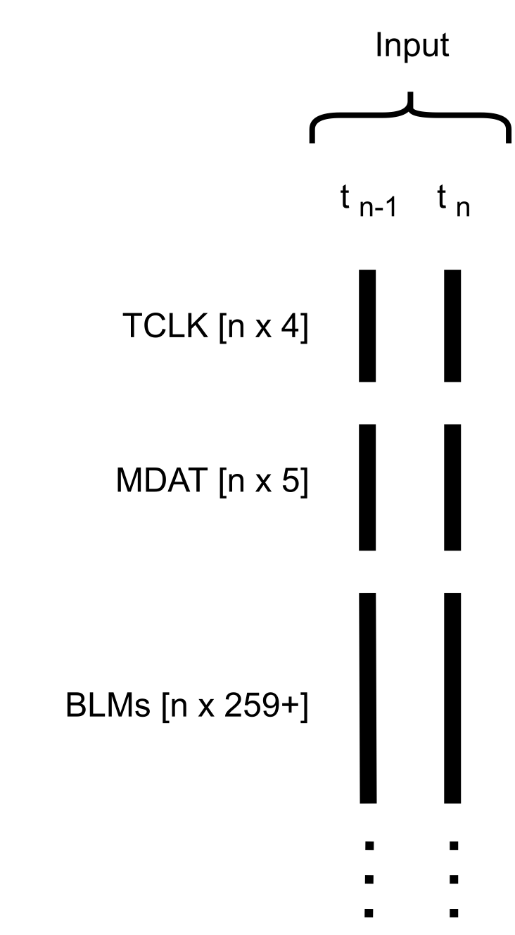
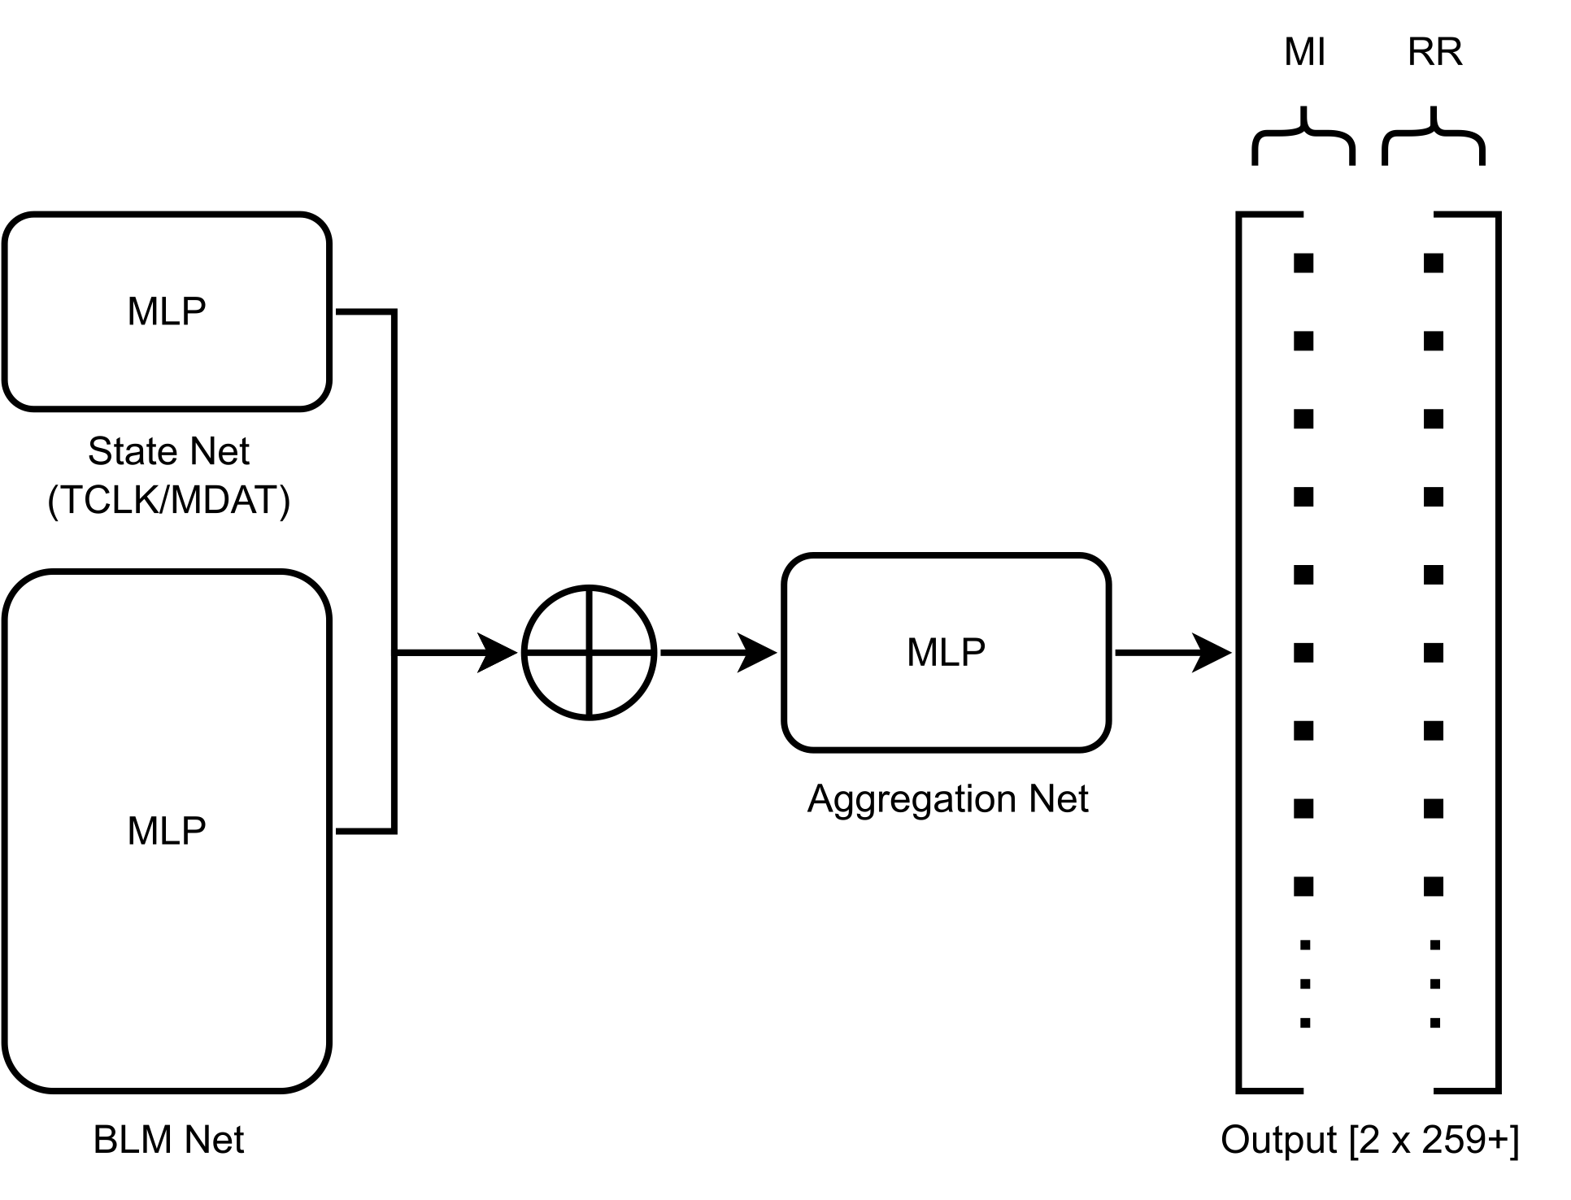
ML Model Architecture: Phase 1, Data-Type-Specific Aggregation (DBLN)
Objective: Assign BLM-wise probabilities for that loss originating in MI/RR
Model architecture
Model inference
11/2/22
Kyle J. Hazelwood | READS: Beam Loss Disentangling for Main Injector and Recycler

Slide 11
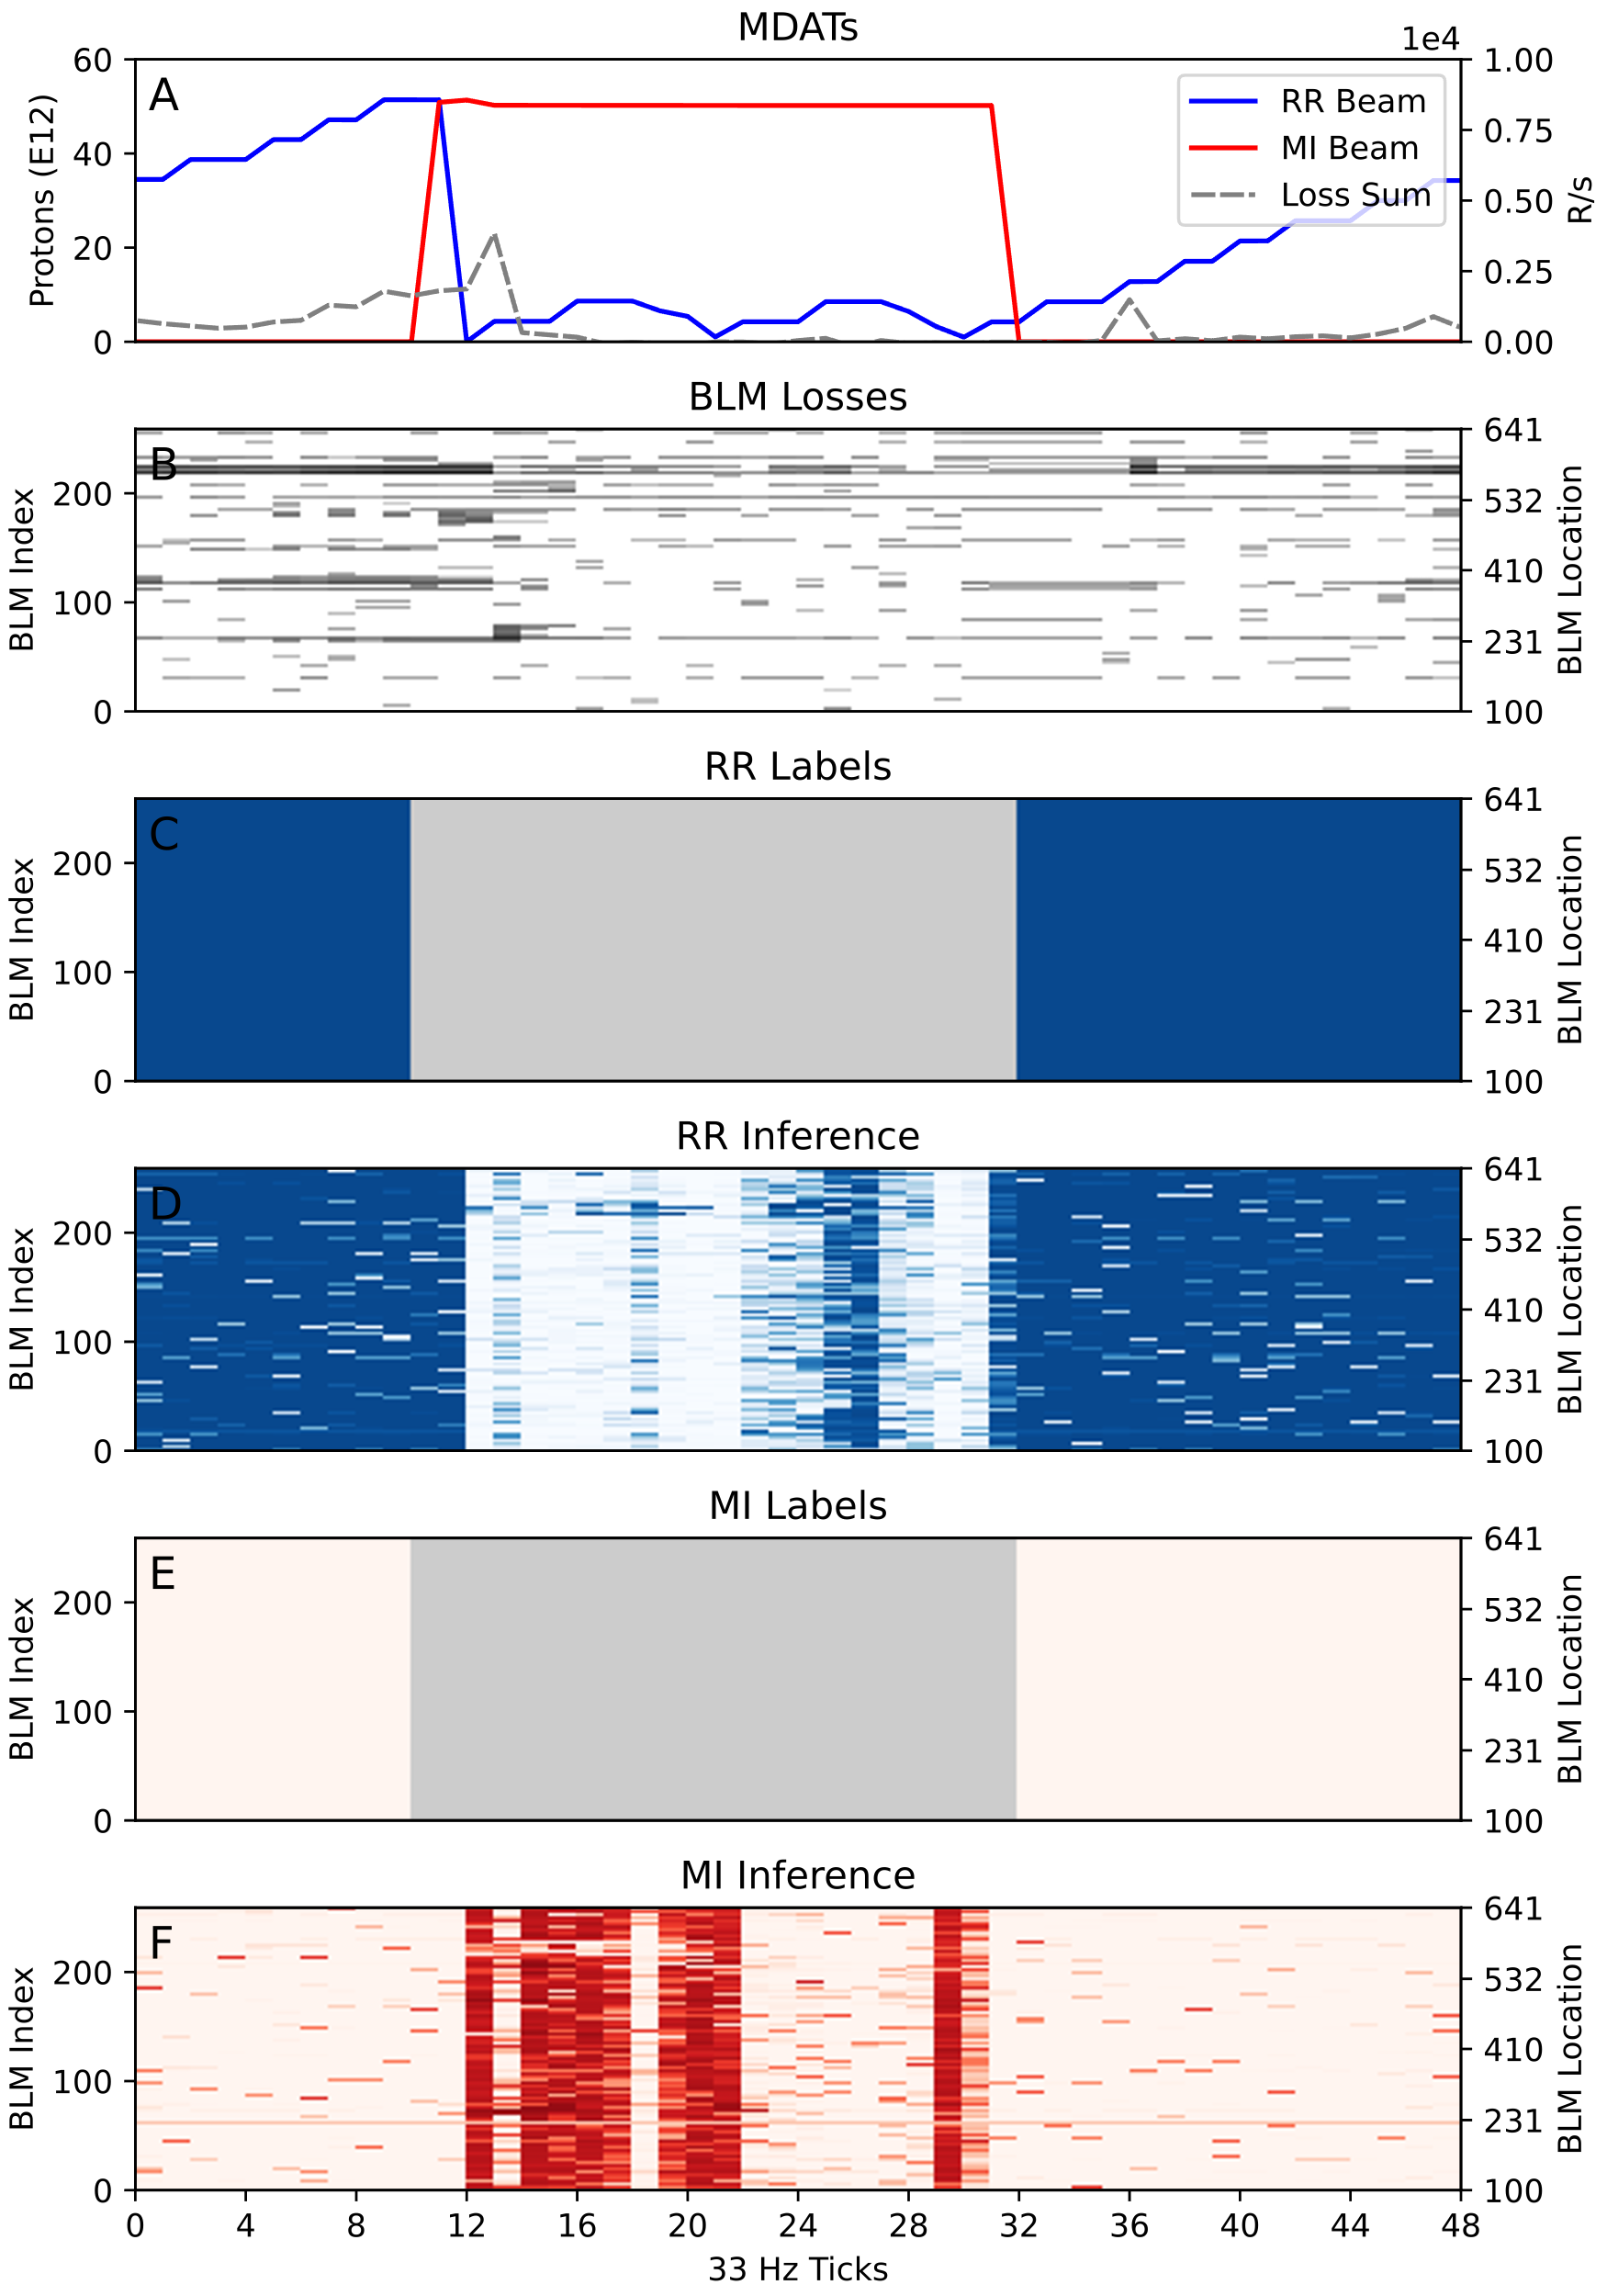
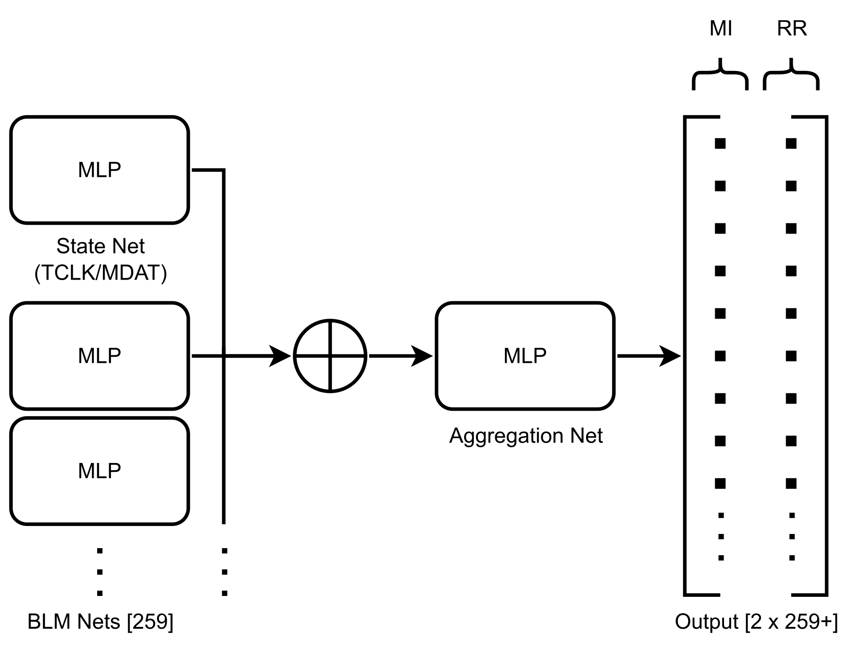
ML Model Architecture: Phase 2, Forcing Locality (ManyModels)
Objective: Assign BLM-wise probabilities for that loss originating in MI/RR
Model architecture
Model inference
11/2/22
Kyle J. Hazelwood | READS: Beam Loss Disentangling for Main Injector and Recycler

Slide 12
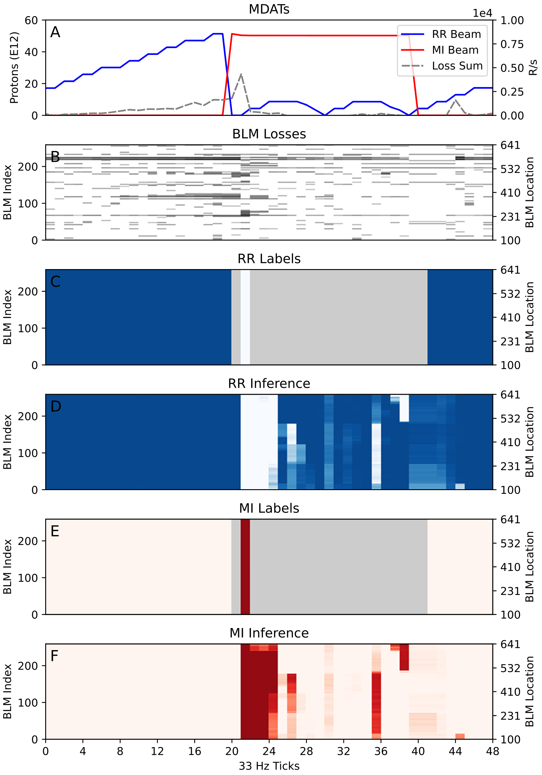
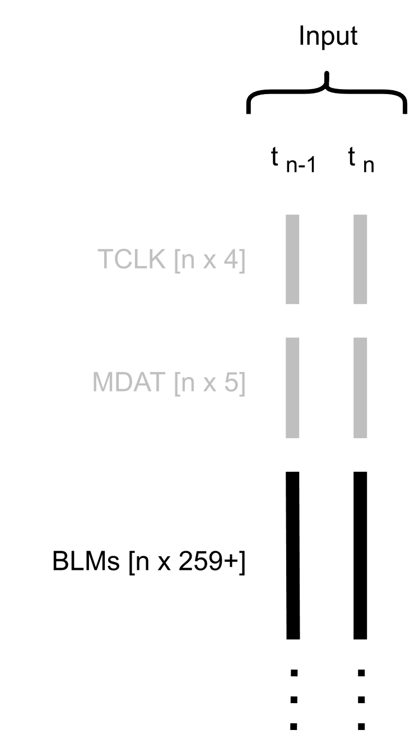
ML Model Architecture: Phase 3, Varying Receptive Fields (UNet)
Objective: Assign BLM-wise probabilities for that loss originating in MI/RR
Model architecture (example)
Model inference
11/2/22
Kyle J. Hazelwood | READS: Beam Loss Disentangling for Main Injector and Recycler

Slide 13
ML Model Architecture: Phase 3, Varying Receptive Fields (UNet)
Example inference accuracies for beam loss values of interest
11/2/22
Kyle J. Hazelwood | READS: Beam Loss Disentangling for Main Injector and Recycler

Slide 14
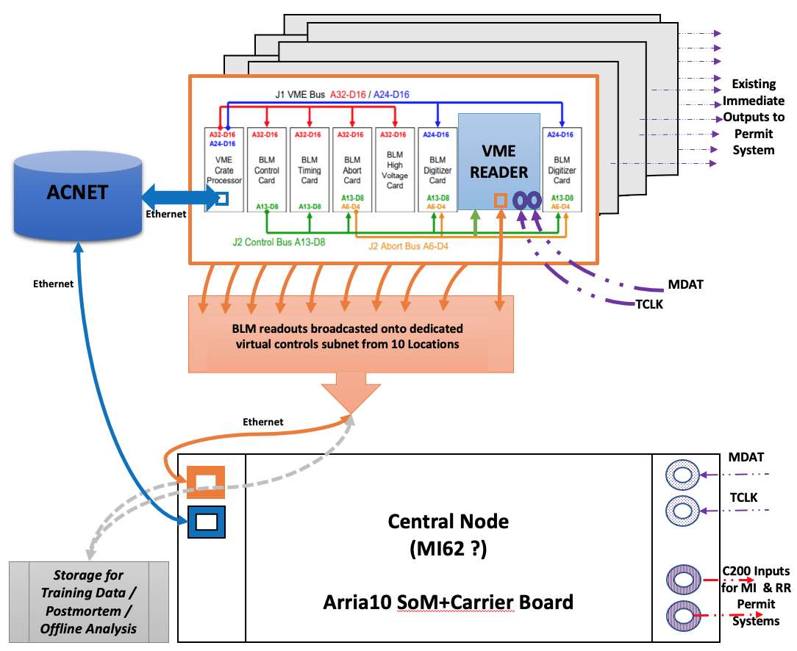
Central Node
Central node is an Aria10 FPGA SOM
ML model will be deployed on FPGA
Two HPS Arm cores and ethernet pots
One dedicated to ingesting VME bus reader card streams
One dedicated to and EPICS IOC to provide control system readings and waveforms
Has inputs for MDAT and TCLK
Has TTL outputs intended for MI and RR c200 permit input
Central node data paths
11/2/22
Kyle J. Hazelwood | READS: Beam Loss Disentangling for Main Injector and Recycler

Slide 15
Remaining Schedule / Work
Build and compile ML model for Aria10 Quartus project using hls4ml
Build out advanced readouts from EPICS IOC
Explore even lower latency VME Bus Reader card stream transmissions
Optimize model(s) further
Tune hyperparameters
Prune/adjust architecture
Explore further data pruning,
Compare normalization and standardization methods
Investigate model robustness
BLM readings missing or incorrect
TCLK, MDAT jitter
Investigate parameter quantization
Investigate active learning
Investigate loss prediction
Research figure of merit to compare expert loss attribution to model inference
Tie Central Node into Main Injector and Recycler machine protection systems
11/2/22
Kyle J. Hazelwood | READS: Beam Loss Disentangling for Main Injector and Recycler

Slide 16
Summary
VME Bus Reader (Pirate) cards were built to stream BLM readings from the enclosure
Large amounts of data have been collected and continue to be collected for model training
A promising ML model has been created to disentangle beam loss in the Main Injector enclosure
Work is underway to implement our model on a Central Node FPGA
Work continues to further optimize the model and explore its robustness and durability
11/2/22
Kyle J. Hazelwood | READS: Beam Loss Disentangling for Main Injector and Recycler

Slide 17
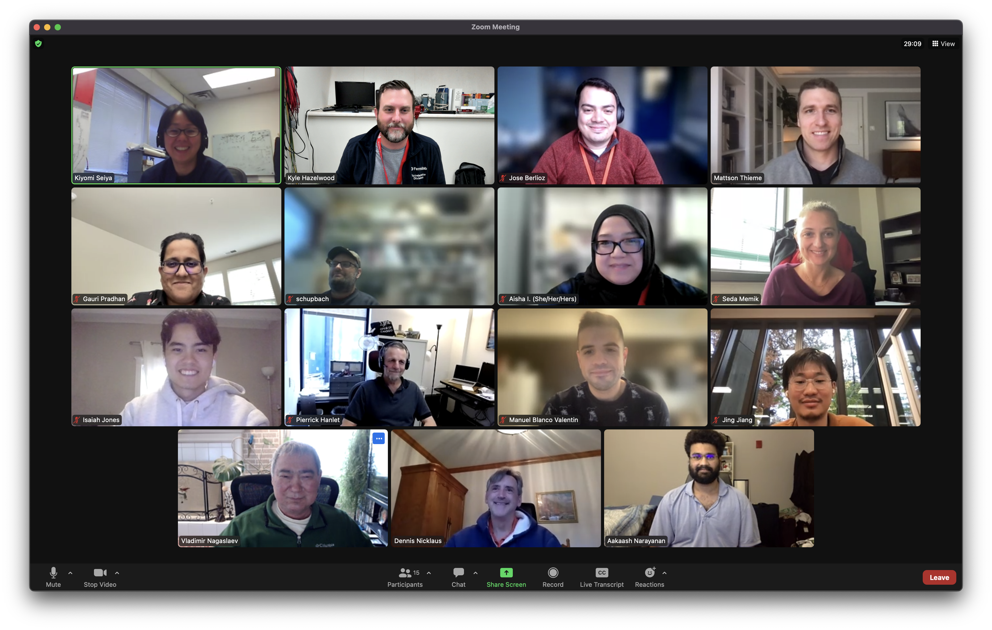
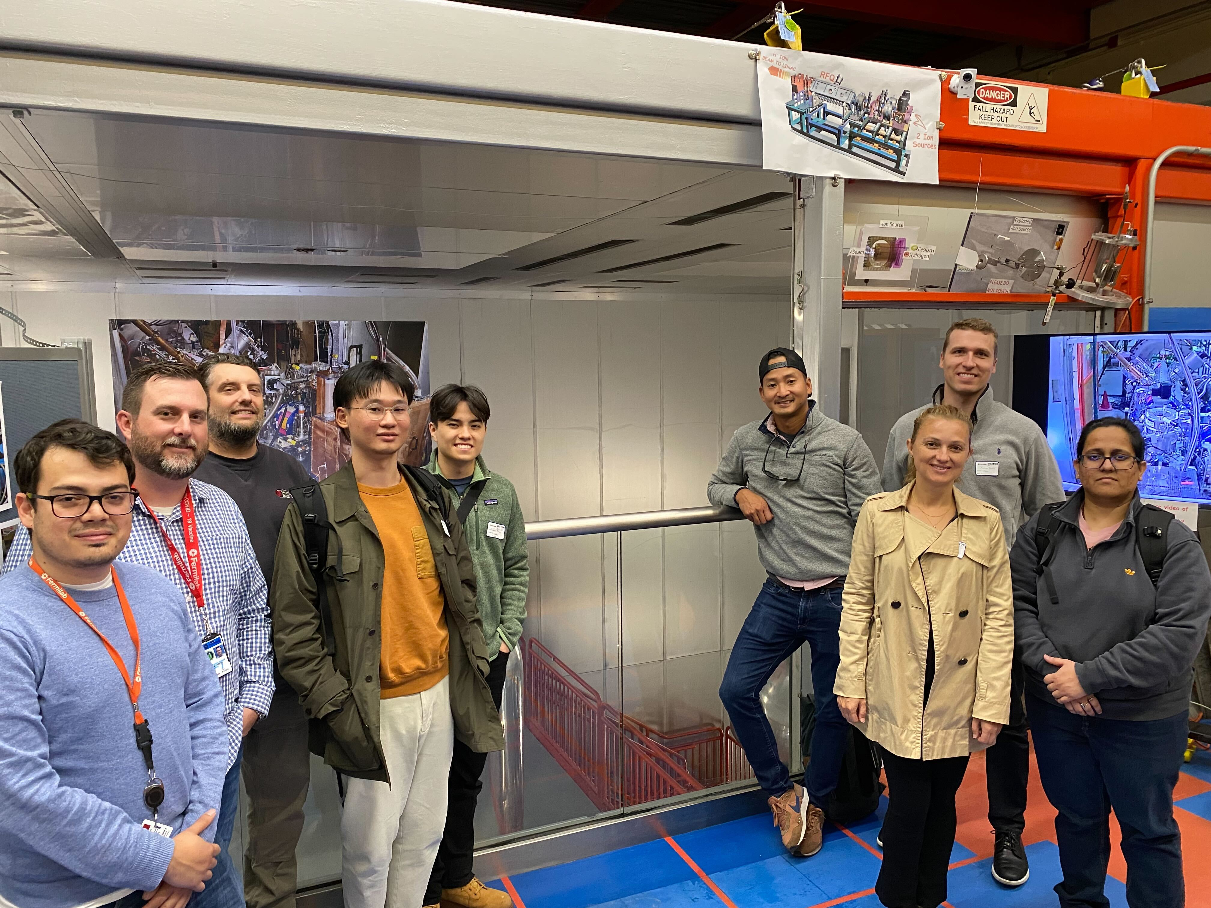
Acknowledgments
Fermilab
M.R Austin, J.M. Arnold, K.J. Hazelwood, P. Hanlet, M.A. Ibrahim, A. Narayanan, D. J. Nicklaus, G. Pradhan, A.L. Saewert, B.A. Schupbach,
K. Seiya, R.M. Thurman-Keup, N.V. Tran
Northwestern University
J. Jang, H. Liu, S. Memik, R. Shi, M. Thieme, M. Valentin
11/2/22
Kyle J. Hazelwood | READS: Beam Loss Disentangling for Main Injector and Recycler

Slide 18
Thank You
K. Seiya et al, “Accelerator Real-time Edge AI for Distributed Systems (READS) Proposal” (March 2020) https://arxiv.org/abs/2103.03928
K.J. Hazelwood et al, “Real-Time Edge AI for Distributed Systems (READS): Progress on Beam Loss De-Blending for the Fermilab Main Injector and Recycler” (August 2021) https://lss.fnal.gov/archive/2021/conf/fermilab-conf-21-603-ad-scd.pdf
J. Berlioz et al, “Synchronous High-Frequency Distributed Readout for Edge Processing at the Fermilab Main Injector and Recycler” (August 2022) https://napac2022.vrws.de/papers/mopa15.pdf
M. Thieme et al, “Semantic Regression for Disentangling Beam Losses in the Fermilab Main Injector and Recycler” (August 2022) https://napac2022.vrws.de/papers/mopa28.pdf
11/2/22
Kyle J. Hazelwood | READS: Beam Loss Disentangling for Main Injector and Recycler

Slide 19
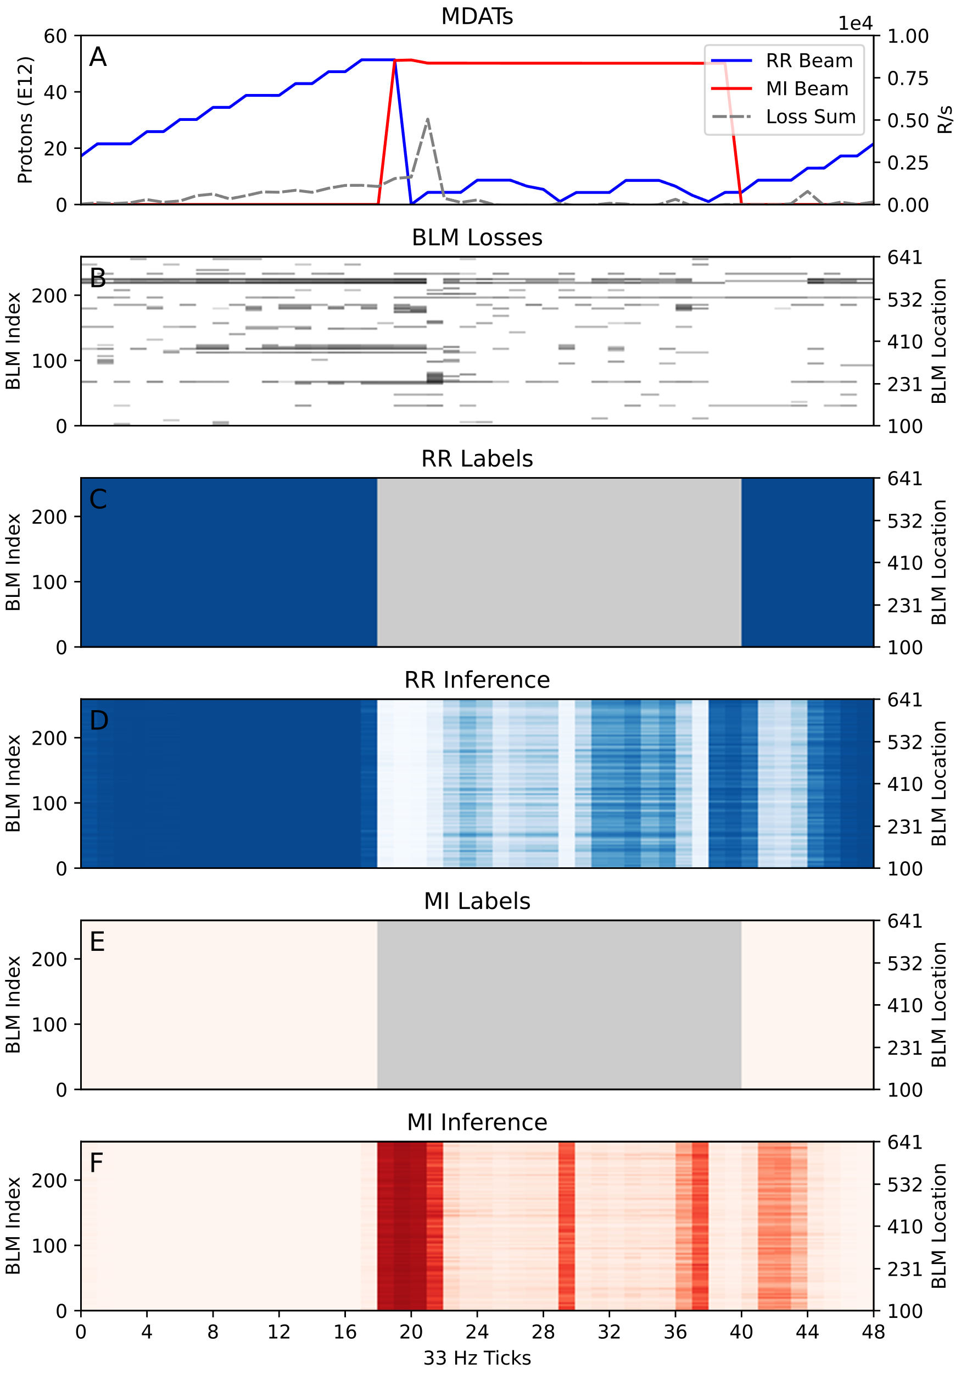
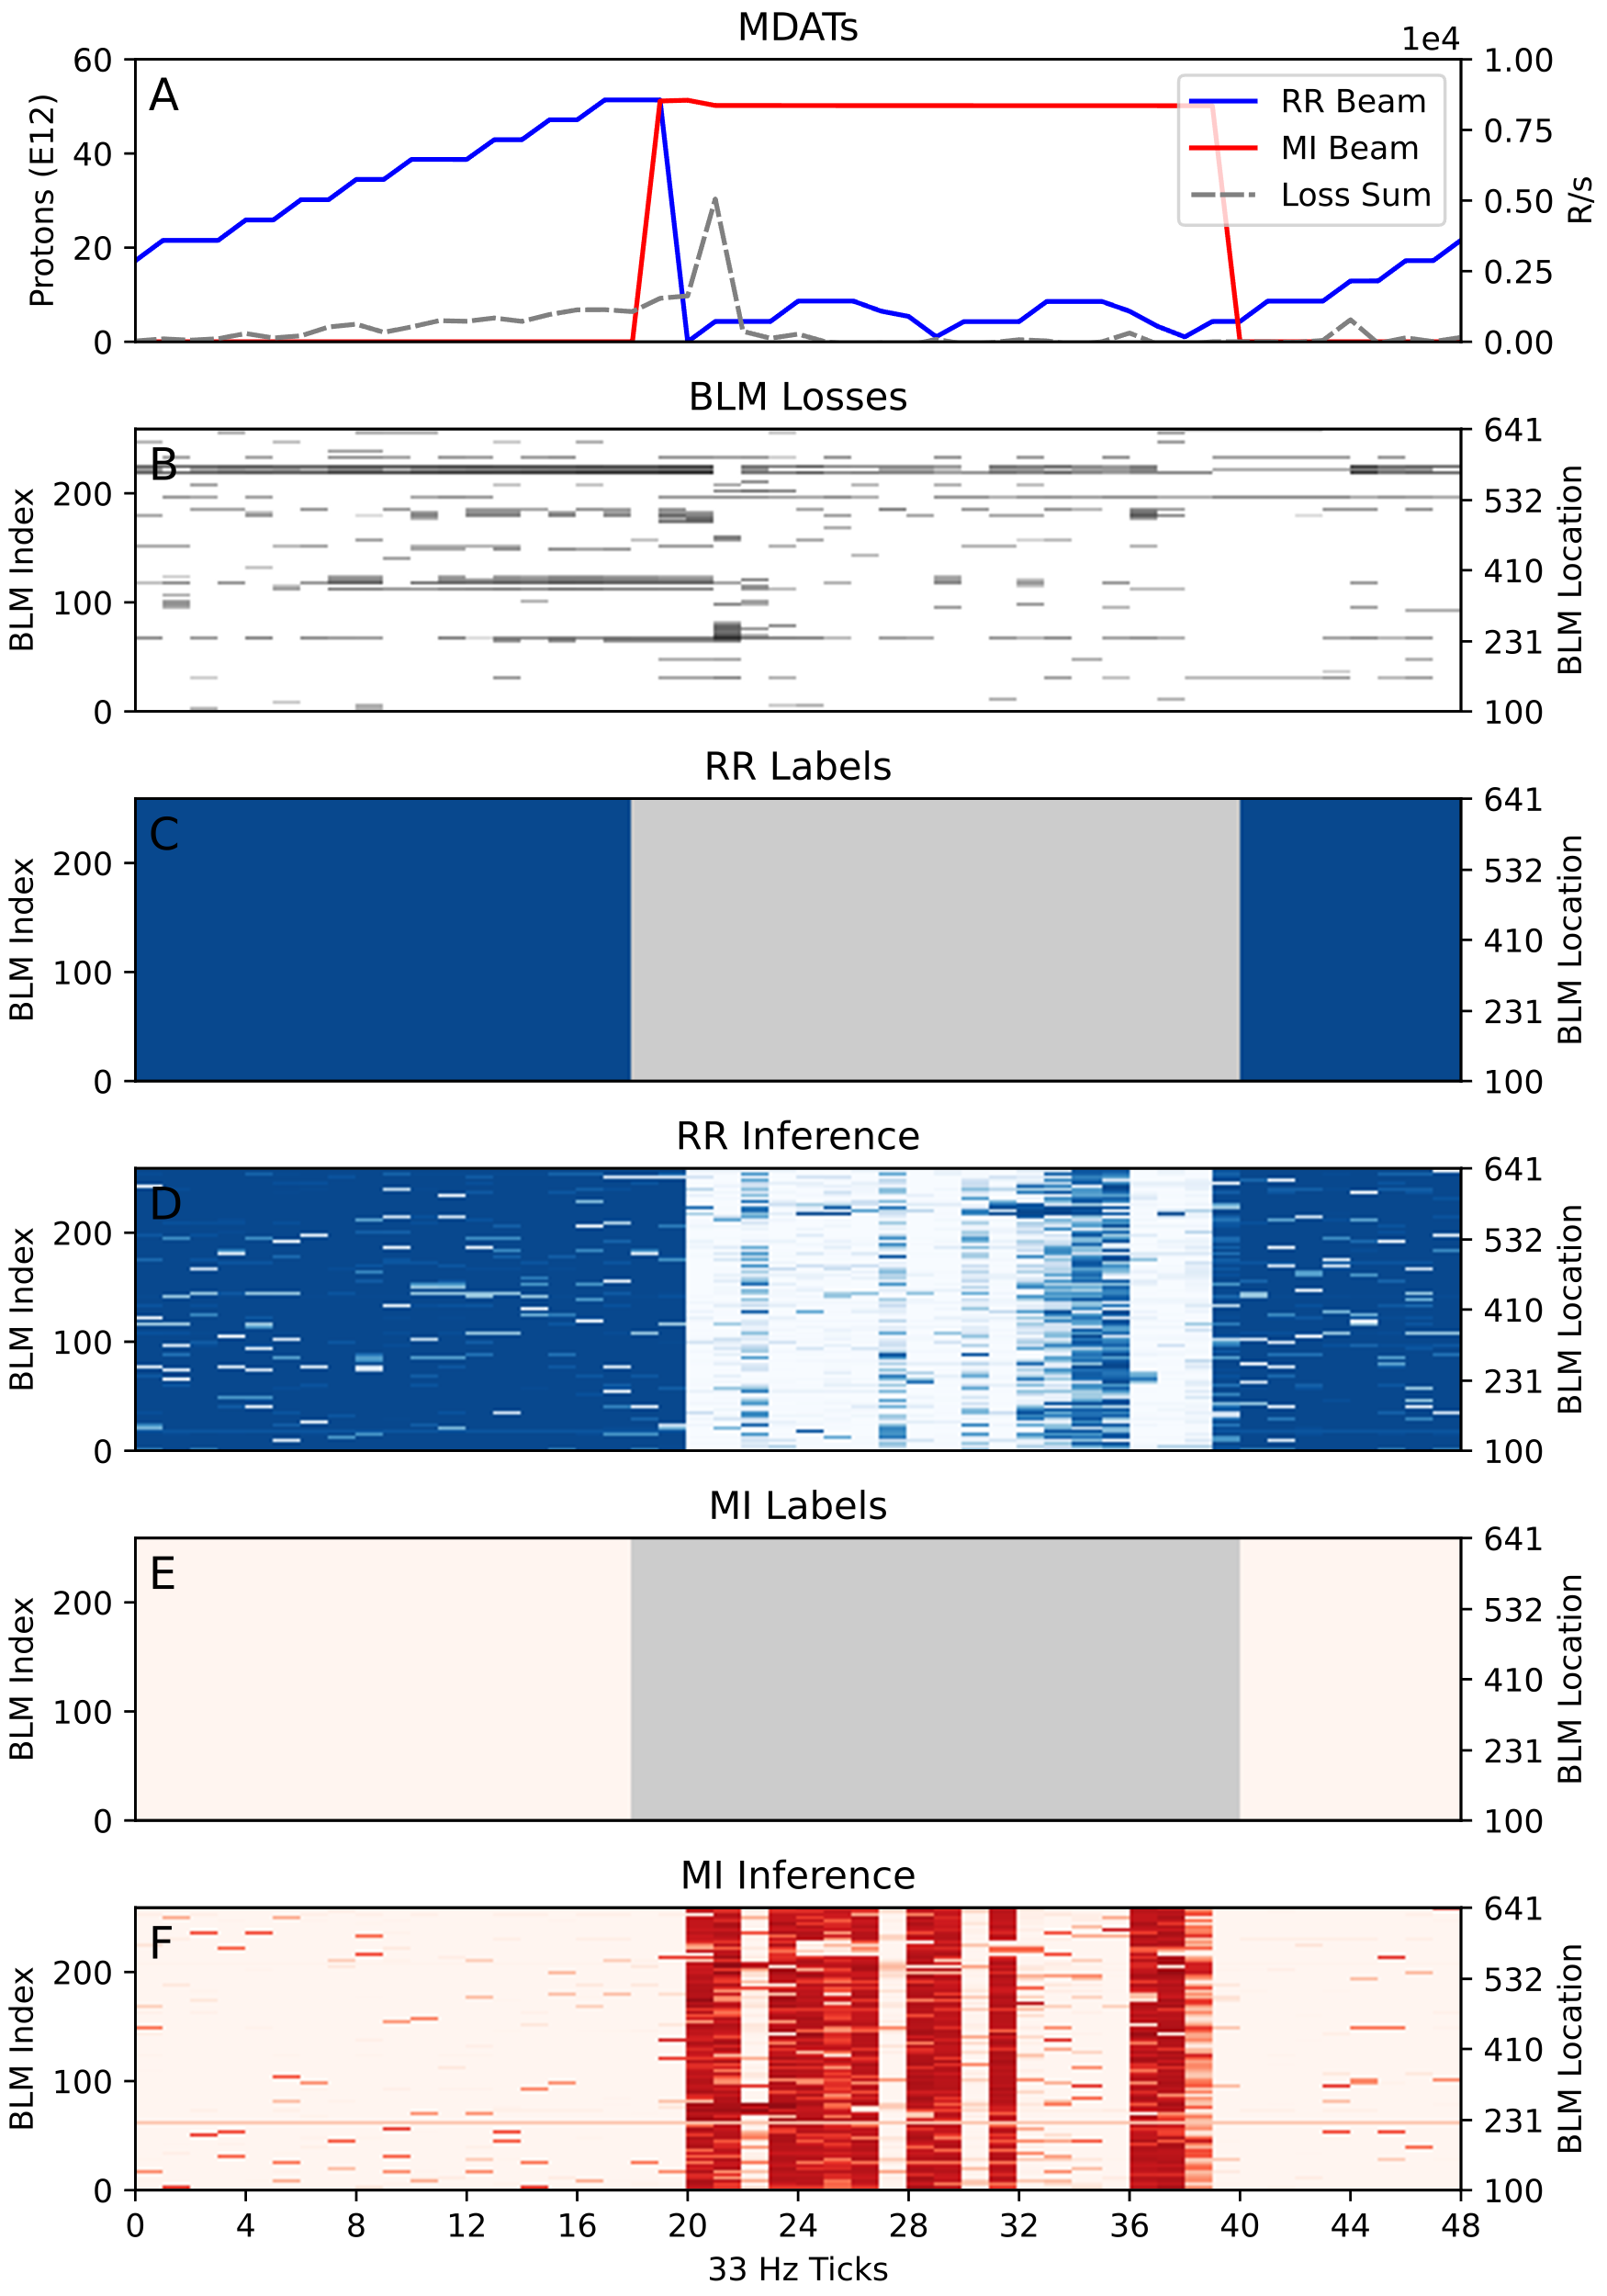
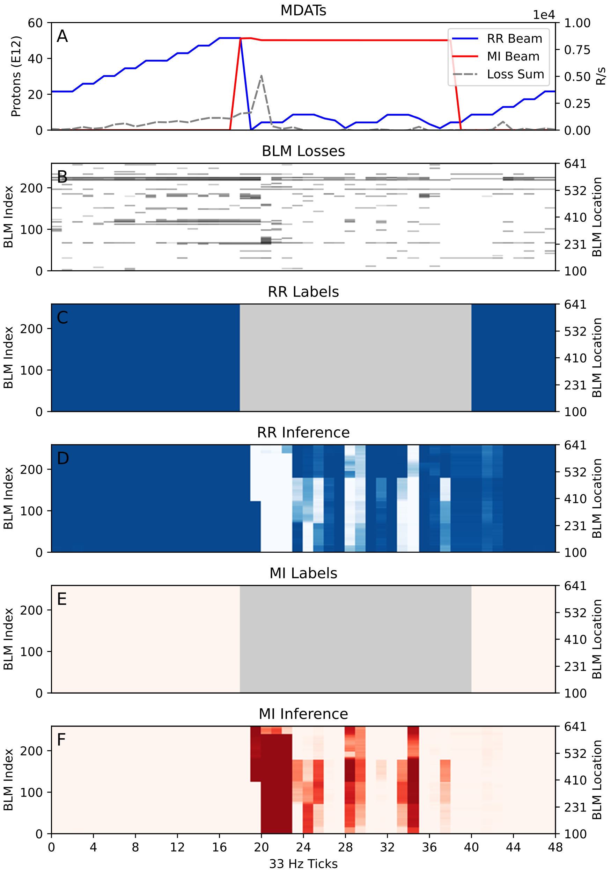
Model Comparison
DBLN
Many Models
UNet
11/2/22
Kyle J. Hazelwood | READS: Beam Loss Disentangling for Main Injector and Recycler

Slide 20
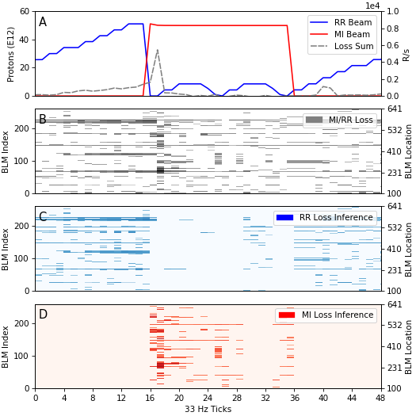
ML Model Inference (continued)
Example model inferred losses
11/2/22
Kyle J. Hazelwood | READS: Beam Loss Disentangling for Main Injector and Recycler

Slide 21
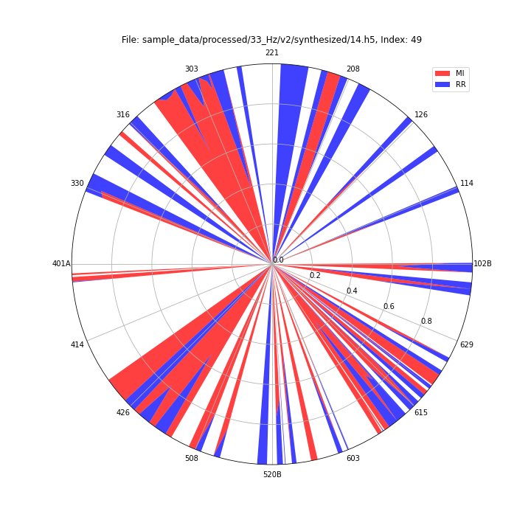
Datasets (continued)
Synthesized Dataset
33 Hz
Using Sample and Study Datasets
Use known losses (attributed to one machine) and sum with known losses attributable to the other machine
Resulting labels are percentages of loss per BLM attributed to a machine
Will be used to attempt a semi-supervised model training
Example of synthesized data labeling
11/2/22
Kyle J. Hazelwood | READS: Beam Loss Disentangling for Main Injector and Recycler

