Slide 1
Uncertainty Aware Anomaly Detection to Predict Errant Beam Pulses and GradCAM Analysis
Kishansingh Rajput
Kishan@jlab.org
On behalf of Errant Beam Prediction Task Force (Jefferson Lab and ORNL)

Slide 2
Outline
Uncertainty Quantification in Deep Learning
Errant Beam Prediction at SNS Accelerator
Introduction
Data Processing
Siamese Model
Uncertainty Aware Siamese Classifier
Equipment Fault Classification
Online Deployment
Future Roadmap
Uncertainty Aware Booster Surrogate for FNAL
Uncertainty Aware Deep Regression with single inference

Slide 3
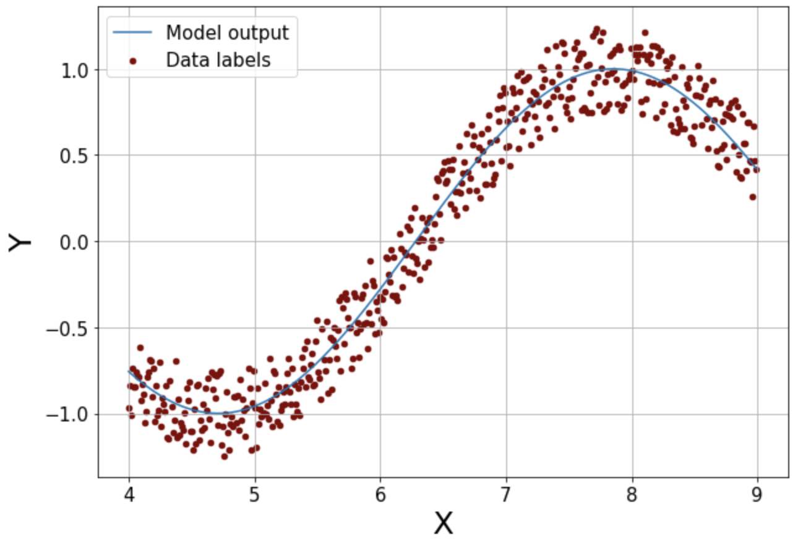
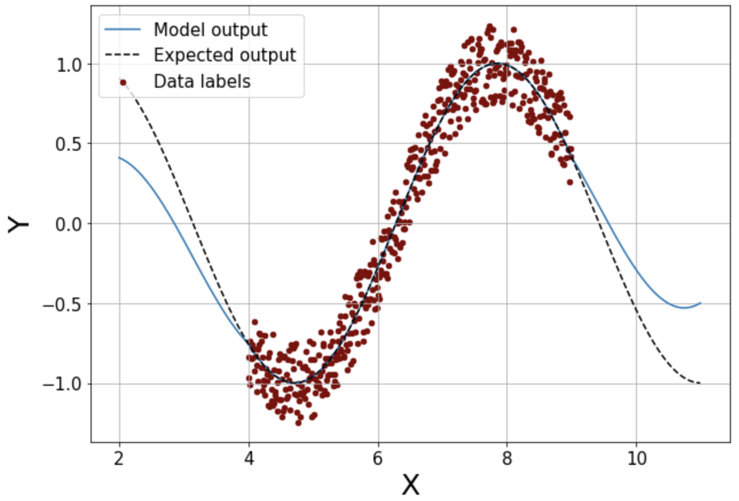
Uncertainty Quantification
Deep Learning (DL) models are deterministic transformation functions from an input to the output
DL models are very powerful and expressive
It is important to know the confidence associated with each prediction from a DL models for decision making
DL model
Input(s)
Output(s)
Aleatoric
Uncertainty Types: Aleatoric vs Epistemic uncertainties
Aleatoric → Data uncertainties
Epistemic → Out of training distribution uncertainty (OOD)
Epistemic

Slide 4
Popular methods for UQ in DL
Q₁
Q₂
Q₃
Q_{n}
(c) Quantile Regression
Model is trained to predict quantiles for the regression problem
(a) MC Dropout
(b) Ensemble
Use dropout during inference to create variability in the prediction which can be used to estimate the uncertainty. Requires offline calibration
Create multiple copies of the same model architecture trained with different parameters initialization. Requires calibration after training

Slide 5
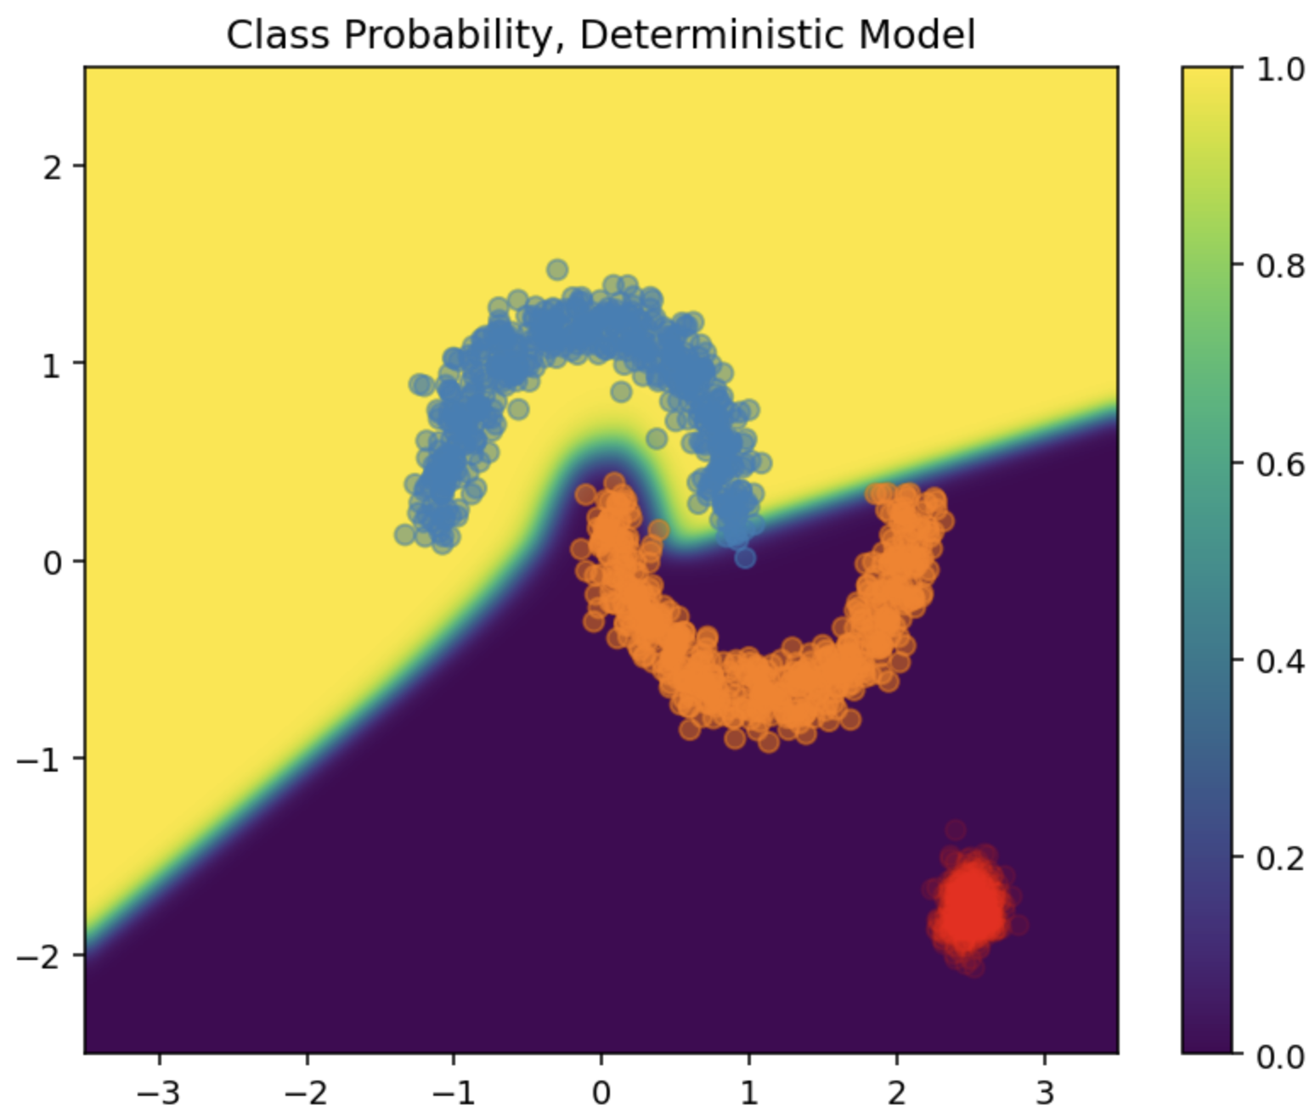
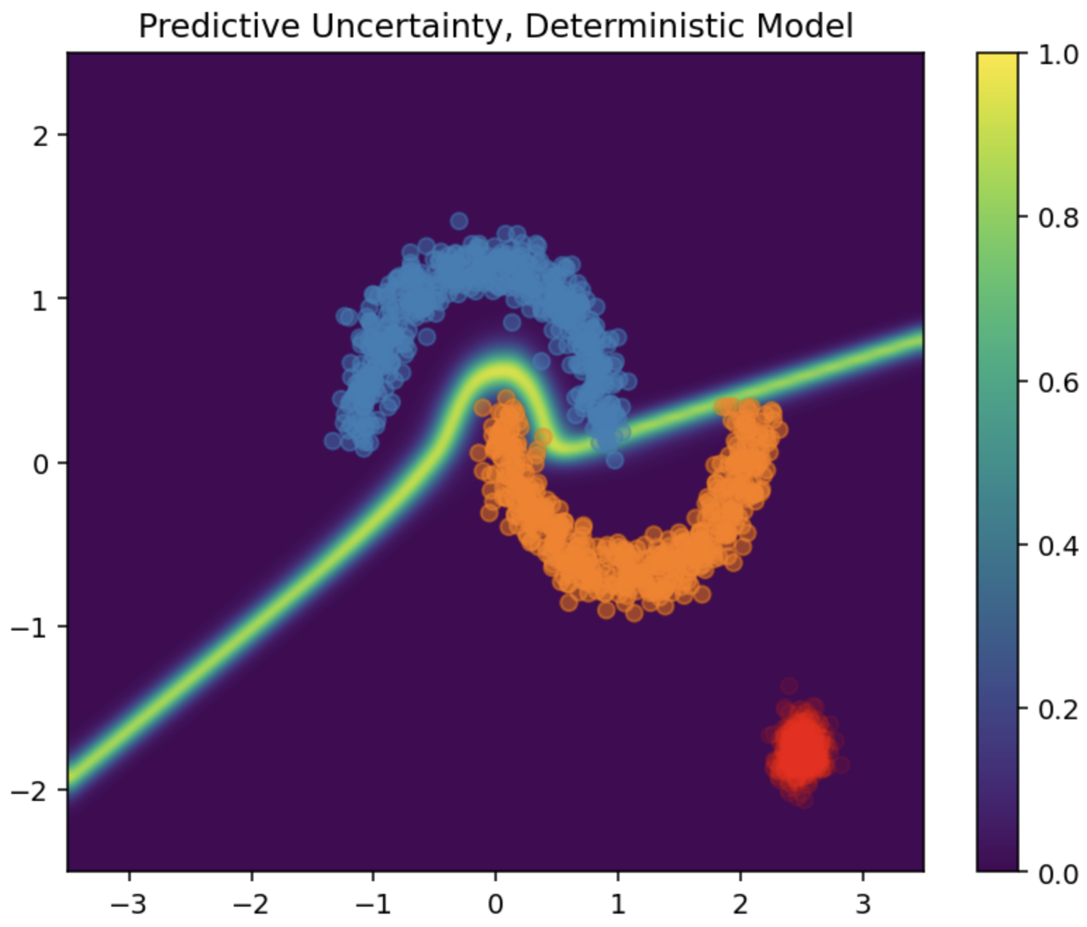
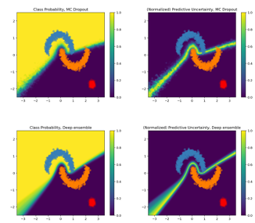
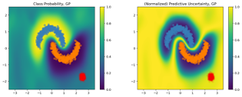
Popular methods for UQ in DL
Unfortunately, majority UQ methods for DL do not account for OOD uncertainty​
This is critical in optimization or control problems​
For example, different methods yield vastly different uncertainty estimation​
Deterministic​ (Prediction value)
MC Dropout​
Deep Ensemble​
Gaussian Processes​​ (GP)
https://arxiv.org/abs/2006.10108

Slide 6
GP for UQ in DL
GP transforms the input space into a higher dimensional space with the help of a kernel
The inferences are based on the distance measure between different input samples
This allows GP to intrinsically provide uncertainty estimates including OOD
GP is limited in terms of Scaling and data reduction techniques are usually required for large data sets
Recent study presented a way to introduce Gaussian Process approximation within a neural network
This allows to use highly expressive deep networks and provide uncertainty estimation
Spectral Neural Gaussian Process*
https://arxiv.org/abs/2006.10108

Slide 7
Outline
Uncertainty Quantification in Deep Learning
Errant Beam Prediction at SNS Accelerator
Introduction
Data Processing
Siamese Model
Uncertainty Aware Siamese Classifier
Equipment Fault Classification
Future Roadmap
Uncertainty Aware Booster Surrogate for FNAL
Uncertainty Aware Deep Regression with single inference

Slide 8
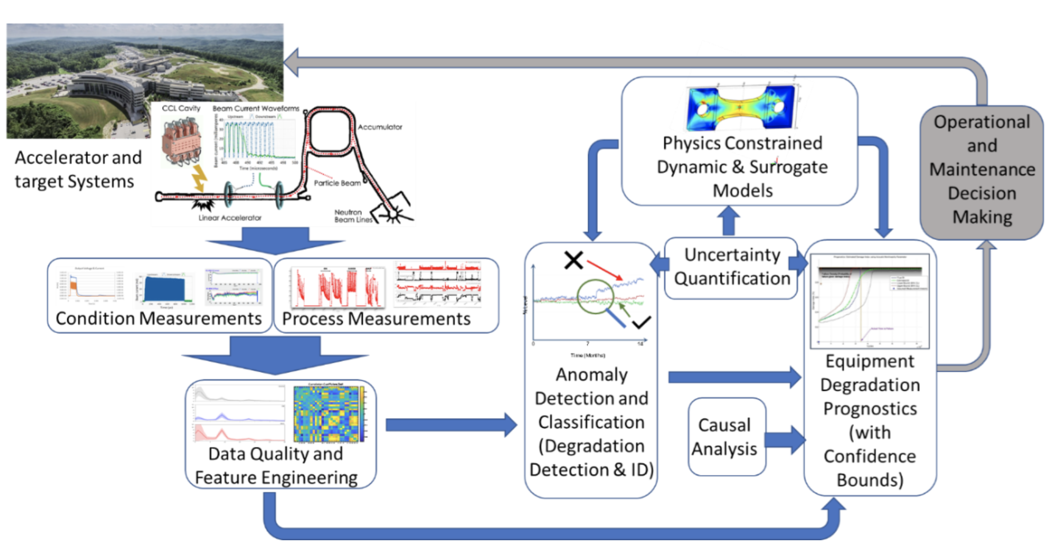
Errant Beam Prediction for SNS Accelerator
Spallation Neutron Source (SNS) accelerator at ORNL delivers 1.4 MW of a 1 GeV pulsed beam at 60 Hz
Ongoing work to predict errant beam pulses as well as equipment degradation and prognostics
Continuous data collection is done by Differential Current Monitor (DCM), Beam Position Monitor (BPM) etc.
Errant beam prediction on one pulse before it occurs to potentially avoid it

Slide 9
Errant Beam Prediction for SNS Accelerator
Goal: Predict an upcoming machine trip before it occurs to potentially allow the crew to change settings to avoid it
How: We use pulses leading to a trip (tagged "Before") and identify features that indicate an upcoming failure
Data science pipeline used:
Data Source
Data Preparation
ML Approach
Training Tools
Results
Real or synthetic
Quality
Dimensionality
Format
Density
Size
Data cleaning
Data restructuring
Correlations
Dynamics
Visualization
Classification
Regression
Clustering
Feature extraction
Cross-validation
HPO
Predictions
Confidence Level
Explainability

Slide 10
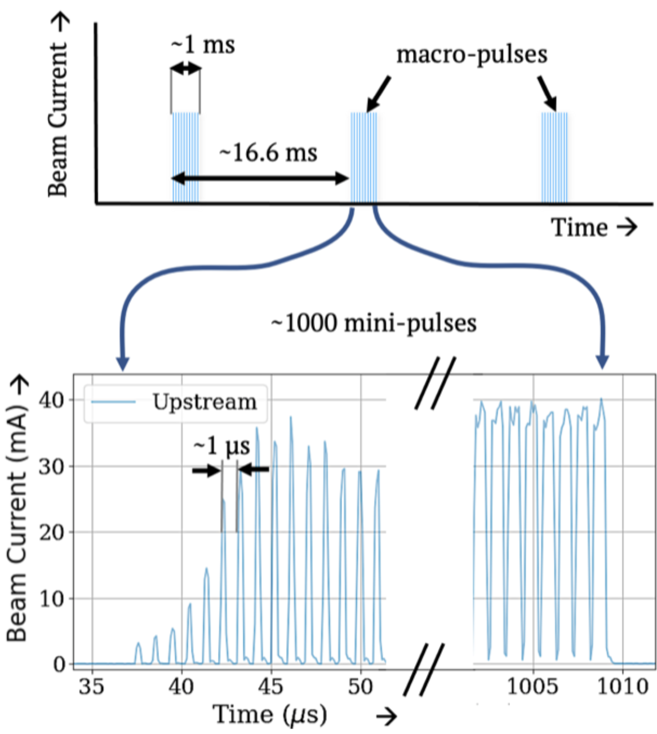
Data Collection and Preparation
How was the data collected and labeled?
DCM creates a series of pulses (“macro-pulses”) with each macro-pulse composed of ~1k mini-pulses
An errant-beam data file is composed of 25 “good” macro-pulses followed by the errant beam pulse
A “normal” data file has no errant beam pulse
We used the macro-pulse before the errant beam pulse (and labeled it as anomaly) and macro-pulses from the normal file (and labeled them as normal) for our studies
Our hypothesis: there is a sign about upcoming anomaly in macro-pulses even before it happens
We also need to forecast the fault within a short time window to be actionable
Samples were divided into 3 orthogonal dataset:
Train (64%)/Test(20%)/Validation(16%)

Slide 11
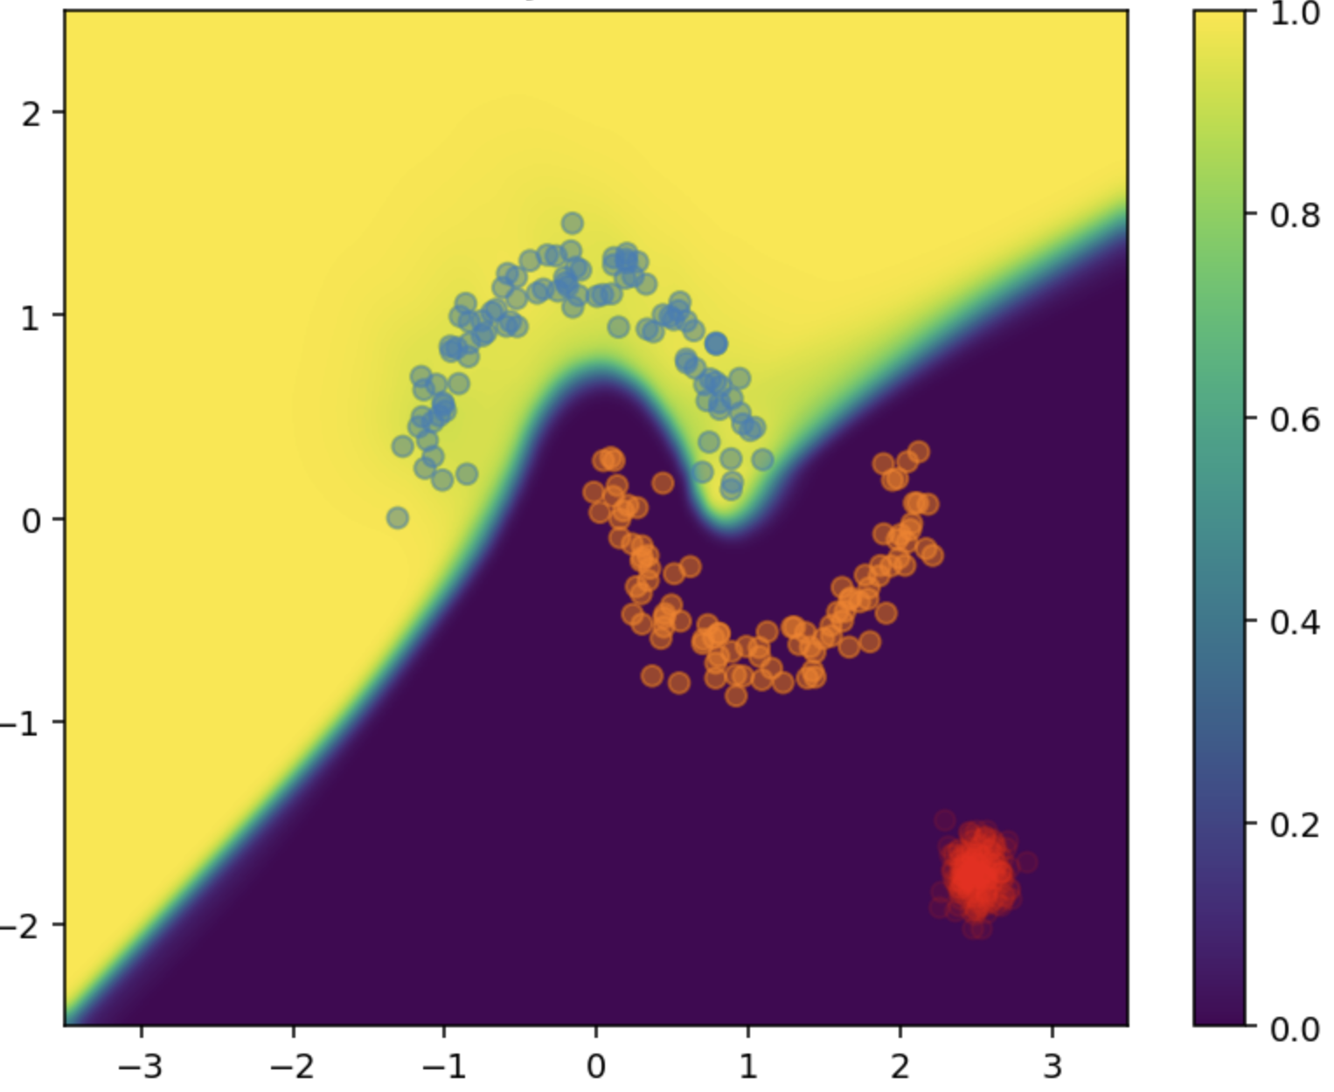
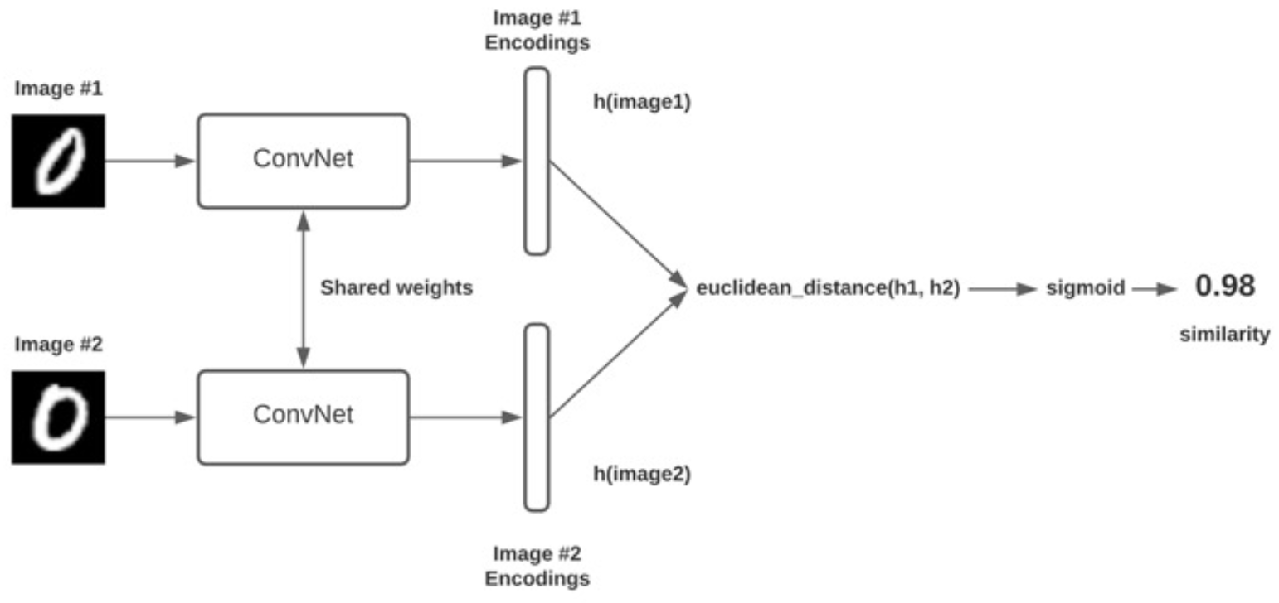
Siamese Neural Network (SNN) Model
Traditional classification models vs Siamese model
Traditional DL classification models fails to identify unseen anomalies (OOD)
Similarity based models can correctly classify unseen anomalies. Ex Siamese model
Siamese model does not explicitly model the classification but focuses on the similarities
Rare anomaly
It learns twin embedding models to transform inputs into a latent space
Distance measures are applied at latent space to compute the similarity

Slide 12
Data Preparation for SNN Model Training
Reference Normal Pulses
Data for the SNN Model
Different Combinations of Normal to Normal (labeled 0) and Normal to “Before” pulses (labeled 1)
1
Pulses before Anomalies
0
0
1

Slide 13
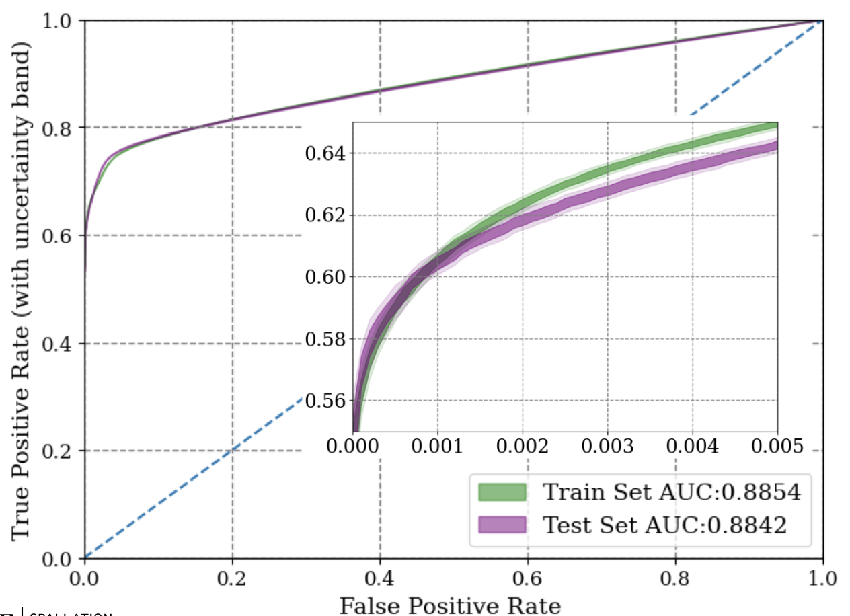
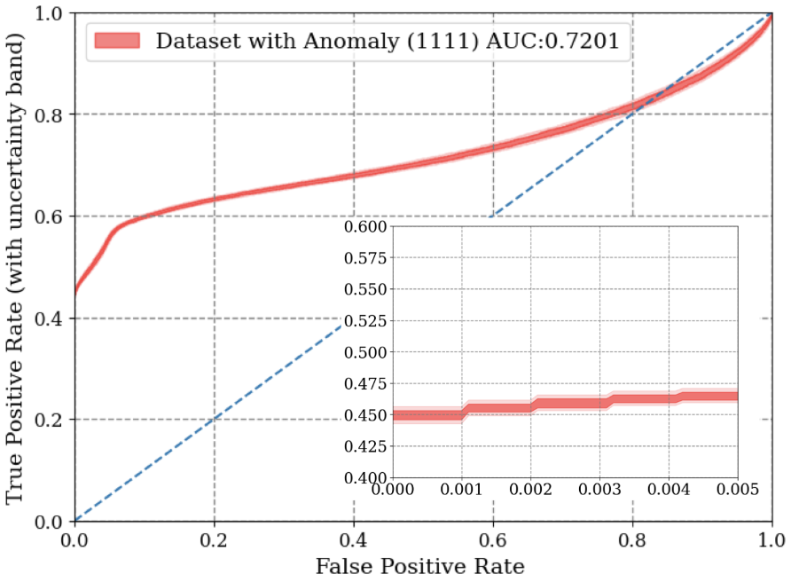
Uncertainty aware Siamese model
We enhanced our Siamese model by adding GP layer providing an uncertainty estimate
Results from similarity model showed a ~4x improvement in performance over previously published results​, it is also much better than a vanilla Auto-encoder
The ROC curves shows true fault detection rate above 60% while keeping the false alarms below 0.5% (not optimized)
We introduced an out-of-domain anomaly, labelled 1111 (red), the UQ-based model performed similar in classifying the anomalies and indicated high uncertainty (as expected)
After a fault is predicted, is it possible to associate with a particular equipment failure?

Slide 14
Gradient Class Activation Mapping (GradCAM)
GradCAM provides mapping between the the model output to the features in the input that the model thinks are the most relevant
Extracts the most active features in the last convolutional layer and maps them back to the input
https://arxiv.org/abs/1610.02391

Slide 15
Equipment Fault Classification using GradCAM
Applied GradCAM on SNN model trained to predict Errant Beam Pulses
It identified sections of the waveform most relevant for a particular decision from the model
Stacked Relevance Vectors (“Before” Pulses)
GradCAM

Slide 16
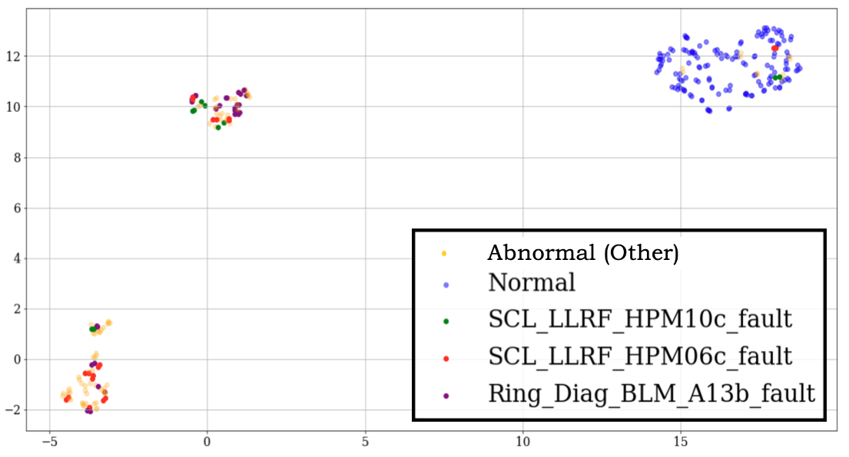
Equipment Fault Classification using GradCAM
The salient feature vectors are reduced to 2-dimensional space using UMAP*
Studying how the cluster location from anomalies relate to specific equipment failures
Normal Pulses
”Before” Pulses
* https://arxiv.org/abs/1802.03426

Slide 17
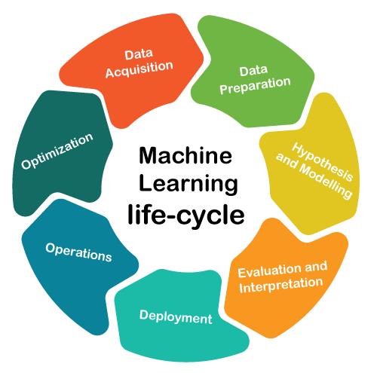
What is Sustainable ML?
Developing a maintainable framework for machine learning projects enabling:
Model lineage (version control)
Tracking model hyperparameters
Updating model per new data
Routine tests to verify model validity
Improving model with new features

Slide 18
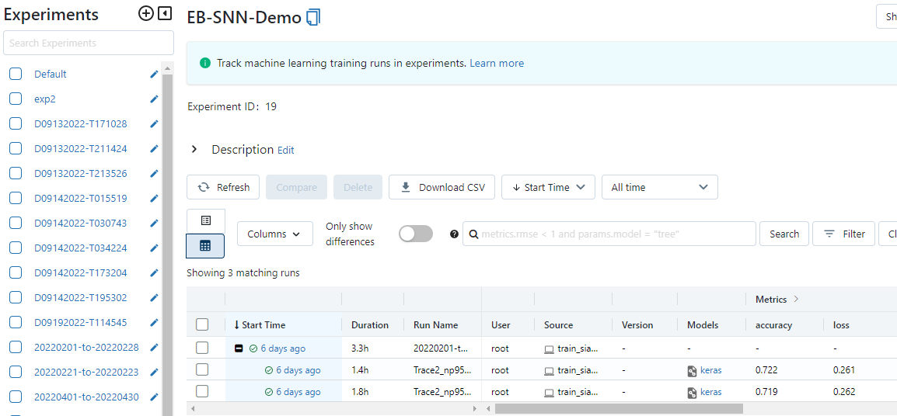
Sustainable ML for SNS with MLflow
Streamlined data processing
Easy model generation and training for non-ML experts with an application
Dockerized parallel training on GPUs (efficient training)
MLflow hosted on Cloud VM for organized and multi-user model tracking
Scalable with more models, use cases, projects
Cloud VM
File Server
ML GUI
Data
Proxy Logger
MLflow’s browser-based interface
Computing Server
Docker

Slide 19
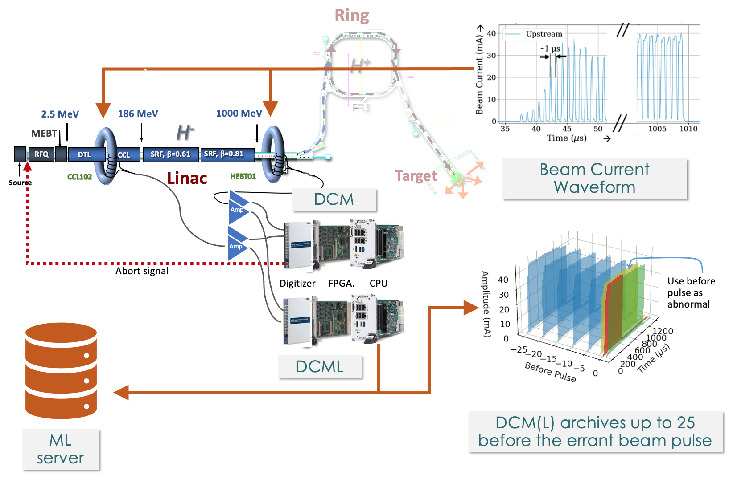
Online system
Upcoming pulse type decision (good or bad) must be made between pulses (≈15 milliseconds)
Random Forest on LabVIEW FPGA
Developed by ORNL collaborators
Siamese twin on LabVIEW RT DCML and Unix ML Server
DCML feeds data for machine learning training and inference while the original DCM still protects the machine

Slide 20
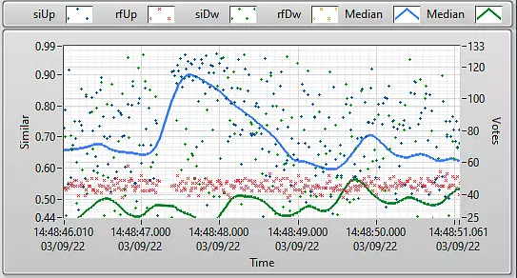
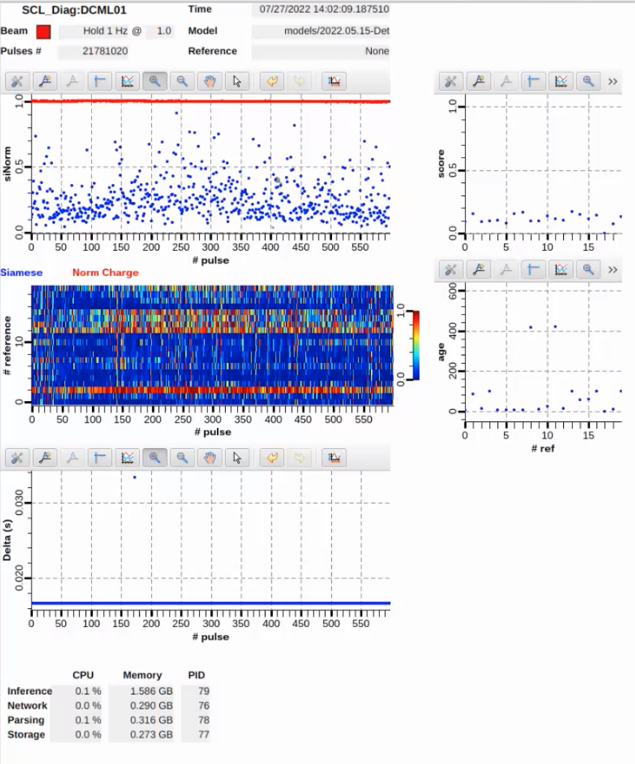
Online results
DCML:
Can run up to 4 deterministic SNN inferences
DCML live results (Siamese/RF upstream/downstream
ML Server:
Can run 20 deterministic inferences per pulse at 60 Hz to compare incoming waveform with multiple references (can be normal or abnormal)
Create average similarity to improve results
Presents results over EPICS
Chopper partial failure is seen as abnormal beam
examples
Similar = 0
Dissimilar = 1
60 Hz
1 Hz
1 Hz beam (instead of 60 Hz) is seen as abnormal
ML Server Results Control Room Screen

Slide 21
Path Forward
Currently deployed deterministic SNN model will be replaced by Uncertainty Aware SNN
Continue the study on equipment fault classification via GradCAM and SNN model
Because SNN focuses on similarity, it is sensitive to changes in the beam configuration
Ongoing work to add beam configuration to the SNN model as conditional inputs

Slide 22
Outline
Uncertainty Quantification in Deep Learning
Uncertainty Aware Errant Beam Prediction at SNS
Introduction
Data Processing
Siamese Model
Uncertainty Aware Siamese Classifier
Equipment Fault Classification
Future Roadmap
Uncertainty Aware Booster Surrogate for FNAL
Uncertainty Aware Deep Regression with single inference

Slide 23
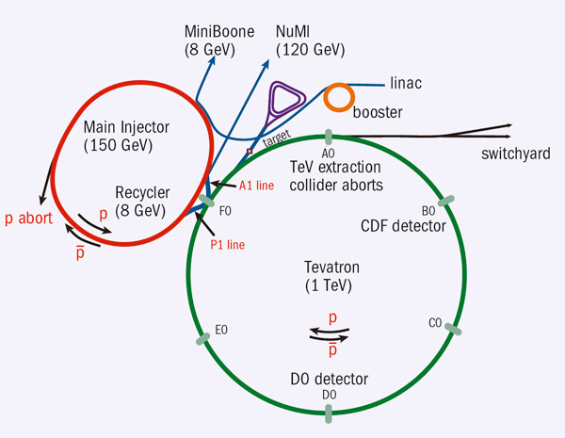
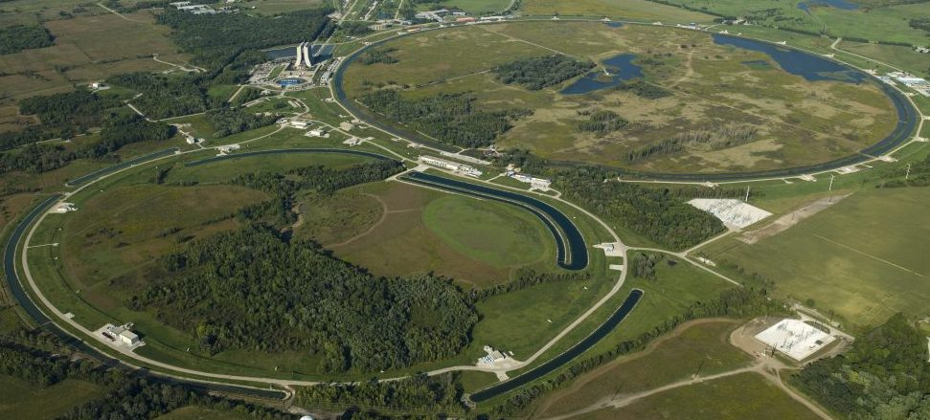
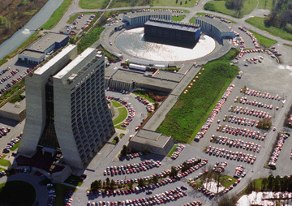
Uncertainty Aware Booster Surrogate
Aim:
Reduce beam losses in the FNAL Booster by developing a Machine Learning (ML) model that provides an optimal set of actions for GMPS regulator
FNAL Accelerator Complex:
Fermilab Site
The Booster receives the 400 MeV (kinetic energy) beam from the Linac
It is then accelerated to 8GeV with the help of booster cavities and Combined-function bending and focusing electromagnets known as gradient magnets.
These magnets are powered by the gradient magnet power supply (GMPS)
Booster ring
Courtesy: Christian Herwig

Slide 24
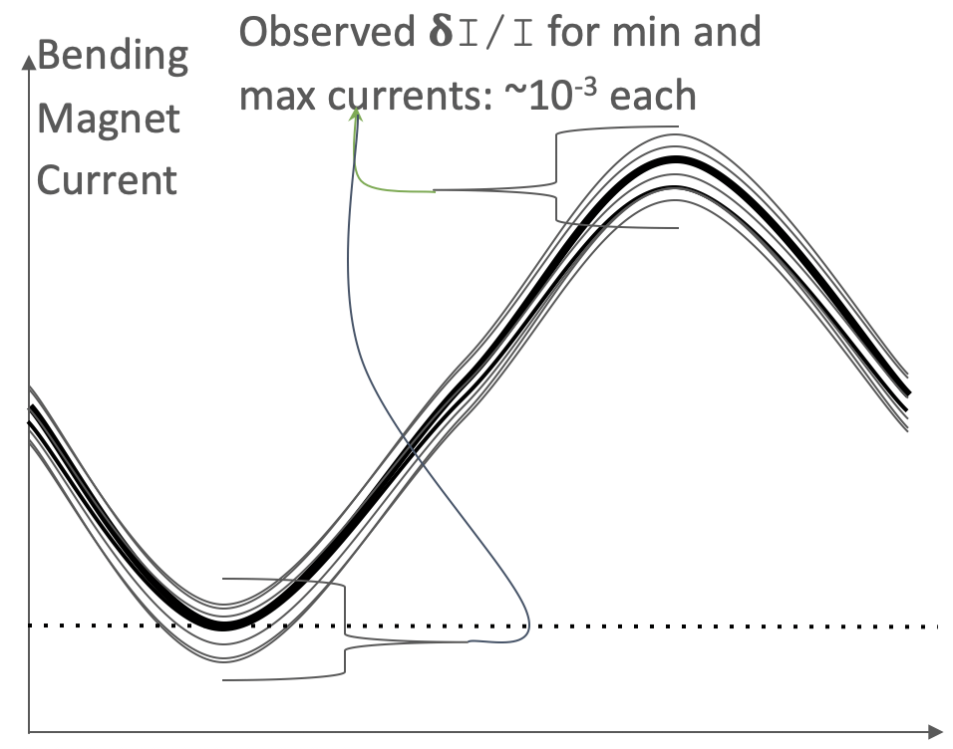
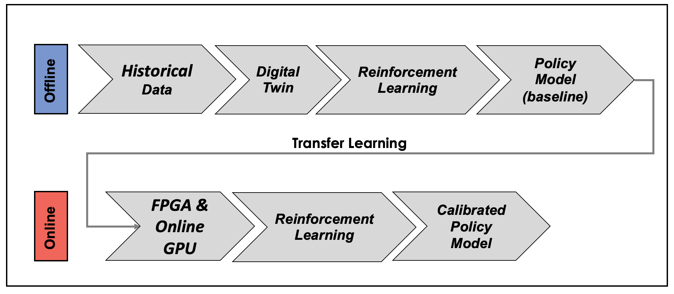
Reinforcement Learning for Booster Control
Other high-current, high-power electrical loads near GMPS varies in time
Causing unwanted fluctuations of the actual GMPS electrical current and thus fluctuations of the magnetic field in the Booster gradient magnets
This spread in B-field degrades the beam quality
A GMPS regulator is required to calculate and apply small compensating offsets in the GMPS driving signal
Use of RL to improve the existing PID based regulator
Policy model is focused on controlling the regulator to reduce the error
This invokes a need of Surrogate model to build the RL environment

Slide 25
Uncertainty Aware DL Regression Model
Why uncertainty quantification is important in Digital Model?
Uncertainty Quantification can help determine how well a region of a phase space is modeled by the surrogate
Gaussian Process Approximation (DGPA) method to quantify the regression uncertainties for a DL model
Unlike most other methods, DGPA does not require multiple inferences and does not require offline calibrations making it easy to deploy in online settings
Arxiv: https://arxiv.org/abs/2209.07458
Poster: NeurIPS Physical Science Workshop 2022
Paper: Under review at PRAB

Slide 26
Thank You!
References:
Uncertainty aware anomaly detection to predict errant beam pulses in the SNS accelerator
W Blokland, K Rajput, M Schram, T Jeske, P Ramuhalli, C Peters, Y Yucesan, A Zhukov… - https://arxiv.org/abs/2110.12006
Uncertainty Aware ML-based surrogate models for particle accelerators: A Study at the Fermilab Booster Accelerator Complex
M Schram, K Rajput, K Somayaji, P Li, JS John… - https://arxiv.org/abs/2209.07458
Umap: Uniform manifold approximation and projection for dimension reduction
L McInnes, J Healy, J Melville - arXiv preprint arXiv:1802.03426, 2018 - https://arxiv.org/abs/1802.03426
Grad-cam: Visual explanations from deep networks via gradient-based localization
RR Selvaraju, M Cogswell, A Das… - Proceedings of the …, 2017 - openaccess.thecvf.com
Simple and principled uncertainty estimation with deterministic deep learning via distance awareness
J Liu, Z Lin, S Padhy, D Tran… - Advances in …, 2020 - proceedings.neurips.cc
Real-time Artificial Intelligence for Accelerator Control: A Study at the Fermilab Booster
Jason St. John, Christian Herwig, Diana Kafkes, Jovan Mitrevski, William A. Pellico, Gabriel N. Perdue, Andres Quintero-Parra, Brian A. Schupbach, Kiyomi Seiya, Nhan Tran, Malachi Schram, Javier M. Duarte, Yunzhi Huang, Rachael Keller
Developing Robust Digital Twins and Reinforcement Learning for Accelerator Control Systems at the Fermilab Booster
D. Kafkes, M. Schram - https://arxiv.org/abs/2105.12847

