Slide 1
Application of Natural Language Processing on Electronic Logbooks (Elog)
Jennefer Maldonado
Collider Accelerator Department, Brookhaven National Laboratory
jmaldonad@bnl.gov

Slide 2
Outline
Overview
Data Preprocessing
Elog Entry Similarity
Classification
Workflow, Summary, & Future Work

Slide 3
Overview

Slide 4
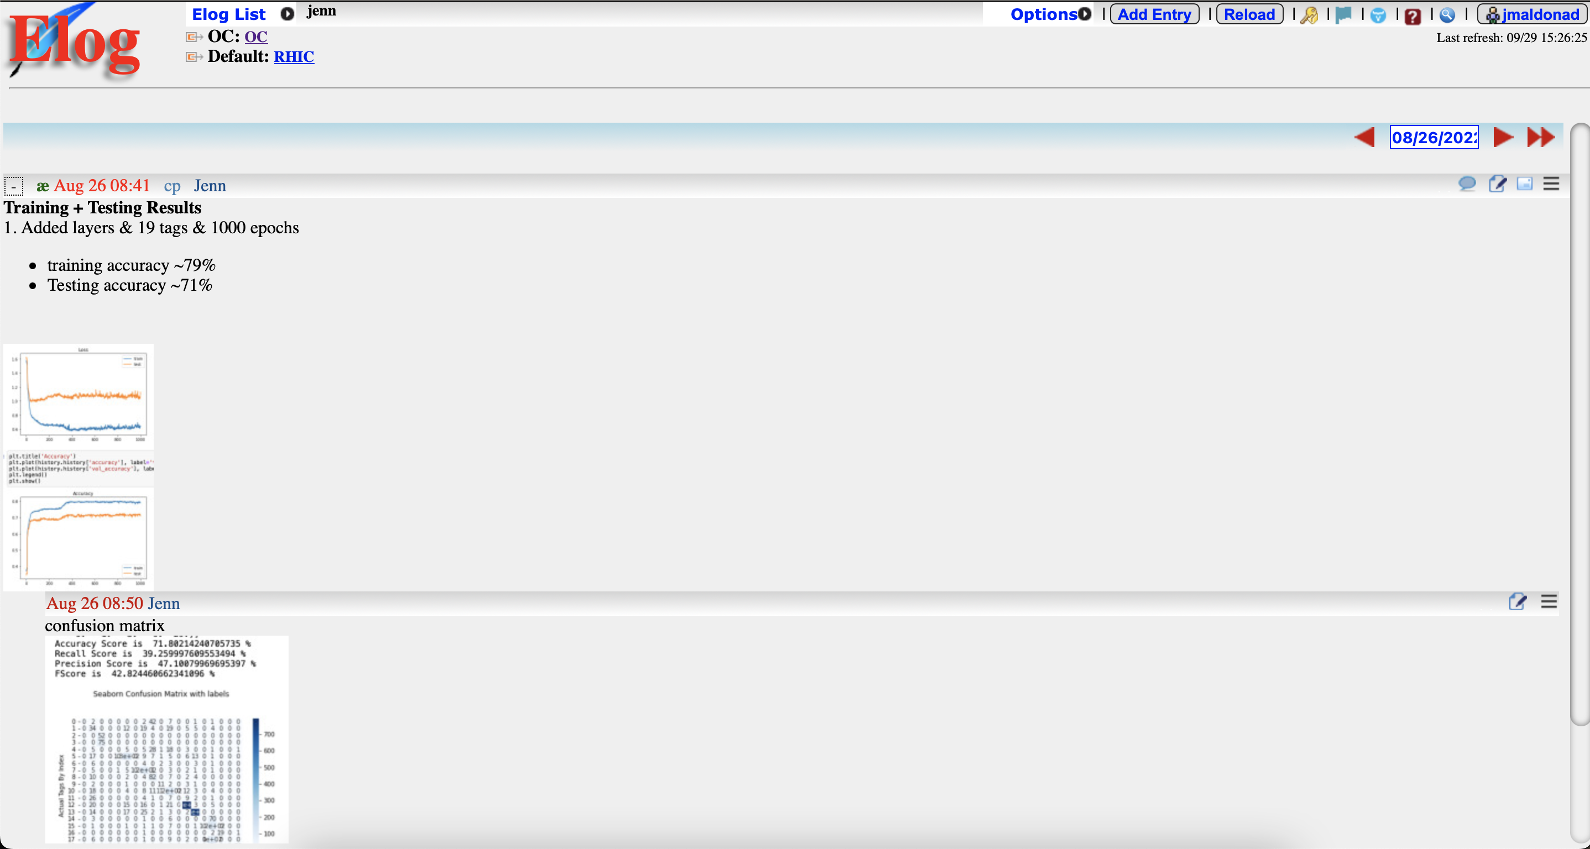
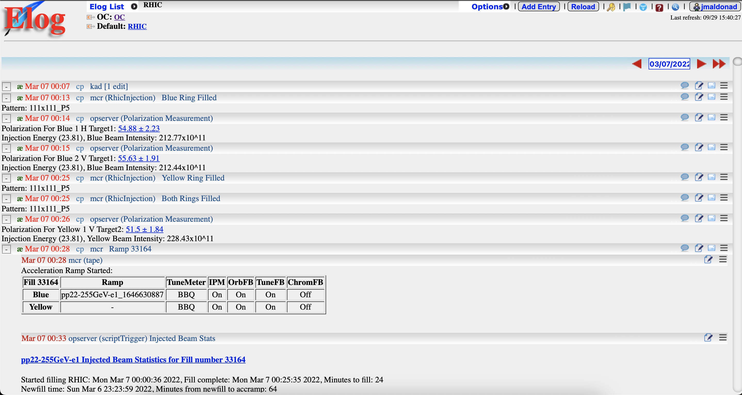
What is the elog system?
The electronic logbook (elog) system is used to record information ranging from meeting notes, to do lists, and critical operations

Slide 5
Motivation
The search feature only provides exactly what a user enters, what if there are other entries that do not include those exact words BUT also are related to these things
Can we determine what the user is interested in viewing?
Eventually provide custom sets of entries based on users' interactions with the system
Notes:
I think this was related to the NLP algorithm that Dale developed. The ‘normal’ search feature provides results that should match exactly. The problem is that it is difficult to find relevant topics because, for example, you want to find out all the entries in March where people were talking about a failure in cryo. So you search “failure” and “cryo” but there may be additional entries that don’t use those keywords which are relevant as well. How do we know that we’ve caught all the entries unless we know all of the search terms to use.
2:28
We hope that the ML algorithm can make this connection for us. So cryo and failure can also match to other words that provide more useful data. Maybe there are entries that don’t have anything to do with cryo but they do have failure connections - is the user interested in that? Maybe not.

Slide 6
Motivation
ML techniques help customize logbook settings and views, including specification of favorite logbooks
Possibly eliminate the need for manual searching

Slide 7
There can be many kinds of elogs in the database. Ex: RHIC, Machine Learning, personal elogs
This assumes we have ALL entries from ALL elogs
Elog
Database
Removes any punctuation, stop words, and empty entries. Tokenize each entry & save this information.
NLP
Preprocessing
Gensim Doc2Vec model trains 100 epochs. Returns the top few similar elog entries.
Doc2Vec
Model
SKLearn MultinomialNB classifer predicts any entry’s tag.
Classification
By classifying the similar entries output by the D2V model we can see if any entries are similar by tag. Otherwise, just use the similar entries in order by most similar.
Similar
Entries

Slide 8
Data Preprocessing

Slide 9
Data
The database includes whether entries are a comment, what book they are in, and time entered
All elog data is stored in a MySQL database

Slide 10
Data Preprocessing
Preprocessing data improves model performance by focusing on important aspects of our data
Remove links, numbers, tokenize, lemmatize, lowercase, remove punctuation, also remove any entries with no content in them
Service, building, and equipment tour complete.
[service, building, equipment, tour, complete]

Slide 11
Data Preprocessing
Tokenize
Lemmatize
Split each elog entry into individual words
This is an elog entry.
Group different forms of one word into the same form
log logs logging logged
[this, is, an, elog, entry]
log

Slide 12
Data Preprocessing
Remove Stop Words
Weight
Remove commonly used words in the English language
This is an elog entry.
[elog, entry]
Compute the weight of an entry
if an entry is a comment
if an entry is flagged
if an entry is tagged

Slide 13
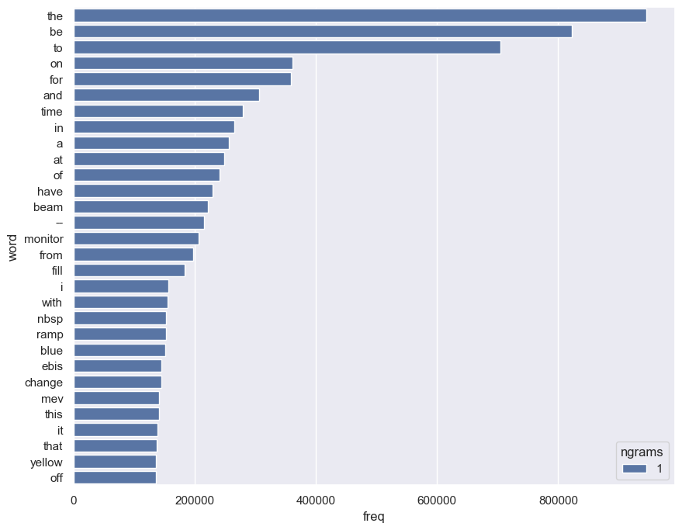
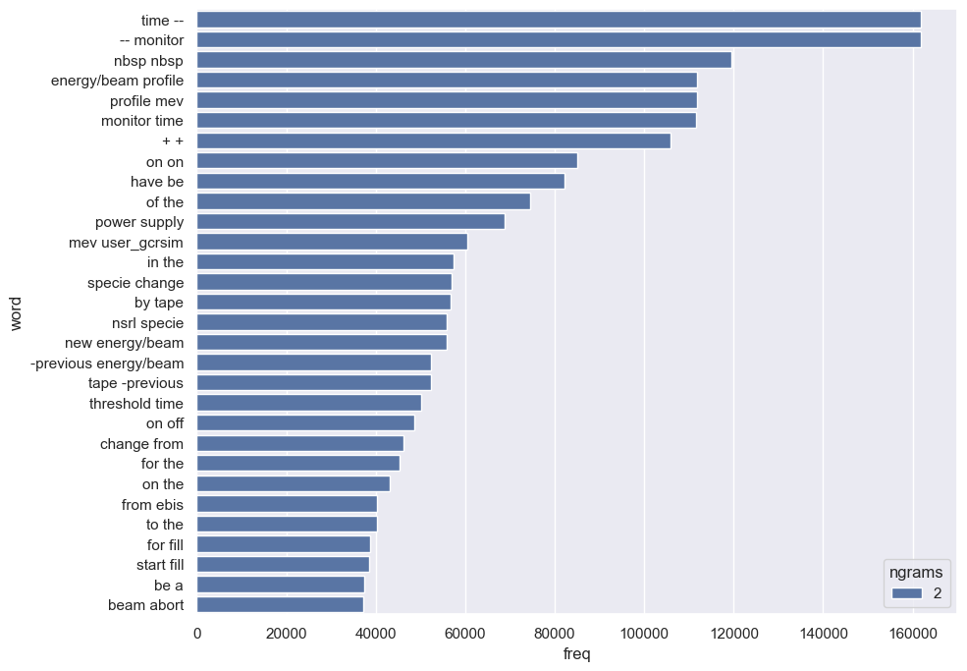
Common Elog Words (before preprocessing)

Slide 14
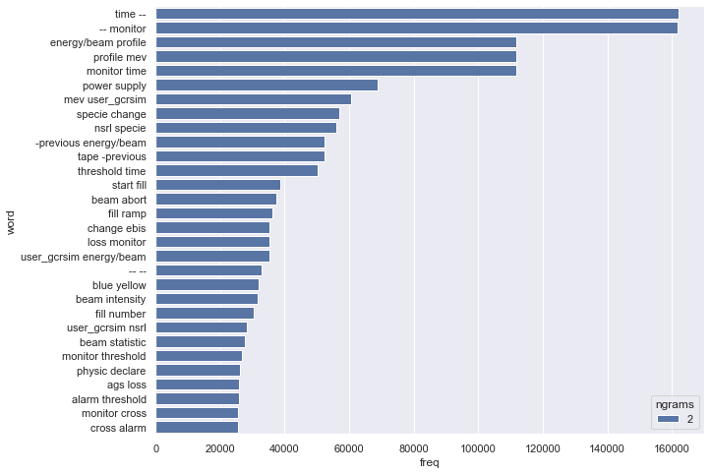
Common Elog Words (after preprocessing)

Slide 15
Elog Entry Similarity
Word2Vec & Doc2Vec

Slide 16
Why Word2Vec?
One Hot Encoding assigns value to word as they appear in text
Word2vec creates a representation based on a word's relations with others
Word2vec combines two models to represent contexts
Continous Bag of Words (CBOW) – predicts context based on surrounding words. The vectors produced represent similar words by different distance metrics.
SkipGram – uses one word to predict the context of all surrounding words
Notes:
(slow but more accurate for less used words)

Slide 17
Doc2Vec
Laboratory
Gensim D2V model based on Distributed Representations of Sentences and Documents by Le and Mikolov
Paragraph vectors predict the next word given a sample of words from the paragraph
Every paragraph is mapped to unique vector which is a column in the paragraph matrix
Every word in each unique vector also gets mapped to a unique column vector in the word matrix
Average or Concatenation
Word Matrix
Word Matrix
Paragraph
Matrix
Elog Entry ID
Brookhaven
National

Slide 18
Doc2Vec
Take processed entries and create a list of d2v tagged documents
The model will build a vocabulary from this list
Trains the model on the list of tagged documents
D2V most_similar computes the cosine similarity between entries

Slide 19
Doc2Vec
Used 100 epochs for the model to learn
~1.5 hours on GPU for 1.5+ million entries
Used 100 epochs for each prediction
For finding similar documents, 0.3s-1s on GPU
Daily Training: 100 epochs
Number of Entries per Day | Time Taken to Train (seconds)
50 | 0.25
100 | 0.39
700 | 2.91
1300 | 4.71

Slide 20
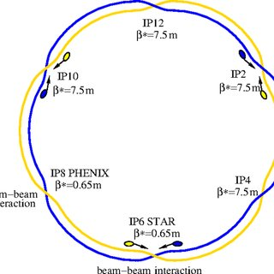
Similar by Words and Most Similar
Polarization
Blue
Background ~ 70%
Beta ~ 69%
Polarimeter ~ 64%
Bunch ~ 63%
Excitation ~63%
Coherence ~62%
Emittances ~60%
Yellow ~94%
RHIC ~87%
Ramp ~84%
Power ~84%
Run ~82%
Fill ~80%
Delay ~79%

Slide 21
Similar Documents
polarization for yellow 2h target1 store energy before physics declared yellow beam intensity
Yellow 1 V6 Polarization: -51.53 6.05%
Yellow 2 H6 Polarization: -51.28 10.83%
Polarization For Yellow 1 V Target2: 51.44 &plus mn 1.94 Store Energy (254.21) Before Physics Declared, Yellow Beam Intensity: 208.3x10^11
Yellow 1 V5 Polarization: -56.67 4.87% Yellow 2 H5 Polarization: -59.46 6.09%
78%
77%
76%

Slide 22
Classification

Slide 23
Metrics
Accuracy: correctly predicted tags / all possible entries to be tagged (TP+TN/ TP+FP+FN+TN)
Recall: correctly predicted tags / all entries that have that tag (TP/TP+FN)
Precision: correctly predicted tag of a specific tag / all entries that were labeled with that tag (TP/ TP+FP)
F-Score: weighted average of precision & recall (2*(recall*precision) / (recall + precision))
https://blog.exsilio.com/all/accuracy-precision-recall-f1-score-interpretation-of-performance-measures/

Slide 24
Multiclass Classifier
19 Tags, 1000 epochs
Training Accuracy: ~79%
Testing Accuracy: ~72%
Recall Score: ~39%
Precision Score: ~47%
F Score: ~0.42
https://www.jeansnyman.com/posts/multi-class-text-classification-with-tensorflow/

Slide 25
Multinomial Naïve Bayes
Naïve Bayes for multinomially distributed data
Naïve Bayes variant for text classification
Data is word vector counts using SKLearn CountVectorizer
Accuracy Score: ~78%
Recall Score: ~74%
Precision Score: ~66%
F-Score: ~0.70

Slide 26
Classification Example
R-Failure
F-MachineSetup
Alarm cleared by access control personnel. Might have been related to power lost or the fire alarm testing.
Received call to inform us that the work at the Booster argon station #1 is completed. It is now back to normal operations.

Slide 27
Workflow, Summary & Future Work

Slide 28
Workflow
Once
Daily
Collect the data from the database
Preprocess and save the data
Train D2V and multinomial classifier on all data
Save trained models
Collect days entries, varies from 50-1,300
Preprocess day’s data
Load and train D2V model
Apply count vectorization
Load, fit, and predict multinomial classifier
Sort entries by most similar, considering tags
Notes:
Daily entry numbers depend on run / month
Messaging service is used to ensure there is a daily run exectution

Slide 29
Future work
System in place to determine what entries each user interacts with
During run time, elog entries are often automated. Should this impact the suggested entries?
Custom model for each user with input data of their written and commented on entries?
Should typos be dealt with?
Web interface implemented into the elog system

Slide 30
Thank you!
Special thanks to Dale Yu & Prerana Kankiya for their contributions over the summer.
Thanks to Kevin Brown, Sam Clark, Wenge Fu, and Seth Nemesure for their knowledge and support.

