Slide 1
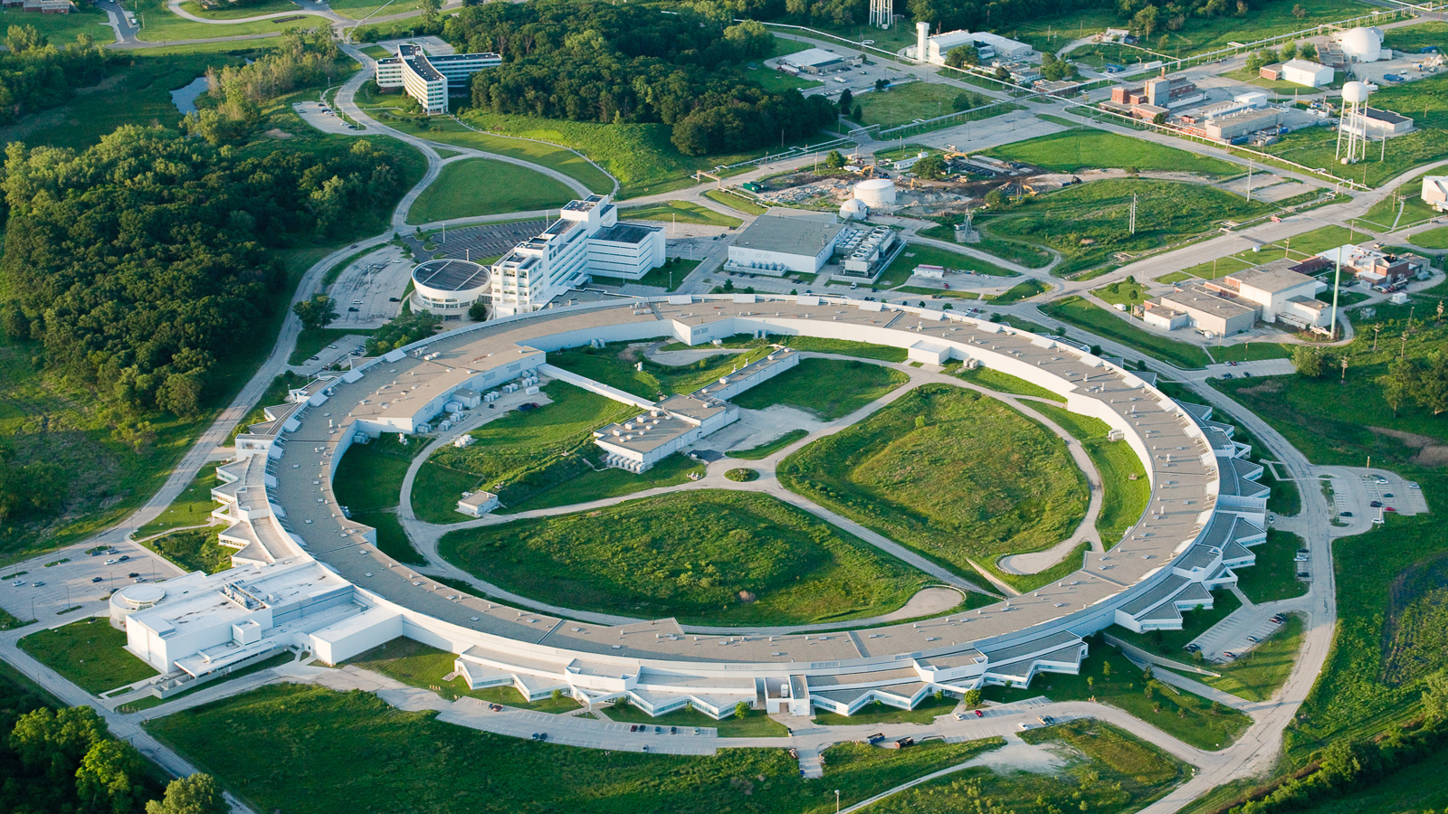
Recent Progress on ML-based Optimization and anomaly prediction at APS
Nikita KUKLEV (Advanced PHOTON SOURCE, ANL, USA)
Ihar Lobach
Yine Sun
Michael Borland
Katherine C. Harkay
Hairong Shang
Greg Fystro
Jonathan Edelen (RadiaSoft)
ICFA ML 2022
November 3, 2022

Slide 2
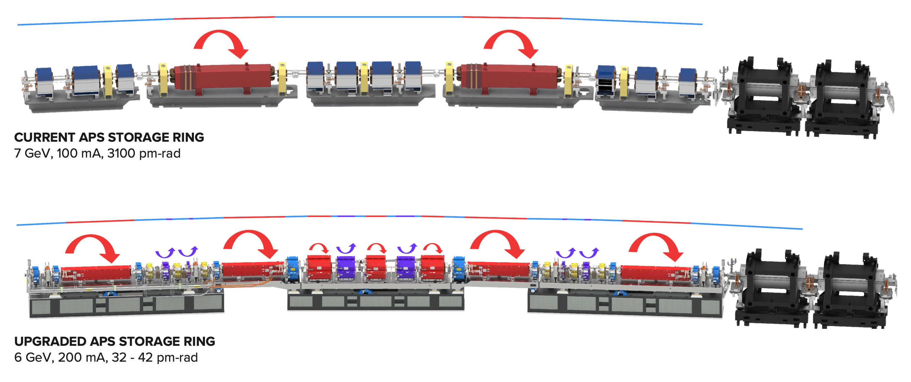
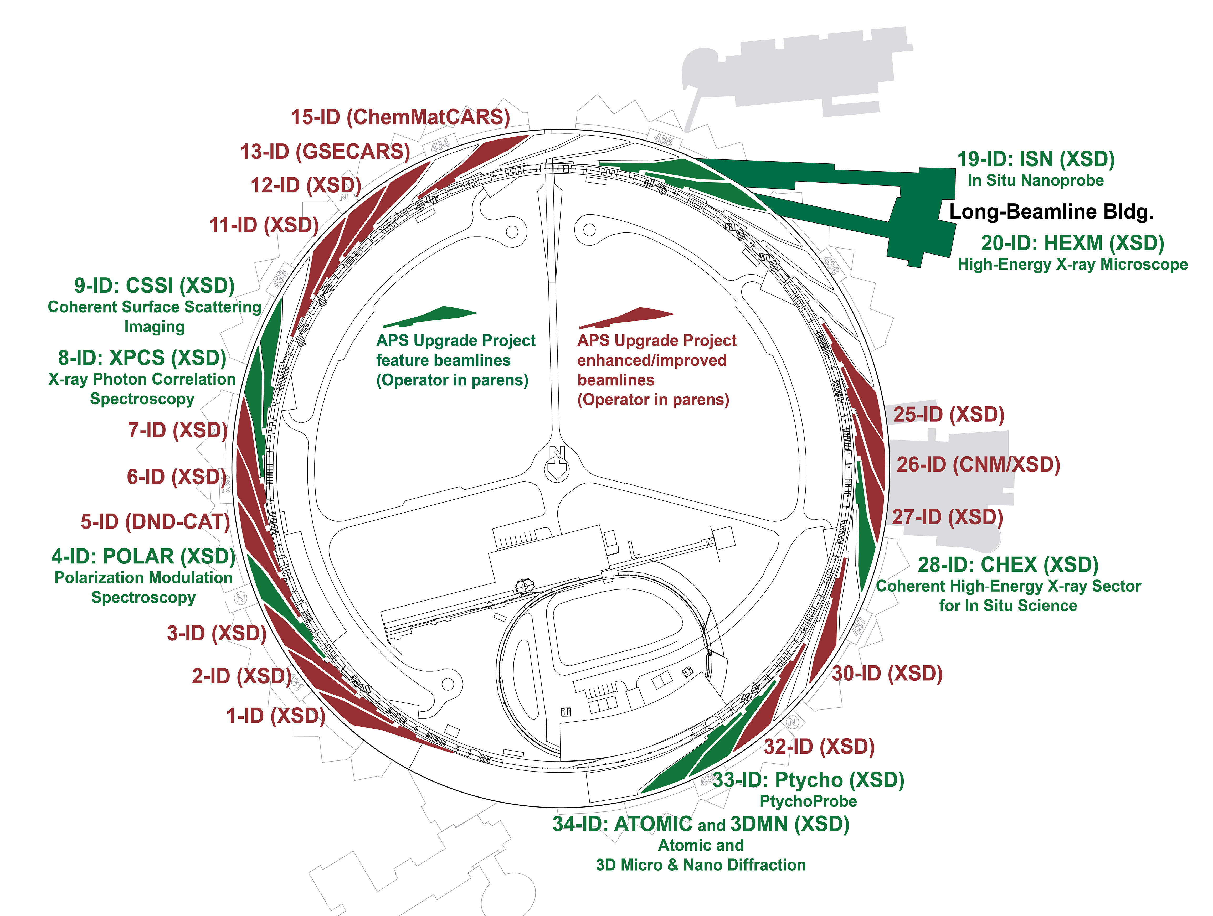
APS
APS is undergoing a major upgrade (APS-U)
New storage ring
Refurbishment of injector complex
More beamlines
Shutdown April 2023, user operation April 2024
Only 3 months of 24x7 beam commissioning
New opportunities and new challenges
More challenging physics
New diagnostics and increased data rates
A chance to demonstrate ML tools at a critical moment

Slide 3
ML @ APS
Several simultaneous efforts underway
Support infrastructure
ML research
Production tools
Optimization
algorithms
Data storage and analytics
Expert-usable CLI/scripts
Anomaly detection and
prediction
Control, I/O, configuration libraries
Operator-usable GUI tools
Surrogate models

Slide 4
OUTLINE
Data logging and analytics
Anomaly detection/prediction (I. Lobach)
Adaptive optimization

Slide 5
APS DATA ANALYTICS
What kind of data does accelerator produce?
Time series of various types
How is data stored?
Read from control system into specialized tools
APS – monthly compressed per-PV files (sddslogger)
Many other labs – yearly compressed per-PV files (Archiver Appliance)
Custom high speed loggers
Device
L3:B1.XPOS = 0.25

Slide 6
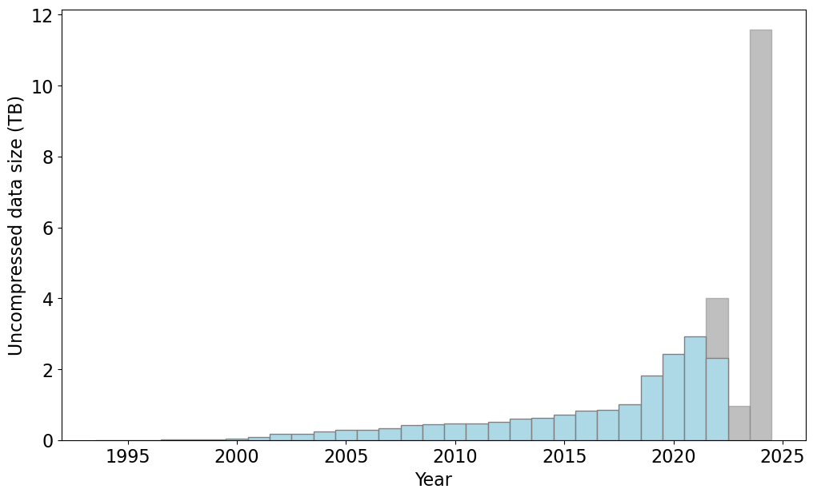
APS DATA ANALYTICS
How much data is there?
So far, not ‘too much’, but growing A LOT
New devices, even more ML data

Slide 7
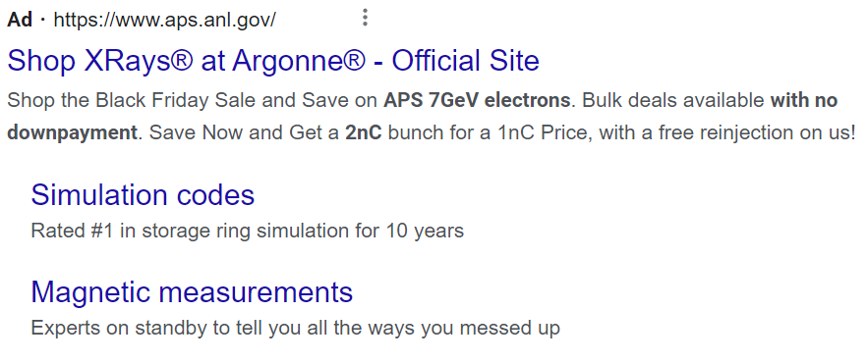
APS DATA ANALYTICS
Current systems well suited to archival storage - why is this a problem for ML?
Different access patterns:
Broad queries – thousands of PVs
Analytical postprocessing (min, max, median, …)
Stricter requirements:
Near-realtime availability
Fault-tolerant
Solution?
Ads!

Slide 8
SOLUTION FOR ML DATA
User data collection created new ‘Big Data’ analytics/time-series databases!
Column oriented data storage
Specialized for fast data ingest, high compression, large mathematical queries
Scales to PB of data
Open-source and (mostly) free

Slide 9
SOLUTION FOR ML DATA
Benchmarked several popular projects on historical data (ask me for details)
Current choice – ClickHouse
VERY fast and has SQL support
How fast is fast? ~20x over existing scripts
Example:

Slide 10
INTEGRATION
Integrated side-by-side with existing tools to minimize disruptions
<1Hz
Standard logged devices
L3:B1.XPOS = 0.25
All events
Extra on-demand devices for ML
L3:B1.XRAW = 0.254
All events
Modified Archiver Appliance to work as
data collector at any rate/event mask

Slide 11
OUTLINE
Data logging and analytics
Anomaly detection/prediction (I. Lobach)
Adaptive optimization

Slide 12
Anomaly Detection and Classification at APS
Several proof-of-principle experiments for use cases of ML in the Injector Complex, using intentional-perturbations data for training and testing https://napac2022.vrws.de/papers/tuye4.pdf
Neural network classifier for sources of poor transmission efficiency
Autoencoder for anomaly detection in the Particle Accumulator Ring (PAR)
$β$-variational autoencoder for clustering of poor-performance data
Program for anomaly detection in the magnet power supplies in the Storage Ring (APS and APS-U) https://napac2022.vrws.de/papers/tupa29.pdf
In this presentation:

Slide 13
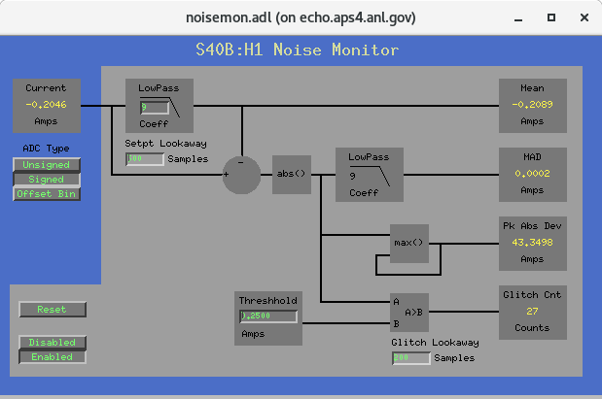
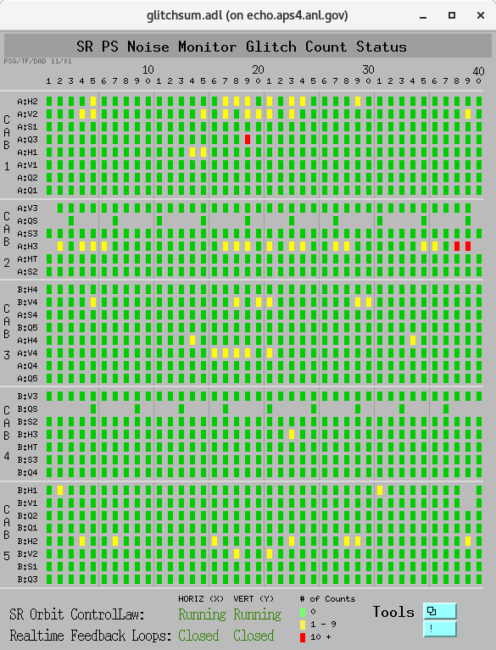
Anomaly Detection in Storage Ring Power Supplies
Motivation: the detected anomalies may help predict trips or (at least) create a priority list of PSs for maintenance. In turn, this reduces downtime.
Available historical data:
APS Storage Ring has 40 sectors, each has A and B subsectors. We consider quadrupoles (Q), sextupoles (S), horizontal (H) and vertical (V) correctors (overall, 1320). Example of a magnet name: S40B:H1
We analyzed the APS run history from 2001 to 2022:
Found 629 ring fills that ended with “Int. Dump: End of Period”
Found 149 ring fills that ended with a PS trip, glitch, fault, or problem
Process Variable | Explanation
CurrentAI | PS current
MagTempAI | Magnet temperature
CapTempAI | PS capacitor temperature
IGBTTempAI | PS transistor temperature
OutVoltageAI | PS voltage
PS Current Noise Monitor Data
Instantaneous Mean Current
Instantaneous Mean Absolute Deviation of Current
MeanMin, MeanMean, MeanMax in a 10 min window
MADMin, MADMean, MADMax in a 10 min window
1 point per 64 seconds starting from 2008
1 point per 10 minutes starting from 2001

Slide 14
Tool to review past detected anomalies
Can be used with any anomaly detection method, based on an anomaly score and a threshold.
Currently, only H and V corrector power supplies
Using current noise monitor data (MADMax-based approach, but also considered autoencoders, LSTMs)
Model is retrained before every APS run, on the previous 10 runs (~3 years)
Anomaly Statistics tab presents the number of fills with anomalies (not the number of anomalous data points)
https://pypi.org/project/PyQt5/

Slide 15
Anomalies in Power Supply Temperatures in the Storage Ring
Detection of anomalies in power supply temperature maps is similar to object detection in images. Therefore, we have used object detection methods. Further, our intern (Alexandre Sannibale) is considering Convolutional Neural Networks for PS temperature maps.
The presented anomaly was related to a stuck mixing valve for the cooling water. There is one mixing valve per every two neighboring sectors in APS. Therefore, we can see rising temperatures in sectors 19 and 20.

Slide 16
Autoencoder for Temperature of a Single Power Supply (in a time window)
One can use several contiguous temperature values of a single PS as input for an autoencoder. Such autoencoders can be sensitive to unusual temperature behavior in time (even if the absolute value of temperature is not high enough to trigger an alarm on high temperature)
Chosen autoencoder architecture: 20 → 10 → 5 → 10 → 20
The autoencoder was trained on 10 preceding reference data files.
This approach did not produce any false positives for this magnet’s PS for the entire observation interval from 2008 to 2022.
This fill ended because of a trip in this PS
(S16B:S2)
*Threshold = 1.5

Slide 17
Anomaly Detection Performance / Outlook
Certain anomalies in PS temperature maps (e.g., stuck mixing valve) can be detected with 100% precision and zero false positive rate.
Autoencoders may be able to detect anomalies invisible to less sophisticated algorithms. The temperature anomaly in S16B:S2 was only detected due to its unusual behavior in time. The value of the temperature was not too high.
We made progress in anomaly detection in the PS Current Noise Monitor data. However, only up to 20% of trips were successfully predicted, the false positive rate was not insignificant. Still, anomalies were up to 500 times more likely in the data leading to a trip, than in the normal-operation data.
Jonathan Edelen and Ihar Lobach are working on improving the performance with more advanced algorithms, such as LSTM recurrent neural networks, which will be using all available process variables in one model (PS current, voltage, temperatures).
In APS-U, we will have PS current data at 22 kHz. We have the freedom to do anything with these data. This will likely further improve performance
Also, in APS-U, the PSs will have unique labels. In APS, they are labeled by magnet names.

Slide 18
OUTLINE
Data logging and analytics
Anomaly detection/prediction (I. Lobach)
Adaptive optimization

Slide 19
ACCELERATOR OPTIMIZATION
Many approaches with various tradeoffs
Humans
Classic methods
Artificial Intelligence
Machine Learning
Deep Learning
Scientists
Engineers
Operators
Nelder-Mead Simplex RCDS Extremum Seeking
Genetic Algorithm Particle Swarm
Bayesian Optimization
Reinforcement Learning Deep Kernel Learning
EXISTS
EXISTS
EXISTS
THIS TALK

Slide 20
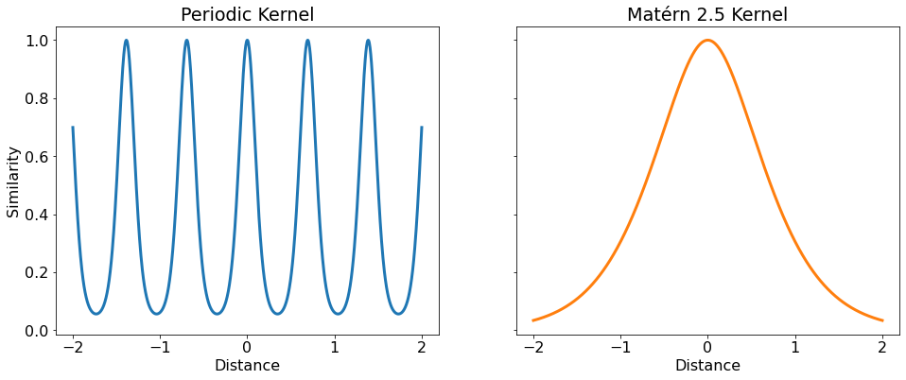
BAYESIAN OPTIMIZATION
MACHINE BLACK BOX
INPUTS
Maximize Acquisition Function
Gaussian Process (GP) Model

Slide 21
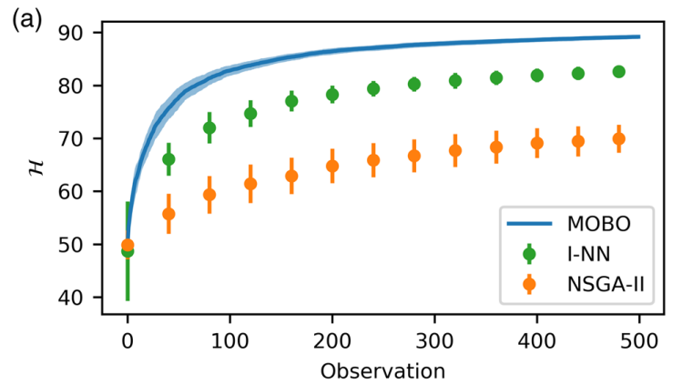
BAYESIAN OPTIMIZATION
Bayesian optimization (BO) a promising method for expensive problems
Model-based and can encode expert knowledge
Interpretable and scalable
Previous work showed good performance in time-invariant tasks
See also Duris PRL 2020
Roussel PRAB 2021

Slide 22
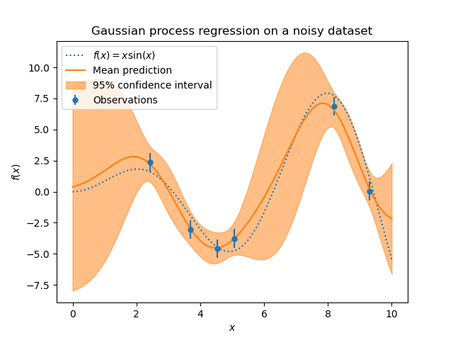
ADAPTIVE BAYESIAN OPTIMIZATION
Many accelerators have time-dependent performance: f(t,x)
External factors (temperature, etc.)
Device drift / degradation
A challenge for conventional BO
Without time model, drift appears as noise
Convergence to average suboptimal state
Common solution – run local optimizer after BO
Can drift be modelled explicitly?
More details in: https://napac2022.vrws.de/papers/thxd4.pdf

Slide 23
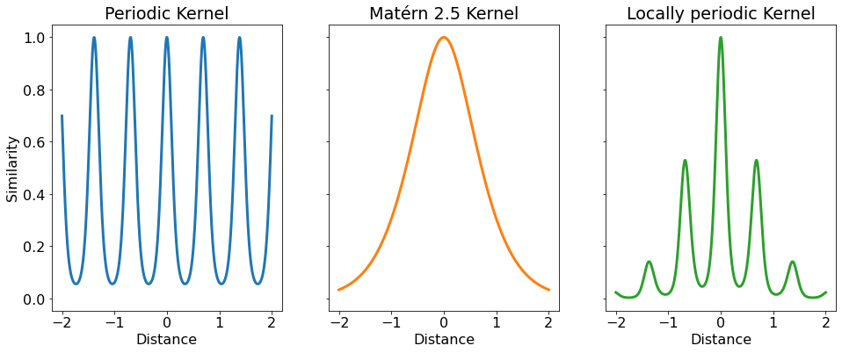
ADAPTIVE BAYESIAN OPTIMIZATION KERNEL
Consider time as another ‘input’ - has very different properties
Periodic on various timescales (minutes, hours, days)
Overall linear/polynomial trends
Can compose sub-kernels along any subspace - what is the right one?
K1 + K2 = LOGICAL OR
K1 * K2 = LOGICAL AND

Slide 24
ISOTROPIC KERNEL
Simplest choice – isotropic kernel
‘Just add a dimension’
Advantages:
Robust and simple to implement
Disadvantages:
No global structure
Lags behind changes
t
x

Slide 25
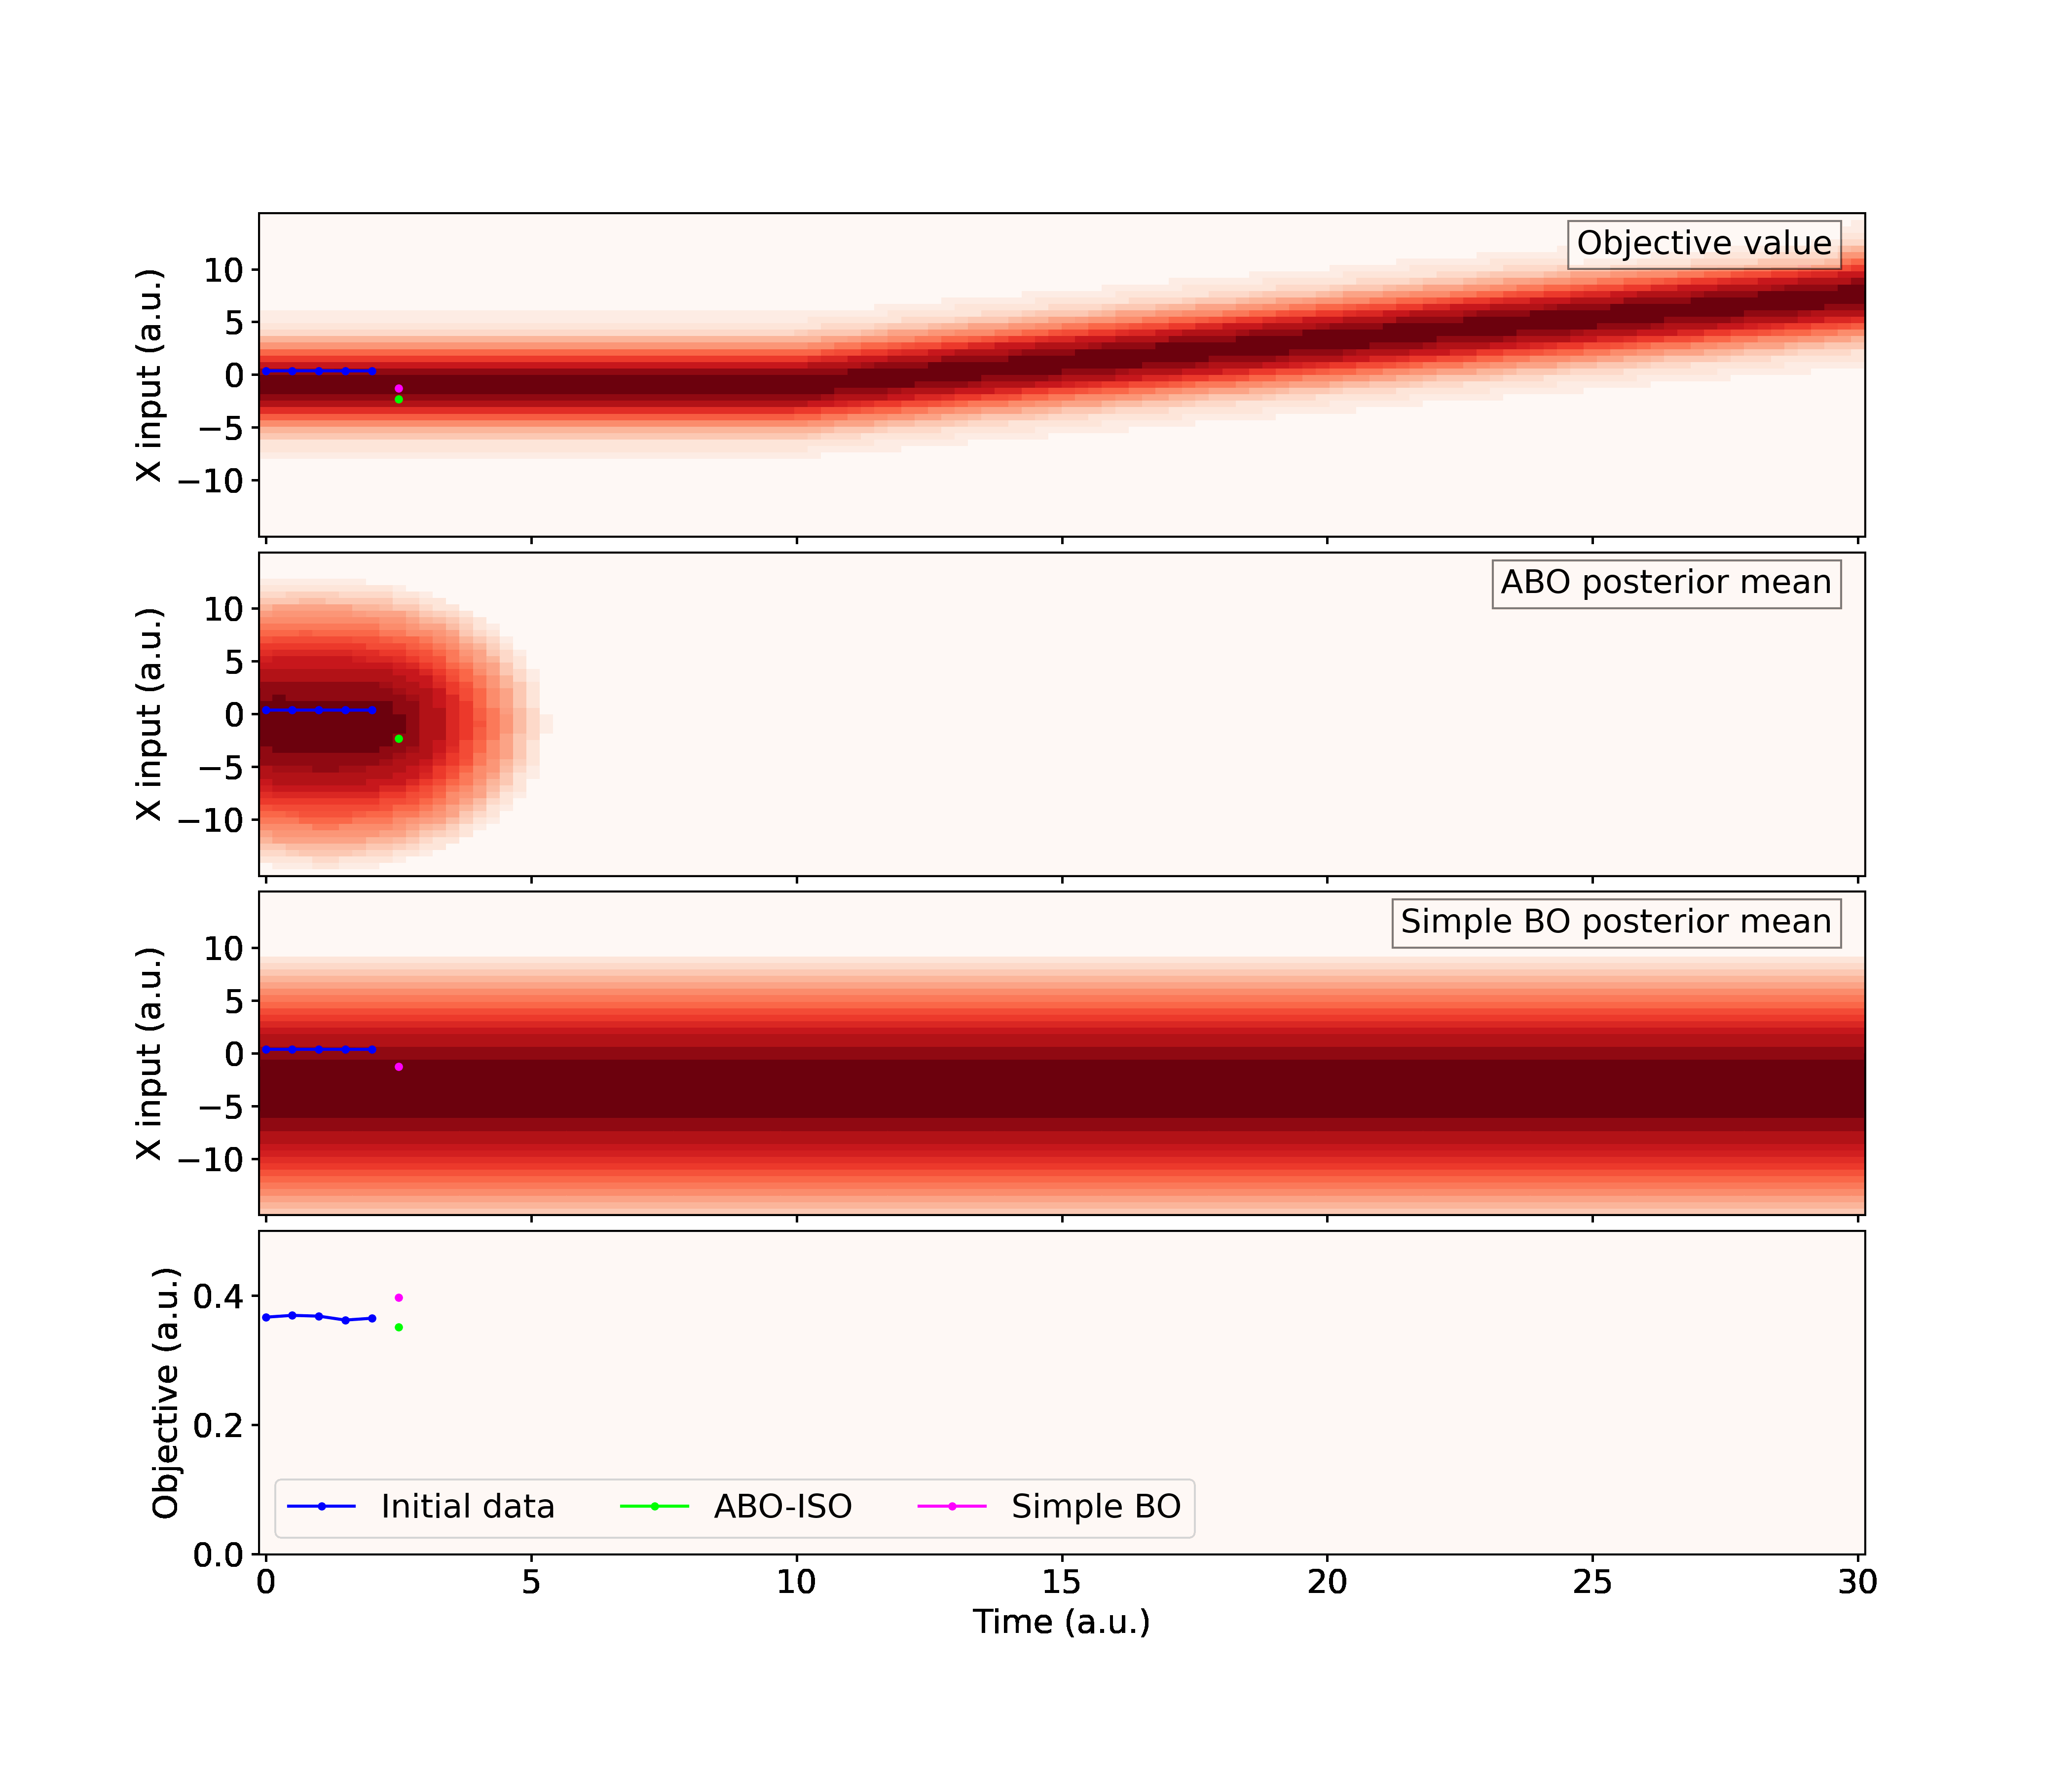
ISOTROPIC KERNEL
NO DRIFT
DRIFT
Simulation – corrector drift

Slide 26
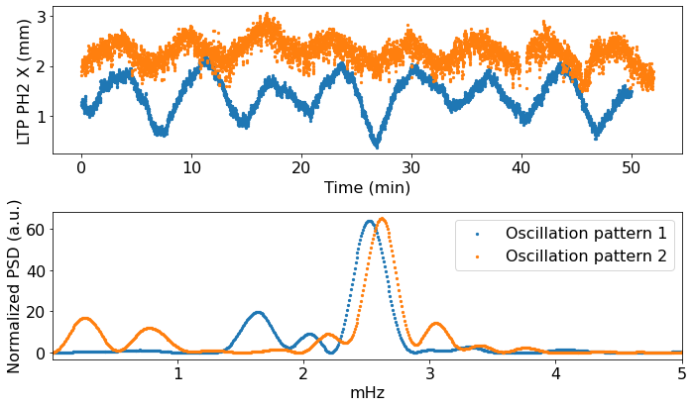
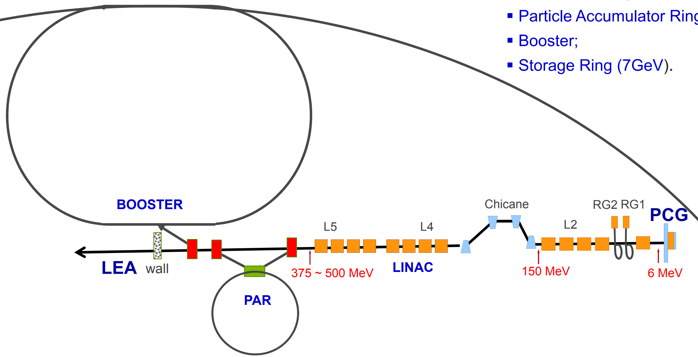
Adaptive ml motivation @ APS
APS injector supplies beam to storage ring and linac extension area
Proportional feedback used to compensate drifts but has high jitter
Drift spectrum varies day to day - requires time-aware and time-adaptive control
Have repeating patterns – want to exploit long-range correlations

Slide 27
ADAPTIVE BAYESIAN OPTIMIZATION KERNEL
Our choice: Spectral Mixture Kernel
Expressed as spectral density of several Gaussians
Can approximate any stationary kernel
No need to explicitly specify like periodic/RBF
Starting point for Deep Kernel Learning
kernel
spectral density
SM ABO model

Slide 28
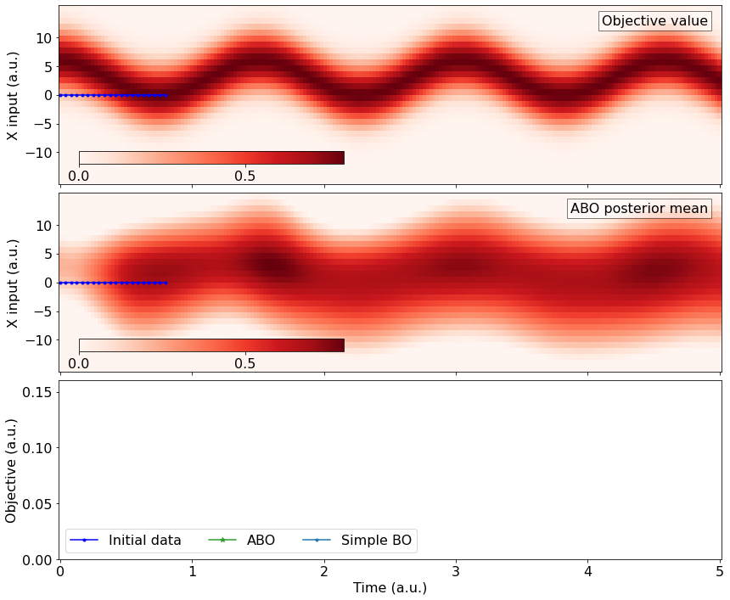
RESULTS - SIMULATION
Example: sinusoidal signal with noise + initial steady state sampling

Slide 29
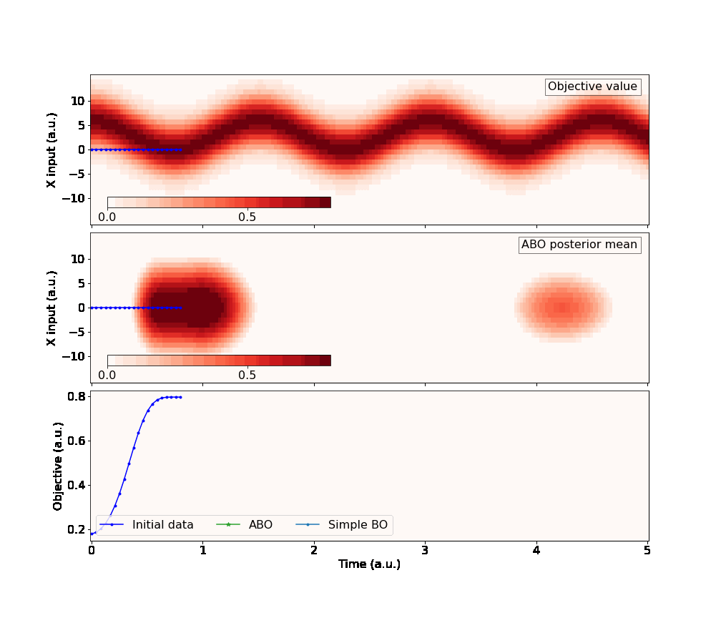
RESULTS - SIMULATION
Example: sinusoidal signal with noise + initial steady state sampling

Slide 30
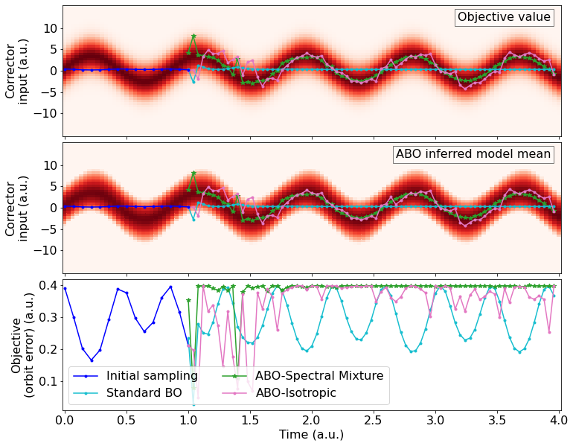
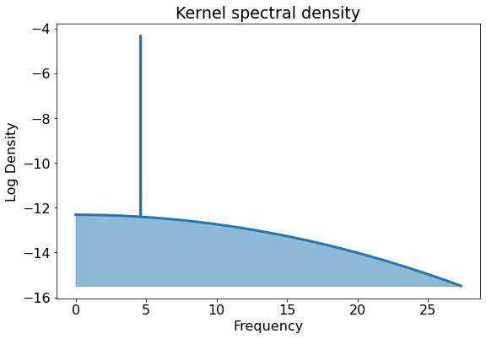
RESULTS - SIMULATION
ABO finds correct oscillation within 1 period
Kernel density reflects broad noise + oscillation frequency

Slide 31
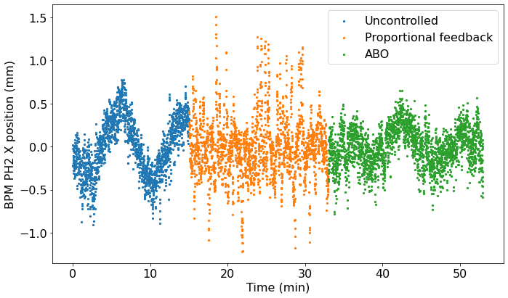
RESULTS - Experiment
Several tests in APS linac – trajectory MSE objective
10s cycle limit
Train with last 20 minutes of history
Overall 2x jitter improvement (0.21/0.36/0.33)!

Slide 32
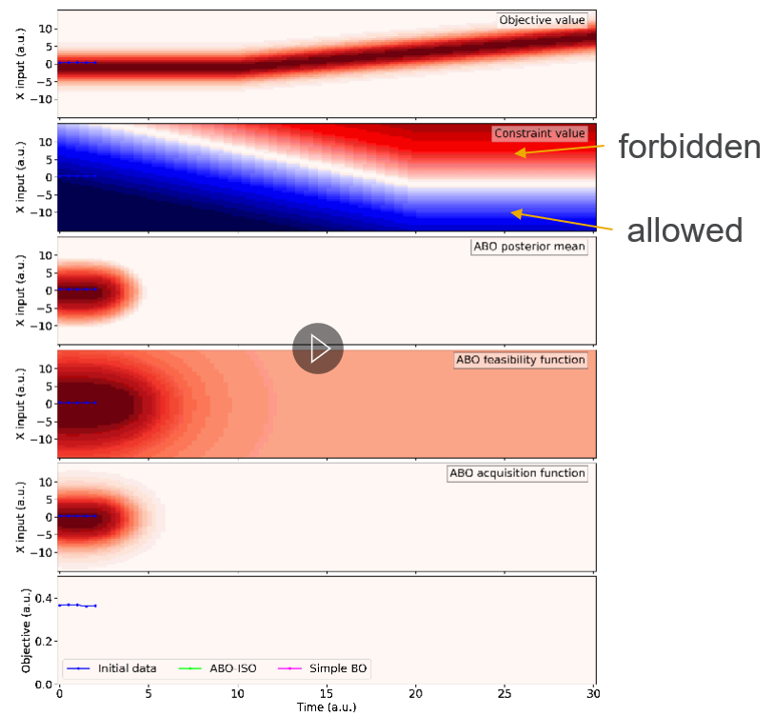
CONSTRAINTS
Time awareness can be added to constraint models
Gives anomaly prediction and avoidance capability!
Can predict ‘lifetime’ – how long is
model capable of holding optimum

Slide 33
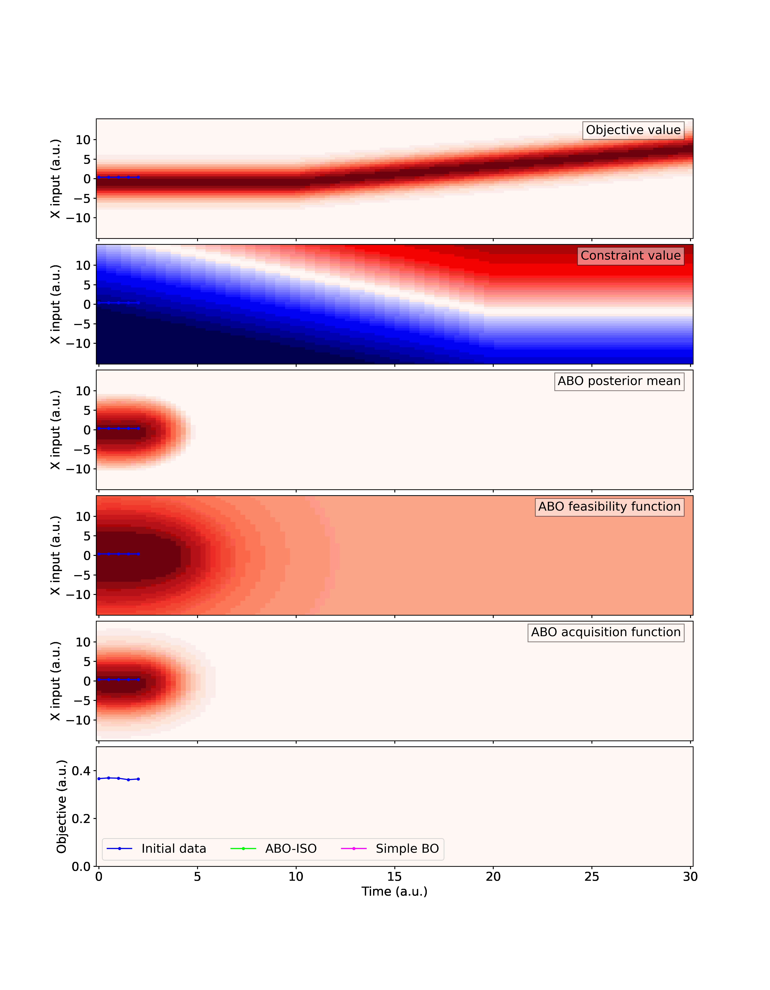
CONSTRAINTS
Time awareness can be added to constraint models
Gives anomaly prediction and avoidance capability!
Can predict ‘lifetime’ – how long is
model capable of holding optimum
forbidden
allowed

Slide 34
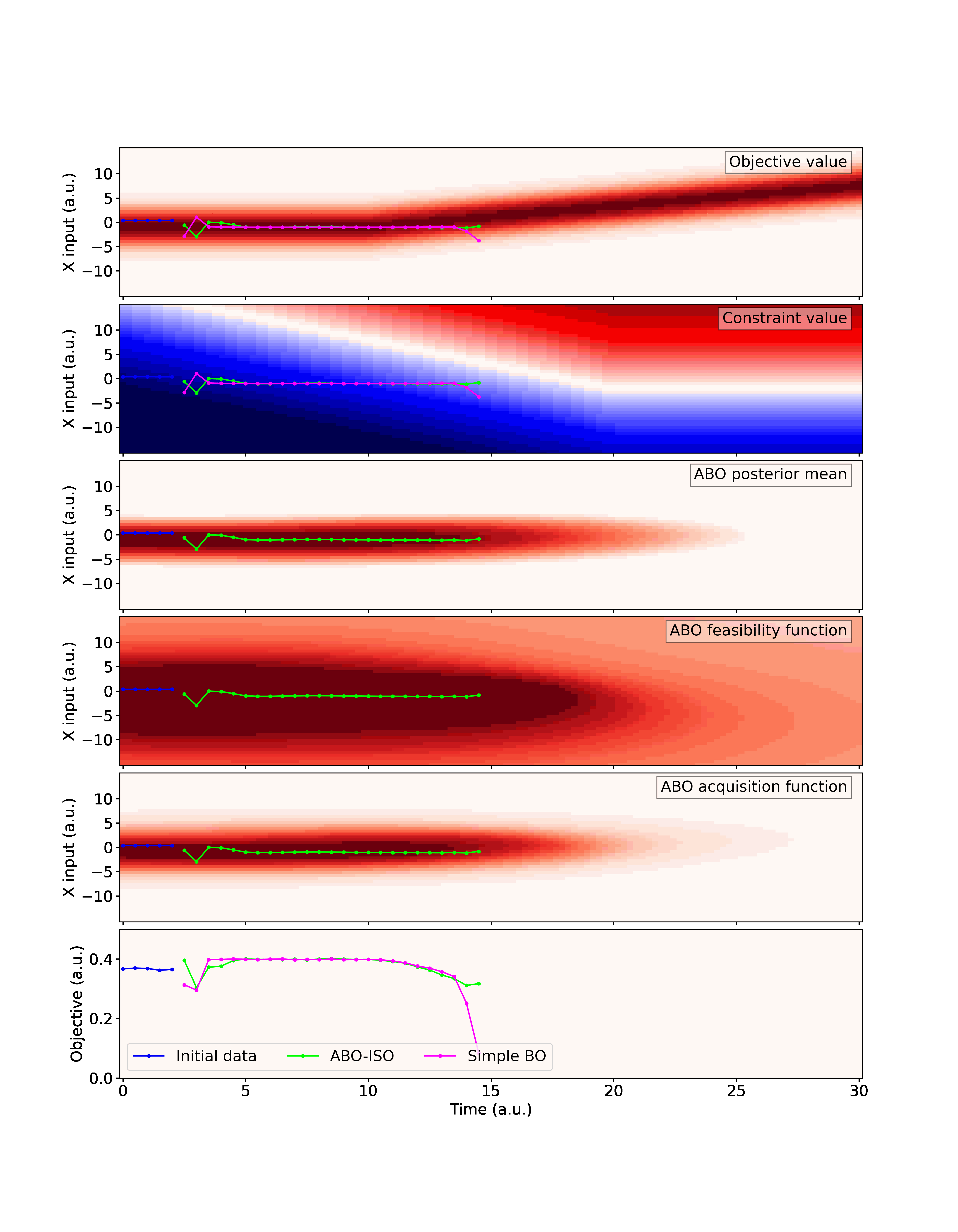
CONSTRAINTS
Time awareness can be added to constraint models
Gives anomaly prediction and avoidance capability!
Can predict ‘lifetime’ – how long is
model capable of holding optimum

Slide 35
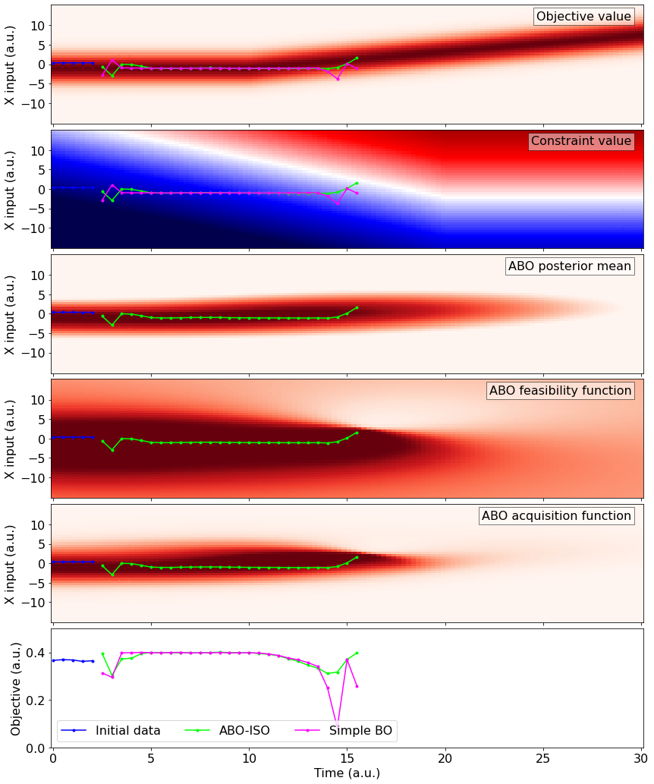
CONSTRAINTS
Time awareness can be added to constraint models
Gives anomaly prediction and avoidance capability!
Can predict ‘lifetime’ – how long is
model capable of holding optimum

Slide 36
CONTINUOUS USE considerations
ABO has several other advantages for continuous ‘feedback’ over BO or PID:
Graceful handling of failed points
Retries will have new time and give different candidates
Can control systems with time-lag
Automatic adaptability to local conditions

Slide 37
CONTINUOUS USE considerations
ABO also inherits several BO disadvantages:
Poor performance scaling (N³)
Advanced techniques extend practical limit to >10k points [arXiv:1803.06058, see GPyTorch LOVE method]
Eventually need to cut data
Simple solution: circular data buffer
Our approach: time-biased bandpass subsampling
No hard robustness/convergence guarantees
Can use lengthscale rate of change as a stability heuristic [arXiv:1803.03432]

Slide 38
Operational implementation
We are making ML libraries to work with operational APS systems
APSopt – algorithms + SDDS toolkit command line interface
Migrate general logic to Xopt for collaborative use soon™
pySDDS – Python SDDS format reader/writer
pybeamtools – soft IOCs, surrogate models, and archiver/DB interface
Can make end-to-end virtual accelerators, test with real data, and deploy operationally

Slide 39
ML @ APS
Several simultaneous efforts underway
Support infrastructure
ML research
Production tools
Optimization
algorithms
Data storage and analytics
Expert-usable CLI/scripts
Anomaly detection and
prediction
Control, I/O, configuration libraries
Operator-usable GUI tools
Surrogate models

Slide 40
CONCLUSIONs
APS is preparing for APS-U
Tight fixed schedule
New known and unknown challenges
ML tools can help in key areas
We are developing an interconnected production-level ML ecosystem:
Shared data infrastructure
Anomaly detection/prediction
Adaptive optimization
GUIs and control room tools
Focusing on internal use, but with portability and open-source in mind.
If you have things that drift/trip but shouldn’t, reach out!

Slide 41
THANK YOU!

