Slide 1

Transverse 2D phase-space tomography using BPMs
ICFA Mini-Workshop on AI/ML
Chicago, Nov, 2022
Kilean Hwang
FRIB
Chad Mitchell, Robert Ryne
LBNL

Slide 2
Theoretical marginal profile estimation
using turn-by-turn kicked beam centroid data

Slide 3

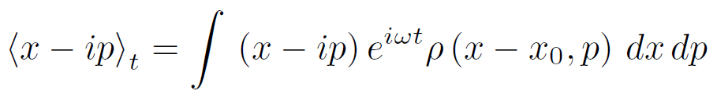

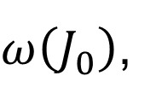
kicked beam centroid in normal form
Time evolution of the 2D canonical variables in normal form read
TBT(turn-by-turn) beam centroid data is function of initial (before kick) beam distribution
We may able to reconstruct beam phase-space using a BPM
$$x\left(t\right)−ip\left(t\right)=\left(x_{0}−ip_{0}\right)e^{iωt}=\sqrt{2J_{0}}e^{i\left(ωt−θ\right)}$$
$ω\left(J_{0}\right)$,
$$J_{0}=\left(x_{0}^{2}+p_{0}^{2}\right)/2$$
$${\left\langle x\right\rangle }_{t}=ℜ∫\left(x−ip\right)e^{iωt}ρ\left(x−x_{0},p−p_{0}\right)dxdp$$

Slide 4
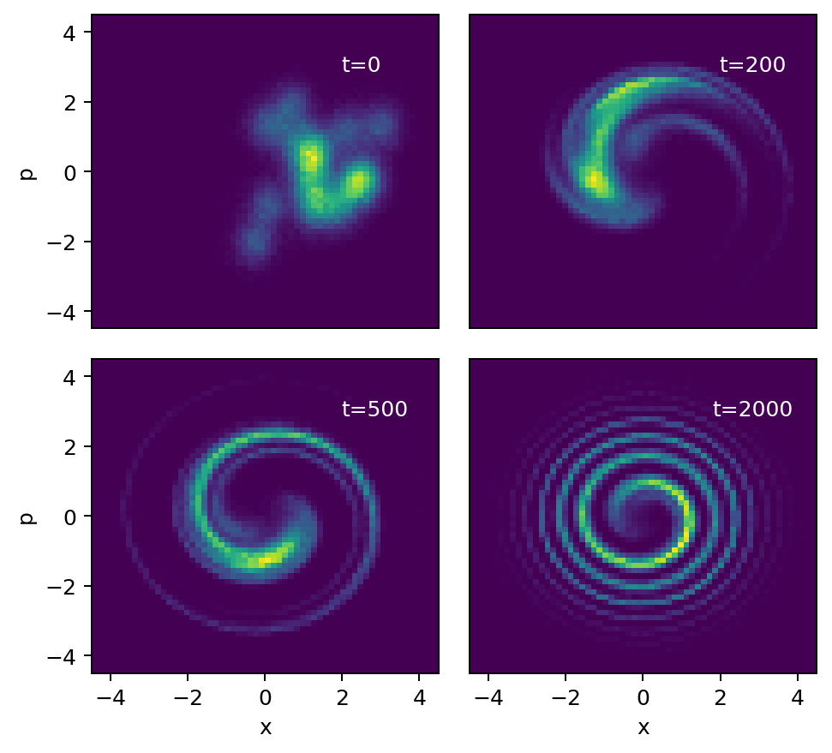
illustration of nonlinear decoherence
(due to phase mixing)
kick

Slide 5


Theoretical estimation of the marginal beam profile
If assume
  slowly varying betatron frequency over the beam area s.t.
  large kick strength s.t.
Marginal beam profile (along the kick angle) can be analytically expressed
$$J_{0}/ε≫1$$

Slide 6
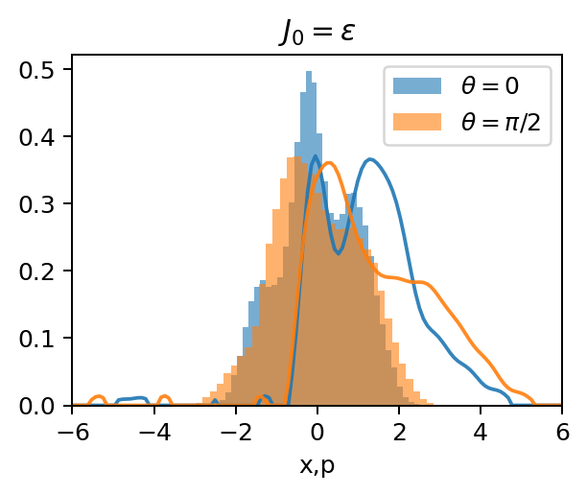
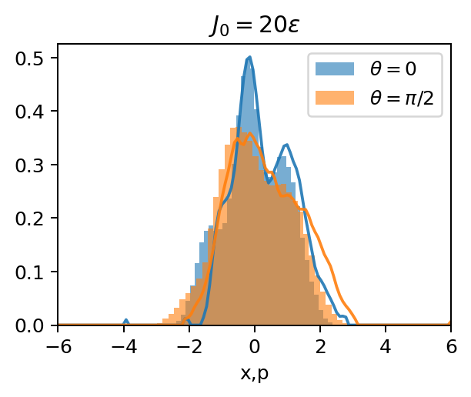
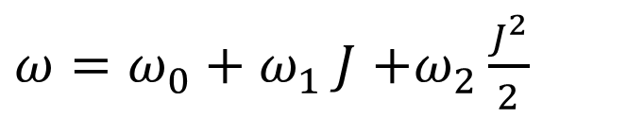
however, the large kick strength assumption can be limited due to beam pipe aperture
Illustration on a toy model:
$ω=ω_{0}+ω_{1} J$ $+ω_{2}\frac{J^{2}}{2}$
Histogram: ground truth
Line: theoretical estimation

Slide 7
Inverse Radon transformation (an algebraic tomography method) using theoretically estimated marginal profiles

Slide 8
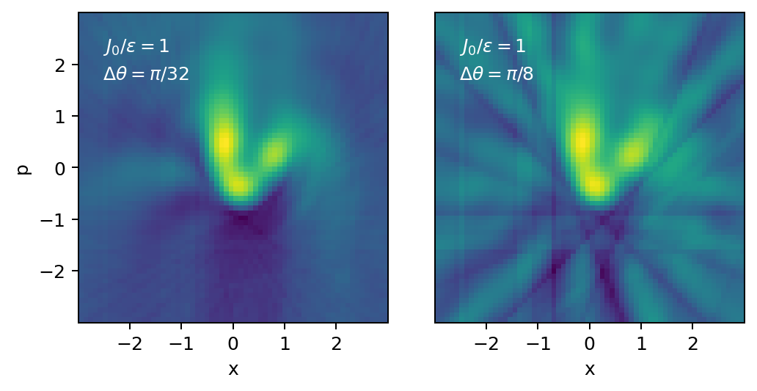

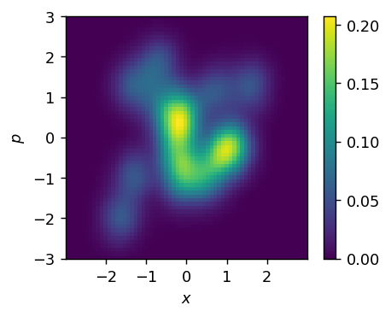
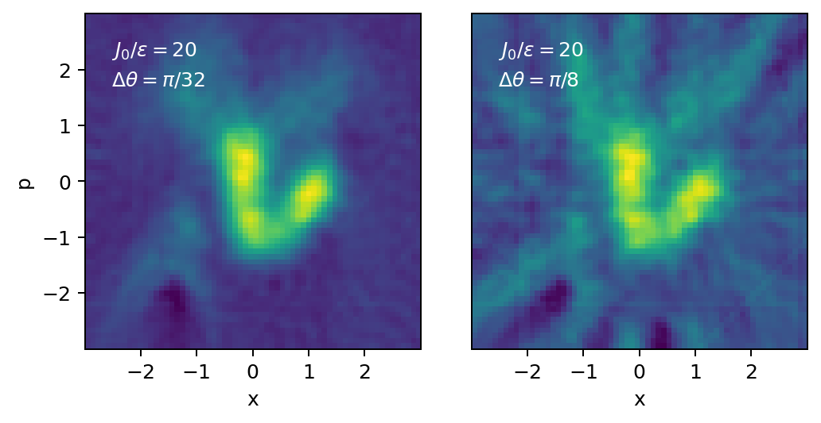
Inverse Radon transformation (an algebraic method) using theoretically estimated marginal profiles
Reconstruction of 2D phase-space via inverse Radon transform using beam profiles estimated theoretically on (virtual) BPM data of kicked beam at various kick angles
Ground truth

Slide 9
Inverse Radon transformation (an algebraic method) using theoretically estimated marginal profiles
Reconstruction of 2D phase-space via inverse Radon transform using beam profiles estimated theoretically on (virtual) BPM data of kicked beam at various kick angles
Ground truth

Slide 10
Summary of inverse Radon with theoretical profile estimation
Requires knowledge of optics parameters
  transformation from physics to normal coordinate
  oscillation frequency at kick action
  nonlinear frequency detuning at kick action
  kick action and angle in normal coordinate
Requires strong kicks
  generally not possible in presence of tight physical aperture
Requires enough angular resolution
  needs many kicks of different angles

Slide 11
Gaussian Mixture Model (GMM)

Slide 12

use Gaussian Mixture Model (GMM)
TBT beam centroid is analytically integrable for isotropic Gaussian
Therefore, one can model the beam density by GMM
$${\left\langle x\right\rangle }_{𝒩,t}=$$

Slide 13
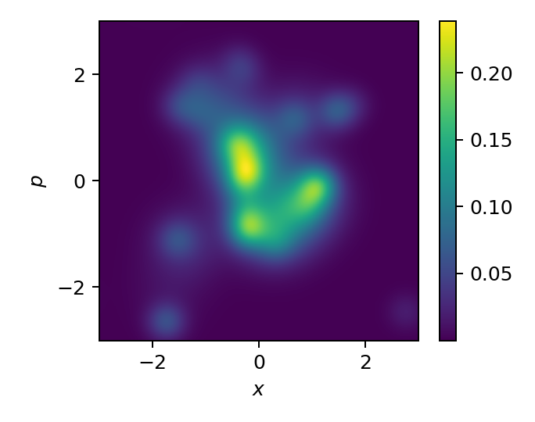



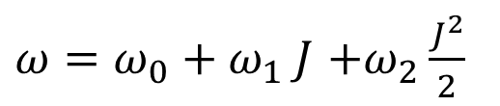
use Gaussian Mixture Model (GMM)
Virtual BPM data ${\left\langle x\right\rangle }_{BPM,k,t}$ is generated from the toy model
Fit parameters by minimizing
  $K(=8)$kick actions from $[2ε,4ε]$and kick angles equally spaced in $[0,π]$
$ω=ω_{0}+ω_{1} J$ $+ω_{2}\frac{J^{2}}{2}$
$$\sum_{k=1}^{K}{\sum_{t=0}^{T}{}}$$
$${\left({\left\langle x\right\rangle }_{BPM,k,t}−{\left\langle x\right\rangle }_{GMM,k,t} \right)}^{2}+α$$
some regularization loss
Ground truth
GMM estimation
In order to reduce computational complexity of optimization, optics parameters are first optimized using single Gaussian kernel model and global optimization (differential evolution method).
Then, all parameters are optimized through Nelder-Mead method.

Slide 14
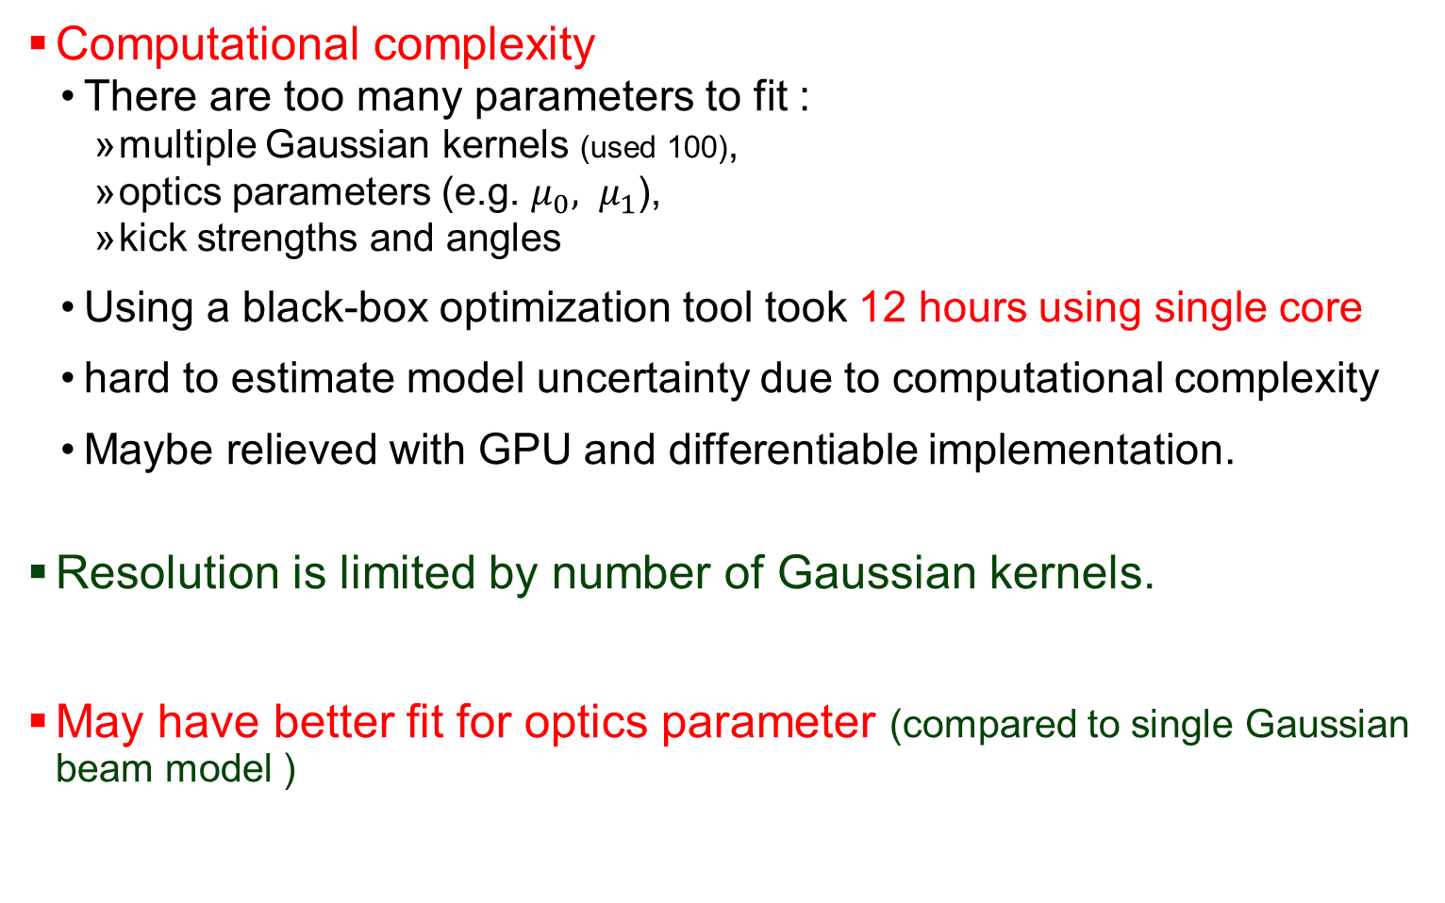
Summary of GMM
Computational complexity
  There are too many parameters to fit :
    multiple Gaussian kernels (used 100),
    optics parameters (e.g. $μ_{0}, μ_{1}$),
    kick strengths and angles
  Using a black-box optimization tool took 12 hours using single core
  hard to estimate model uncertainty due to computational complexity
  Maybe relieved with GPU and differentiable implementation.
Resolution is limited by number of Gaussian kernels.
May have better fit for optics parameter (compared to single Gaussian beam model )

Slide 15
Differentiable Particle simulation Model (DPM)

Slide 16

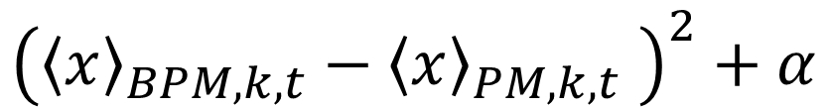

use Differentiable Particle Model
Use particle model and simple differentiable simulation model
  Motivated by [1] to reduce computational complexity with
  Simple betatron frequency model:
  Particle locations, optics parameters are updated through gradient decent of the objective minimizing difference between prediction and true BPM TBT data with 8 different kicks ~corresponds to negative log likelihood
  Approximate Bayesian ensemble by anchoring (with L2 regularization) [2,3] model parameters to the randomized particle locations and prior optics parameter estimations using single Gaussian model. ~corresponds to negative log prior
$$ω=μ_{0,k}+μ_{1}ΔJ$$
$$\sum_{k=1}^{K}{\sum_{t=0}^{T}{}}$$
$${\left({\left\langle x\right\rangle }_{BPM,k,t}−{\left\langle x\right\rangle }_{PM,k,t} \right)}^{2}+α$$
some regularization loss
[1] Ryan Roussel et al, “Phase Space Reconstruction from Accelerator Beam Measurements Using Neural Networks and Differentiable Simulations”
[2] Ian Osband et al, “Randomized Prior Functions for Deep Reinforcement Learning”, NeurIPS 2018
[3] Tim Pearce et al, “Bayesian Inference with Anchored Ensembles of Neural Networks, and Application to Exploration in Reinforcement Learning”, ICML2018

Slide 17
use Differentiable Particle Model
Use particle model and simple differentiable simulation model
  Motivated by [1] to reduce computational complexity with
  Simple betatron frequency model:
  Particle locations, optics parameters are updated through gradient decent of the objective minimizing difference between prediction and true BPM TBT data with 8 different kicks ~corresponds to negative log likelihood
  Approximate Bayesian ensemble by anchoring (with L2 regularization) [2,3] model parameters to the randomized particle locations and prior optics parameter estimations using single Gaussian model. ~corresponds to negative log prior
$$ω=μ_{0,k}+μ_{1}ΔJ$$
$$\sum_{k=1}^{K}{\sum_{t=0}^{T}{}}$$
$${\left({\left\langle x\right\rangle }_{BPM,k,t}−{\left\langle x\right\rangle }_{PM,k,t} \right)}^{2}+α$$
some regularization loss
[1] Ryan Roussel et al, “Phase Space Reconstruction from Accelerator Beam Measurements Using Neural Networks and Differentiable Simulations”
[2] Ian Osband et al, “Randomized Prior Functions for Deep Reinforcement Learning”, NeurIPS 2018
[3] Tim Pearce et al, “Bayesian Inference with Anchored Ensembles of Neural Networks, and Application to Exploration in Reinforcement Learning”, ICML2018

Slide 18
use Differentiable Particle Model
Use particle model and simple differentiable simulation model
  Motivated by [1] to reduce computational complexity with
  Simple betatron frequency model:
  Particle locations, optics parameters are updated through gradient decent of the objective minimizing difference between prediction and true BPM TBT data with 8 different kicks ~corresponds to negative log likelihood
  Approximate Bayesian ensemble by anchoring (with L2 regularization) [2,3] model parameters to the randomized particle locations and prior optics parameter estimations using single Gaussian model. ~corresponds to negative log prior
$$ω=μ_{0,k}+μ_{1}ΔJ$$
$$\sum_{k=1}^{K}{\sum_{t=0}^{T}{}}$$
$${\left({\left\langle x\right\rangle }_{BPM,k,t}−{\left\langle x\right\rangle }_{PM,k,t} \right)}^{2}+α$$
some regularization loss
[1] Ryan Roussel et al, “Phase Space Reconstruction from Accelerator Beam Measurements Using Neural Networks and Differentiable Simulations”
[2] Ian Osband et al, “Randomized Prior Functions for Deep Reinforcement Learning”, NeurIPS 2018
[3] Tim Pearce et al, “Bayesian Inference with Anchored Ensembles of Neural Networks, and Application to Exploration in Reinforcement Learning”, ICML2018

Slide 19
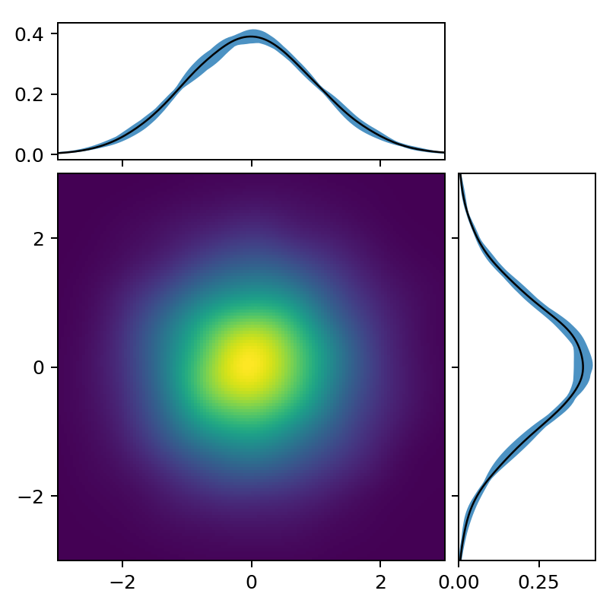
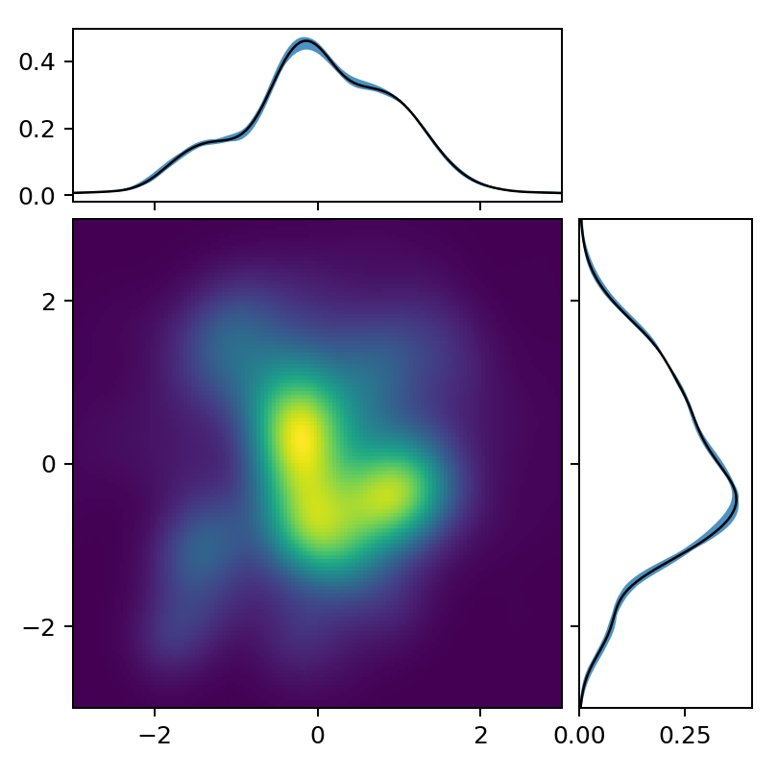
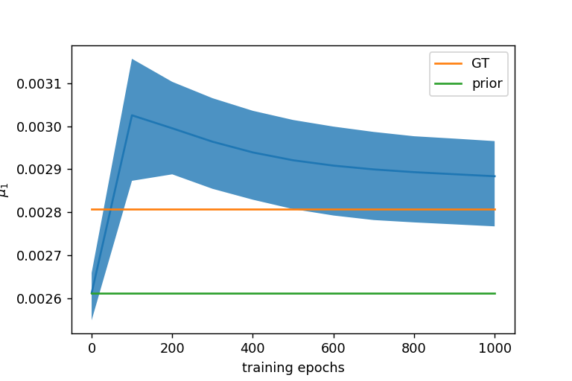
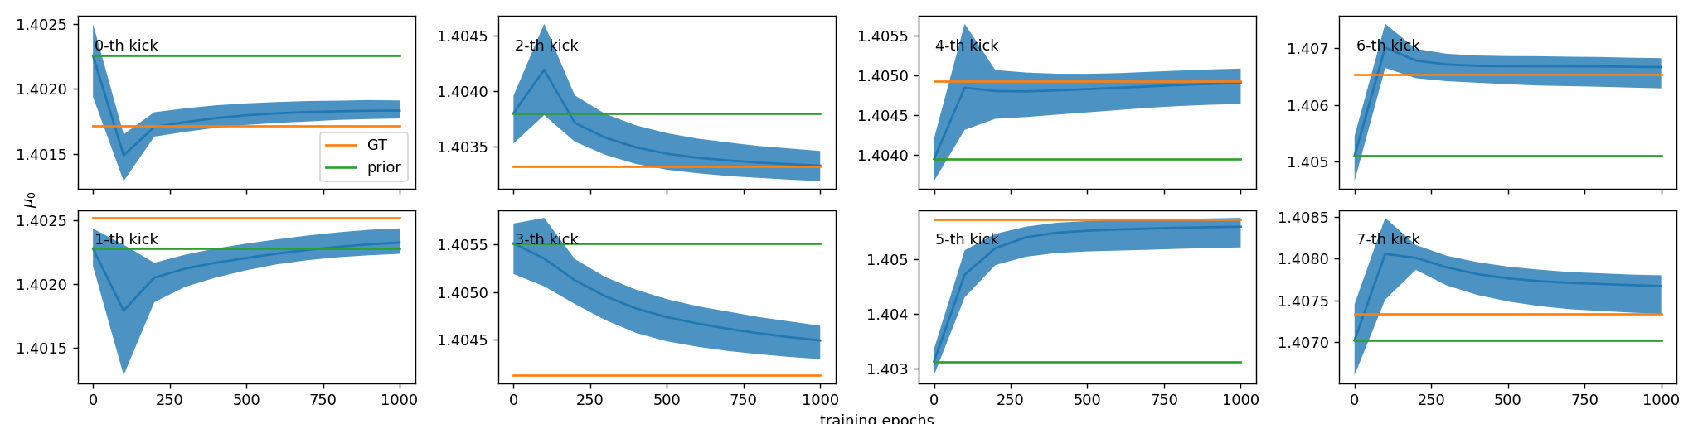

use Particle Model
8 ensemble models
Ground truth
at initialization
end of training
$$μ_{1}$$

Slide 20
Summary of PM
Computational complexity
  With gradient decent (ADAM) optimization, it still took 10 hours (using one CPU core) for 8 models ( ~ 1h for each model)
  Maybe relieved with implementation.
UQ may be feasible due to faster training (compared to GMM without differentiable model)
Better fit for optics parameter (compared to single Gaussian beam model )

Slide 21
Neural Network (NN) Model
with supervised learning
and model uncertainty

Slide 22
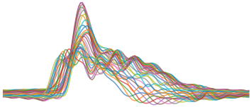
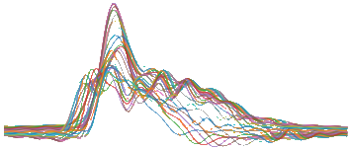
Use NN
Input: theoretically estimated marginal profiles
Output: beam density plot and reconstructed marginal profiles
Minimize pixel-wise prediction error
Minimize Reconstruction Error
[4] Alex Scheinker, “Adaptive machine learning”, information 2021
Motivated by [4]

Slide 23
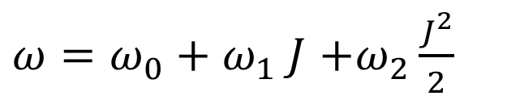
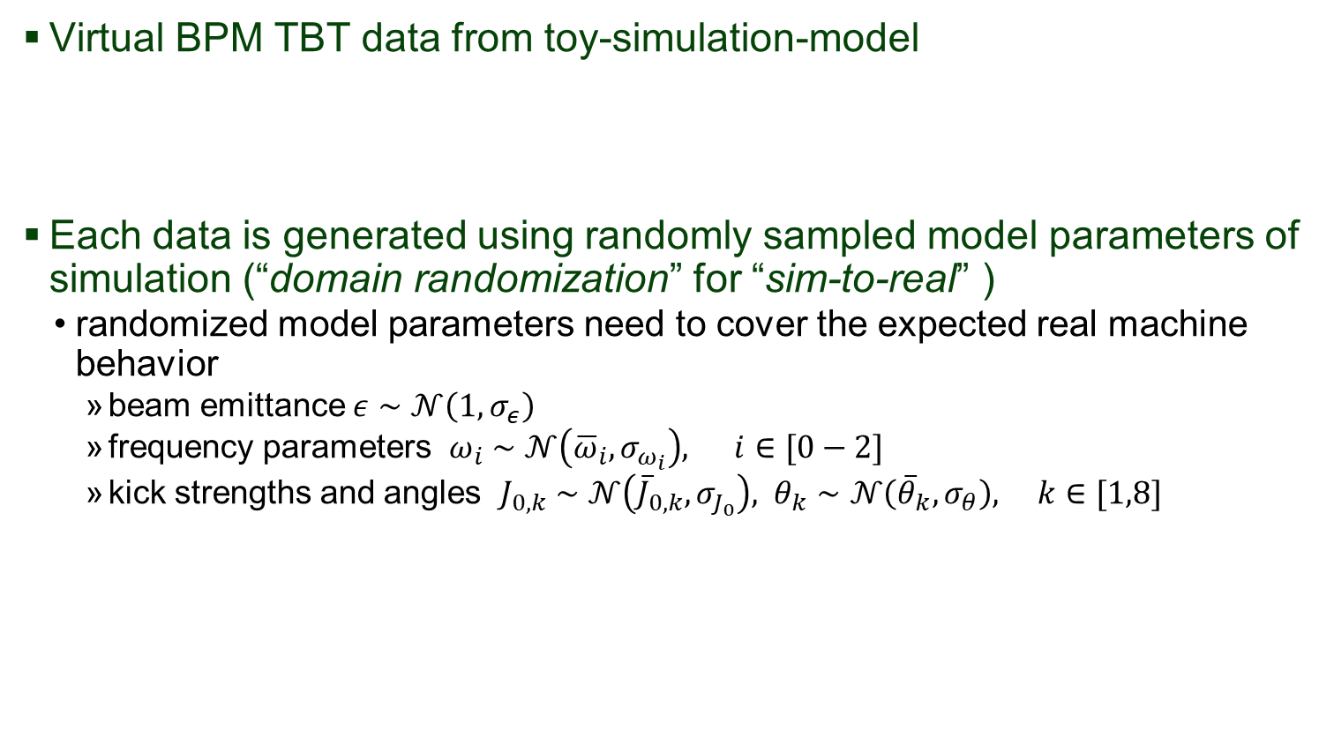
How training data generated
Virtual BPM TBT data from toy-simulation-model
Each data is generated using randomly sampled model parameters of simulation (“domain randomization” for “sim-to-real” )
  randomized model parameters need to cover the expected real machine behavior
    beam emittance $ε∼𝒩\left(1, σ_{ε}\right)$
    frequency parameters $ω_{i}∼𝒩\left({\overline{ω}}_{i},σ_{ω_{i}}\right), i∈[0−2]$
    kick strengths and angles $J_{0,k}∼𝒩\left({\overline{J}}_{0,k},σ_{J_{0}}\right), θ_{k}∼𝒩\left({\overline{θ}}_{k},σ_{θ}\right), k∈[1,8]$
$ω=ω_{0}+ω_{1} J$ $+ω_{2}\frac{J^{2}}{2}$

Slide 24
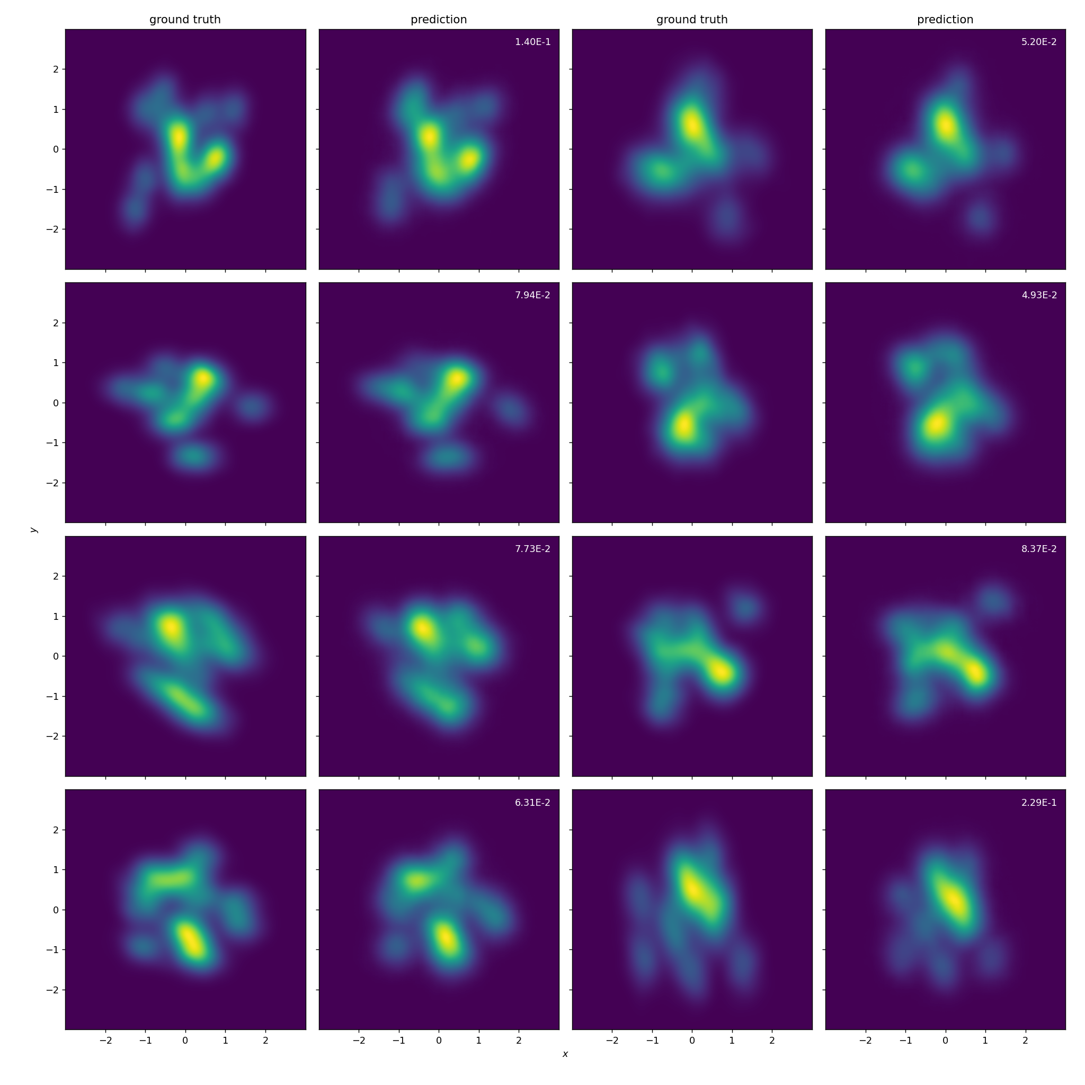
Some of random (except the 1st one) prediction samples

Slide 25
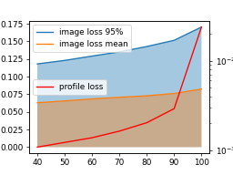
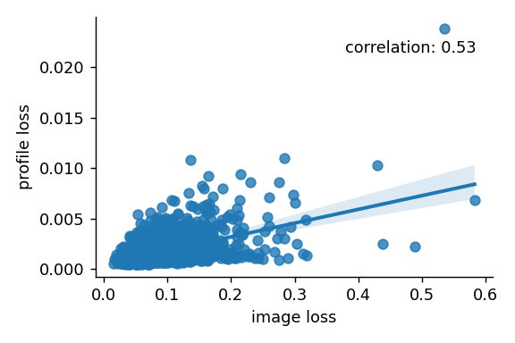
UQ using reconstruction loss of input profile
UQ using ensemble
  As it is expected that the model predictions in the training distribution are close each other while predictions in out-of-distribution show large variance for each model
The reconstruction loss can also be used for UQ
  As it is also expected to be small in the training distribution while large in out-of-distribution
mse loss of image
2E-3
1.5E-3
retention

Slide 26

Out of distribution samples
OOD samples are generated by sampling from 4 times larger parameter variances (than the variance used for the training data generation)
    beam emittance $ε∼𝒩\left(1, 4σ_{ε}\right)$
    frequency parameters $ω_{i}∼𝒩\left({\overline{ω}}_{i},4σ_{ω_{i}}\right), i∈[0−2]$
    kick strengths and angles $J_{0,k}∼𝒩\left({\overline{J}}_{0,k},4σ_{J_{0}}\right), θ_{k}∼𝒩\left({\overline{θ}}_{k},4σ_{θ}\right), k∈[1,8]$

Slide 27
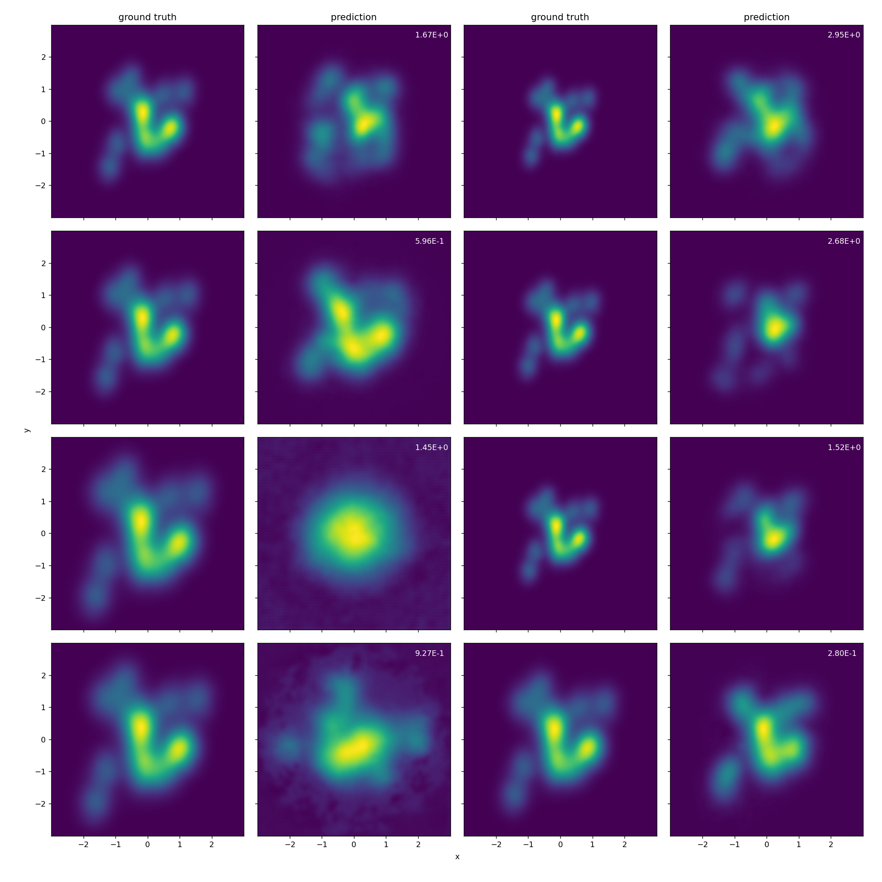

Slide 28
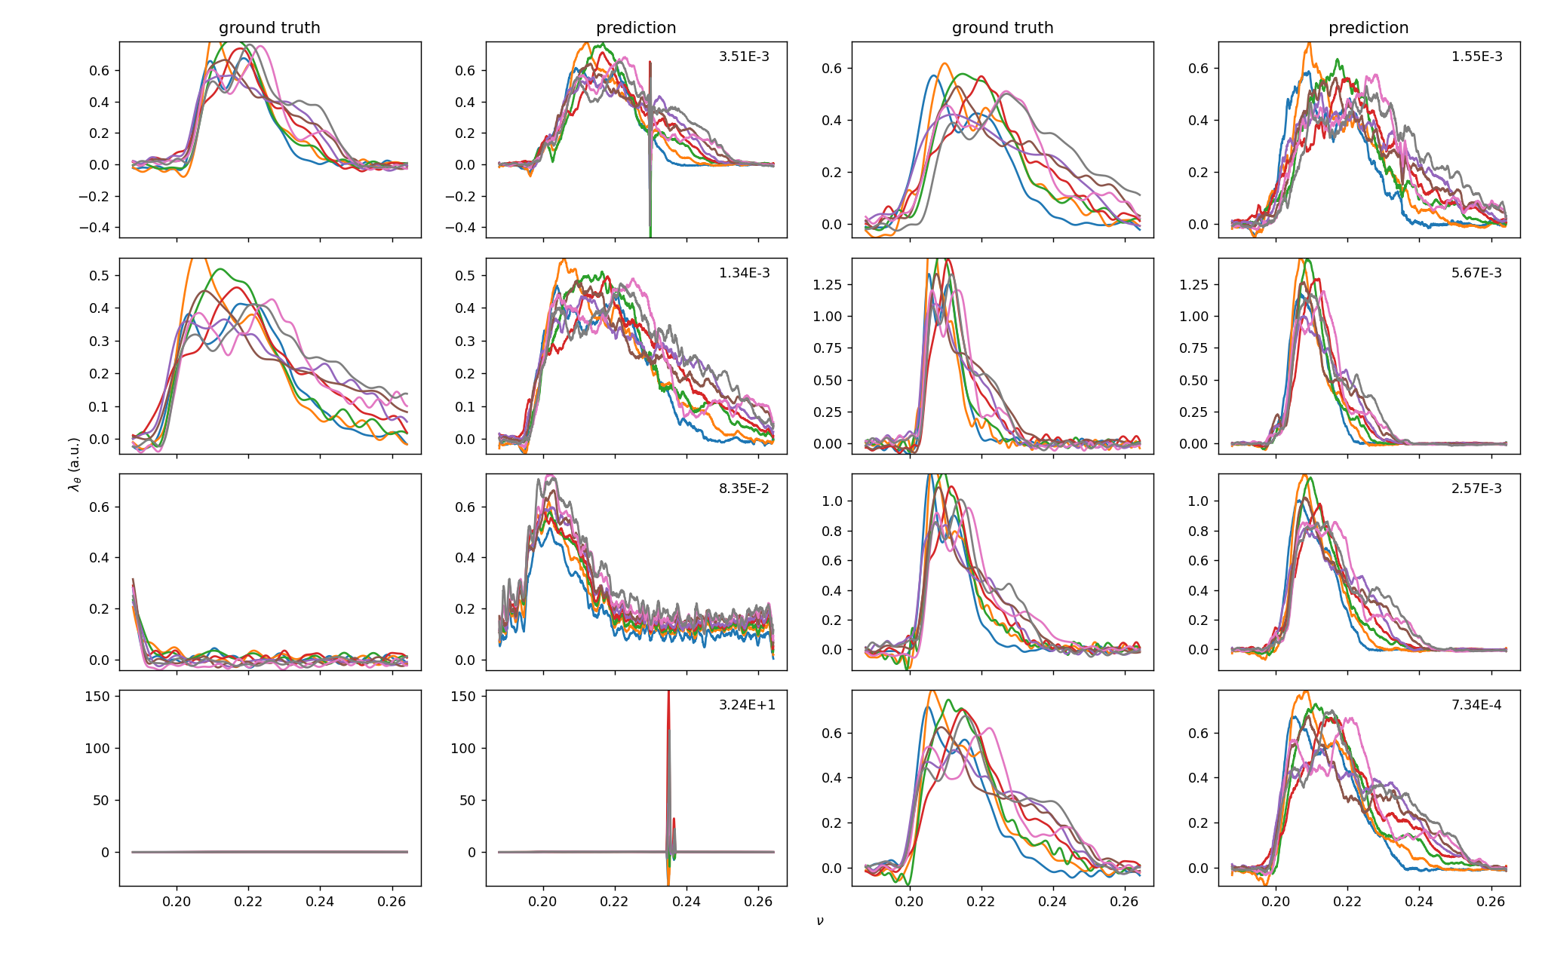
profile reconstruction losses

Slide 30
Summary of NN
Computational complexity is no longer a problem but the collection of training data and training time can be problematic
The reconstruction loss looks promising alternative method for UQ
Domain randomization is used for “sim-to-real” adaption.
  However, (as is the case of GMM or PM) the simulation model may not enough for real machine

Slide 31
Conclusion

Slide 32
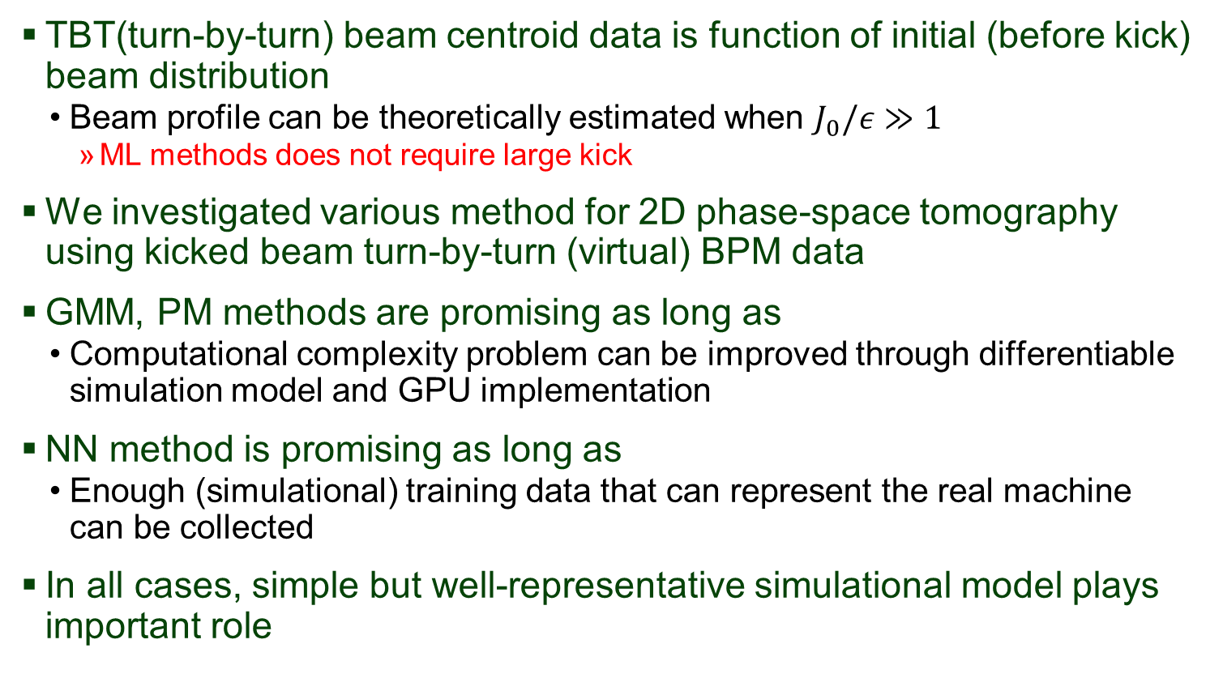
Conclusion
TBT(turn-by-turn) beam centroid data is function of initial (before kick) beam distribution
  Beam profile can be theoretically estimated when $J_{0}/ε≫1$
    ML methods does not require large kick
We investigated various method for 2D phase-space tomography using kicked beam turn-by-turn (virtual) BPM data
GMM, PM methods are promising as long as
  Computational complexity problem can be improved through differentiable simulation model and GPU implementation
NN method is promising as long as
  Enough (simulational) training data that can represent the real machine can be collected
In all cases, simple but well-representative simulational model plays important role

Slide 33
Acknowledgements
Work supported by the Director of the Office of Science of the US Department of Energy under Cooperative Agreement DE-SC0000661, the State of Michigan and Michigan State University

Slide 34
Backup slide

Slide 35
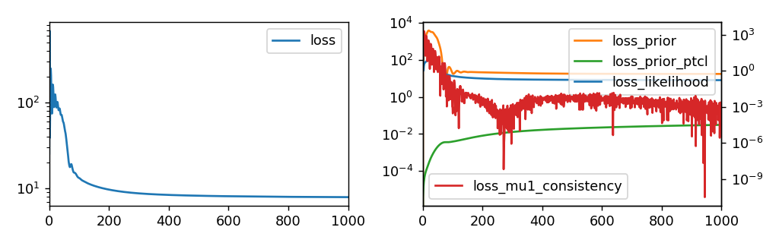
PM training loss

Slide 36
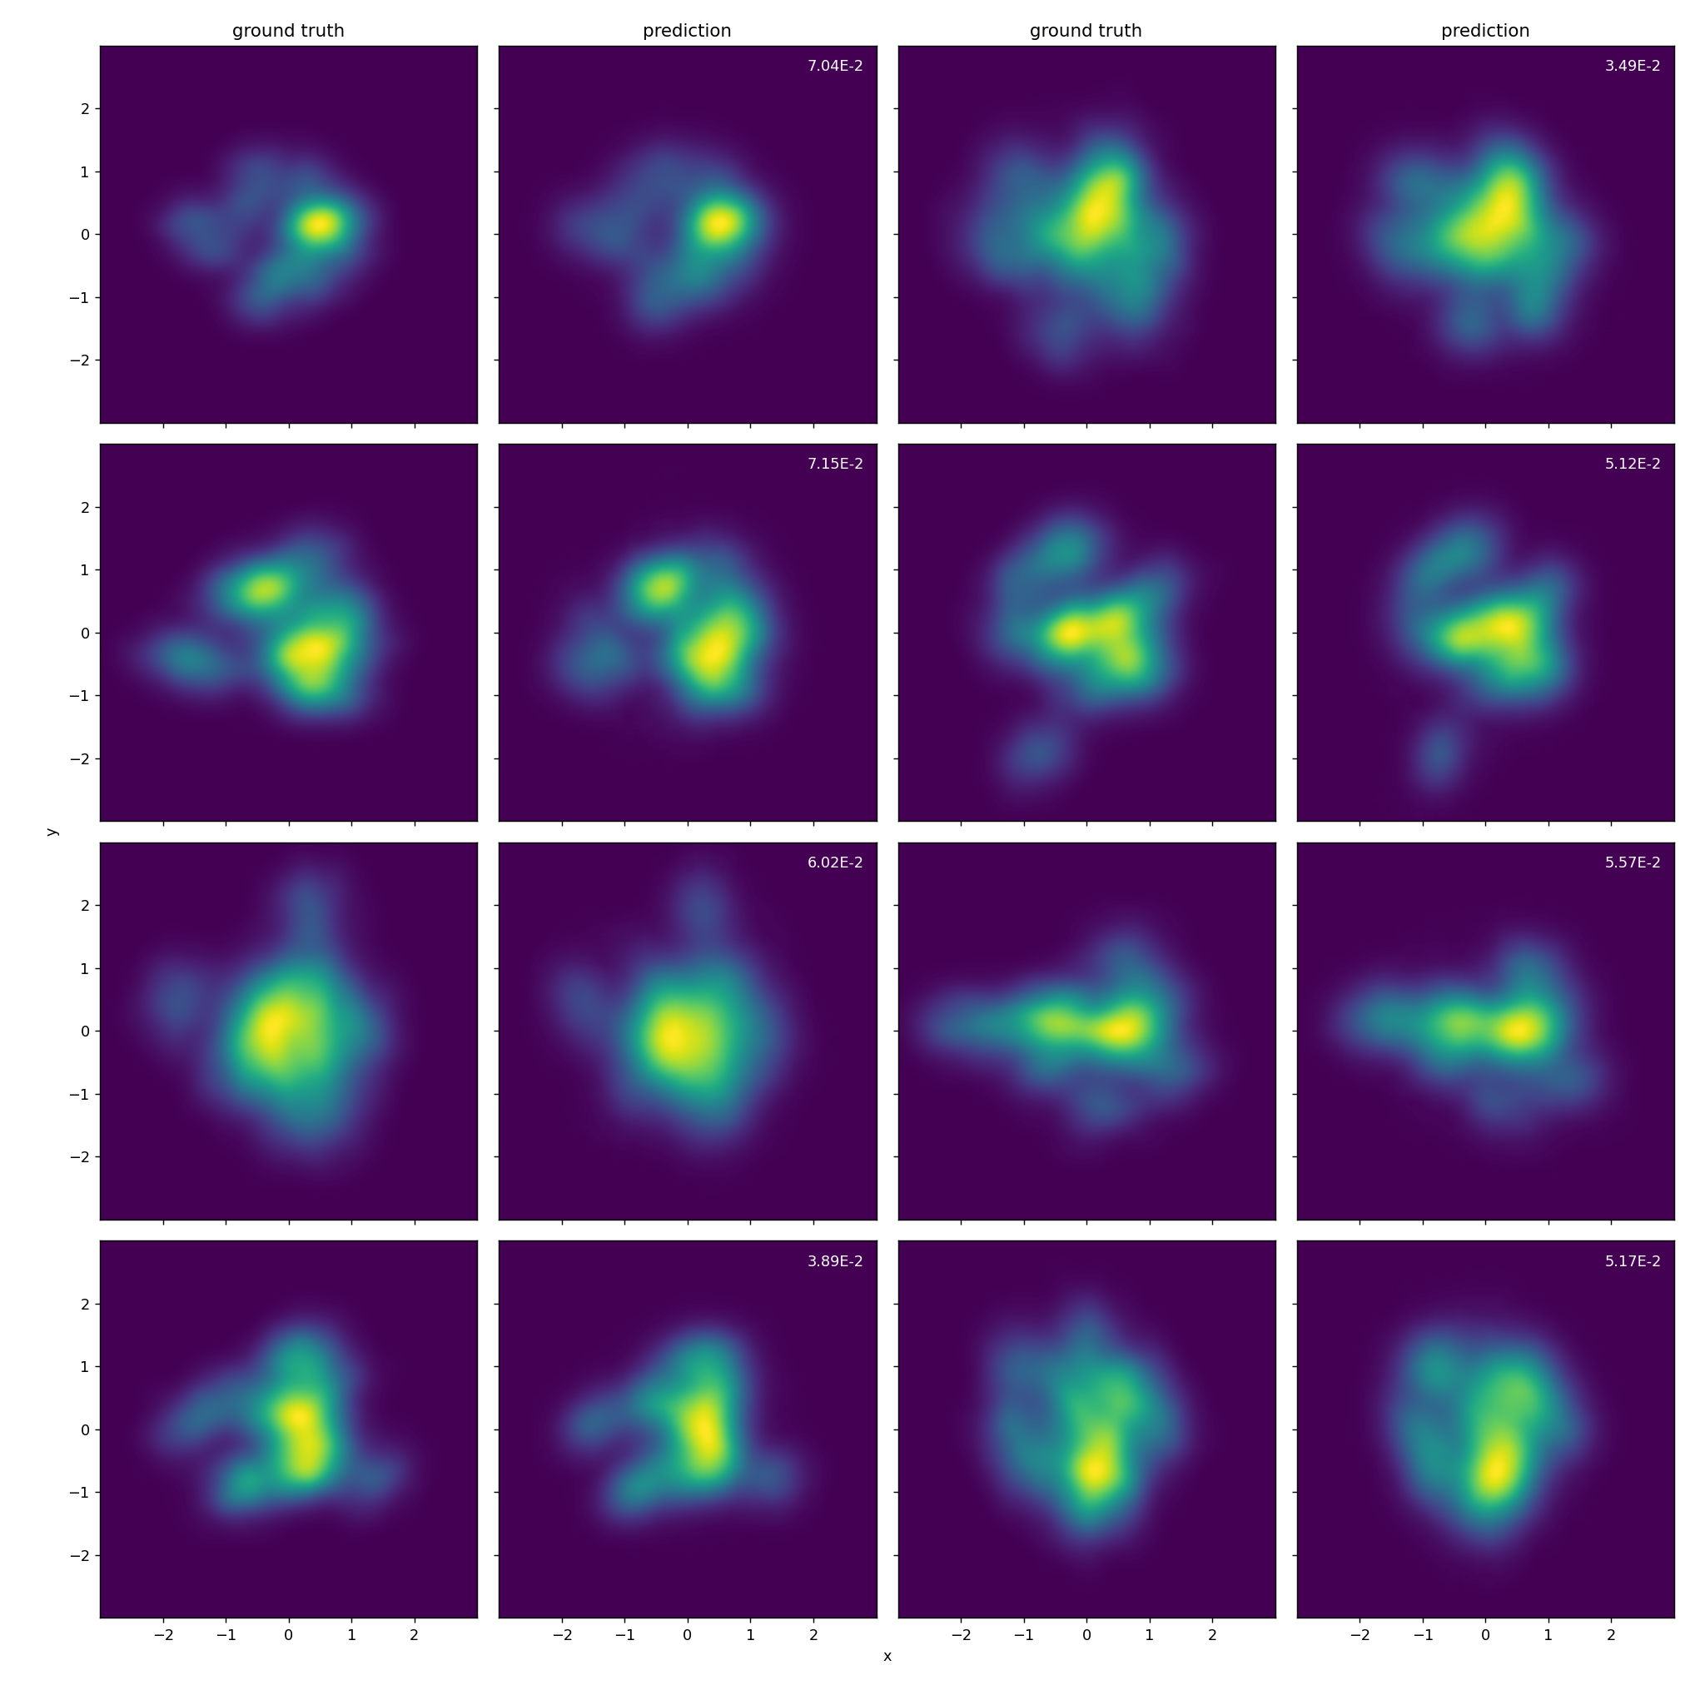
NN test samples of best profile loss

Slide 37
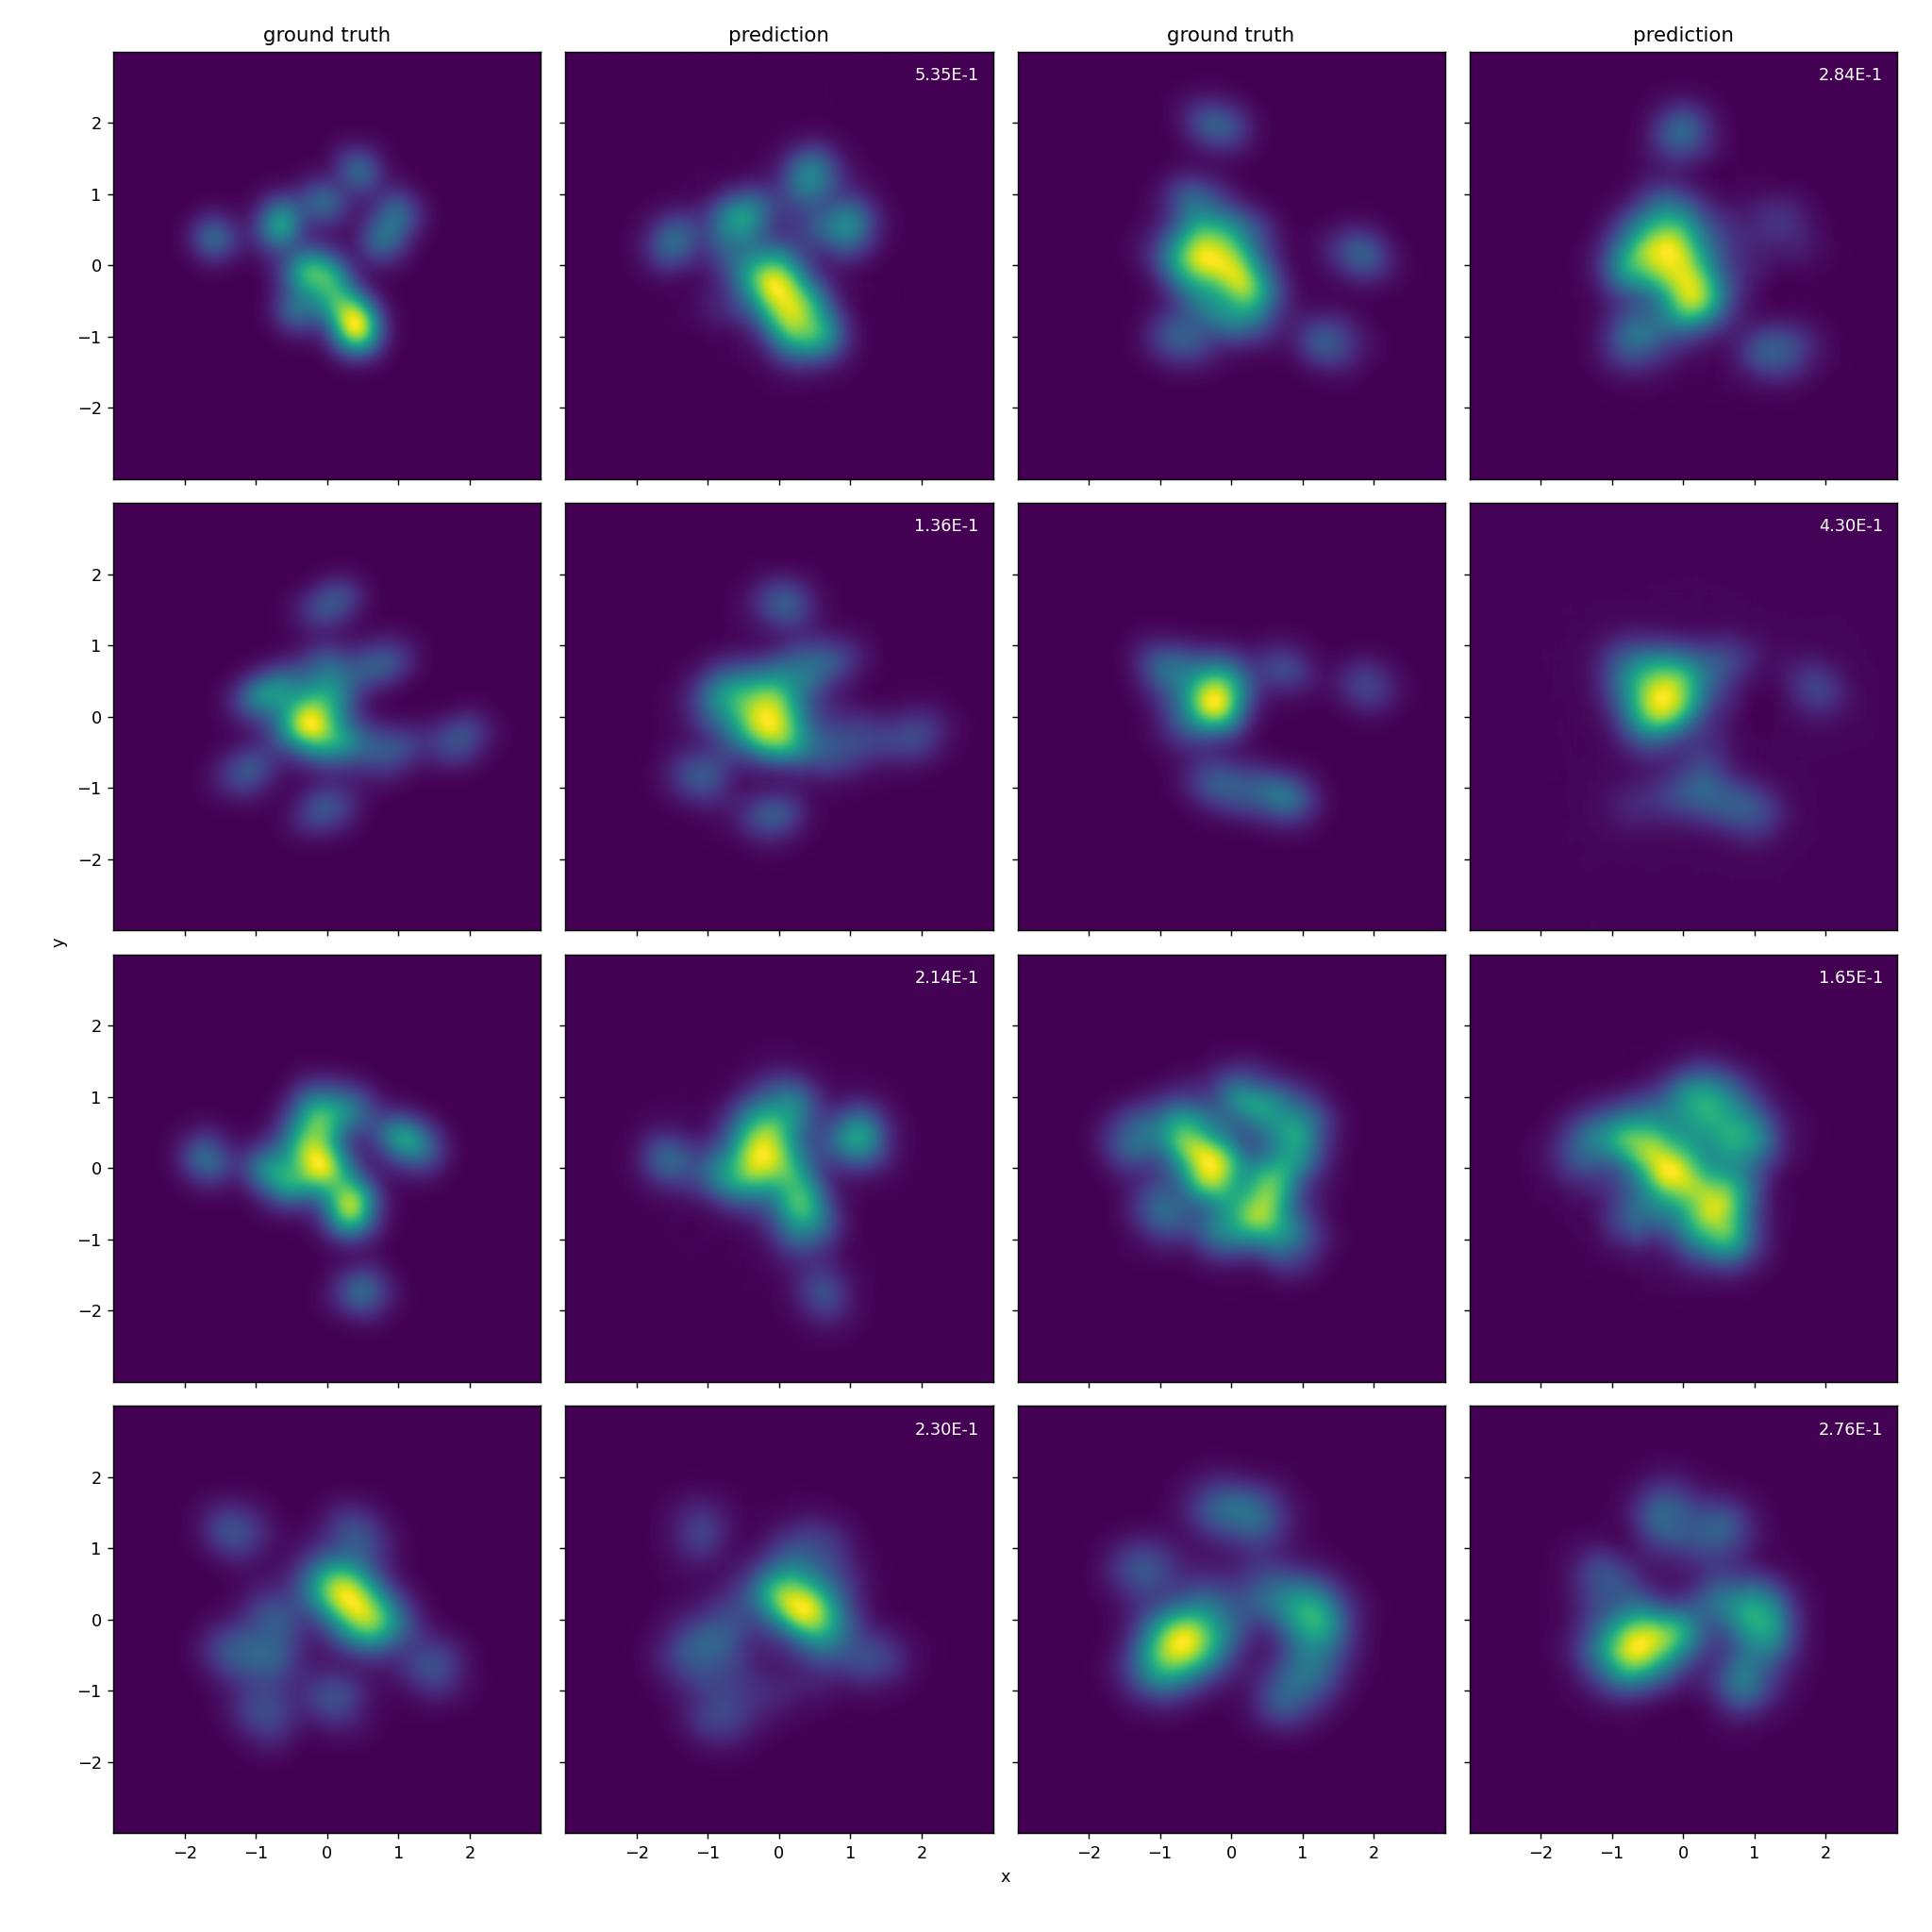
NN test samples of worst profile loss

