Slide 1
🤯
Modeling Session

Slide 2
Modeling Session: November 3, 2022
talks spanned the full spectrum – from brainstorming ideas, to promising proof-of-principle demonstrations, to mature systems
Data-Driven Chaos Indictor for Nonlinear Dynamics and Applications on Storage Ring Lattice Design
Robert Rainer
Towards End-to-End Differentiable Accelerator Modeling
Juan Pablo Gonzalez-Aguilera
Experience with Integrated Systems for Online Physics Modeling, Adaptive ML Modeling, and Model-Based Control
Auralee Edelen
Luminosity Tuning for Future Electron Ion Collider
Derong Xu

Slide 3
Modeling Session: November 3, 2022
Data-Driven Chaos Indictor for Nonlinear Dynamics and Applications on Storage Ring Lattice Design
Robert Rainer
Towards End-to-End Differentiable Accelerator Modeling
Juan Pablo Gonzalez-Aguilera
Experience with Integrated Systems for Online Physics Modeling, Adaptive ML Modeling, and Model-Based Control
Auralee Edelen
Luminosity Tuning for Future Electron Ion Collider
Derong Xu

Slide 4
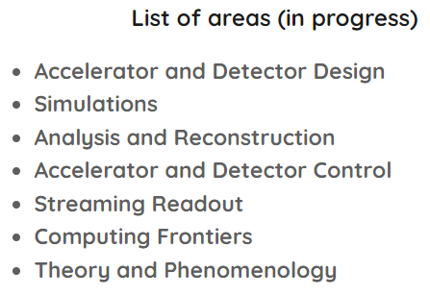
https://eic.ai/

Slide 5
Deployed Systems
only third ML workshop – but work spans 5 years
what started as brainstorming areas of application and initial proof-of-principle projects has rapidly matured
developed software packages, deployed tools, plethora of use cases using a variety of techniques
session in the future on making the leap from proof-of-principle to deployed: challenges, highlights, gotchas, etc.

Slide 6
Discussion Questions
Questions/comments/feedback on Modeling/Analysis specifically?
What is missing that the community needs?
How can the community collaborate, educate, exchange information to address those needs?
Summary of the state of art capabilities

Slide 7
Talk Summary Slides

Slide 8
Talk Summary Slides

Slide 9
Talk Summary Slides

Slide 10
Talk Summary Slides

