Slide 1
Summary of the Optimization Session
Hirokazu Maesaka
RIKEN SPring-8 Center
Nov. 4th, 2022

Slide 2
Highlights and Suggestions
Simple Bayesian optimization tools are commonly used at many accelerator facilities.
Available tools for accelerator optimization: Xopt/Badger, GeOFF, rsopt, APSopt, Ocelot-optimize, etc.
Sharing these tools with each other is important for benchmarking and further improvements.
Research frontier is to improve the optimization performance in combination with other ML techniques.
Reinforcement learning.
NN-based surrogate model.
Adaptive learning.
Sharing these new techniques will be helpful to other facilities.
Collaboration on each tool/technique is also encouraged.

Slide 3
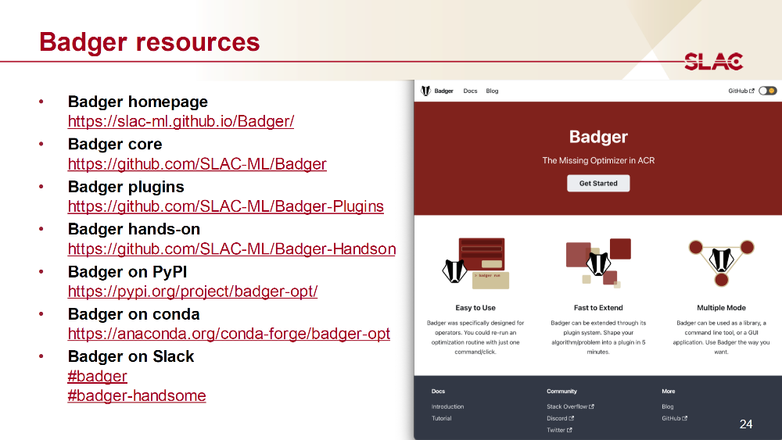
Tutorial by R. Roussel
N. Madysa in Facility session
Z. Zhang in collab. session
J. Edelen in collab. session

Slide 4
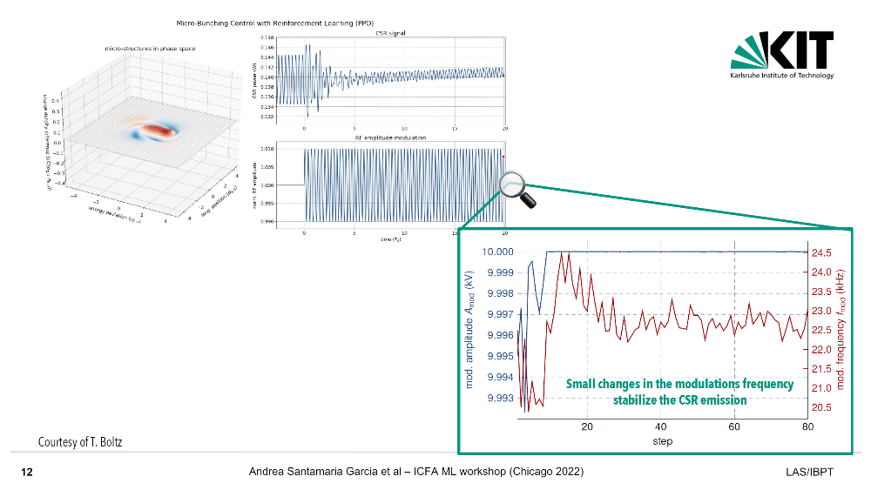
Optimization with Reinforcement Learning
Machine learning for tuning, prediction, and control at the KIT electron accelerators
Andrea Santamaría García
CSR signal is regulated by an RL-based optimizer.

Slide 5
Optimization with NN-based Surrogate Model
Towards Linac RF Optimization with Machine Learning
Ralitsa Sharankova

Slide 6
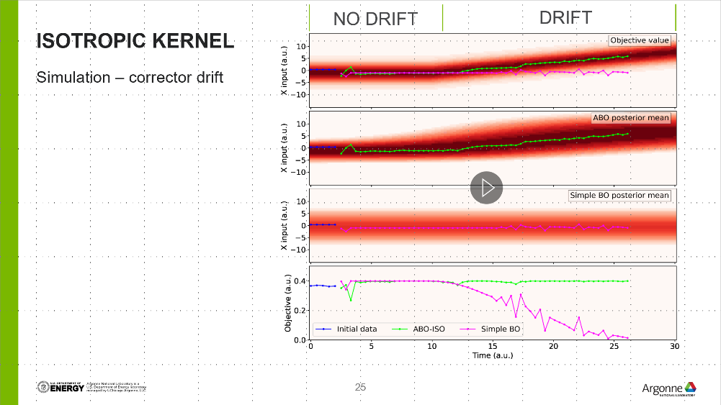
Optimization with Adaptive Learning
Machine Learning-based ID gap compensation scheme for PETRA III
Bianca Veglia
Recent Progress on ML-based Optimization and Anomaly Prediction at APS
Nikita Kuklev
Adaptive Learning with Recurrent NN
Adaptive Bayesian Optimization Kernel

