Slide 1
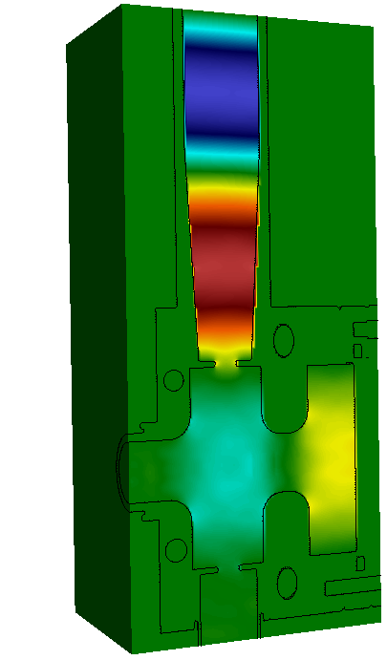
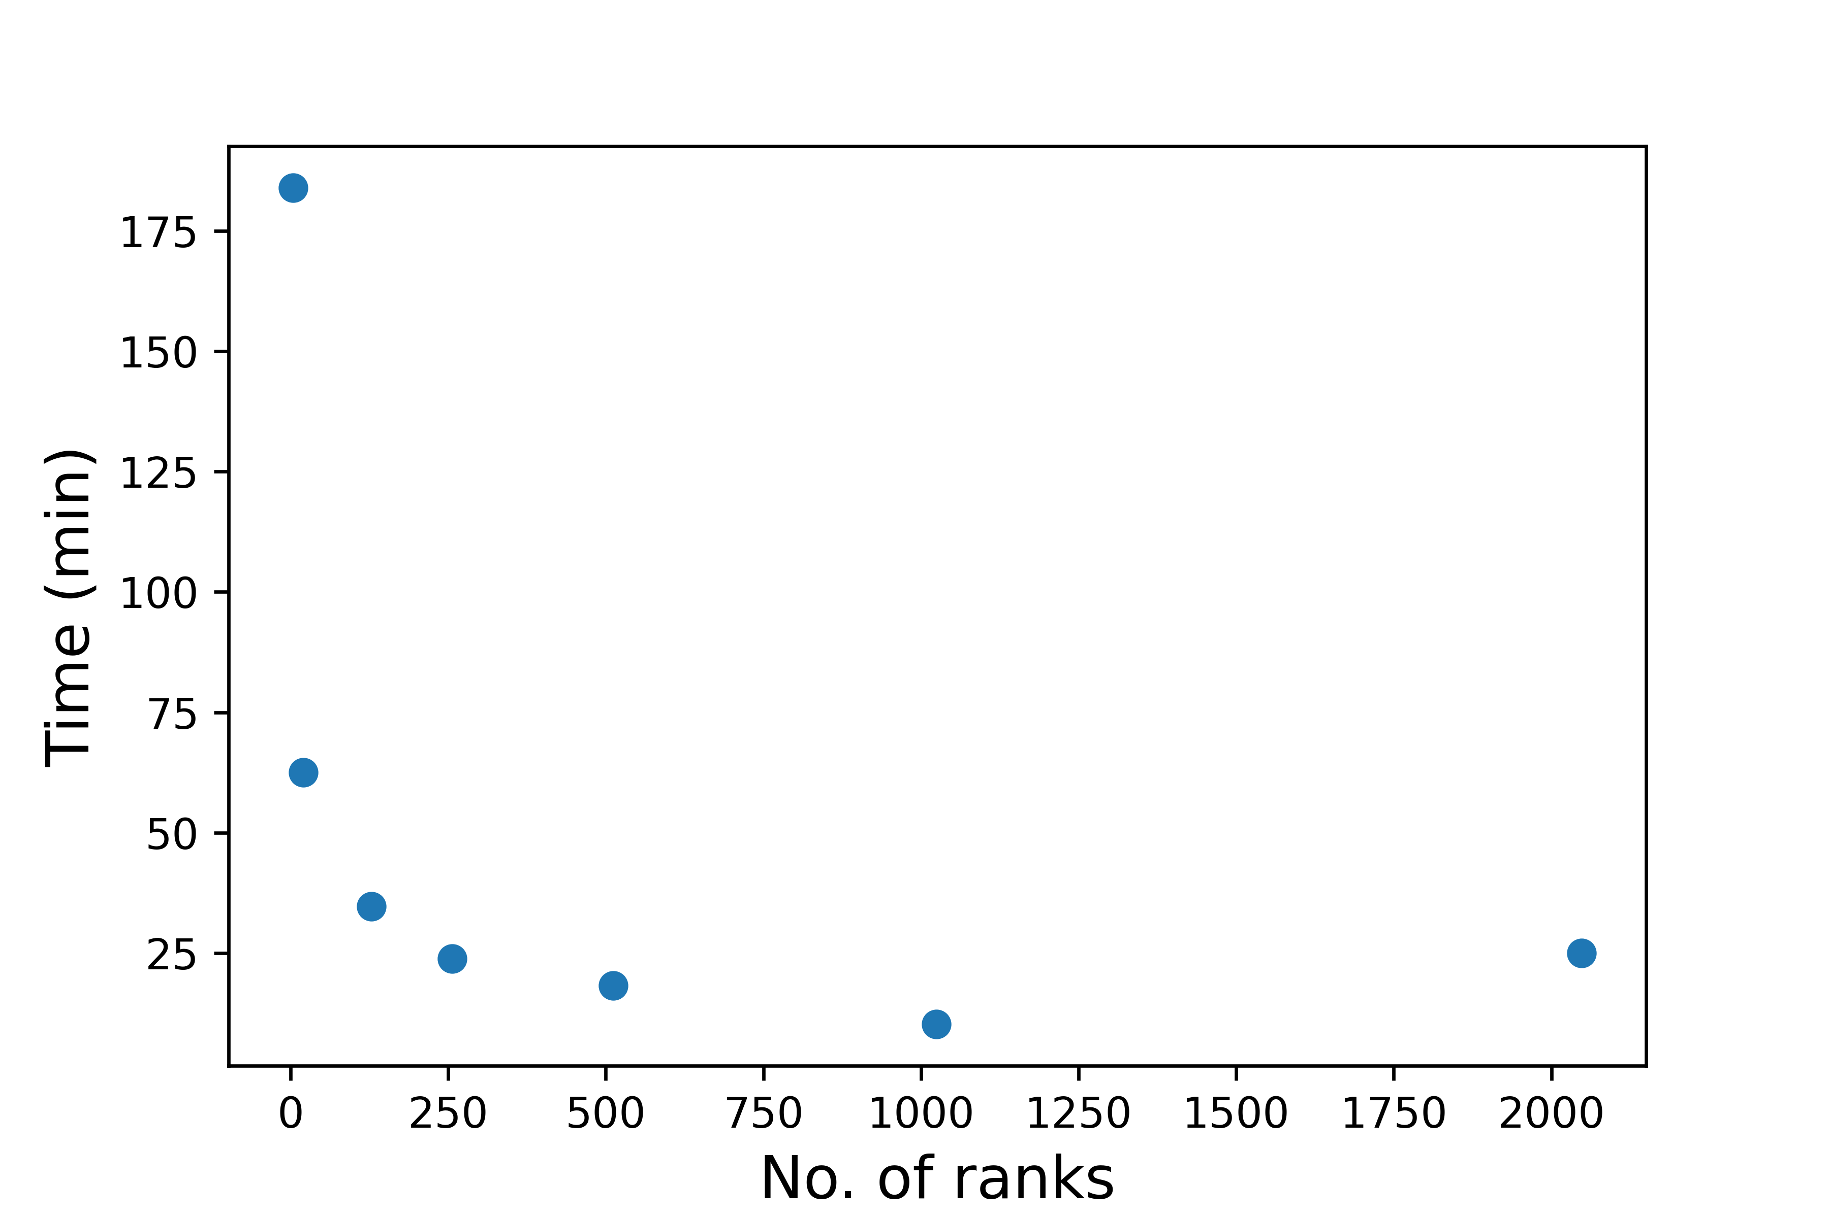
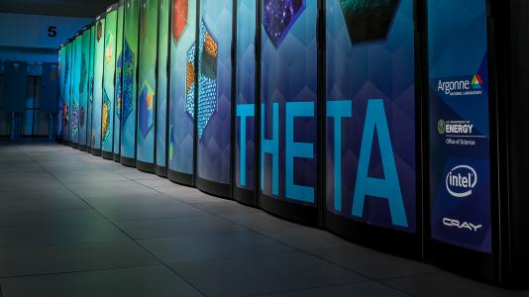
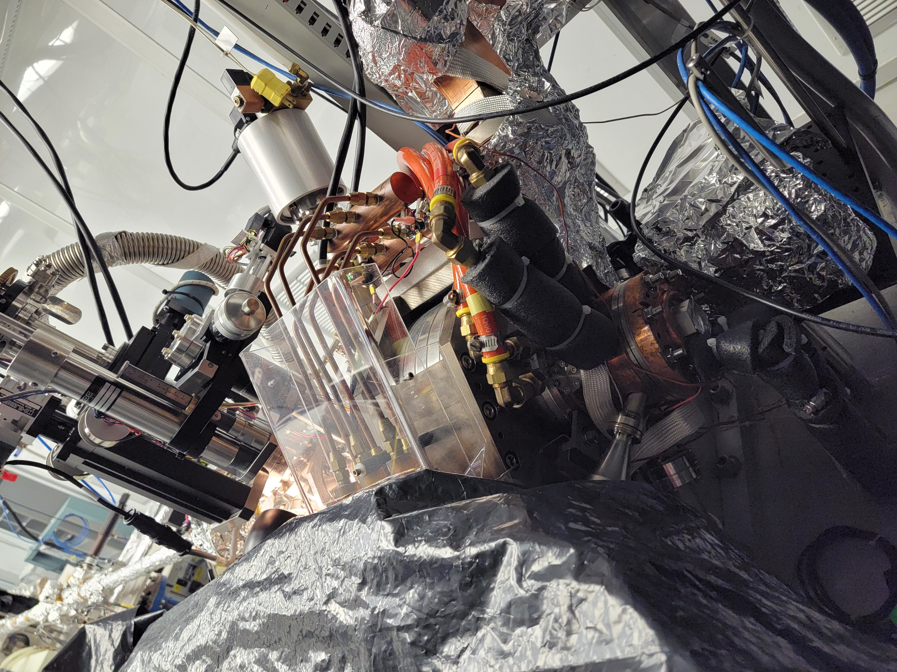
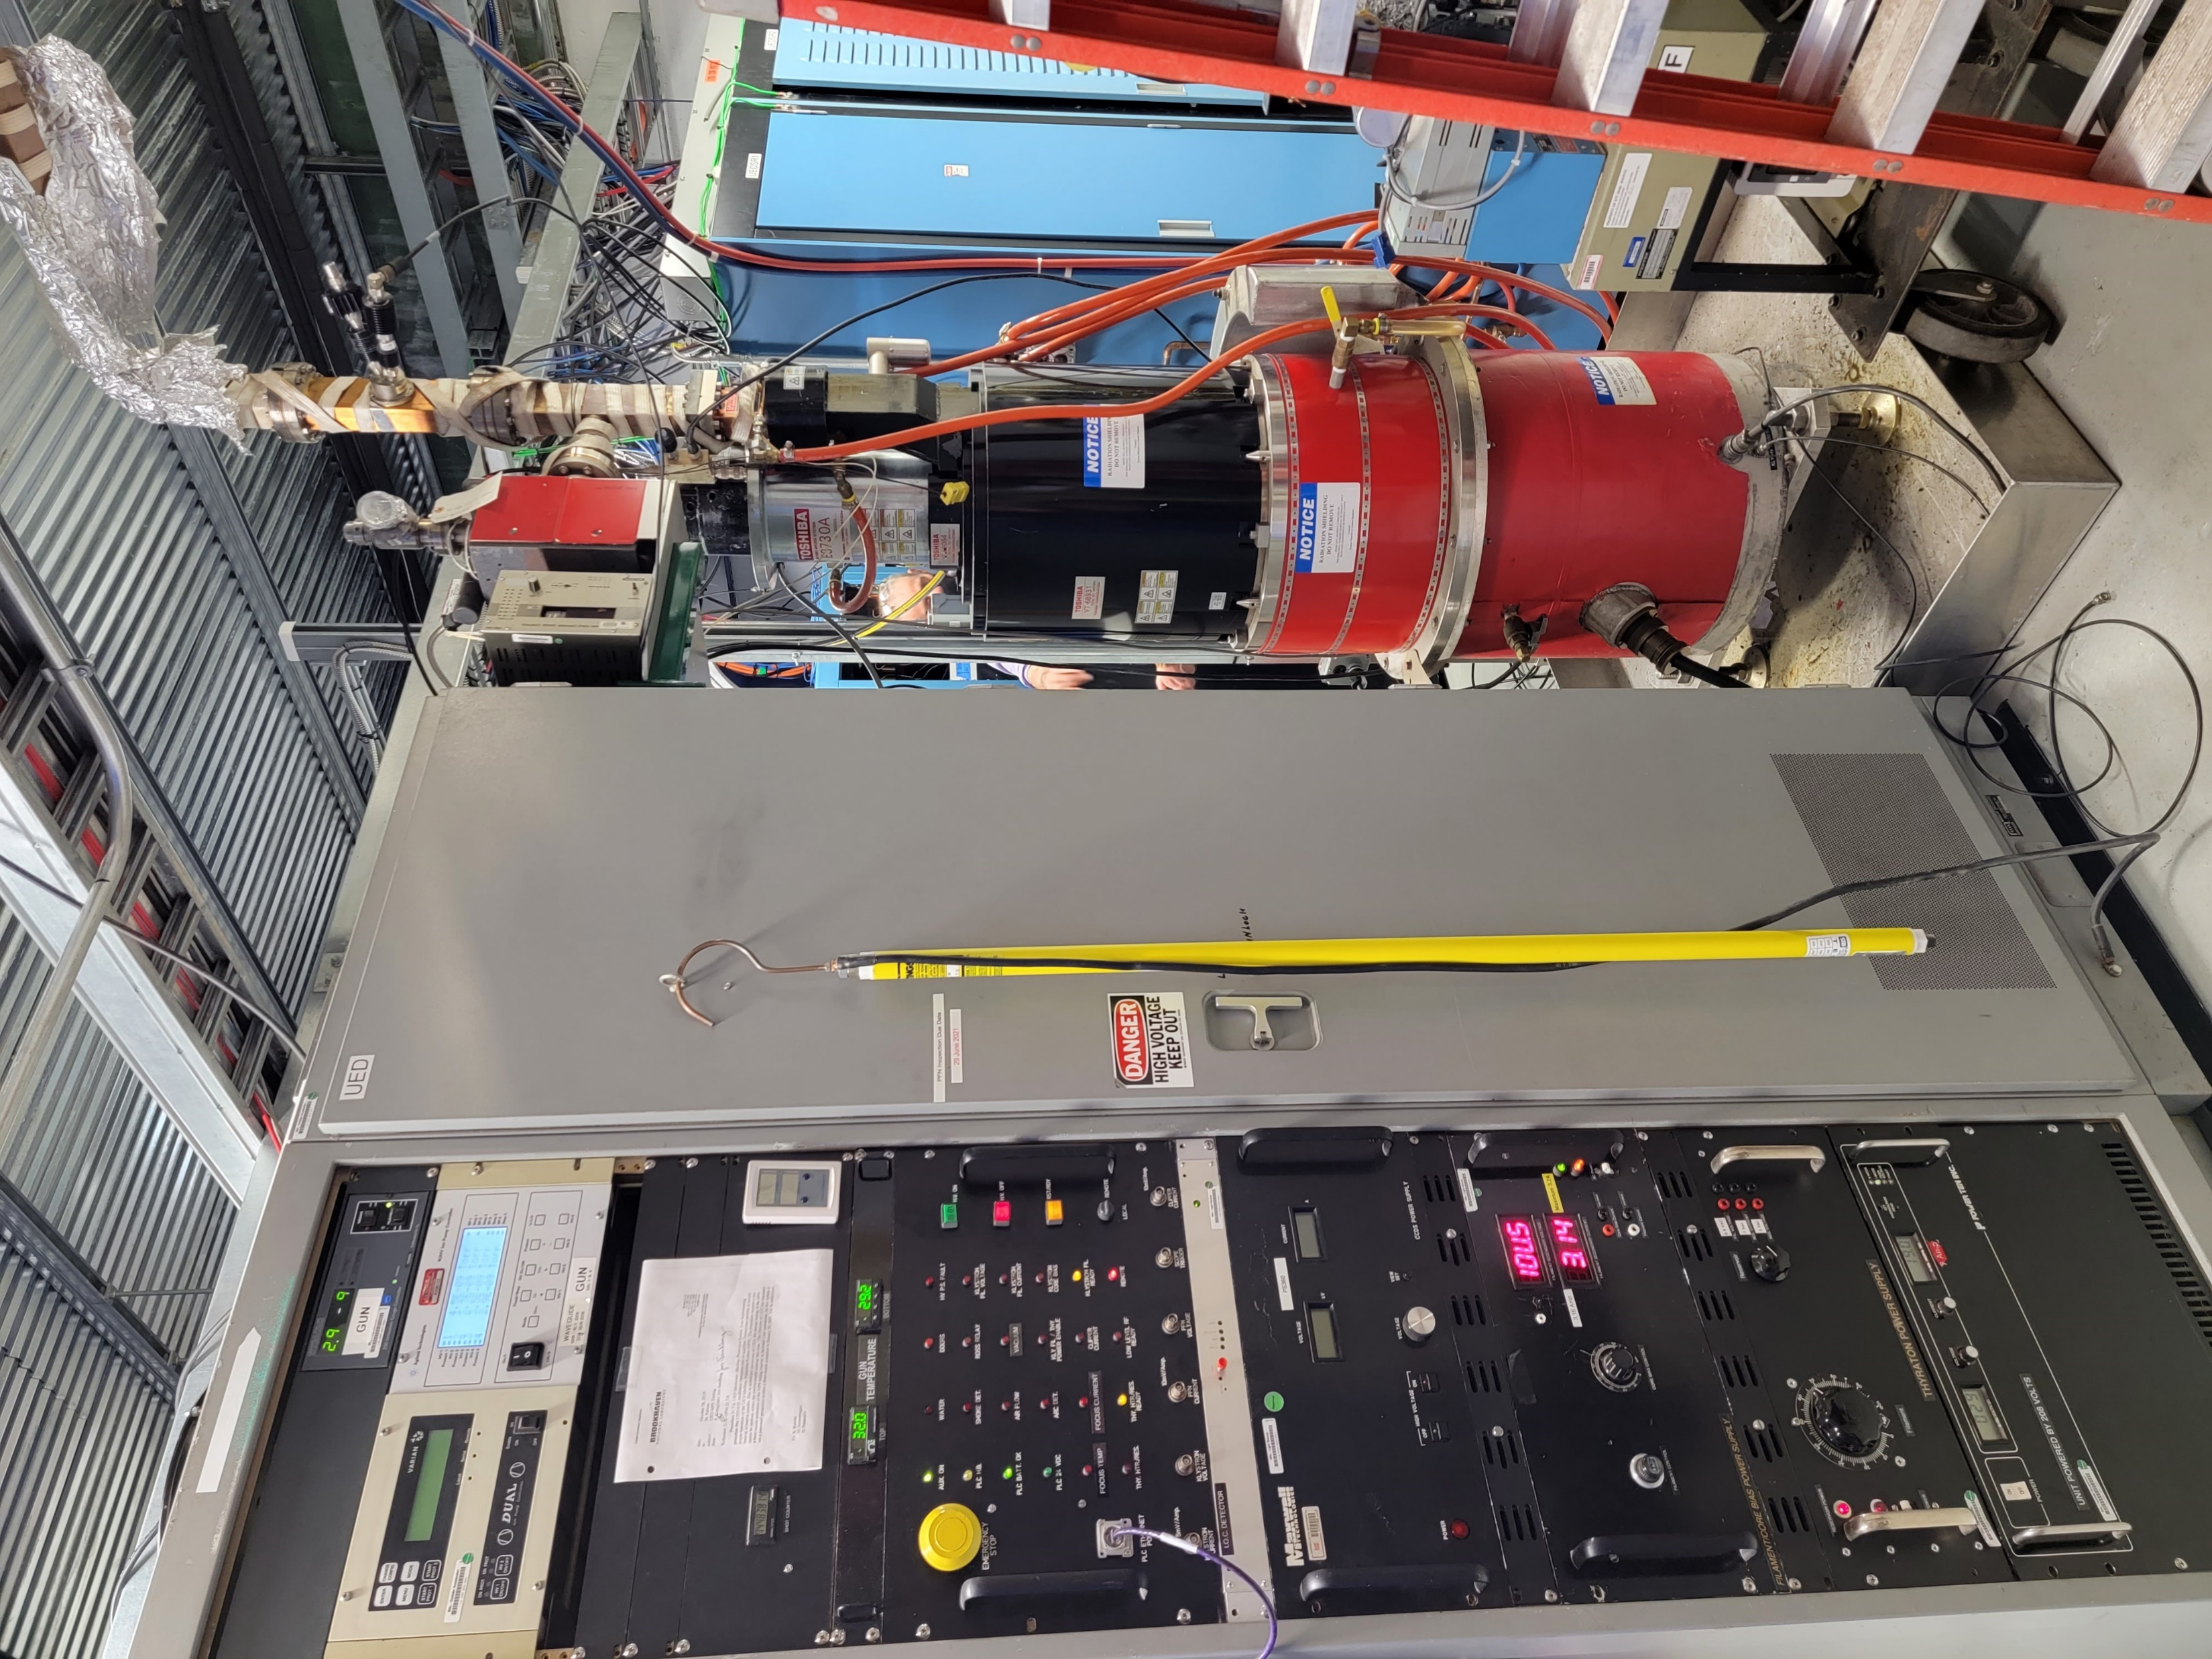
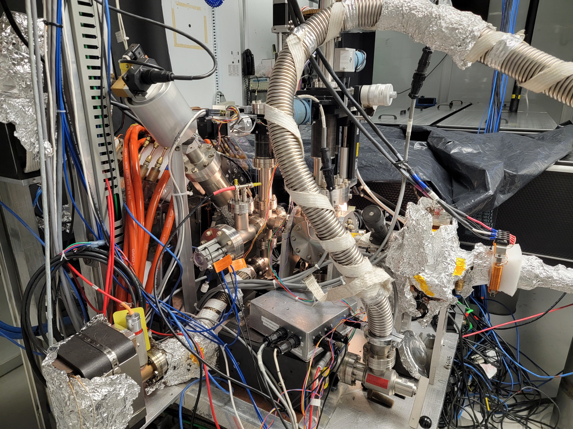
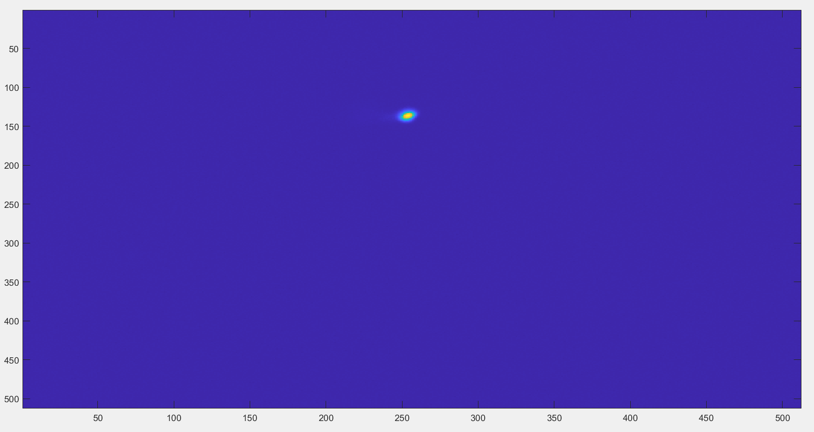
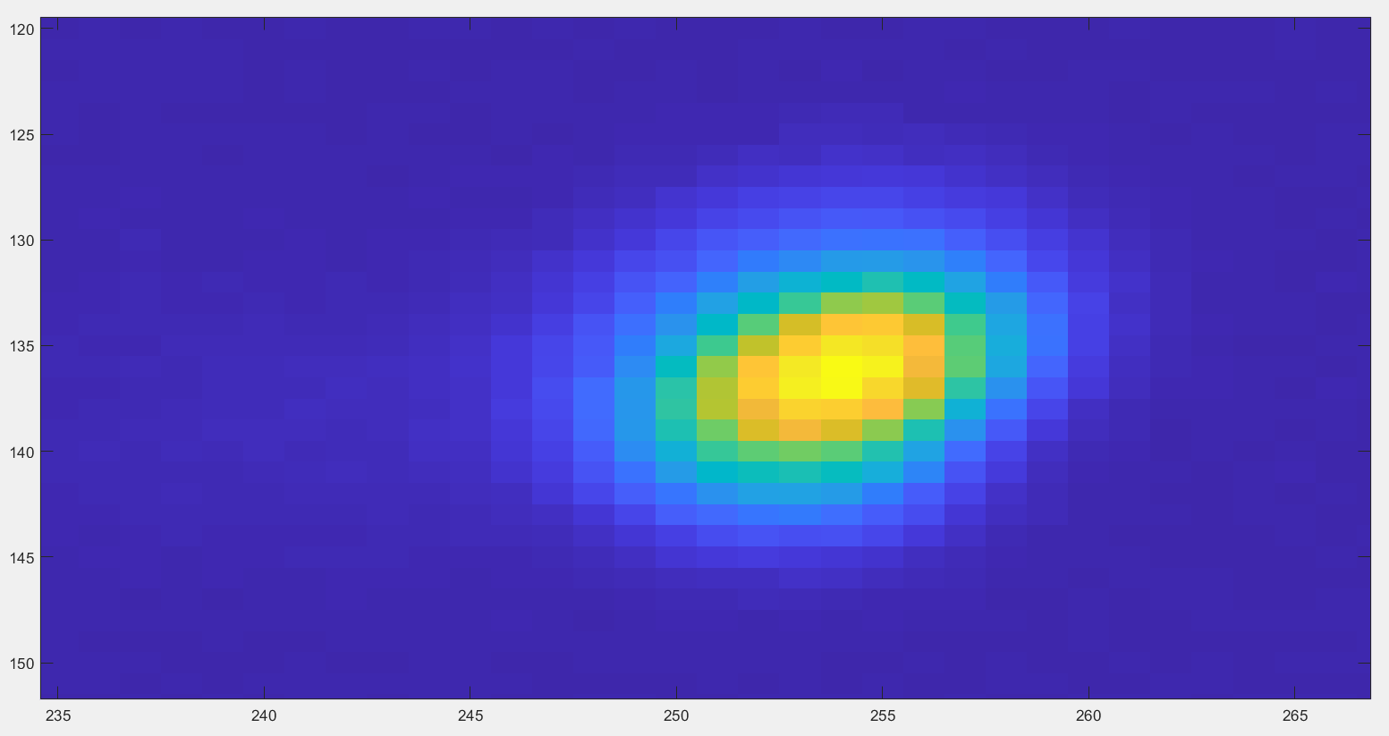
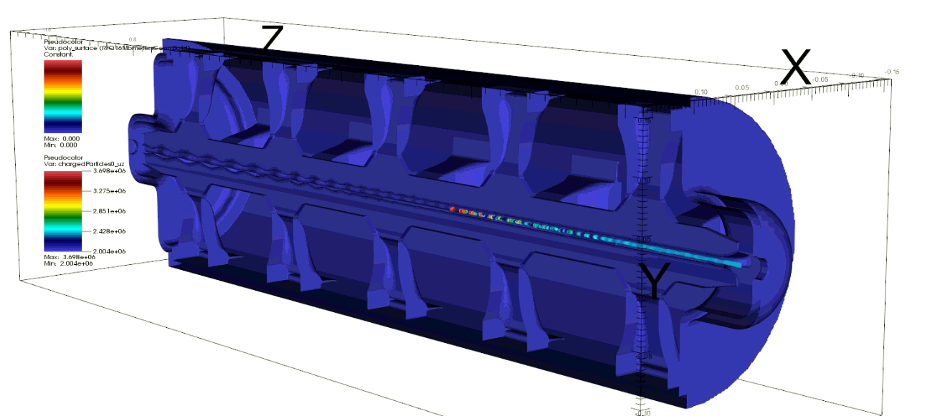
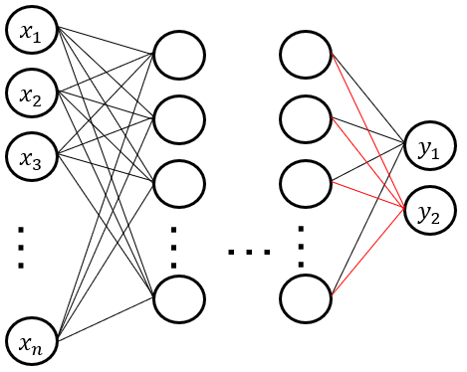
Updates on the surrogate model design for MUED
Salvador Sosa¹, Sandra Biedron^{1,2}, Trudy Bolin^{1,2}
¹Department of Electrical and Computer Engineering, University of New Mexico, Albuquerque, NM
²Element Aero, Chicago, IL
Abstract
The MeV Ultrafast Electron Diffraction (MUED) system at Brookhaven National Laboratory presents a unique capability for material science. As part of the plan to make this a true user facility, we are exploring machine development approaches based on tools like Machine Learning, we are designing a surrogate model of the MUED beamline to support control tasks of the instrument. We use VSim to model the beam dynamics of the rf gun and elegant to transport the beam through the rest of the beamline. We use High Performance Computing to generate the data for the surrogate modeling based on the original simulation as well as training of the model.
End-to-end simulation of MUED
We use VSim and elegant to model the beam dynamics of MUED.
VSim is used to model the rf gun in full detail, including waveguide, ports and tuners.
Elegant tracks the beam through the rest of the beamline.
We use THETA supercomputer @ ALCF to expedite the VSim simulations.
Also, for ML data production and training.
https://txcorp.com/vsim/
The MeV Ultrafast Electron Diffraction
beam-line at BNL
Laptop - 4 cores
The MUED system at Brookhaven National Laboratory uses ultra-short pulses of MeV electrons to produce high resolution diffraction images of materials.
MUED is composed by a radiofrequency gun and optical elements to help direct the beam into the sample and into the detector.
The 2856 MHz normal conducting radiofrequency gun.
A solenoid helps focus the beam after the gun.
Horizontal and vertical corrector magnets help direct the beam towards the sample and into the detector downstream.
Collimator and sample holder.
The detector sits at the end of the beamline and is imaged by an Andor camera.
Workstation - 20 cores
THETA
Sample holder & collimator
Figure. PIC code parallel optimization.
Collimator
Benchmarking simulation to experimental data (Summer 2022).
Detector
(downstream)
Waveguide (from Klystron)
Sample chamber
RF Gun
Solenoid
Laser (covered)
Solenoid
Steering magnets
Figure. The longitudinal electric field on the MUED rf gun (VSim).
Figure. Benchmarking. Example of un-diffracted electron beam at the detector.
Figure. The radiofrequency gun and beam control elements of MUED.
Surrogate model plan for MUED
We are investigating surrogate models to support MUED operations.
Physics simulations can produce accurate results but are also time and computationally intensive.
Training data-set requires thousands of VSim-Elegant simulations with varying inputs.
Use of HPC and automation is required.
Our interest in MUED is two-fold, to maximize the throughput of experimental data by integrating ML algorithms into the data analysis and processing, and to minimize instrumentation downtime by means of intelligent controls.
X1000s
With varying inputs
Physics sim
Very detailed (FDTD/PIC)
Time consuming.
Surrogate model
Training is done offline.
Fast computation is better suited for controls.
Summary and future work
We are using VSim (rf gun) and elegant (optical elements) to simulate the beam dynamics of the MUED instrument at BNL.
This model will be used to train a surrogate model of MUED, suitable for controls and operations.
A surrogate model harness the accuracy of physics-intensive simulations, while capable of producing a result close to real-time.
We are coupling our simulation capabilities with the HPC resources at the Argonne Leadership Computing Facility.
Including real-time data transfer, analysis and processing between ATF-BNL and ALCF through a Globus Point.
We are scheduled for beam-time later this Summer. We’ll benchmark our model against experimental data and produce data for training.
References
[1] X. J. Wang, X. Qiu and I. Ben-Zvi, “Experimental observation of high-brightness microbunching in a photocathode rf electron gun,” in Phys. Rev. E 54.R3121, 1996.
[2] A. Edelen, et. al., “Machine learning for orders of magnitude speedup in multiobjective optimization of particle accelerator systems,” in PRAB 23, 044601, 2020.
This material is based upon work supported by the U.S. Department of Energy, Office of Science, Office of Basic Energy Sciences, under award number DE-SC0021365. This funding was made available through the Department of Energy's Established Program to Stimulate Competitive Research (EPSCoR) State-National Laboratory Partnerships program in the Office of Basic Energy and Sciences.

