Slide 1
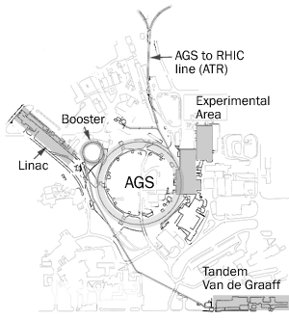
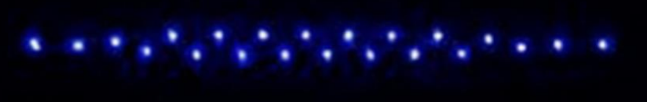
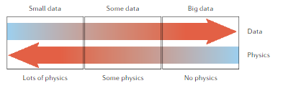
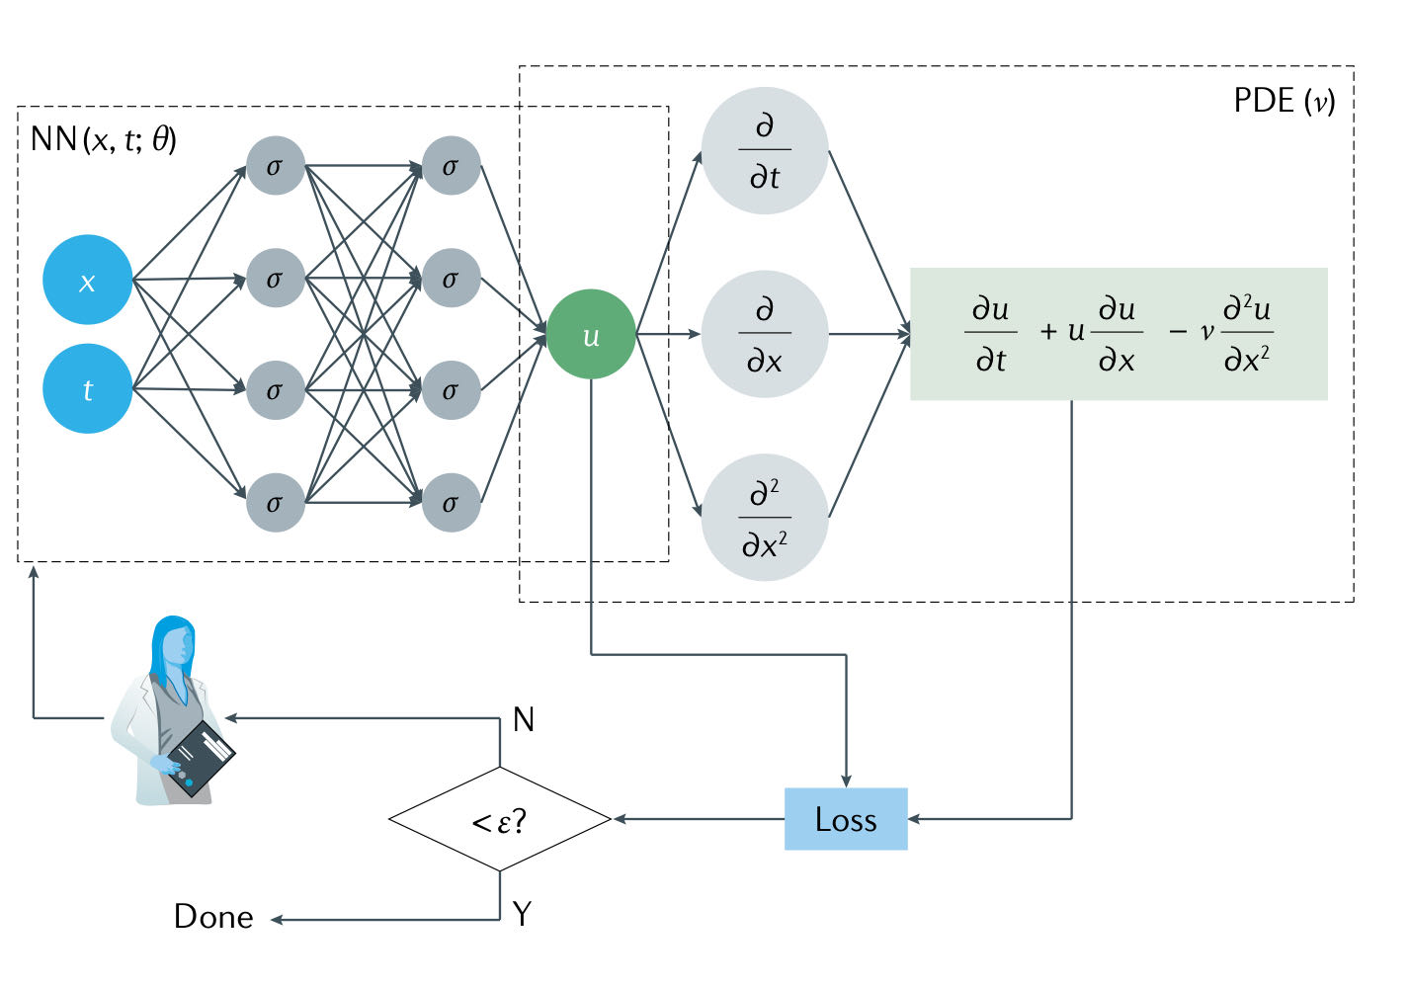
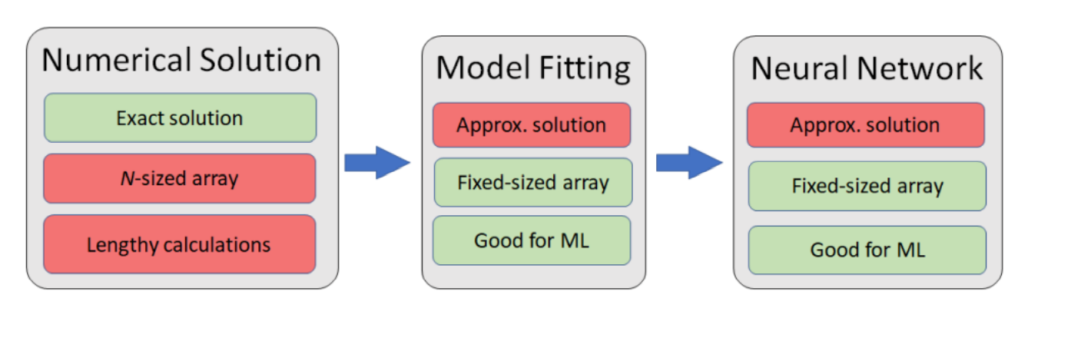
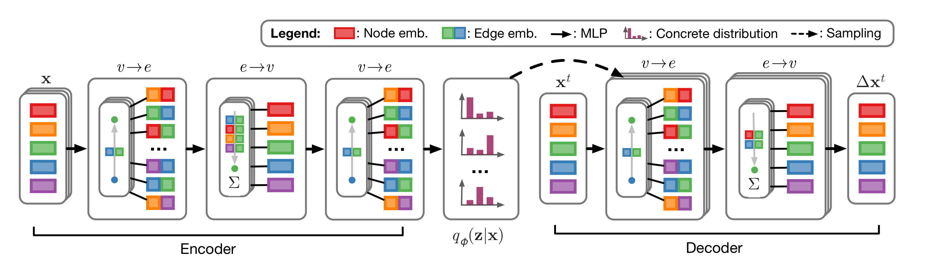


Exploring and Applying Different Machine Learning Techniques in a Synchrotron
Bohong Huang¹, Kevin A Brown^{1,2}, Thomas Robertazzi¹
¹Stony Brook University, ²Collider-accelerator Department, Brookhaven National Laboratory.
Accelerator Self-Evaluation
A synchrotron accelerates particle beams that travel around an equilibrium orbit.
$X\left(s\right)= \left[\begin{matrix}X(s) \\ X′(s)\end{matrix}\right]=M\left(s | s_{0}\right)X(s_{0})$, $M\left(s_{0} | s\right)=\left[\begin{matrix}\cos{φ} & K^{−1/2}\sin{φ} \\ {\left(−K\right)}^{1/2}\sin{φ} & \cos{φ}\end{matrix}\right]$,
where $φ=K^{1/2}\left(s−s_{0}\right)$, and $K\left(s+C\right)=K(s)$
For synchrotron studies:
The conventional methods are less efficient because :
1. real machine and instrumentation errors, resolution, and other systematics
2. analysis takes iterations with model comparisons to resolve true errors
The Machine learning methods can reduce the unwanted fluctuations and predict unrecognized patterns, so they may give us the ability to handle a variety of data that can hardly be done in traditional way.
See Lucy Lin’s talk on Thursday: Simulation Studies and ML applications for orbit correction at the AGS
Rapid calculation of the Ion Coulomb Crystal Baseline State
Physics-Informed Neural Networks
Karniadakis, G.E., Kevrekidis, I.G., Lu, L. et al. Physics-informed machine learning. Nat Rev Phys 3, 422–440 (2021).
B. Huang, C. González-Zacarías, S. Sosa Güitrón, A. Aslam, S. G. Biedron, K. Brown, T. Bolin, IEEE Access, Volume 10, 2022, pp.14350-14358
Data driven method:
Pro: fit observations very well. Con: poor generalization performance
Physics driven method:
Pro: able to extract interpretable information. Con: hard to get data.
The physics-informed neural networks combine the advantages from both methods by integrating prior knowledge into the data driven methods.
The model of a one-dimensional ion coulomb crystal basically uses the coupled harmonic oscillators with the coulomb interaction acting as the spring constant between the masses.
The numerical solution needs to simultaneously solving a N coupled nonlinear system of algebraic equations, and it is a time-consuming process. Define the dimensionless parameter $u_{i}≡ξ_{i,0}/z_{s}$
Then, for ion$j, u_{j}−\sum_{n=1}^{j−1}{\frac{1}{{\left(u_{j}−u_{n}\right)}^{2}}}+\sum_{n=j+1}^{N}{\frac{1}{{\left(u_{j}−u_{n}\right)}^{2}}}=0$
Problem encountered when applying neural network method is:
The solution vector’s size is not fixed and cannot be directly accommodated into a neural network model which usually takes fixed-sized input and output.
Our solution: Adding a model fitting process to get an approximate solution and a fixed-sized input for NN.
The framework of Physics informed neural networks (PINN):
Discuss: When try to find the particles’ motion with a Lagrangian equation, our PDE contains only u(x,t). The data of boundary condition and Initial condition cannot represent motion.
Neural Relational Inference for interacting System ( Unsupervised model)
Thomas Kipf, Ethan Fetaya, Kuan-Chieh Wang, Max Welling, Richard Zemel Proceedings of the 35th International Conference on Machine Learning, PMLR 80:2688-2697, 2018.
The NRI model learns the dynamics with a Graph NN over a discrete latent graph and performs inference over these latent variables. Jointly trained an encoder that predicts the interactions given the trajectories, and a decoder that learns the dynamical model given the interaction graph.
Discuss: For the particle motion prediction, the forces diverge when the distance between particles goes to zero, It can cause issues when integrating with fixed step size.

